Slide 1
Predicting Polycystic Ovary Syndrome (PCOS) Risk Based on Lifestyle and Symptom Patterns: A Statistical and Machine Learning Approach

Slide 2
GROUP MEMBERS:
ZAINAB NAVEED
BSDSF22M013
HASAAN RANA
BSDSF22M027
USMAN AHMAD BSDSF22M033
AREEBA CHAUDHARY
BSDSF22M018

Slide 3
Objective:
This project aims to predict PCOS risk by analyzing lifestyle factors and symptoms using statistical and machine learning techniques. It identifies key predictors, develops accurate models, and provides insights to support early detection and proactive health management.

Slide 4
About Data:
Sources:
1. Survey - 200 2. Kaggle - 2000

Slide 5
Attributes:
PCOS (yes/no)
Age (years)
Weight (Kg)
Height (cm)
BMI
Blood Group
Pulse rate (bpm)
RR (breaths/min)
Cycle (regular/irregular
Marital Status (years)
Pregnancy Status
Weight gain (yes/no)
Hair growth (yes/no)
Skin darkening (yes/no)
Hair loss (yes/no)
Acne (yes/no)
Fast food Intake
Regular Exercise
Cycle length(days)

Slide 6
DESCRIPTIVE ANALYSIS

Slide 7
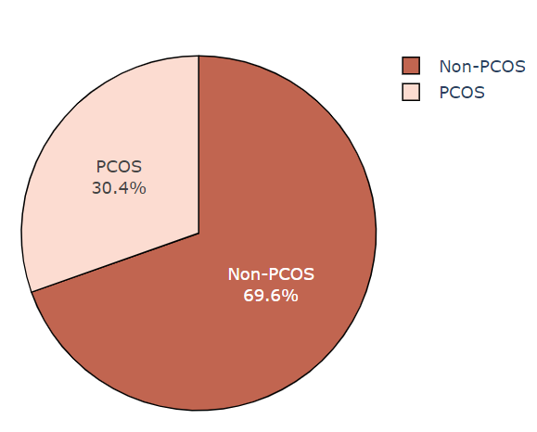
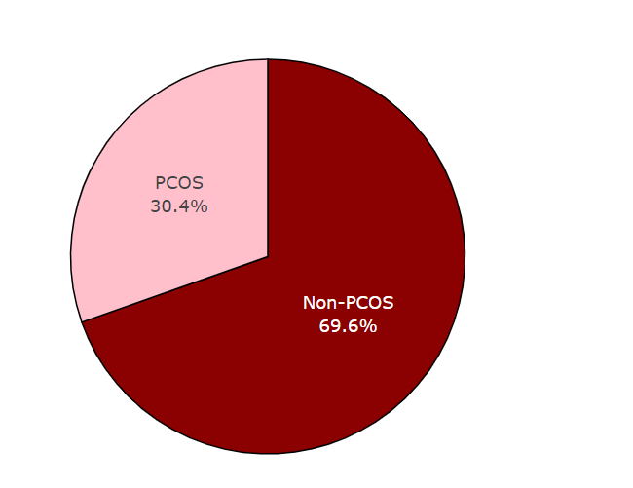
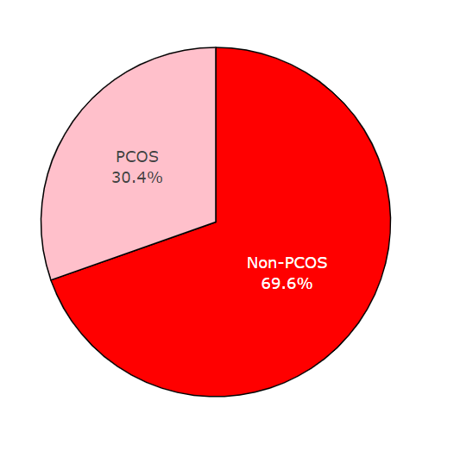
Distribution of PCOS and Non-PCOS Cases

Slide 8
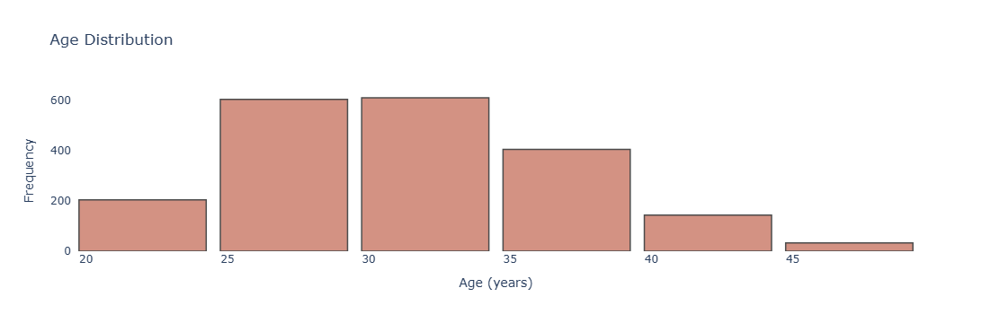
Age Distribution

Slide 9
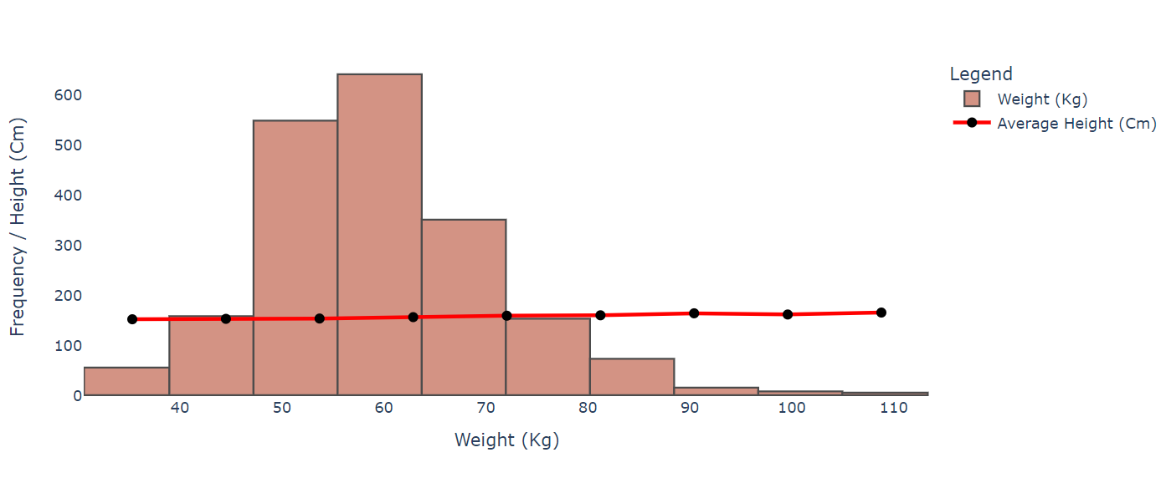
Weight Distribution and Average Height

Slide 10

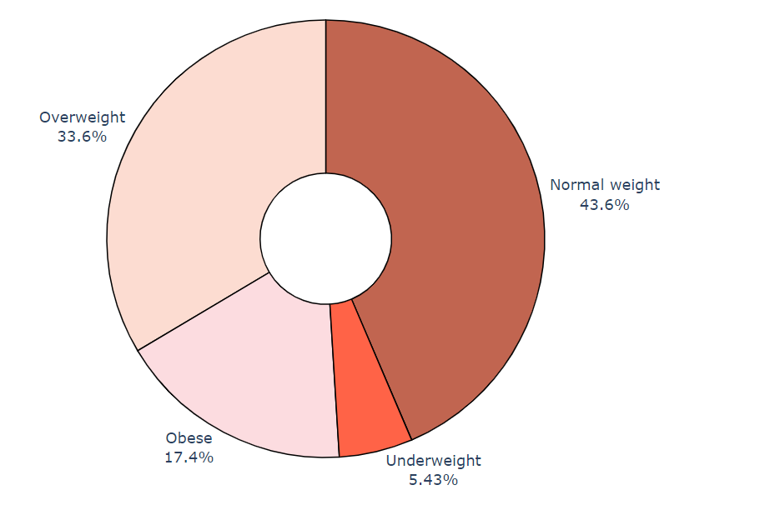

Slide 11
STATISTICAL ANALYSIS
Z- test of proportionality
Chi-Square Test
Spearman's correlation
Random Forest Model

Slide 12
“Chi-Square Test of Independence”
Hypothesis:
H₀ : There is significant relationship between PCOS and the symptoms.
H₁ :There is no significant relationship between PCOS and the symptoms.
_{Conclusion:}
Accept H0 and reject H1 which shows that :
" There is significant relationship between PCOS and the symptom."

Slide 13
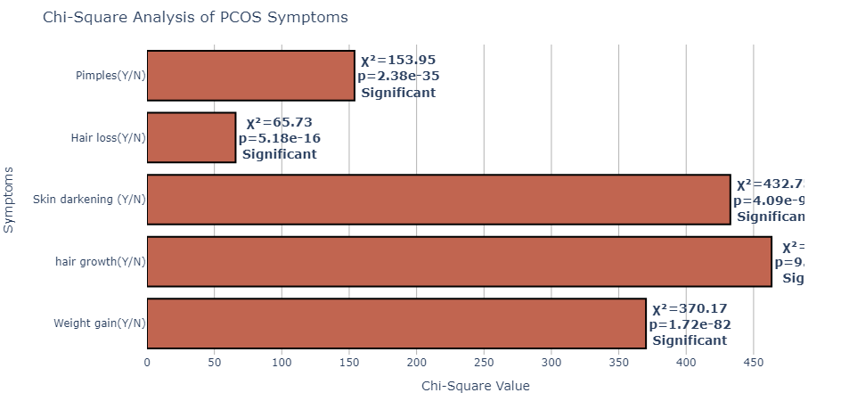

Slide 14
Z-Test of Proportionality
Hypothesis:
H₀ : Significant difference in proportions of weight gain and exercise.
H₁ : No Significant difference in proportions of weight gain and exercise.
_{Results:}
_{Z-Statistic: -3.47}
_{P-value: 0.0005}
_{Conclusion:}
We failed to reject null hypothesis so :
“There’s significant difference in proportions”.

Slide 15
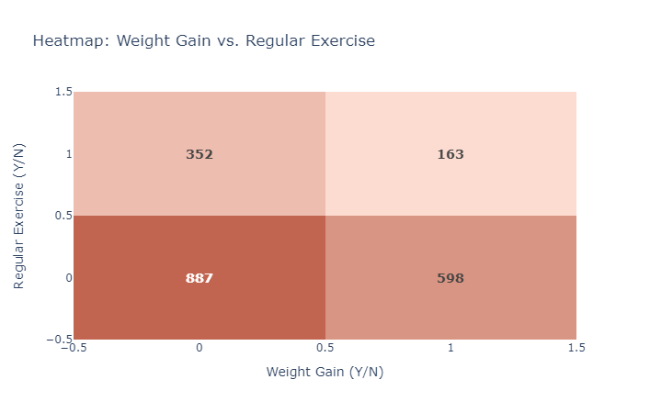

Slide 16
Z-Test of Proportionality
Hypothesis:
H₀ : Significant difference in proportions of fast food and pimples.
H₁ : No significant difference in proportions of fast food and pimples.
_{Results:}
_{Z-Statistic: 13.96}
_{P-value: 0.0000}
_{Conclusion:}
So we failed to reject null hypothesis , shows that “Significant difference in proportions of fast food and pimples”

Slide 17
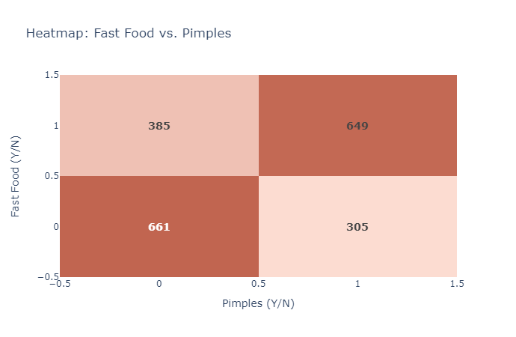

Slide 18
“Spearman's correlation”
Hypothesis:
H₀ : There is an association between BMI and cycle length
H₁ : There is no association between BMI and cycle length.
_{Results:}
_{r = -0.065968}
_{p = 0.003162}
_{Conclusion:}
Failed to reject null hypothesis so:
“there is an association between BMI and cycle length”.

Slide 19
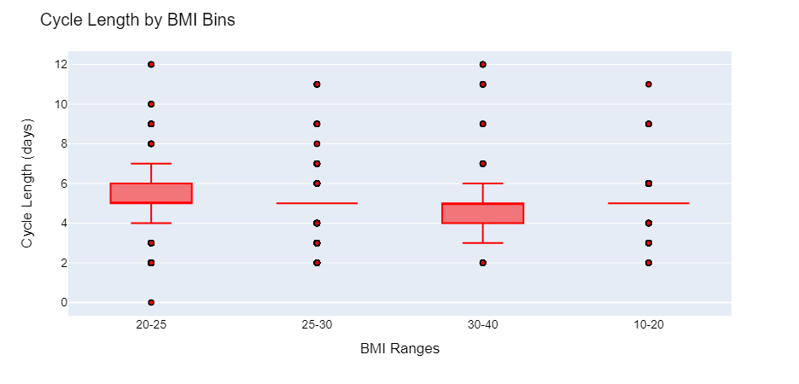

Slide 20
“Spearman's correlation”
Hypothesis:
H₀ : There is an association between Age and cycle length
H₁ : There is no association between Age and cycle length.
_{Results:}
_{r = -0.074324}
_{p = 0.000880}
_{Conclusion:}
Failed to reject null hypothesis so:
“there is an association between Age and cycle length”.

Slide 21
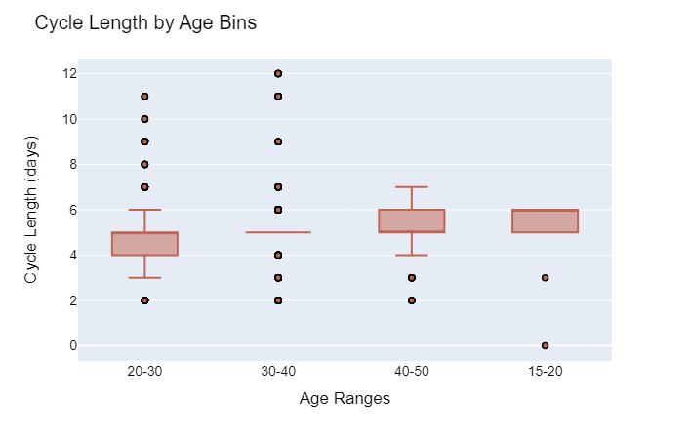

Slide 22
“Chi-Square Test”
Hypothesis:
H₀ : There is a significant association between PCOS and Pregnancy.
H₁ : There is no significant association between PCOS and Pregnancy.
_{Results:}
_{Chi-Square Statistic: 0.2976}
_{P-Value: 0.5853}
_{Conclusion:}
Failed to reject null hypothesis so:
There is no significance association between PCOS and Pregnancy.

Slide 23
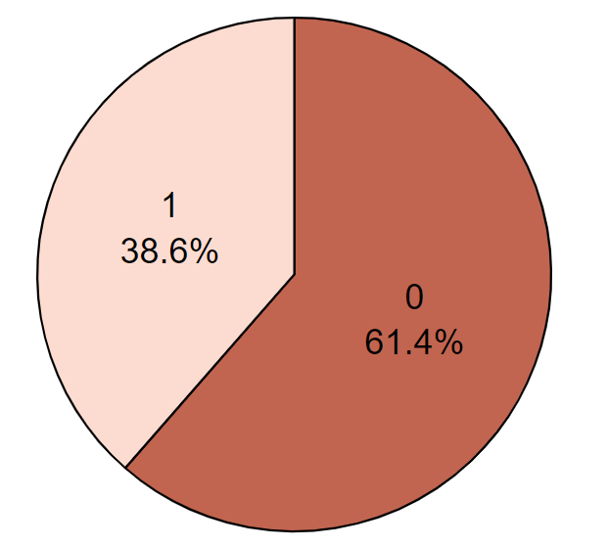
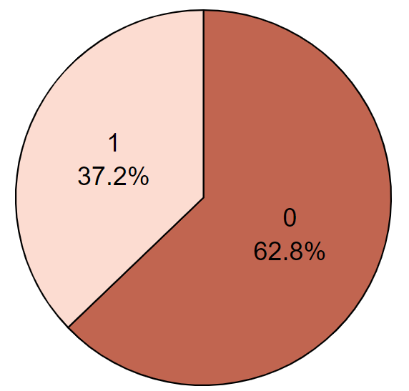


Slide 24
“Model Development”
A random forest model was trained using the
preprocessed data to predict the existence of PCOS.
Accuracy: 0.987

Slide 25
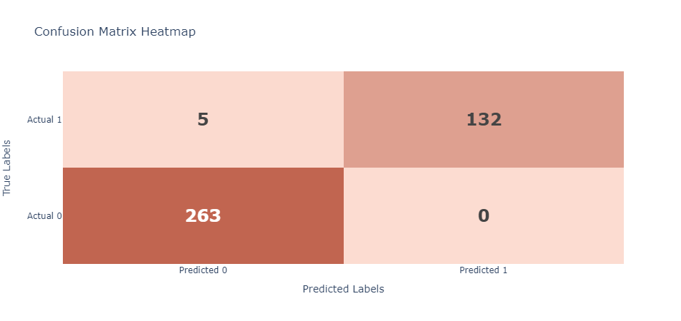
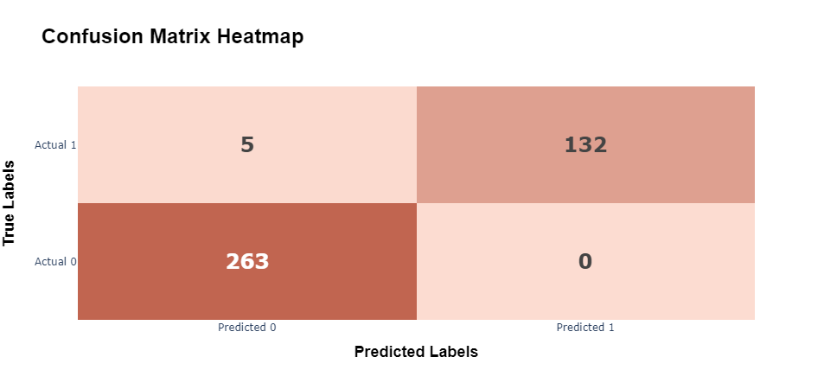

Slide 26
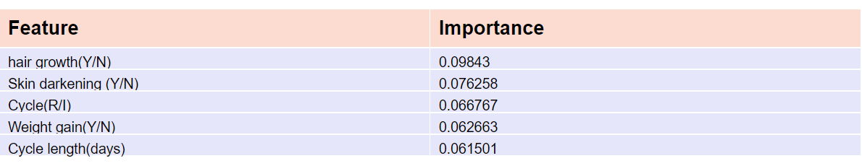
TOP FEATURES

Slide 27
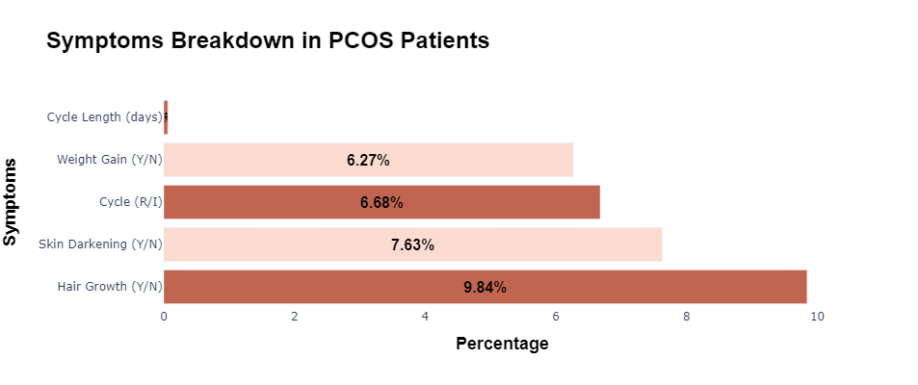
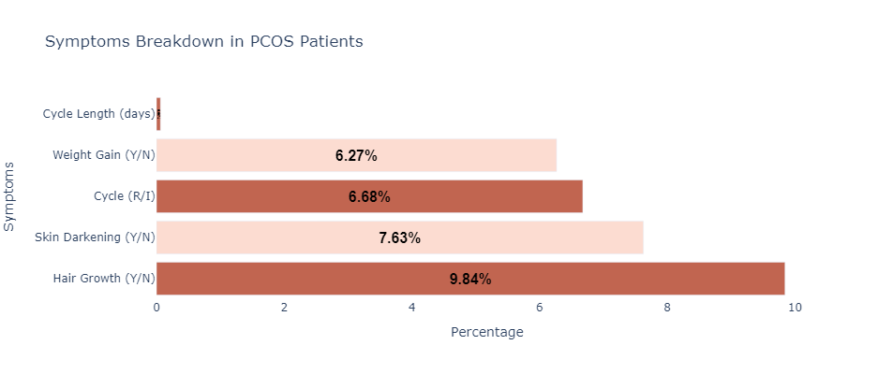

Slide 28
THANKYOU

