Slide 1
Mobile (Android)
Concepts

Slide 2
Android, a mobile OS
Android is the world’s most popular mobile OS
Controls phones, tablets, wearable

Slide 3
Working with a programming language
What does it mean to write idiomatic code?
In Kotlin, try to avoid explicit null checks
highScores.sortWith(compareByDescending<Score>{it.score}.thenBy{it.name})
File("file.txt").copyTo(File("target_file.txt"));
Lateinit

Slide 4
How to succeed at programming
Start with casting spells
Fake it till you make it
Pattern match from other code
Manage your frustration
Keep trying new angles
Write notes
Explain your problem in an email (don’t have to send it)
Am I doing things correctly and efficiently?
Get something working quickly, then improve
Move from one working version to the next (you can always roll back)
Add functionality bit by bit

Slide 5
Android Project Checklist
Code up to date
Layout files up to date
Gradle file up to date, has proper dependences
AndroidManifest.xml
Drawables
Values, like strings and colors, styles, etc.

Slide 6
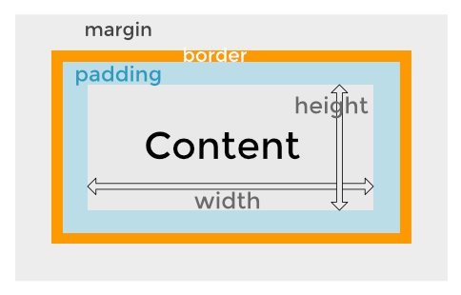
Widgets
https://kb.wpbeaverbuilder.com/article/81-margins-and-padding

Slide 7
Starting a new Activity
Activities in Android control the screen
Apps typically have several screens
E.g., Game play, high scores, settings
Starting an activity > calling a function
Android runtime constructs the new activity
Eventually calls onCreate
How do we pass parameters?
Returning from an activity isn’t a function return
Where do we return to?

Slide 8
Intents: Specifying operations
An intent is an abstract description of an operation to be performed (Android docs)
Implicit intent: abstract action (e.g., dial this number)
Explicit intent: execute this class
Provides a mechanism to pass parameters
Key/value bundles
Used on entry and exit of Activities
// Get the Intent that called for this Activity to open val activityThatCalled = intent // Get the data that was sent val callingBundle = activityThatCalled.extras callingTV.text = callingBundle?.getString("callingActivity")

Slide 9
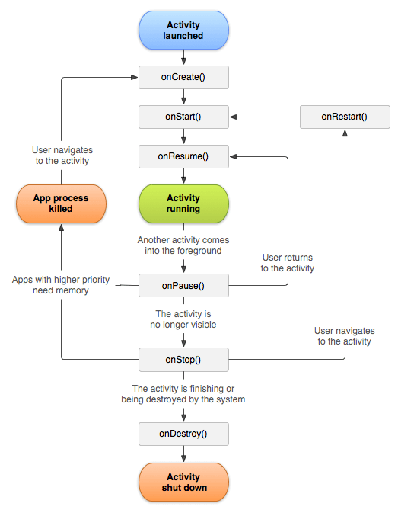
Activity lifetime
State machine for activities
Android tells you about significant events
Your app might want to clean up when it goes to the background
Trend away from explicit callbacks

Slide 10
ListView
Layout up to this point has been simple
A TextView object might have some default text
Then we change the text in our program
textView.text = “Watch this space”
But how to we display a scrollable list of 100 items?
listView.list[1] = “Item 1” ????
list = {“Item 0”, “Item 1”}; ???? screenView[1] = list[1] ????
Spoiler alert, not like this, but using the same concepts

Slide 11
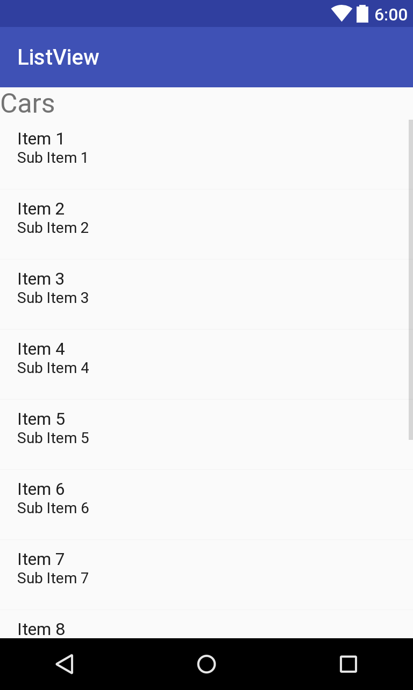
Adapting a list to your screen
The list is long and is in your code
val list = List(100) {it}
val list = repository.fetchData()
The viewList is on the screen
E.g., 8 items in screen over here
The adapter marries your list to screen
Runtime calls adapter to bind list item to
to row on the screen
bindView(position: Int, theView: View)
Write data from list[7] into theView

Slide 12
Adapting a list to your screen
The list is long and is in your code
val list = List(100) {it}
val list = repository.fetchData()
The viewList is on the screen
E.g., 8 items in screen over here
The adapter marries your list to screen
Runtime calls adapter to bind list item to
to row on the screen
bindView(position: Int, theView: View)
Write data from list[position] into theView

Slide 13
RecyclerView glossary
Adapter: A subclass of RecyclerView.Adapter responsible for providing views that represent items in a data set.
Position: The position of a data item within an Adapter.
Binding: The process of preparing a child view to display data corresponding to a position within the adapter.
Recycle (view): A view previously used to display data for a specific adapter position may be placed in a cache for later reuse to display the same type of data again later. This can drastically improve performance by skipping initial layout inflation or construction.

Slide 14
Binding a recycled view
The first time an item is displayed, create a view
Inflater.inflate(R.layout.xml_file,…
Inflation takes xml data file and turns it into a View
Inflation is expensive, let’s minimize it by reusing views
val tv = view.findViewById<TextView>(R.id.TV)
tv.text = rowList[5] //“Row 5”
Row 1
Row 1
Row 2
Row 2
Row 2
User
scrolls
Row 3
bind
view
Row 3
Row 3
Row 4
Row 4
Row 4
Row 5
Row 5

Slide 15
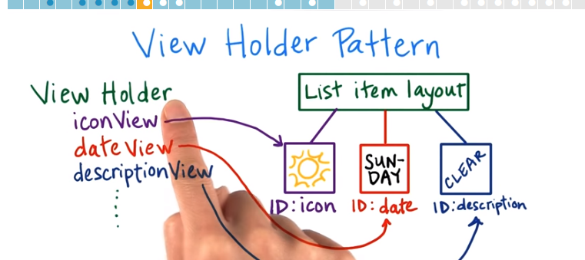
ViewHolder
Every time we rebind, we call findViewById a lot
Silly, since the structure of the view doesn’t change
E.g., there will always be 1 TextView & 1 ImageView

Slide 16
ViewHolder
Every time we rebind, we call findViewById a lot
Silly, since the structure of the view doesn’t change
E.g., there will always be 1 TextView & 1 ImageView
Create a holder for the view that “points” into it
class ViewHolder(v: View)
: RecyclerView.ViewHolder(v) {
var tv = v.findViewById<TextView>(R.id.TV)
var iv =v.findViewById<ImageView>(R.id.IV)
Bind operation just uses tv and iv
fun bind(item: Data) {tv.text = item.name}

Slide 17
ViewHolder
The first time an item is displayed, create a view
Inflater.inflate(R.layout.xml_file,…
Inflation takes xml data file and turns it into a View
Inflation is expensive, let’s minimize it by reusing views
val tv = view.findViewById<TextView>(R.id.TV)
tv.text = rowList[5] //“Row 5”
Row 1
Row 1
Row 2
Row 1
Row 2
Row 2
User
scrolls
Row 3
bind
view
Row 3
Row 3
Row 4
Row 4
Row 4
Row 5
Row 5

Slide 18
Why is activity/fragment killed?
1. You meant to navigate away permanently: The user navigates away or explicitly closes the activity — say by pushing the back button or triggering some code that calls finish(). The activity is permanently gone.
2. There is a configuration change: The user rotates the device or does some other configuration change. The activity needs to be immediately rebuilt.
3. The app is put in the background and its process is killed: This happens when the device is running low on memory and needs to quickly free some up. When the user navigates back to your app, the activity will need to be rebuilt.
https://medium.com/androiddevelopers/viewmodels-with-saved-state-jetpack-navigation-data-binding-and-coroutines-df476b78144e

Slide 19
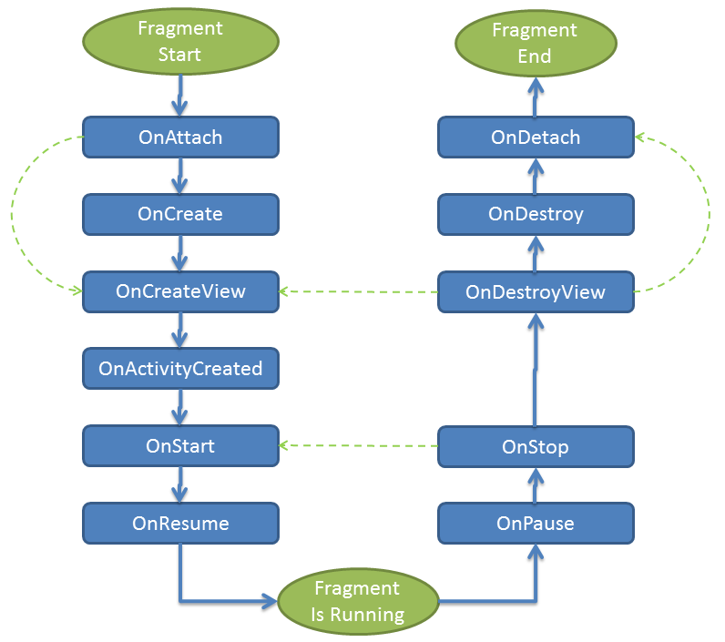
Fragments
Fragment lifetime

Slide 20
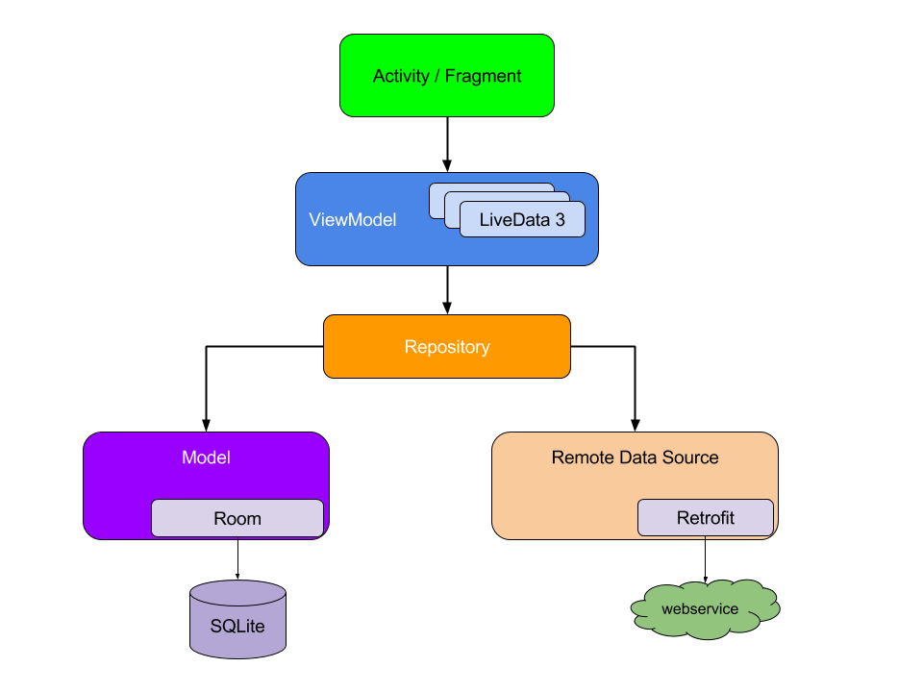
LiveData, ViewModels, MVVM
Separate logic from display
Display in activity/fragment (View)
“Application logic” goes in ViewModel (ViewModel)
Model holds the “real data” (Model)
Encourages an app style
Raises the level of abstraction
Enables powerful apps quickly

Slide 21
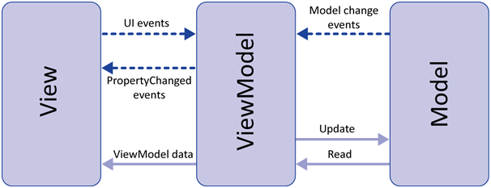
View, ViewModel, Model (MVVM)
View is your fragment
It manages the screen, inflates XML
Observes LiveData, reflects changes to the display
Observes display, feeds events to ViewModel
ViewModel manages LiveData, exports it.
Contains most of the application logic.
Model is the data
Source from network or database/files
Might feel weird at first, but wisdom becomes clear

Slide 22
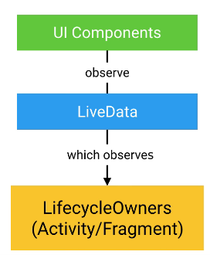
MVVM, lifetime and scope
LiveData allows communication without dependence
Multiple observers ok
Observers can die, be reborn, no code changes
ViewModels have scope
Fragment (it dies when fragment dies)
Activity (fragments can share state and communicate)
Application (activities can share state and communicate)

Slide 23
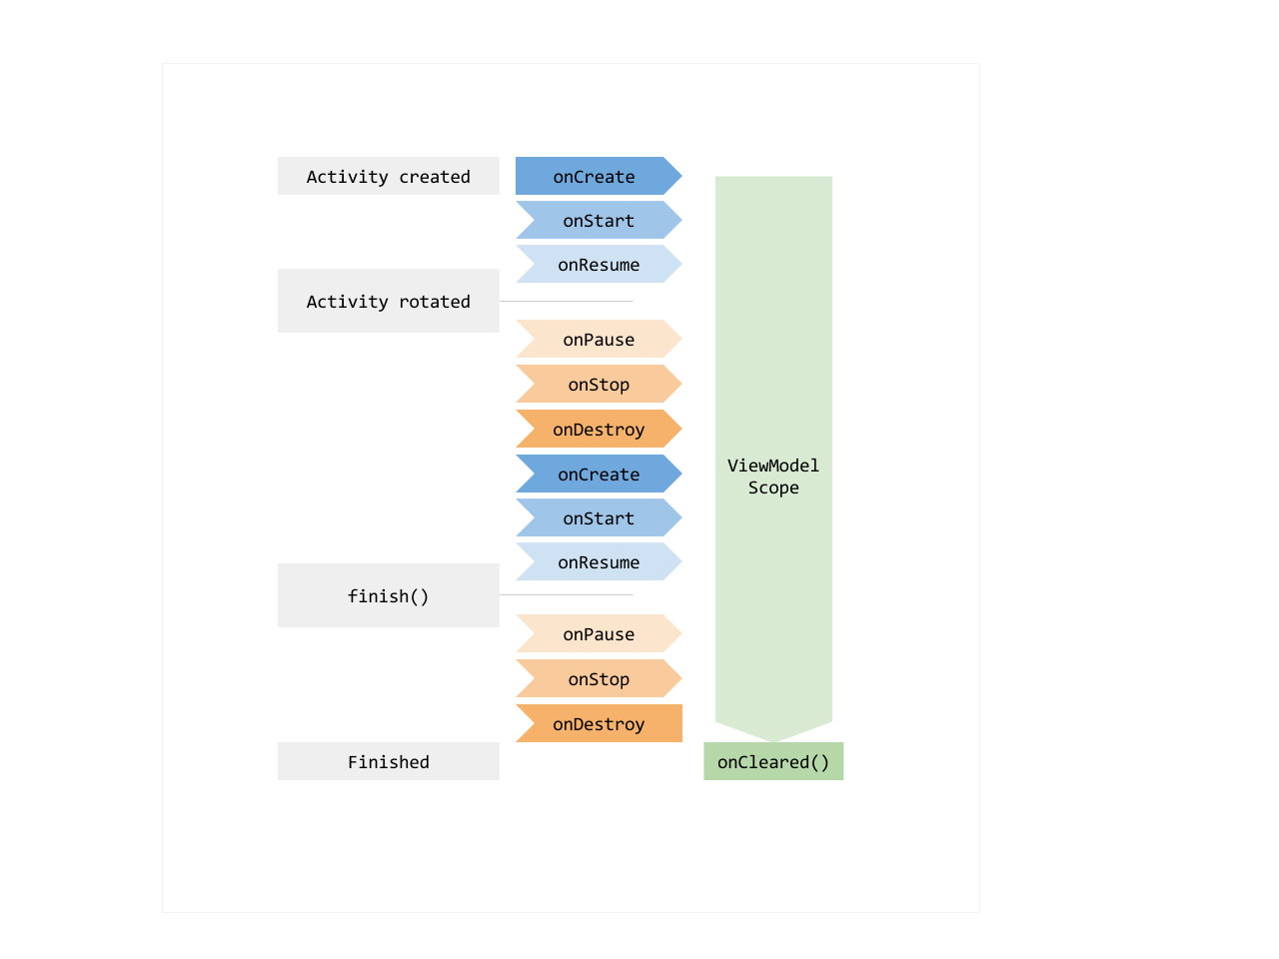
ViewModels have long lifetimes
Data in a ViewModel is in memory even if device rotates or is paused
Fewer surprises at runtime!
You still sometimes need onSaveInstanceState() for persistence

Slide 24
Networking(!)
What “language” do we speak with servers?
Representational state transfer (REST)
Use text (JSON)
Servers are “stateless”
Requests give them all the context they need
What tools do we need in Android
Retrofit2: Talk to servers
Gson: parse JSON
Coroutines & Dispatchers: Fetch on background thread
Glide: display & cache images given a URL
Glide is independent, but fetching images is common

Slide 25
Coroutine dispatchers
Dispatcher.Main - main thread
Must be quick
Required if you have to update the UI
Dispatcher.Default - background thread possibly on other processor
For background work, like diffing lists
Dispatcher.IO - for network or file system
withContext – allows you to switch dispatchers
withContext(Dispatchers.Main) {
textView.text = “hi there”
Background threads must use postValue, not setValue

Slide 26
JSON (JavaScript Object Notation) Example
{
"Title": "The Cuckoo's Calling",
"Author": "Robert Galbraith",
"Detail": { "Pages": 494 },
"Price": [
{ "type": "Hardcover",
"price": 16.65 },
{ "type": "Kidle Edition",
"price": 7.03 }
]
}
http://www.w3resource.com/JSON/introduction.php

Slide 27
Elements of JSON
Four basic and built-in data types in JSON.
Strings, numbers, Booleans (i.e true and false) and null.
These can be used as values
Two structured data types
Objects are wrapped within '{' and '}'.
Objects are list of label-value pairs.
Arrays are enclosed by '[' and ']'.
Arrays are list of values.
Both objects and arrays can be nested.

Slide 28
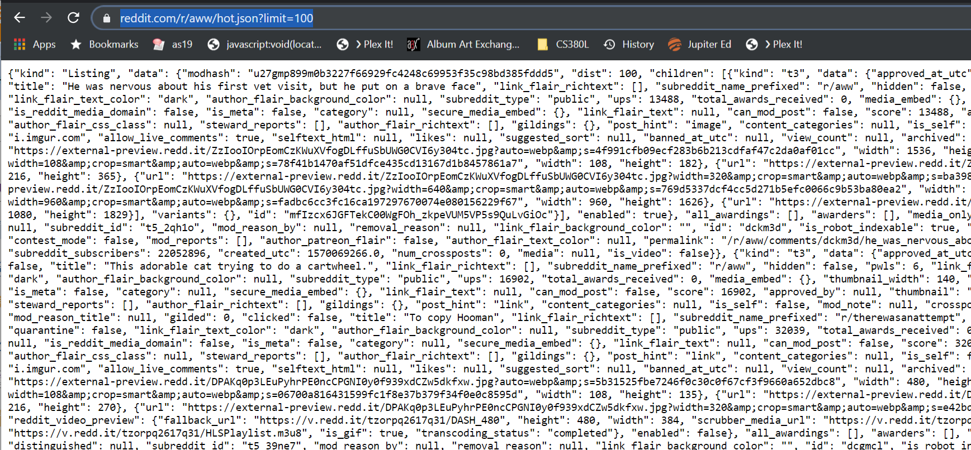
Web services often return JSON

Slide 29
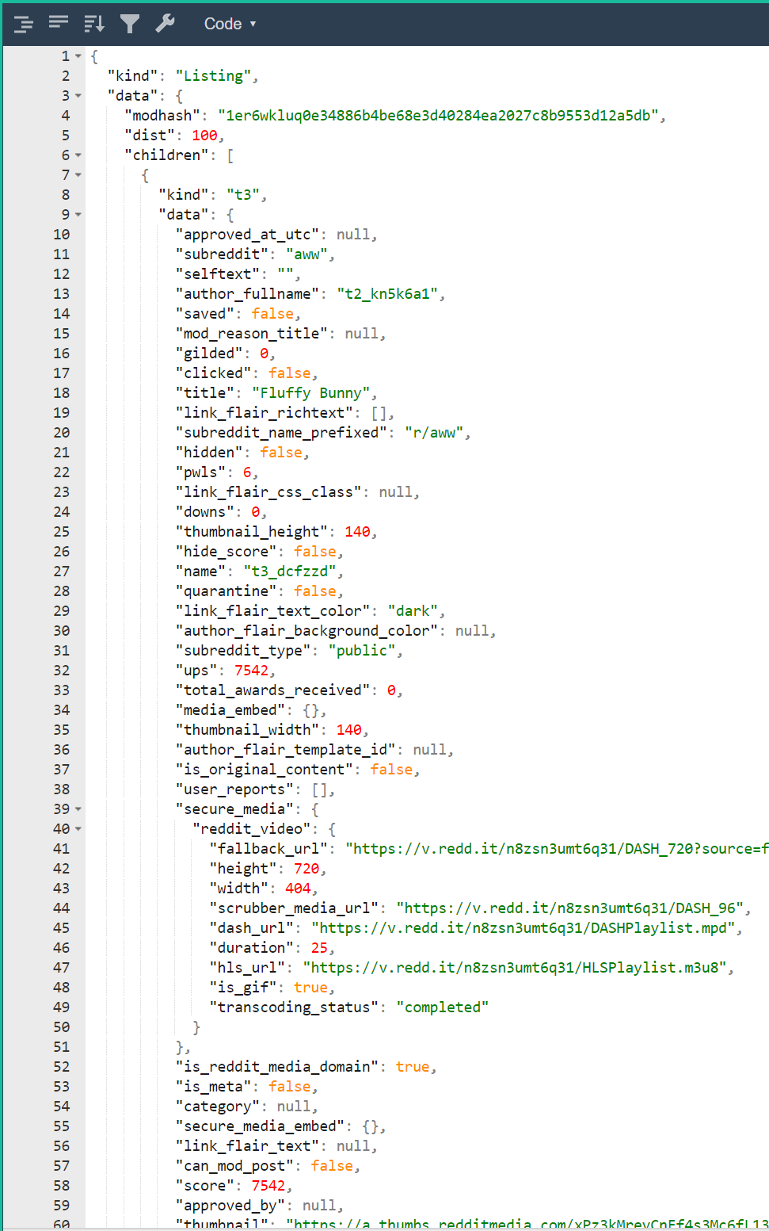
Web pretty-printers
https://jsonformatter.org/json-pretty-print

Slide 30
Network services for mobile
User authentication
Anonymous users
Email/Password
Google/facebook/phone number,…
Storage
Files (e.g., images, video)
Structured data (e.g., documents, collections)
Access control
Cloud functions (not in this class)
Code executes on your behalf in the cloud. No VMs

Slide 31
Authentication
How do you prove you are who you say you are?
Know a secret (e.g., password)
Possess a token (e.g., phone number)
Vouched for by third party (e.g., google or facebook)
Firebase authentication
Manages multiple users without a server
Configure a web-based console
Open source activity that does best practices login

Slide 32
Google firestore
Store data in a flexible format in the cloud
No server, web console
Collections and documents
Documents are key/value pairs and sub-collections
Alternate collection/document/collection/document…
Real-time updates!
Cool for features like chat
Works well with live data

Slide 33
Working with a database
Know what parts of your model are written by client code and what by the db/server
E.g., timestamps, ids are often db/server only
Expose fetched data via your viewModel
LiveData super useful if update is asynchronous
Understand how items are cached/modified
Generalize your notion of pointer
A pathname to an image is a “pointer.”
If pathname is in database, file better exist (referential integrity)
A foreign key points from one table to row of another

Slide 34
Android navigation library
Who likes newInstance? argument bundles? back stack management?
Android navigation minimizes this hassle
Helps manage fragment transitions
Toolbar titles
Argument passing
Android navigation strict about killing fragments
Must store state in viewModel
Tougher to use than .add, but more correct

Slide 35
Taking pictures
Must start camera intent from an activity
Must give create a file name for camera to write
Must give camera permissions on that file (Uri)
Camera intent returns, without info about file
Our workflow
MainActivity will startActivityForResult
ViewModel chooses & remembers file camera writes
MainActivity calls viewModel when camera finishes
sqlite: name by create timestamp, firebase uuid

Slide 36
Notes: dealing with dependences
Consider a simple note.
text: String
imageFiles: List<String>
imageFiles is a list of path names
Each path name refers to an image
Image might be a local file (sqlite)
Image might be a cloud file (firebase)
Note depends on images
Danger: a note that refers to a non-existent image

Slide 37
How to create/edit a note (sqlite)
In-memory note has list of image files (newList)
In-DB note has list of image files (oldList)
Algorithm to modify image table
Leave members shared between oldList & newList
In oldList and not in newList -> delete file
In newList and not in oldList -> add row

Slide 38
How to create a note (firestore)
For list of image files -> start upload
Write note
What is wrong with this picture?
note.pictureUUIDs = [ffjsjsjsj-sjfjfj]
storage/images/ffjsjsjsj-sjfjfj does not exist
Violates referential integrity!
Error when displaying new note (via live data)

Slide 39
How to create a note (firestore)
Take a picture
Start file upload
When file successfully uploaded…
Delete local file
Update note to have new pictureUUID
Write note to server
Maintains referential integrity!
Write data before writing pointers to it
Might be user-visible delay for their picture to show up

