Slide 1
My Store
Sign In
Sign Up
We are glad you visited our site. We hope you like it.
Type Products:-
Welcome to our store
1. Books
2. Glasses
3. Watches
Any questions about the products?
Communicate on social media:
Facebook
Phone number: ………………………….
Twitter
Email: ………………………….
Instagram

Slide 2
My Store
Sign In
User name
Password
Sign In
New to Pearson? Create an account
Login as Guest

Slide 3
My Store
Sign Up
User name
Password
Phone number
Email
Sign Up
Already have an account? Sign in
Login as Guest

Slide 4
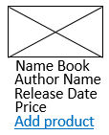
My Store
Sign In
Sign Up
Books
Type Products:-
1. Books
2. Glasses
3. Watches
Finished shopping

Slide 5
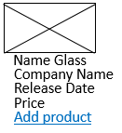
My Store
Sign In
Sign Up
Glasses
Type Products:-
1. Books
2. Glasses
3. Watches
Finished shopping

Slide 6
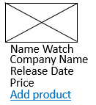
My Store
Sign In
Sign Up
Watches
Type Products:-
1. Books
2. Glasses
3. Watches
Finished shopping

Slide 7

My Store
Sign In
Sign Up
Type Products:-
Amount to be paid while receiving the order: ……$
1. Books
Submit
2. Glasses
Thank you for your marketing
You will be contacted to confirm the request
3. Watches
Any questions about the products?
Communicate on social media:
Phone number: ………………………….
Email: ………………………….

