Slide 1
Yoga-Do
A Full-Stack Task Management Web Application
with Integrated DevOps Practices
Full Stack + DevOps
React
TypeScript
Django
SQLite
Docker
GitHub Actions
Mohammed Aqueel (1604-23-733-135) & Hasan Ali (1604-23-733-174)
Guide: Prof. Himayatullah Shareef
B.E. Computer Science & Engineering · Academic Year 2025–26

Slide 2
Introduction
What is Yoga-Do and why does it matter?
21+
Features Implemented
• A cloud-deployed, calendar-first task management web application for students and professionals.
3
• Provides Month, Week, and Day calendar views with color-coded task priorities (Critical / Important / Routine).
Calendar Views (Month/Week/Day)
• RRULE-based Recurring Task Engine, create and edit a single occurrence or the full series.
3
• Real-time Analytics Dashboard: productivity streaks, and per-priority task breakdown.
Priority Levels (Critical/Important/Routine)
• Integrated Pomodoro Focus Timer, Personal Notes, all in one app.
100%
• Secured with Django Session Authentication + CSRF Token on every protected API endpoint.
CI/CD Fully Automated
• Full DevOps pipeline: Git → GitHub → GitHub Actions CI → Docker → Render + Vercel.
2
Cloud Deployment Targets (Render + Vercel)

Slide 3
Abstract
Yoga-Do is a full-stack, calendar-first task management web application designed to help users plan, organise, and track their daily activities with clarity and efficiency. Built with React (TypeScript) on the frontend and Django REST Framework on the backend, it delivers a rich, responsive UI featuring Month, Week, and Day calendar views, priority-based task categorisation (Critical / Important / Routine), and a powerful RRULE-based recurring task engine that supports editing a single occurrence or an entire series independently. The application includes an Analytics Dashboard showing real-time completion statistics and streak tracking, a Pomodoro-style Focus Timer, a Personal Notes section, and Motivational Quotes. All API endpoints are secured with Django session authentication and CSRF token validation. Beyond the application itself, Yoga-Do integrates a complete DevOps pipeline: version control through Git and GitHub, automated Django backend tests and Playwright end-to-end tests executed via GitHub Actions CI, Docker containerisation for consistent cross-environment deployment, and cloud hosting on Render (backend) and Vercel (frontend). This project demonstrates the successful convergence of modern full-stack web development with professional-grade DevOps engineering practices.
Frontend
React + TypeScript + Vite
Backend
Django + REST Framework
Auth
Session + CSRF Token
Recurrence
RRULE (iCal standard)
DevOps
Docker + GitHub Actions
Deploy
Render + Vercel (Cloud)

Slide 4
Existing System & Problems
Limitations of current task management tools
⚠ No Calendar Integration
⚠ Manual Recurring Tasks
⚠ No DevOps in Academics
Most to-do apps show tasks as plain lists — no Month, Week, or Day calendar visualization.
Users must re-enter repetitive tasks manually. No RRULE engine or exception handling.
Most student projects lack CI/CD pipelines, Docker, or automated test suites.
⚠ Limited Analytics
⚠ No Integrated Timer
⚠ Weak Authentication
Basic apps provide no completion tracking, productivity streaks, or priority dashboards.
Productivity timers exist as separate tools — not linked to individual task sessions.
Many apps skip proper session management, CSRF protection, or secure cookie attributes.

Slide 5
Proposed System
Yoga-Do - A complete, modern solution
📅 Calendar-First UI
🔁 Smart Recurring Tasks
Month / Week / Day views with color-coded priorities. Click any slot to create a task instantly.
RRULE engine: Daily or Weekly recurrence. Edit a single occurrence or the entire series independently.
📊 Analytics Dashboard
⏱ Focus Timer (Pomodoro)
Real-time stats: completion %, task counts (today/week/month), and consecutive-day productivity streak.
25-min work / 5-min break cycles. Timer floats over the app — toggle show/hide from the nav bar.
🔒 Secure Authentication
🐳 Full DevOps Pipeline
Django Session Auth + CSRF Token. Login persists across sessions. Logout clears session server-side.
GitHub Actions CI runs backend + E2E tests, builds Docker image, and deploys to Render + Vercel.

Slide 6
Software & Hardware Requirements
Software Requirements
Hardware Requirements
Frontend
React 18, TypeScript, Tailwind CSS, Vite
Development Machine
Processor:
Intel Core i5 / AMD Ryzen 5 or higher
Backend
Django 4.x, Django REST Framework, python-dateutil
RAM:
8 GB minimum (16 GB recommended)
Database
SQLite 3 (POC) → PostgreSQL (Production)
Storage:
20 GB SSD free space
Authentication
Session Auth, CSRF Middleware, secure cookie flags
OS:
Windows 10/11, macOS, Ubuntu 20.04+
DevOps
Docker, GitHub Actions CI/CD, Render, Vercel
Browser:
Chrome or Firefox (latest)
Testing
Django TestCase (unit) + Playwright (E2E tests)
Cloud Server (Render / EC2)
CPU:
1 vCPU, 512 MB RAM minimum
Version Control
Git, GitHub (public repository)
Network:
HTTPS with custom domain
Browser Support
Chrome, Firefox, Edge — latest versions
OS:
Ubuntu Linux 22.04 LTS

Slide 7
Literature Survey
1
Task Management System Design Using Django REST Framework
Singh R., Patel A. et al. — Int. Journal of Computer Applications, 2022
Proposes a REST API-driven task management system with Django; highlights session auth and ORM-driven analytics.
2
Containerisation with Docker for Academic and Enterprise Web Applications
Mehta S. et al. — IEEE Access, Vol. 10, 2023
Demonstrates 40% reduction in environment inconsistency using Docker pipelines; advocates CI/CD integration.
3
Automating CI/CD Pipelines Using GitHub Actions for Python-Django Projects
Kumar V., Rao M. — Journal of Open-Source Software, Vol. 8, 2023
Presents a GitHub Actions CI/CD pipeline for Django with automated tests, Docker build, and staged deployment.
4
Efficient RRULE Processing for Calendar-Based Task Management Applications
Li W., Chen J. — ACM SIGAPP Applied Computing Review, Vol. 24, No. 1, 2024
Proposes a bounded RRULE expansion algorithm used in this project to prevent unbounded calendar computation.
5
Integrating Full-Stack DevOps in BE/B.Tech Capstone Engineering Projects
Sharma P., Nair K. — Int. Conf. on Software Engineering Education, 2024
Reviews academic projects integrating Docker and CI/CD, demonstrating industry-readiness in student deliverables.

Slide 8
System Architecture
Three-tier web application with REST API and session security
PRESENTATION LAYER
Request / Response Flow
React + TypeScript + Tailwind CSS Month View · Week View · Day View · Dashboard · Focus Timer
🌐 User (Browser)
↕ HTTPS Request
⚛️ React SPA — Vercel CDN
APPLICATION / API LAYER
↕ REST API Calls
Django REST Framework Auth · Tasks · Occurrences · Tags · Analytics endpoints
🐍 Django DRF — Render
↕ ORM Queries
🗄️ SQLite Database
DATA LAYER
Security: Session Cookie + CSRF Token
SQLite Database User · Task · RecurrenceException · Tag (Django ORM models)
All protected endpoints verify session identity. CSRF token required on POST/PUT/DELETE.
Key API Endpoints
/api/auth/ · /api/tasks/ · /api/tasks/occurrences/ · /api/analytics/ · /api/tags/

Slide 9
DevOps Pipeline
Automated CI/CD — From code commit to live cloud deployment
Developer Commits
GitHub Repository
Actions CI Trigger
Backend Tests
Playwright E2E Tests
Docker Build
Deploy Render/EC2
Live App + Vercel
GitHub Actions — ci.yml (actual workflow)
Frontend Deployment (Vercel)
Trigger: push / pull_request → branches: [main] Job 1: backend-tests (ubuntu-latest) • pip install -r requirements.txt • python manage.py migrate • python manage.py test -v2 Job 2: e2e-tests (needs: backend-tests) • npm ci + playwright install --with-deps • nohup python manage.py runserver & • npm run test:e2e Job 3: deploy (needs: e2e-tests) • docker build -t taskmanager-app . • docker save → SCP → SSH → docker run
• Auto-deploy on every push to main branch
• Preview URL generated for every pull request
• CDN-backed global distribution
• Environment variables injected at build time
Backend Deployment (Docker → Render / EC2)
• Python 3.11-slim base image in Dockerfile
• EXPOSE 8000 → gunicorn / runserver 0.0.0.0:8000
• docker save → SCP to EC2 → docker run -d -p 8000:8000
• Auto-restart on container failure

Slide 10
UML — Use Case Diagram
System actors and their interactions with Yoga-Do
« Yoga-Do System »
◉ Register / Login / Logout
◉ Set Recurring Task (RRULE)
◉ View Month Calendar
◉ Edit Single Occurrence
◉ View Week Calendar
◉ Edit Entire Recurring Series
👤
◉ View Day View
◉ View Analytics Dashboard
User (Actor)
◉ Create New Task
◉ Use Focus Timer
◉ Edit or Delete a Task
◉ Write Notes / View Quotes
«include»: Authentication check performed on every protected use case
«extend»: Set Recurring Task extends Create New Task

Slide 11
UML — Class Diagram
Django data models and their relationships
User
Task
RecurrenceException
Tag
+ id: UUID (PK)
+ id: UUID (PK)
+ id: UUID (PK)
+ id: UUID (PK)
+ username: CharField
+ user: FK(User)
+ task: FK(Task)
+ name: CharField (unique)
+ email: EmailField
+ title: CharField
+ occurrence_date: DateTimeField
+ password: hashed
+ date: DateTimeField
+ is_deleted: BooleanField
⊕ register()
+ priority: CharField
+ override_data: JSONField
⊕ login()
+ status: CharField
⊕ apply()
⊕ logout()
+ is_recurring: BooleanField
⊕ override()
+ recurrence_rule: TextField
⊕ create()
⊕ update()
⊕ delete()
⊕ expand_occurrences()
User ──(1:N)──► Task
Task ──(1:N)──► RecurrenceException
Task ──(M:N)──► Tag
Cascade delete — all user tasks removed
Cascade delete — exceptions removed with task
ManyToMany; tags normalised for analytics

Slide 12
UML — Activity & Sequence Diagrams
Activity Diagram — Task Creation Flow
Sequence Diagram — Login & Load Calendar
React Browser
Django DRF
SQLite DB
User opens + Create Task
POST /api/auth/login/
Fill title, date, priority
SELECT user WHERE username=?
◇ Enable Recurring?
Yes →
Return User object
Set RRULE (freq/days/count)
Set session + CSRF cookie
No, skip →
GET /api/tasks/occurrences/
Submit to /api/tasks/
Expand RRULE + apply exceptions
Server expands occurrences
Occurrence list (JSON)
Calendar view refreshed
200 OK — JSON response

Slide 13
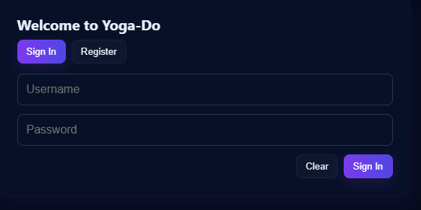
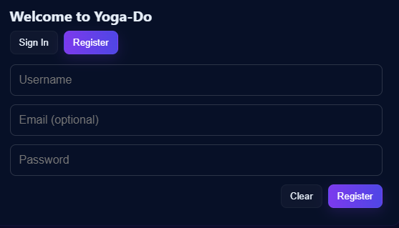
Implementation - Authentication Pages
Login and Registration UI
Session Authentication · CSRF Protection · Inline Error Messages · Toggle Login/Register · Welcome Animation on Success

Slide 14
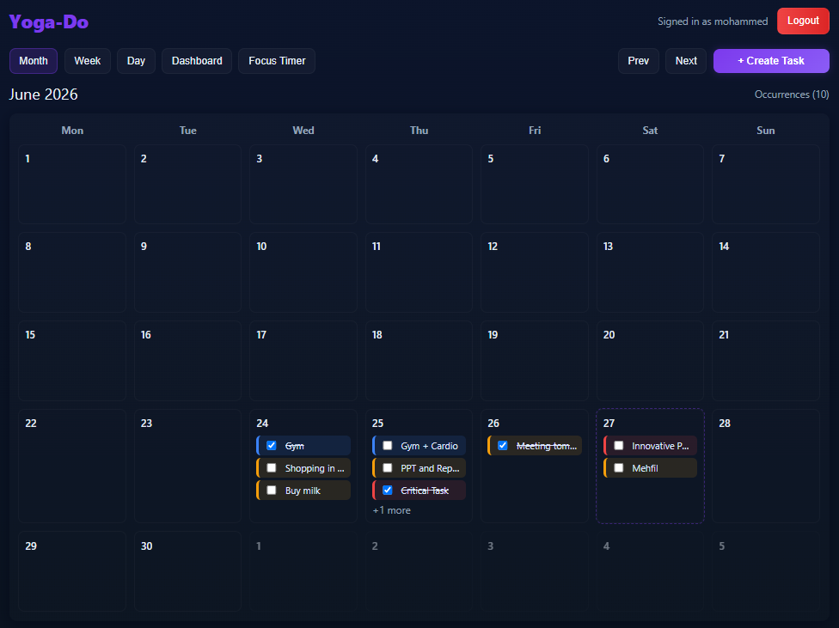
Implementation - Calendar Views
Monthly calendar views with priority-coded tasks

Slide 15
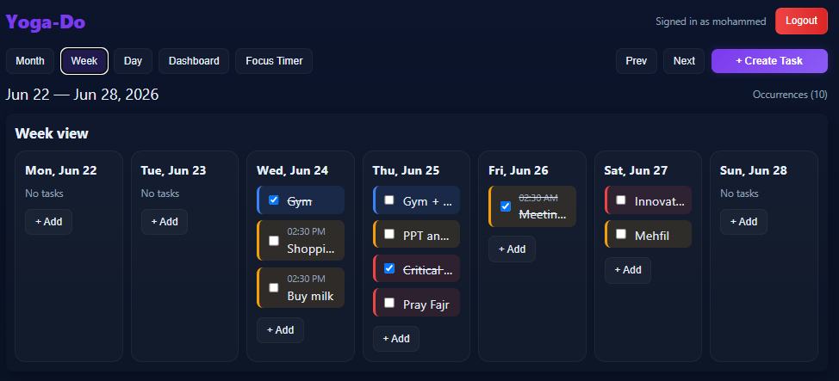
Implementation - Week Views
Weekly and Daily views with priority-coded tasks

Slide 16
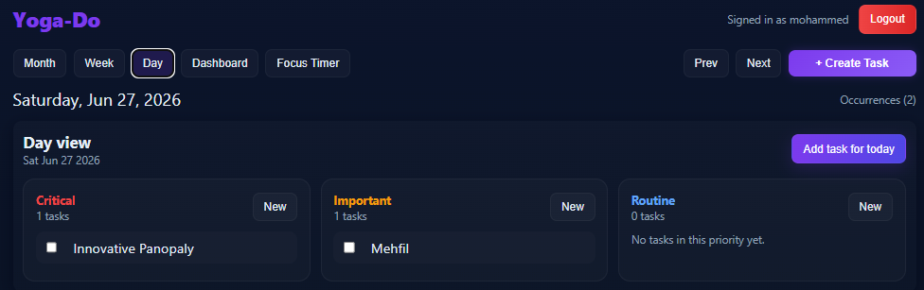
Implementation - Day Views
Daily views with priority-coded tasks

Slide 17
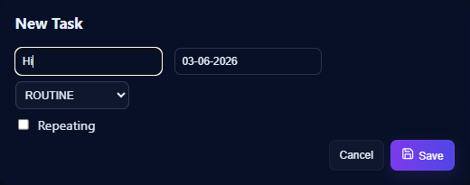
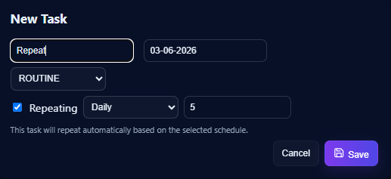
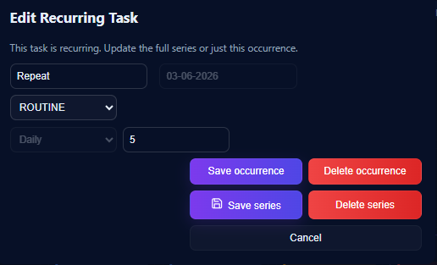
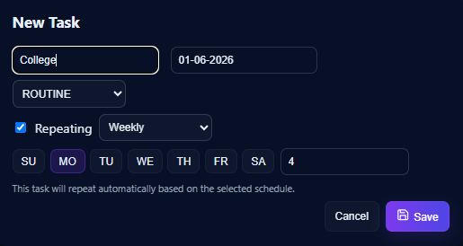
Implementation — Task Management
Creating, editing, and managing normal and recurring tasks

Slide 18
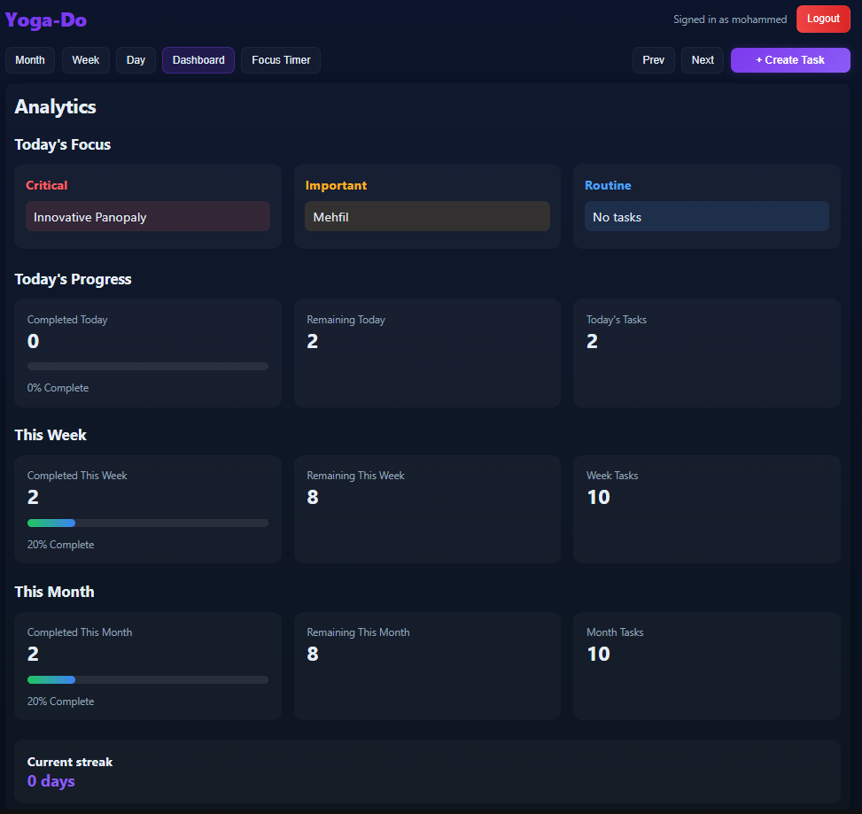
Implementation — Analytics Dashboard
Real-time productivity tracking and statistics
Today's Focus
Critical / Important / Routine priority breakdown
Completion %
Real-time progress bars for Today / Week / Month
Task Counts
Total, Completed, and Remaining tasks at a glance
Streak Counter
Consecutive productive days tracked and displayed
Live Updates
Dashboard refreshes on every task status change

Slide 19
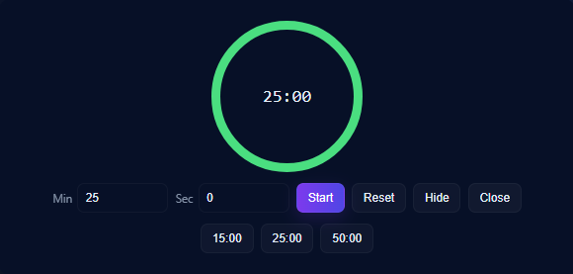
Implementation — Focus Timer & Extra Features
Productivity tools embedded in the application
Focus Timer
• Pomodoro: 25-min work / 5-min break
• Visual countdown display
• Floats over app — non-intrusive overlay
• Show / Hide toggle from nav bar

Slide 20
Future Enhancements
Planned improvements for production scale and expanded feature set
🗄️ PostgreSQL Migration
⚡ Redis Caching
🤖 AI Task Prioritisation
Replace SQLite with PostgreSQL for production concurrency, indexing, and reliability.
Cache analytics aggregations and RRULE expansions for sub-50 ms API response times.
ML-based suggestions to re-prioritise tasks using completion history and deadlines.
📧 Email Notifications
📅 Google Calendar Sync
🔔 Push Notifications
SMTP reminders for task deadlines and overdue alerts via SendGrid / Mailgun.
Two-way sync with Google Calendar API using OAuth 2.0 tokens.
Browser Web Push API for overdue task alerts and upcoming deadline reminders.
⎈️ Kubernetes Orchestration
👥 Team Workspaces
🔐 Role-Based Access Control
Migrate Docker deployment to K8s for horizontal auto-scaling and high availability.
Shared task boards, team dashboards, and task assignment to collaborators.
Admin / Manager / Member roles with fine-grained permission enforcement.
📴 Offline PWA Support
📊 Cloud Monitoring
🌙 Dark/Light Theme Toggle
Service workers for offline task viewing with background sync on reconnect.
Grafana + Prometheus dashboards for API latency, error rate, and server health.
User-selectable theme with preference persisted in localStorage.

Slide 21
Conclusion
Key outcomes and achievements
✅ Full-Stack Web Application
Successfully built Yoga-Do with a React + TypeScript frontend and a Django REST Framework backend, delivering a complete, calendar-driven task management experience with a responsive, professional UI.
✅ RRULE Recurring Task Engine
Implemented a standards-compliant RRULE engine supporting daily and weekly recurrence with per-occurrence exception handling — edit or delete a single instance without affecting the entire series.
✅ Analytics & Productivity Tools
Real-time Analytics Dashboard, Pomodoro Focus Timer, Personal Notes, and Motivational Quotes are integrated directly into the application, providing a comprehensive productivity platform.
✅ Complete DevOps Pipeline
Git → GitHub → GitHub Actions CI (backend unit tests + Playwright E2E) → Docker build → Render/EC2 backend + Vercel frontend. Fully automated with zero manual deployment steps.
✅ Security & Engineering Best Practices
Session-based auth, CSRF token protection, React error boundaries, automated testing, and Docker containerisation demonstrate professional software engineering standards.
Yoga-Do demonstrates that modern full-stack web development and professional DevOps practices can be successfully combined in an academic mini-project to deliver a real-world quality application.

Slide 22
References
[1]
R. Singh, A. Patel et al., "Task Management System Design Using Django REST Framework," Int. Journal of Computer Applications, Vol. 183, No. 12, pp. 1–8, 2022.
[2]
S. Mehta et al., "Containerisation with Docker for Academic and Enterprise Web Applications," IEEE Access, Vol. 10, pp. 45123–45135, 2023.
[3]
V. Kumar, M. Rao, "Automating CI/CD Pipelines Using GitHub Actions for Python-Django Projects," Journal of Open-Source Software, Vol. 8, No. 91, 2023.
[4]
W. Li, J. Chen, "Efficient RRULE Processing for Calendar-Based Task Management Applications," ACM SIGAPP Applied Computing Review, Vol. 24, No. 1, 2024.
[5]
P. Sharma, K. Nair, "Integrating Full-Stack DevOps in BE/BTech Capstone Projects," Proc. Int. Conf. on Software Engineering Education, pp. 211–218, 2024.
[6]
Django REST Framework — Official Documentation. https://www.django-rest-framework.org/
[7]
React Documentation. https://react.dev/
[8]
Docker Official Documentation. https://docs.docker.com/
[9]
GitHub Actions Documentation. https://docs.github.com/en/actions
[10]
python-dateutil RRULE Reference. https://dateutil.readthedocs.io/
[11]
Playwright Testing Framework. https://playwright.dev/

