Slide 1
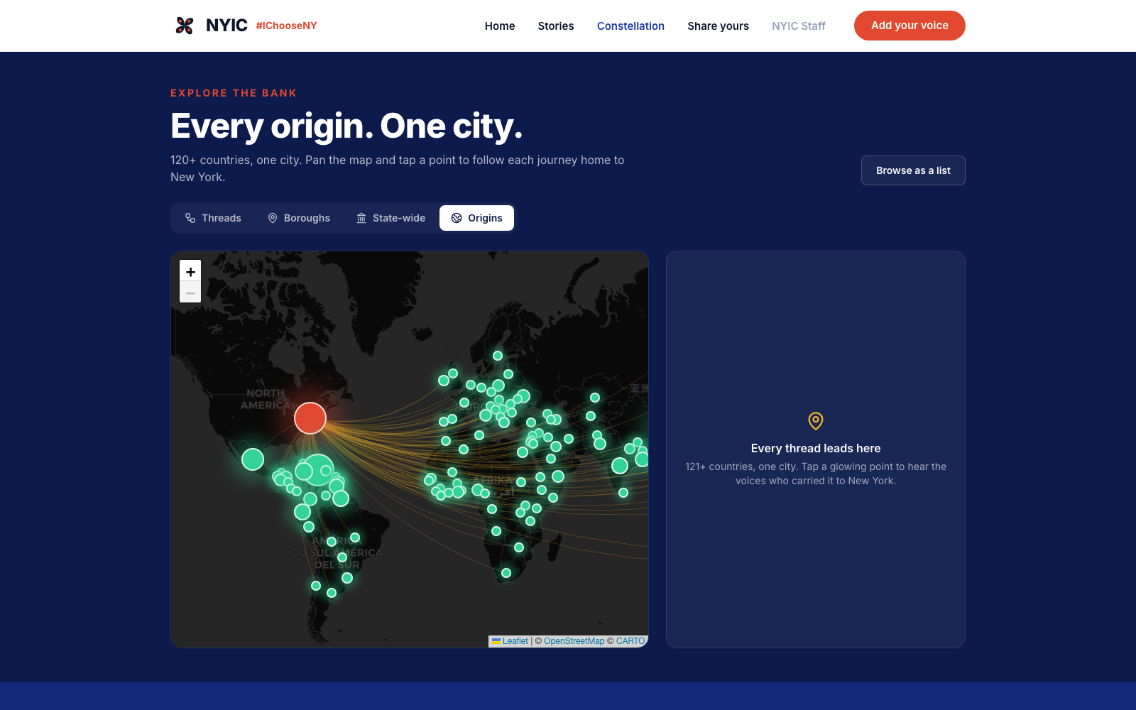
#IChooseNY
#IChooseYou
Belonging isn't a transaction.
NYIC Social Impact Hackathon · [Your team name]
Notes:
Before we say anything — listen. Go STRAIGHT into the 30-second real interview audio. Do not read the slide. Let it breathe, then begin.

Slide 2
Who we are
We listened to NYIC's narrative — then built its next chapter.
[Name]
[Name]
[Name]
[Name]
Product
Design
Data / AI
Storytelling
Notes:
20 seconds. Names + the one promise: we didn't replace NYIC's message, we evolved it. Move fast.

Slide 3
The question a system asks is a statement about what it thinks a person is for.
Everyone else asks:
“What did you contribute?”
Usefulness only buys tolerance. You may stay as long as you produce.
We ask:
“What did you hold onto that you were told to give up?”
#IChooseYou — un-extractable by design.
Notes:
The narrative shift. Usefulness only ever buys tolerance — you stay as long as you produce. We built a system where belonging is the premise, not the prize. This EVOLVES NYIC's 'we built New York'.

Slide 4
15-second concept film
Insert > Video here in Google Slides / Canva · file: ichooseny-teaser.mp4 (see HERO_VIDEO.md)
Notes:
Play the 15-sec teaser. Say nothing during it. After: 'That's the feeling. Here's the machine that makes it scale.'

Slide 5
Journey of a story
Five minutes of audio → a living archive
Record
›
Transcribe
›
Care-check
›
Tag
›
Connect
›
Activate
friend → friend
ElevenLabs
Claude Haiku
Claude Sonnet
embeddings
IG · Runway
One story. Two cents. Fully automatic after the interview.
A daughter interviews her mother for five minutes — everything after is the pipeline.
Notes:
Walk the path of ONE story (Amina). Everything after the 5-min interview is automatic — and costs two cents.

Slide 6
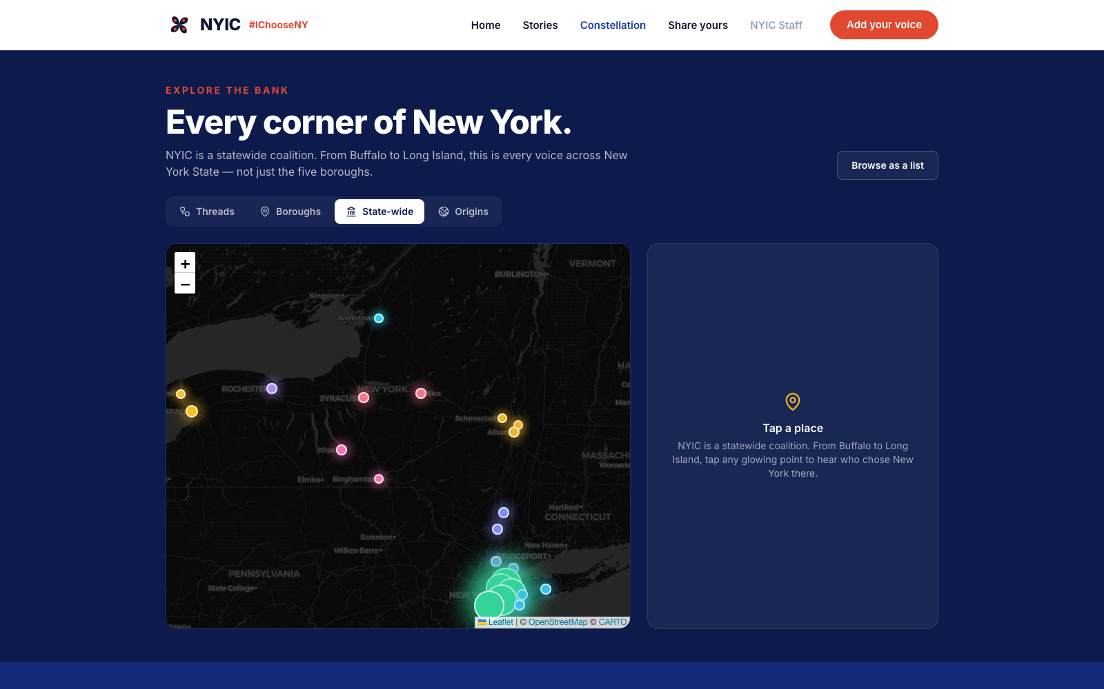
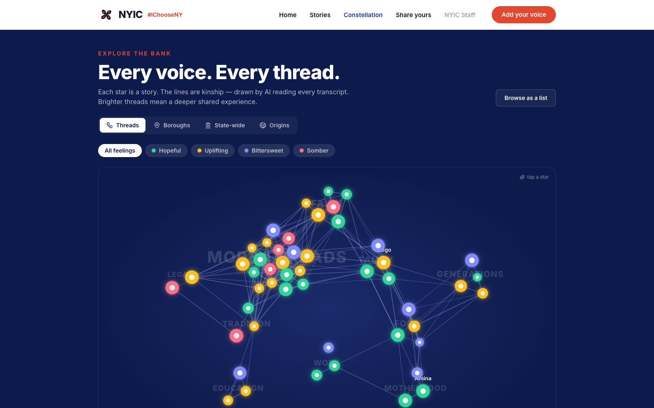
A bank you can feel, not scroll
Threads (kinship) · Boroughs & State-wide · 120+ origins → one city
Real maps.
Dark CARTO / OpenStreetMap — open-source, the same stack pros use.
All of NY.
Buffalo, Rochester, Long Island, the Hudson Valley — not just five boroughs.
Notes:
NYIC serves all of New York — so do we. Click a glowing point, play a voice. Show Origins arcs converging on NYC.

Slide 7
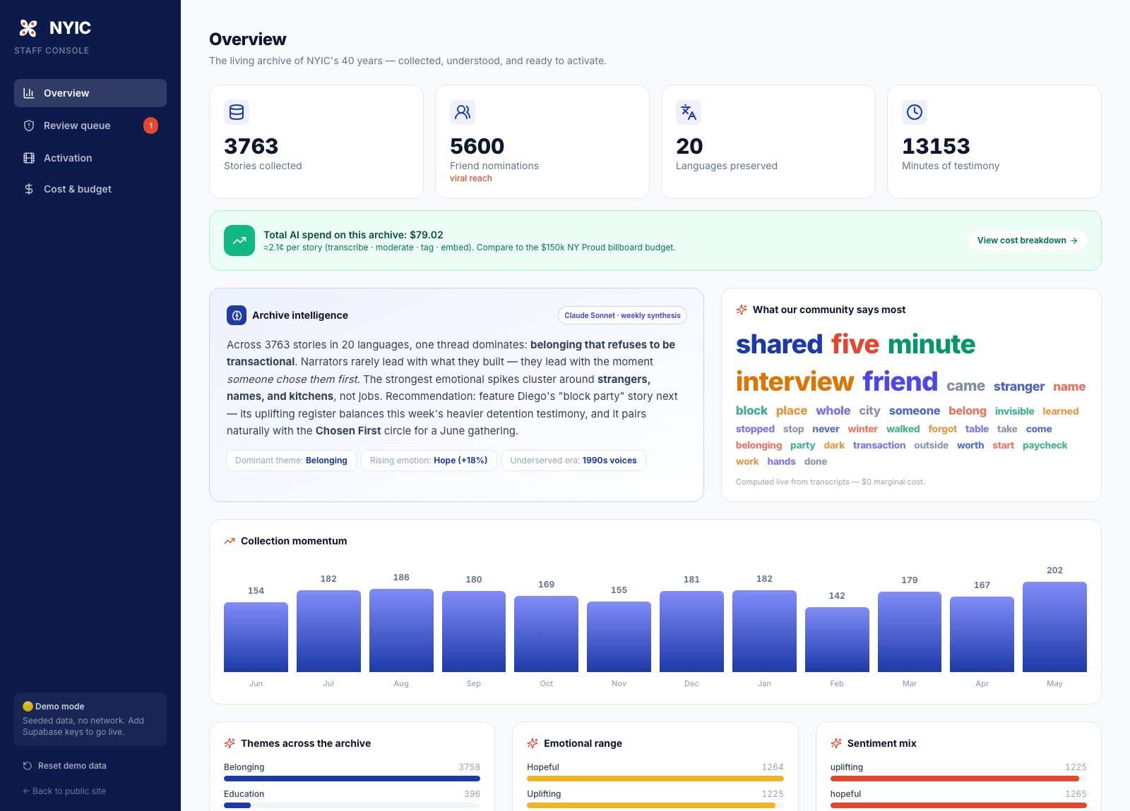
The team's daily cockpit
Care-first review · live analytics · activation · cost transparency
8 tag dimensions
mood · theme · topic · struggle · cultural heritage · neighborhood · member org · life stage
A live needs-assessment
“Struggles named” + “Cultural heritage” charts turn stories into advocacy data.
Notes:
Every story tagged across 8 dimensions, so the dashboard doubles as a live needs-assessment for advocacy & services.

Slide 8
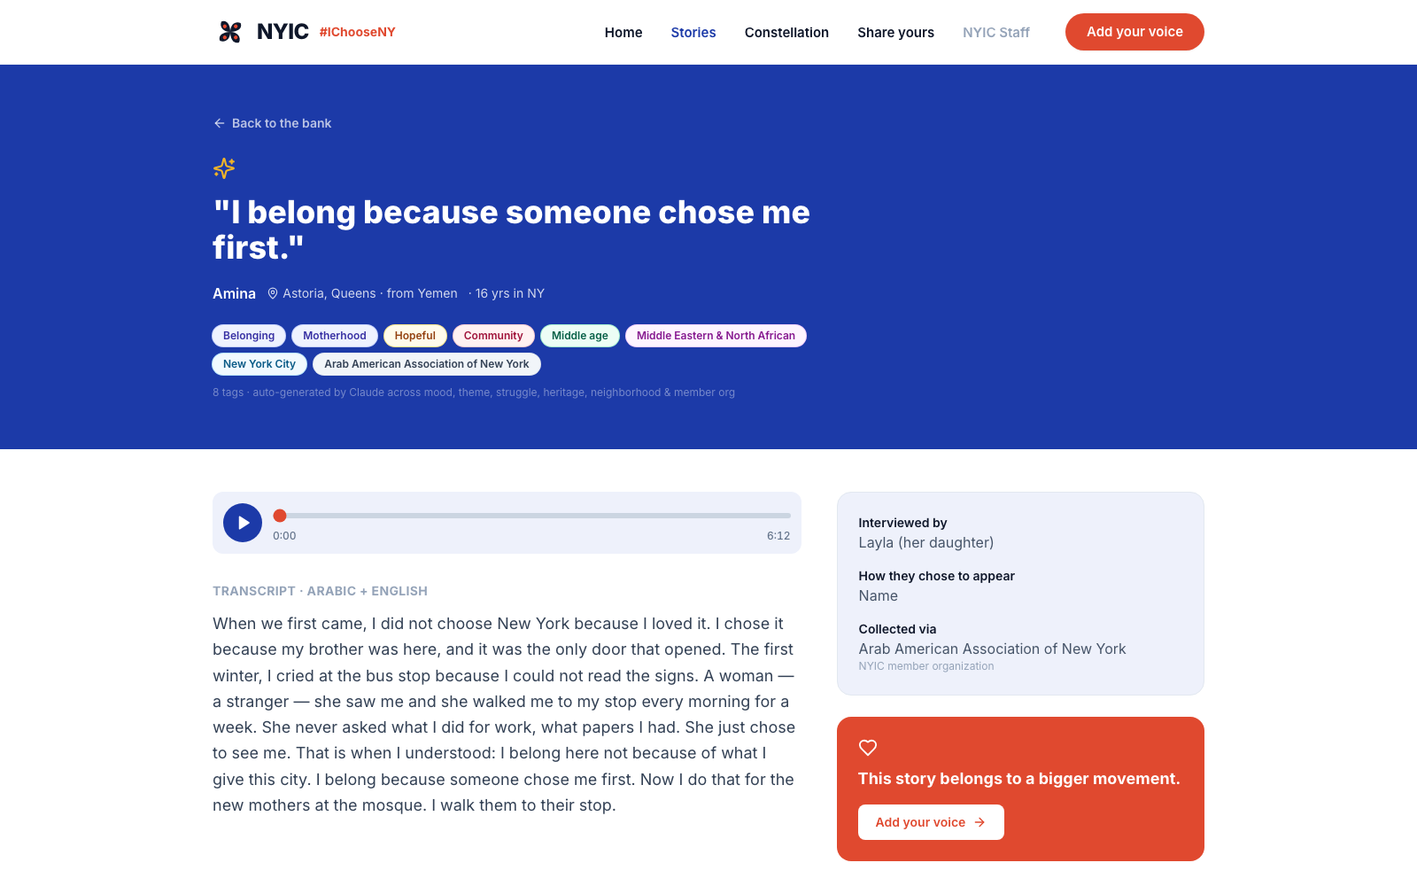
People over data. Always.
Granular consent
Name, pseudonym, or fully anonymous — chosen per story.
Voice protection
ElevenLabs voice-masking for narrators at risk.
Care, not censorship
Claude Haiku flags trauma to a human — never auto-rejects.
Credit where due
Member-org attribution + role-based access for 200+ orgs.
Notes:
Two doors: tell your story as you, or under protection. We never trade safety for a testimonial. Directly answers NYIC's StoryCorps / UnLocal data-security concerns.

Slide 9
One story a day. A movement a year.
Daily feature
The system surfaces one story a day, ready to post to Instagram + LinkedIn.
Runway animation
Anonymized voices become animated shorts — safe and shareable.
Advocacy match
“A bill is moving” → instantly find consenting stories that fit.
Viral loop
Every narrator nominates two friends. The bank grows itself.
Notes:
Collection is worthless if it sits in a database. Every day the system surfaces one story, ready to post / testify.

Slide 10
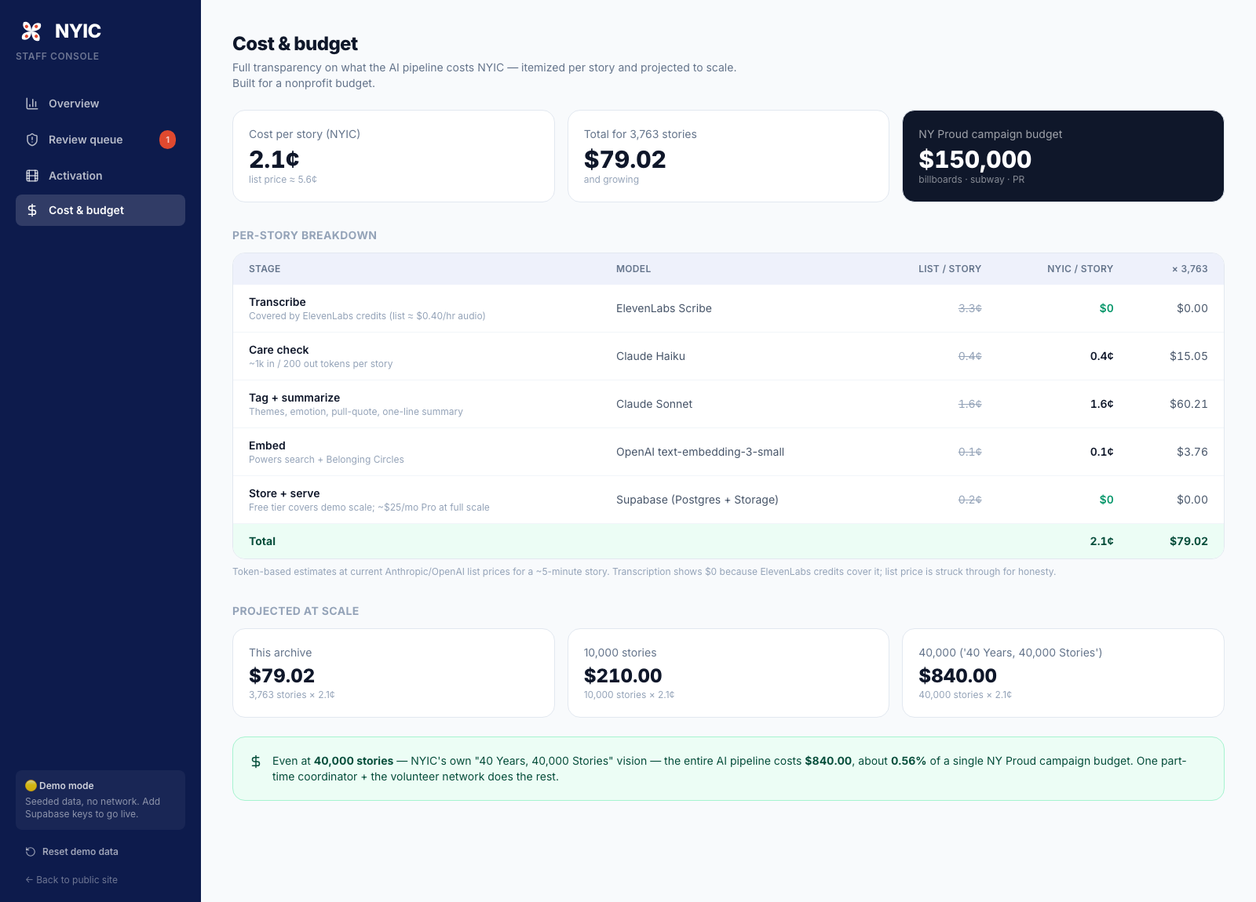
Impact & cost
Built for a nonprofit budget
3,700+
120+
20
~2.1¢
stories
countries
languages
per story
≈ $79
to process the entire archive.
$150,000 = one NY Proud campaign. We're a rounding error of that.
Notes:
At NYIC's own '40 Years, 40,000 Stories' vision, the whole AI pipeline costs under $850 — half a percent of one billboard campaign. One part-time coordinator + volunteers does the rest.

Slide 11
Deployable Monday — and built to last
Demo-proof
Runs offline-first on seeded data — no live API can break the pitch.
No vendor lock
Supabase + open-source Leaflet/OpenStreetMap maps.
Volunteer-powered
Code-4-Good & campus partners staff the recording booths.
Coalition-native
Every one of 200+ member orgs is credited and sees its own stories.
4.5M immigrants served · 40 years · a coalition of 200+ organizations
Notes:
Sustainability + partnership story. This isn't a hack-week toy — it's deployable Monday.

Slide 12
“We don't ask immigrants to prove they belong.
We ask them to choose us back.”
#IChooseNY · #IChooseYou
[ QR code to site ]
ichooseny.netlify.app
Notes:
The memorized close. End on the tagline, then SILENCE. Don't keep talking.

