Slide 1


CRICKET DATABASE
MANAGEMENT SYSTEM

Slide 2

Introduction
Welcome to my presentation on the Oracle Cricket Database Management System. This system is designed to manage cricket data in a streamlined and efficient manner, providing users with a comprehensive solution that meets their needs.

Slide 3
Introduction
Cricket is a sport that has been played around the world for more than eight centuries. It involves two teams with 11 players on each side. The captain who wins the toss decides whether his team bats or bowls first. If they bat first, their aim is to score a lot of runs and make sure the other
team does not reach that score.

Slide 4
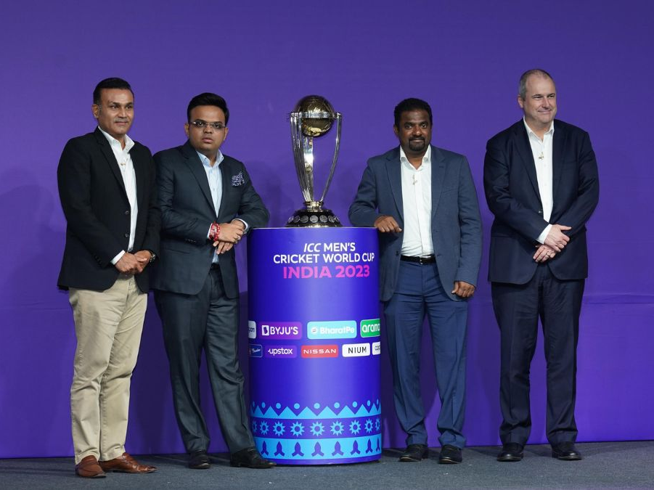
Purpose
This project can be very useful for Cricket match broadcasters to get information quickly. Also for Cricket lovers who are very much interested in Cricket Statistics. In other words this document will provide a basis for validation and verification.

Slide 5
Cricket Database System – Overview
Name of The Table
TEAM
WICKET_KEEPER
UMPIRE
PLAYER
COACH
CAPTAIN
MATCHES
PLAYS

Slide 6










ICC World Cup 2023 Team List
New Zealand
England
India
Bangladesh
Pakistan
Afghanistan
South Africa
Sri Lanka
Netherlands
Australia

Slide 7
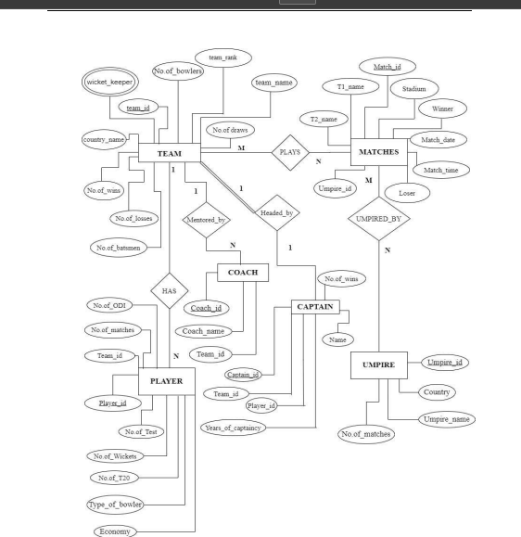
ER DIAGRAM

Slide 8
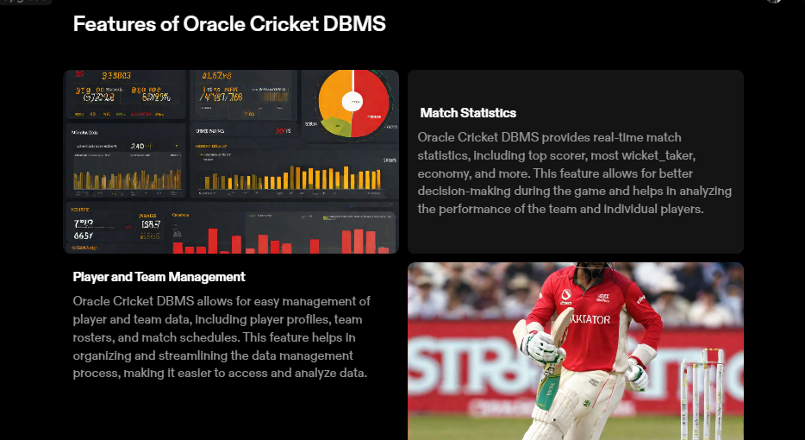
Features

Slide 9

IMPROVED DECISION MAKING
Cricket DBMS enables better decision making by providing real-time data analytics and insights into player performance, team statistics, and match outcomes.

Slide 10
EFFICIENT DATA MANAGEMENT
Oracle Cricket DBMS streamlines data management by automating data entry, storage, and retrieval processes, reducing manual errors and improving efficiency.

Slide 11
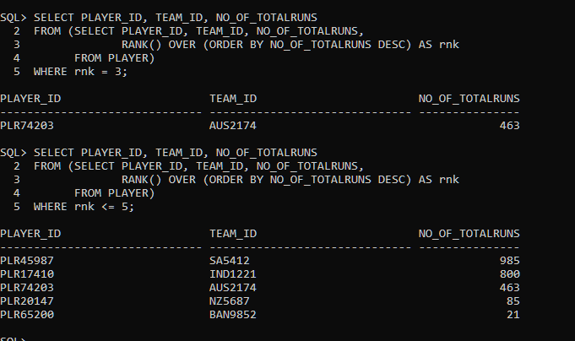
FINDING THE MOST RUN GETTER
.
-

Slide 12
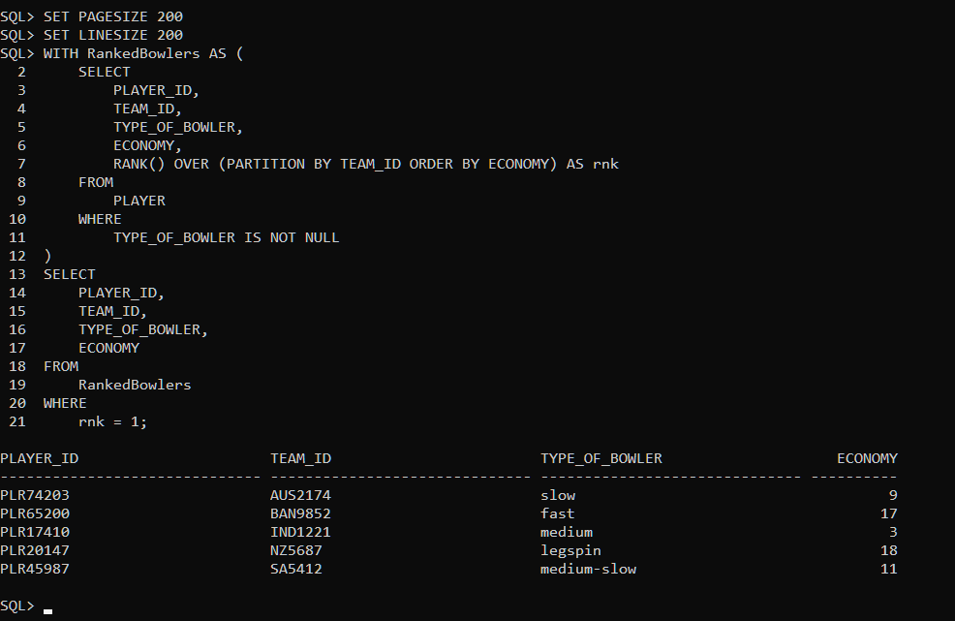
FINDING MOST ECONOMICAL BOWLER FROM EACH TEAM
.

Slide 13


Conclusion
To sum it up, our Cricket World Cup Database is like the MVP for all things cricket. Admins, you're the bosses in charge. It's a global playground for fans, where you can dive into player and team details, get the scoop on personal player info, and stay updated with the latest news. We're bringing a fresh vibe to accessing player and team data,

