Slide 1
SYED HASAN SAEED
Email: hasansaeedcontrol@gmail.com
Web Page: hasansaeed872726549.wordpress.com
Shasansaeed.yolasite.com

Slide 2
BOOKS
AUTOMATIC CONTROL SYSTEM: KUO & GOLANARAGHI
2. CONTROL SYSTEM: ANAND KUMAR
3. AUTOMATIC CONTROL SYSTEM: S. HASAN SAEED
ELECTRICAL MACINE & AUTOMATIC CONTROL: J.B.GUPTA & S. HASAN SAEED
AUTOMATIC CONTROL SYSTEM: R. A . BARAPATE

Slide 3
SIGNAL FLOW GRAPH
(SFG)

Slide 4
OUTLINE
Introduction to signal flow graph.
Definitions
Terminologies
Properties
Examples
Mason’s Gain Formula.
Construction of Signal Flow Graph.
Signal Flow Graph from Block Diagram.
Block Diagram from Signal Flow Graph.
Effect of Feedback.

Slide 5
INTRODUCTION
SFG is a simple method, developed by S.J.Mason
Signal Flow Graph (SFG) is applicable to the linear systems.
It is a graphical representation.
A signal can be transmitted through a branch only in the direction of the arrow.

Slide 6
Consider a simple equation
y= a x
The signal Flow Graph of above equation is shown below
a
x y
Each variable in SFG is designed by a Node.
Every transmission function in SFG is designed by a branch.
Branches are unidirectional.
The arrow in the branch denotes the direction of the signal flow.

Slide 7
TERMINOLOGIES
Signal Flow Graph
a₄₄
a₁₂
a₂₃
a₃₄
a₄₅
a₅₆
x₁
x₂
x₃
x₄
x₅
x₆
a₃₂
a₄₃
a₃₅

Slide 8
Input Node or source node: input node is a node which has only outgoing branches. X₁ is the input node.
Output node or sink node: an output node is a node that has only one or more incoming branches. X₆ is the output node.
Mixed nodes: a node having incoming and outgoing branches is known as mixed nodes. x₂, x₃, x₄ and x₅ are the mixed nodes.
Transmittance: Transmittance also known as transfer function, which is normally written on the branch near arrow.

Slide 9
Forward path: Forward path is a path which originates from the input node and terminates at the output node and along which no node is traversed more than once. X₁-x₂-x₃-x₄-x₅-x₆ and x₁-x₂-x₃-x₅-x₆ are forward paths.
Loop: loop is a path that originates and terminates on the same node and along which no other node is traversed more than once. e.g x₂ to x₃ to x₂ and x₃ to x₄ to x_{3 .}
Self loop: it is a path which originates and terminates on the same node. For example x₄

Slide 10
Path gain: The product of the branch gains along the path is called path gain. For example the gain of the path x₁-x₂-x₃-x₄-x₅-x₆ is a₁₂a₂₃a₃₄a₄₅a₅₆
Loop Gain: The gain of the loop is known as loop gain.
Non-touching loop: Non-touching loops having no common nodes branch and paths. For example x₂ to x₃ to x₂ and x₄ to x₄ are non-touching loops.

Slide 11
PROPERTIES OF SIGNAL FLOW GRAPH:
Signal flow graph is applicable only for linear time-invariant systems.
The signal flow graph along the direction of the arrow.
The gain of the SFG is given by Mason’s formula.
The signal gets multiplied by branch gain when it travels along it.
The SFG is not be the unique property of the system.
Signal travel along the branches only in the direction described by the arrows of the branches.

Slide 12
COMPARISON OF BLOCK DIAGRAM AND SIGNAL FLOW GRAPH METHOD
S.NO. | BLOCK DIAGRAM | SFG
1. | Applicable to LTI systems only | Applicable to LTI systems only
2. | Each element is represented by block | Each variable is represented by node
3. | Summing point and take off points are separate | Summing point and take off points are not used
4. | Self loop do not exists | Self loop can exits
5. | It is time consuming method | Requires less time
6. | Feedback path is present | Feedback loops are present.

Slide 13
CONSTRUCTION OF SFG FROM EQUATIONS
Consider the following equations
Where y₁ is the input and y₆ is the output
First draw all nodes. In given example there are six nodes. From the first equation it is clear that y₂ is the sum of two signals and so on.

Slide 14
CONSTRUCTION OF SFG FROM EQUATIONS
Consider the following equations
Where y₁ is the input and y₆ is the output
First draw all nodes. In given example there are six nodes. From the first equation it is clear that y₂ is the sum of two signals and so on.
y₂ = t₁₂ y₁ + t₃₂ y₃
y₃ = t₂₃ y₂ + t₃₃ y₃ + t₁₃ y₁
y₄ = t₃₄ + t₂₄ y₂
y₅ = t₄₅ y₄
y₆ = t₅₆ y₅ + t₄₆ y₄

Slide 15
<
>
>

Slide 16

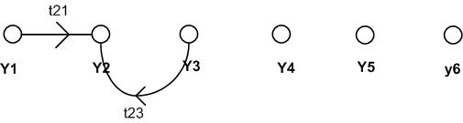
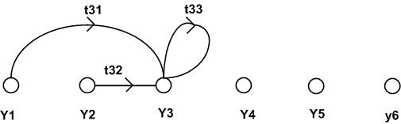

Slide 17
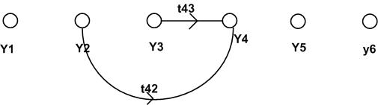

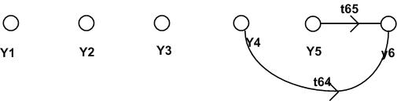

Slide 18
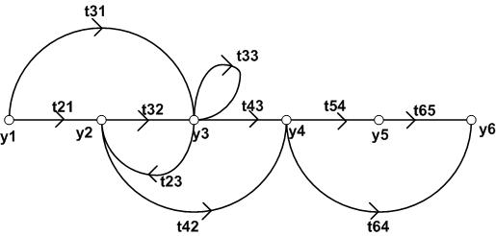
Complete Signal Flow Graph

Slide 19
CONSTRUCTION OF SFG FROM BLOCK DIAGRAM
All variables, summing points and take off points are represented by nodes.
If a summing point is placed before a take off point in the direction of signal flow, in such case represent the summing point and take off point by a single node.
If a summing point is placed after a take off point in the direction of signal flow, in such case represent the summing point and take off point by separate nodes by a branch having transmittance unity.

Slide 20
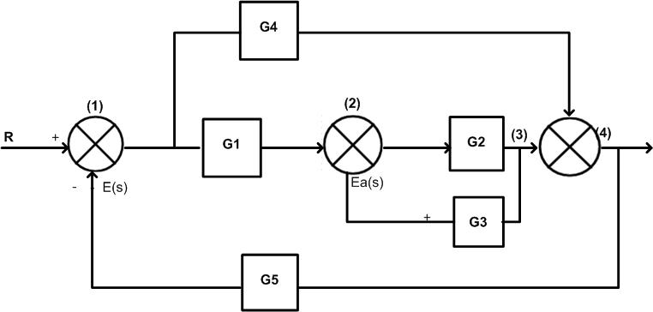
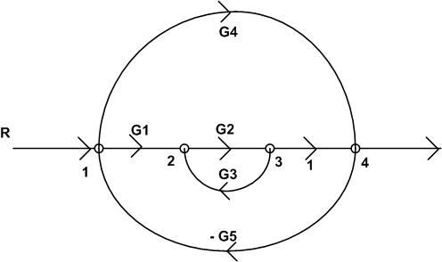

Slide 21
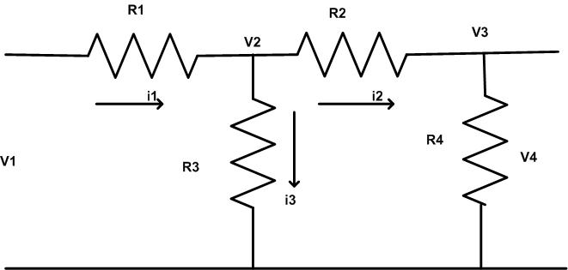
Draw the SFG for the network shown in fig, take V₃ as output node

Slide 22
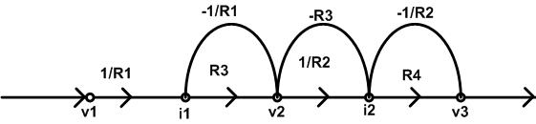

Slide 23
MASON’S GAIN FORMULA
By using Mason’s Gain formula we can determine the overall transfer function of the system in one step.
Where Δ=1- [sum of all individual loop gain]+[sum of all possible gain products of two non-touching loops]-[sum of all possible gain products of three non-touching loops]+…………
g_{k} = gain of k^{th} forward path
Δ_{k} =the part of Δ not touching the k^{th} forward path

Slide 24
For the given Signal Flow Graph find the ratio C/R by using Mason’s Gain Formula.
SFG:
G₅
H₄
1
2
G₁
G₂
G₃
G₄
1
7
R
1
3
4
5
C
6
- H₁
- H₂
- H₃

Slide 25
The gain of the forward path
Individual loops
Two non-touching loops

Slide 26
Three non-touching loops

Slide 27
BLOCK DIAGRAM FROM SFG
For given SFG, write the system equations.
At each node consider the incoming branches only.
Add all incoming signals algebraically at a node.
for + or – sign in system equations use a summing point.
For the gain of each branch of signal flow graph draw the block having the same transfer function as the gain of the branch.

Slide 28
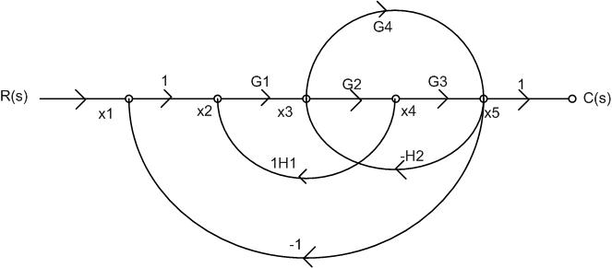
Draw the block diagram from the given signal flow graph

Slide 29
Solution:
At node x₁ the incoming branches are from R(s) and x₅
x₁=1.R(s)-1 x₅
At node x_{2,} there are two incoming branches
x₂ =1 x₁-H₁ x₄
At node x₃ there are two incoming branches
X₃ = G₁ x₂ – H₂ x₅
Similarly at node x₄ and x₅ the system equations are
X₄=G₂ x₃
x₅=G₃ x₄ +G₄ x₃

Slide 30
Draw the block diagram for x₁=1.R(s)-1 x₅
R(s) x₁
x₅
Block diagram for x₂ = x₁-H₁ x₄
x1 + x₂
x4 4
1
+
1
1
H₁

Slide 31
Block diagram for x₃ = G₁ x₂ – H₂ x₅
x₂ + x₃
x₅
Block diagram for x₄=G₂ x₃
x₃ G₂ x₄
G₁
H₂

Slide 32
Block diagram for x₅=G₃ x₄ +G₄ x₃
x₄ + x₅
₊
x₃
G₃
G₄

Slide 33
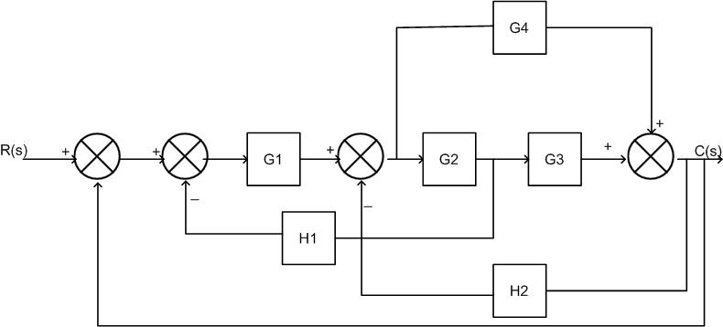
Combining all block diagram

Slide 34
EFFECT OF PARAMETER VARIATION IN OPEN LOOP CONTROL SYSTEM
R(s)
G(s)
C(s)
The transfer function of open loop system is

Slide 35

EFFECT OF PARAMETER VARIATION IN OPEN LOOP CONTROL SYSTEM
$$\text{from} \text{equation} (1) \\ \text{C} (s) + Δ \text{C} (s) = \left[ \text{G} (s) + Δ \text{G} (s)\right] \text{R} (s) \\ \text{C} (s) + Δ \text{C} (s) = \text{G} (s) \text{R} (s) + \text{R} (s) Δ \text{G} (s) \\ \text{G} (s) \text{R} (s) = \text{C} (s) \\ \text{C} (s) + Δ \text{C} (s) = \text{C} (s) + Δ \text{G} (s) \text{R}\text{(}\text{s}) \\ Δ \text{C} (s) = Δ \text{G} (s) \text{R} (s)\text{ −−−−−−−−−−−− }(2)$$
Equation 2 gives the change in output due to parameter variations in G (s) in open loop system

Slide 36
EFFECT OF FEEDBACK ON OVERALL GAIN R(s) C(s)
G(s)
The overall transfer function of open loop system is
The overall transfer function of closed loop system is
For negative feedback the gain G(s) is reduced by a factor
So due to negative feedback overall gain of the system is reduced

Slide 37
EFFECT OF FEEDBACK ON STABILITY
Consider the open loop system with overall transfer function
The pole is located at s=-T
Now, consider closed loop system with unity negative feedback, then overall transfer function is given by
Now closed loop pole is located at s=-(T+K)
Thus, feedback controls the time response by adjusting the location of poles. The stability depends upon the location of the poles. Thus feedback affects the stability.

Slide 38
THANK YOU

