Slide 1
The Difference Between Annual Members and
Casual Riders in Using Cyclistic Bikes
By Hasan Ibrahim

Slide 2
Objective
To know the difference between annual members and casual riders in order to determine whether it is a good thing to increase the number of annual members from casual riders.

Slide 3
Questions
How often do annual members and casual riders use the Cyclistic Bike?
How many casual riders and annual members use the Cyclistic Bike?
Do the number of casual riders in line with the annual users?

Slide 4
Present Data

Slide 5
Disclaimer
Before we go further into the analysis, please note that the "number of users" stated in this presentation is NOT the number of users by the individual, it is a record number of users using the Cyclistic Bike.

Slide 6
How often do annual members and casual riders use the Cyclistic Bike?

Slide 7
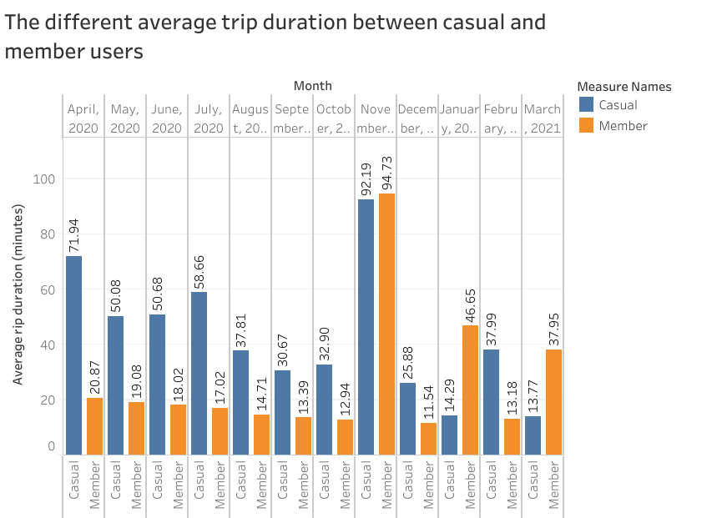
The data shows that casual riders were using the Cylistic Bike more often than the annual members.

Slide 8
How many casual riders and annual members use the Cyclistic Bike?

Slide 9
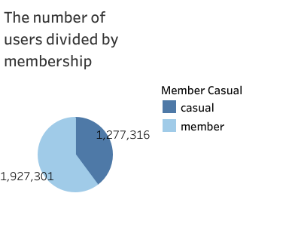
The pie chart shows that casual riders also have a large number of total trips in the last 12 months.

Slide 10
Do the number of casual riders in line with the annual users?

Slide 11
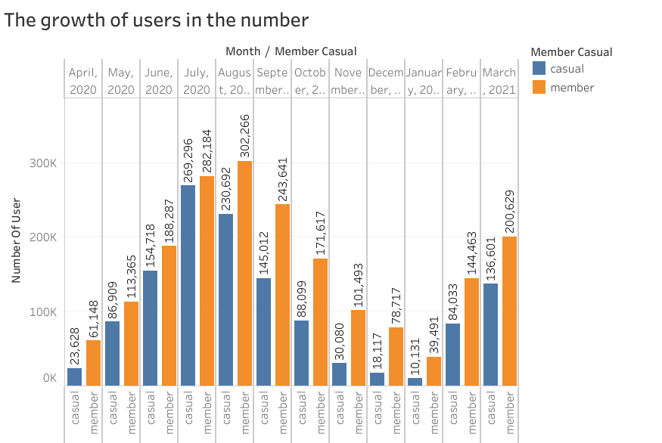
From the chart, we can see that the number of casual riders using the Cyclistic Bikes gradually increases following the annual members.
The cause for the decrease in number needs more additional analysis, for it's not related to the topic for now.

Slide 12
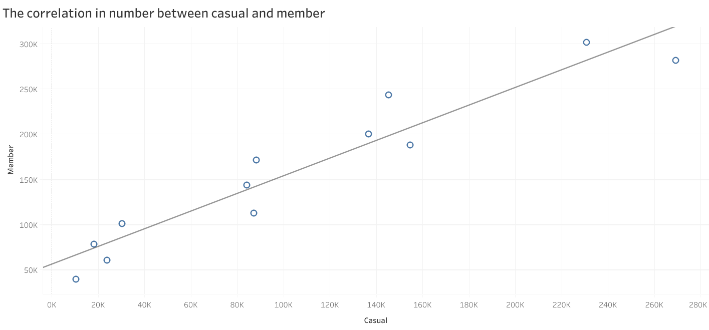
Positive correlation between casual riders and annual members in using The Cyclistic Bikes.

Slide 13
Conclusion

Slide 14
From the average trip duration in the last 12 months, the casual riders were more often in using the Cylclistic Bikes. It will be a big contribution to the company if we can increase the number of annual users.
The number of trips from Casual Riders in the last 12 months can also be a big consideration, for the number is more than a million trips.
The number of casual riders using the Cyclistic Bikes each month in the last 12 months is gradually following the number of annual members. The number of casual riders and annual members also shows a positive correlation. It is implied that the casual riders are a good chance to increase the number of annual members.

Slide 15
Further Exploration
Data about member ID so that we can know the exact number of users from casual riders and annual members.
Data about users' address, sex, and age to determine the advertisement strategy.

Slide 16
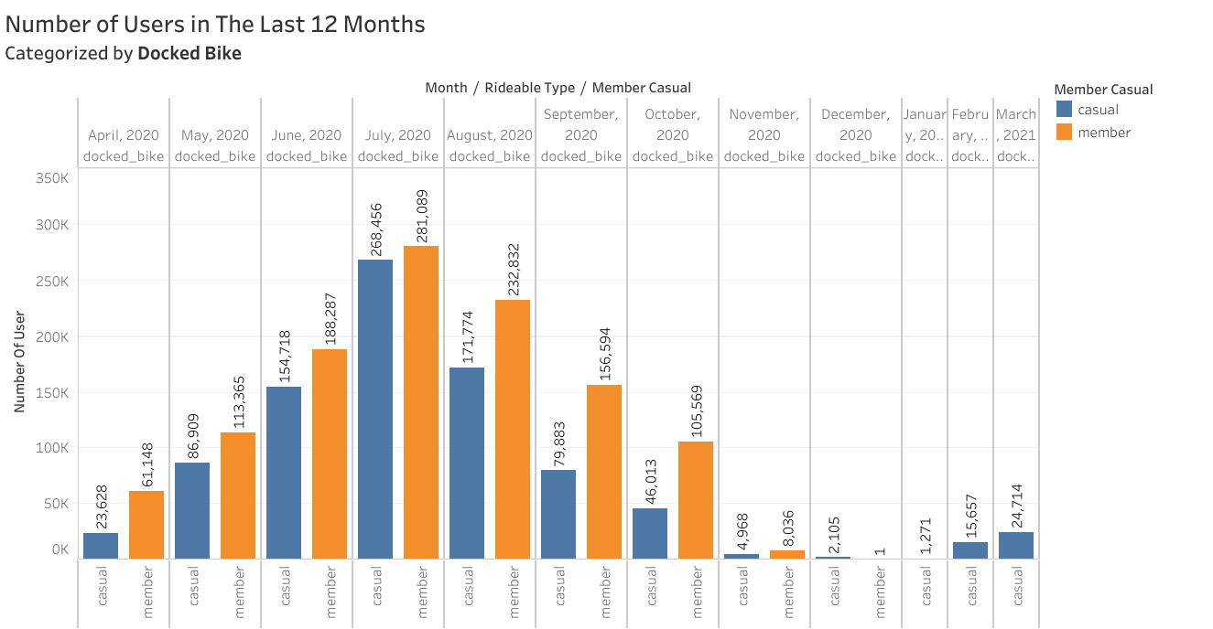
Additional Insight for Further Analysis
From April to October most of the user using the docked bike.

Slide 17
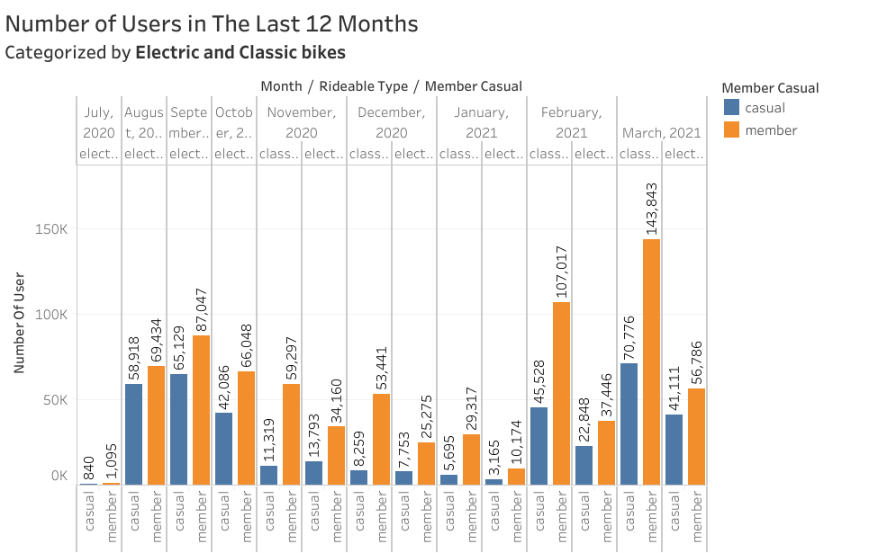
Starting August and the following months most of the users start to use the electric and classic bikes.

Slide 18
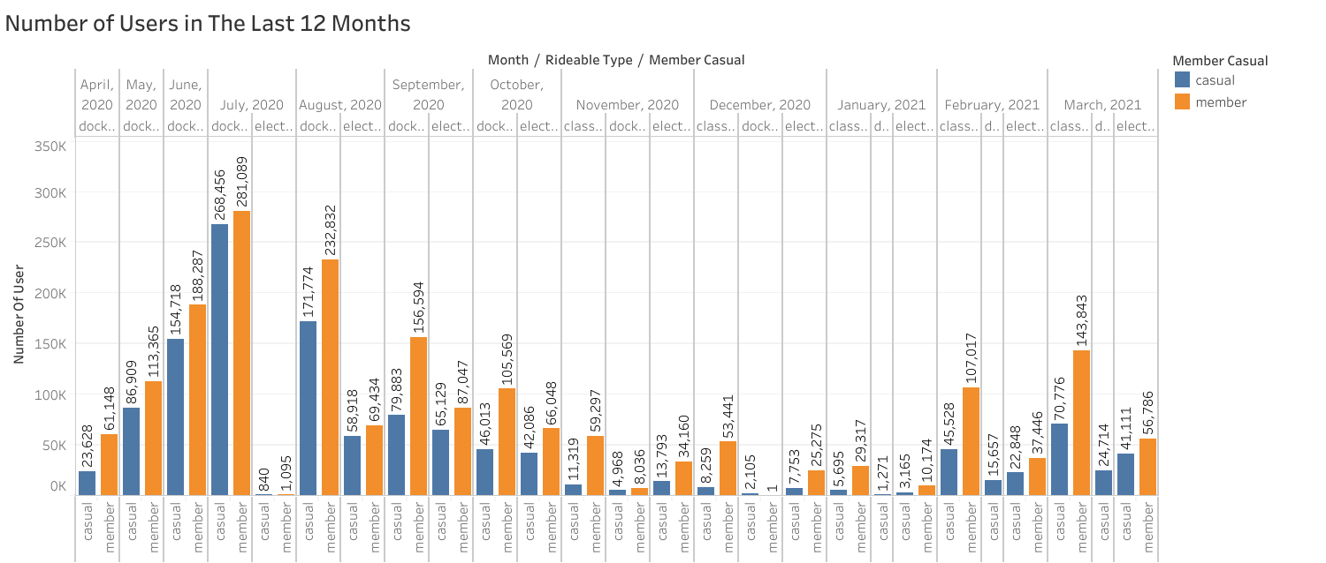

Slide 19
Thank You

