Slide 1

StudyMafia.Org
Fuel Cell
Submitted To: Submitted By:
Studymafia.org Studymafia.org

Slide 2
Table Contents
Definition
Introduction
About Fuel Cell
Working of Fuel Cell
Types of Fuel Cell
Applications of Fuel Cell
Conclusion
2
Notes:
SAY: Before we wrap up the course, let’s review what we have learned today.
During this course, we have
<READ the bullets from the slide.>
GO to next slide.

Slide 3
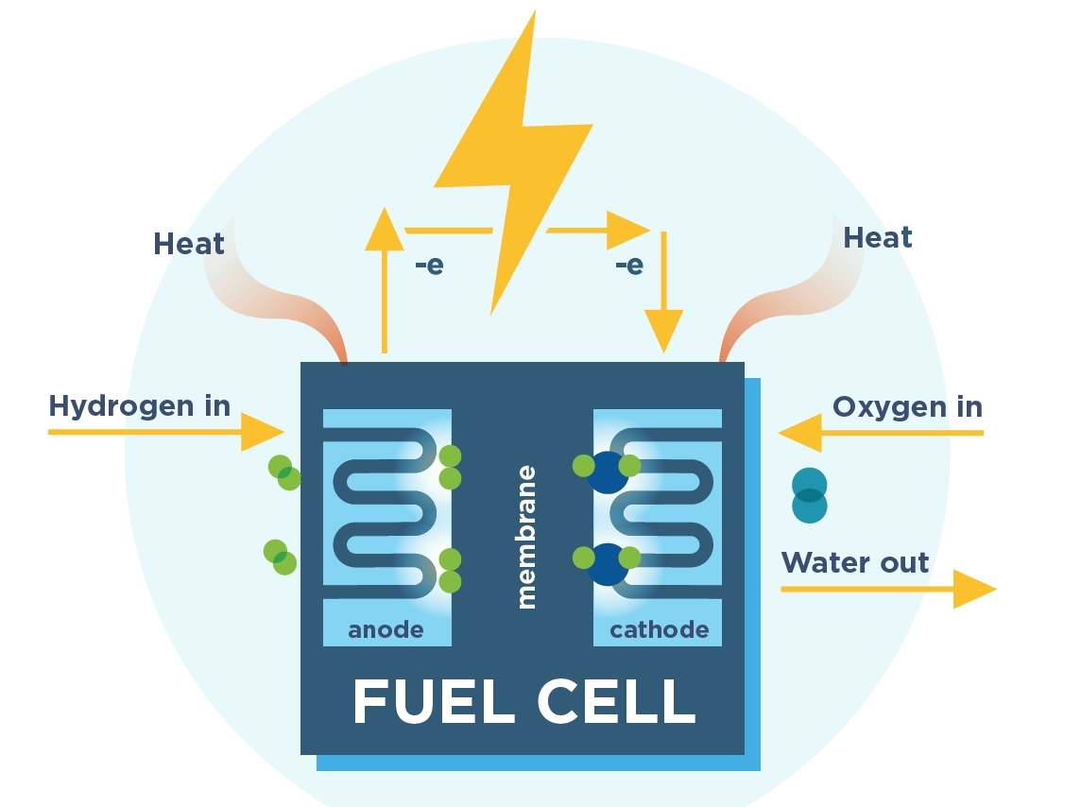
Definition
A fuel cell can be defined as an electrochemical cell that generates electrical energy from fuel via an electrochemical reaction.
3
Notes:
SAY: Before we wrap up the course, let’s review what we have learned today.
During this course, we have
<READ the bullets from the slide.>
GO to next slide.

Slide 4
Introduction
Fuel cells require a continuous input of fuel and an oxidizing agent (generally oxygen) in order to sustain the reactions that generate the electricity. Therefore, these cells can constantly generate electricity until the supply of fuel and oxygen is cut off.
Despite being invented in the year 1838, fuel cells began commercial use only a century later when they were used by NASA to power space capsules and satellites.
4
Notes:
SAY: Before we wrap up the course, let’s review what we have learned today.
During this course, we have
<READ the bullets from the slide.>
GO to next slide.

Slide 5
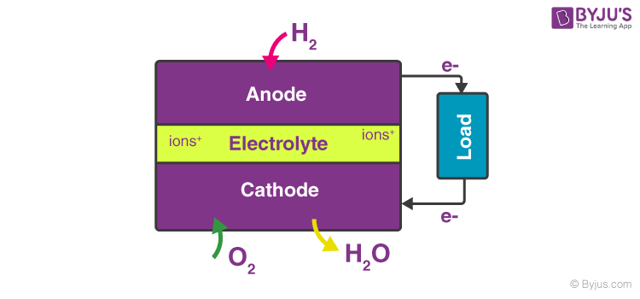
About Fuel Cell
5
Notes:
SAY: Before we wrap up the course, let’s review what we have learned today.
During this course, we have
<READ the bullets from the slide.>
GO to next slide.

Slide 6
About Fuel Cell
The efficiency of the fuel cell described above in the generation of electricity generally approximates to 70% whereas thermal power plants have an efficiency of 40%.
This substantial difference in efficiency is because the generation of electric current in a thermal power plant involves the conversion of water into steam, and the usage of this steam to rotate a turbine.
6
Notes:
SAY: Before we wrap up the course, let’s review what we have learned today.
During this course, we have
<READ the bullets from the slide.>
GO to next slide.

Slide 7
Working of Fuel Cell
The reaction between hydrogen and oxygen can be used to generate electricity via a fuel cell.
Such a cell was used in the Apollo space programme and it served two different purposes – It was used as a fuel source as well as a source of drinking water (the water vapour produced from the cell, when condensed, was fit for human consumption).
●●●
7
Notes:
SAY:
The purpose of epidemiology in public health practice is to
discover the agent, host, and environmental factors that affect health;
determine the relative importance of causes of illness, disability, and death;
identify those segments of the population that have the greatest risk from specific causes of ill health; and
evaluate the effectiveness of health programs and services in improving population health.
GO to next slide.

Slide 8
Working of Fuel Cell
The working of this fuel cell involved the passing of hydrogen and oxygen into a concentrated solution of sodium hydroxide via carbon electrodes.
The cell reaction can be written as follows:
Cathode Reaction: O2 + 2H2O + 4e– → 4OH–
Anode Reaction: 2H2 + 4OH– → 4H2O + 4e–
Net Cell Reaction: 2H2 + O2 → 2H2O
●●●
8
Notes:
SAY:
The purpose of epidemiology in public health practice is to
discover the agent, host, and environmental factors that affect health;
determine the relative importance of causes of illness, disability, and death;
identify those segments of the population that have the greatest risk from specific causes of ill health; and
evaluate the effectiveness of health programs and services in improving population health.
GO to next slide.

Slide 9
Working of Fuel Cell
However, the reaction rate of this electrochemical reaction is quite low. This issue is overcome with the help of a catalyst such as platinum or palladium.
In order to increase the effective surface area, the catalyst is finely divided before being incorporated into the electrodes.
9
Notes:
SAY:
The purpose of epidemiology in public health practice is to
discover the agent, host, and environmental factors that affect health;
determine the relative importance of causes of illness, disability, and death;
identify those segments of the population that have the greatest risk from specific causes of ill health; and
evaluate the effectiveness of health programs and services in improving population health.
GO to next slide.

Slide 10
Types of Fuel Cell
The Polymer Electrolyte Membrane (PEM) Fuel Cell:
These cells are also known as proton exchange membrane fuel cells (or PEMFCs).
The temperature range that these cells operate in is between 50oC to 100oC
The electrolyte used in PEMFCs is a polymer which has the ability to conduct protons.
A typical PEM fuel cell consists of bipolar plates, a catalyst, electrodes, and the polymer membrane.
●●●
10
Notes:
SAY:
The purpose of epidemiology in public health practice is to
discover the agent, host, and environmental factors that affect health;
determine the relative importance of causes of illness, disability, and death;
identify those segments of the population that have the greatest risk from specific causes of ill health; and
evaluate the effectiveness of health programs and services in improving population health.
GO to next slide.

Slide 11
Types of Fuel Cell
Phosphoric Acid Fuel Cell
These fuel cells involve the use of phosphoric acid as an electrolyte in order to channel the H+
The working temperatures of these cells lie in the range of 150oC – 200oC
Electrons are forced to travel to the cathode via an external circuit because of the non-conductive nature of phosphoric acid.
●●●
11
Notes:
SAY:
The purpose of epidemiology in public health practice is to
discover the agent, host, and environmental factors that affect health;
determine the relative importance of causes of illness, disability, and death;
identify those segments of the population that have the greatest risk from specific causes of ill health; and
evaluate the effectiveness of health programs and services in improving population health.
GO to next slide.

Slide 12
Types of Fuel Cell
Solid Acid Fuel Cell
A solid acid material is used as the electrolyte in these fuel cells.
The molecular structures of these solid acids are ordered at low temperatures.
At higher temperatures, a phase transition can occur which leads to a huge increase in conductivity.
●●●
12
Notes:
SAY:
The purpose of epidemiology in public health practice is to
discover the agent, host, and environmental factors that affect health;
determine the relative importance of causes of illness, disability, and death;
identify those segments of the population that have the greatest risk from specific causes of ill health; and
evaluate the effectiveness of health programs and services in improving population health.
GO to next slide.

Slide 13
Types of Fuel Cell
Alkaline Fuel Cell
This was the fuel cell which was used as the primary source of electricity in the Apollo space program.
In these cells, an aqueous alkaline solution is used to saturate a porous matrix, which is in turn used to separate the electrodes.
The operating temperatures of these cells are quite low (approximately 90oC).
●●●
13
Notes:
SAY:
The purpose of epidemiology in public health practice is to
discover the agent, host, and environmental factors that affect health;
determine the relative importance of causes of illness, disability, and death;
identify those segments of the population that have the greatest risk from specific causes of ill health; and
evaluate the effectiveness of health programs and services in improving population health.
GO to next slide.

Slide 14
Types of Fuel Cell
Solid Oxide Fuel Cell
These cells involve the use of a solid oxide or a ceramic electrolyte (such as yttria-stabilized zirconia).
These fuel cells are highly efficient and have a relatively low cost (theoretical efficiency can even approach 85%).
The operating temperatures of these cells are very high (lower limit of 600oC, standard operating temperatures lie between 800 and 1000oC).
●●●
14
Notes:
SAY:
The purpose of epidemiology in public health practice is to
discover the agent, host, and environmental factors that affect health;
determine the relative importance of causes of illness, disability, and death;
identify those segments of the population that have the greatest risk from specific causes of ill health; and
evaluate the effectiveness of health programs and services in improving population health.
GO to next slide.

Slide 15
Types of Fuel Cell
Molten Carbonate Fuel Cell
The electrolyte used in these cells is lithium potassium carbonate salt. This salt becomes liquid at high temperatures, enabling the movement of carbonate ions.
Similar to SOFCs, these fuel cells also have a relatively high operating temperature of 650oC.
15
Notes:
SAY:
The purpose of epidemiology in public health practice is to
discover the agent, host, and environmental factors that affect health;
determine the relative importance of causes of illness, disability, and death;
identify those segments of the population that have the greatest risk from specific causes of ill health; and
evaluate the effectiveness of health programs and services in improving population health.
GO to next slide.

Slide 16
Applications of Fuel Cell
Fuel cell technology has a wide range of applications. Currently, heavy research is being conducted in order to manufacture a cost-efficient automobile which is powered by a fuel cell.
A few applications of this technology are listed below:
Fuel cell electric vehicles, or FCEVs, use clean fuels and are therefore more eco-friendly than internal combustion engine-based vehicles.
●●●
16
Notes:
SAY:
The purpose of epidemiology in public health practice is to
discover the agent, host, and environmental factors that affect health;
determine the relative importance of causes of illness, disability, and death;
identify those segments of the population that have the greatest risk from specific causes of ill health; and
evaluate the effectiveness of health programs and services in improving population health.
GO to next slide.

Slide 17
Applications of Fuel Cell
They have been used to power many space expeditions including the Appolo space program.
Generally, the byproducts produced from these cells are heat and water.
The portability of some fuel cells is extremely useful in some military applications.
These electrochemical cells can also be used to power several electronic devices.
Fuel cells are also used as primary or backup sources of electricity in many remote areas.
17
Notes:
SAY:
The purpose of epidemiology in public health practice is to
discover the agent, host, and environmental factors that affect health;
determine the relative importance of causes of illness, disability, and death;
identify those segments of the population that have the greatest risk from specific causes of ill health; and
evaluate the effectiveness of health programs and services in improving population health.
GO to next slide.

Slide 18
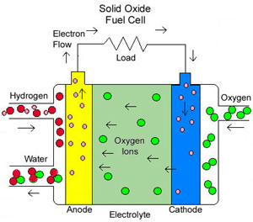

Slide 19
Conclusion
Fuel cells provide clean energy and emit no pollution. Moreover, it also offers high efficiency and zero emissions.
No carbon dioxide is produced while generating chemical energy from a fuel cell.
19
Notes:
SAY:
The purpose of epidemiology in public health practice is to
discover the agent, host, and environmental factors that affect health;
determine the relative importance of causes of illness, disability, and death;
identify those segments of the population that have the greatest risk from specific causes of ill health; and
evaluate the effectiveness of health programs and services in improving population health.
GO to next slide.

Slide 20
Thanks To StudyMafia.org

