Slide 1

CLOUD BASED MOVIE STREAMING PLATFORM
Tanim Ahmed (2312597042)
Mustakim Ahmed Hasan (2421349042)
MD. Nafiz Al Mamun (2232050642)
Ahamed Osman Asif (2031080642)
Notes:
Tanim Ahmed (2312597042)
Mustakim Ahmed Hasan (2421349042)
MD. Nafiz Al Mamun (2232050642)
Ahamed Osman Asif (2031080642)

Slide 2

ABSTRACT
Online video streaming is one of the most popular forms of digital media consumption.
Modern streaming platforms require scalable backend services, adaptive video delivery, and cloud deployment.
This project develops a cloud-based movie streaming platform inspired by Netflix and Amazon Prime Video.
Built using Next.js (Frontend), FastAPI (Backend), PostgreSQL (Database), and Supabase Storage.
Supports secure authentication, movie browsing, search, HLS streaming, watch history, and trending logic.
Demonstrates a scalable full-stack cloud architecture similar to real-world streaming platforms.
Notes:
Tanim Ahmed (2312597042)
Mustakim Ahmed Hasan (2421349042)
MD. Nafiz Al Mamun (2232050642)
Ahamed Osman Asif (2031080642)

Slide 3

Introduction
Streaming platforms require secure authentication, adaptive media delivery, and scalable infrastructure.
Many academic web projects focus only on basic CRUD operations, lacking real-world complexity.
This project builds a simplified yet realistic movie streaming system.
Integrates Next.js frontend with FastAPI backend.
Implements HLS streaming, movie browsing, authentication, and watch history tracking.
Goal: Provide hands-on experience with modern full-stack cloud architecture.
Notes:
Tanim Ahmed (2312597042)
Mustakim Ahmed Hasan (2421349042)
MD. Nafiz Al Mamun (2232050642)
Ahamed Osman Asif (2031080642)

Slide 4

Literature Review
Modern streaming services use distributed cloud architectures to deliver media at scale.
Cloud computing enables dynamic resource scaling based on user demand (Armbrust et al.).
Many platforms use microservice-based architectures to separate frontend and backend services.
HTTP Live Streaming (HLS) enables adaptive video delivery by segmenting video files.
Adaptive streaming reduces buffering and adjusts video quality based on bandwidth.
Streaming platforms enhance user experience through search systems, watch-history tracking, and trending algorithms.
Few academic implementations focus on simplified educational versions of real streaming architectures.
Notes:
Tanim Ahmed (2312597042)
Mustakim Ahmed Hasan (2421349042)
MD. Nafiz Al Mamun (2232050642)
Ahamed Osman Asif (2031080642)

Slide 5
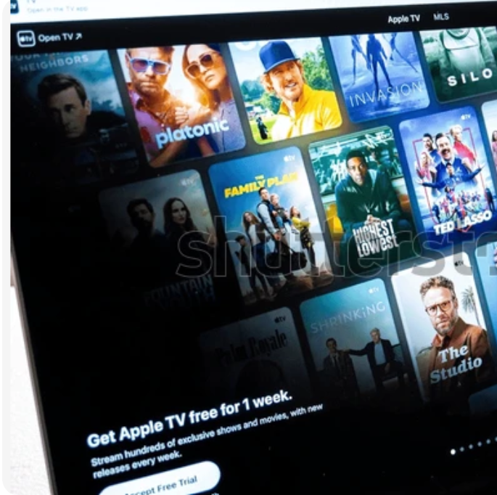
Problem Statement
Users often require multiple subscriptions to access different streaming platforms.
Many academic projects lack realistic streaming system architecture.
Typical classroom applications miss key components such as:
Secure token-based authentication
Adaptive video streaming
Scalable cloud deployment
Proper frontend–backend separation
This project develops a centralized streaming platform with realistic architecture.
Notes:
Tanim Ahmed (2312597042)
Mustakim Ahmed Hasan (2421349042)
MD. Nafiz Al Mamun (2232050642)
Ahamed Osman Asif (2031080642)

Slide 6

System Architecture
Three-layer architecture
Presentation Layer
Built using Next.js + TypeScript
Responsive UI with Tailwind CSS
Video playback using HLS.js
Service Layer
Backend developed using FastAPI
REST APIs for authentication, movie retrieval, and watch history
Modular backend services
Data Layer
PostgreSQL for user and movie data
Supabase Storage for media files
HLS playlists and video segments
Notes:
Tanim Ahmed (2312597042)
Mustakim Ahmed Hasan (2421349042)
MD. Nafiz Al Mamun (2232050642)
Ahamed Osman Asif (2031080642)

Slide 7

Implementation Challenges
Git repository issues caused by large binary files
Backend deployment errors (routing conflicts, entry-point mismatches)
Database connectivity problems with PostgreSQL SSL configuration
Frontend build failures due to TypeScript errors
Authentication state management issues
Solutions included:
Cloud storage for media assets
Backend routing restructuring
Stable database configuration
Improved API response typing
Notes:
Tanim Ahmed (2312597042)
Mustakim Ahmed Hasan (2421349042)
MD. Nafiz Al Mamun (2232050642)
Ahamed Osman Asif (2031080642)

Slide 8
Expected Outcomes
Fully functional cloud-based movie streaming web application
Features include:
User authentication
Movie browsing and search
Adaptive HLS streaming
Watch history tracking
Trending movie logic
Scalable architecture enabling future enhancements like recommendation systems.
Notes:
Tanim Ahmed (2312597042)
Mustakim Ahmed Hasan (2421349042)
MD. Nafiz Al Mamun (2232050642)
Ahamed Osman Asif (2031080642)

Slide 9

Conclusion
Developed a cloud-based movie streaming platform using modern technologies.
Implemented secure authentication, adaptive streaming, and scalable APIs.
Addressed several deployment and infrastructure challenges.
Successfully demonstrated real-world streaming platform architecture in an academic project.
Future improvements include recommendation systems, analytics, and search optimization.
Notes:
Tanim Ahmed (2312597042)
Mustakim Ahmed Hasan (2421349042)
MD. Nafiz Al Mamun (2232050642)
Ahamed Osman Asif (2031080642)

Slide 10

Notes:
Tanim Ahmed (2312597042)
Mustakim Ahmed Hasan (2421349042)
MD. Nafiz Al Mamun (2232050642)
Ahamed Osman Asif (2031080642)

