Slide 1

Cloud-Based Movie Streaming Platform Using FastAPI and Next.js
Mustakim Ahmed Hasan 2421349042
MD. Nafiz Al Mamun 2232050642
Tanim Ahmed 2312597042
Ahamed Osman Asif 2031080642
Notes:
Mustakim Ahmed Hasan 2421349042
MD. Nafiz Al Mamun 2232050642
Tanim Ahmed 2312597042
Ahamed Osman Asif 2031080642

Slide 2
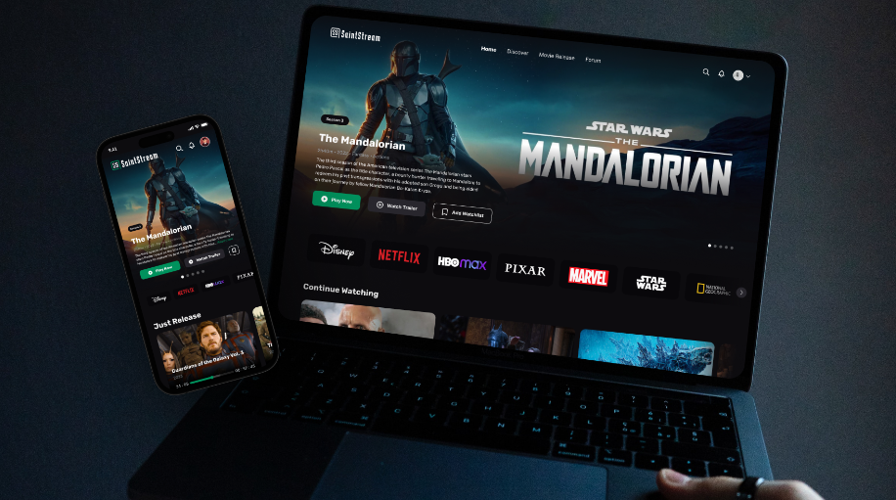
System Features
Core Features of the Platform
1. User Authentication
Secure login and logout functionality.
Authentication state persists across page reloads.
2. Content Browsing
Featured content displayed on the homepage.
Sections for Trending Now and Latest Releases.
3. Video Streaming
Built-in media player with playback controls.
Supports pause, seek, and fullscreen playback.
4. Watch History
Tracks user viewing activity.
Allows users to continue watching previously started content.
5. Responsive User Interface
Modern streaming-style UI similar to major platforms.
Optimized for usability and visual clarity.
Notes:
Mustakim Ahmed Hasan 2421349042
MD. Nafiz Al Mamun 2232050642
Tanim Ahmed 2312597042
Ahamed Osman Asif 2031080642

Slide 3
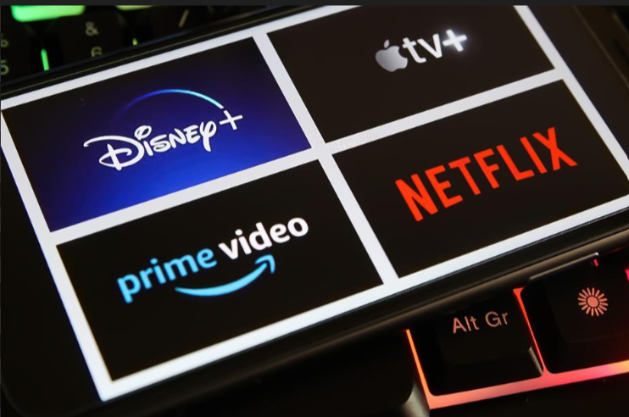
Problems Identified
Several issues were identified that impacted system performance and usability:
1. Authentication UI Flicker
Navbar briefly showed Login/Signup even when users were already authenticated.
Caused by delayed authentication state loading.
2. Search Limitations
Initial search functionality only supported exact text matches.
Users could not find results with typos or partial keywords.
3. Deployment Build Issues
Frontend build errors occurred due to Next.js server cookie handling incompatibilities.
Notes:
Mustakim Ahmed Hasan 2421349042
MD. Nafiz Al Mamun 2232050642
Tanim Ahmed 2312597042
Ahamed Osman Asif 2031080642

Slide 4
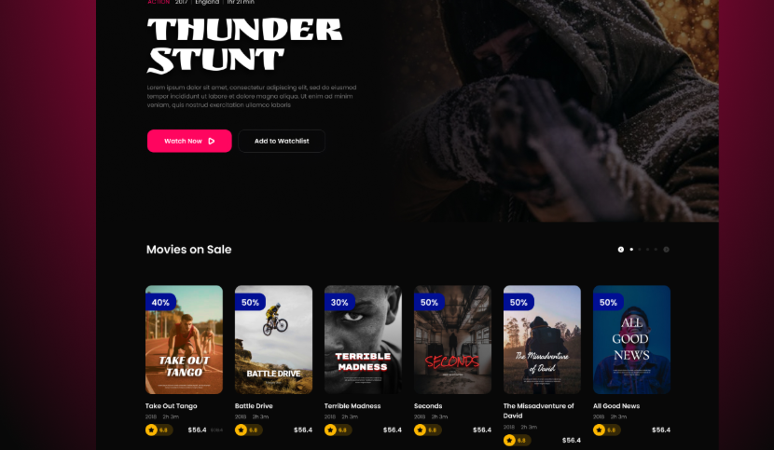
Implemented Solutions
1. Authentication Stability
Implemented server-side authentication state seeding.
Added Bearer Token support to overcome cross-origin cookie issues.
Ensured logout properly clears authentication state.
2. Improved Search System
Implemented fuzzy search with relevance ranking.
Search now supports:
Typo tolerance
Partial query matches
Similar title detection.
3. Deployment Fixes
Corrected server cookie access in Next.js.
Verified successful production build before deployment.
Notes:
Mustakim Ahmed Hasan 2421349042
MD. Nafiz Al Mamun 2232050642
Tanim Ahmed 2312597042
Ahamed Osman Asif 2031080642

Slide 5
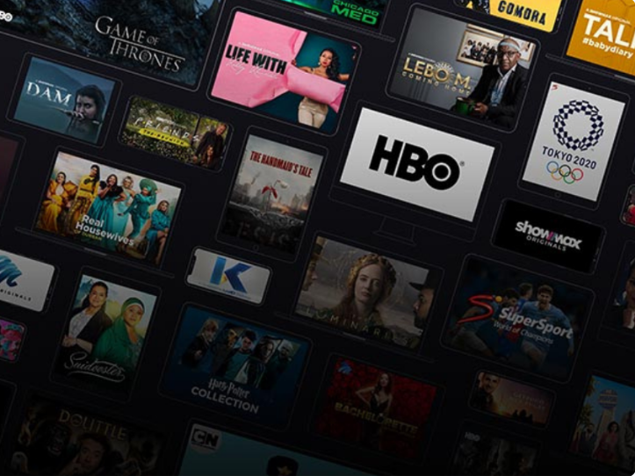
Current Progress and Future Work
Current System Status
✔ Authentication system stable ✔ Navbar state correctly reflects login status ✔ Video streaming working with media controls ✔ Watch history tracking implemented ✔ Search functionality improved with fuzzy matching
Future Improvements
Monitor authentication behavior after deployment.
Fine-tune search ranking based on user feedback.
Improve recommendation and trending algorithms.
Expand content catalog and metadata support.
Continue testing edge cases in watch history and streaming features.
Notes:
Mustakim Ahmed Hasan 2421349042
MD. Nafiz Al Mamun 2232050642
Tanim Ahmed 2312597042
Ahamed Osman Asif 2031080642

Slide 6

Notes:
Mustakim Ahmed Hasan 2421349042
MD. Nafiz Al Mamun 2232050642
Tanim Ahmed 2312597042
Ahamed Osman Asif 2031080642

