Slide 1

Online movie streaming platform
Mustakim Ahmed Hasan (2421349042)
MD. Nafiz Al Mamun (2232050642)
Tanim Ahmed (2312597042)
Ahamed Osman Asif (2031080642)

Slide 2

Problem Context & Key Challenges
Major Challenges Faced
Deployment instability (local vs Vercel/Render mismatch)
FastAPI entrypoint and routing conflicts
PostgreSQL SSL and connection errors
Incorrect trending computation logic
Incomplete watch-history payloads
TypeScript build failures
CORS instability
Non-reactive authentication state handling

Slide 3

Architecture & Backend Improvements
Infrastructure Improvements
Removed large binaries from Git history
Implemented strict artifact exclusion
Stored media in Supabase Storage
Separated infrastructure and application commits
Backend Stabilization
Normalized FastAPI routing and entrypoints
Pinned dependency versions
Corrected trending logic using watch_history aggregation
Enriched history API responses with full metadata
Validated PostgreSQL SSL configuration

Slide 4

Frontend & User Experience Enhancements
Authentication & Access Control
Route guards: only /login and /register accessible when logged out
Redirected unauthorized users from protected routes
Fixed navbar state update after login
Reduced authentication flicker (including mobile)
Search & Navigation
Integrated search directly in navbar
Query-driven rendering (dynamic results view)
Responsive hamburger menu
Fixed mobile header UI conflicts

Slide 5
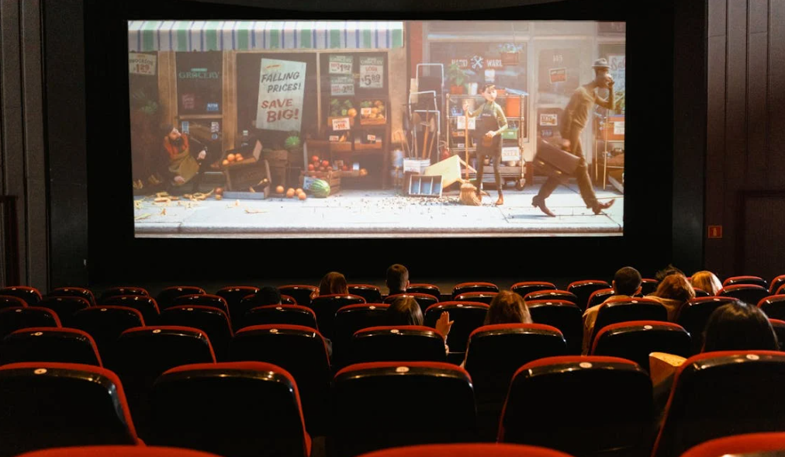
Current Status & Expected Outcome
Current Status
Authentication flow stabilized
Protected routing functioning correctly
Player interactions fully integrated
Search and movie discovery aligned
Watch-history tracking operational
TypeScript validation and route testing completed
Expected Outcome
Stable cloud-deployed streaming system
Accurate trending logic
Reliable authentication and session handling
Production-ready academic demonstration platform
Scalable architecture for future enhancements

Slide 6


