Slide 1

Cloud based movie streaming platform
Tanim Ahmed 2312597042
Mustakim Ahmed Hasan 2421349042
MD. Nafiz Al Mamun 2232050642
Ahamed Osman Asif 2031080642
Notes:
Tanim Ahmed 2312597042
Mustakim Ahmed Hasan 2421349042
MD. Nafiz Al Mamun 2232050642
Ahamed Osman Asif 2031080642

Slide 2

Project Overview
Objective: To build a scalable, cloud-hosted video streaming using HLS technology for smooth playback.
Core Idea: Convert MKV video files into HLS format and stream them efficiently using a modern full stack architecture
Technologies used:
Frontend(React + TypeScript + TailwindCSS)
Backend: FastAPI(Python)
Database: PostgreSQL(Superbase)
Storage: Superbase Cloud storage
Deployment: Vercel
Notes:
Tanim Ahmed 2312597042
Mustakim Ahmed Hasan 2421349042
MD. Nafiz Al Mamun 2232050642
Ahamed Osman Asif 2031080642

Slide 3
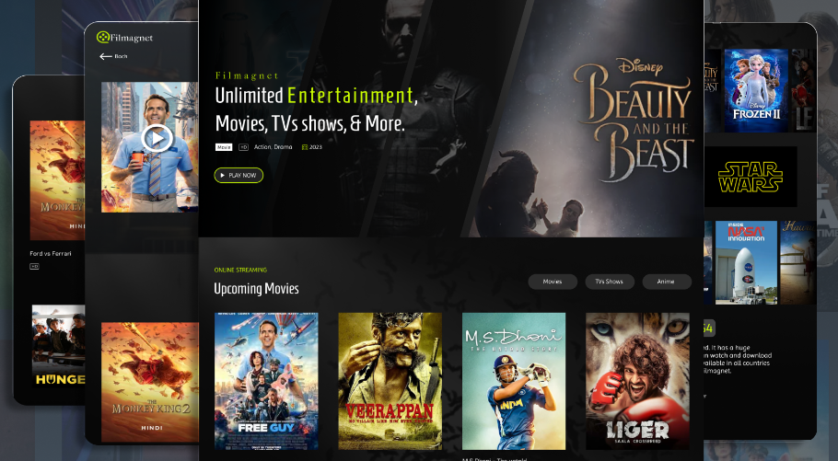
System Architecture
Streaming Workflow:
MKV file is converted into HLS format
.m3u8 playlist
.ts segment files
HLS files are uploaded to Supabase Storage
FastAPI backend connects to:
Supabase Storage
PostgreSQL database
Frontend requests video data via REST API
HLS.js loads .m3u8 playlist and streams video smoothly
Architecture Type: Client–Server Cloud Architecture
Notes:
Tanim Ahmed 2312597042
Mustakim Ahmed Hasan 2421349042
MD. Nafiz Al Mamun 2232050642
Ahamed Osman Asif 2031080642

Slide 4
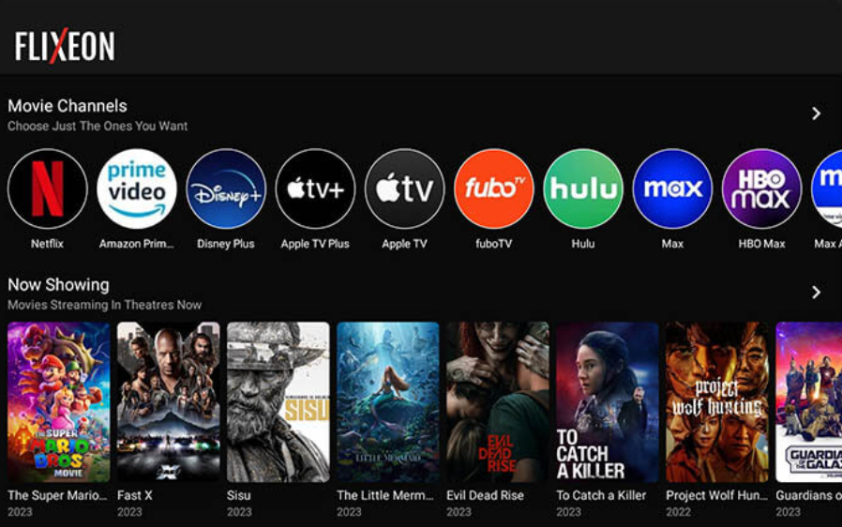
Backend & Database Design
Backend (FastAPI)
Handles REST API endpoints
Retrieves video metadata from PostgreSQL
Sends HLS playlist URLs to frontend
Acts as bridge between storage and UI
Database (PostgreSQL – Supabase)
Stores:
Video title
Storage path
Metadata
Future: user data, watch history, recommendations
Key Role: Ensure secure and structured communication between frontend and cloud storage.
Notes:
Tanim Ahmed 2312597042
Mustakim Ahmed Hasan 2421349042
MD. Nafiz Al Mamun 2232050642
Ahamed Osman Asif 2031080642

Slide 5

Frontend & Streaming
The frontend is built using Next.js with TypeScript and styled using TailwindCSS (dark theme UI). It uses SWR for efficient data fetching and communicates with the backend through REST APIs to retrieve video metadata and streaming URLs.
For video playback, the system uses HLS.js, which loads the .m3u8 playlist and dynamically streams segmented .ts files. This segmented streaming approach ensures smooth playback and reduced buffering.
Both the frontend and backend are deployed on Vercel, making the system fully cloud-based and scalable.
Notes:
Tanim Ahmed 2312597042
Mustakim Ahmed Hasan 2421349042
MD. Nafiz Al Mamun 2232050642
Ahamed Osman Asif 2031080642

Slide 6

Achievements & Future Improvements
Completed Features
MKV to HLS conversion
Cloud storage integration
REST API-based streaming
Full-stack deployment
Smooth browser-based streaming
Future Improvements:
Admin login page
User login page
Improved UI
Notes:
Tanim Ahmed 2312597042
Mustakim Ahmed Hasan 2421349042
MD. Nafiz Al Mamun 2232050642
Ahamed Osman Asif 2031080642

Slide 7

Notes:
Tanim Ahmed 2312597042
Mustakim Ahmed Hasan 2421349042
MD. Nafiz Al Mamun 2232050642
Ahamed Osman Asif 2031080642

