Slide 1
Outline
Creating your Bitbucket account
Clone the Lab Repository
Commit your source back to Bitbucket
MySQL Server and Workbench Installation

Slide 2

A web-based hosting service for projects that use Git revision control systems.
written in Python using the Django web framework
Open the following link using your browser: https://bitbucket.org/
User name: U###### (replace ###### with your Student ID)
Repository: https://bitbucket.org/erdemturk/dblab2021/src/master/

Slide 3
Clone the Lab Repository
Create a directory named «db-workspace» in your home folder
In the workspace folder enter the following command, but replace username with your actual user
git clone https://U######@bitbucket.org/U######/dblab2021.git
A folder named “dblab2021” will be created after executing the command.
If you are using a machine running windows OS you can install git from https://git-for-windows.github.io/

Slide 4
Committing your source back to Bitbucket
Open your browser and go to https://dys.mu.edu.tr
Download DB_recit_week2.pptx file and put it under your lab repository folder
Execute the following commands in the given order (use your own email & Bitbucket user name U######)
git add DB_recit_week2.pptx.docx
git config --global user.email «YOUR EMAIL"
git config --global user.name «YOUR USERNAME"
git commit -m "Initial commit"
git push -u origin master
Enter your password

Slide 5

An open-source relational database management system (RDMS)
combination of "My", the name of co-founder Michael Widenius' daughter and "SQL", the abbreviation for Structured Query Language
written in C/C++
Wide range of customers
Applications: Joomla, Wordpress, Drupal …
Websites: Facebook, Twitter, Youtube …
Healthcare: The Institute for Genomic Research (The J. Craig Venter Institute)

Slide 6
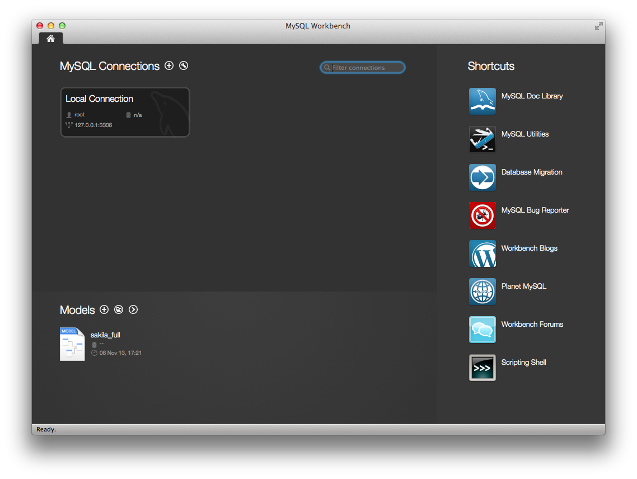
MySQL Workbench
A visual database design tool that integrates
SQL development and administration
Database design, creation and maintenance into a single integrated development environment for the MySQL database system.

Slide 7
How to install MySQL on my PC?
Download MySQL Installer from https://dev.mysql.com/downloads/installer/ OR https://dys.mu.edu.tr
Follow the instructions on MySQL_startup.docx

