Slide 1
Vehicle Speed Monitoring and Traffic Routing System

Slide 2
Group Members:
Name | Id
Snigdha,Sraboni Bhowmick | 15-293336-1
Khondoker Md. Hasan | 15-29388-1
Rahman,Mizanur | 15-293334-1
Barmon, Prosenjit | 14-27705-3

Slide 3
Motivation
Building new roads isn’t feasible solution for many cities to reduces road accidents. Wireless Sensor Network for Intelligent Transportation is a system that reduce congestions
Infer Congestions
Suggest alternative routes and emergency exits

Slide 4
Introduction
A wireless sensor network is a wireless network consisting of spatially distributed autonomous devices using sensor to cooperatively monitor physical or environmental nature,sound,vibration at different locations.

Slide 5
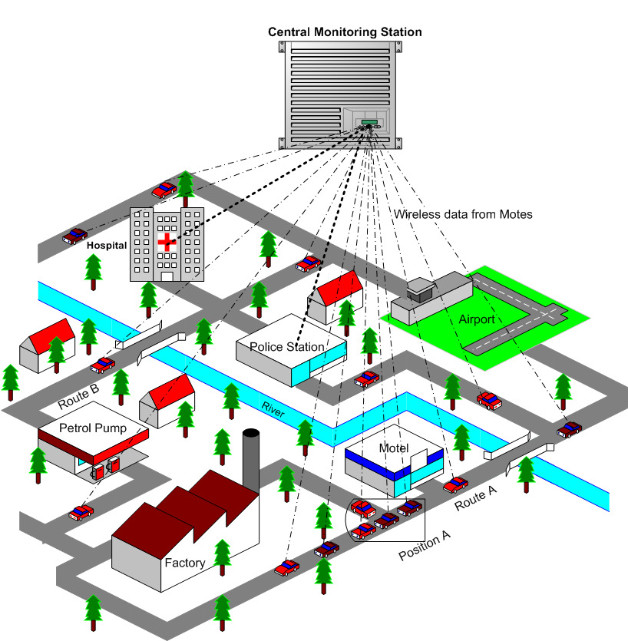
Fig. Illustration of a typical VSMTRS

Slide 6
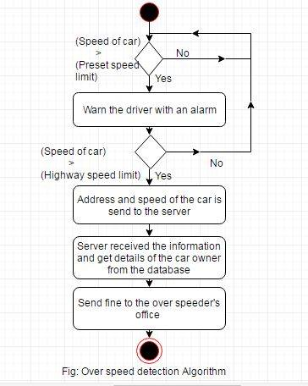
Survey of reviewed paper

Slide 7
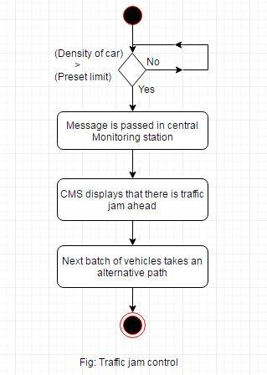
Traffic Routing Algorithm

Slide 8
Problem Identification
The system is network dependent. Hence, network congestion can reduce the reliability of the system.
Every car must have Bluetooth and GPS tracer to communicate with each other.
Sometimes it may be costly when routing path longer than current path.

Slide 9
Solution Of the Problem
The system can create extra network for communicate properly.
Use minimum Bluetooth version 4.0 for faster data transfer.

Slide 10
Solution Of the Problem
SPEED Control System
Get SPEED (from gps using Wheel speed sensor)
Get speed_limit (from gps device ang traffic server)
if (SPEED >speed_limit) then
do{
Show warnig;
Send sms to traffic Control System;
10 Sec time to reduce SPEED
if (SPEED >speed_limit) then
do{
Send sms to traffic Control System;
Traffic police will take the action against the vehicle
}else do{
Show that the vehicle is Okay;
}
}else do{
Show that the vehicle is Okay;
}

Slide 11
Solution Of the Problem
Traffic Information System
Get SPEED (from gps using Wheel speed sensor)
Get speed_limit (from gps device ang traffic server)
Get road_capacity (from traffic server)
Get vehicle_location (from gps device)
if (total_vehicle>= road_capacity&& SPEED = 0) then
do{
Show ("Black :Blocked, Heavy traffic delays");
}elseif (total_vehicle<road_capacity&& SPEED=<speed_limit/3) then
do{
Show ("Red :Slower traffic delays");
}elseif (total_vehicle<road_capacity&& SPEED=<speed_limit/2) then
do{
Show ("Orrange :Medium traffic delays");
}elseif (total_vehicle<road_capacity&& SPEED=<speed_limit/3) then
do{
Show ("Green :No traffic delays");
}

Slide 12
Conclusion
The system is highly flexible and adaptive to our Bangladeshi conditions. The proposed VSMTRS is capable of routing the traffic on heavily crowded roads with minimal human supervision and higher efficiency. Large scale deployment of the same will ensure better traffic management on Bangladeshi turf.

