Slide 1
AI Opportunity Agent
A simple AI agent project for job matching
Final project | AI Agents course
Notes:
Project source: README.md and flask_app/app.py.

Slide 2
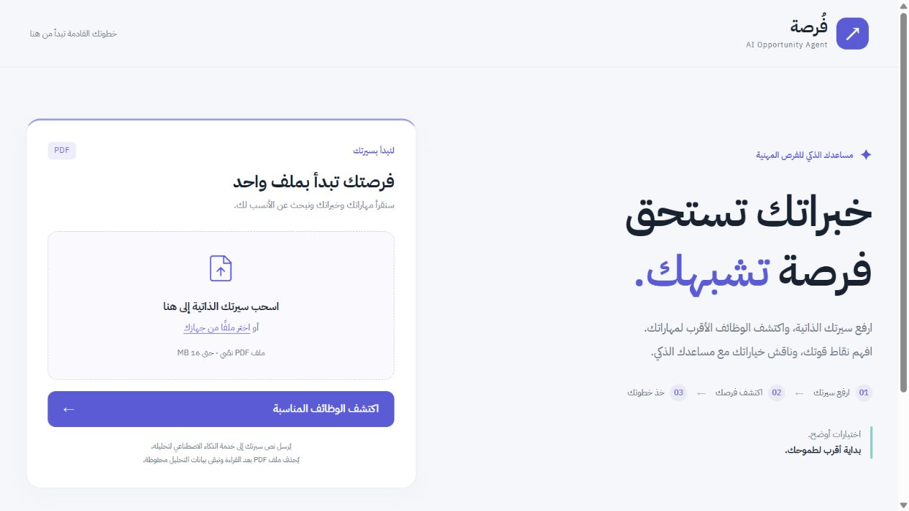
What the app does
Upload a PDF CV
See jobs matched to your skills
Understand strengths and missing skills
Ask for help in the chat
Screenshot: local demo
Notes:
Source: README.md, flask_app/templates/index.html. Screenshot uses synthetic data from tests/preview_ui.py.

Slide 3
User workflow
1 User uploads a PDF CV
2 CV Analysis Expert extracts skills and experience
3 Embeddings find similar jobs
4 Match Scoring Expert evaluates each shortlisted job
5 Results and analysis status appear on the page
6 The user asks the chat about a selected job
Notes:
Source: flask_app/app.py analyze_and_match(), agents/cv_analyzer.py, utils/embedding_service.py, agents/match_scorer.py.

Slide 4
System architecture
Flask
SQLite
Handles upload, results, and access checks
Stores profiles, jobs, matches, and chat history
Socket.IO
OpenRouter
Sends progress updates and chat messages
Runs the shared LLM with a different prompt for each agent
Notes:
Source: flask_app/app.py, flask_app/database/db.py, flask_app/utils/llm_service.py, flask_app/static/js/main.js.

Slide 5
Agent roles
During CV analysis
In the chat
CV Analysis Expert
Match Scoring Expert
Chat Orchestrator
Chat Query Expert
CV Improvement Expert
Cover Letter Generator Expert
One LLM, with a focused prompt for each role.
Notes:
Source: flask_app/agents/* and flask_app/database/initial_data/llm_roles.csv. Six configured LLM roles in total.

Slide 6
How chat routing works
Free message
The Orchestrator chooses one expert.
“Why does this job fit me?”
Chat Query Expert
“How can I improve my CV?”
CV Improvement Expert
“Write a cover letter.”
Cover Letter Generator Expert
Job buttons pass a checked job_id directly to the correct expert.
Notes:
Source: flask_app/agents/chat_orchestrator.py and flask_app/app.py process_chat_message(). Buttons use explicit action and job_id.

Slide 7
Reliability and limits
What I tested
Known limits
31 automated tests
Profile access and job ownership
Partial analysis and service failure
Chat routing and saved history
A text-based PDF works best
A model API key is required
Scores help comparison; they are not hiring probabilities
The assistant suggests CV edits. It does not change the saved CV.
Notes:
Source: tests/test_backend.py, tests/test_startup.py, flask_app/app.py and README.md. 31 tests passed on 22 September 2026.

Slide 8
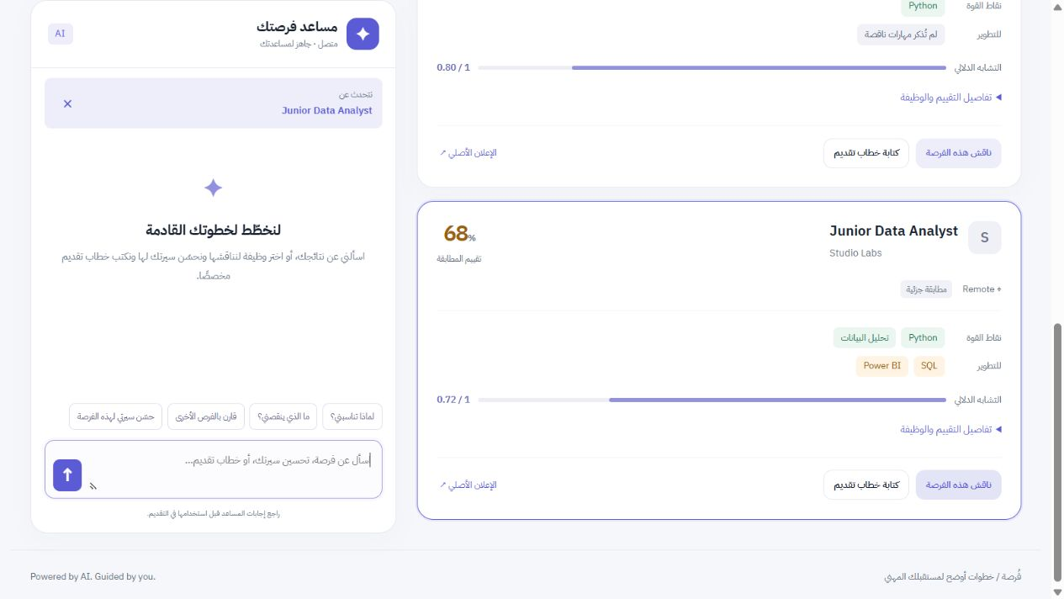
Live demo
1 Upload a sample CV
2 Review the matched jobs
3 Select one job
4 Ask the chat to improve the CV
Screenshot: synthetic demo data
Notes:
Source: local preview with synthetic data, tests/preview_ui.py. For a live demo use python run.py and a sample text-based PDF.

