Slide 1



Predictive Modeling of Life Insurance Premiums Based on Health Risks
Project by
Bhakti Nayak A006
Hasan Bombaywala A015
Jash Chitalia A016
Sandarbh Jantwal A049
Soham Patil A051
Under the guidance of Prof.Shaishavi
B. Sc. (Applied Statistics and Analytics) | Actuarial Science

Slide 2
Index
Serial No. | CONTENT | Page No.
1 | Introduction | 3
3 | Literature Review | 5
4 | Objectives | 7
5 | Methodology | 8
6 | Results | 22
7 | Limitations | 23
8 | Future Scope | 24
9 | Biblography | 25

Slide 3
Introduction
Actuarial science plays a critical role in assessing risks associated with life insurance policies by leveraging statistical models and mortality data. The concept of life expectancy estimation based on non-communicable diseases (NCDs) is well-documented in actuarial studies, as NCDs significantly impact mortality rates and, consequently, insurance premiums. Traditional actuarial models rely on mortality tables, which are refined using multipliers that adjust for individual risk factors such as age, sex, and pre-existing conditions.

Slide 4
Life Insurance & Epidemiology
NCDs significantly impact mortality risk, and incorporating them into actuarial models improves life expectancy predictions. Actuarial mortality rates serve as a baseline, refined by individual health risks for greater accuracy. Discounting techniques in insurance pricing help actuaries calculate fair premiums by balancing risk exposure and the time value of money.
This project integrates these actuarial principles into a user-friendly calculator that allows for real-time premium estimations based on individual health conditions. By leveraging actuarial data and risk-free discounting, the model aims to improve the accuracy and transparency of insurance pricing, benefiting both insurers and policyholders.

Slide 5
Literature Review
Title | Author | Year | Citation | Key findings
Premiums calculation of terminal illness insurance | Neva Satyahadewi , Hani Dwi Retnani , Hendra Perdana , Ray Tamtama | 2023 | Satyahedewi, N., Retnani, H. D., Perdana, H., Tamtama, R., & Aprizkiyandari, S. (2023). Premiums Calculation of Terminal Illness Insurance. BAREKENG: Journal of Mathematics and Its Applications, 17(2), 0913-0918. OJS | Satyahedewi et al. (2023) examine LTC insurance premium calculations with annuity riders, emphasizing actuarial modeling for accurate pricing. The study highlights mortality risk adjustments, discounting techniques, and epidemiological factors to refine terminal illness insurance premiums.
Premium calculation in insurance activity | Pedro Lima Ramos | 2017 | Ramos, P. L. (2017). Premium calculation in insurance activity. Journal of Statistics and Management Systems. ResearchGate | The paper covers premium calculation methods, emphasizing risk assessment, statistical modeling, and regulatory influences. It highlights the role of credibility theory and experience rating in refining premiums. While focused on general insurance, its insights are useful for health-based life insurance modeling.

Slide 6
Title | Authors | Year | Citations | Key findings
Automated Health Insurance Processing Framework with Intelligent Fraud Detection, Risk Classifcation and Premium Prediction | Sreegeethi Devaguptam Sai Srivatsa Gorti T. Leela Akshaya S. Sowmya Kamath | 2024 | Devaguptam, S., Gorti, S. S., Akshaya, T. L., & Kamath, S. S. (2024). Automated health insurance processing framework with intelligent fraud detection, risk classification, and premium prediction. Springer | This paper presents an AI-driven framework for automated health insurance processing, utilizing machine learning for fraud detection, risk classification, and premium prediction. The findings emphasize AI's role in enhancing risk management, claims processing, and premium accuracy, highlighting its impact on modernizing the health insurance industry.
Risk classification in life and health insurance: Extension to continuous covariates | Michel Denuit Catherine Legrand | 2018 | Denuit, M., & Legrand, C. (2018). Risk classification in life and health insurance: Extension to continuous covariates. Springer. | This study examines risk classification in life and health insurance using continuous covariates, improving mortality modeling with individual risk factors. By leveraging policyholder data, it enhances mortality estimations, refines pricing models, and strengthens risk assessment strategies.

Slide 7

Objectives
  To develop a risk classification model for life insurance based on health factors.
  To analyze the impact of medical conditions on life expectancy and insurance premiums
  To enhance risk assessment accuracy using data-driven methods and AI.
  To ensure ethical and regulatory compliance in insurance pricing.
8

Slide 8
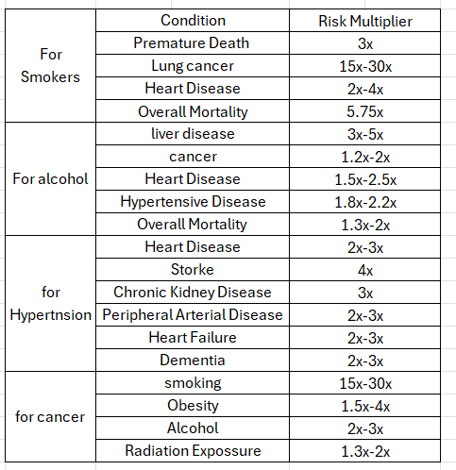
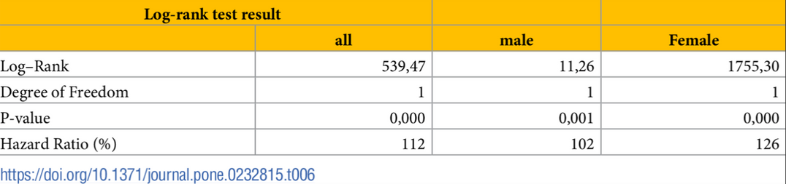
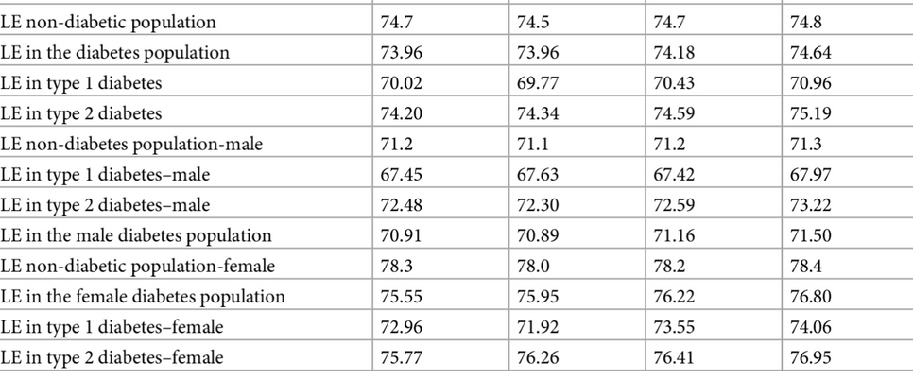
Data Collection
9

Slide 9
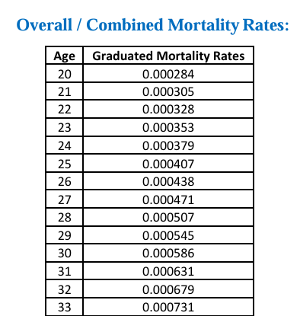
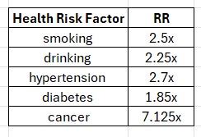
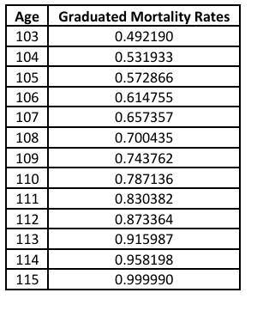
Data Processing
Combined Mortality Rates
Risk Factor
actuariesindia.org/mortality-table
10

Slide 10
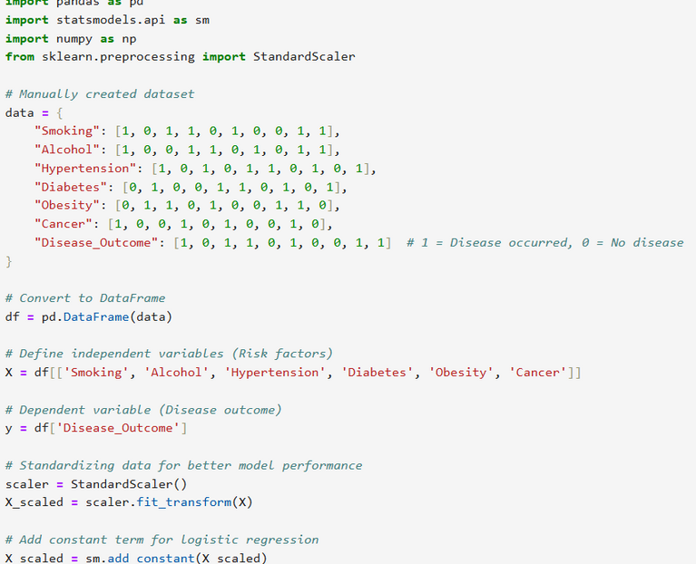
Binary Regression on Dataset
  Binary Logistic Regression: Models relationships between variables, specifically for dichotomous dependent variables.
  Interpretation: Results are analyzed using coefficients,
p-values, and odds ratios.
  Purpose: Identifies significant variables contributing
to an individual's mortality risk.
  Independent Variables (Risk Factors)
  Treated as binary (0 = absence, 1 = presence).
  Dependent Variable (Outcome - Disease/Death):
  Represents disease occurrence or mortality.
  0 = No disease/death, 1 = Disease/mortality occurs.

Slide 11
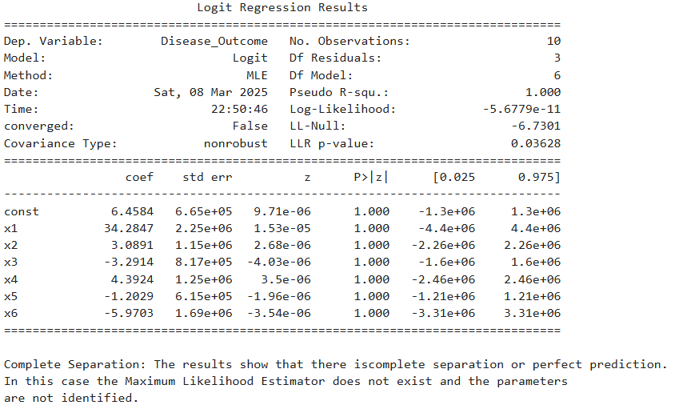
Binary Regression on Dataset
  Complete Separation: The model achieves perfect prediction, preventing proper parameter estimation.
  Overfitting: A Pseudo R² value of 1.000 indicates unrealistic accuracy.
  Convergence Failure: Data separation hinders optimal parameter estimation.
  Instability: Large standard errors and wide confidence intervals suggest unreliable coefficients.
  Lack of Significance: All p-values are 1.000, meaning no predictor variables are statistically significant.
16

Slide 12
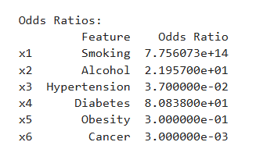
Odds Ratio
We look at p-values from the model summary:
  If p-value < 0.05, the factor is statistically significant in predicting the outcome.
  Compute Odds Ratios:
  If Odds Ratio > 1, it increases the risk.
  If Odds Ratio < 1, it decreases the risk.
16

Slide 13

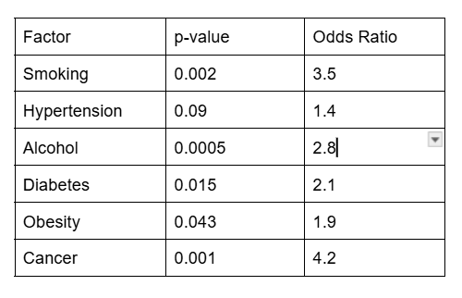

Leading contributors to increased mortality risk
Smoking
Cancer
Hypertension
Diabetes
14

Slide 14
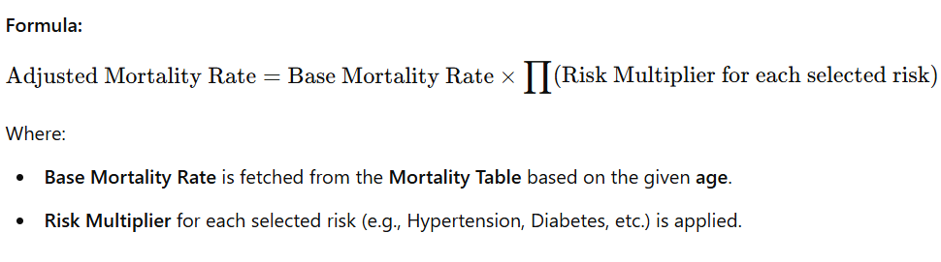
1. Adjusting Mortality Rates for Risk Factors
  The adjusted mortality rate takes into account the risk factors selected by the user.
  For each selected risk, the mortality rate from the Mortality Table is multiplied by the corresponding risk multiplier

Slide 15
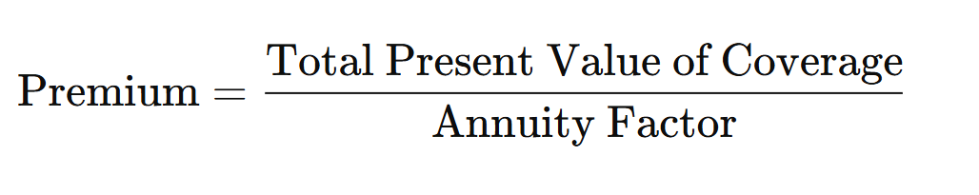
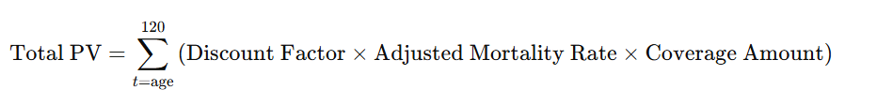
2. Life Insurance Premium Calculation
The premium is based on the present value (PV) of the total coverage, adjusted for mortality rates, and spread over the payment tenure.
Formula to Calculate the Premium:
Where:
  Total Present Value of Coverage (PV) is calculated by summing the present value of coverage for each year of life, from age to 120 years:

Slide 16

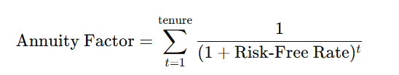
  Discount Factor for year t is given by:
where
  Adjusted Mortality Rate is calculated based on the selected health risks.
  Coverage Amount is the amount of insurance coverage chosen by the user.
2. Annuity Factor is the sum of the present value of an annuity (the amount paid annually over the tenure years):

Slide 17

3. Once the Total PV and Annuity Factor are calculated, the annual premium is obtained by
dividing the Total PV by the Annuity Factor.
4. If the payment frequency is set to Monthly, the monthly premium is:
13

Slide 18
Creating the Life Insurance Model
  Identify Key Health Factors
  Assign Risk Multipliers
  Compute Adjusted Life Expectancy
  Calculate Insurance Premiums
13

Slide 19
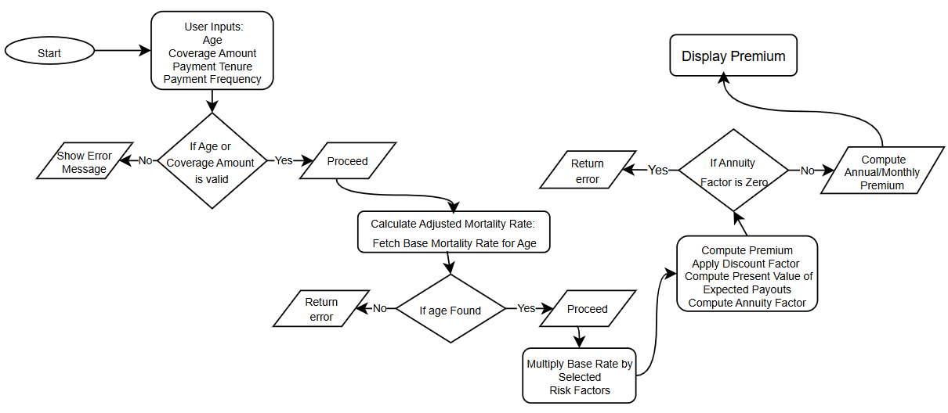
Calculator flowchart
13

Slide 20
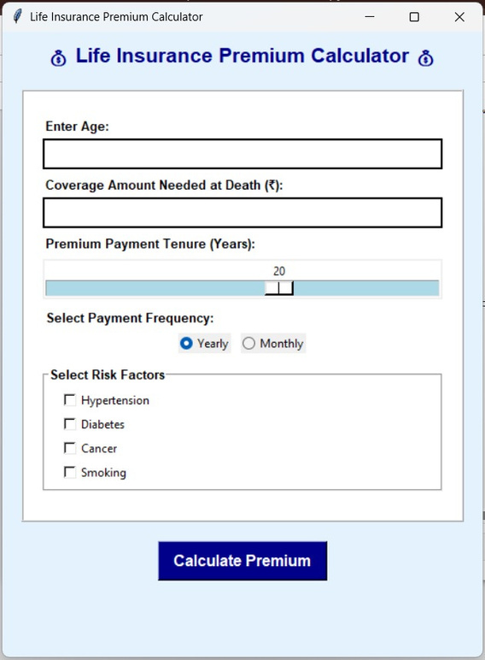
Results
Life Insurance Premium Calculator

Slide 21
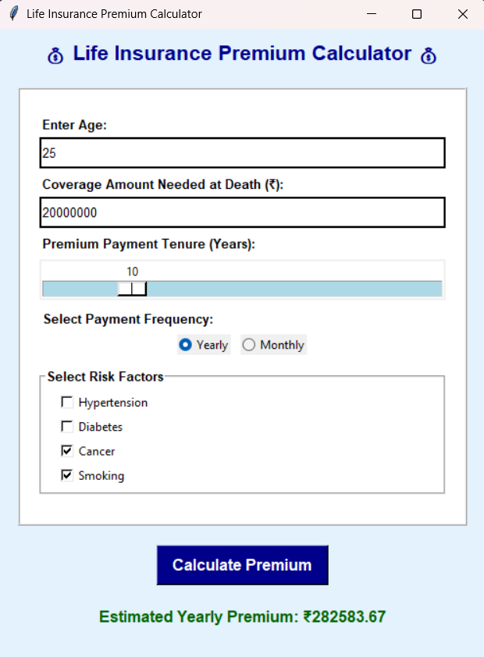
Results

Slide 22
Limitations
  Limited Data Access & Reliability – Finding accurate and updated mortality tables and health risk data can be challenging, which may affect the precision of the model.
  Lack of Personalization – The use of general risk multipliers may not fully capture individual differences in lifestyle, genetics, and overall health conditions.
  Dependence on Assumptions – The model is based on estimated health impacts on mortality, which may not always reflect real-world scenarios accurately.
  Impact of Medical Advances – Continuous improvements in healthcare and treatments can change mortality risks, making older data or models less reliable over time.
  Ethical and Legal Considerations – Using health factors to adjust insurance premiums must align with fairness and regulatory guidelines to prevent discrimination or unethical pricing practices.

Slide 23
Future Scope
  Integration of AI & Machine Learning – Advanced predictive models can improve risk assessment by analyzing large datasets and identifying hidden patterns in health-related mortality risks.
  Personalized Insurance Policies – Future models can incorporate genetic data, wearable health trackers, and lifestyle monitoring to offer customized insurance plans.
  Real-Time Data Utilization – Leveraging real-time health data from medical records, fitness apps, and IoT devices can enhance the accuracy of life expectancy predictions.
  Adjustments – Policies could be structured to adjust premiums based on improved health conditions or lifestyle changes over time.
  Global Adaptation & Inclusivity – Expanding the model to consider diverse demographics, environmental factors, and regional healthcare developments for more accurate and fair risk assessment.

Slide 24
Bibliography
  https://www.actuariesindia.org/mortality-table
  https://nphic.org/news/news-highlights/2225-single-cigarette-takes-20-minutes-off-life-expectancy-study
  https://www.theguardian.com/australia-news/commentisfree/article/2024/aug/28/australia-hypertension-deaths-blood-pressure
  https://www.theguardian.com/food/2024/nov/24/the-truth-about-salt-how-to-avoid-one-of-the-worlds-biggest-hidden-killers
  https://www.eatingwell.com/myths-about-high-blood-pressure-to-stop-believing-8746582
  https://en.wikipedia.or
  g/wiki/Long-term_effects_of_alcohol
  https://time.com/7210400/why-is-alcohol-unhealthy/
  https://journals.plos.org/plosone/article?id=10.1371/journal.pone.0232815
  https://jamanetwork.com/journals/jamainternalmedicine/fullarticle/2811807
  https://pubmed.ncbi.nlm.nih.gov/38143046/
  https://journals.plos.org/plosone/article?id=10.1371/journal.pone.0232815

