Slide 1
CS350 Project Final Report Project Topic: Write a device driver for a simple device
Group Members: Hasan Erdem Bilgin, Yamaç Demirkan Yılmaz, Peker Çelik

Slide 2
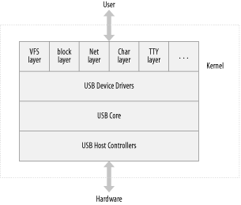
Background Research
USB Devices are usually more complex than one would think. Thankfully, the Linux kernel has a USB Core subsystem that handles the majority of the complexities. It provides us functions such as probe, disconnect, etc.

Slide 3
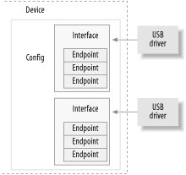
USB Devices typically consist of configurations which are made of interfaces. Each interface has at least one endpoint.

Slide 4
There are four types of endpoints:
Control: for configuring, retrieving information, sending commands and retrieving status reports
Interrupt: for transferring small amounts of data at a fixed rate, preferable for transferring time-sensitive data
Bulk: for transferring large amounts of bulk data
Asynchronous: also for transferring large amounts of data but the data is not always guaranteed to make it through, preferable for devices where constant data-flow matters, such as audio devices
- Every endpoint type is unidirectional except for control. Control is bidirectional.
- All USB devices always have the default control endpoint point 0.

Slide 5
Our USB Device (split into columns)
Bus 001 Device 009: ID 05dc:a81d Lexar Media, Inc. LJDTT16G [JumpDrive 16GB] Couldn't open device, some information will be missing Device Descriptor: bLength 18 bDescriptorType 1 bcdUSB 2.00 bDeviceClass 0 bDeviceSubClass 0 bDeviceProtocol 0 bMaxPacketSize0 64 idVendor 0x05dc Lexar Media, Inc. idProduct 0xa81d LJDTT16G [JumpDrive 16GB] bcdDevice 11.00 iManufacturer 1 iProduct 2 iSerial 3 bNumConfigurations 1 Configuration Descriptor: bLength 9 | bDescriptorType 2 wTotalLength 0x0020 bNumInterfaces 1 bConfigurationValue 1 iConfiguration 0 bmAttributes 0x80 (Bus Powered) MaxPower 200mA Interface Descriptor: bLength 9 bDescriptorType 4 bInterfaceNumber 0 bAlternateSetting 0 bNumEndpoints 2 bInterfaceClass 8 Mass Storage bInterfaceSubClass 6 SCSI bInterfaceProtocol 80 Bulk-Only iInterface 0 Endpoint Descriptor: | bLength 7 bDescriptorType 5 bEndpointAddress 0x81 EP 1 IN bmAttributes 2 Transfer Type Bulk Synch Type None Usage Type Data wMaxPacketSize 0x0200 1x 512 bytes bInterval 255 Endpoint Descriptor: bLength 7 bDescriptorType 5 bEndpointAddress 0x02 EP 2 OUT bmAttributes 2 Transfer Type Bulk Synch Type None Usage Type Data wMaxPacketSize 0x0200 1x 512 bytes bInterval 255

Slide 6
Observations
We observe that our USB Device’s model is Lexar Media, Inc. LJDTT16G [JumpDrive 16GB] and its vendor id and product id are 05dc and a81d respectively.
It has one configuration which consists of one interface which contains two endpoints of type bulk.
These two endpoints can handle a total of 1 kilobyte of data at once.

Slide 7
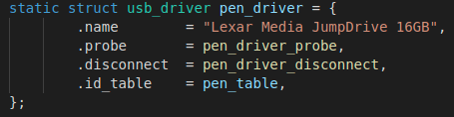
Structure of Our Driver Module (pen_driver.c)
Our driver module can be formed of these variables and functions.
The descriptions of these are in the next slide.

Slide 8
The name variable is a string that describes the USB driver. It is used everywhere to specify the driver in system logs.
The disconnect and probe function pointers are called when a USB device matched with a device in the id_table is connected to or disconnected from the machine.
The fops and minor variables are optional. We are not going to implement them in our project.
We need to create an id_table to load the driver automatically when we plug our USB. Therefore, an id_table defines which devices the driver supports at its current status.

Slide 9

ID_TABLE
In our case, the USB drive that our driver will support will have the following specifications:
Vendor ID: 0x05dc Lexar Media, Inc.
Product ID: 0xa81d LJDTT16G [JumpDrive 16GB]

Slide 10
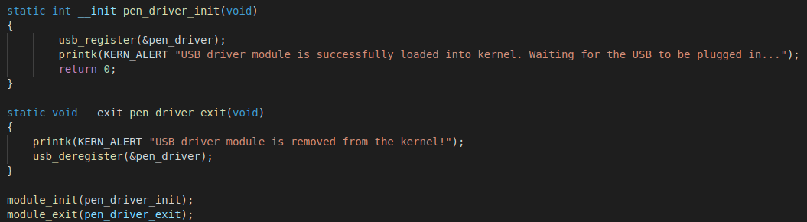
“__init” and “__exit” methods
Static method init stands for initialize and contains the functionality that we want to execute when the module is installed to the Linux kernel. In our case, we register the struct usb_driver with the USB subsystem.
Static method exit is called when the module is removed from the Linux kernel. The struct usb_driver should be unregistered from the kernel when the USB driver is unloaded.

Slide 11
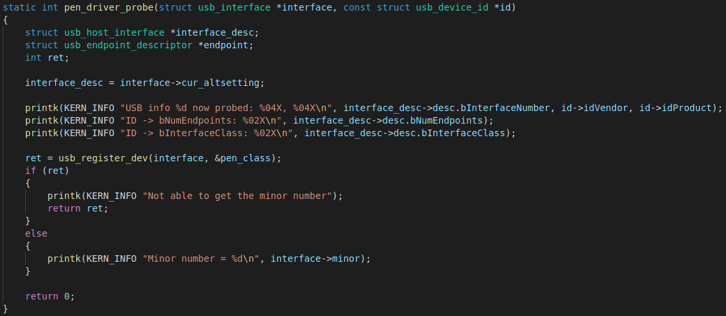
Probe function takes a usb interface and a usb device id as arguments and returns a int. This function gets called whenever any device supported by this driver gets installed to the host device.
probe function

Slide 12

static void my_usb_disconnect(struct usb_interface *interface)
{
Disconnect function takes only a usb interface as an argument and doesn’t return anything. This function gets called whenever any device supported by this driver gets removed from the host device.
disconnect function

Slide 13
System Specifications
Operating System: Ubuntu 20 LTS
CPU Model: Intel Core i7 9th Generation
Device model: Monster Tulpar T7 V20.1

Slide 14
Software Setup
On Linux there is a kernel module named usb_storage which operates as the USB Mass Storage driver for Linux. In order for our module's probe and disconnect functions to be called, we have to remove the default usb_storage module from the kernel. However, this module can be being used by some other modules so (generally uas) those modules have to be removed as well.
This can be done by the following commands:
sudo rmmod uas
sudo rmmod usb_storage
No additional setup is required

Slide 15

Module in work
When loaded into kernel
When USB Device is plugged in
When removed from the module

Slide 16
https://www.oreilly.com/library/view/linux-device-drivers/0596005903/ch13.html
https://kernel.readthedocs.io/en/sphinx-samples/writing_usb_driver.html
http://matthias.vallentin.net/blog/2007/04/writing-a-linux-kernel-driver-for-an-unknown-usb-device/
https://sysplay.github.io/books/LinuxDrivers/book/Content/Part11.html
References

