Slide 1



IUBAT–INTERNATIONAL UNIVERSITY OF BUSINESS AGRICULTURE AND TECHNOLOGY
Founded 1991 by Md. Alimullah Miyan
1991-2026
MessManager — Bachelor Mess Expense & Meal System
Course Code: Practicum CSC 490
Prepared for:
Practicum Defense Committee
Department of Computer Science and Engineering
Supervised by:
Faculty Name: Jannatul Ferdous
Designation: Lecturer
Prepared by:
Student Name: Hasan Imam
Student ID: 22203032
01/06/2026

Slide 2
Topics To Be Covered
Organization Overview
Project Overview
Objectives
System Benefits
Feasibility Analysis
Project model
Requirement Engineering
System Architecture
Diagrams
Dashboard Overview
Risk Analysis
Rmmm plan
Timeline
Function Point Estimation
Cost estimation
Testing
limitation
Future Work
Conclusion

Slide 3

Organization Overview
CODETREE is a software and IT solutions company.
Provides web, mobile, saas, pos, and management systems.
Focuses on scalable and user-friendly digital solutions.

Slide 4
Project Overview
MessManager automates shared mess management.
Tracks meals, expenses, deposits, balances, and billing.
Provides role-based dashboards for super admin, manager, and user.
Reduces manual calculation errors and improves transparency.

Slide 5
Problem Statement
Manual mess systems are paper-based and error-prone.
Meal rate calculations are difficult.
Deposit and balance tracking becomes confusing.
No centralized management system exists.

Slide 6
Objectives
Develop a secure role-based mess management system.
Automate meal tracking and monthly billing.
Implement deposit approval and refund settlement.
Provide financial transparency and reporting.

Slide 7
System Benefits
Automated calculations
Reduced human error
Transparent financial tracking
Role-based access control
Centralized digital management

Slide 8
Feasibility Analysis
Technical feasibility: laravel, react, mysql
Economic feasibility: open-source technologies
Operational feasibility: user-friendly workflows
Schedule feasibility: agile 12-week development

Slide 9
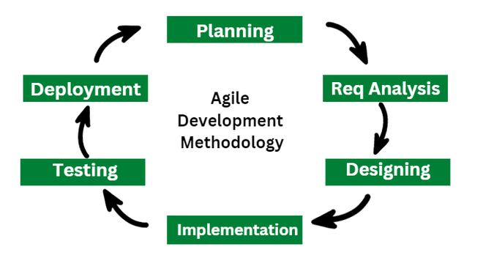
Agile Process Model
Iterative development approach
Continuous testing and improvement
Sprint-based module implementation

Slide 10
Requirement Engineering
Stakeholder analysis
Requirement elicitation
Functional requirements
Non-functional requirements

Slide 11
Functional Requirements
Meal entry
Expense management
Deposit approval
Monthly billing
Member management
Refund settlement

Slide 12
Non-Functional Requirements
Security
Performance
Responsiveness
Availability
Scalability
Maintainability

Slide 13
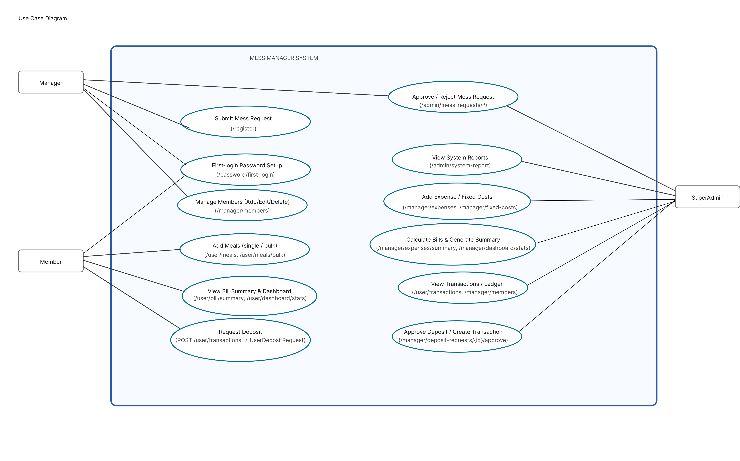
Use Case Diagram

Slide 14
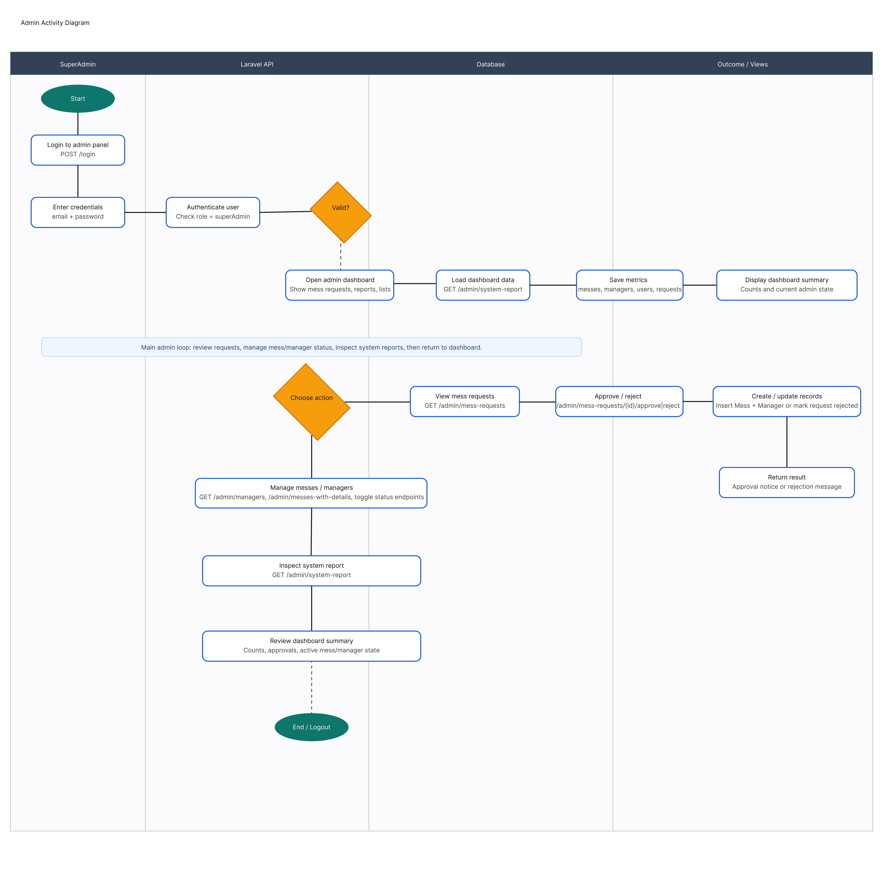
Activity Diagrams
Admin Activity Diagram

Slide 15
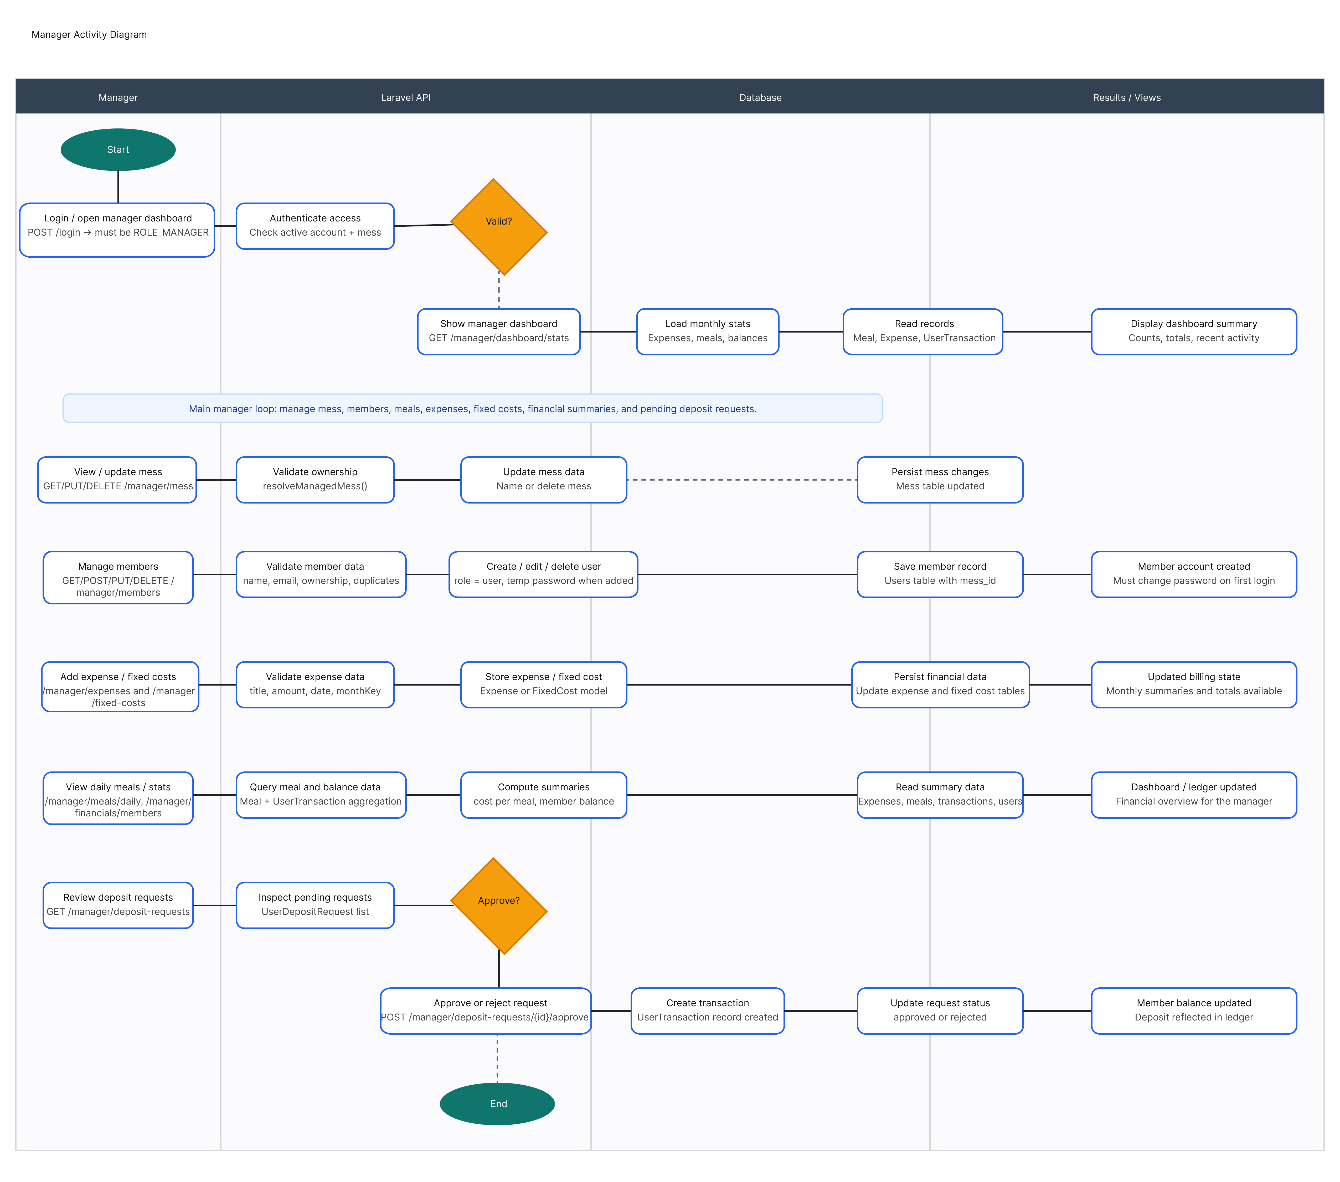
Activity Diagrams
Manager Activity Diagram

Slide 16
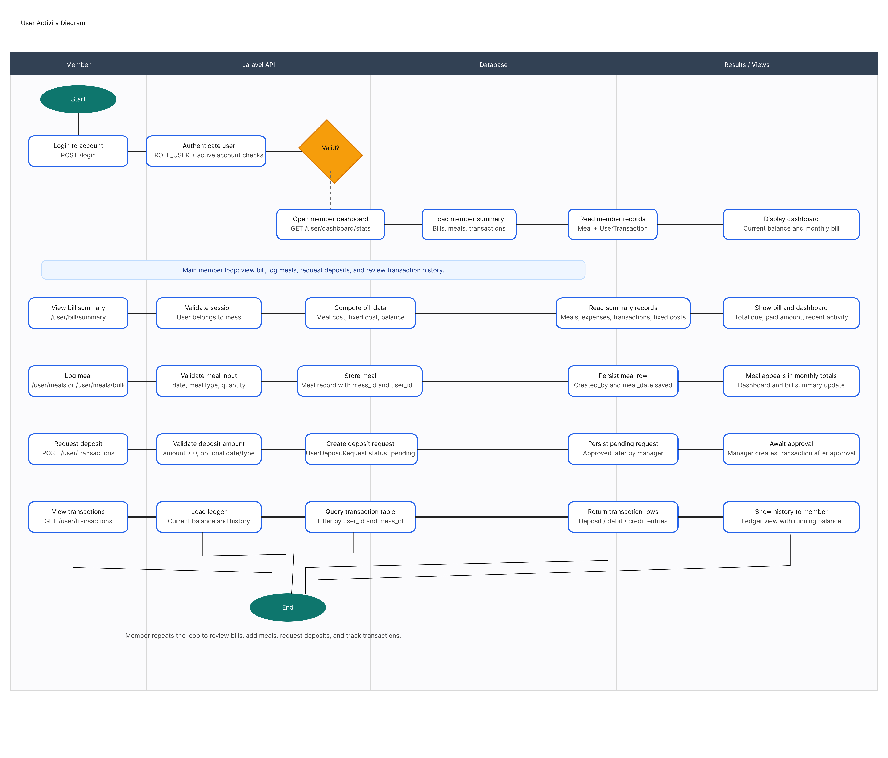
Activity Diagrams
User Activity Diagram

Slide 17
Swimlane Diagram

Slide 18
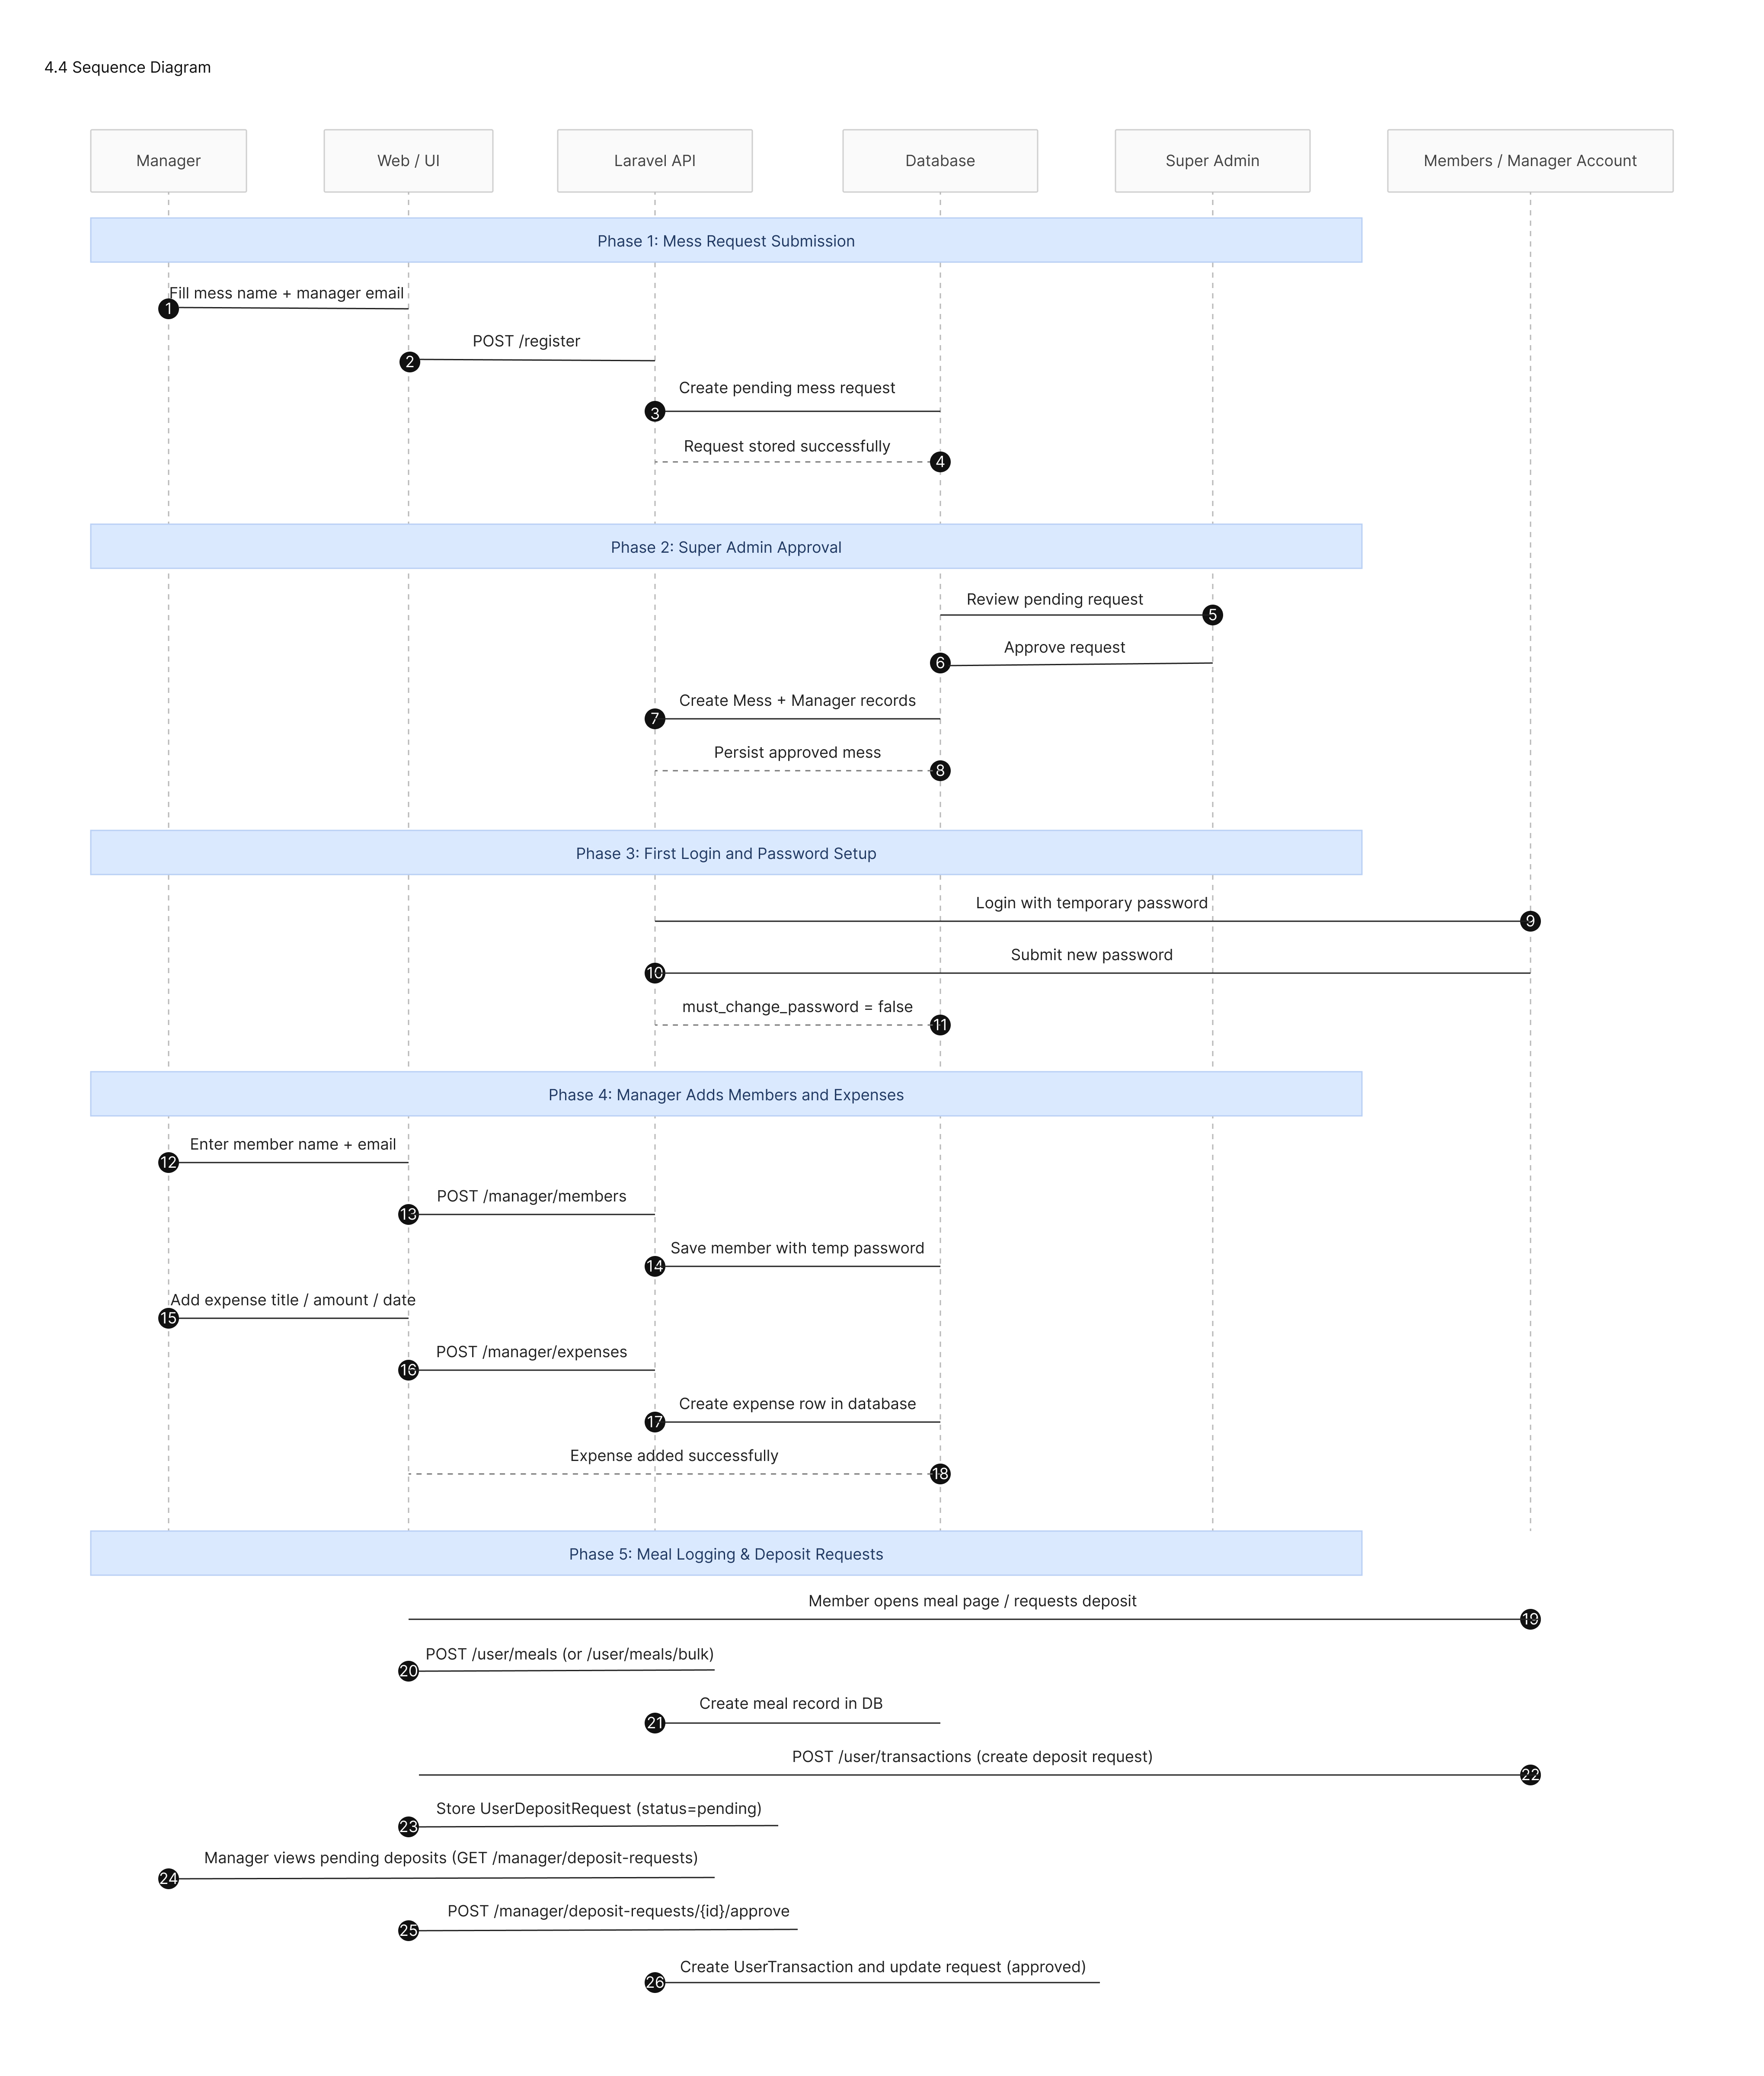
Sequence Diagram
Monthly billing calculation workflow.
Deposit approval process.
Refund settlement sequence.

Slide 19
Class Diagram

Slide 20
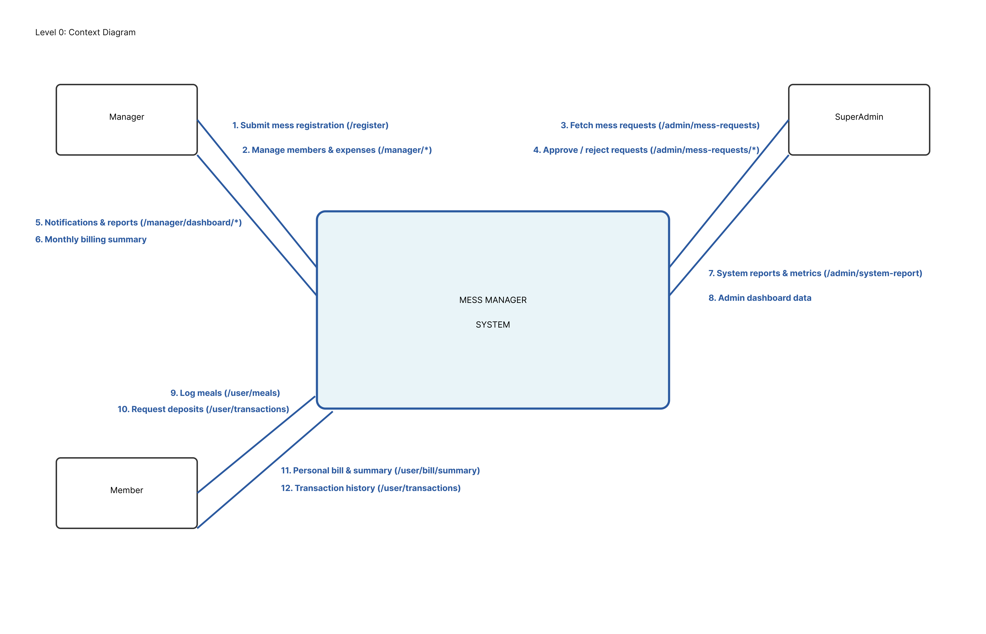
DFD Level 0

Slide 21
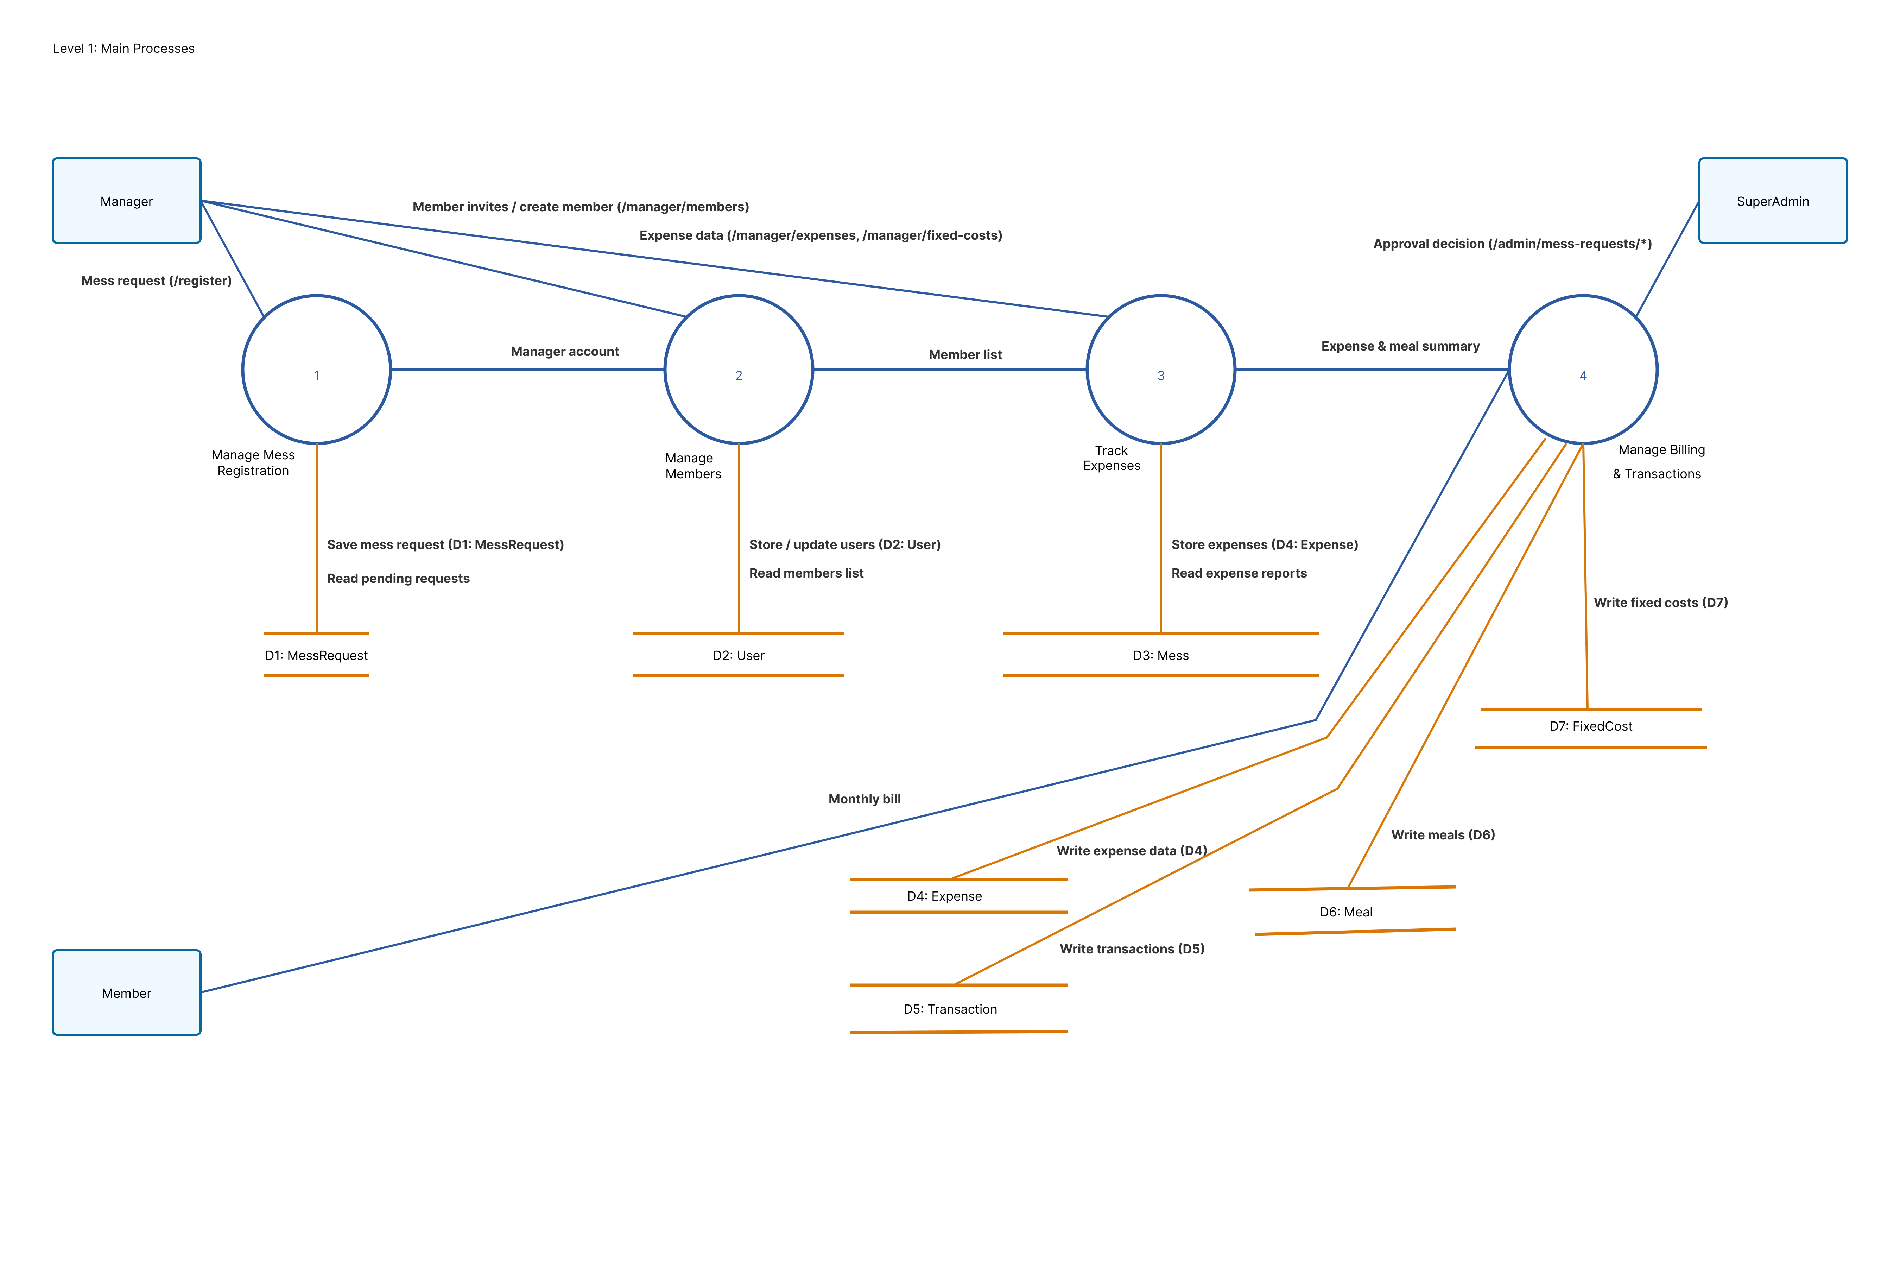
DFD Level 1

Slide 22
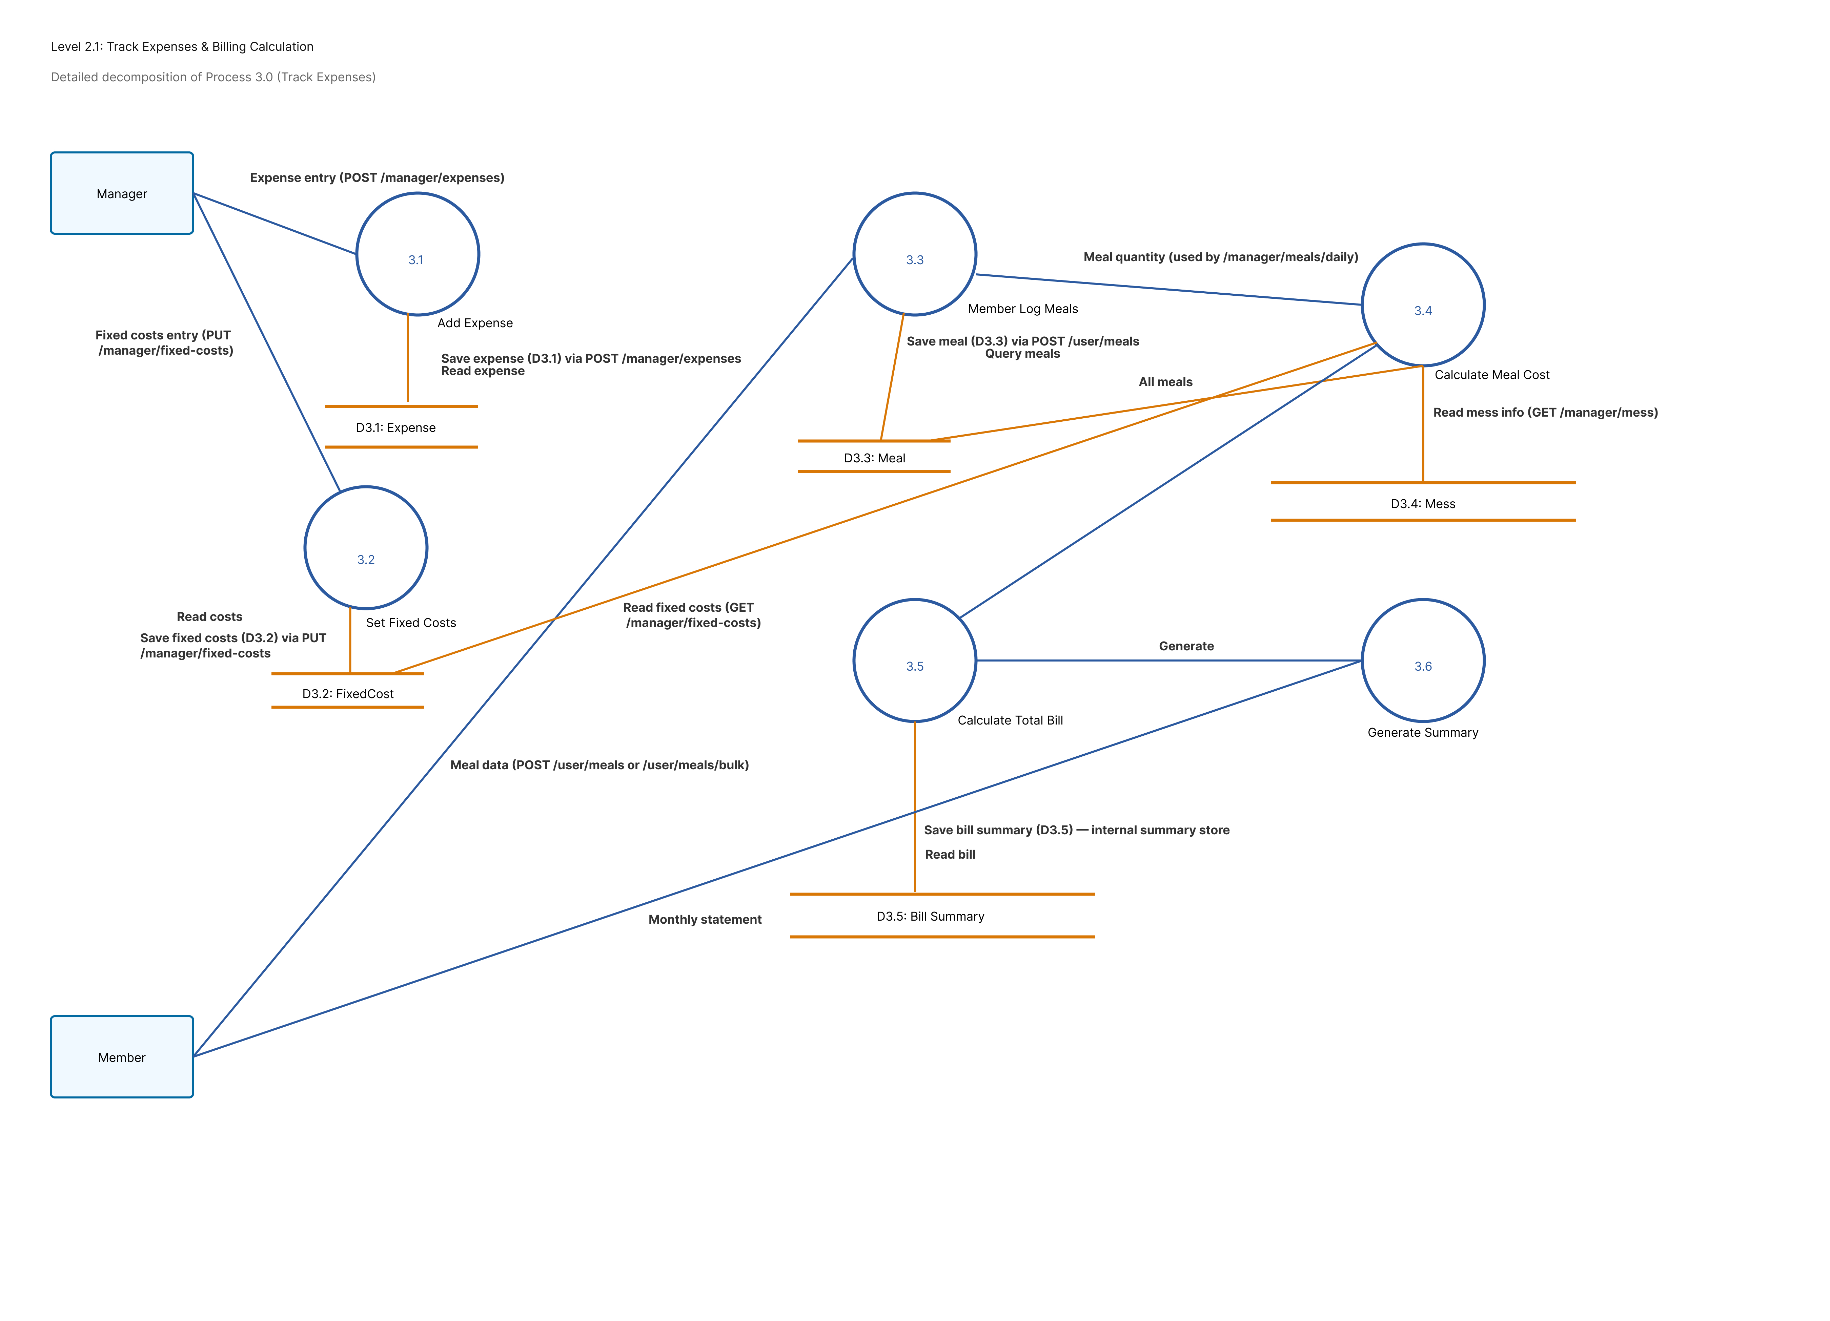
DFD Level 2 (Billing Sub-flow)

Slide 23
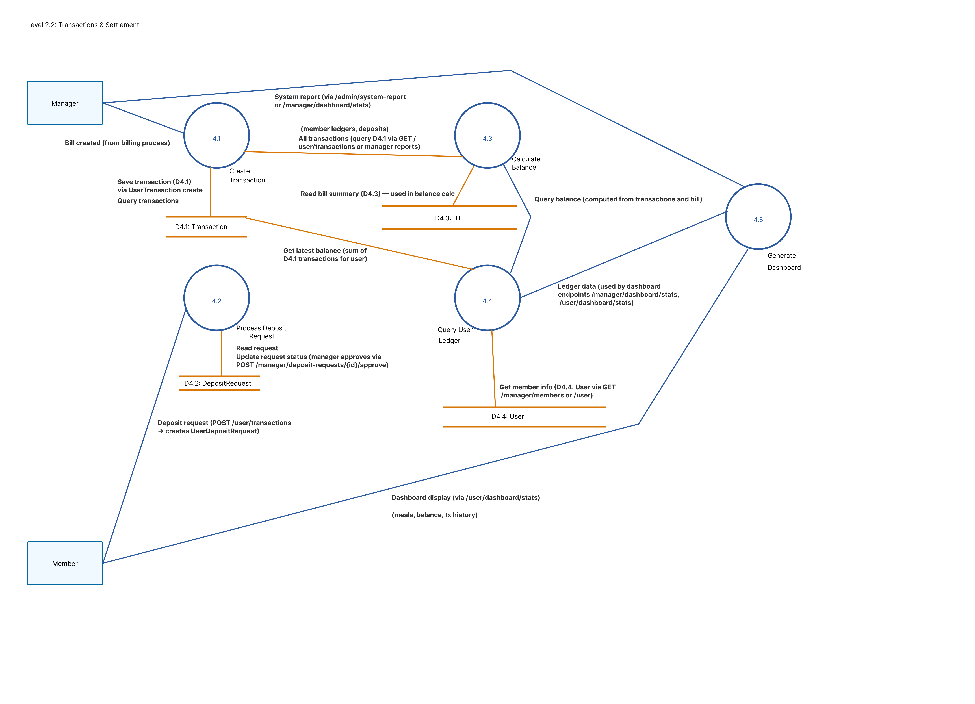
DFD Level 2 ( Transaction & Settlement )

Slide 24
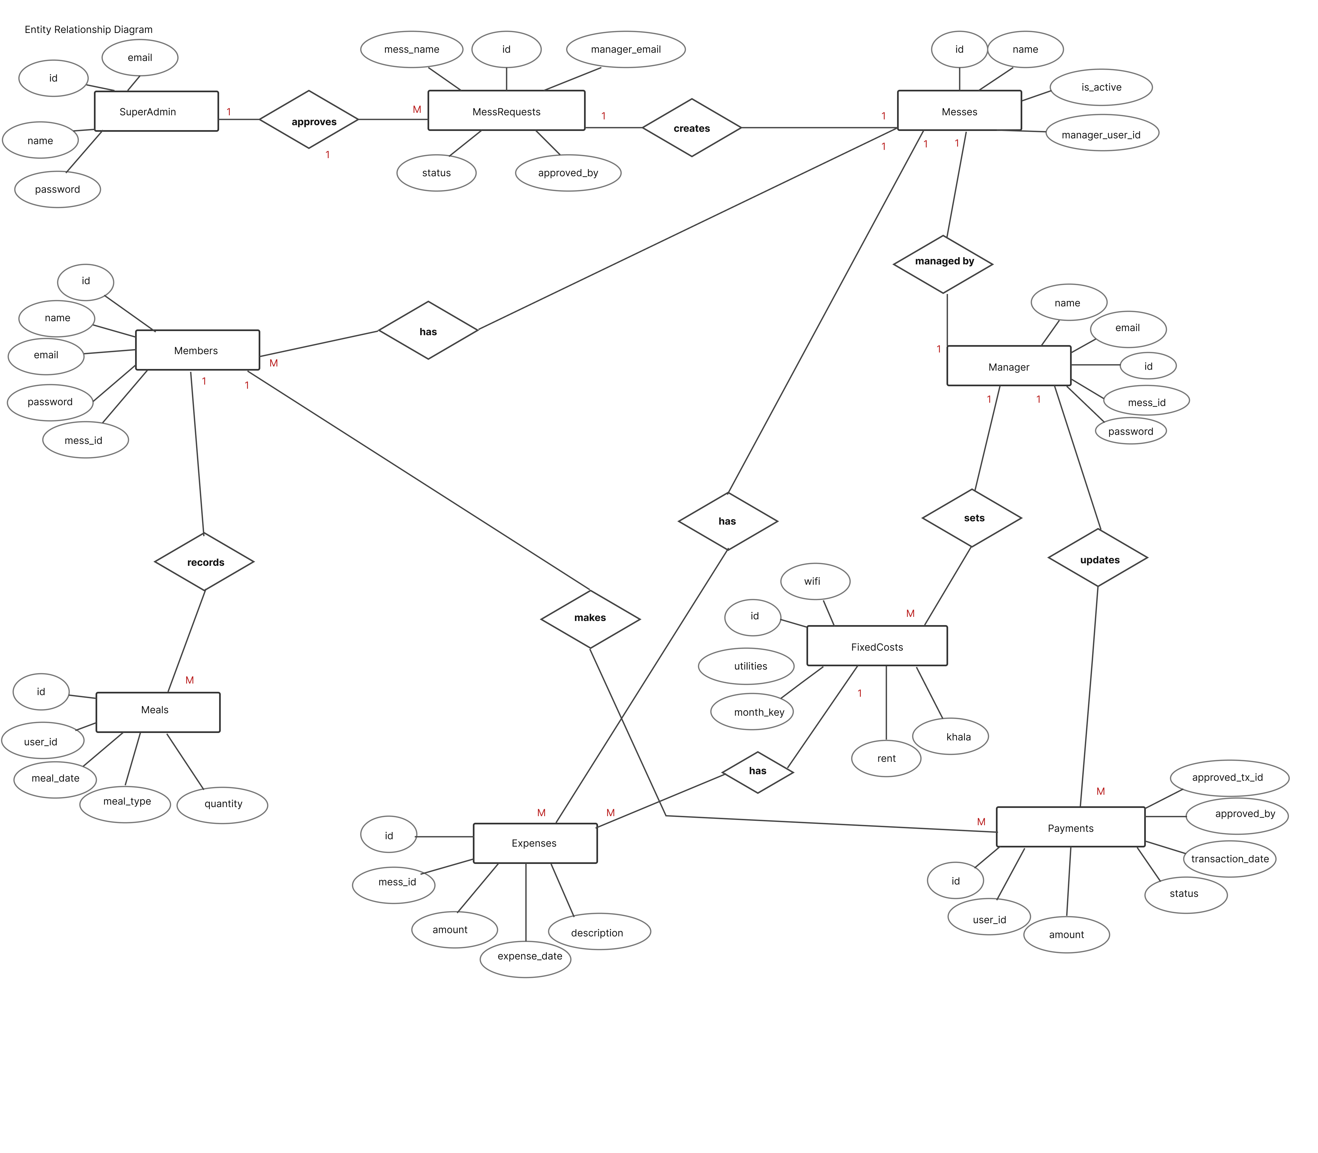
Entity Relationship Diagram (ERD)

Slide 25
System Architecture
Frontend: react + redux toolkit
Backend: laravel API
Database: mysql
Authentication: laravel sanctum

Slide 26
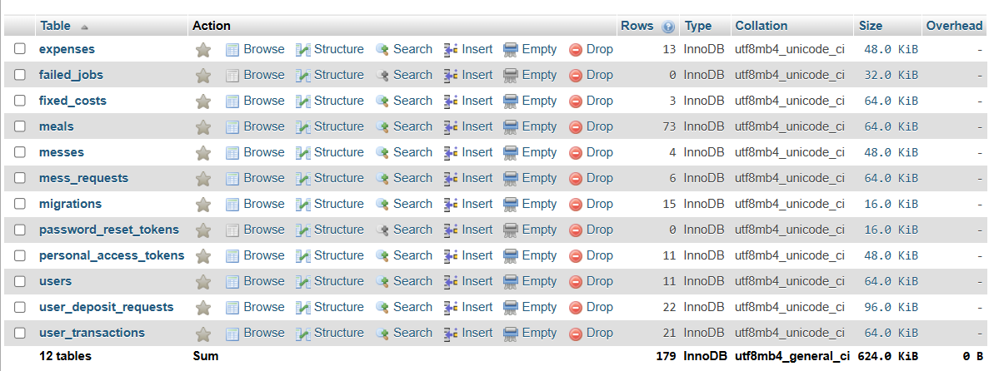
Database Design

Slide 27
API Design Summary
REST API based architecture
Role-based route groups
Secure token authentication
Examples: /api/login, /api/user/meals

Slide 28
Billing Calculation Logic
Meal rate = total bazaar expense / total meals
Total bill = meal cost + fixed share
Backend handles authoritative calculations

Slide 29
Refund Settlement Logic
Handles overpaid member settlements.
Separates meal and fixed refund amounts.
Creates negative transactions for auditing.

Slide 30
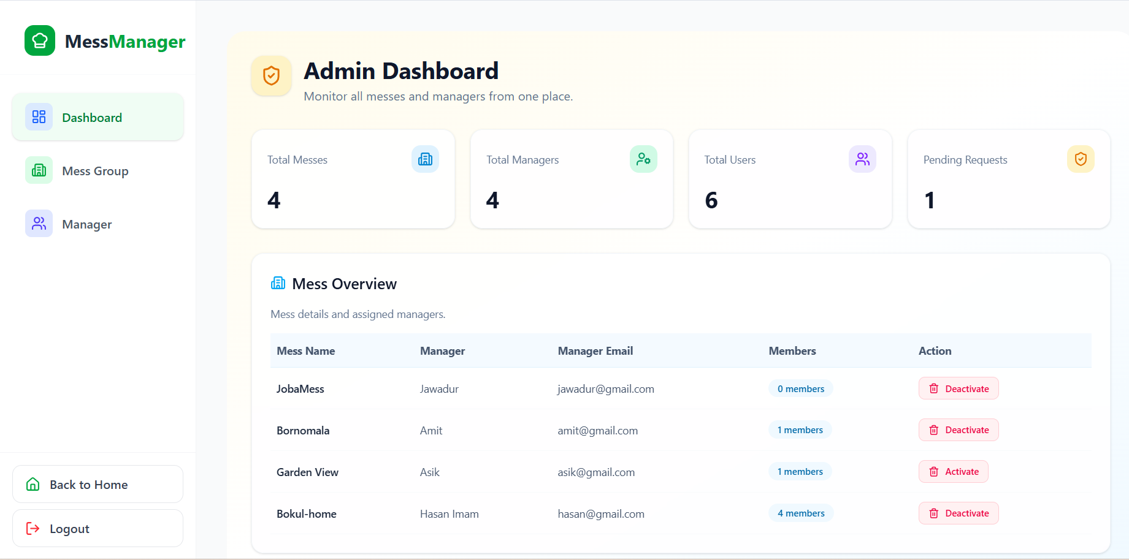
Super Admin Dashboard
Manage mess requests
Approve/reject managers
View system reports

Slide 31
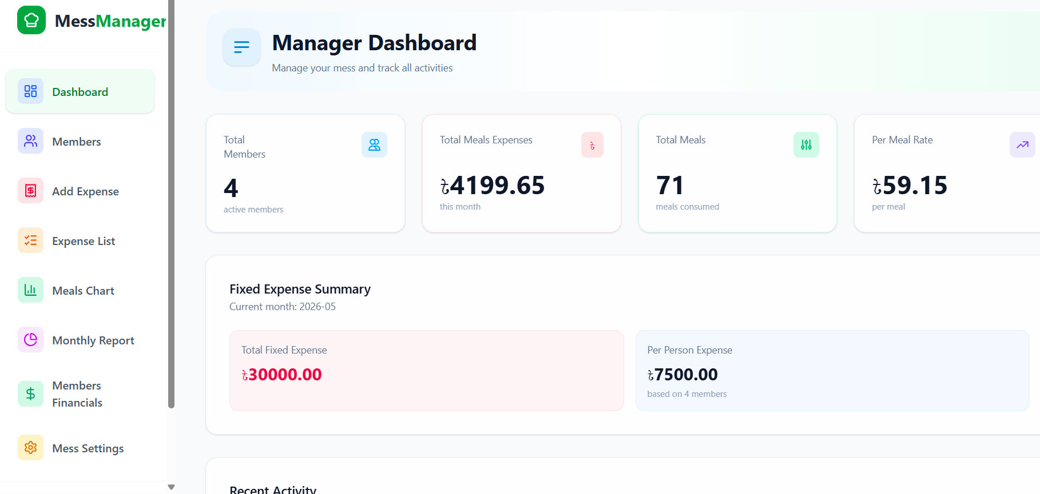
Manager Dashboard
Manage members and expenses
Approve deposits
View monthly reports

Slide 32
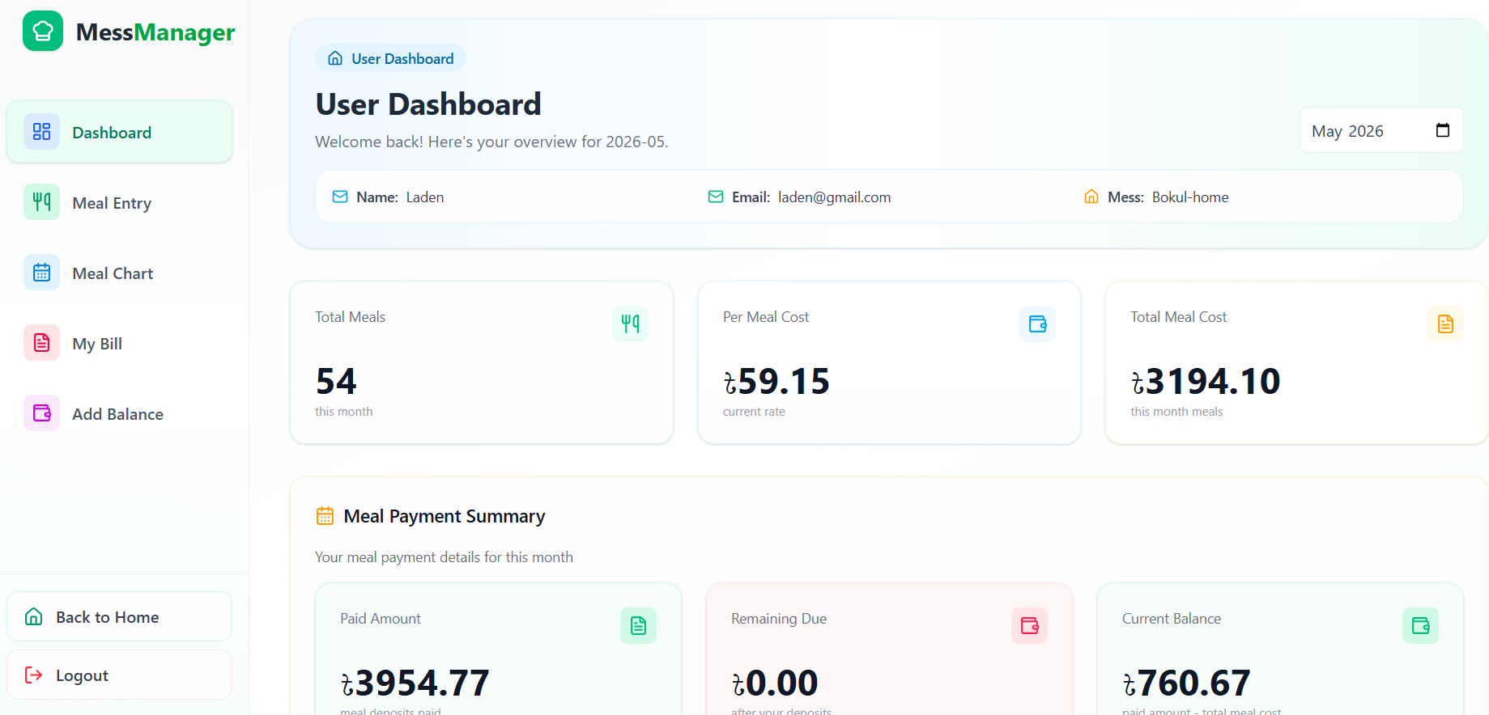
User Dashboard
Meal entry and meal chart
View bills and balance
Deposit requests

Slide 33
Testing
Authentication testing
Meal entry testing
Billing calculation testing
Refund settlement testing
All core modules passed successfully.

Slide 34
Testing
Test Case ID | Module | Test Title | Expected Result | Actual Result | Status
TC-01 | Auth | User Login Test | User is redirected to their specific dashboard based on role. | Logged in and redirected to Manager Dashboard. | Pass
TC-02 | Auth | First Login Password Setup | User is forced to change their temporary password on first login. | "Change Password" prompt appeared and updated successfully. | Pass
Test Case ID | Module | Test Title | Expected Result | Actual Result | Status
TC-03 | Meals | Add Meal Entry | System stores meal status and updates quantity to 0 for "Off". | Meal stored correctly with accurate quantities. | Pass
TC-04 | Billing | Meal Rate Calculation | System correctly divides total bazaar costs by total meals. | Calculation matched manual verification exactly. | Pass
TC-05 | Deposits | Deposit Approval | Manager approval creates a transaction and updates user balance. | Balance updated and transaction record created. | Pass

Slide 35
Risk Analysis
Risk Type | Possible Risk
Technical | System crashes, Laravel/PHP framework issues, or MySQL database downtime.
Security | Data breaches, unauthorized access to member financial records, or token leakage.
Operational | Low user adoption, data entry errors by managers, or calculation discrepancies.
Financial | Failures in deposit tracking or future payment gateway integrations.
Performance | Slow response times during peak hours when all members log meals simultaneously.

Slide 36
Risk Analysis
Possible Risk | Probability | Impact
System Downtime | 30-40% (Moderate) | Serious
Data Breaches | 20-30% (Moderate) | Catastrophic
Unauthorized Edits | 20-30% (Moderate) | Serious
Low User Adoption | 30-40% (Moderate) | Tolerable

Slide 37
RMMM Plan
Risk ID | Risk Type | Risk Description | Mitigation Plan | Monitoring Plan | Management Strategy
R1 | Technical Risk | System crashes or server downtime | Use reliable cloud hosting and automated database backups to prevent data loss | Implement real-time monitoring tools to detect service interruptions | Restore services immediately using latest backup and respond to alerts quickly
R2 | Security Risk | Unauthorized access or data breaches | Use Bcrypt password hashing and Laravel Sanctum token authentication | Review activity logs and login logs to detect suspicious access attempts | Revoke affected tokens and apply security patches to middleware if breach occurs
R3 | Operational Risk | Low user adoption, data entry mistakes, or calculation discrepancies | Design simple user-friendly interfaces and provide proper workflow guidance | Collect user feedback and review system usage regularly | Improve UI/UX gradually and provide corrections for operational issues
R4 | Financial Risk | Deposit tracking failures or future payment gateway integration issues | Maintain transaction validation and backup financial records | Monitor transaction logs and payment activities regularly | Resolve transaction mismatches quickly and maintain audit history
R5 | Performance Risk | Slow response time during peak usage or simultaneous meal entries | Optimize database queries and use efficient API handling | Track server response time and monitor heavy traffic conditions | Scale server resources and optimize performance bottlenecks when needed

Slide 38
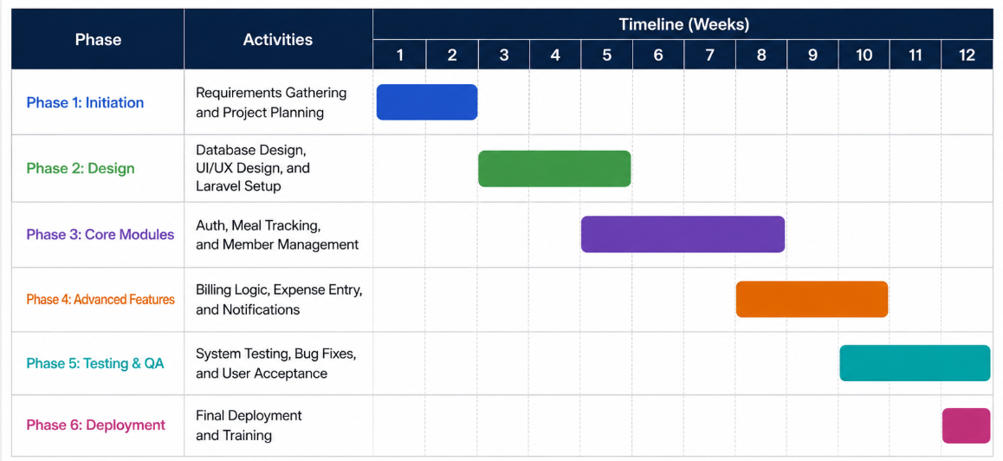
Project Timeline
12-week Agile development plan.

Slide 39
Function Point Estimation
The value adjustment factor (VAF) and adjusted function point (AFP) are calculated as follows:
Total degree of influence (TDI) = 55
Value adjustment factor (VAF) = 0.65 + (0.01 \times TDI)
Vaf = 0.65 + (0.01 \times 55) = 1.10
Total unadjusted function point (UFP) = ufp(transaction) + ufp(data) = 25 + 35 = 60
Adjusted function point (AFP) = UFP \times VAF = 60 \times 1.10 = 66

Slide 40
Cost Estimation
Cost Category | Resource / Tool | Estimated Cost | Remarks
Development Environment | VS Code, Node.js, PHP, Laravel, React | Free | Open-source technologies used
Database Management | MySQL | Free | Open-source relational database
Version Control | Git & GitHub | Free | Used for source code management
Hosting / Server | Localhost / XAMPP | Free | Used during development phase
Internet & Utilities | Internet connection and electricity | Approx. 500 BDT | Daily development usage
Hardware | Personal Laptop | Existing Resource | No additional hardware cost
 | Mouse | 1000 BDT | Bought new mouse
Testing & Debugging | Browser DevTools, Postman | Free | Used for API testing and debugging
Human Resource | Developer (Self) | Internship Based | Developed during practicum/internship
Documentation | Microsoft Word | Free / Existing | Used for report preparation
Design | Figma | 1500 BDT | For diagram design

Slide 41
Limitations
Manual expense entry: managers manually enter bazaar expenses.
Offline access: requires internet connection for syncing data.
Currency restriction: supports only bangladeshi taka (bdt).
No mobile app: native mobile app is not available yet.

Slide 42
Future Work
Ocr-based bazaar receipt scanning
Mobile application support
Ai-based expense prediction

Slide 43
Conclusion
MessManager automates mess operations efficiently.
Improves transparency and accountability.
Provides scalable role-based architecture.
Reduces manual work and billing errors.

Slide 44


Slide 45


