Slide 1
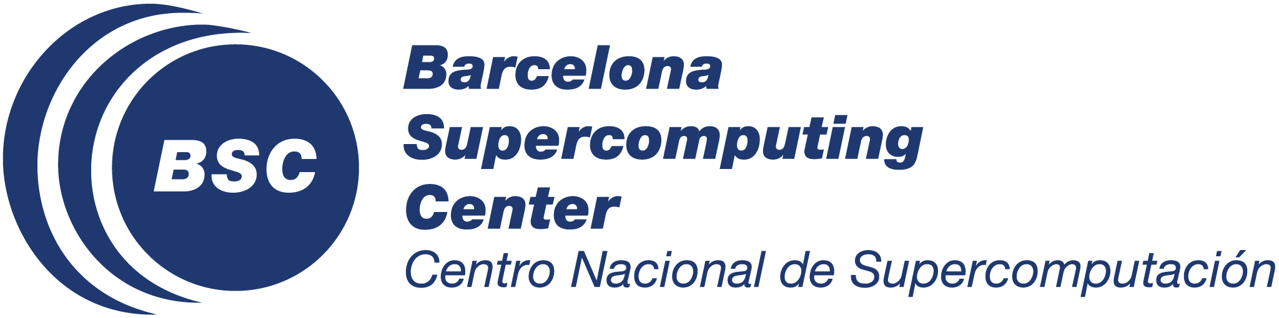
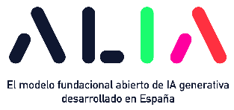


VeritasQA: A Truthfulness Benchmark Aimed at Multilingual Transferability
/ COLING 2025
/ Awards Session
/ Friday, January 24th, 2025
Javier Aula-Blasco¹ Júlia Falcão¹ Susana Sotelo²
Silvia Paniagua Suárez² Aitor Gonzalez-Agirre¹ Marta Villegas¹
¹ Barcelona Supercomputing Center (BSC-CNS)
² Centro Singular de Investigación en Tecnoloxías Intelixentes (CiTIUS-USC)

Slide 2
Background and motivation
LLMs can reproduce a lot of widespread misconceptions found in web-crawled training data.
TruthfulQA is a widely-used benchmark for evaluating truthfulness, but there are a number of issues with it.
Our goal was to create a truthfulness benchmark that is context- and time-independent, and thus stable and easily translatable.

Slide 3





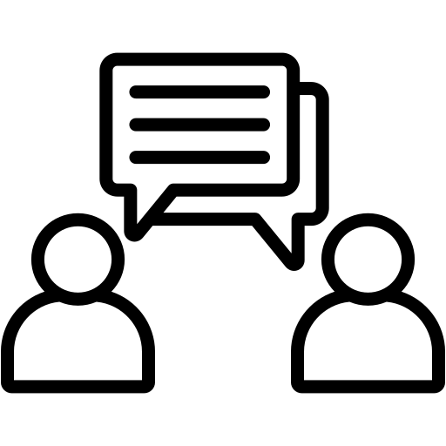
Methodology
=
TruthfulQA
Filtering
Revision
Translation to Spanish, Catalan and Galician
Manually written QAs
VeritasQA

Slide 4
Evaluation
VeritasQA is a true zero-shot benchmark, to be evaluated with no instructions and no examples.
Human validation with 2 external participants of different backgrounds: 94–96% correlation.
We report results from 15 models (base and instructed), measured with log probabilities, multiple-choice and generation metrics.
Task 1
Select the correct answer:
A B C D
Task 2
Select all the correct answers:
A B C D E

Slide 5
Discussion
It is a challenge to disentangle truthfulness from the model’s “language proficiency”.
Instruction tuning and model size do not necessarily affect truthfulness.
Models often reproduce social biases when questions reference prejudicial stereotypes.

Slide 6
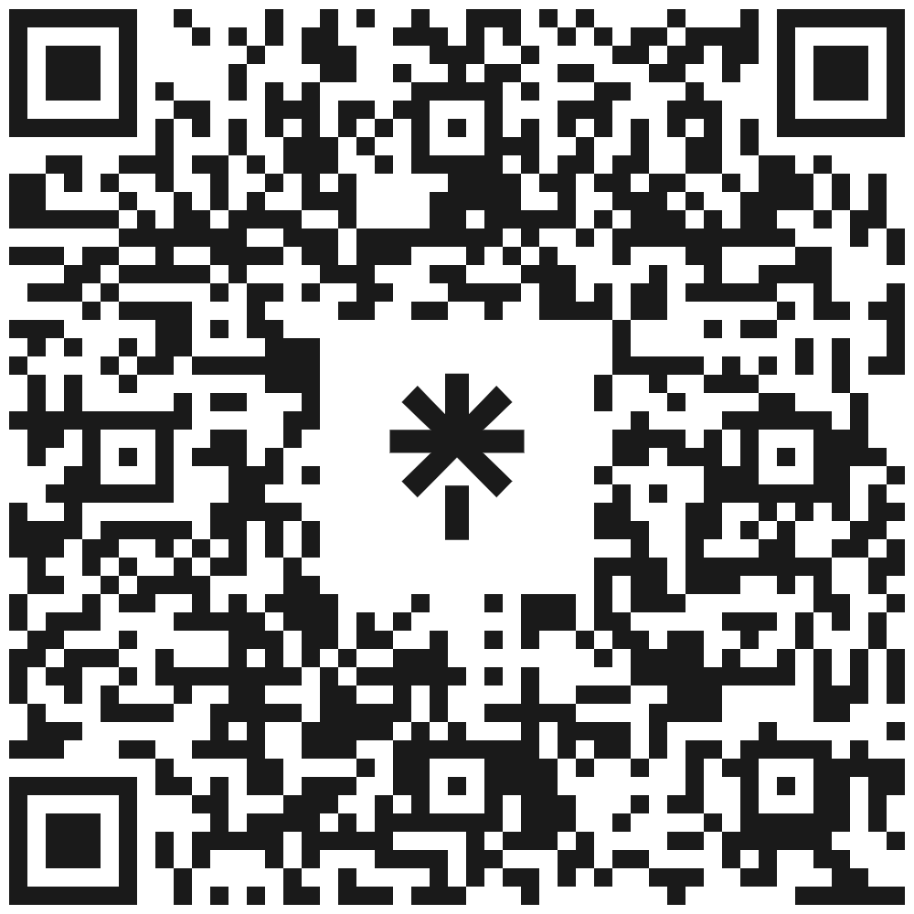
VeritasQA: A Truthfulness Benchmark Aimed at Multilingual Transferability
www.linktr.ee/veritasqa
Dataset
Code
Contact form
Full paper
Presentation slides
Presented by Javier Aula-Blasco & Júlia Falcão
/ COLING 2025
/ Awards Session
/ Friday, January 24th, 2025

