Slide 1





CHIFRAUD: A Long-term Web Text Dataset for Chinese Fraud Detection
Min Tang, Lixin Zou*, Shujie Cui, Shiuan-Ni Liang, Zhe Jin, Weiqing Wang
Contact: min.tang@monash.edu
Notes:
Hello, everyone. Today, I'm pleased to share our work 'CHIFRAUD: A Long-term Web Text Dataset for Chinese Fraud Detection’.

Slide 2
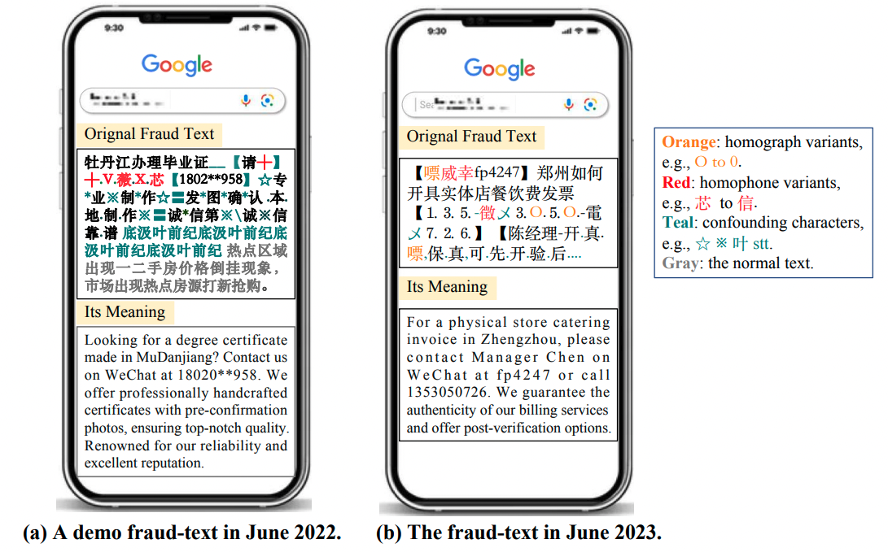
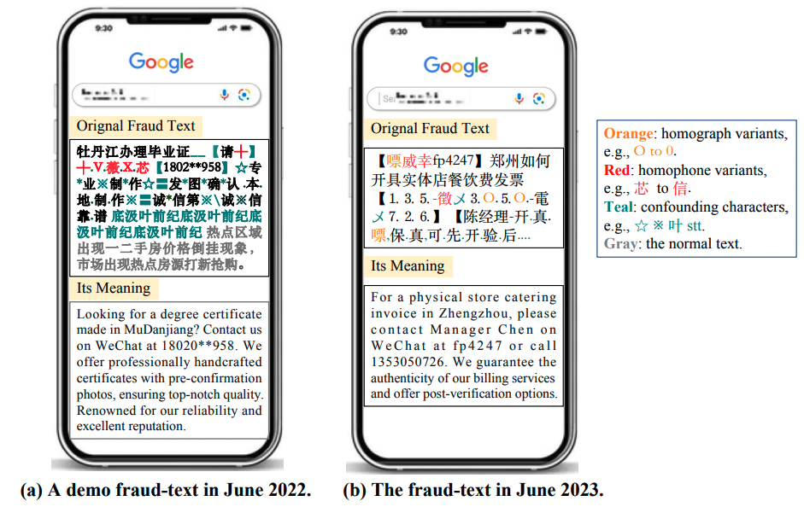
1. Motivation
Fraudulent Text
Fraud-text Detection
Concise texts deliberately crafted to disseminate deceptive or illegal trading, thereby contravening Chinese laws and regulations.
Determine whether a given text is normal content or fraudulent and assigns it to the appropriate fraud category.
Camouflage techniques
homophone variants
confounding characters
interspersing deceptive content with normal text
Perpetually shifting
Notes:
We define a new type of malicious text: fraudulent text. These are short, deceptive messages designed to spread illegal trading information and violate Chinese laws. Their main goal is to lure users to other platforms for activities like gambling. Detecting this kind of text is crucial, but scammers often use camouflage techniques to avoid detection. These tricks quickly reduce the effectiveness of detection systems.

Slide 3
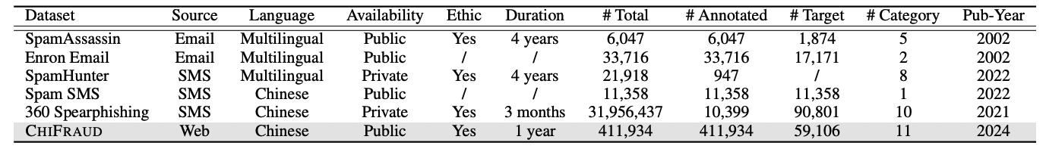
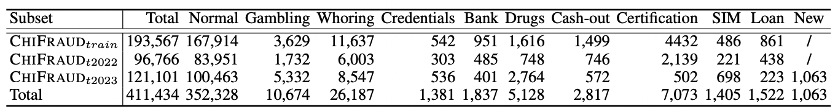
Bias of Data-driven RecSys
2. CHIFRAUD Dataset
First anonymous public Chinese fraud-text detection dataset.
extensive expert annotations (59,106 fraudulent texts)
Long-term data collection duration
Dataset Comparison
CHIFRAUD Construction
CHIFRAUD Composition
Web Crawling
Web Crawling
Notes:
To tackle this issue, we’re introducing a brand-new dataset: CHIFRAUD. It’s the first anonymous, publicly available Chinese fraud-text detection dataset and is designed to handle real-world challenges like shifting distribution detection. We collected webpage content from 2022 and 2023, then processed and anonymized it to create a large collection of short texts.

Slide 4
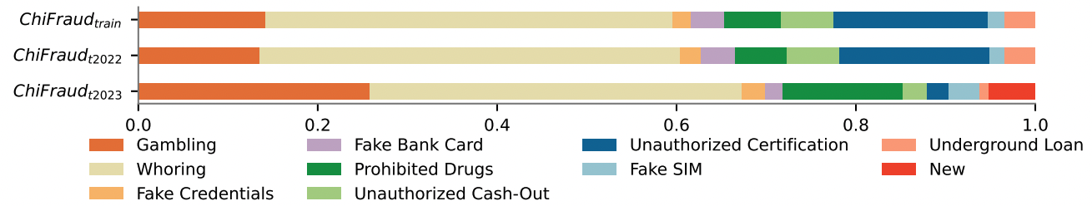
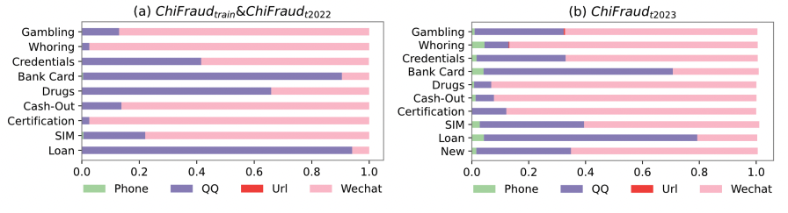
2. CHIFRAUD Dataset
Unbalanced Fraud
Fraudulent texts constitute a small portion compared to normal texts.
Significantly skewed distribution across different fraud categories.
Distribution Shifts
Distribution of fraud fluctuates significantly over time.
Distribution of contacts in fraudulent texts varies over time.
Newly emergent fraudulent texts.
Notes:
We also conducted an empirical analysis of fraud attackers’ behavior and uncovered some key findings. First, fraud texts show an inherent imbalance. We also observed noticeable distribution shifts between the 2022 and 2023 datasets in four areas. Additionally, the characteristic patterns of fraudulent texts over time.

Slide 5
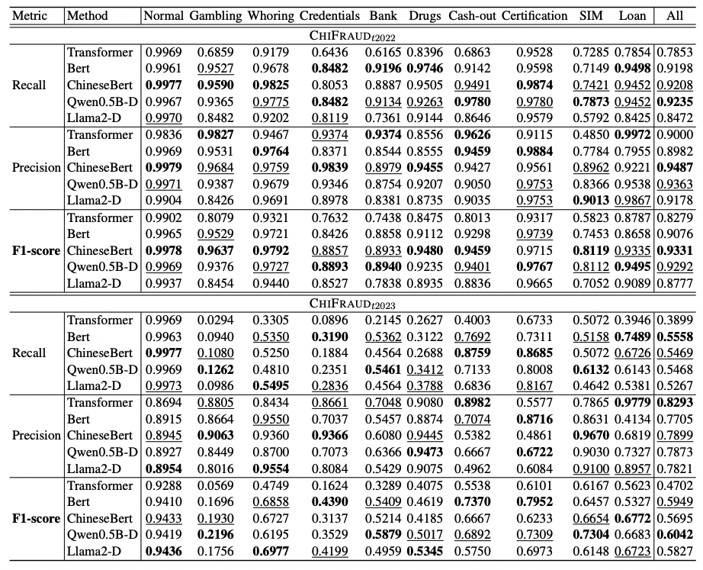
Sys
3. Bechmark Detectors
Large language model-based detectors
Llama2-D
Qwen-D
ChatGPT-D
Pre-trained language model-based detectors
Bert-D
ChineseBert-D
Deep learning-based detectors
Transformer-D
Noticeable performance degradation over time!
Notes:
We also carried out an empirical study of several benchmark detectors, including Large language model-based detectors, Pre-trained language model-based detectors and Deep learning-based detectors. From results, We noticed that all detectors exhibit noticeable performance degradation across all frauds. This highlights the lack of robustness in these fine-tuned detectors.

Slide 6
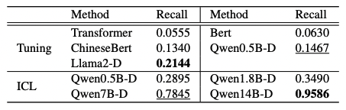
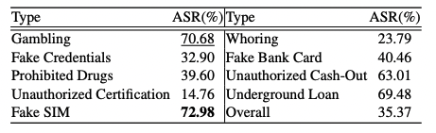
Sys
4. Research Directions
Robust Detection
Attacks on Detectors
Detectors need further improvement to consistently achieve high recall and precision rates.
LLM-based detectors demonstrate limitations in countering carefully designed deceptions.
Efficient Detection
Billion-parameter detectors pose challenges for practical implementation in industry applications.
Notes:
ChiFraud opens up several new research directions for significant practical value. First, detectors need further improvement to achieve high performance. LLM-based detectors show limitations in handling carefully crafted deceptions. Lastly, efficiency is a critical concern, it pose challenges for practical use in industrial applications.

Slide 7
Thank you
Q & A
Notes:
That’s all about our work. Thank you for your attention.

