Slide 1



BERT-based Classical Arabic Poetry Authorship Attribution
Lama Alqurashi, Janet Watson, Jacob Blakesley, Serge Sharoff

Slide 2
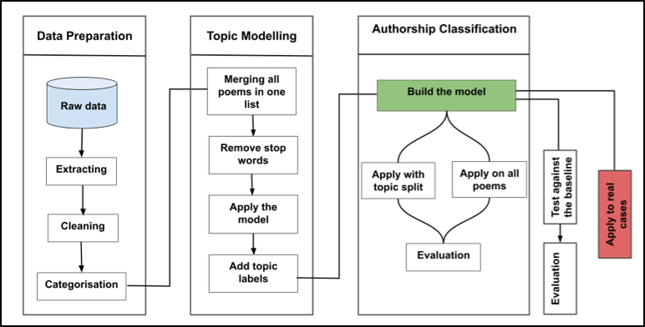
Method

Slide 3
Our Data
Web scraping of AlDiwan website.
Category | Total number
Poets | 784
Poems | 77,850
Words | 6,609,495

Slide 4
Topic Modeling
we applied Embedded Topic Modeling (ETM) to label each poem with its topic contributions, further enhancing the dataset’s value. (Dieng et al., 2020)
https://github.com/ssharoff/ETM

Slide 5
Authorship Classification
Ensemble model based on CAMeLBERT was developed and tested across three dimensions:
Topic
Number of poets
Number of training examples

Slide 6
Authorship Classification
After parameter optimization, the model achieved F1 scores ranging from 0.97 to 1.0. at:
Topic: No significant effect
Number of poets: Binary
Number of training examples: 60

Slide 7
Authorship Classification
The analysis of average F1 scores for the tested models shows that the ensemble model achieved a score of 0.98
Significantly outperforming the single model, which obtained a score of 0.75.

Slide 8
Authorship Classification
We investigated the probability distributions of correctly classified versus misclassified.
0.7 |  |  |  |  |  | 0.8 |  |  |  |  |  | 0.9 |  |  |  |  |  |  | 1.0
Probabilities with
incorrect classification
Probabilities with
correct classification

Slide 9
Application to Pre-Islamic Mis-attribution Cases
Poem 1 (Imru' al-Qays):
showed a low confidence score of 0.71
Poem 2 (Al-Aʿshā):
The model's confidence in attribution was 0.86
Poem 3 (Al-Aʿshā):
0.85
Poem 4 (ʻUbayd Ibn Al-Abraṣ):
high confidence score of 0.99, strongly supporting its attribution
أَلا لا أَلَا إِلَّا لآلاءِ لابِثٍ
ولا لَا أَلَا إِلا لِآلاءِ مَن رَحَل

Slide 10
Thank you ALL!

