Slide 1


NYT-Connections A Deceptively Simple Text Classification Task That Stumps System-1 Thinkers
Angel Yahir Loredo Lopez¹, Tyler McDonald², Ali Emami²
¹ - Universidad Autónoma de San Luis Potosí, San Luis Potosí, MX
² - Brock University, Niagara Falls, ON, Canada
Notes:
Hello! My name is Tyler McDonald, and I am from Brock University in St. Catharines, Canada. I am humbled and honored to be presenting our work, (title)

Slide 2
Connections
FOLD
GAUGE
STANDARD
YARDSTICK
MARY
NORMAL
DRY
BENCHMARK
COMBINATION
CHECK
CALL
MASS
KENT
BET
OILY
WASH
3
Notes:
Show of hands for Connections?
Connections is simple to understand but hard to master; create four groups of four words. If a group contains three of the four terms, the game gives you a “One Away!” hint to encourage you to manipulate your current grouping.
You are permitted four incorrect groupings before the game ends.

Slide 3
Connections
GAUGE
STANDARD
YARDSTICK
WASH
MARY
NORMAL
BENCHMARK
DRY
COMBINATION
CHECK
CALL
MASS
FOLD
KENT
BET
OILY
3
Notes:
- How about this grouping? Do we see a potential fourth word? Multiple?

Slide 4
Connections
GAUGE
STANDARD
YARDSTICK
WASH
MARY
NORMAL
BENCHMARK
DRY
COMBINATION
CHECK
CALL
MASS
FOLD
KENT
BET
OILY
3
Notes:
- How about this grouping? Do we see a potential fourth word? Multiple?

Slide 5
Connections
Starts of U.S States
Benchmark
Poker Actions
Skin Types
STANDARD
FOLD
DRY
WASH
YARDSTICK
CHECK
NORMAL
MASS
BENCHMARK
CALL
OILY
MARY
GAUGE
BET
COMBINATION
KENT
3
Notes:
- Some of these categories may be less obvious, and less likely to be deduced by simple semantic association

Slide 6
NYT-Connections
Consists of 554 puzzles designed to penalize System 1 thinking.
Isolated to text classification – evaluates shortcut learning.
Updated monthly, providing novel puzzles.
6
Notes:
NYT-Connections is designed to penalize those who fall back on System 1. It is composed of 554 puzzles from June 2023 to December 2024
Moreover, it is isolated to text classification as a sole task; can you identify the appropriate groups of terms?
To resist data leakage, we update our dataset monthly, preventing total memorization when training new models

Slide 7


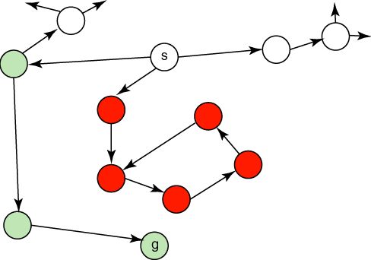
Methodology
Claude 3.5 Sonnet
GPT-4
GPT-4o
Gemini 1.5 Pro
Llama 3 70B
Llama 3.1 405B
Human Evaluators
Heuristic
Random Guess
8
Notes:
To better grasp the challenge of Connections and the state at which LLMs can complete the task, we evaluate six recent LLMs from four publishers using one-shot standard prompting, Chain-of-Thought, and Self-Consistency.
To provide a human benchmark for this challenge, we use human evaluators to set a baseline human performance score.
We also use the heuristic described priorly, as well as a random guess metric which has a four hundred thousandths chance of succeeding on any puzzle.
All subjects are given a sample set of 100 puzzles formed of the median difficulty puzzles as determined by community raters.

Slide 8
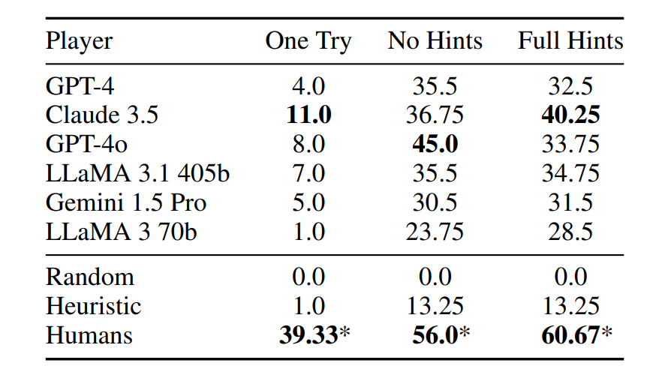
Do LLMs Perform Like Humans?
10
Notes:
After evaluating LLMs on Connections, we can reveal several interesting insights.
Firstly, even in the full hints setup, the highest performing LLM still performs 33% worse than humans.

Slide 9
Do LLMs Perform Like Humans?
10
Notes:
This trend is far more pronounced in the challenging One Try configuration, where Claude 3.5 performs 72% worse than human evaluators.
In fact, LLaMa 3 70B is on par with the clustering heuristic described earlier, demonstrating a fundamental weakness in this configuration.

Slide 10
Do LLMs Perform Like Humans?
10
Notes:
- In all cases, humans perform statistically significantly better than all other subjects, highlighting the objective difficulty of Connections.

Slide 11
Conclusion
NYT-Connections provides a linguistically isolated and continually novel challenge requiring deliberate reasoning.
LLMs perform below human benchmarks, exhibiting tendencies between System 1 and System 2.
Prompt engineering is ineffective, failing to promote System 2 behaviour.
13
Notes:
In conclusion, we introduce NYT-Connections, which provides a linguistically isolated and ever-growing novel task that challenges LLMs to utilize deliberate reasoning practices.
When evaluated on NYT-Connections, we show that LLMs fall below human benchmarks for performance, exhibiting tendencies that fall between System 1 and System 2, but short of full System 2 behaviour.
We also demonstrate that prompt engineering is an ineffective way to solve Connections, as prompting techniques designed to promote System 2 behaviours fail to do so.

Slide 12


Thank You!
Paper Link
HuggingFace
13

