Slide 1

CREATING YOUR PRODUCTION APPLICATION · PART 3 OF 4
Which search
wins?
The same documents cut two ways, two more techniques, and a scoreboard
Wednesday we judged retrieval by eye, one question at a time. Tonight we measure it: by kind of question, at what cost, with leaks at zero.
Fri 13 Nov · checkpoint 03-retrieval
SE
Factory
1
Notes:
Time: 1 minute. Clock check: 0:00.
Say: "Wednesday we tried five retrieval techniques by eye: one question, one dropdown, look at the sources. Tonight we measure. The same Acme documents cut two ways, two more techniques that use the second cut, and a scoreboard that tells us which technique wins which kind of question, what it costs, and that none of them leaks."
"If you're lost, write it in the chat. I read the chat at every section break."
Before class: Postgres up, Monday's index synced with 03 (89 sections + 136 small chunks), the app on port 8000 signed in as the intern, a terminal in the repo root. part3.md, section 2.

Slide 2
Where we are
Acme Desk, one app over Acme's documents. Each session adds one layer.
1
The source
2
By eye
3
Measure it
4
Ship it
Mon 9 Nov
a real Google Drive folder
edits and deletions noticed
re-synced on a timer
Wed 11 Nov
where plain top-k misses
five fixes, tried live
one question at a time
tonight
the same documents, cut twice
parent-document and HyDE
a scoreboard per kind of question
Mon 16 Nov
guardrails on input and output
evals as a release gate
kill switch, Docker
Tonight runs offline on your laptop: local embeddings, Postgres in Docker, no key needed for the scoreboard.
2
Notes:
Time: 1 minute. Point at tonight's card and move on.
Say: "Monday the documents and the sync. Wednesday retrieval, by eye. Tonight we measure it. Next Monday we make it safe to ship, and Monday's release gate reads tonight's scoreboard."
For their laptops: pull the repo, then the four commands on the reference slide "Commands" (migrate, fake_drive reset + apply all, sync, scoreboard).

Slide 3



Tonight in three ideas
Say them now, after the break, and at the end.
1
2
3
Measure by kind of question
Measure what the model needs
Correct, not only faithful
No technique wins every kind. The average across all questions hides it.
The words that answer, not just the document. What it costs. Leaks at zero.
A faithful answer to the wrong context is wrong. Tell a retrieval miss from a generation miss.
Three parts tonight: two cuts of the documents, a scoreboard you can trust, correct versus faithful.
3
Notes:
Time: 2 minutes. One sentence per card.
1: "No technique wins every kind of question. If you average over all questions, you hide that."
2: "We measure what the model actually needs: the words that answer, not just 'the right document somewhere'. And what it costs: model calls, milliseconds. And leaks: zero, for every technique."
3: "An answer can be faithful to its context and still wrong. When it's wrong, we want to know whose fault it is: the search's or the model's."

Slide 4
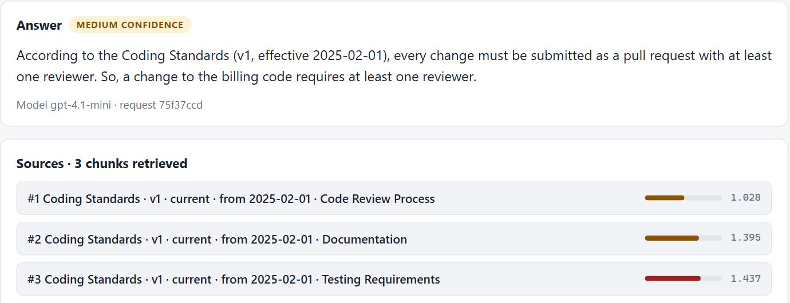
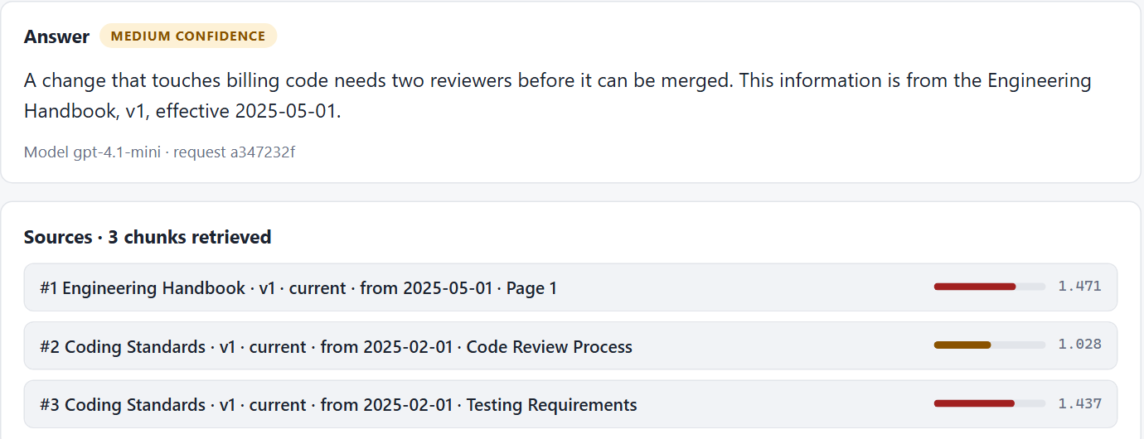
Wednesday, by eye
"How many reviewers does a change to the billing code need?" Same question, two strategies, in the lab.
dense "at least one reviewer" (Coding Standards)
rerank "two reviewers" (Engineering Handbook)
Tonight's question
Which technique wins which kind of question, how often, at what cost, and does any of them ever show you a document you may not read?
One question proves a technique can help. It doesn't tell you how often, on which questions, or at what price.
4
Notes:
Time: 2 minutes. Clock check: about 0:04.
Left: "Plain search, dense: the coding standards' 'at least one reviewer'. Grounded, and wrong for billing code."
Right: "Rerank: the handbook first, 'two reviewers'. Right."
Then the question for tonight: "That was one question. Is rerank better on lists? On ticket ids? On questions nothing answers? Does it cost anything? You can't answer that by looking. You need a set of questions, built so the techniques disagree, and a scoreboard. That's tonight."
Screenshots: the lab, 11 Nov (fallbacks/part2/screens-rag r4 and r3).

Slide 5

PART A · ABOUT 24 MINUTES
Two cuts of
the same documents
Sections for context, small chunks for precision. Both written by the sync.
sections · small chunks · parent-document · HyDE
SE
Factory
5
Notes:
Time: 30 seconds. Clock check: about 0:06. Read the chat.
Say: "First: what we store. Until tonight every document was cut one way, into sections. Tonight we add a second cut, and two techniques that use it."

Slide 6
One section, two small chunks
Onboarding checklist, Week 1. The section keeps its heading; each small chunk is a few whole sentences.
SECTION · HR-ONBOARDING::000 · 443 chars
New Employee Onboarding Checklist > Week 1: Getting Started
- Collect your laptop and access badge from the IT desk on Floor 2.
- Set up your company email and Slack account using the credentials in your welcome packet.
- Complete the mandatory security awareness training on the learning portal.
- Schedule a 1-on-1 with your direct manager to discuss your first 30-day goals.
- Join the #general, #engineering, and #your-team Slack channels.
SMALL CHUNK ::000#00 · 190 chars
New Employee Onboarding Checklist: Collect your laptop and access badge from the IT desk on Floor 2. Set up your company email and Slack account using the credentials in your welcome packet.
parent_id: HR-ONBOARDING::000
SMALL CHUNK ::000#01 · 252 chars
New Employee Onboarding Checklist: Complete the mandatory security awareness training on the learning portal. Schedule a 1-on-1 with your direct manager to discuss your first 30-day goals. Join the #general, #engineering, and #your-team Slack channels.
parent_id: HR-ONBOARDING::000
Both cuts are in the index. Every small chunk knows its section: parent_id = HR-ONBOARDING::000.
6
Notes:
Time: 3 minutes. The real rows from the chunks table.
Left: "This is a section, what Parts 1 and 2 stored. 443 characters, five checklist items, and a header line: the document title and the heading, 'Week 1: Getting Started'."
Right: "The second cut: the same text split into whole sentences, up to 220 characters each. Two small chunks. Each starts with the document title only, not the heading. And each remembers its section: parent_id."
"Look at the second one: three of the five items. Ask 'what do I do in my first week?' and a search over small chunks can find this one, and hand the model three items out of five."
Ids: HR-ONBOARDING::000 (the section), ::000#00 and ::000#01 (its small chunks).

Slide 7
Precise, or in context?
A vector is one summary of its text. The longer the text, the more it averages.
Small chunk precise
Section in context
its vector is one or two sentences
billing question → the handbook sentence: 0.90
but it loses the heading: "Complete the security training…" doesn't say week 1
its vector averages the whole section
billing question → handbook Page 1 (905 chars): 1.46, not in the top 5
but it carries the heading and the neighbours: the whole Week 1 list
Small chunks find the sentence; sections carry what the sentence needs around it. You want both.
7
Notes:
Time: 3 minutes. The trade-off, with one real pair of distances.
Left: "A small chunk's vector is about one or two sentences. 'A change that touches billing or authentication needs two reviewers' is a small chunk, and it's 0.90 from the billing question: close. The same sentence inside its section, the handbook's Page 1, 905 characters about code review, deployments and incidents: 1.46. Not even in the top 5."
Right: "But a small chunk carries little context. The second small chunk on the last slide says 'Complete the security training...' and nothing about week 1: the heading stayed with the section. Ask about week 1, and the small chunk doesn't know it's about week 1."
"So: small for finding, sections for reading. The next slide does both."
Numbers: Search tab, intern, 12 Nov: parent's matched small chunk 0.898; the handbook section by dense: 1.46.

Slide 8



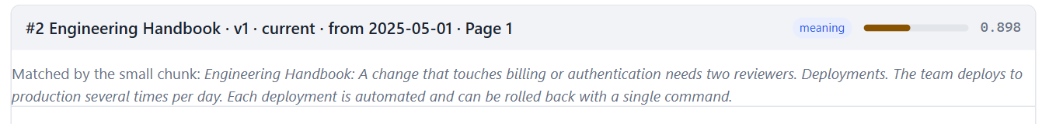
Parent-document: match small, return big
Search the small chunks, return the sections they point to, fetched through the access filter again.
1
2
3
4
Embed the question
as always
Search small chunks
dense, 20 deep
Keep distinct parents
first k parent_ids, in rank order
Fetch the sections
by_ids(), inside the access filter
Search tab, strategy parent, as the intern: "How many reviewers does a change to the billing code need?"
The handbook page, invisible to plain search, comes back second, with the sentence that found it.
8
Notes:
Time: 4 minutes. The diagram, then the real result under it.
Left to right: "One: the question is embedded, as always. Two: we search the SMALL chunks, 20 deep. Three: each small chunk names its section; we keep the first five distinct ones, in the order their best small chunk ranked. Four: we fetch those sections with a second query, and that query goes through the access filter again."
"Why again? The small chunk is exactly as readable as its section today. 'The ids came from a search I trust' is how a leak starts the day that stops being true. Two lines of SQL; we pay them."
Bottom, the real Search tab, strategy parent, as the intern: "Coding Standards first, then the Engineering Handbook, Page 1, the 905-character page plain search couldn't find. And it says which small chunk picked it: 'A change that touches billing or authentication needs two reviewers.'"
Distances on a parent result are the matched small chunk's, so the confidence means 'how close was the sentence'.

Slide 9



Built by the sync, not at question time
The worker writes both cuts in one transaction, from the same parsed text. The API can't write either.
acme_sync writes both cuts
one transaction, same parsed text
app/rag/children.py
def small_chunks(sections, title, max_chars):
small = []
for section in sections:
header, _, body = section["text"].partition("\n")
for n, sentence in enumerate(
split_sentences(body or header, max_chars)):
small.append({
"id": f"{section['id']}#{n:02d}",
"text": f"{title}: {sentence}",
"metadata": {**section["metadata"],
"parent_id": section["id"]}})
return small
a foreign key to the section
no small chunk without its section
acme_app can't write chunks
the lab built them at question time; we can't, and shouldn't
the same labels as the section
access, status, dates: a relabel reaches both
Sections and small chunks change together, flip together (blue/green) and are deleted together.
9
Notes:
Time: 3 minutes. Why this isn't the lab's version.
Left, the rules: "The lab built its small chunks when a question came in, from whatever the index held. Here the API runs as acme_app, which cannot write chunks, on purpose. So the worker, acme_sync, writes both cuts, in the same transaction, from the same parsed text. They can never be out of step."
"A foreign key from the small chunk to its section: a small chunk whose section is gone is impossible. Delete the section, and its small chunks go with it."
Right, the code: "The whole cut, eleven lines. For each section, drop the header line, split the body into whole sentences up to 220 characters, prefix the document title, copy the section's labels, add parent_id. The labels matter: access, status and dates treat a small chunk exactly like its section."
File: checkpoints/03-retrieval/app/rag/children.py; the migration: 006_small_chunks.sql.

Slide 10
Read your chunks
Before any metric: what did the cut actually produce, on our documents?
89
136
50 of 89
sections
avg 275 characters
small chunks
up to 220 characters
sections fit in ONE small chunk
parent = dense for those
A REAL SMALL CHUNK, IN FULL · IT-HELPDESK-EXPORT::000#01
IT helpdesk tickets (October 2026): Fixed.
The splitter cut a ticket row after "version 6.2." Which ticket? Fixed how? The chunk can't say.
local MiniLM embeddings, Monday's documents, 12 Nov · the chunks table after sync.py --apply
Half our sections fit in one small chunk. For those, parent returns exactly what plain search would.
10
Notes:
Time: 3 minutes. Numbers from the chunks table after Monday's sync.
Stats: "89 sections, 136 small chunks. Sections average 275 characters. And 50 of the 89 sections fit in ONE small chunk: for those, the small chunk is the section without its heading. Parent-document can't change anything there: it finds the small chunk and returns... the same section plain search would have."
Hold that thought: it predicts the scoreboard. "Acme's documents are short: policies, lists, a CSV. Parent-document pays off when sections are long. We have one long one: the handbook PDF page."
The red box: "And here's a real small chunk, in full: 'IT helpdesk tickets (October 2026): Fixed.' The sentence splitter cut the ticket row after a full stop. No ticket id, no problem, just 'Fixed.' That's what 'a chunk that lost its context' looks like. Nobody would find it by reading the code. You find it by reading your chunks."

Slide 11

HyDE: search with a made-up answer
A question doesn't look like its answer, so search with an answer-shaped passage the model writes.
The question
"Who do I ring if I'm locked out?"
HYDE_PROMPT · app/prompts/query_rewrite.py
1
Write a short passage (3 to 5 sentences) from an
internal company document (a policy, handbook, FAQ,
ticket or announcement) that would answer the
question below. Write it as the document would, with
concrete specifics. Do not mention the question.
The model writes
a short passage, in a document's voice
2
Embed the passage
and search with it, inside your access
+1 model call, every question
about a second or more, before the search even starts
3
looks surer than it is
the distance is to the made-up passage, not to your question
One model call before every search. The made-up passage only steers the search; it is never shown or quoted.
11
Notes:
Time: 3 minutes. Clock check: about 0:28.
Steps: "One: the question goes to the model with this prompt, the real one from the code. Two: the model writes three to five sentences in the voice of a company document. It doesn't need to be correct, only shaped like our documents. Three: we embed that passage instead of the question, and search."
The two warnings, slowly: "It costs a model call, a second or more, on EVERY question. And the distance it reports is to the made-up passage, not to your question. A made-up answer looks very like a real document, so HyDE looks surer than it is. Keep that in mind for the questions nothing answers."
"Tonight's laptop numbers have no model, so HyDE's row is starred on the scoreboard: it fell back to plain search. The class machine's numbers are in the notes."
Prompt: app/prompts/query_rewrite.py, HYDE_PROMPT.

Slide 12

PART B · ABOUT 20 MINUTES
A scoreboard
you can trust
Questions built so the techniques disagree. Numbers that say what the model needs.
needs · seven kinds · Hit@1, MRR, calm · cost · leaks
SE
Factory
12
Notes:
Time: 30 seconds. Clock check: about 0:30. Read the chat.
Say: "Ten techniques now. To compare them we need two things: questions that make them disagree, and numbers that don't flatter them."

Slide 13
"Right document in the top 5" is too kind
Part 2 asked: did the right document come back? Tonight: did the words the answer needs come back?
small, whole-section
score
A NEED
one document + the words the answer can't do without
MEETS IT
a chunk from that document holding every one of the words (case, spaces and punctuation ignored)
doc@5 HIGH, Hit@5 LOW
found the document, handed over the wrong piece
right document in the top 5 (doc@5)
1.00
kind
the words it needs in the top 5 (Hit@5)
0.25
honest
local MiniLM embeddings, Monday's documents, 12 Nov · scoreboard.py, whole-section table, 4 questions
Same results, two scores. The kind one says small chunks are perfect on lists; the honest one says they fail 3 times out of 4.
13
Notes:
Time: 3 minutes. The reason for the new metric.
Left: "Strategy small, on the four whole-section questions: 'what do I do in my first week?', 'what are the rules for code reviews?' and two more. Did the right DOCUMENT come back in the top 5? Every time: 1.00."
"Did the WORDS come back, the whole list the answer needs? Once in four: 0.25. A sentence of the week-1 checklist is not the checklist."
Right: "So each question says what the model needs: a document, plus the words it can't do without. A chunk meets the need when it's from that document and holds every one of those words. We keep Part 2's number too, as doc@5: when doc@5 is high and Hit@5 is low, the search found the document and handed over the wrong piece."
Numbers: scoreboard.py, whole-section table, row small: doc@5 1.00, Hit@5 0.25, Hit@1 0.00.

Slide 14
A question: person, question, needs, facts
shared/golden/golden_scenarios.json, question S09, exactly as stored.
QUESTION S09
user
asked as this person's real account, inside the access filter
{"id": "S09", "scenario": "buried", "user": "intern",
"question": "How many reviewers does a change
to the billing code need?",
"needs": [{"doc": "ENG-HANDBOOK",
"evidence": ["two reviewers"]}],
"facts": [["two", "2"]],
"answer": "Two: changes that touch billing or
authentication need two reviewers."}
needs
what the CONTEXT must hold: scores the search
facts
what the ANSWER must say: scores the answer
answer
for people reading the set; never scored
needs score the search (no model). facts score the answer (answers.py). Neither needs a judge.
14
Notes:
Time: 3 minutes. Walk the JSON top to bottom.
"scenario: the kind of question, 'buried', one sentence inside a section about something else. user: who asks. Every question is asked as its own person's real account, through the same access filter as the app. question: what they type."
"needs: what the context must hold. One need here: the Engineering Handbook, and the words 'two reviewers'. A two-document question has two needs."
"facts: what a correct ANSWER must say. A list is alternatives: 'two' or '2'. answer: a reference answer for people, never scored."
"Both checks are string matching. No model judges anything, so it costs nothing and gives the same result every run."

Slide 15
Seven kinds of question, built to disagree
28 questions, 4 of each kind, written from the documents before any technique ran on them.
Kind
What makes it hard
Example (asked as)
The bet
casual
everyday words, not the document's
"How fast do I need to get back to people on chat?" (intern)
dense, HyDE
identifier
an exact id, code or name
"How was IT-4112 resolved?" (intern)
keyword
buried
one sentence in a section about something else
"Does a team offsite need anyone's sign-off?" (intern)
parent
whole-section
the answer is a whole list
"What do I need to do in my first week?" (intern)
sections
lost-context
the placing words are in the heading
"What is on my onboarding list for week 4?" (intern)
sections
two-docs
the answer needs two documents
"…core hours, and the home office setup allowance?" (intern)
nobody
unanswerable
nothing this person may read answers it
"Salary range for a senior developer?" (intern)
"I don't know"
Each kind is a bet about which technique should win it. The scoreboard settles the bet.
15
Notes:
Time: 3 minutes. One row each, with the bet.
casual: "everyday words. Bet: dense, or HyDE." identifier: "an exact ticket id. Bet: keyword, hybrid." buried: "one sentence in a section about something else. Bet: parent, rerank." whole-section: "the answer is a list. Bet: sections, parent; small should lose." lost-context: "the words that place the answer are in the heading. 'Week 4' is only in the heading. Bet: sections, with their header; small should lose." two-docs: "core hours from one policy, the allowance from another. Bet: nobody wins Hit@1: one chunk can't hold two documents." unanswerable: "the intern asking for the salary bands, which they may not read. The right answer is 'I don't know', and zero leaks."

Slide 16
The numbers, in plain words
One table per kind of question, one row per technique. Six columns.
Number
In plain words
Good is
Hit@1
the first result alone holds everything the question needs
1.00
MRR
1 / the position where the context first holds everything (1, ½, ⅓ … 0)
1.00
doc@5
the right document somewhere in the top 5 (Part 2's Hit@5)
read it next to Hit@5
calm
nothing answers it, and the best result is not high confidence
1.00
LLM / ms
model calls and milliseconds per question, before the answer
low
leaks
questions where a result came from a document this person may not read
0, always
Quality first, then cost. A technique that leaks once wins nothing, however good its other numbers.
16
Notes:
Time: 3 minutes. Read the plain-words column only.
"Ready: the position at which the results so far hold everything the question needs. Hit@1: ready at 1, the first result alone is enough. MRR: one over that position, averaged: 1.0, 0.5, 0.33, zero when never."
"Calm, for questions nothing answers: the best result is NOT high confidence, so the answer step gets a warning."
"LLM calls and milliseconds per question: the price. Leaks: questions where any result came from a document this person may not read. It must be zero for every technique."
"The winner rule: best Hit@1, then MRR (or calm), then fewer model calls, then faster. A leak disqualifies."

Slide 17


Freeze it, and lint it
A question set that quietly rots measures the wrong thing, with confidence.
Written first
from the documents, before any technique ran on them
tests/test_scoreboard.py
def test_every_evidence_string_is_in_its_document_on_monday(q):
groups = set(IDENTITIES[q["user"]]["groups"])
for need in q["needs"]:
for doc_id in docs_of(need):
entry = REGISTER[doc_id] # Monday's register
assert entry["status"] == "current"
assert groups & set(entry["allowed_groups"])
text = monday_text(doc_id) # parsed + redacted
for evidence in need["evidence"]:
assert words(evidence) in text
# 28 questions, no Postgres, no model, under a second
Frozen
never edited because a technique missed; add, don't edit
Linted
a test checks every need against Monday's documents
Never edit a question because a technique missed it. A test checks every evidence word is really in its document.
17
Notes:
Time: 3 minutes. Clock check: about 0:48.
Left, the rules: "Written from the documents before any technique ran. Frozen: you never edit a question because a technique missed it. That's how a test set turns into a mirror of whatever you shipped. You may ADD questions, that's tonight's stretch exercise."
Right, the lint: "tests/test_scoreboard.py rebuilds Monday's documents from the weekend's events, without a database, and checks three things for every need: the document is current, the person asking may read it, and every evidence word is really in it. If HR edits a policy and the words move, this test fails before the scoreboard lies."
"It runs in under a second, no Postgres, no model."

Slide 18

BREAK · 10 MINUTES
Break
then the scoreboard, live
Pull the repo if you haven't: the four commands are on the reference slide "Commands".
back at about 1:00
SE
Factory
18
Notes:
Time: 10 minutes. Clock check: about 0:50.
During the break: run scoreboard.py once in the terminal so the embedder is warm; open the Search tab as the intern, strategy small. Read the chat and answer what's there.
After the break, say the three ideas again.

Slide 19

LIVE · THE SCOREBOARD
scoreboard.py
one table per kind of question
1
Run it: 28 questions × 8 techniques, each as its own person, about 10 seconds
2
Read one table: whole-section. Find small's row: doc@5 1.00, Hit@5 0.25
3
Read "Who wins what": one winner per kind, and the line under it
4
Last line: leaks, every technique, every question: 0
python checkpoints/03-retrieval/scoreboard.py
19
Notes:
Time: 5 minutes. Clock check: about 1:00. Say the three ideas again first.
Run it in the repo root. It prints seven tables, then "Who wins what", then the leaks line, then the starred note.
Step 2: scroll to whole-section, point at small (doc@5 1.00, Hit@5 0.25) and parent (Hit@5 1.00).
Step 3: "Who wins what": dense, hybrid, keyword, dense, hybrid, hybrid, and a tie on the unanswerable ones.
Step 4: the leaks line: 0. "Ten techniques, 28 questions, and the intern never once got the salary bands."
The starred rows (rerank, hybrid_rerank, routed; with --llm also hyde and multi_query): "no reranker or model on this laptop, so they fell back to plain search; starred rows can't win. The class machine's numbers are in the notes."
Fallback: instructor-notes/fallbacks/part3/scoreboard-local.txt (the same run, with --details).

Slide 20
What you should see: Hit@1 by kind of question
28 questions, top 5, as each question's own person. Green: the winner of that row.
Kind of question
dense
keyword
hybrid
small
parent
casual
0.75
0.00
0.00
0.50
0.50
identifier
0.50
0.75
0.75
0.25
0.50
buried
0.50
0.75
0.50
0.50
0.50
whole-section
0.50
0.00
0.25
0.00
0.25
lost-context
0.25
0.25
0.50
0.25
0.25
two-docs (MRR)
0.32
0.33
0.40
0.25
0.33
unanswerable (calm)
0.75
0.75
0.75
0.75
0.75
local MiniLM embeddings, Monday's documents, 12 Nov · scoreboard.py · two-docs: Hit@1 is 0 for all, MRR shown
Every column has a row it loses. Leaks: 0 for every technique on every question. Every search: 30 to 45 ms.
20
Notes:
Time: 4 minutes. Go row by row, quickly; the next slide is the point.
casual: dense 0.75; keyword 0.00: everyday words aren't the document's words.
identifier: keyword and hybrid 0.75; hybrid wins on MRR (0.88). Dense 0.50 on ticket ids.
buried: keyword 0.75: "offsite" and "VP" are rare words. Parent 0.50.
whole-section: dense 0.50; small 0.00.
lost-context: hybrid 0.50.
two-docs: 0 everywhere, by construction: one chunk can't hold two documents. Read MRR: hybrid 0.40, both arrive, but late.
unanswerable (calm): 0.75 for all: three of four calm; S27 "sure of itself" for every technique (slide 27).
Not shown: rerank, hybrid_rerank, routed, HyDE, multi-query: starred on this laptop (no reranker, no model).

Slide 21
The average lies
Hit@1 over every answerable question, the number you'd put on a slide. Then the tables.
Hit@1, all 24 answerable questions
Who wins each kind
dense
0.42
casual
dense
hybrid
0.33
identifier
hybrid
buried
keyword
parent
0.33
whole-section
dense
keyword
0.29
lost-context
hybrid
small
0.25
two-docs
hybrid
unanswerable
a tie
local MiniLM embeddings, Monday's documents, 12 Nov
winner: best Hit@1, then MRR, then fewer LLM calls, then speed
"Which search is best?" has no answer. "Which is best for this kind of question?" does.
21
Notes:
Time: 3 minutes. The first big idea, with our numbers.
Left: "Average Hit@1 over all 24 answerable questions. Dense wins: 0.42. If that's the only number you look at, you ship dense and you're done."
Right: "Now the tables. Hybrid wins three kinds: ids, lost context, two documents. Keyword wins one: buried. Dense wins two: casual and whole-section. And dense is the WORST at ids and two documents."
"So the average picks the technique that's never terrible and rarely best. If your users ask about ticket ids all day, the average just told you the wrong thing. Know what kinds of questions your users ask, then read that table."
"And that's idea one."

Slide 22
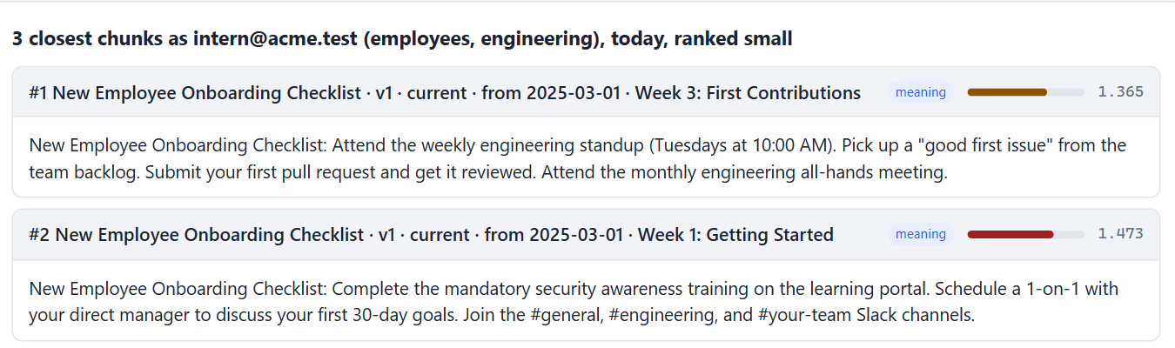
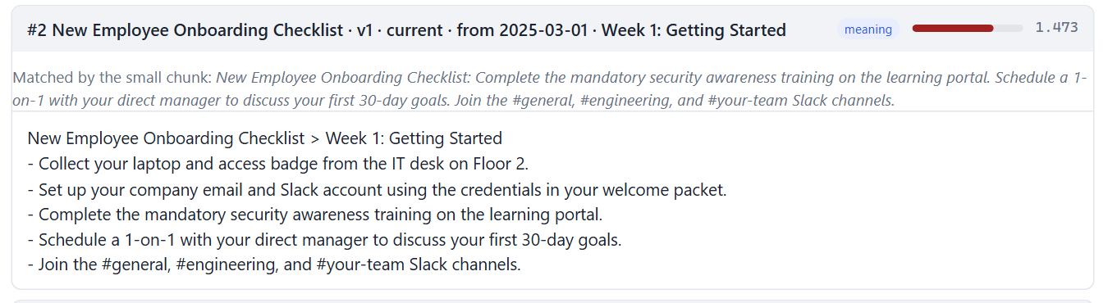
Live: small vs parent on the first-week question
"What do I need to do in my first week?" Search tab, as the intern, top 3. Look at #2.
small
#1 Week 3 (the word "first")
#2 a Week 1 fragment: 3 of 5 items, no laptop, no badge
parent
#2 the whole Week 1 section, all 5 items
and the small chunk that found it
small hands over three of the five Week 1 items; parent hands over all five, and says which sentence found them.
22
Notes:
Time: 4 minutes. LIVE in the Search tab (signed in as the intern, top_k 3): the question, strategy small, Search; then strategy parent, Search. Open result #2 each time.
Left, small: "#1 is Week 3, 'First Contributions': the word 'first'. #2 is a Week 1 small chunk: security training, the 1-on-1, the Slack channels. Three items of five. The laptop and the badge aren't there."
Right, parent: "Same #1, same #2, but #2 is now the whole Week 1 section, five items, and above it: 'Matched by the small chunk: Complete the mandatory security awareness training...'. That's parent-document doing its job: matched small, returned big."
"On the scoreboard: small missed this question, right document, wrong piece. Parent: ready at 2."
Fallback: fallbacks/part3/screens/p1-firstweek-small.png and p2-firstweek-parent.png.

Slide 23

So why does parent win nothing here?
It fixed small on lists (Hit@5 0.25 → 1.00). It found the billing sentence. And it tops no table.
Where parent helps
Why it rarely gets the chance
What it costs
whole-section: small's Hit@5 0.25 → parent's 1.00
the billing sentence in a 905-character PDF page: invisible to dense, #2 for parent
sections average 275 characters
50 of 89 fit in one small chunk: parent returns what dense returns
225 vectors instead of 89, on every sync
~396 tokens a question to the model, vs ~360 for dense (small: ~228)
local MiniLM embeddings, Monday's documents, 12 Nov · tokens = characters / 4, median per question, top 5
The scoreboard's advice: don't ship parent for these documents. On a corpus of long pages, measure again.
23
Notes:
Time: 3 minutes. Clock check: about 1:15. The honest result.
"Remember slide 10: 50 of our 89 sections fit in ONE small chunk. For those, parent finds the small chunk and returns the same section dense would have returned. It can't do better than dense on them, only the same."
"Where a section IS long, parent shines: the handbook page, 905 characters, which dense can't find for the billing question and parent returns second. We have exactly one page like that."
"So the bill: small chunks double the vectors we store, 225 instead of 89, and parent hands the model a bit more text than dense, about 396 tokens a question against 360. For no win on these documents. Don't ship it here."
"On a wiki of long pages, or contracts, the same scoreboard might say the opposite. That's the point: you don't decide by reputation. You measure on your documents."

Slide 24

PART C · ABOUT 10 MINUTES
Correct,
not only faithful
An answer can stick to its context perfectly, and still be wrong.
faithful and wrong · answers.py · sure of itself
SE
Factory
24
Notes:
Time: 30 seconds. Clock check: about 1:16. Read the chat.
Say: "So far we scored the search. Now the answer, because that's what the person reads."

Slide 25
Faithful, and wrong
S20, as the intern: "How many days of unused vacation can I carry over now?"
#1
0.47
Company FAQ · What happens if I don't use all my vacation days?
"Up to 5 days of unused annual leave can be carried over to the next year."
#2
0.81
Leave Policy · Annual Leave (edited Monday)
"Unused leave can be carried over to the next year, up to a maximum of 10 days."
A FAITHFUL ANSWER TO THIS CONTEXT WOULD SAY
"You can carry over up to 5 days."
faithful to its context? yes
correct? no: the policy says 10
Every technique ranks the stale copy first. An answer from it is 100% faithful to its context, and wrong.
25
Notes:
Time: 3 minutes.
"On Monday HR edited the leave policy: carry-over went from 5 to 10 days. The FAQ quotes the old policy, and nobody updated it. Both are current documents."
"Plain search, dense, top 2: the FAQ first, 0.47, 'up to 5 days'. The leave policy second, 0.81, 'up to a maximum of 10 days'. And it isn't just dense: every technique on the scoreboard ranks the FAQ first."
"Give the model that context and it may well say '5 days'. Ask a judge 'is this answer faithful to the context?' and it says yes: 5 days is right there in the context. Faithful, and wrong."
"That's why the answer check compares the answer with facts a person wrote down, not with the context."
Numbers: Search tab, dense, intern, 12 Nov. Part 1's register warned us: the FAQ depends_on the leave policy, which changed in this sync.

Slide 26
answers.py: whose fault is a wrong answer?
Retrieve as the person, write the answer exactly as POST /query does, check it against the facts.
correct
every fact is in the answer; or "I don't know" when nothing answers
retrieval miss
wrong, and the context never held the facts: fix the search
generation miss
wrong, although the context held every fact: fix the prompt or model
made it up
nothing answers it, and it answered anyway
python checkpoints/03-retrieval/answers.py --strategies dense,hybrid,parent # needs a model; cached
Fix retrieval misses in the search, generation misses in the prompt. The two need different fixes.
26
Notes:
Time: 3 minutes. The four verdicts. The numbers from the class run are in part3.md; read them aloud if you have them, don't put them on a slide.
"Correct: every fact is in the answer, or for a question nothing answers, it says it doesn't know."
"Wrong, and the context never held the facts: a retrieval miss. No prompt in the world fixes that: fix the search."
"Wrong, although the context held every fact: a generation miss. That's the model or the prompt: fix those."
"Made it up: a question nothing answers, answered anyway."
"No LLM judge anywhere. String matching against facts a person wrote: cheap, the same every run, no opinions. It needs a model to WRITE the answers, cached in runs/llm_cache.json, so the second run is free."
Command: python checkpoints/03-retrieval/answers.py --strategies dense,hybrid,parent

Slide 27
Sure of itself, about the wrong question
S27, as hr-partner: "How many weeks of parental leave will primary caregivers get in 2027?"
dense #1 · 0.50 · high confidence (≤ 0.8)
Leave Policy > Parental Leave
"Primary caregivers receive 16 weeks of paid parental leave."
every technique
"sure of itself" on S27
about the topic: yes
answers "in 2027": no
THE ONLY DOCUMENT ABOUT 2027
Parental Leave Policy 2027 (draft): 24 weeks
status draft: never indexed, for anyone
local MiniLM embeddings, Monday's documents, 12 Nov · scoreboard.py --details, S27
A distance can tell "about this topic". It can't tell "answers this question". That's the answer step's job.
27
Notes:
Time: 3 minutes. Clock check: about 1:25.
"Only a draft talks about 2027, 24 weeks, and drafts are never indexed. Today's policy says 16 weeks. So the honest answer is: nothing in force covers 2027; today it's 16."
"Dense's best result: the Leave Policy, Parental Leave, 0.50. High confidence: our threshold is 0.8. And every technique on the scoreboard: high confidence, 'sure of itself'. It IS about parental leave. It just doesn't answer 'in 2027'."
"No retrieval number catches this. The answer step has to read the question and say what's missing. answers.py checks it does."
If someone asks about HyDE: "on questions like this, a made-up answer about 2027 lands even closer to the policy. Its calm column on the class run is in the notes."

Slide 28
Three ideas to take home
All three from tonight's scoreboard.
1
2
3
Measure by kind of question
Measure what the model needs
Correct, not only faithful
Dense tops the average; hybrid wins three tables, keyword one. The average hides who wins what.
The words, not the document: small found the document every time and the list once in four. Leaks: 0.
"5 days" from the stale FAQ is faithful and wrong. Tell a retrieval miss from a generation miss.
28
Notes:
Time: 2 minutes. Clock check: about 1:26. One sentence per card, pointing at it.

Slide 29
Tonight
About an hour, offline. 1 to 3 need no key. All in checkpoints/03-retrieval/README.md.
Exercise
What you do
1
Read the scoreboard
scoreboard.py --details: one question where small and parent disagree; explain it from the chunks (Search tab)
2
The price nobody prints
context_tokens() and a tokens column; the test waits in tests/test_scoreboard.py (remove its skip)
3
Move the knob
--save-baseline; CHILD_MAX_CHARS=120, sync, --against-baseline; then 400. What moved, and why?
4
Stretch: your questions
add two questions where you predict the winner, before running anything. Were you right?
5
Stretch, with a key
answers.py --strategies dense,hybrid: retrieval misses vs generation misses. Fix which first?
Each exercise ends in something you can show: an explanation, a column, a before-and-after.
29
Notes:
Time: 2 minutes.
Say: "One, everyone: read the scoreboard and explain one disagreement from the chunks. Two: the price nobody prints, a tokens column, the test is waiting. Three: move the knob, CHILD_MAX_CHARS, and see what moves against a baseline. Four and five are stretch: your own questions, and the answer check if you have a key."
Exercise 2's solution: instructor-notes/fallbacks/part3/solutions/context_tokens.py (don't share it tonight).

Slide 30

MONDAY · PART 4 OF 4
Ship it,
behind a gate
Guardrails, and evals as a release gate. Tonight's scoreboard is one of them.
scoreboard.py --save-baseline freezes tonight's numbers. Monday's release.py compares every change against them: a technique that loses a table, or leaks once, doesn't ship.
Mon 16 Nov
SE
Factory
30
Notes:
Time: 1 minute. Clock check: about 1:30.
Say: "Tonight we built the measuring stick. Monday it becomes a gate: a change that makes the scoreboard worse, or leaks once, doesn't ship. Plus guardrails on what comes in and goes out, a kill switch, and Docker."
"Pull the repo Monday morning." Read the chat one last time and answer what's there before you end the call.

Slide 31

REFERENCE
For after class
Not presented. Read these with the code open.
The metrics · the winner rule · the store · the sync's fix · commands · the regression drill · the class machine
SE
Factory
31
Notes:
Not presented. If someone asks a detail question in the chat, jump here.

Slide 32
Reference: the metrics, exactly
app/evals/scoreboard.py. No model is needed to score.
Term
Definition
need
one document (or a list of documents, each good enough) + evidence words the answer can't do without
meets
a chunk from that document holding every evidence word: lower case, letters, digits, $ and % only, whole words
ready
the position in the top 5 at which the results so far meet EVERY need (two-document questions have two)
Hit@1 / Hit@5
ready at 1 / ready within 5
MRR
mean of 1 / ready (0 when never ready)
doc@5
every needed document appears in the top 5, words or not (Part 2's Hit@5)
calm
no needs (nothing answers it), and the best distance is above CONFIDENCE_HIGH_THRESHOLD (0.8)
LLM, ms
model calls before the search; wall time, plus the original time of any cached model call
leaks
questions where any result's document is not readable by the asker (app/evals/judge.py)
32
Notes:
The banner of app/evals/scoreboard.py, as a table.

Slide 33
Reference: the winner rule, and the starred rows
scoreboard.py prints a winner per kind of question. This is all it does.
app/evals/scoreboard.py
Order: Hit@1 (or calm), then MRR, then fewer LLM calls, then faster, then the name.
Starred: a technique whose trace says its reranker or model was unavailable fell back to plain search. Its row is printed with a *, and it can't win: those are another technique's numbers.
Ties: on equal quality and cost, speed decides; a 2 ms difference can flip the unanswerable winner between runs. Read it as a tie.
def winner(table):
def key(item):
name, s = item
quality = ((s["calm"] or 0, 0) if s["hit@1"] is None
else (s["hit@1"] or 0, s["mrr"] or 0))
return (-quality[0], -quality[1],
s["llm"] or 0, s["ms"] or 0, name)
clean = [(n, s) for n, s in table.items()
if s["leaks"] == 0] # a leak disqualifies
return min(clean, key=key)[0] if clean else None
33
Notes:
app/evals/scoreboard.py winner(); scoreboard.py print_scenario().

Slide 34
Reference: the store, and parent in the retriever
app/rag/store_pg.py and app/rag/retriever.py. Every query says which cut it reads.
store_pg.py
retriever.py
LEVELS = {"sections": sql.SQL("c.parent_id IS NULL"),
"small": sql.SQL("c.parent_id IS NOT NULL")}
def by_ids(ids, access, collection=None):
# sections by id, in the order asked,
# with the SAME filter as search():
# c.id = ANY(ids) AND c.parent_id IS NULL
# AND status / as_of
# AND EXISTS (document_acl ⨝ your groups)
...
return [found[i] for i in ids if i in found]
def _parent(embedding, top_k, depth, access, steps):
best = {}
for small in search(embedding, top_k=depth,
access=access, level="small"):
best.setdefault(small["parent_id"], small)
sections = by_ids(list(best)[:top_k], access)
return [{**s,
"distance": best[s["id"]]["distance"],
"matched": best[s["id"]]["text"]}
for s in sections]
34
Notes:
LEVELS is spliced into search(); keyword_search() and records() read sections only. by_ids() is the second query parent makes.

Slide 35
Reference: a new cut reaches every document
A bug fixed on the way: before Part 3, same bytes meant "unchanged", even after the chunking changed.
app/ingest/sync.py
Before
After
def pipeline_id() -> str:
return (f"{PIPELINE_VERSION}|{PARSER_VERSION}|"
f"{SECTION_MAX_CHARS}|{CHILD_MAX_CHARS}")
# every chunk's metadata now carries "pipeline": pipeline_id()
# the eTag shortcut: same bytes AND cut the same way
if (old and old.get("etag") == item.etag
and old.get("pipeline") == pipeline_id()):
... # unchanged or relabel: not even downloaded
same eTag → "unchanged"
same eTag + same pipeline → "unchanged"
new cut reached only edited files
new cut reaches all 18
the worker's gate opened, the sync did nothing
the gate opens, the sync re-cuts
Change PIPELINE_VERSION or CHILD_MAX_CHARS, and the next sync re-cuts and re-embeds everything, once.
35
Notes:
app/ingest/sync.py. Coming from Part 2's database, the first 03 sync plans "change 18" because of this. Going back to Part 2 needs 02's sync.py --rebuild --apply: Part 2's sync still trusts the eTag alone.

Slide 36
Reference: the commands
From the repository root. Postgres runs in Docker on port 5433.
TONIGHT
docker compose up -d db
python checkpoints/03-retrieval/db.py migrate # adds 006_small_chunks
python checkpoints/03-retrieval/db.py seed # skip if Part 2's accounts exist
python checkpoints/03-retrieval/fake_drive.py reset # Friday's files (offline)
python checkpoints/03-retrieval/fake_drive.py apply all # Monday: all five events
python checkpoints/03-retrieval/sync.py --apply # 89 sections + 136 small chunks
python checkpoints/03-retrieval/scoreboard.py # no model needed
python run_checkpoint.py 03-retrieval # Search tab: small / parent
python checkpoints/03-retrieval/scoreboard.py --details --llm
python checkpoints/03-retrieval/answers.py --strategies dense,hybrid,parent # needs a model
pytest checkpoints/03-retrieval/tests -q # 157 pass, 2 skipped
36
Notes:
The same commands as checkpoints/03-retrieval/README.md, "Run it".

Slide 37
Reference: the regression drill
Freeze the numbers, move one knob, ask what moved, question by question.
THE DRILL
What it prints, per technique
<id>: miss -> HIT@1 explain this one
<id>: HIT@1 -> miss explain this one
<id>: calm -> SURE explain this one
<id>: new flags [...]
or "unchanged". The line formats from scoreboard.py; which ids move depends on the knob.
python scoreboard.py --save-baseline
# .env: CHILD_MAX_CHARS=120
python sync.py --apply # change 18: why?
python scoreboard.py --against-baseline
# .env: CHILD_MAX_CHARS=400, sync again, compare
# and back to 220 before Monday
Every line --against-baseline prints ends in "explain this one". That's the habit Monday's gate automates.
37
Notes:
Tonight's exercise 3. On Windows PowerShell set the knob in .env (CHILD_MAX_CHARS=120), not inline.

Slide 38
Reference: what the starred rows need
Tonight's laptop numbers had no cross-encoder and no model. Here is what each starred row needs.
Starred row
Needs
On a laptop without it
rerank, hybrid_rerank
the cross-encoder (~90 MB from Hugging Face, warmup.py)
first-stage order, starred
routed
the cross-encoder, for its pointwise path
lists still route; the rest starred
hyde, multi_query
a model: LLM_PROVIDER and its key (scoreboard.py --llm)
plain dense, starred
answers.py
a model to write the answers (cached after the first run)
stops with "No model"
every other row
nothing: local MiniLM, Postgres in Docker
the numbers on these slides
Run 03 with EMBEDDING_PROVIDER=local in class, so the live numbers equal these slides and your laptop.
38
Notes:
On 12 Nov the build laptop couldn't download the cross-encoder (a corporate network blocks Hugging Face) and had no model key, so rerank, hybrid_rerank, routed, hyde, multi_query and answers.py were starred or skipped. The class machine adds the reranker and Azure gpt-4.1-mini; those numbers are in part3.md, not on any slide.
Recommended live setup: EMBEDDING_PROVIDER=local (the scoreboard numbers on slides 20 to 23 are local MiniLM), LLM_PROVIDER=azure for the starred rows and answers.py.

