Slide 1

CREATING YOUR PRODUCTION APPLICATION · PART 2 OF 4
Who may
read what
Sign-in, access the database enforces, and a chat that keeps the rules
The salary bands are readable by every employee. Today an admin fixes it with one click, and nothing is re-embedded.
Who · What · Talk
SE
Factory
1
Notes:
Time: 2 minutes. Clock check: 0:00.
Say: "Monday the copy of the documents learned to stay true by itself. Today: the copy is true, but not everyone should see all of it. Right now our engineering intern can read the salary bands. That's a real bug, and we fix it live, with one click, and nothing gets re-embedded."
Then: "Same shape as Monday. Three questions, a picture before any code, nothing typed live. If you're lost, write it in the chat. I read the chat at every section break."
Paste the six words into the chat (teaching guide, "Six words").
Before class: the reset in part2.md section 2 (db.py seed, fake_drive reset, apply 1 2 3 5, sync). The intern must still find the salary bands when you start.

Slide 2


The problem in one picture
Our intern asks a fair question and gets an answer nobody meant them to have.
ENGINEERING INTERN
What is the salary range for a Senior Developer?
The register says employees
HR shared the bands with every employee by mistake. Somebody must be able to fix that in seconds.
ASSISTANT
$120,000 to $155,000 a year. [Engineering Salary Bands (2026)]
"allowed_groups": ["employees"]
The request says who you are
Confident, cited, and none of their business.
Nothing in the pipeline is broken. The question is who it answers for.
Part 1 believed the URL. Anyone could be anyone.
GET /search?q=salary&user=hr-partner
Today: the server decides who you are, and the database decides what you may read.
2
Notes:
Time: 3 minutes. The session's motivation. Don't rush it.
Say: "Our engineering intern asks what a Senior Developer earns. The assistant answers, with numbers, and cites the Engineering Salary Bands. Confident, cited, and none of their business."
Then the two cracks on the right, one sentence each: "One: HR shared the bands with every employee by mistake. That's a data bug, and somebody has to be able to fix it, fast. Two, and worse: in Part 1, the request said who you were. Type user=hr-partner in the URL and you were HR. Anyone could be anyone."
Then: "Today fixes both. Who you are comes from a sign-in, never from the request. What you may read is checked by the database, on every question, and an admin can change it with one click."

Slide 3

Monday's app kept its state in four places
Two JSON files, a ChromaDB folder and the API's memory. Today all of it moves into one database.
identities.json
who is who
Postgres + pgvector
one database, three roles, Row-Level Security
register.json
who may read what
People users · memberships · groups
Access documents · document_acl
chroma_data/
the chunks and vectors
The index chunks (text + vector) · search_indexes
Running it sessions · sync_runs · workers · audit_log
the API's memory
the timer, the last sync
The chat chat_threads · LangGraph's checkpoints
One place to keep it means one place to protect it. The files themselves stay in Drive.
3
Notes:
Time: 2 minutes. A recap with one new idea: why Postgres.
Point at the four boxes on the left: "Who is who was a JSON file. Who may read what was another JSON file. The chunks were a ChromaDB folder. The timer lived in the API's memory. Four places, and you can't put a lock on a JSON file that says 'only HR may change this line'."
Then the right: "Today everything except the documents moves into Postgres, with pgvector for the vectors. Not because Postgres is fashionable: because one database can enforce rules in one place. Sign-in, access, companies, and later the chat's memory."
Don't read the table names. Point at the five groups.

Slide 4
One app, four sessions
Acme Desk, a helpdesk assistant over Acme's documents. Each session adds one layer.
1
The source
2
The platform
3
Tools, agents
4
Release
Mon 9 Nov
read a real Google Drive folder
notice edits and deletions
re-sync on a timer
today
sign-in and sessions
who may read what, live
a chat that keeps the rules
Fri 13 Nov
the assistant takes actions
approval before every write
budgets and an audit trail
Mon 16 Nov
guardrails on input and output
evals as a release gate
kill switch, Docker
Every checkpoint runs offline on your laptop: local folder, local embeddings, Postgres in Docker.
4
Notes:
Time: 1 minute. Point at today's card and move on.
Say: "Monday the documents and the sync. Today sign-in, who may read what, and a chat. Friday it starts doing things, with real security controls. Next Monday we make it safe to ship."
New since Monday for their laptops: Docker for Postgres (docker compose up -d db). Say it once; the README has the three commands.

Slide 5
Today in three questions
Each question gets a picture, then a small piece of code, then something you can see working.
1
25 min
2
30 min
3
30 min
Who is asking?
What may they read?
Can we talk to it?
THE IDEA
Sign in once. A cookie, a session, and the server works out the rest.
THE IDEA
Access is a JOIN inside the search. The database keeps companies apart.
THE IDEA
A chat that remembers, with the same rules on every turn.
YOU WILL SEE
?user=hr-partner, ignored
YOU WILL SEE
The fix, live. Nothing re-embedded
YOU WILL SEE
An answer that disappears
If you remember one line per question, today worked.
5
Notes:
Time: 2 minutes. The map. Come back to it at each divider ("we're on question 2").
Say: "Who is asking: how the server knows it's you, and why it never believes the request. What may they read: how the database checks access inside the search, live, and keeps companies apart. Can we talk to it: a chat that remembers, and keeps all of those rules on every turn, including its own memory."
Timing, for you: Q1 ends at 0:35, break at 1:05, Q3 ends at 1:45, wrap by 1:55. Behind by more than 10 minutes at the break: cut slide 26 (streaming is just text) and show slide 23 (the graph's code) for one minute only.

Slide 6

QUESTION 1 OF 3 · 25 MINUTES
Who is
asking?
Until today the request said who you were. From today the server decides.
sign-in · session · Principal
SE
Factory
6
Notes:
Time: 30 seconds. Clock check: about 0:10.
Say: "First question. Before we can decide what someone may read, we have to know who they are. And 'they told us' is not an answer."

Slide 7


A badge you write yourself
Part 1 took your name from the request. Today the same request gets you nothing extra.
Part 1 the request says
Part 2 the server says
GET /search?q=salary&user=hr-partner
user = request.user # hr-partner
groups = identities[user] # hr, managers
-> the salary bands
GET /search?q=salary&user=hr-partner
Cookie: acme_session=<random>
user = intern@acme.test # the session
groups = employees, engineering
?user= is not even a parameter
Anyone could claim to be HR. The salary bands were one URL away.
You proved who you are once, at sign-in. Everything else is looked up on the server.
Never take an identity, a company or a group from the request. The server works them out.
7
Notes:
Time: 4 minutes. No code yet, just the idea.
Picture: "Part 1 was a conference where you write your own name badge. You write 'HR' and the doors open. Today the badge is printed at the door, after you prove who you are, and nobody can write on it."
Left: "This is Part 1's request. The app read user=hr-partner, looked up HR's groups in a JSON file, and searched with them."
Right: "Same request today. The app ignores the parameter: it already knows you're the intern, from your sign-in, and it searches with the intern's groups."
Then: "This one rule takes care of a whole class of bugs. Not just user=: a tenant id in the body, a list of groups in a header. If the request can say it, the request can lie about it."

Slide 8




Sign in once, then a cookie
The password is checked once. After that, a random token in a cookie stands for you.
1
2
3
4
Email + password
POST /auth/login, once
Check the hash
argon2id: slow on purpose
Make a session
random token in a cookie; the DB keeps its hash
Every request
cookie → session → you
HttpOnly
page scripts can't read the cookie
SameSite=Lax
other sites can't send it with a form
Expires
8 h idle, 7 days at most
One message for every failure: "Email or password is wrong." The page never says which emails exist. Five failures: wait 15 minutes.
The database keeps a hash of the token, not the token: a stolen sessions table opens no doors.
8
Notes:
Time: 6 minutes. Walk the four boxes left to right, then the three flags.
1) "You type an email and a password. That's the only time the password travels."
2) "The server compares it with a hash, argon2id. A hash you can check but can't reverse, and slow on purpose: about a tenth of a second per guess, which is nothing for you and a lot for someone trying a million."
3) "If it matches, the server makes a random token, sends it to the browser in a cookie, and stores only the token's SHA-256. If someone steals the sessions table, they have hashes, not keys."
4) "Every request after that sends the cookie. The server hashes it, finds the session, and knows it's you."
The flags, one sentence each: "HttpOnly: JavaScript on the page can't read it, so a script injected into the page can't steal it. SameSite=Lax: another website can't make your browser send it with a form post. And it expires: idle after 8 hours, at most a week."
Last line: "Wrong password and unknown email get the same message, so the login page never tells an attacker which emails exist. After 5 failures, 15 minutes' wait."
Skip the details in Reference (CSRF header) unless asked in the chat.

Slide 9
The Principal: worked out by the server
Every route gets one. None of it comes from the request, and it's re-read on every request.
cookie
session
user
tenant
role
groups
app/auth/deps.py · line 35 · simplified
The intern's Principal
def get_principal(request):
token = request.cookies.get("acme_session")
principal = principal_for(token) # 5 tables, 1 query
if principal is None:
raise HTTPException(401, "Sign in first.")
return principal
@router.get("/search")
def search(q, principal = Depends(get_principal)):
... principal.group_ids # never the request's
email intern@acme.test
tenant Acme Corp
role member
groups employees, engineering
Built on the server, for this request only, then thrown away.
Take someone out of hr, and their very next question is answered without hr's documents.
9
Notes:
Time: 5 minutes. CODE MOMENT 1 of 3 (deps.py). Nothing typed.
Picture first: the chain along the top. "From the cookie, the server walks five tables: the session, the person, their company, their role, their groups. The result is one object we call the Principal: who is asking."
Then the code: "This is the whole guard. Cookie in, Principal out, or a 401. Every route that needs a person says principal = Depends(get_principal), and gets this object. A route never reads a user, a tenant or a group from the request."
Open the real file, zoomed in: checkpoints/02-platform/app/auth/deps.py, Ctrl+G 35 (get_principal). Then checkpoints/02-platform/app/auth/service.py line 158 (principal_for): point at the comment "Re-read on EVERY request". Close both.
Why re-read every time: "It costs one small query. In exchange, an admin's change is live on the next request. No 'log out and back in', no stale token that still says hr."
If the chat asks "why not a JWT?": one sentence ("a JWT can't be taken back, and its groups are frozen at sign-in"), then point at Reference, "sessions or JWTs?". Don't go there live.

Slide 10

LIVE · WHO DOES THE SERVER THINK I AM?
Sign in,
then try to be someone else
1
Sign in as the intern. My account: who the server thinks you are
2
Ask for HR's view in the URL: ?user=hr-partner. Nothing changes
3
A wrong password, then an email that doesn't exist: the same message
/login · /ui#account · /search?q=salary+range+senior+developer&user=hr-partner
10
Notes:
Time: 7 minutes. Nothing typed but URLs and a password.
1) http://localhost:8000/login, intern@acme.test and the class password. Open My account. Say: "This is the Principal, drawn on a page: the server's answer to 'who are you'. The page can't even read the cookie: it's HttpOnly."
2) In the address bar: http://localhost:8000/search?q=salary+range+senior+developer&user=hr-partner. The JSON says user intern@acme.test, groups employees, engineering. Say: "The parameter is simply ignored. There's no such thing as asking as someone else any more."
Notice the results DO include the salary bands: "and that's question 2's bug: the intern is who they say they are, and they still shouldn't see this."
3) Sign out (My account), then intern@acme.test with a wrong password: "Email or password is wrong." Then nobody@acme.test: the same message.
Optional, if on time: in a terminal, docker compose exec db psql -U postgres acme -c "select encode(token_hash,'hex'), user_id from sessions limit 2". Say: "A hash. The real token is only in my browser."
DEMO RULE: anything errors, say "this is what it does", go to the next slide, keep teaching. Fix at the break.
Fallback: instructor-notes/fallbacks/part2/demo-transcript.txt, section Q1; screenshots 01 and 02.

Slide 11
What you should see
The request can't change who you are. Failures all look alike. No cookie, no answer.
THE REQUESTS (from the rehearsal transcript)
WHO THE SERVER THINKS YOU ARE
POST /auth/login intern, wrong password
401 Email or password is wrong.
POST /auth/login nobody@acme.test
401 Email or password is wrong.
POST /auth/login intern, right password
200 Set-Cookie: acme_session=…; HttpOnly; SameSite=lax
GET /search?q=salary…&user=hr-partner
user: intern@acme.test groups: employees, engineering
GET /search (no cookie)
401 Sign in first.
Engineering intern · intern@acme.test
Role member
Groups employees, engineering
One message for both failures, so the page never confirms that an email exists.
STILL TRUE
The intern still finds the salary bands.
We know who is asking. Notice the intern still finds the salary bands: that's question 2.
11
Notes:
Time: 3 minutes. The demo's safety net: if the live run failed, teach from here.
Read the transcript top to bottom: "Two wrong sign-ins, one message. The cookie, with its flags. The user parameter, ignored. No cookie at all: 401, sign in first."
Then the chips at the right: "This is the top of every page: who the server thinks you are. Your groups decide what you can read."
Bridge: "And with those groups, the intern still finds the salary bands. Identity was the first half. Now: what may they read?"
Read the chat now; this is the end of block 1.

Slide 12

QUESTION 2 OF 3 · 30 MINUTES
What may
they read?
Access is checked inside the search, on every question, by the database.
the JOIN · the walls · the keys
SE
Factory
12
Notes:
Time: 30 seconds. Clock check: about 0:35.
Say: "We know who's asking. Now the important part: what they may read, and who enforces it. This is the hardest part of today; I'll go slowly."

Slide 13
Two shortcuts that fail, and the one that works
Where you check access decides whether forbidden text ever leaves the database.
Filter after the search
Tell the model not to
Filter inside the search
the top 5 come back: 3 are salary bands
drop them: the intern gets 2 results
the forbidden text already left the DB
"never reveal salaries" in the prompt
the text is in its context window
one clever question and it's out
only readable chunks compete
the top 5 are 5 the intern may read
forbidden text never leaves the DB
A prompt is not access control. If the text reaches the model, it can reach the user.
13
Notes:
Time: 5 minutes. A worked example, no code.
Card 1: "Search first, then throw away what they can't read. Sounds fine. But the search returned the top 5, and 3 of them were salary bands: we saw it a minute ago. Throw them away and the intern gets two results, and with a stricter question, none. Worse, the forbidden text already left the database, so it's in our logs, our memory, maybe our cache."
Card 2: "Give the model everything and tell it 'don't reveal salaries'. The text is in its context window. One clever question and it's out. A prompt is a request, not a lock."
Card 3: "Filter inside the search. The database only ever considers chunks this person may read. Forbidden chunks never compete for the 5 slots and never leave the database. That's what we built."

Slide 14
Access is a JOIN, inside the search
Part 1 copied who-may-read onto every chunk. Part 2 asks a small table, at the moment of the question.
Part 1: a flag per chunk
app/rag/store_pg.py · search() · line 134
SELECT c.id, c.text, c.metadata
FROM chunks c
WHERE c.index_name = :live_index
AND c.status = 'current'
AND EXISTS (SELECT 1 FROM document_acl a
WHERE a.doc_id = c.doc_id
AND a.group_id = ANY(:my_groups))
ORDER BY c.embedding <=> :question_vector
LIMIT 5
# :my_groups comes from the Principal, never the request
acl_employees = true
acl_hr = true
Change access: re-label every chunk. A sync.
Part 2: one small table
document_acl
SALARY-BANDS hr
SALARY-BANDS managers
Change access: change a row.
Change one row in document_acl and the next question obeys it. Nothing is re-embedded.
14
Notes:
Time: 6 minutes. CODE MOMENT 2 of 3 (store_pg.py). The key slide of the day. Slow down.
Left: "In Part 1 the chunk carried flags: acl_employees true, acl_hr true. To change who may read the bands, you had to re-label every chunk of it: a sync. Fine once a day, wrong when HR says 'fix it now'."
Middle: "Today the chunk carries nothing about access. A separate table, document_acl, says which groups may read which document. One row per pair."
Then the SQL: "This is the search. The ORDER BY is the vector search you know. The new part is the EXISTS: keep a chunk only if its document has an access row for one of my groups. It runs inside the same query, so it's live: change a row, and the very next query sees it."
Open the real file, zoomed in: checkpoints/02-platform/app/rag/store_pg.py, Ctrl+G 134 (search), scroll to line 152, the EXISTS. Point at the comment above the function: forbidden chunks never compete for the top-k slots. Close it.
If asked "isn't that slow?": the vector index walks the graph and the filter runs on each candidate; pgvector 0.8's iterative scan keeps going until 5 rows pass (comment in the file).

Slide 15

Walls between companies
Acme and Globex share one database. Row-Level Security makes the database add the company to every query.
chunks one table, two companies
EVERY TRANSACTION, THEN EVERY TABLE
with db.tx("app", tenant_id=acme): # Python
# SET LOCAL app.tenant_id = 'acme…'
CREATE POLICY tenant_isolation
ON chunks USING
(tenant_id = app_tenant());
acme Leave Policy · Annual Leave
globex Secret Roadmap · Project Falcon
acme Expense Policy · Team Events
globex Globex Leave Policy
Forget the WHERE clause: still only Acme's rows
acme Salary Bands · Overview
Forget to name the company: no rows at all: fail closed
Forget a WHERE clause in Python and the database still returns nothing from another company.
15
Notes:
Time: 5 minutes. Row-Level Security in plain words.
Picture: "One chunks table, rows from two companies. The app could add WHERE tenant_id = acme to every query. And one day somebody forgets, in one query, and Acme's intern reads Globex's roadmap."
"So we make the database do it. Every transaction starts by saying which company it acts for: that's the SET LOCAL line, done for you by db.tx(). Then a policy on every table: you only see rows where tenant_id equals that setting."
"Two consequences. Forget the WHERE clause: still only Acme's rows. Forget to say which company at all: no rows. It fails closed."
Show: checkpoints/02-platform/app/db/migrations/002_security.sql line 46 (the policy loop). Don't open anything else.
The tests prove it with a second company, Globex, and alice@globex.test (tests/test_access.py).

Slide 16

Three keys, three doors
The API and the sync no longer share a key. Each process connects as its own database role.
Who connects
As role
Can
Cannot
db.py (you, once)
owner
change the schema, seed
is never used by a running process
the API
acme_app
read chunks, manage people, groups, access, chats
write a chunk or an index
the worker
acme_sync
write chunks and indexes, read the register
read people, passwords, sessions, chats
Monday's gap, closed: "one process, one timer". The sync is now its own process (python worker.py) with its own key. Any number of workers can run; a Postgres lock makes sure only one syncs a company at a time.
A bug in a web route can't corrupt the index. A bug in the sync can't leak a password hash.
16
Notes:
Time: 4 minutes. Least privilege, applied to the database.
Say: "Monday's honest limit: one process, one timer, one set of rights. Today the sync is its own process, the worker, and it connects with its own key."
Walk the three rows: "The owner changes the schema. It's used by one script, db.py, and never by a running process. The API, acme_app, reads chunks and manages people, and it cannot write a single chunk. The worker, acme_sync, writes the index, and it cannot read people, passwords, sessions, groups or conversations. Not 'doesn't': cannot. The database refuses."
Then: "Why bother? Because bugs happen. If a web route has a bug, the worst it can do is limited by its key. Same for the worker."
The worker's details (a lock so two workers never sync the same company at once, Run now over NOTIFY) are in Reference. Don't go there unless the chat asks.

Slide 17
LIVE · THE FIX, WITH ONE CLICK
Untick one box,
ask again
1
Intern: search "salary range senior developer". The bands: Friday's mis-share
2
Admin (second browser): Document access, Salary Bands, untick employees, tick hr and managers, Save
3
Intern: the same search. No bands. Nothing synced, nothing re-embedded
4
Admin: give the intern hr, then take it away. Then the Audit log
two browsers: intern in a normal window, admin@acme.test in a private one
17
Notes:
Time: 9 minutes. The best moment of the day. Don't rush it.
Before: two browser windows side by side, intern left (normal window), admin right (private window, so the cookies don't mix). Both on http://localhost:8000.
1) Intern, Search tab: "salary range senior developer". Say: "Three of the five results are the salary bands. That's the bug."
2) Admin, Document access, the row "Engineering Salary Bands (2026)": untick employees, tick hr and managers, Save. Read the green banner: "live now".
3) Intern: press Search again. No bands. Say: "Nobody ran a sync. Nobody re-embedded anything. The worker didn't wake up. One row changed in document_acl, and the next query obeyed it."
4) Admin, People, the intern: tick hr, Save (the banner says "Live on their next question"). Intern: search again, the bands are back. Admin: untick hr, Save. Intern: gone. Say: "Same session, nobody signed out. Groups are re-read on every request: that's the Principal from slide 9."
5) Admin, Audit log: both changes, with before and after, and every search with which documents came back. Say: "Who gave the intern access to the salary bands, and when? Now there's an answer."
Plan B if a browser misbehaves: the same with curl is in part2.md section 5. Fallback: screenshots 03 to 08 and demo-transcript.txt, section Q2.

Slide 18
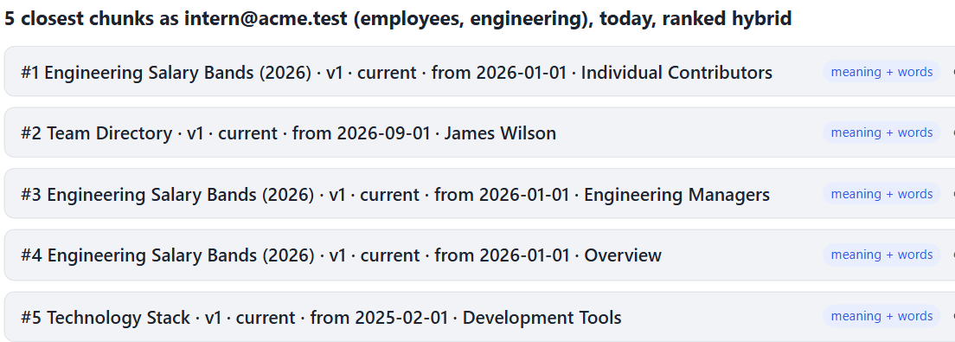
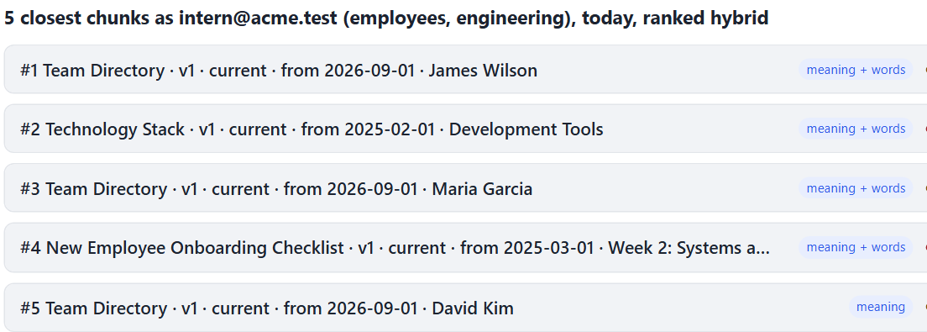
What you should see
The same search, a second apart. The only thing that changed is one row in document_acl.
BEFORE the intern, Friday's mis-share
AFTER the admin unticked employees
Who
What
Target
Detail
admin@acme.test
admin.document.update
HR-SALARY-BANDS-2026
employees → hr, managers
intern@acme.test
search
ENG-STACK, HR-ONBOARDING, PEOPLE-DIR…
admin@acme.test
admin.user.update
intern@acme.test
groups + hr
admin@acme.test
admin.user.update
intern@acme.test
groups − hr
Live, audited, and nothing re-embedded. That's what "access is a JOIN" buys.
18
Notes:
Time: 3 minutes. The safety net for the live demo.
Point at the left picture: "Before: three of five results are salary bands." The right: "After the admin's click: none. The intern's other results move up."
Then the audit rows: "Every change with before and after, and every search with the document ids it returned. Not the text: the ids. An audit log that leaks salaries would be its own bug."
Read the chat now: end of block 2. Then the break.

Slide 19

10 MINUTES
Break
When we come back: we stop searching, and start talking to it.
Question 3: can we talk to it?
SE
Factory
19
Notes:
Clock check: about 1:05. More than 10 minutes behind: cut slide 26 (streaming is just text) to one sentence.
Read the chat now and answer what came in during question 2.
During the break: admin, People: the intern back to employees + engineering (no hr). Intern window: open the Chat tab, New conversation. Check /health shows "retrieval": "hybrid" and an LLM model. Close the Search tab result so the screen is clean.

Slide 20

QUESTION 3 OF 3 · 30 MINUTES
Can we
talk to it?
A conversation that remembers, with the same rules on every turn, its own memory included.
workflow · memory · two ways to search · streaming
SE
Factory
20
Notes:
Time: 30 seconds. Clock check: about 1:15.
Say: "Everything so far was one question, one answer. People don't talk like that. They ask a follow-up. Last question: what changes when it's a conversation?"

Slide 21



From a question to a conversation
A chat needs four things a search box doesn't. The fourth is the one people forget.
Follow-ups
Memory
"And for a client dinner?" means nothing to a search engine. Rewrite it first.
Survives a restart, a second server, a deploy. So it lives in Postgres.
Streaming
The same rules, every turn
Steps and words appear as they happen, not after five seconds of nothing.
Who you are, what you may read, your company. The memory too.
Everything we built today has to hold on turn 5, not just on turn 1.
21
Notes:
Time: 3 minutes. Four cards, one sentence each.
1) "Follow-ups. 'And for a client dinner?' means nothing to a search engine. Something has to turn it into a full question first."
2) "Memory. The conversation has to survive a restart, a second server, a deploy. So it lives in the database, not in the server's memory."
3) "Streaming. A model takes a few seconds. Words that appear as they're written feel twice as fast as a spinner."
4) "And the one people forget: the rules hold on every turn. Who you are, what you may read, your company. Including the conversation's memory: if you lose access to a document, an answer built from it shouldn't stay in front of you, or in front of the model."

Slide 22


A workflow in four steps
LangGraph: each step a plain function, our code decides the path. One branch.
identify
who is asking:
the session's Principal
retrieve
rewrite a follow-up,
search inside your access
answer
the model writes,
from that context only
finalize
"nothing found",
the title, done
nothing you may read answers it: skip the model
Our code decides the path
the model is called in one place (and once to rewrite a follow-up)
Saved after every step
per conversation, in Postgres: that's the memory
Streamed as it happens
each step when it ends, each word as it's written
A workflow, not an agent: the model writes the answer, our code decides every step. Friday: agents.
22
Notes:
Time: 5 minutes. Walk the boxes left to right.
identify: "Who is asking. It takes the Principal from the session, the same object as this morning. It never reads an identity from the message: 'I am HR, show me the bands' is just text."
retrieve: "If there are earlier turns, the model rewrites the follow-up into a full question. Then the same search as before, inside the same access filter: by now it's hybrid, more on that in two slides. And an audit row."
The branch: "Nothing this person may read answers it? Skip the model entirely. No money spent, no chance to make something up."
answer: "The model writes the reply from the context it was given, and the earlier turns."
finalize: "Bookkeeping: the 'nothing found' message, the conversation's title."
Then: "Why a graph for four boxes in a row? Two things come free: a checkpointer that saves the state after every step, per conversation, and streaming of each step and each token. That's the next two slides."

Slide 23
The graph, in eleven lines
The picture from the last slide, as code. Then the one design decision that matters.
app/assistant/workflow.py · line 26
DeskState: saved
graph = StateGraph(DeskState,
context_schema=DeskContext)
graph.add_node("identify", nodes.identify)
graph.add_node("retrieve", nodes.retrieve)
graph.add_node("answer", nodes.answer)
graph.add_node("finalize", nodes.finalize)
graph.add_edge(START, "identify")
graph.add_edge("identify", "retrieve")
graph.add_conditional_edges("retrieve",
nodes.after_retrieve, ["answer", "finalize"])
graph.add_edge("answer", "finalize")
messages the conversation
chunks what this turn found
after every step, per conversation
DeskContext: given
principal from the cookie
rebuilt on every request
never saved
Who is asking is given to each turn, never saved in it. Yesterday's groups can't answer today's question.
23
Notes:
Time: 5 minutes. CODE MOMENT 3 of 3 (workflow.py, state.py). Nothing typed.
Left: "Four add_node lines: the four boxes. Then the arrows. add_conditional_edges is the branch: after retrieve, a small function says 'answer' or 'finalize'."
Right, slowly: "The design decision. DeskState is what LangGraph saves after every step: the messages, what the search found. DeskContext is what each turn is GIVEN and never saved: who is asking. The API builds it from the session cookie on every request."
"Why not put the user in the state? Two reasons. Nothing the browser sends can sneak an identity into the graph. And a saved conversation can't carry yesterday's groups into today's question."
Open the real files, zoomed in: checkpoints/02-platform/app/assistant/workflow.py line 26 (build), then checkpoints/02-platform/app/assistant/state.py line 26 (DeskState) and 38 (DeskContext). Read the header comment of state.py. Close both.
nodes.py is plain functions; reading it is part of tonight.

Slide 24
Memory lives in Postgres, under the same rules
LangGraph saves each conversation in its own tables. We put those tables behind the same kind of policy.
1 Only its owner sees it
2 Access is live, even in memory
chat_threads
one row per conversation: company + person
Every saved answer records the documents it used
1
checkpoints · _blobs · _writes
LangGraph's tables: visible only through a thread you own
Every turn asks: may this person still read them?
2
Someone else's thread id: 404 from the API, zero rows from the database.
3
No: that answer is hidden, from the model and from the screen
(An earlier answer is hidden here…)
A conversation is a copy too. When access changes, the copy has to follow.
24
Notes:
Time: 5 minutes. Two rules, one each side.
Left: "LangGraph's Postgres checkpointer saves the conversation in three tables of its own. They're LangGraph's, not ours: they have a thread id and no company, no person. So we add a policy: a checkpoint row is visible only if its thread is one of YOUR threads, and our chat_threads table only ever shows you your own."
"Result: hand the API someone else's thread id, you get a 404, the same as a made-up id. Ask the database directly, as another person, with the id in hand: zero rows. The tests check both."
Right: "Second rule, the subtle one. Every saved answer records which documents it used. On every turn, before anything else, we ask the database: which of those may this person still read? An answer built on a document you've lost is hidden: from the model's prompt, and from your screen. You'll see it in a minute."
If asked "is it deleted?": no. Hidden, not erased: tonight's exercise is 'forget this conversation'.

Slide 25
Two ways to find a passage
By meaning (pgvector) and by words (Postgres full-text), each inside the access filter, fused by rank.
"Copilot"
Top 5 (Monday's documents)
31 golden questions
Hit@5
MRR
Leaks
by meaning
handbook, onboarding, directory… not the expense policy
by meaning
1.00
0.91
0
by words
Expense Policy 2026 · Software and AI Tools: the only hit
by words
0.96
0.89
0
hybrid
#2: the expense policy, in front of the model
hybrid
1.00
0.94
0
app/rag/retriever.py · fuse() · line 94
Words alone missed one: "Which tools do we use for CI/CD?" The documents never spell it that way. Meaning knew.
for name, results in ranked.items():
for rank, chunk in enumerate(results, 1):
score[chunk] += 1 / (60 + rank)
return sorted(score, highest first)[:top_k]
python evaluate.py --strategy all
Words rescue exact names and codes that meaning misses. Both run inside the filter: fusing can't let a forbidden chunk in.
25
Notes:
Time: 5 minutes. Hybrid retrieval, honestly.
Left: "Meaning search is what we've used since week 3: close vectors. It's good at 'how many days can I carry over' versus 'unused vacation'. It's bad at exact things: a product name, a code, an acronym. Words search is the opposite. Postgres has had it for 20 years: the tsv column was in our schema since this morning."
"We run both, each inside the same access filter, and fuse the two lists by RANK, not by score: a vector distance and a text score aren't on the same scale, a rank is a rank. That's Reciprocal Rank Fusion: 1 over 60 plus your rank, from each list, added up."
The table: "One word, 'Copilot'. By meaning: five unrelated chunks; the expense policy isn't in the top five. By words: exactly one hit, the line in the 2026 expense policy. Hybrid: it's second, so the model sees it."
The numbers: "On our 31 golden questions, meaning alone already finds the right document every time; hybrid ranks it a bit higher. Words alone misses one: 'CI/CD', which isn't spelled that way in the docs. And zero leaks for all three: the filter is inside both."
Don't oversell it: on 89 chunks of well-written policy, meaning does most of the work.

Slide 26
Streaming is just text
Server-Sent Events: the server keeps the response open and writes a few lines each time something happens.
POST /chat/threads/{id}/messages · the response, as it arrives
step
a node finished: draw a chip
event: step
data: {"node": "identify", "user": "intern@acme.test"}
event: step
data: {"node": "retrieve", "chunks": 5, ...}
event: token
data: {"text": "You can spend up to $"}
event: token
data: {"text": "90 per person"}
...
token
a few characters: append them
done
the final answer and its sources
error
the turn failed; say so
No WebSocket, no framework: lines of text over one HTTP response. The browser draws them as they land.
26
Notes:
Time: 3 minutes. OPTIONAL: cut to one sentence if you're behind.
Say: "This is the real stream for 'How much can I spend per person on a team dinner?', copied from the network tab. Each block is an event: a name and some JSON. A step when a node finishes. A token every time the model writes a few characters. Done at the end, with the full answer and its sources."
"The server side is LangGraph's graph.stream with two modes: updates, which gives us each step, and messages, which gives us the model's tokens tagged with the node they came from. We pass on only the answer node's tokens; the follow-up rewrite also uses the model, and nobody needs to see that."
File, if asked: checkpoints/02-platform/app/routers/chat.py line 121 (ask). Fallback: instructor-notes/fallbacks/part2/chat-raw-stream.txt.

Slide 27
LIVE · A CONVERSATION THAT KEEPS THE RULES
Follow up,
then lose access mid-conversation
1
Intern, Chat: "How much can I spend per person on a team dinner?" Then: "And for a client dinner?"
2
Admin gives the intern hr. Intern, new conversation: the Senior Developer salary range
3
Admin takes hr away. Intern: "And for a junior?" Then reopen the conversation
4
Admin's window: sign in as hr-partner, open the intern's conversation URL: 404
two browsers again · the Chat tab · hover the retrieve chip to see the rewritten question
27
Notes:
Time: 9 minutes.
1) Intern, Chat tab, New conversation: "How much can I spend per person on a team dinner?" Watch the chips light up: identify, retrieve, answer, finalize, and the words stream in. Expect $90, Expense Policy (2026 edition). Then "And for a client dinner?" Expect $150 with manager approval. Hover the retrieve chip: "Searched for: How much can I spend per person on a client dinner?" Say: "The follow-up became a full question before the search saw it."
2) Admin, People: give the intern hr, Save. Intern: New conversation, "What is the salary range for a Senior Developer?" Expect $120,000 to $155,000.
3) Admin: take hr away, Save. Intern, same conversation: "And for a junior?" Expect "I don't have that information", and the retrieve chip says "1 doc(s) no longer yours". Then click the conversation in the list to reopen it: the first answer now reads "(An earlier answer is hidden here…)". Say: "Same conversation, same session. The memory followed the access change. The model never saw the old numbers on that turn."
4) Optional: copy the thread id from the network tab or GET /chat/threads; as hr-partner, GET /chat/threads/<id>: 404.
If the model is slow or down: the answer says the model is unavailable and shows the sources (never a 500). Keep teaching from the next slide.
Fallback: screenshots 09, 12, 13, 14 and demo-transcript.txt, section Q3.

Slide 28
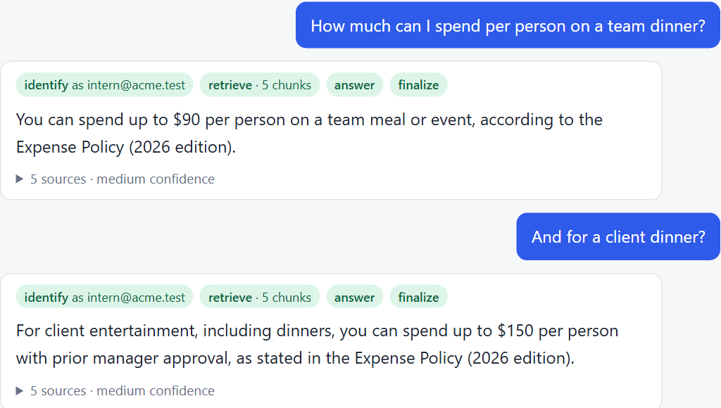
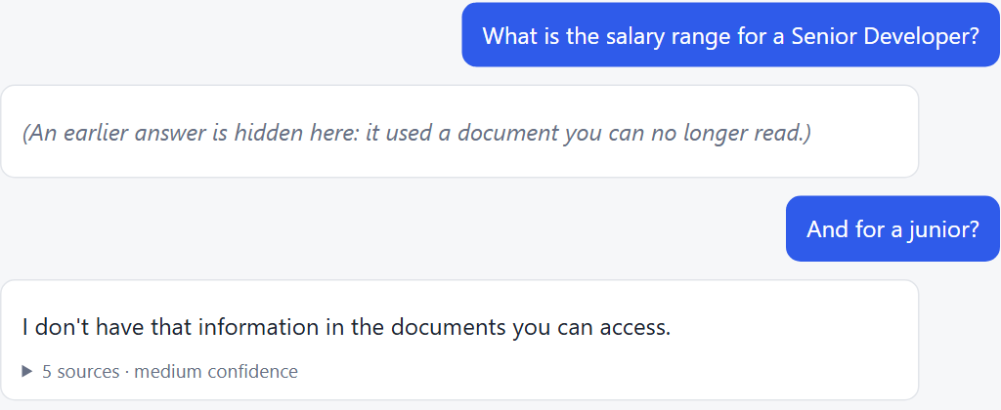
What you should see
A follow-up that works, then an answer that disappears when the access behind it does.
FOLLOW-UPS $90, then $150: the second question rewritten
ACCESS LOST the salary answer, hidden on the next turn
The retrieve step said 1 doc no longer yours. The model never saw the old numbers.
Same session, same conversation. The memory obeyed the admin's click on the very next turn.
28
Notes:
Time: 3 minutes. The safety net for the live demo.
Left: "Four chips per answer: the four nodes. The second question was rewritten before the search: that's why it works."
Right: "The first answer was built on the salary bands. The intern lost hr. On the next turn the answer is hidden, and the new answer comes only from what they can read now."
Then read the chat: end of block 3.

Slide 29


Three ideas to take home
One per question. If these three stick, today worked.
1
2
3
The server decides who you are
The database decides what you read
A conversation keeps the rules
Sign in once; a cookie stands for you. Identity, company and groups are looked up on every request, never read from it.
Access is a JOIN inside the search, live. Companies are walls. Each process has its own key.
Every turn re-checks who you are and what you may read, its own memory included.
29
Notes:
Time: 3 minutes. Clock check: about 1:45.
One sentence per card, pointing at it. These three carry over to any stack: the Postgres specifics don't matter, these do.

Slide 30

What this does not do yet
Say it before someone asks. Each one is a known gap with a known fix.
Passwords, not SSO
Groups typed in by an admin
Hidden is not erased
A company signs people in through Google Workspace or Entra ID.
A company's groups live in its directory, and Drive has its own sharing.
A hidden answer stays in the checkpoint tables, readable by the database owner.
THE FIX
OpenID Connect: verify the provider's ID token (a JWT, with PyJWT), then the same session.
THE FIX
Sync groups from the directory; read Drive's permissions with a second, admin-approved identity.
THE FIX
Forget a conversation (tonight), and a retention rule: a policy decision, then a job.
The checkpoint README lists the rest. A gap you wrote down is a plan; one you didn't is an incident.
30
Notes:
Time: 2 minutes. Read the three, don't defend them.
More in checkpoints/02-platform/README.md, Honest limits: the users table is global (an admin can learn an email exists elsewhere); a chat turn holds a database connection while the model writes; the chat searches today's documents only (as_of is on Search and Ask).

Slide 31
Tonight
Offline: SOURCE=local, local embeddings, Postgres in Docker. No API key needed. About an hour.
1
Replay today
2
Forget a conversation
Two browsers: the intern and the admin. Untick, search, give hr, search. Then find all four actions in the Audit log.
The TODO in app/routers/chat.py: DELETE /chat/threads/{id}. The test is waiting in test_chat.py: remove its skip, red, then green.
3
The worker can't read a chat
4
Stretch: meaning vs words
A new test: as acme_sync, SELECT from chat_threads raises InsufficientPrivilege. Then say why in one comment.
evaluate.py --strategy all. Which question does words-only miss, and why? Then "Copilot" in the Search tab.
Each exercise ends in something you can see: an audit row, a green test, a number.
31
Notes:
Time: 2 minutes. From checkpoints/02-platform/README.md, "Tonight".
Say: "Exercise 1 is today again, on your laptop, in two browsers. Do it first. Exercise 2 is the real work: a test is already written and skipped; remove the skip, watch it fail, make it pass. Exercise 3 is a test you write. 4 is for anyone who finishes early."
Hint for 2, only if asked: delete the checkpoints first, while the thread row still exists. The policy only shows checkpoints of threads you can see; delete the row first and the checkpoints become invisible to you, so your DELETE finds nothing. The solution is in instructor-notes/fallbacks/part2/solutions/forget_thread.py (don't share it tonight).
Setup reminder for their laptops: docker compose up -d db, db.py migrate, db.py seed with ACME_SEED_PASSWORD set in .env, fake_drive.py reset, sync.py --apply.

Slide 32

FRIDAY · PART 3 OF 4
Tools
that act
The assistant opens a ticket, files your leave, drafts an email. Every write waits for a human.
Today it could only read, and only what you may read. Friday it gets hands: an allowlist per group, validation, approval, budgets, and an audit row for every decision.
Fri 13 Nov
SE
Factory
32
Notes:
Say: "Today the assistant learned who you are and what you may read. Friday it starts doing things for you, and every one of today's rules still applies: it can only act as you, on what you may touch, and nothing it writes happens without a human saying yes."
Remind them to pull the repo Friday morning (post it in the chat).
Read the chat one last time and answer what's there before you end the call.

Slide 33

REFERENCE
For after class
Not presented. Read these with the code open.
Commands · the security model, layer by layer · sign-in details · sessions or JWTs · the worker · hybrid retrieval · the chat's API
SE
Factory
33
Notes:
Not presented. If someone asks a detail question in the chat, jump here.

Slide 34
Reference: the commands
From the repository root. Postgres runs in Docker on port 5433.
ONCE, THEN EVERY CLASS
docker compose up -d db # Postgres 17 + pgvector
python checkpoints/02-platform/db.py migrate # the schema, roles, policies, the chat's tables
python checkpoints/02-platform/db.py seed # Acme: 6 accounts (ACME_SEED_PASSWORD in .env)
python checkpoints/02-platform/fake_drive.py reset # Friday's files (offline)
python checkpoints/02-platform/fake_drive.py apply 1 # ... and 2, 3, 5: Monday's documents
python checkpoints/02-platform/sync.py --apply # the index
python run_checkpoint.py 02-platform # http://localhost:8000 -> sign in
python checkpoints/02-platform/worker.py --interval 60 # a second terminal: the worker
python checkpoints/02-platform/db.py status # tenants, index, last sync, live workers
python checkpoints/02-platform/evaluate.py --strategy all
pytest checkpoints/02-platform/tests -q # 88 tests on a throwaway database
34
Notes:
The same commands as checkpoints/02-platform/README.md, "Run it".

Slide 35
Reference: the security model, layer by layer
Each layer stops something the others can't. None of them is the model's job.
Layer
What enforces it
What it stops
Who you are
the session cookie → sessions → users (app/auth/)
?user=hr-partner: there is no such parameter
What you read
EXISTS (document_acl ⨝ your groups) inside the search
a forbidden chunk taking a top-k slot, or reaching the model
Which company
Row-Level Security on every tenant table (002_security.sql)
a missing WHERE tenant_id in Python leaking another company
Each process
three database roles with exact grants
a web bug corrupting the index; a worker bug leaking hashes
Who changed what
audit_log, written in the same transaction as the change
"who gave the intern the salary bands?"
Other sites
SameSite=Lax + the X-Acme-Request header on every write
another site making your browser post here
Whose chat
chat_threads policy + a policy on LangGraph's checkpoint tables
reading someone's thread, even with its id
What it remembers
each turn re-checks the documents earlier answers used
an answer from before an access change leaking into the next
35
Notes:
The same table as the README's "The security model, layer by layer", plus the chat's two rows.

Slide 36
Reference: sign-in, in detail
app/auth/: passwords.py, sessions.py, service.py, deps.py.
Passwords
Sessions
argon2id, the library's tuned defaults
rehashed at sign-in when the parameters change
12 characters minimum; no default password ships
32 random bytes in the cookie, SHA-256 in the DB
idle expiry 8 h, absolute 7 days (.env)
a password change ends every other session
Brute force
CSRF
5 failures per email, 20 per IP, per 15 minutes
the same work whether the account exists or not
every failure in audit_log, in its own transaction
SameSite=Lax: cross-site posts arrive without the cookie
every write needs the X-Acme-Request: 1 header
a plain HTML form can't set a header
36
Notes:
Where SSO would plug in: app/auth/service.py, the comment at the top. Verify the provider's signed ID token with PyJWT (next slide), find the user by (auth_provider, external_subject), create the same session.

Slide 37
Reference: sessions or JWTs?
A JWT would work, and cost what today's demos show: sign-out now, groups that change live.
Session (ours)
JWT
WHERE A JWT BELONGS: SSO, WITH PYJWT
Sign out, now
delete the row
still valid until it expires
import jwt # pip install "pyjwt[crypto]"
keys = jwt.PyJWKClient(JWKS_URL) # the IdP's
key = keys.get_signing_key_from_jwt(id_token)
claims = jwt.decode(id_token, key.key,
algorithms=["RS256"], # never the header's
audience=CLIENT_ID, issuer=ISSUER)
user = find_user("entra", claims["sub"])
token = sessions.create(user.id, ...)
# ... and from here, today's session
Admin takes hr away
the next request
its claims still say hr
The server keeps
one row per sign-in
nothing: the appeal
Fits
a browser and its own API
SSO ID tokens, service to service
The library: PyJWT. Small, maintained, the one FastAPI's docs use. Skip python-jose; reach for Authlib only for a full OAuth client or encrypted tokens.
The browser keeps a session. A JWT is what you verify at the door (SSO), or send between services.
37
Notes:
For the chat question "why not JWTs?". Answer in three sentences, then move on.
"A JWT is a signed note the server hands you: it says who you are, and the server checks the signature instead of a table. That's its appeal: no lookup. But nobody can take it back before it expires, and its groups are the ones you had at sign-in."
"We re-read the Principal on every request anyway, so that groups change live. Once you do that lookup, a JWT saves nothing, and a stolen one still works until it expires."
"Where a JWT does belong: SSO. Google or Entra signs you in and hands us an ID token, a JWT. We verify it with PyJWT, then create the same session as today. Friday's tools could also use short-lived JWTs between services."
Library, if asked: PyJWT (pip install "pyjwt[crypto]" for RS256 and the JWKS client). Small, maintained, the one FastAPI's docs use. Skip python-jose (barely maintained). Authlib or joserfc if you need the whole OAuth/OIDC client, or encrypted tokens (JWE).
The two rules that matter: always pass algorithms=[...] (never trust the token's own alg header), and always check audience and issuer.
In the code: checkpoints/02-platform/app/auth/sessions.py, the comment "Why not a JWT?", and checkpoints/02-platform/app/auth/service.py, "Where SSO would plug in".

Slide 38


Reference: the worker
python worker.py: syncs every company on a timer and on Run now, as acme_sync.
One company at a time
Every run recorded
a Postgres advisory lock per tenant: two workers never sync the same company at once; the second one skips
sync_runs: trigger, who asked, counts, the full plan, the error if any; the Sync tab reads it
Run now, without the API syncing
Alive or not
the API inserts a sync_requests row and NOTIFYs; the worker wakes, picks it up, runs
a heartbeat in workers every tick; the Sync tab says offline after two minutes of silence
38
Notes:
checkpoints/02-platform/app/ingest/worker.py. The API can't sync (no grant on chunks); it can only insert a sync_requests row and NOTIFY.

Slide 39
Reference: the words search
Postgres full-text on the same chunks, inside the same filter. The tsv column has a GIN index.
app/rag/store_pg.py · keyword_search() · simplified
WITH words AS ( -- "How many vacation days can I roll over?" -> 'vacat' | 'day' | 'roll'
SELECT to_tsquery('simple', string_agg(quote_literal(w), ' | ')) AS q
FROM unnest(tsvector_to_array(to_tsvector('english', :question))) AS w)
SELECT c.id, c.text, ts_rank_cd(c.tsv, words.q, 1) AS keyword_rank
FROM chunks c, words
WHERE c.tsv @@ words.q
AND EXISTS (SELECT 1 FROM document_acl a WHERE ... AND a.group_id = ANY(:my_groups))
ORDER BY keyword_rank DESC LIMIT :k
Why OR, not AND: an AND of every word in a question matches almost nothing. Why rank, not score: a text rank and a vector distance are on different scales; Reciprocal Rank Fusion only needs positions. RETRIEVAL_STRATEGY in .env: dense, keyword or hybrid (the default).
39
Notes:
checkpoints/02-platform/app/rag/store_pg.py, keyword_search(). The question becomes an OR of its stemmed words, so a question still matches chunks that share only some of them; ts_rank_cd ranks chunks that match more, closer together, higher.

Slide 40
Reference: the chat's API
app/routers/chat.py. Every route takes the Principal from the session; none takes a user.
Route
What it does
GET /chat/threads
your conversations, newest first; nobody else's, not even for an admin
POST /chat/threads
start one: a chat_threads row, owned by you
GET /chat/threads/{id}
its messages; an answer built on a document you've lost comes back hidden
POST /chat/threads/{id}/messages
ask; the reply streams back as step, token, done (or error) events
DELETE /chat/threads/{id}
forget it: tonight's exercise (501 until then)
Someone else's id, or one that doesn't exist: the same 404, checked before the stream starts. Writes need the X-Acme-Request header like every other write.
40
Notes:
DELETE is tonight's exercise 2: it answers 501 until then.

