Slide 1
Project title: Airport Management System
Submitted By:
Hasan Khan
Akshat Shukla
Abhishek Nagre
Manisha Dangi
Safa Khan

Slide 2
Abstract
The project aims to design & implementation of an airport management system which will provide Admin a facility to shedule there flight without any hassle. It is a web based system & it will save valuable time and effort of airport staff. The air management system designed in this project was developed using java css and html as the programming languages and Mysql as the database Management system. The framework adopted for this project is the spring boot which is open source Java-based framework. This system allows real time communication between admin and user. This system allows the admin to add and schedule flight, if any problem occurs so admin can cancel the flight and user can create account. This system allows the airline passengers to book for flights that are available between the two travel cities, namely the “srcAirport” and “dstnAirport” for a particular departure and arrival dates. The system shows all the flight’s details such as flight number, name, available seats and duration of journey etc. After search the system display list of available flights and allows passenger to choose a particular flight. Then the system checks for the availability of seats on the flight . Then it book the flight.

Slide 3
Objectives
To make airport management easier for staff.
To save time and effort of potential airport staff.
To reduce the hassle of the user and management.

Slide 4
Introduction
Online Airport Management is a kind of Admin and user assistance where passenger can reserve tickets for flight in online. This is an easy method which saves a lot of time. This project entitled design and implement of an airport management system can be applicable to any airlines. The feature of this system will be similar as a common ticketing system.
As a user :
You can view the schedule
You can reserve ticket
You can cancel your reservation
As a admin :
You can schedule the flight.
You cancel the flight.
You can view all the passenger booking.

Slide 5
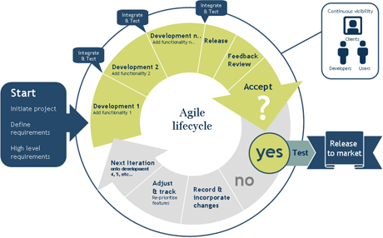
Methodology
A methodology is a set of ideas or guidelines about how to proceed in gathering and validating knowledge of a subject matter.
Agile methods
An Agile process is characterized by the division of task into short phases of work and frequent reassessment and adaption of plans.

Slide 6
Language and Tools
Postgresql
Springboot
JPA
Junit
java

Slide 7
Technical Requirements
For User
Registration
Login
View schedule /Book ticket
Cancel booking
Uploading Information into the system
For Admin
Registration
Login
View schedule /schedule flight
Cancel flight
Viewing statistics
Show Information into the system

Slide 8
Types of User
Admin
Creating a flight
Changing time schedule
Cancel flight
Updating airport information
Registering and managing users
View statistics
Registered user
View flight schedule
Book, confirm/cancel reservation
Unregistered User
View flight schedule

Slide 9
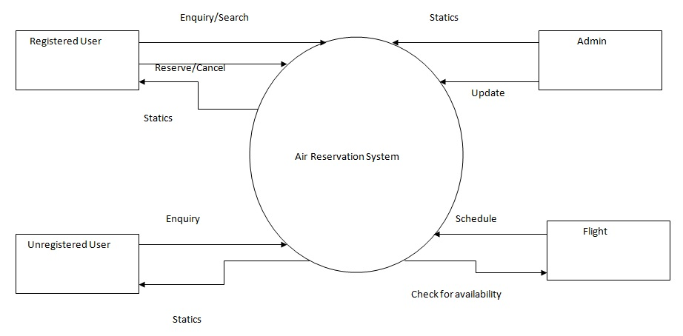
Data Flow Diagram

Slide 10
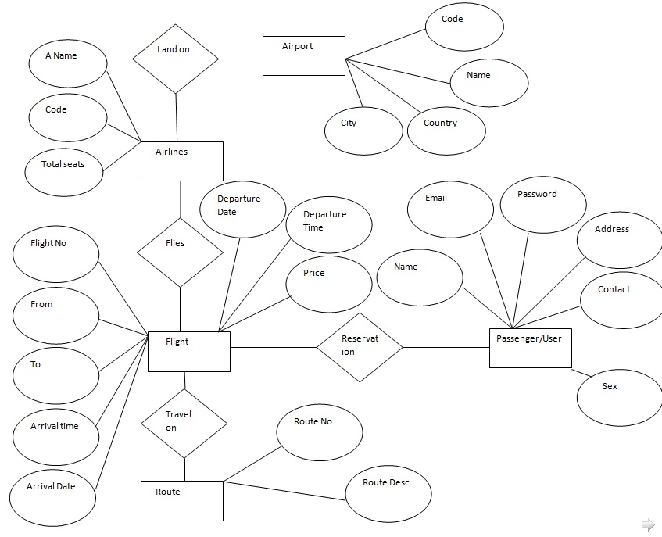
E-R Diagram

Slide 11
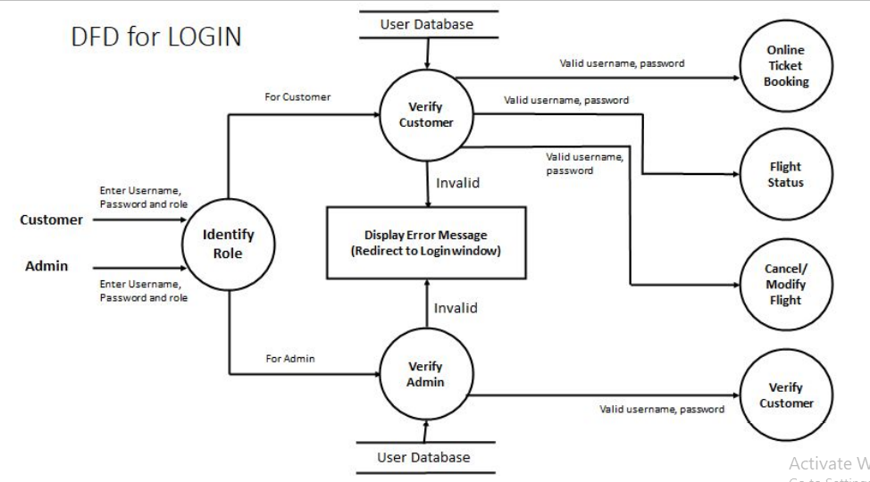
Use Case Diagram

Slide 12
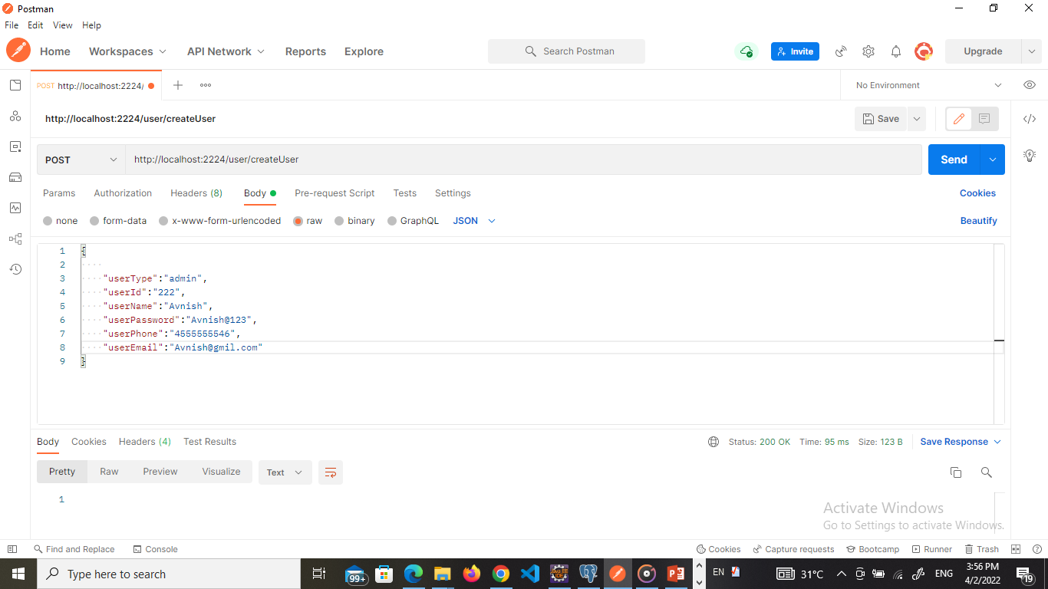
Project Description
Registration Page
For reserve a ticket for flight a user must be registered into the system. A user must use valid email address and valid mobile number during registration. User information is stored into the database. Multiple user can not use the same email and mobile number. User must need to fill up all fields for registration.

Slide 13
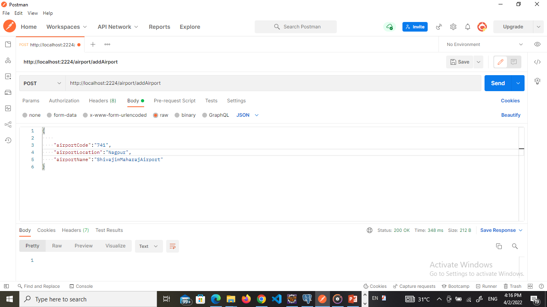
Create Flight Admin can create flight here by giving value(Flight name, Total Seat, City, Status)

Slide 14
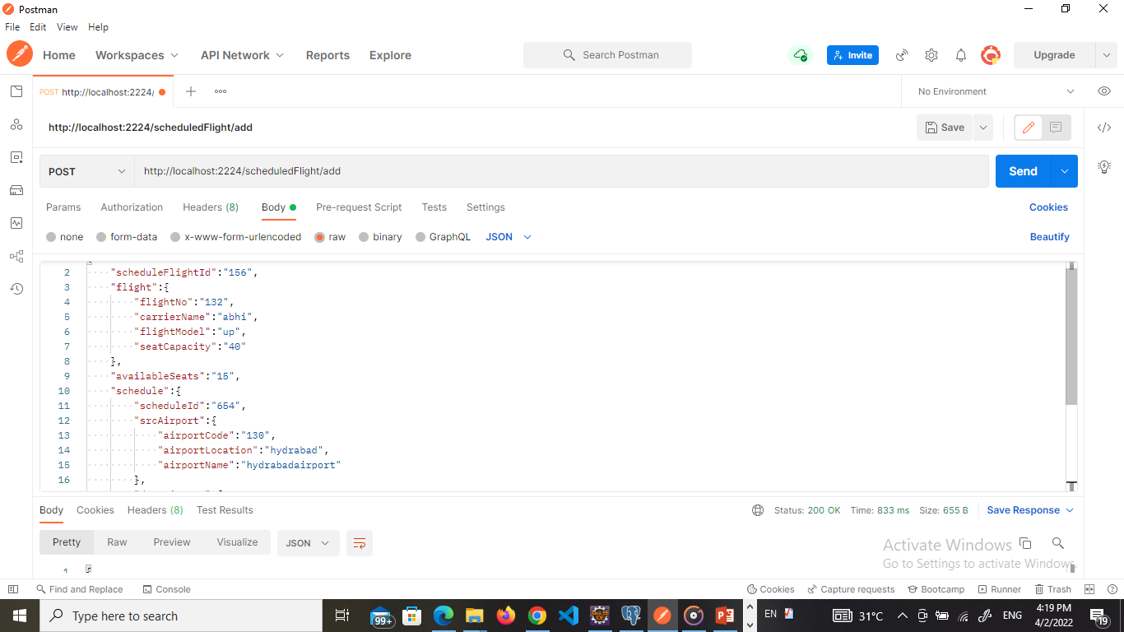
Add Schedule Admin can add flight schedule here by giving value(Choose flight, Choose Route, Departure time/date).

Slide 15

Admin profile
Admin can edit his/her profile information here. Admin can change password, email, user name, contact no.

Slide 16
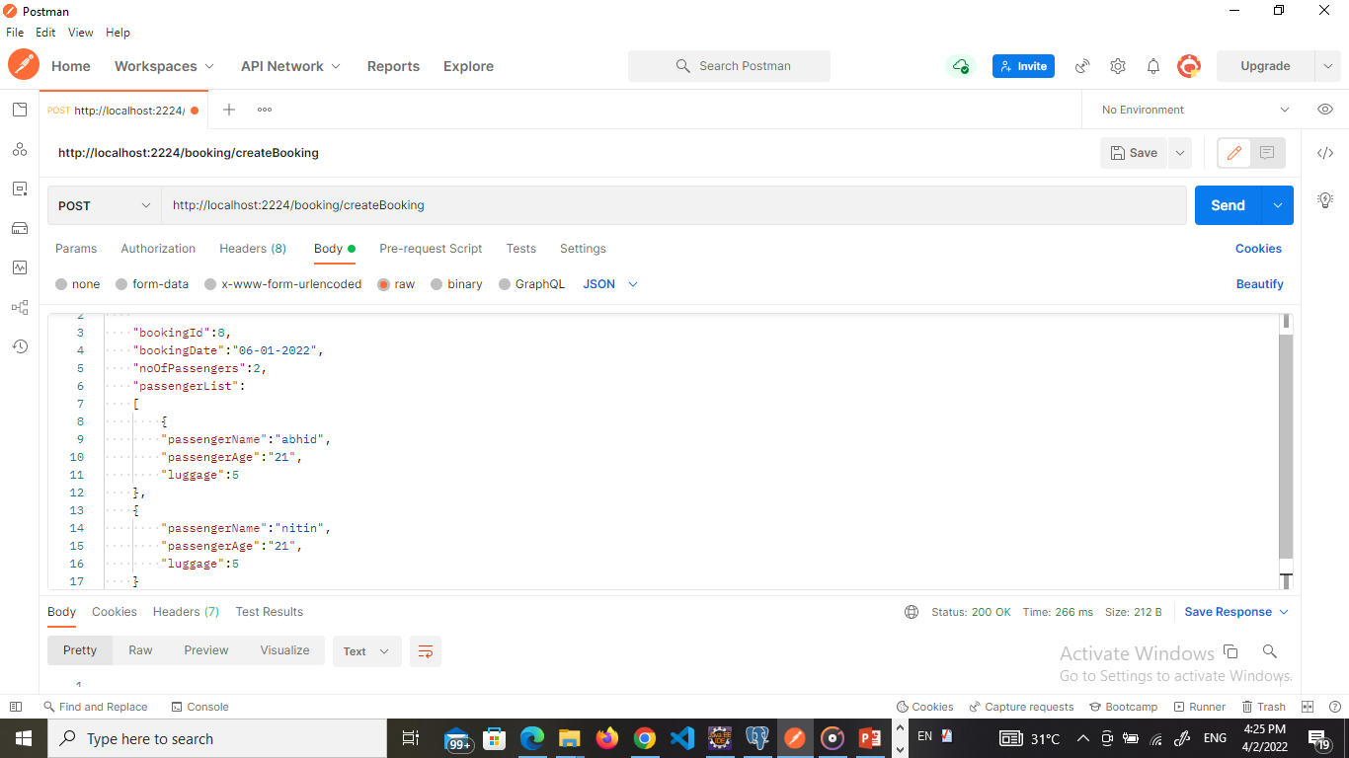
Flight Booking
Registered user can book flight by using value (Departure, Destination, Schedule id, Seat).

Slide 17
Confirm/Cancel Reservation
Registered user can confirm his/her reservation by giving value (User id, Card no). And also can cancel reservation very easily.
User Profile
Registered user also can edit his/her profile. User can update user name, contact no, email & password.

Slide 18
Limitations
Currently we are didn’t worked on frontend.
Currently we are not able to add online payment system , help page etc.

Slide 19
Future Works
Develop front end part of this project.
Introduce online payment system.
Add mobile verification system.
Introduce live chat between admin & user.

Slide 20
Conclusion
The online airport management system automates the process of booking airline tickets, thus reducing the time wasted as well as the errors that are involved in the manual process. We analyzed different Airort management System worldwide and tried to gather different features from them. We accumulated all the feature currently used by the Airport Management System apart from front end development. In this project we had to think about the various options which we can provide to user. We have tried to make this project user friendly by providing many features.
A lot of experimental work can be done with this project. Looking forward for any advice which can help us to improve the project.

