Slide 1
JavaFX Movie Ticket Booking System
CSE-2112 (OOP) Final Project
University of Dhaka

Slide 2
Key Features
Text File based Database
Clean UI with Animation
Unique Username for each profile
Password Recovery Option
Admin Dashboard for control Movie Database
Logout/Back Button in all window
Booked Ticket Display
Easy Booking Option
Video Sample: Demo

Slide 3
Overview of Project:
Start Menu
Login Menu
User Login
Sign up
Admin Login
Admin DashBoard

Slide 4
User Login
Main Menu
User Profile
Select Movie
Booked
Booking Movie

Slide 5
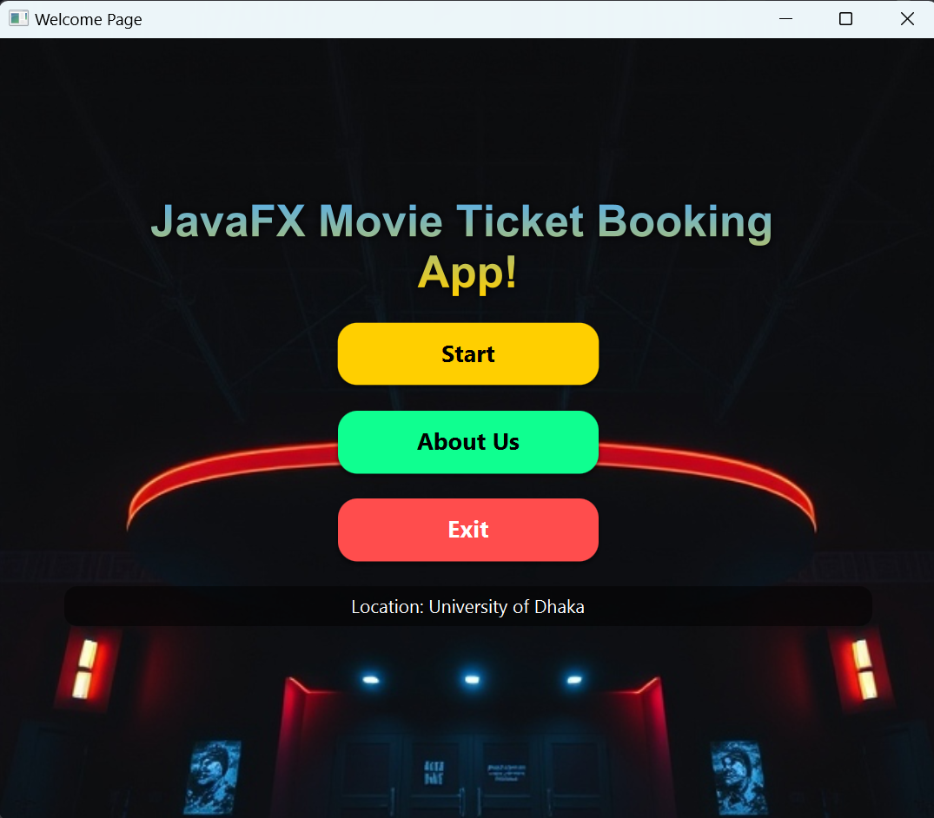
Start Menu
HelloApplication.java
Methods:
handle_Login, handle_About, handle_exit,
apply_animation
public static void main(String[ ], args){
launch();
}
Start Window

Slide 6
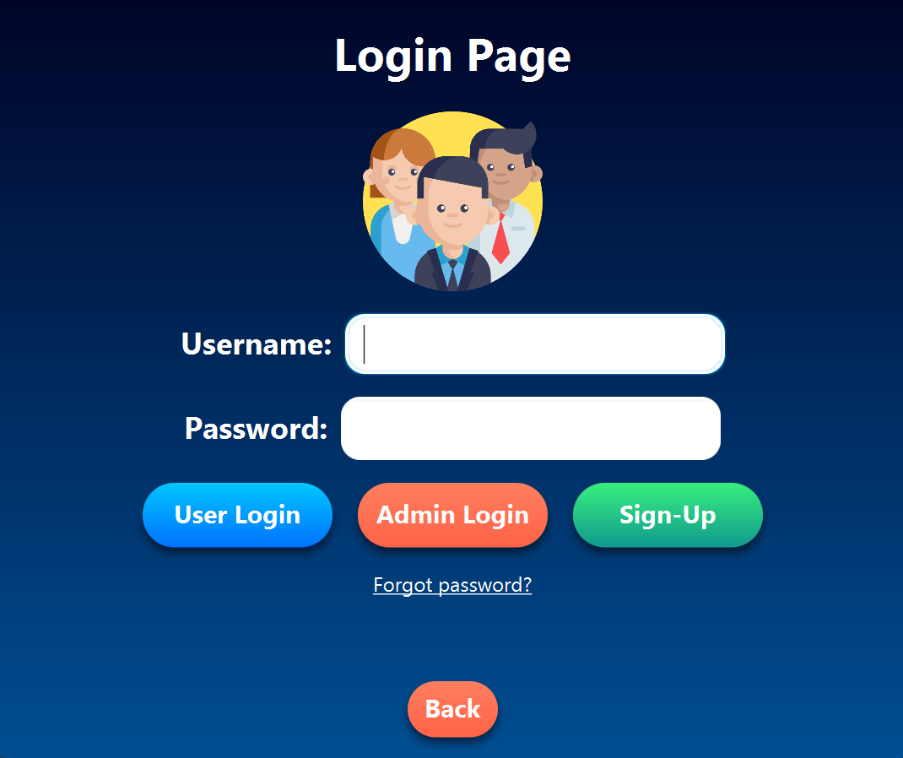
Login Menu
Text File Database format:
Username|password|firstname|lastname|DOB|Due|Tickets
Takes username and password and match in the
user_database.txt file.
After matching, create a user class object to pass all details.
Login Window

Slide 7
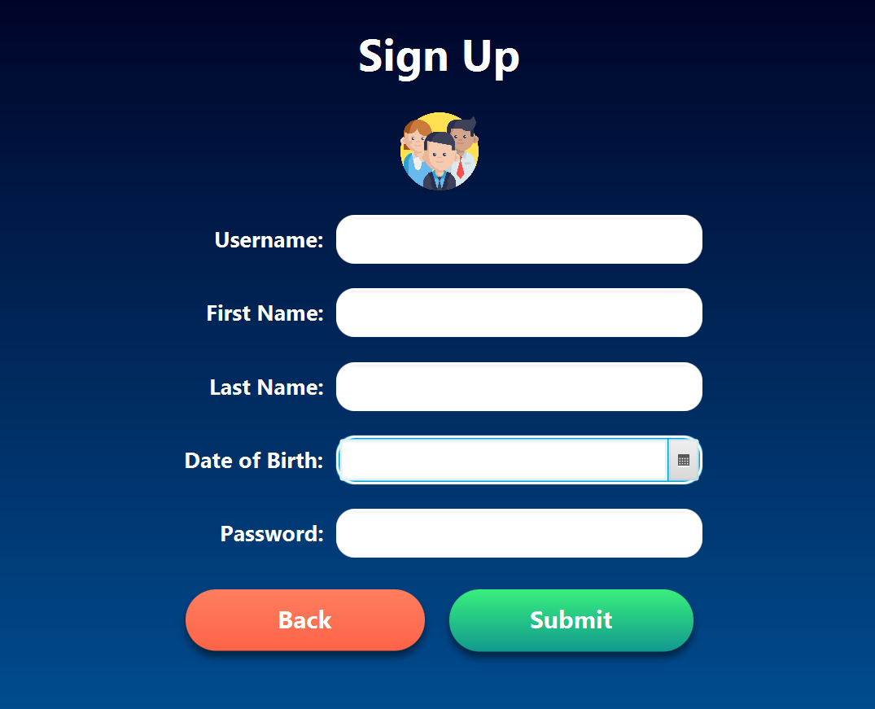
Sign Up
Text File Database format:
Username|password|firstname|lastname|DOB|Due|Tickets
Takes input of unique username, firstname,
last name, Date of birth and password.
Add all to the user_database.txt file used for login handle.
SignUp Window

Slide 8
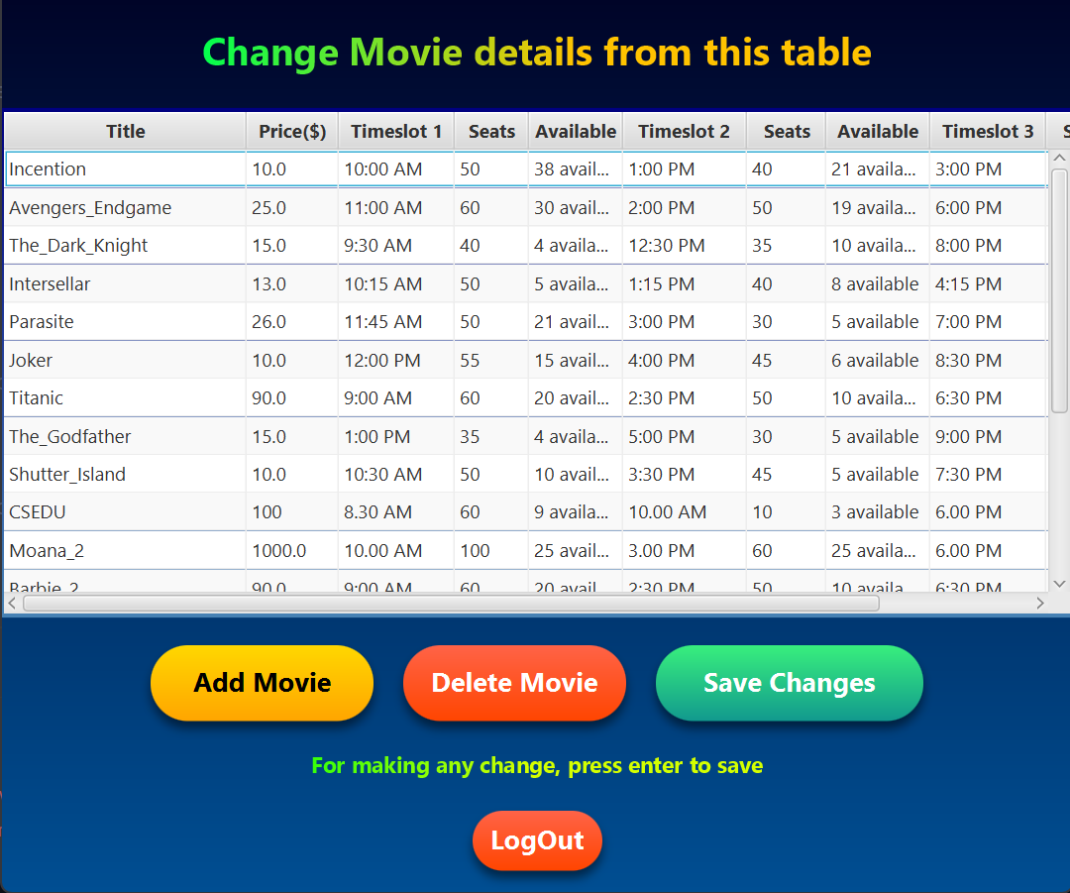
Admin Menu
Text File Database format:
Movie|price|timeslot1|seats1|available1|timeslot2|
seats2|available2|timeslot3|seats3|available3
Add, remove directly any data in
the movie_database.txt file
Admin Window

Slide 9
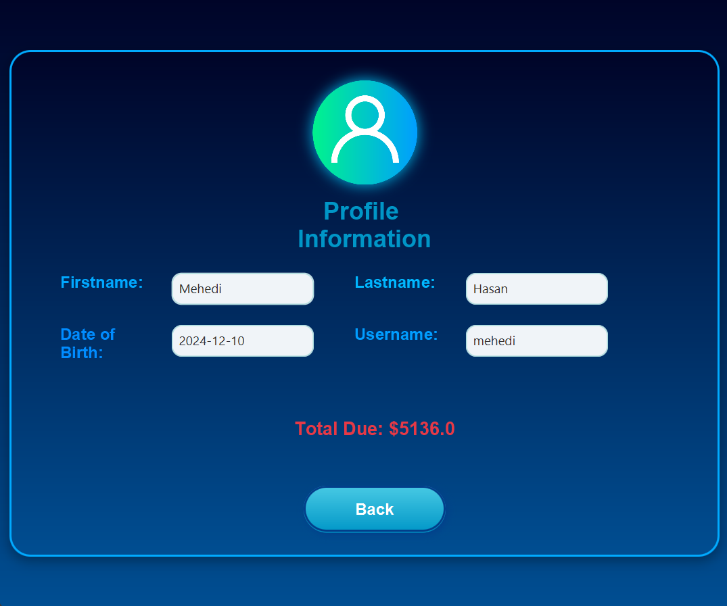
User Profile
User class object from login, pass all data.
Display all the details (without password)
Dashboard Type window

Slide 10
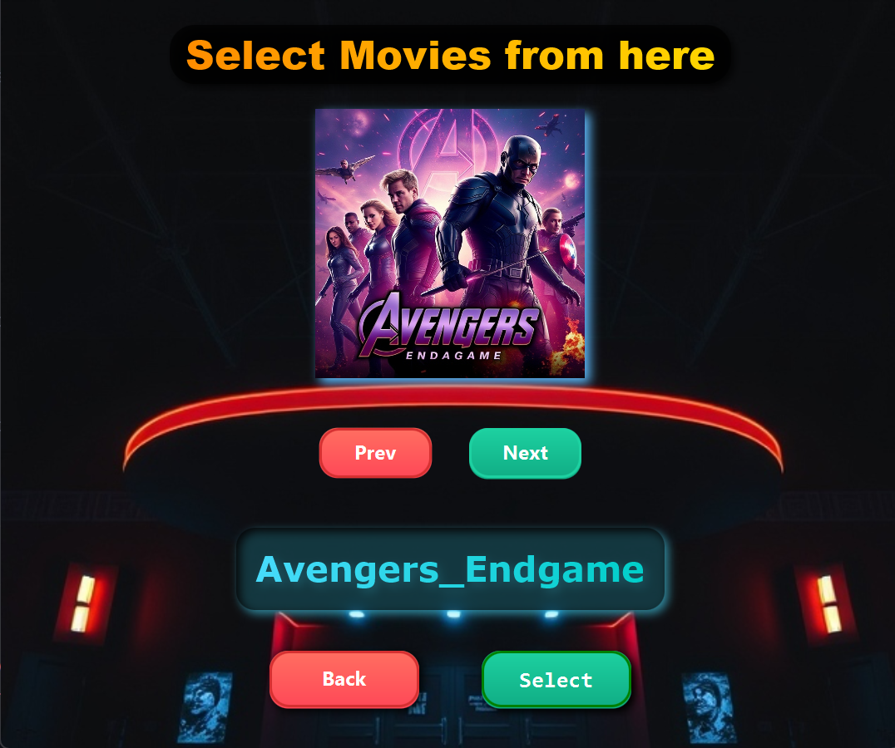
Movie Selection (UI-1)
A Movie class was made for handle movie.
AI Generated Thumbnails were stored in a file,
With the same name of my folder.
An ArrayList() was made for store thumbnails
with the same name of files.

Slide 11
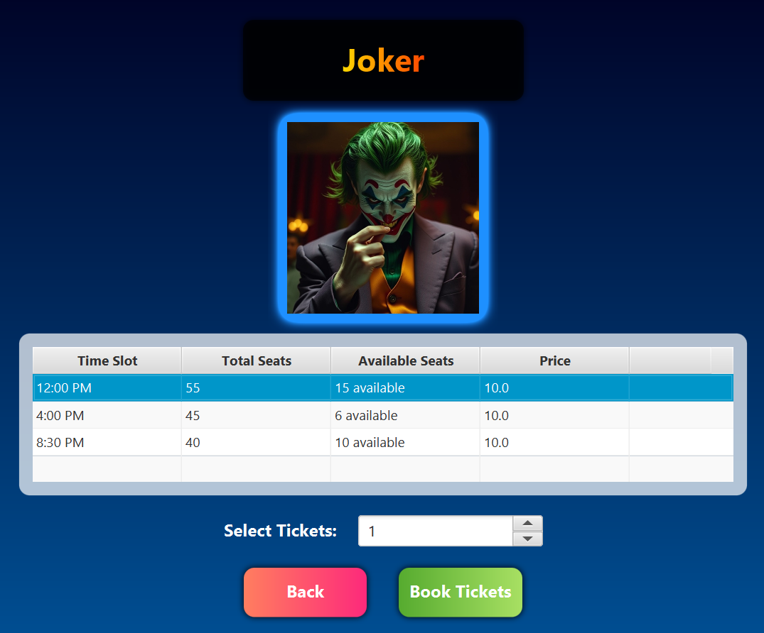
Ticket Booking (UI-2)
Handles booking mechanism
Selects tickets from the movie object selected
In previous window.
Update again user_database.txt for tracking
The booked movie objects

Slide 12
Future Enhancements
Database integration (e.g., MySQL) for scalable data management.
Payment gateway integration for online ticket booking.
Graphical seat selection interface.

Slide 13
References
All the movie thumbnails were generated from the website: AI Image Generator
Icons that has been used, collected from a free website: Flaticon
Reference Book: JavaFX 9 by Example, Carl Dea, Gerrit Grunwald, Jose Pereda, Sean Phillips, Mark Heckler
End

