Slide 1
K-MEANS CLUSTERING ALGORITHM IMPLEMENTATION USING CUDA
CMP 674 PROJECT
HASAN MUTLU
UFUK UYAN
NECATİ ÇAĞAN

Slide 2
OUTLINE
ALGORITHM DEFINITON
SERIAL IMPLEMENTATION
PARALLEL IMPLEMENTATION (CPU)
PARALLEL IMPLEMENTATION (GPU)
COMPARISONS

Slide 3
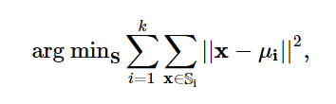
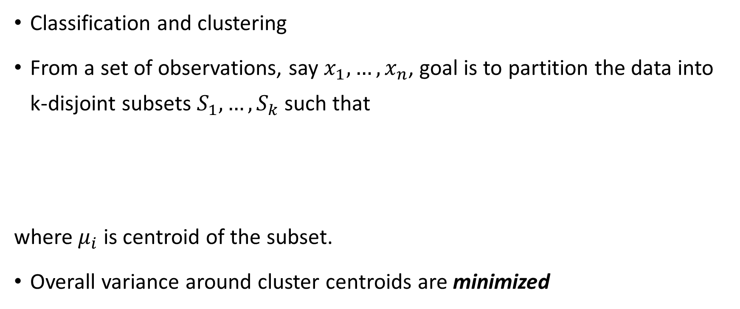
ALGORITHM DEFINITON
Classification and clustering
From a set of observations, say $x_{1}, …{,x}_{n}$, goal is to partition the data into k-disjoint subsets $S_{1},…,S_{k}$ such that
where $μ_{i}$ is centroid of the subset.
Overall variance around cluster centroids are minimized

Slide 4
SERIAL IMPLEMENTATION
Generate random points
Initialize centroids randomly
Find closest points and assign the point to each centroid
Update centroid locations according to the points assigned to them
Stop the algorithm until centroid locations do not change anymore

Slide 5
SERIAL IMPLEMENTATION
Cluster Size \ Data Count | 1.000 | 10.000 | 100.000 | 1.000.000
5 | 7 ms | 30 ms | 417 ms | 2.29 s
10 | 10 ms | 99 ms | 1.42 s | 12.80 s
15 | 18 ms | 175 ms | 1.55 s | 18.96 s
20 | 16 ms | 165 ms | 1.39 s | 16.01 s

Slide 6
PARALLEL IMPLEMENTATION (CPU)
Same approach as the serial one except that;
N threads are used in order to find the closest centroid locations
K threads are used in order to find new centroid locations

Slide 7
PARALLEL IMPLEMENTATION (CPU)
Cluster Size\ Data Count | 1.000 | 10.000 | 100.000 | 1.000.000
5 | 4 ms | 47 ms | 267 ms | 3.92 s
10 | 12 ms | 63 ms | 395 ms | 6.70 s
15 | 16 ms | 114 ms | 859 ms | 9.17 s
20 | 23 ms | 137 ms | 1.10 s | 13.99 s

Slide 8
PARALLEL IMPLEMENTATION (GPU)
Points are generated in random seed
Number of points are fed as an argument
Number of centroids are fed as an argument
Since not object-oriented fashion;
Data structures are implemented as arrays
Points are assigned for each centroid with a mapping array
Two kernel functions are used;
One of them is for finding the mapping array
The other one is for updating centroid positions

Slide 9
PARALLEL IMPLEMENTATION (GPU)
Cluster Size\ Data Count | 1.000 | 10.000 | 100.000 | 1.000.000
5 | 79 ms | 83 ms | 130 ms | 620 ms
10 | 79 ms | 104 ms | 168 ms | 1.12 s
15 | 81 ms | 93 ms | 257 ms | 2.04 s
20 | 78 ms | 111 ms | 395 ms | 2.28 s

Slide 10
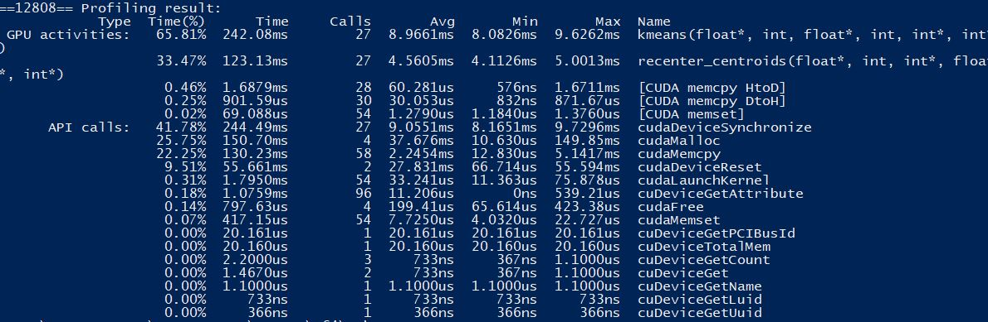
PROFILER

Slide 11
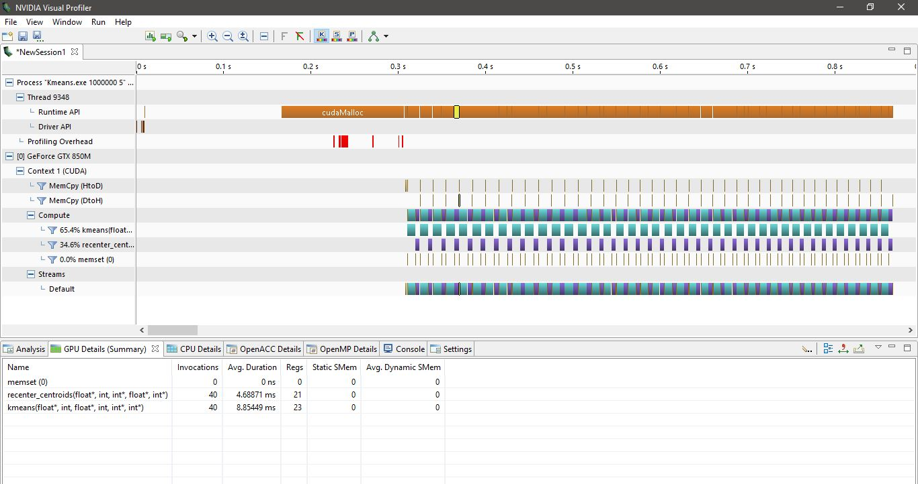
VISUAL PROFILER

Slide 12
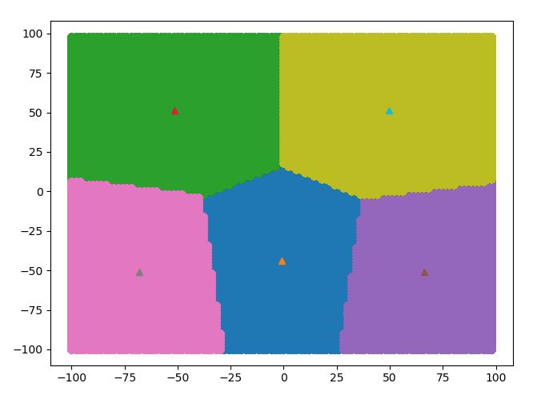
RESULTING PLOT
5 clusters
1.000.000 2-tuples

Slide 13
COMPARISONS

Slide 17
OVERALL COMPARISONS
Serial execution time 8x
Parallel execution time in CPU 7x
Parallel execution time in GPU x

Slide 18

THANK YOU…

Slide 19
REFERENCES
http://www.goldsborough.me/c++/python/cuda/2017/09/10/20-32-46-exploring_k-means_in_python,_c++_and_cuda/

