Slide 1


HANGMAN PROJECT
Retaj Tarek 20010606
Rowan Ashraf Ali 20011312
Hassan Nader Hassan 20010492
Haneen Ahmed Shabaan 20010505
Rowan Tarek Elsayed 20010586
Mohamed Khamis Awad 20011560
Youssef Galal Mohamed 20012259

Slide 2
C-project 27-Hangman Game
Hangman is a classic word game in which you must guess as many secret words as you can before your trials run out.
Most people would have played the game Hangman when they were kids as a fun way of learning words and improve spelling.

Slide 3
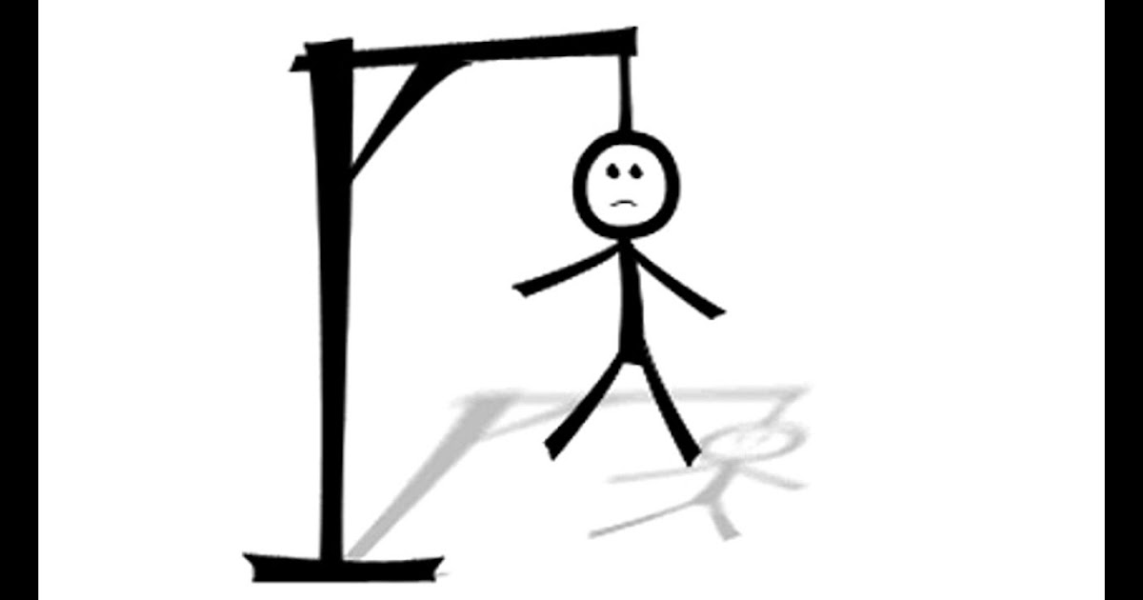
Reason of choice of Hangman
Hangman provides children and adults the opportunity to expand their vocabulary.
It teaches them deductive reasoning.
it’s a purposeful game as it helps us to improve our understanding of words, pronouncing the word, and using the word based on the context given.
It improves the ability to work under pressure, where it puts them under the pressure of helping the man to not be hanged.

Slide 4
Problem Analysis
We should make the outline of the game:-
-Welcome the user and notify the user about the rules of the game and start drawing the gallows.
-Show the output using (printf) function
-Compare the letter that the user entered and the letters of the chosen word, with the help of (arrays) and (functions)
-Limit the inputs of the user to make him enter letters only, and draw a new part of the hanged man on the gallows will be made by (conditional if and switches)
-Increase the counter each time, decrease the number of trials after each wrong attempt the user made, get the right order of the word and replace each letter with a dot and show it to the user using (looping either by while or for-loop).

Slide 5
Pseudo Code
Store ten words in an array in the code (hardcoded array)
The user (player) will choose the order of a word from the ten words and then there will be dots for each letter will appear on the screen, also gallows will be drawn
The user will be asked to guess the letters of the word in the order he has chosen.
The user will have 10 trials to make wrong attempts for each wrong attempt part of the hanged man will be drawn part by part from hair to legs.
There will be a list of the user’s wrong attempts that will appear on the screen to make sure the user doesn’t choose any of these letters again.
if the user succeeded to guess the word before finishing the trials so he won the game
if the user failed to guess the word, the hanged man will be drawn then the game is over
The word will appear on the screen
The user will be asked if he wants to complete playing the game, he should press “1”, and if he wants to close the game, he should press “0” and that is the game in a simple way.

Slide 6
Algorithm of Hangman game
-CHOOSE A RANDOM WORD
-SHOW WORD PROGRESS
-SHOW REMAINING GUESSES
-PROMPT FOR GUESS
-GUESS LETTER
-GAME OVER WHEN NO MORE CHANCES
-IN CASE OF PLAYING MORE THAN ONCE

Slide 7
Bugs encountered:-
1. Overflowing a string
2. Logical Error
3. Uninitialized variables
4. Compilation Errors
5. Runtime Errors
6. Syntax Error

Slide 8
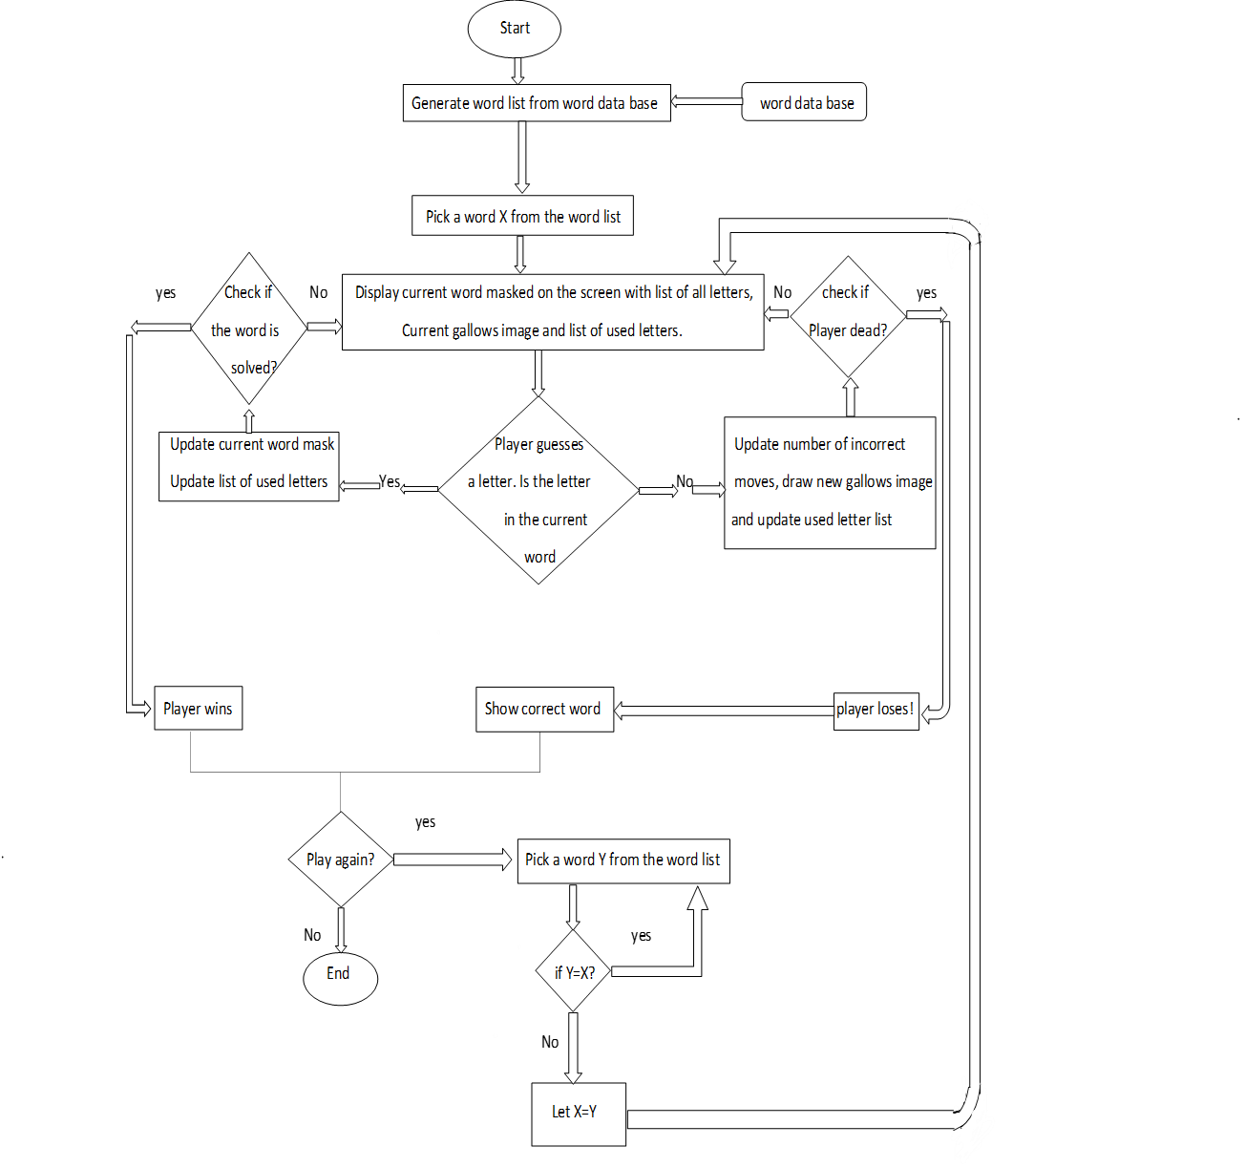
Flowchart

Slide 9
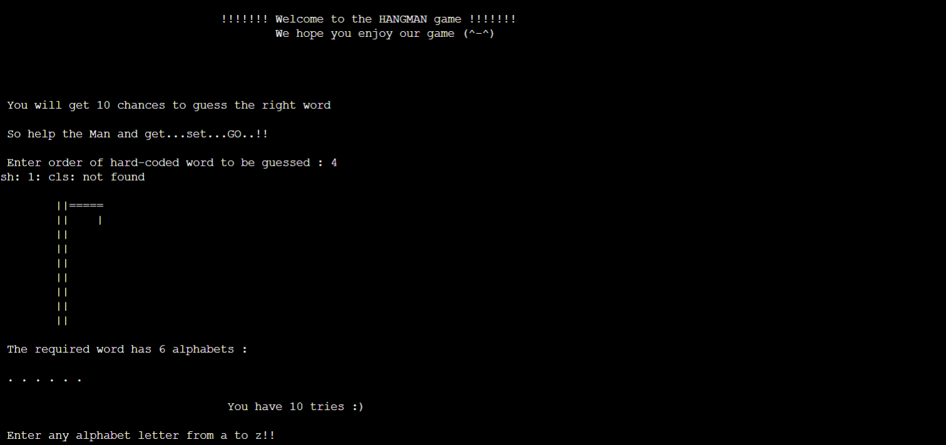
Sample input test cases and corresponding outputs:

Slide 10
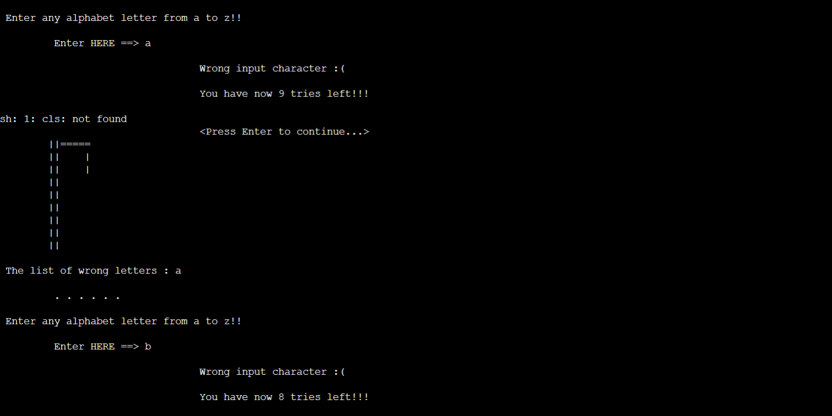

Slide 11
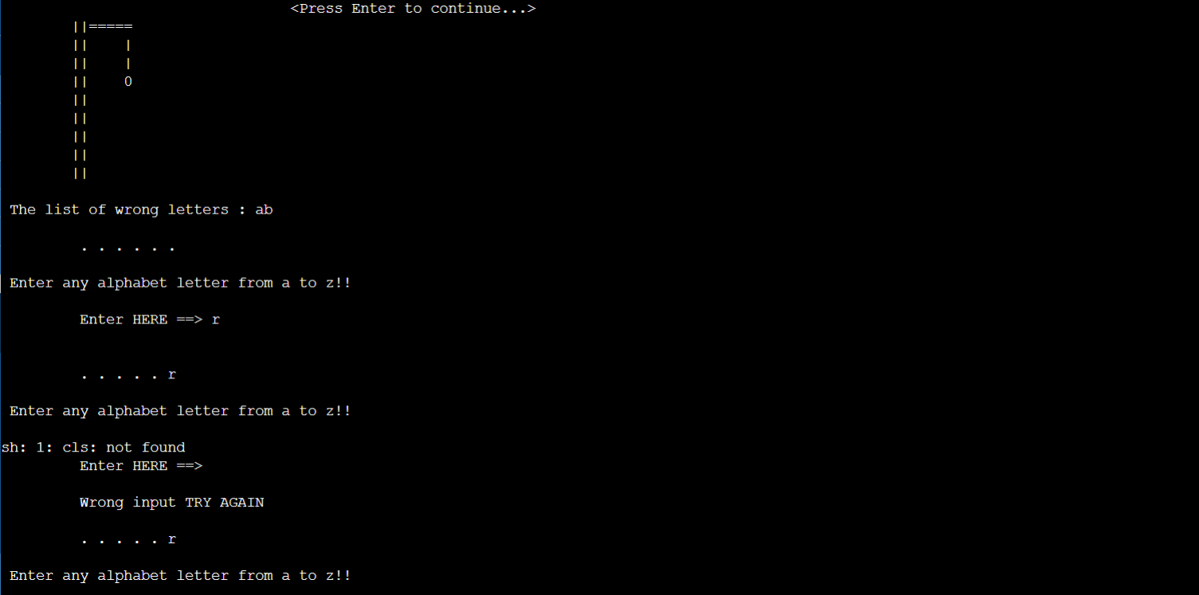

Slide 12
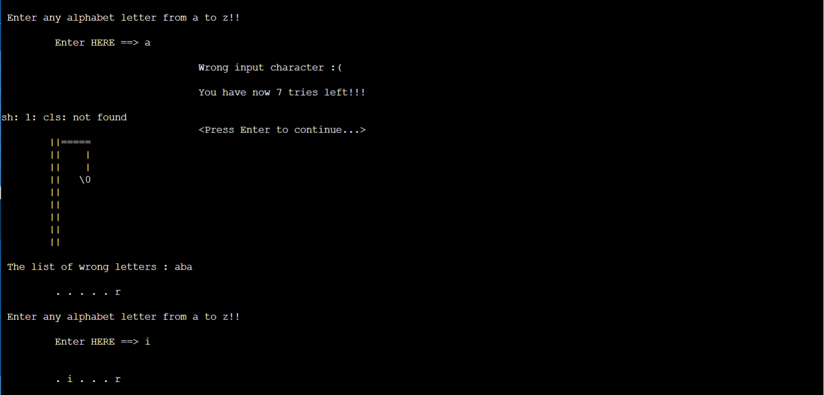

Slide 13
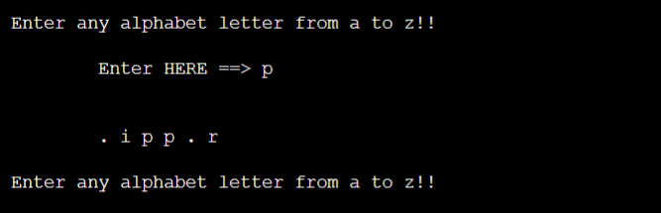

Slide 14
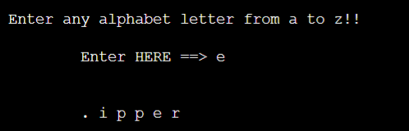

Slide 15
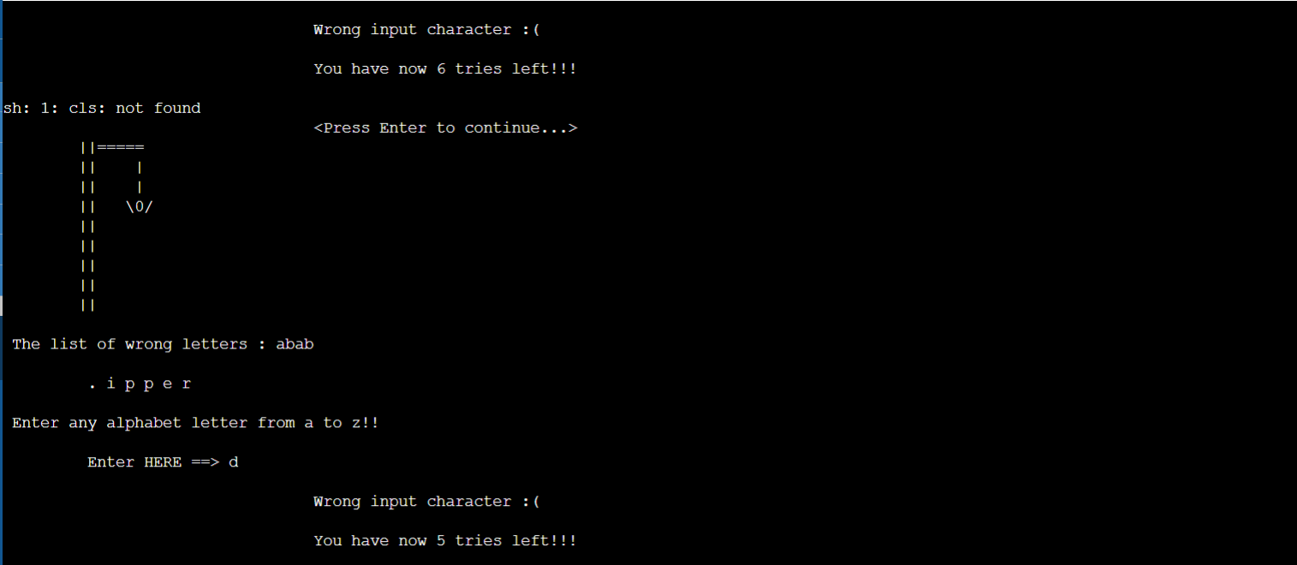

Slide 16
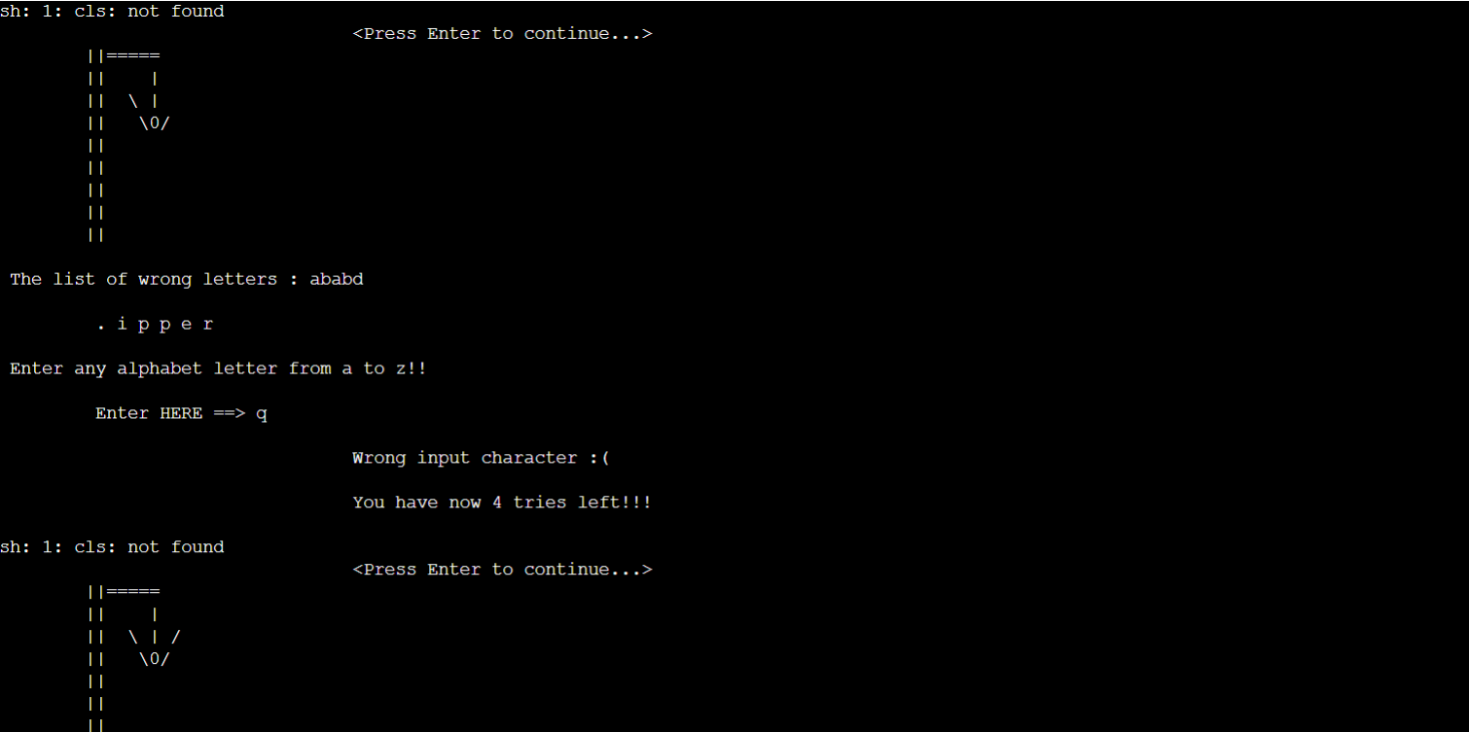

Slide 17
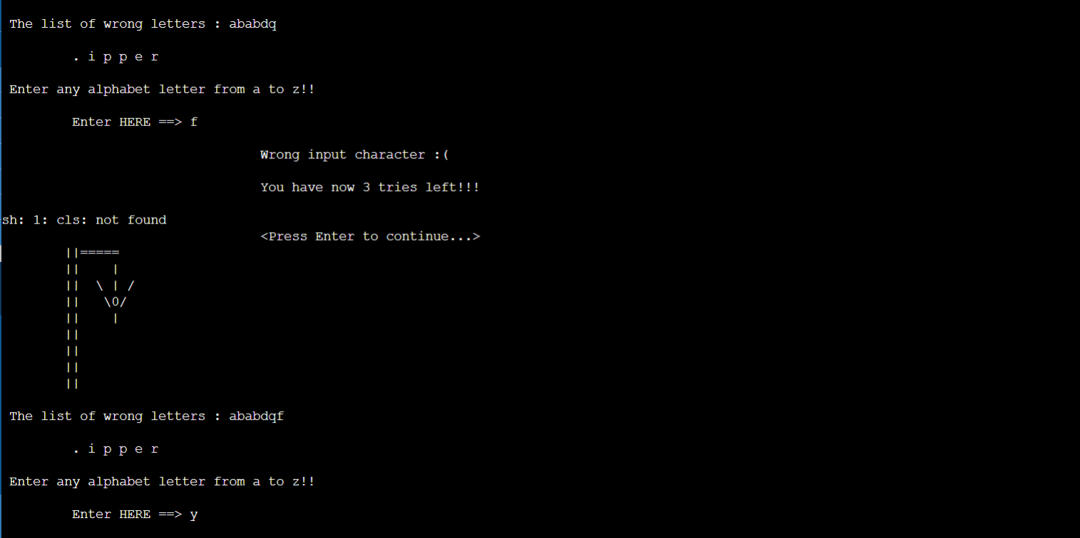

Slide 18
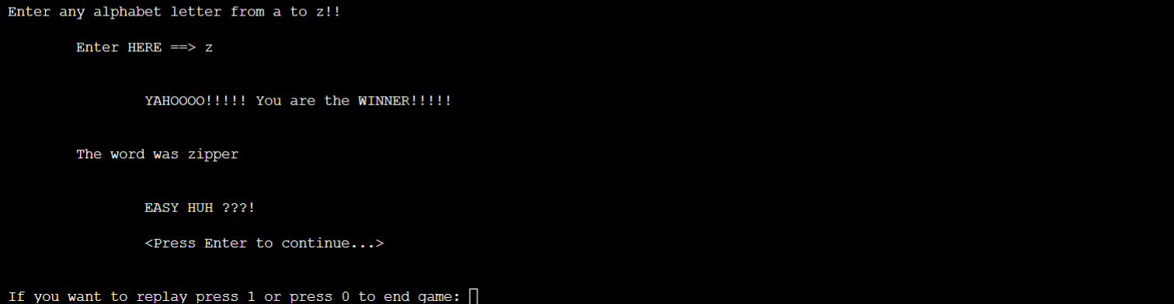
YAHOOOOO!!!!!!

Slide 19

Thanks
References:
https://github.com/tintinmj/Hangman-game/blob/master/game.c
https://gist.github.com/c13iscuit/e67c6f992cbfb8b316ab
https://textexpander.com/blog/the-7-most-common-types-of-errors-in-programming-and-how-to-avoid-them
https://opensource.com/article/21/10/programming-bugs
https://www.b4x.com/android/forum/threads/hangman-tutorial-part-1.32893/#post-191861

Slide 20
Future Improvements
-Refactoring our code to make it more orderly and easier to update.
-Accepting just one-letter input.
-Expanding our dictionary to include much more words.
-Language diversity in future editions.
-Incorporating graphics into our game to encourage users to play it more frequently.
-Including difficulty levels and online playing to create a more competitive atmosphere

