Slide 1
PANIC ALARM
Submitted by: GROUP 1
Yamir Rashid
Prince Md. Waziuddin Shoumik Meher Afroz
Syeda Ibnat Rumman Kenedy Sarkar

Slide 2
Concept of Using Panic Alarm
There can be any sudden situation of panic.
It could be because of an intruder entering our house.
It could be because of an elderly person requiring assistance .

Slide 3
Materials Required
IC 555 timer
Buzzer
Resistors – 1K, 100K, 22K, 220K
Push Button
Capacitors – 22 uF , 10 pF
Connecting wire – a lot
Battery - 9 V
Bret Board

Slide 4
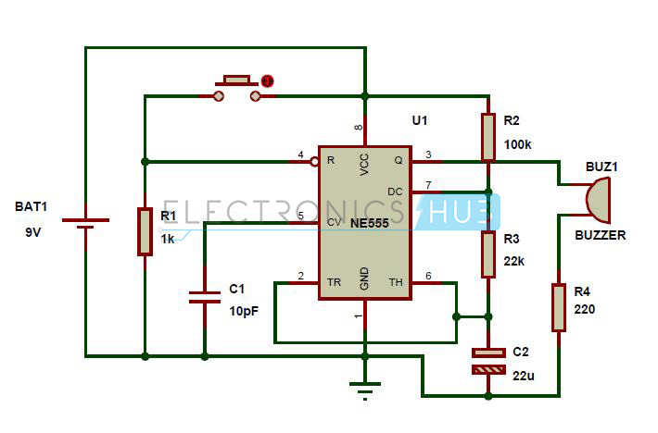
Circuit Diagram

Slide 5
Description
The frequency of operation of the circuit is given by 0.000455Hz. This means the circuit has a on -off repeating time period of about 2.2 seconds.
By analyzing the ON and OFF time period of the panic alarm circuit given above, we find that the circuit will remain on for about 1.88 seconds and off for about 0.339 seconds.
The circuit is in the disabled mode when the button is not pressed and hence the alarm will not function when the button is not pressed.
The power supply will be supplied to the IC 555 all the time, the circuit will operate in the monostable mode only when the IC is enabled.
The IC is in the enable mode only when pin 4 of the 555 IC is given a high voltage. This happens only when the button is pressed.

Slide 6
Cost
IC 555 timer Tk. 40
Buzzer 15
Resistors 30
Push Button 5
Capacitors
10 pF 24
22 uF 16
Connecting Wire 30
Bret Board 300
Battery (9V) 100
_______________________
Total Tk. 560

Slide 7
Scheduling
1st week : Collecting equipments
2nd week : Checking equipments
3rd week : Building circuits and test
4th week : Rechecking circuit to find error (if any)

Slide 8
Thank You !!

