Slide 1
SYED HASAN SAEED
Email: hasansaeedcontrol@gmail.com
Web Page: hasansaeed872726549.wordpress.com
shasansaeed.yolasite.com

Slide 2
BOOKS
AUTOMATIC CONTROL SYSTEM: KUO & GOLANARAGHI
2. CONTROL SYSTEM: ANAND KUMAR
3. AUTOMATIC CONTROL SYSTEM: S. HASAN SAEED
ELECTRICAL MACINE & AUTOMATIC CONTROL: J.B.GUPTA & S. HASAN SAEED
AUTOMATIC CONTROL SYSTEM: R. A . BARAPATE

Slide 3
OUTLINE
Definition of Transfer Function.
Poles & Zeros.
Characteristic Equation.
Advantages of Transfer Function.
Mechanical System (i) Translational System and (ii) Rotational System.
Free Body diagram.
Transfer Function of Electrical, Mechanical Systems.
D’Alembert Principle.

Slide 4
TRANSFER FUNCTION
Definition: The transfer function is defined as the ratio of Laplace transform of the output to the Laplace transform of input with all initial conditions are zero.
We can define the transfer function as
In equation (1.0), if the order of the denominator polynomial is greater than the order of the numerator polynomial then the transfer function is said to be STRICTLY PROPER. If the order of both polynomials are same, then the transfer function is PROPER. The transfer function is said to be IMPROPER, if the order of numerator polynomial is greater than the order of the denominator polynomial.

Slide 5
CHARACTERISTIC EQUATION: The characteristic equation can be obtained by equating the denominator polynomial of the transfer function to zero. That is

Slide 6
POLES AND ZEROS OF A TRANSFER FUNCTION
POLES : The poles of G(s) are those values of ‘s’ which make G(s) tend to infinity.
ZEROS: The zeros of G(s) are those values of ‘s’ which make G(s) tend to zero.
If either poles or zeros coincide, then such type of poles or zeros are called multiple poles or zeros, otherwise they are known as simple poles or zeros.
For example, consider following transfer function

Slide 7
This transfer function having the simple poles at s=0, s=-2, multiple poles at s=-4 and simple zero at s=-3.
Advantages of Transfer Function:
Transfer function is a mathematical model of all system components and hence of the overall system and therefore it gives the gain of the system.
Since Laplace transform is used, it converts time domain equations to simple algebraic equations.
With the help of transfer function, poles, zeros and characteristic equation can be determine.
The differential equation of the system can be obtained by replacing ‘s’ with d/dt.

Slide 8
DISADVANTAGES OF TRANSFER FUNCTION:
Transfer function cannot be defined for non-linear system.
From the Transfer function , physical structure of a system cannot determine.
Initial conditions loose their importance.

Slide 9
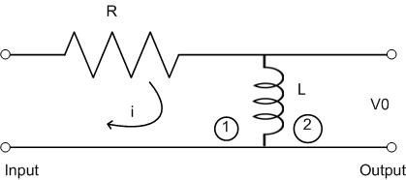
Find the transfer function of the given figure.
Solution:
Step 1: Apply KVL in mesh 1 and mesh 2

Slide 10
Step 2: take Laplace transform of eq. (1) and (2)
Step 3: calculation of transfer function
Equation (5) is the required transfer function

Slide 11
A system having input x(t) and output y(t) is represented by
Equation (1). Find the transfer function of the system.
Solution: taking Laplace transform of equation (1)
G(s) is the required transfer function

Slide 12
The transfer function of the given system is given by
Find the differential equation of the system having input x(t) and output y(t).
Solution:
Taking inverse Laplace transform, we have
Required differential equation is

Slide 13
MECHANICAL SYSTEM
TRANSLATIONAL SYSTEM: The motion takes place along a straight line is known as translational motion. There are three types of forces that resists motion.
INERTIA FORCE: consider a body of mass ‘M’ and acceleration ‘a’, then according to Newton’s law of motion
F_{M}(t)=Ma(t)
If v(t) is the velocity and x(t) is the displacement then
M

Slide 14
DAMPING FORCE: For viscous friction we assume that the damping force is proportional to the velocity.
F_{D}(t)=B v(t)
Where B= Damping Coefficient in N/m/sec.
We can represent ‘B’ by a dashpot consists of piston and cylinder.

Slide 15
SPRING FORCE:A spring stores the potential energy. The restoring force of a spring is proportional to the displacement.
Where ‘K’ is the spring constant or stiffness (N/m)
The stiffness of the spring can be defined as restoring force per unit displacement

Slide 16
ROTATIONAL SYSTEM: The rotational motion of a body can be defined as the motion of a body about a fixed axis. There are three types of torques resists the rotational motion.
Inertia Torque: Inertia(J) is the property of an element that stores the kinetic energy of rotational motion. The inertia torque TI is the product of moment of inertia J and angular acceleration α(t).
Where ω(t) is the angular velocity and θ(t) is the angular displacement.

Slide 17
T_{i} (t)
J
θ(t)
T_{θ} (t)
K
θ(t)

Slide 18
2. Damping torque: The damping torque T_{D}(t) is the product of damping coefficient B and angular velocity ω. Mathematically
3. Spring torque: Spring torque T_{θ}(t) is the product of torsional stiffness and angular displacement.
Unit of ‘K’ is N-m/rad

Slide 19
D’ALEMBERT PRINCIPLE
This principle states that “for any body, the algebraic sum of externally applied forces and the forces resisting motion in any given direction is zero”

Slide 20
D’ALEMBERT PRINCIPLE contd……
External Force: F(t)
Resisting Forces :
Inertia Force:
Damping Force:
Spring Force:
K
B
M
X(t)
F(t)

Slide 21
According to D’Alembert Principle

Slide 22
Consider rotational system:
External torque: T(t)
Resisting Torque:
(i) Inertia Torque:
(ii) Damping Torque:
(iii) Spring Torque:
According to D’Alembert Principle:

Slide 23
D'Alembert Principle for rotational motion states that
“For anybody, the algebraic sum of externally applied torques and the torque resisting rotation about any axis is zero.”

Slide 24
TANSLATIONAL-ROTATIONAL COUNTERPARTS
S.NO. | TRANSLATIONAL | ROTATIONAL
1. | Force, F | Torque, T
2. | Acceleration, a | Angular acceleration, α
3. | Velocity, v | Angular velocity, ω
4. | Displacement, x | Angular displacement, θ
5. | Mass, M | Moment of inertia, J
6. | Damping coefficient, B | Rotational damping coefficient, B
7. | Stiffness | Torsional stiffness

Slide 25
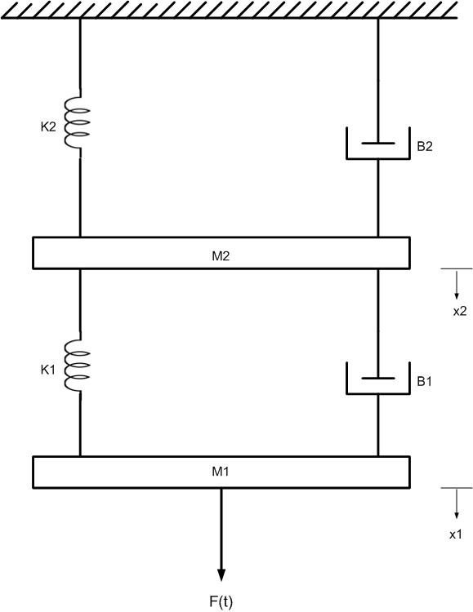
EXAMPLE1: Draw the free body diagram and write the differential equation of the given system shown in fig.
Solution:
Free body diagrams are shown in next slide

Slide 28
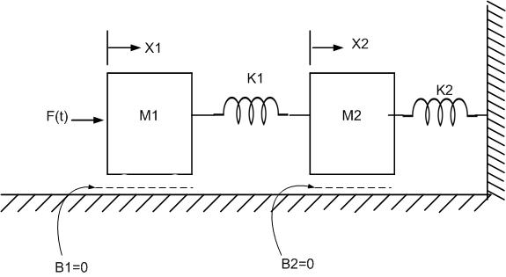
figure
Example 2: Write the differential equations describing the dynamics of the systems shown in figure and find the ratio

Slide 29
FREE BODY DAIGRAMS

Slide 30
Differential equations are

Slide 31
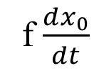
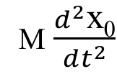
FREE BODY DAIGRAMS
Example 3: Draw the free body diagram of the given system.
F
F
x₀
M
M
M
K
f
M
K x₀
f $\frac{dx_{0}}{dt}$
M $\frac{d^{2}\text{x}\text{0}}{dt^{2}}$

Slide 32
MECHANICAL EQUIVALENT NETWORK
The mechanical equivalent network is useful to determine the transfer function of the system. Following steps are applied to draw the mechanical equivalent network.
STEP 1: Draw a reference line. Consider the fixed points as reference.
STEP 2: Corresponding to the displacement x₁, x₂ ...., select the nodes.
STEP 3: Connect one end of the masses to the reference line.
STEP 4: Connect other elements of the system to the nodes.
STEP 5: Apply nodal analysis, write the equations.

Slide 33
EXAMPLE 4: Consider the fig 1 and draw the mechanical equivalent network and write the equation.
K
B
M
B
K
f(t)
M
Fig. 1
X(t)
Fig.2 Mechanical Equivalent Network
F(t)

Slide 34
EXAMPLE 5: Draw the mechanical equivalent
Network and write the equation fig.(3).
B₁
K₂
B₂
X₁(t)
X₂(t)
M₂
K₁
X₂(t)
M₁
M₂
K₁
B₁
B₂
f(t)
K₂
M₁
X₁(t)
fig.(4) Mechanical Equivalent Network
F(t)
fig.(3)

Slide 36
THANK YOU

