Slide 1

Towards Adapter-based Multi-domain Knowledge Integration and Enhancing Factuality in Large Language Models
Selim Yagci
Research Group Social Computing Department of Computer Science
School of Computation, Information and Technology
Technische Universität München (TUM)
28.05.2024, Thesis Kick-off

Slide 2
Outline
Motivation
Background
Domain Adaptation
Adapters
Factuality Evaluation
Research Questions
Methodology
Progress
Timeline

Slide 3
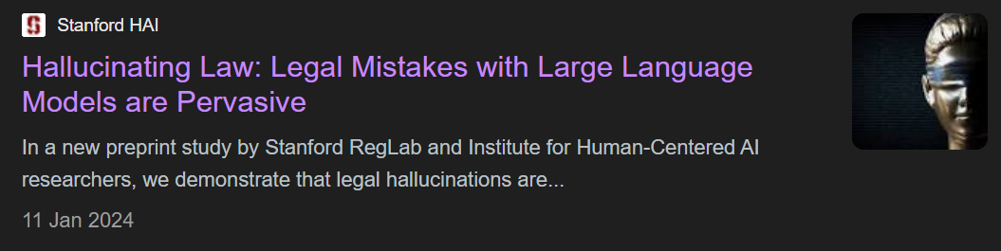
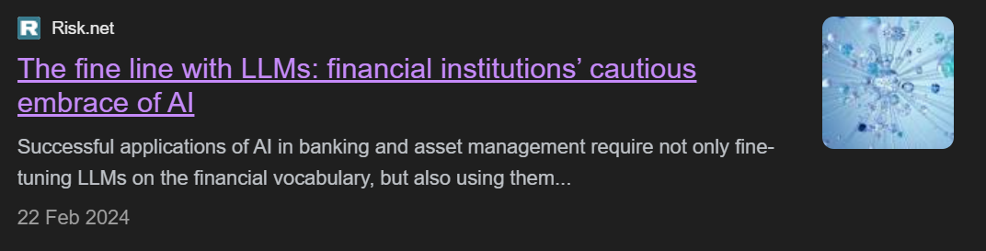
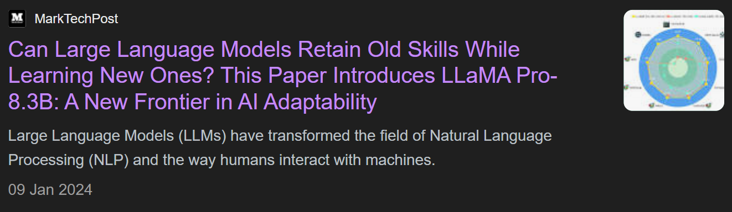
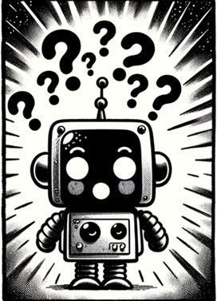
Motivation

Slide 4
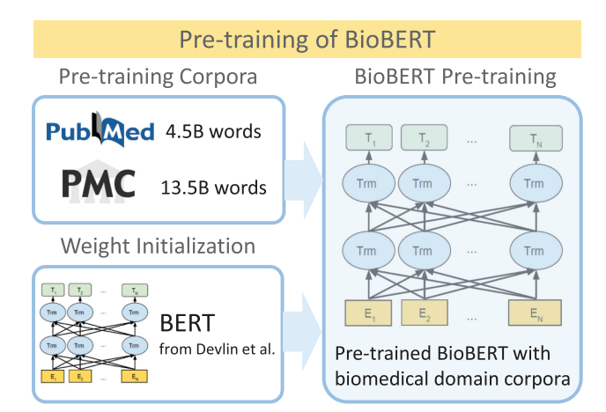
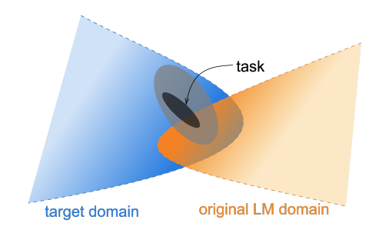
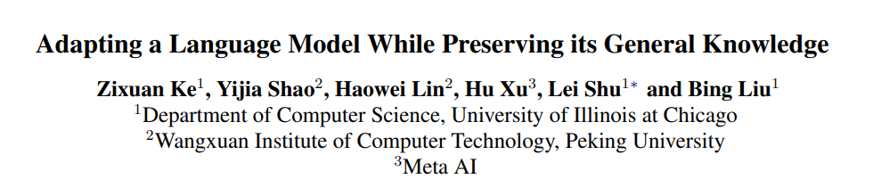
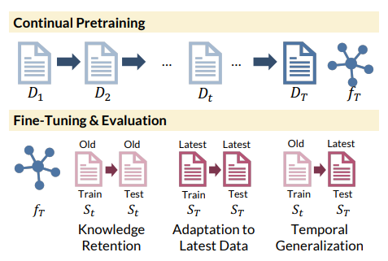
Background: Domain Adaptation

Slide 5
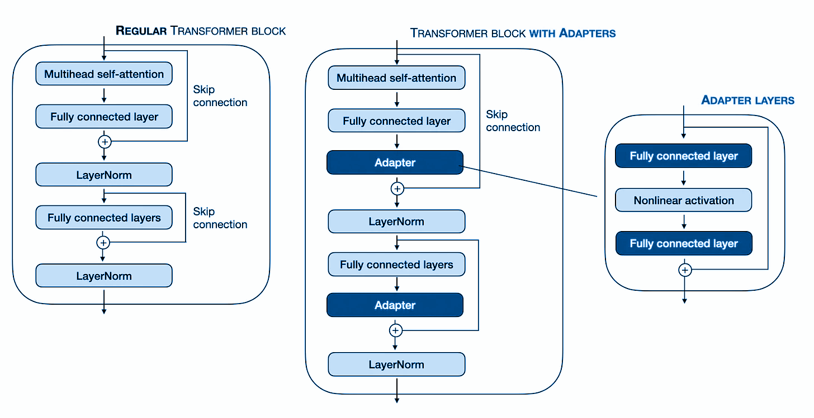
Background: Adapters

Slide 6
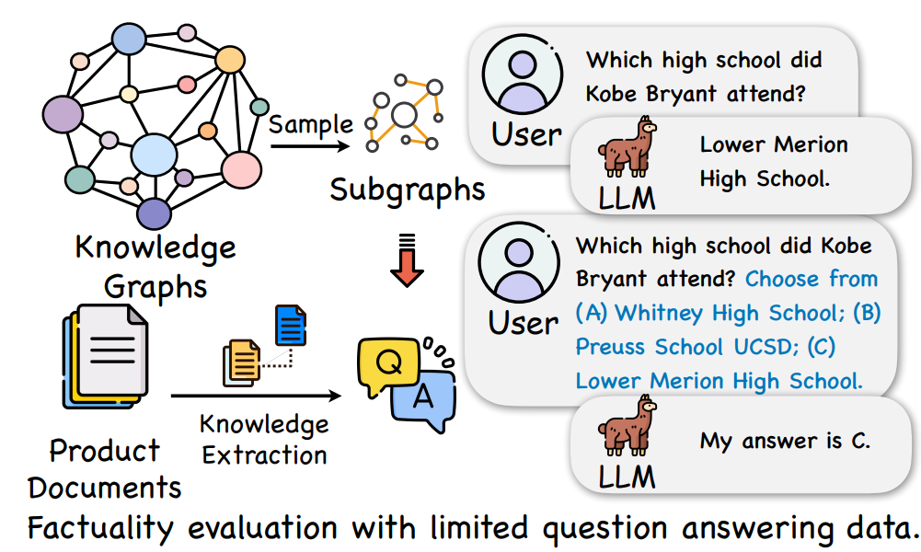
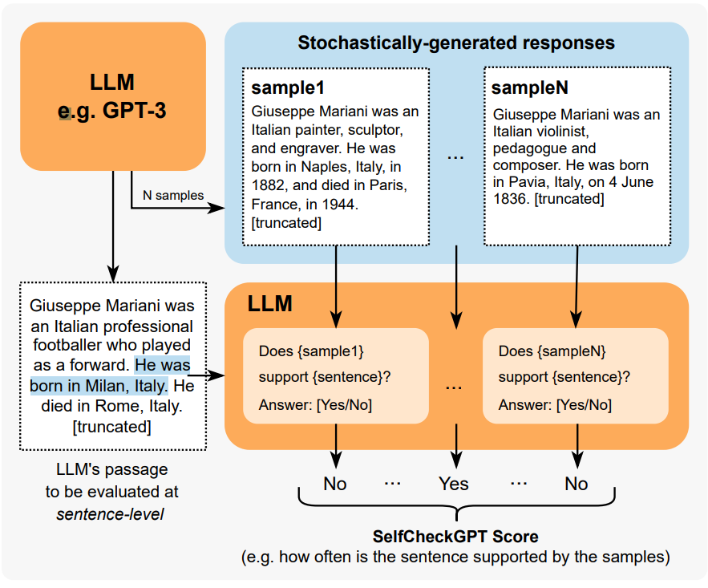
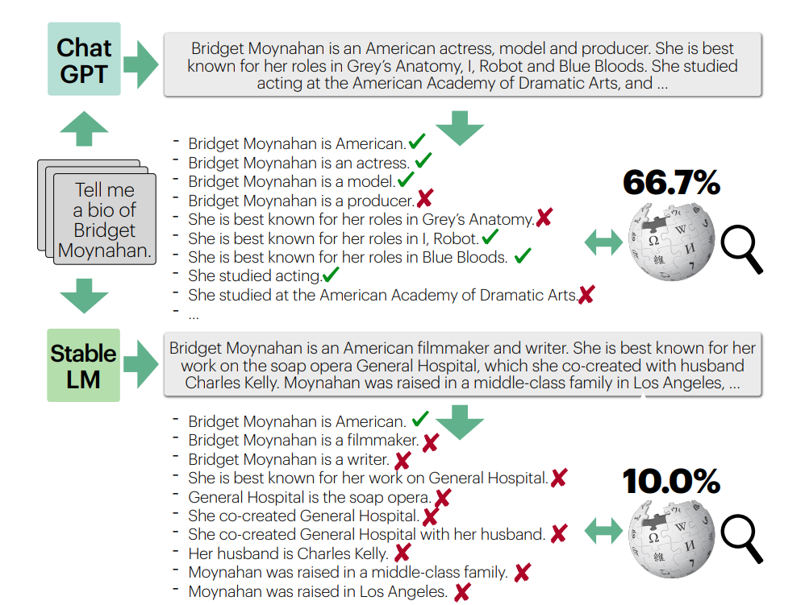
Background: Evaluating Factuality

Slide 7
Research Questions
RQ1. Can language models enhance their capability of generating contextually (domain) relevant text by synthesizing multiple adapters trained on distinct domain-specific knowledge sources?
RQ2. Why integrating domain knowledge in Large Language Models is important, and how does it affect their factual accuracy?
RQ3. Are state-of-the-art automatic evaluation metrics for factual precision in text generation comprehensive enough to assess the performance of LLMs across various domains?
RQ4. How does the selection of specific domain/task adapters during inference influence the explainability of models?

Slide 8




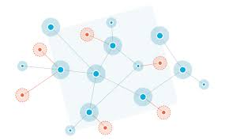
Methodology
Domain Adapter 1
active
Domain Adapter 2
LLM
Domain Data
Domain Adapter 3
Transformer

Slide 9
Methodology
Domain Adapter 1
active
Domain Adapter 2
LLM
Domain Data
Domain Adapter 3
Transformer

Slide 10
Methodology
Domain Adapter 1
active
Domain Adapter 2
LLM
Domain Data
Domain Adapter 3
Determining the right adapter
A domain specific question...
Transformer

Slide 11
Progress
Systematic Literature Review
Implementing adapter training for individual domains
Configuring pre trained adapter modules for different downstream tasks
Designing the selection/gate mechanism
Evaluation and refinement
Further work on literature review including factuality, explainability and comparison with other approaches

Slide 12
Timeline
today
Kick-off
Submission
05
06
07
08
09
10
W1
W2
W3
W4
W1
W2
W3
W4
W1
W2
W3
W4
W1
W2
W3
W4
W1
W2
W3
W4
W1
W2
W3
W4
Systematic Literature Review
Experimental Setup
Training (single) domain-spec adapters
Training the multi approach
Evaluating models for Factuality
Writing of thesis

