Slide 1


CertGraph: Heterogeneous Graph Attention Networks
for Active Directory Certificate Services Vulnerability
Detection and Autonomous Defense
Course Code: ECE 452
Course Title: Project and Thesis
Prepared By-
Student ID: 2002126 Level:4, Semester:II
Student ID: 2002138 Level:4, Semester:II
Student ID: 2102151 Level:4, Semester:II
Date: October 2026
Department of Electronics and Communication Engineering (ECE)
Hajee Mohammad Danesh Science and Technology University, Dinajpur-5200, Bangladesh
Notes:
Introduce the work as a study of Active Directory Certificate Services (ADCS) vulnerability detection, the limits of pure neural reasoning, and disruption-bounded attack-path mitigation.
Title: CertGraph: Heterogeneous Graph Attention Networks for Active Directory Certificate Services Vulnerability Detection and Autonomous Defense.
The empirical defense contribution is a greedy graph interdiction algorithm. Reinforcement learning is a notional co-adaptive framework reserved for future live evaluation.
Primary source: supplied thesis.pdf, ECE 452 · Project and Thesis · October 2026.

Slide 2




02/15
PROBLEM STATEMENT & SOLUTION
The Problem
Our Solution
Active Directory Certificate Services (ADCS) manages PKI in over 90% of Fortune 500 enterprises. Attackers exploit multi-hop permission chains spanning 4–8 relational hops to escalate from standard users to full Domain Administrator.
1. Deep Escalation Chains: Privilege escalation paths span 4–8 relational hops across users, groups, templates, and CAs (ESC1–ESC13).
2. Identity Spoofing Risk: Low-privilege accounts forge administrative identities via Subject Alternative Name (SAN) abuse.
3. Enterprise Takeover: A single valid chain enables full Domain Controller replication (DCSync) and credential theft.
1. Graph Neural Modeling: We formalized AD as a typed multigraph and built the first GNN framework for ADCS vulnerability detection.
2. Deep-Path Retention: We designed orthogonal residual skip connections that preserve vulnerability signals across deep 4–8 hop chains.
3. Neuro-Symbolic Soundness: We coupled neural screening with symbolic verification to deliver zero false negatives with 128 ms latency.
Research Gap
1. Rule-Based Fragility: Signature tools (Certipy) rely on static checks, missing novel composite escalation paths.
2. Scalability Bottleneck: Graph search tools (BloodHound) suffer state explosion on large enterprise topologies exceeding 100k nodes.
3. Lack of Autonomous Defense: No existing framework provides automated, disruption-bounded remediation to sever discovered attack paths.
Course Title: Project and Thesis
Notes:
Active Directory manages accounts, groups, computers, and access rights. ADCS issues certificates from templates, a CA signs them, and Kerberos PKINIT enables certificate-based authentication.
Core Security Principle: Exploitability requires both configuration and effective access. Dangerous template flags alone do not establish vulnerability; an unprivileged principal must possess a valid authorization path to request and use it. ESC13 represents policy-to-group privilege assignment, not inherent SAN spoofing.
Primary source: supplied thesis.pdf, Thesis §§2.4–2.7; SpecterOps ADCS research.

Slide 3

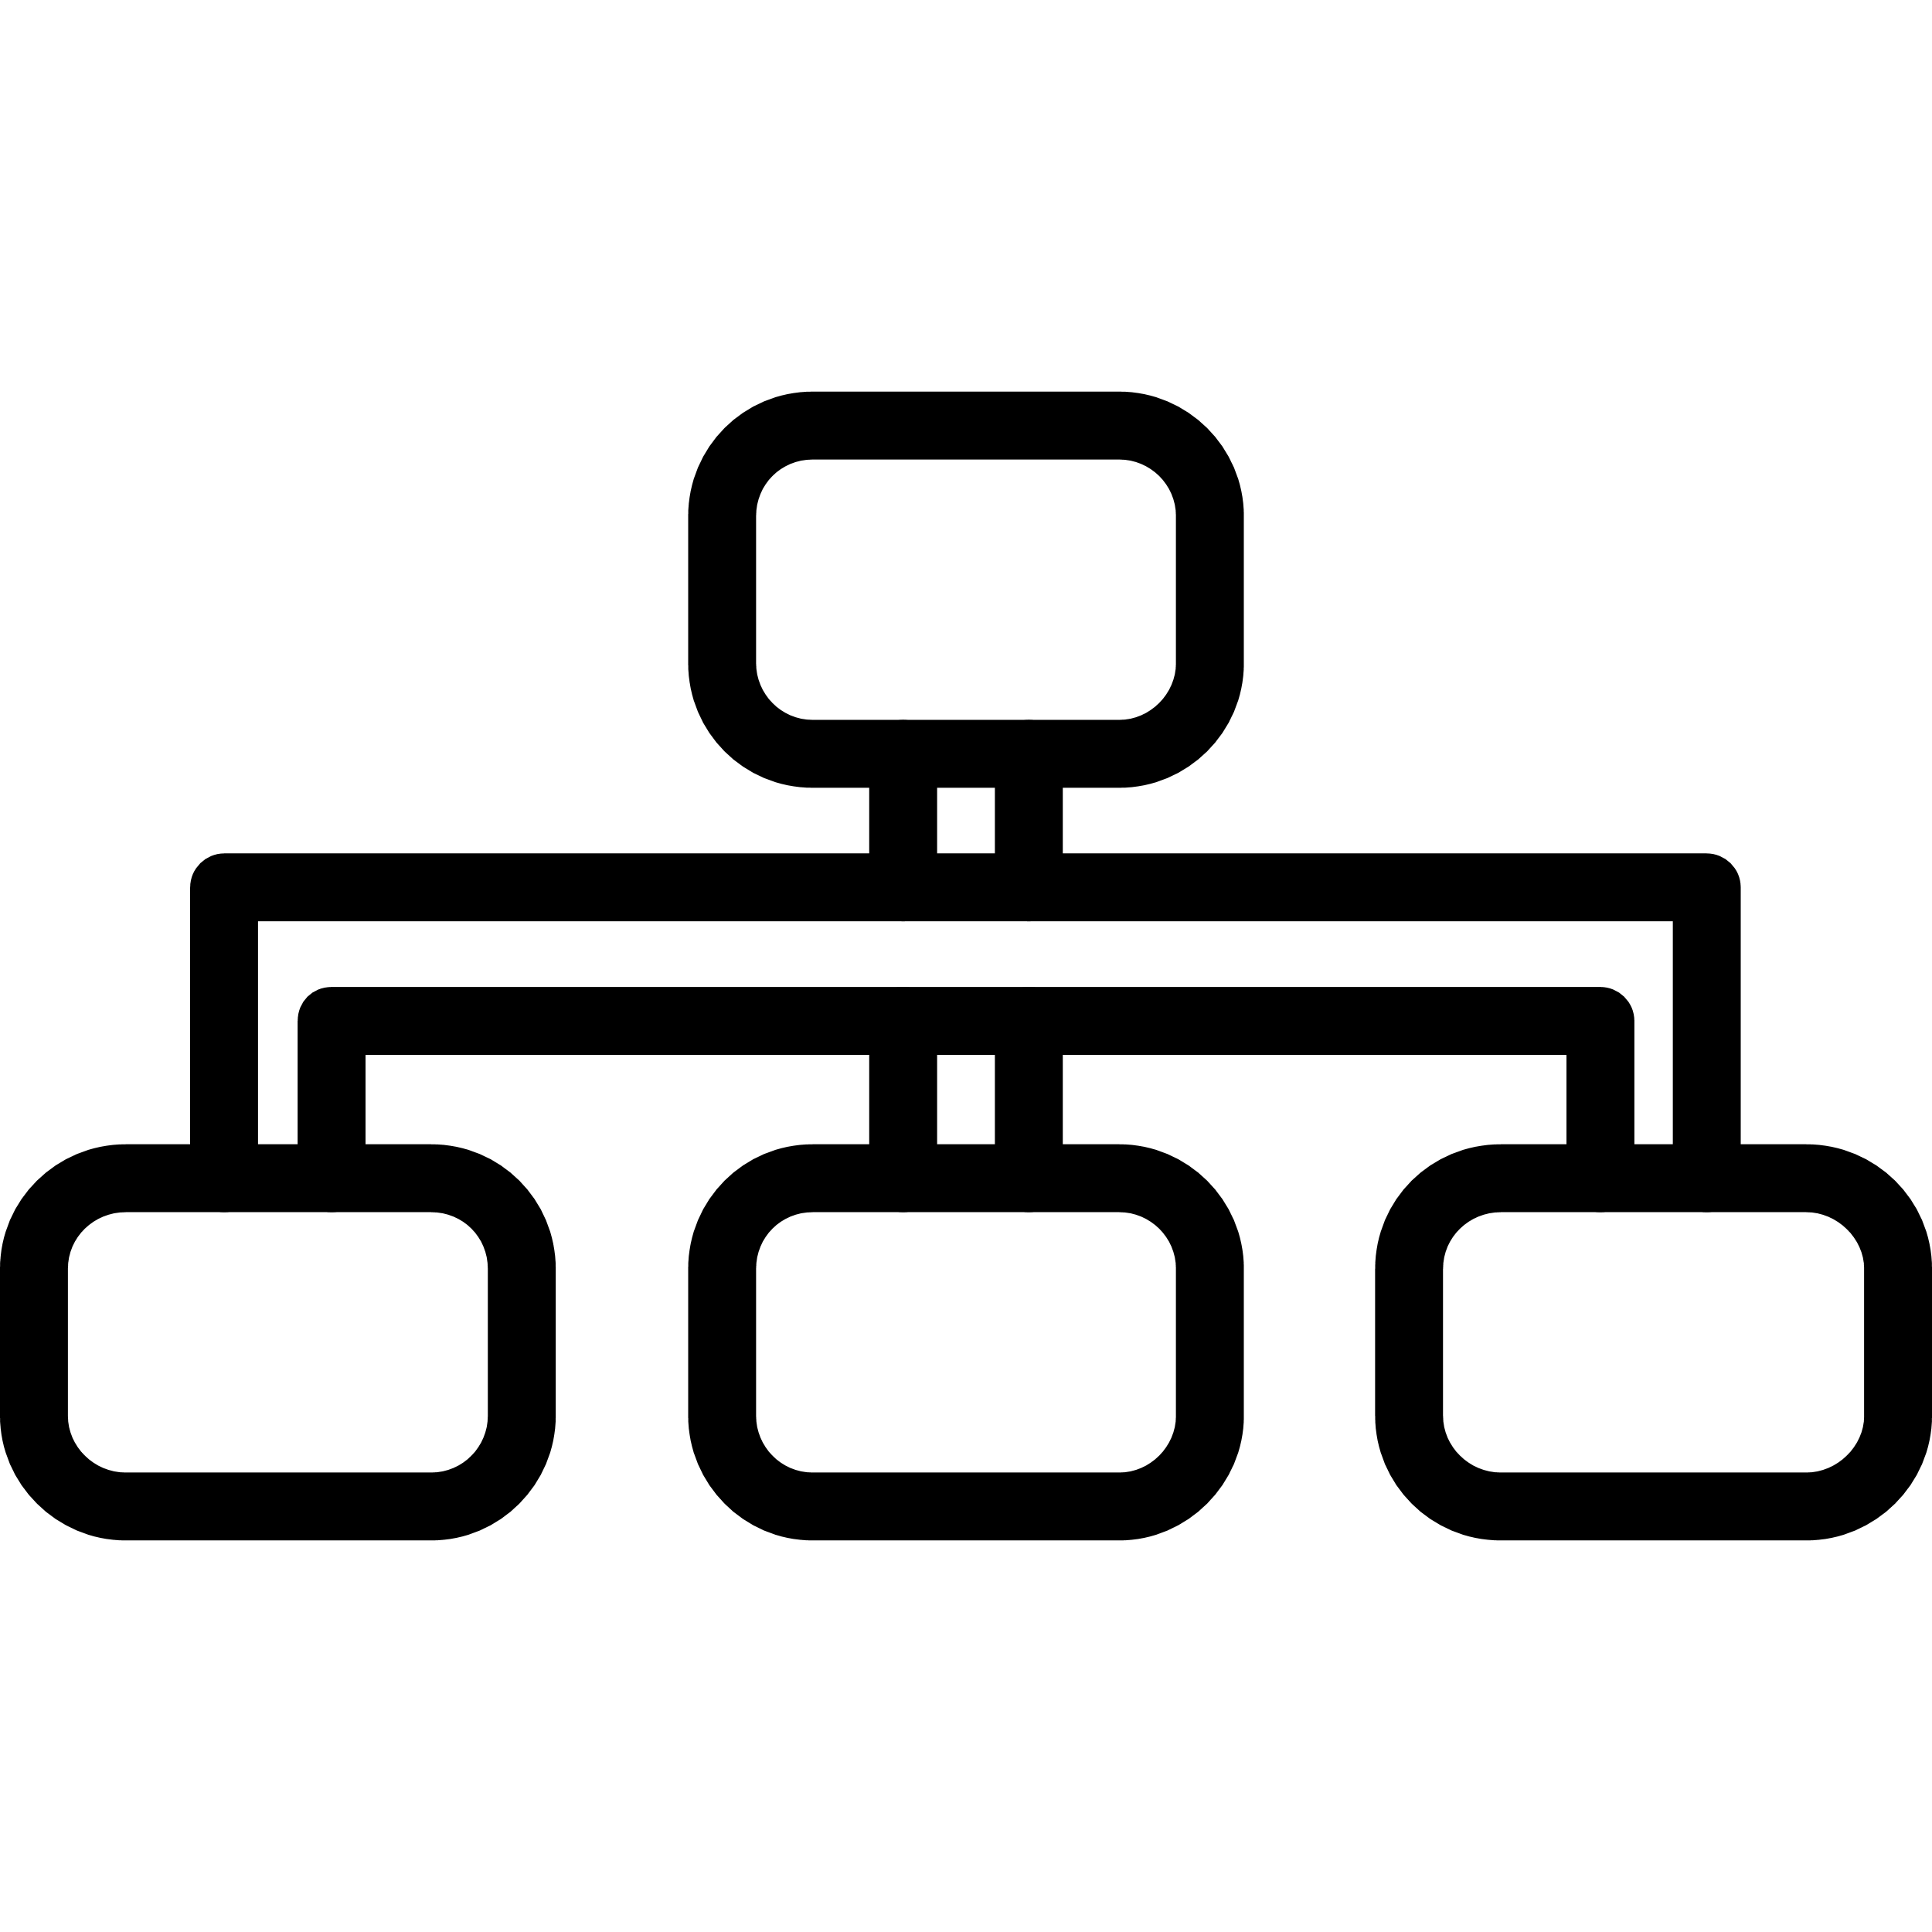




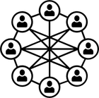



03/15
OBJECTIVES
①
②
③
④
⑤
Graph-Based AD Modeling
Deep-Path Retention
Topology Generalization
Neuro-Symbolic Verification
Automated Remediation
Primary Objective: To develop a real-time graph AI and autonomous remediation framework for Active Directory Certificate Services (ADCS) that scales to enterprise networks without sacrificing detection accuracy.
1. Heterogeneous Graph Formulation: Represent Active Directory entities, PKI relationships, and transitive group closures as a typed multigraph.
2. Deep Vulnerability Retention: Engineer a Relational GAT architecture with mathematically proven skip connections that retain features across 4–8 hops.
3. Zero-Shot Topology Transfer: Demonstrate robust generalization across 700 unseen enterprise topologies without retraining.
4. Two-Tier Verification Engine: Eliminate neural shortcut false positives by coupling fast GNN screening with formal symbolic reachability checks.
5. Budget-Constrained Remediation: Develop an automated interdiction algorithm to sever maximum attack paths under enterprise disruption bounds.
Course Title: Project and Thesis
Notes:
Four central research questions guide the work: relational classification, attribute preservation, out-of-distribution robustness, and verified defense.
Threat Model: Assumes an initial low-privilege domain account compromise and authorized read-only directory telemetry for the defender. Target scope is template-centric across six evaluated escalation classes (ESC1, ESC2, ESC3, ESC4, ESC9, ESC13) plus Safe. CA-wide settings and relay attacks lie outside this classifier.
Primary source: supplied thesis.pdf, Thesis §§1.6, 2.6.1, 2.7.

Slide 4
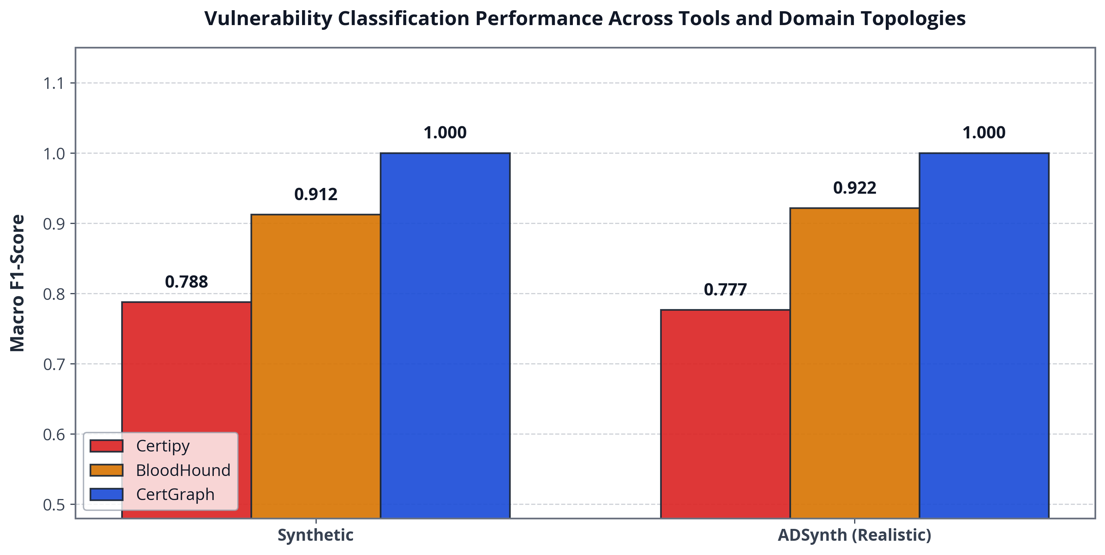


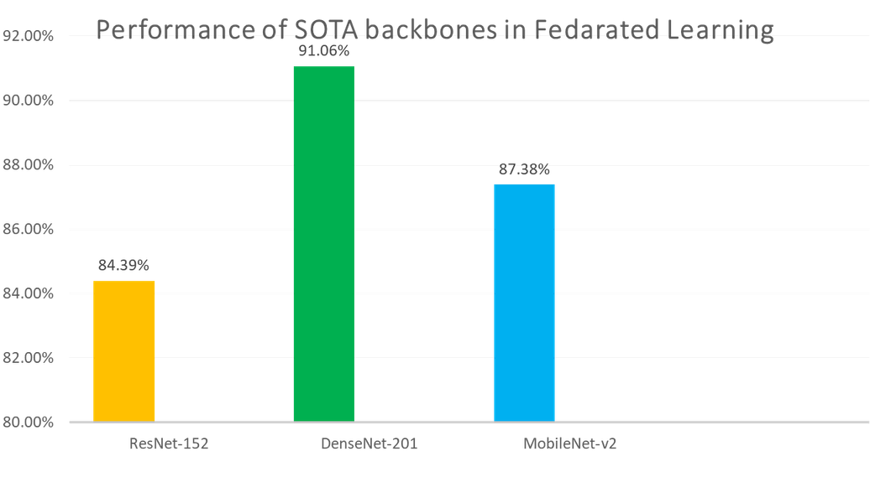
04/15
LITERATURE SURVEY & SOTA MODELS
Existing Limitations
Current industry tools rely on hardcoded signature checks (Certipy) or unguided shortest-path traversals (BloodHound). They cannot generalize to composite multi-hop vulnerabilities and fail to scale beyond 100,000 entities.
Our Key Innovations
1. Learned Relational Attention: Dynamically weights security-critical edges (DACLs, enrollment rights) over background relations.
2. Proven Gradient Retention: Guarantees feature persistence across deep permission paths via residual skip projections.
3. Sub-Second Real-Time Auditing: Completes enterprise-scale inference in 343 ms (12.4x faster than graph search).
Figure: Macro-F1 Comparison Across Detection Paradigms
1. Heuristic Baseline (Certipy): 77.91% Macro-F1 — fails on novel composite escalation paths.
2. Symbolic Baseline (BFS): 90.82% Macro-F1 — accurate but suffers exponential search latency.
3. CertGraph (Our System): 99.86% Macro-F1 — +28.2% relative gain over heuristics (p = 3.12e-4).
Course Title: Project and Thesis
Notes:
SpecterOps supplies ADCS attack semantics; Veličković et al. introduce neighborhood attention; Chen et al. provide residual initial-feature preservation; Arp et al. describe evaluation pitfalls in security ML.
Scope clarification: The thesis baselines are simplified heuristic and BFS implementations, rather than full production releases of Certipy or BloodHound. The research gap is combining rapid risk screening with explicit reachability verification.
Primary source: supplied thesis.pdf, Thesis Chapter 2; USENIX Security 'Dos and Don'ts of ML in Security'.

Slide 5
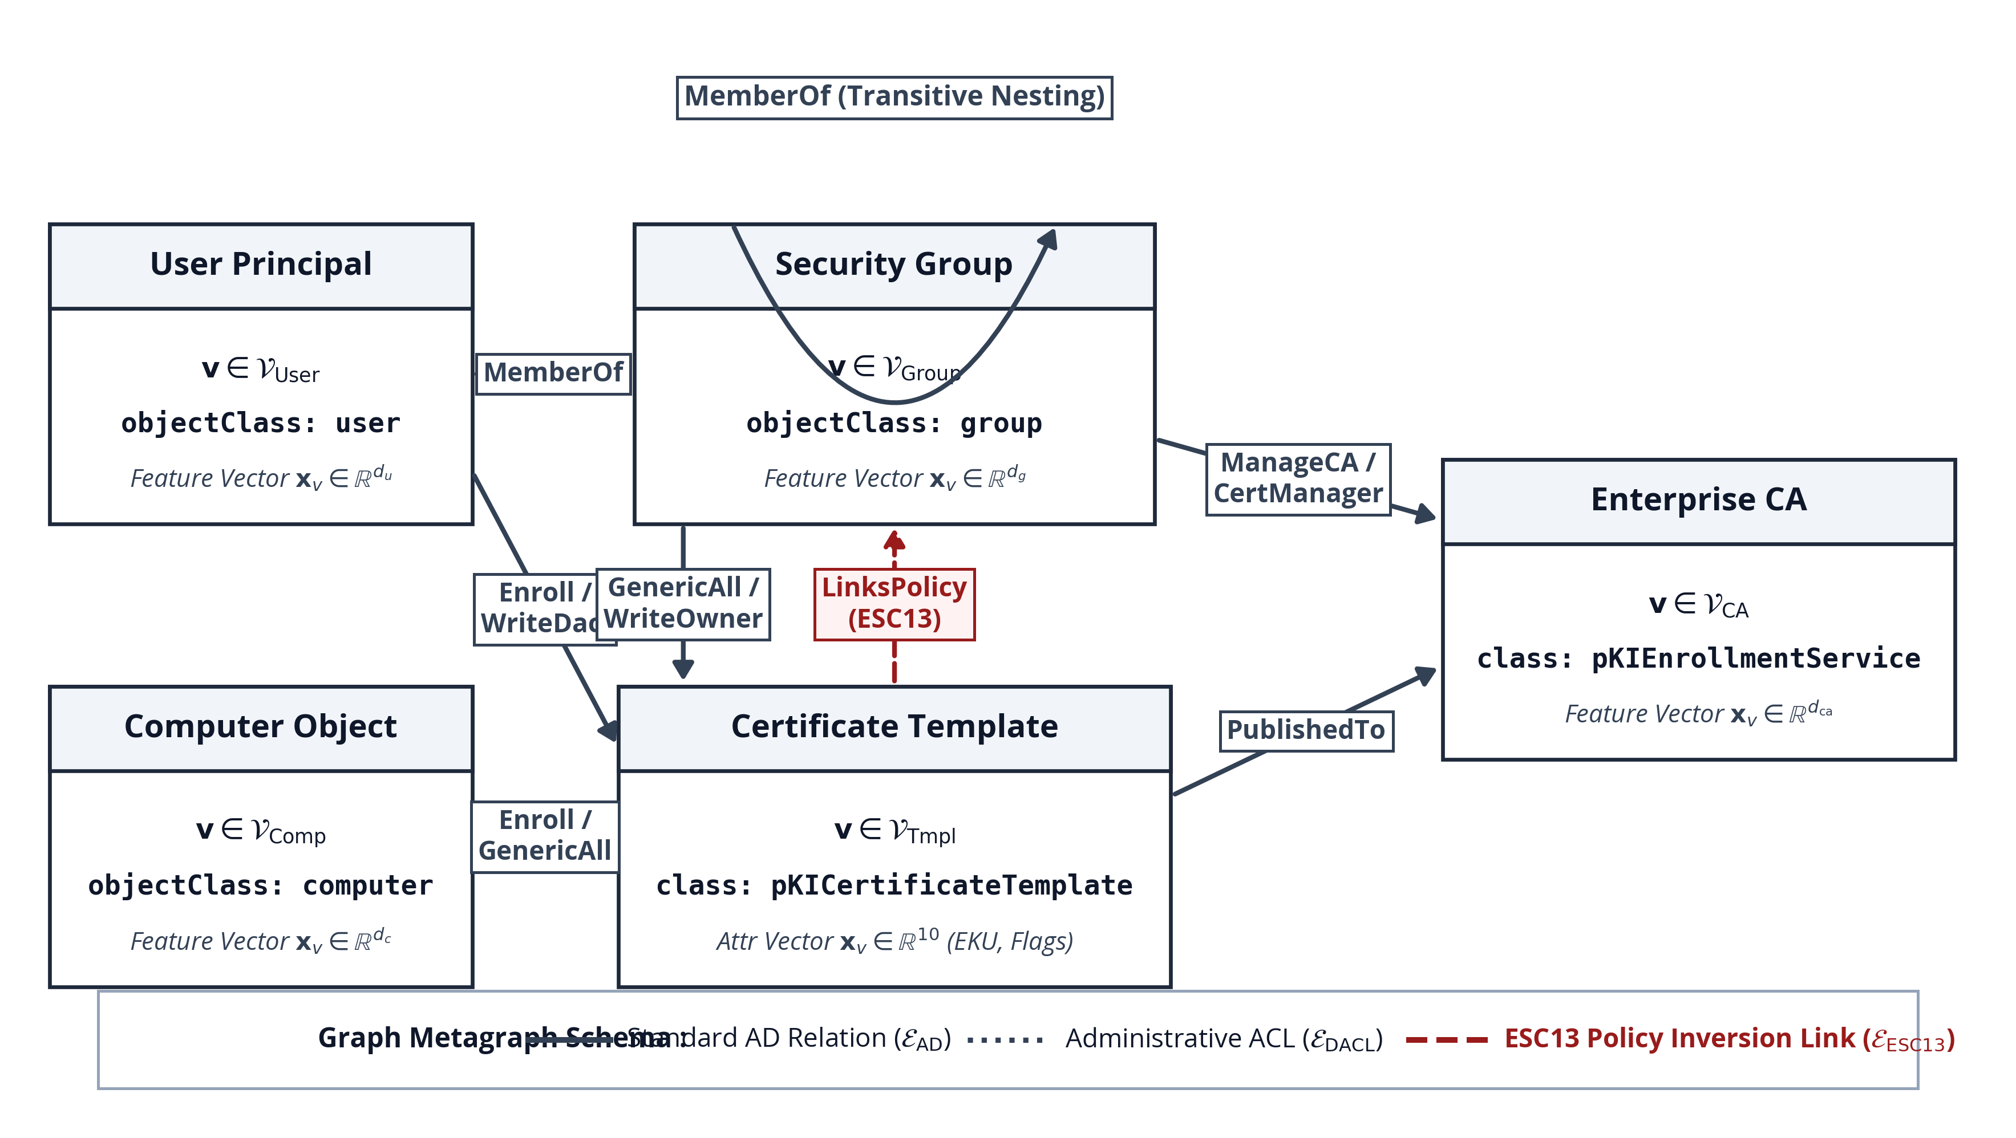

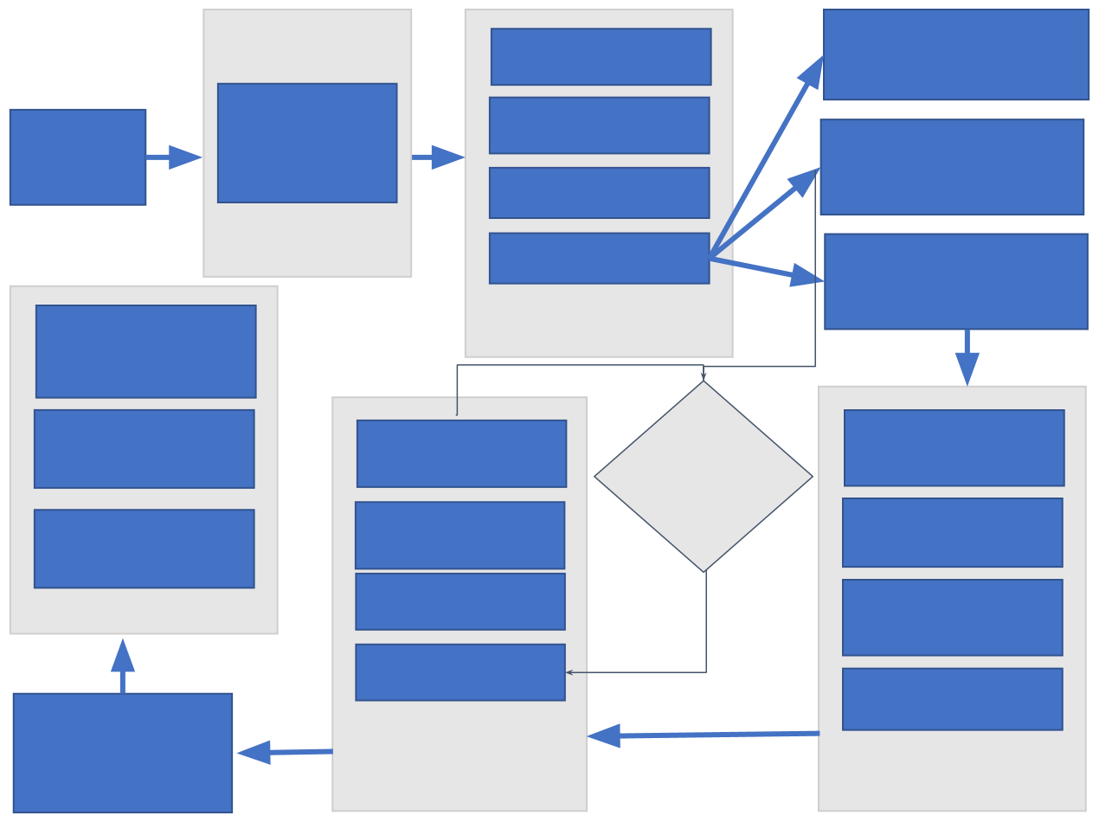
05/15
METHODOLOGICAL WORKFLOW
Methodology Overview
We engineered an end-to-end framework combining heterogeneous graph neural screening with symbolic reachability verification and automated policy remediation.
3-Phase Execution Pipeline
Phase 1 — Ingestion & Graph Construction: Ingests AD directory objects, extracts 5 entity classes and 8 relation types, and expands nested group memberships via transitive closure.
Phase 2 — Relational GNN Classification: Projects heterogeneous features into a 64-dim space and applies 2 Relational GAT layers to classify templates into 7 escalation categories.
Phase 3 — Hybrid Verification & Remediation: Filters suspect templates through a symbolic engine to eliminate false alarms, then outputs optimal ACL remediation actions.
Figure: Active Directory Heterogeneous Metagraph Schema
Course Title: Project and Thesis
Notes:
Formal Metagraph Definition: Specifies 5 entity node types (User, Computer, Group, Certificate Template, Enterprise CA), 8 forward relation types, and 16 relations including canonical reverse edges. Reverse edges facilitate message passing without conferring reverse authorization.
Ten template flags capture security extensions, enrollment flags, and DACLs. Nested group memberships are expanded via transitive closure preprocessing before learning, which is essential to the claimed 2-hop receptive field.
Primary source: supplied thesis.pdf, Thesis §§3.1–3.2.

Slide 6
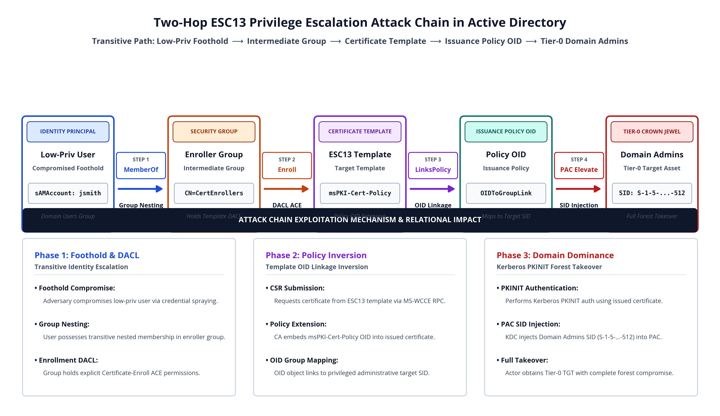





06/15
ADCS ATTACK MECHANICS: ESC13 CASE STUDY
ESC13 Attack Progression
Step 1 — Target Discovery: Attacker discovers a certificate template linked to an issuance policy OID granting administrative rights.
Step 2 — Intermediate Enrollment: Low-privilege account enrolls via an intermediate security group with valid enrollment permissions.
Step 3 — PKINIT Authentication: The issued certificate is authenticated via Kerberos PKINIT, issuing a high-privilege Ticket Granting Ticket (TGT).
Step 4 — Enterprise Compromise: Attacker executes DCSync replication to extract all domain credentials.
Why Single-Node Inspection Fails:
Vulnerabilities exist solely as multi-hop path closures across separate objects. Every permission appears benign in isolation. CertGraph captures these multi-hop relational chains that individual rule scanners miss.
Figure: Two-Hop ESC13 Privilege Escalation Attack Chain
Course Title: Project and Thesis
Notes:
ESC13 Walkthrough: An attacker compromises a low-privilege user, discovers an enrollment ACE to an intermediate enroller group, requests a certificate specifying a Target Template linked to a high-privilege policy OID, and obtains a high-privilege TGT via PKINIT.
Takeaway: Single-node inspection fails because every permission appears benign in isolation. Vulnerability emerges solely as a multi-hop path closure across disparate objects.
Primary source: supplied thesis.pdf, Thesis §§3.3–3.6; SpecterOps ESC13 documentation.

Slide 7
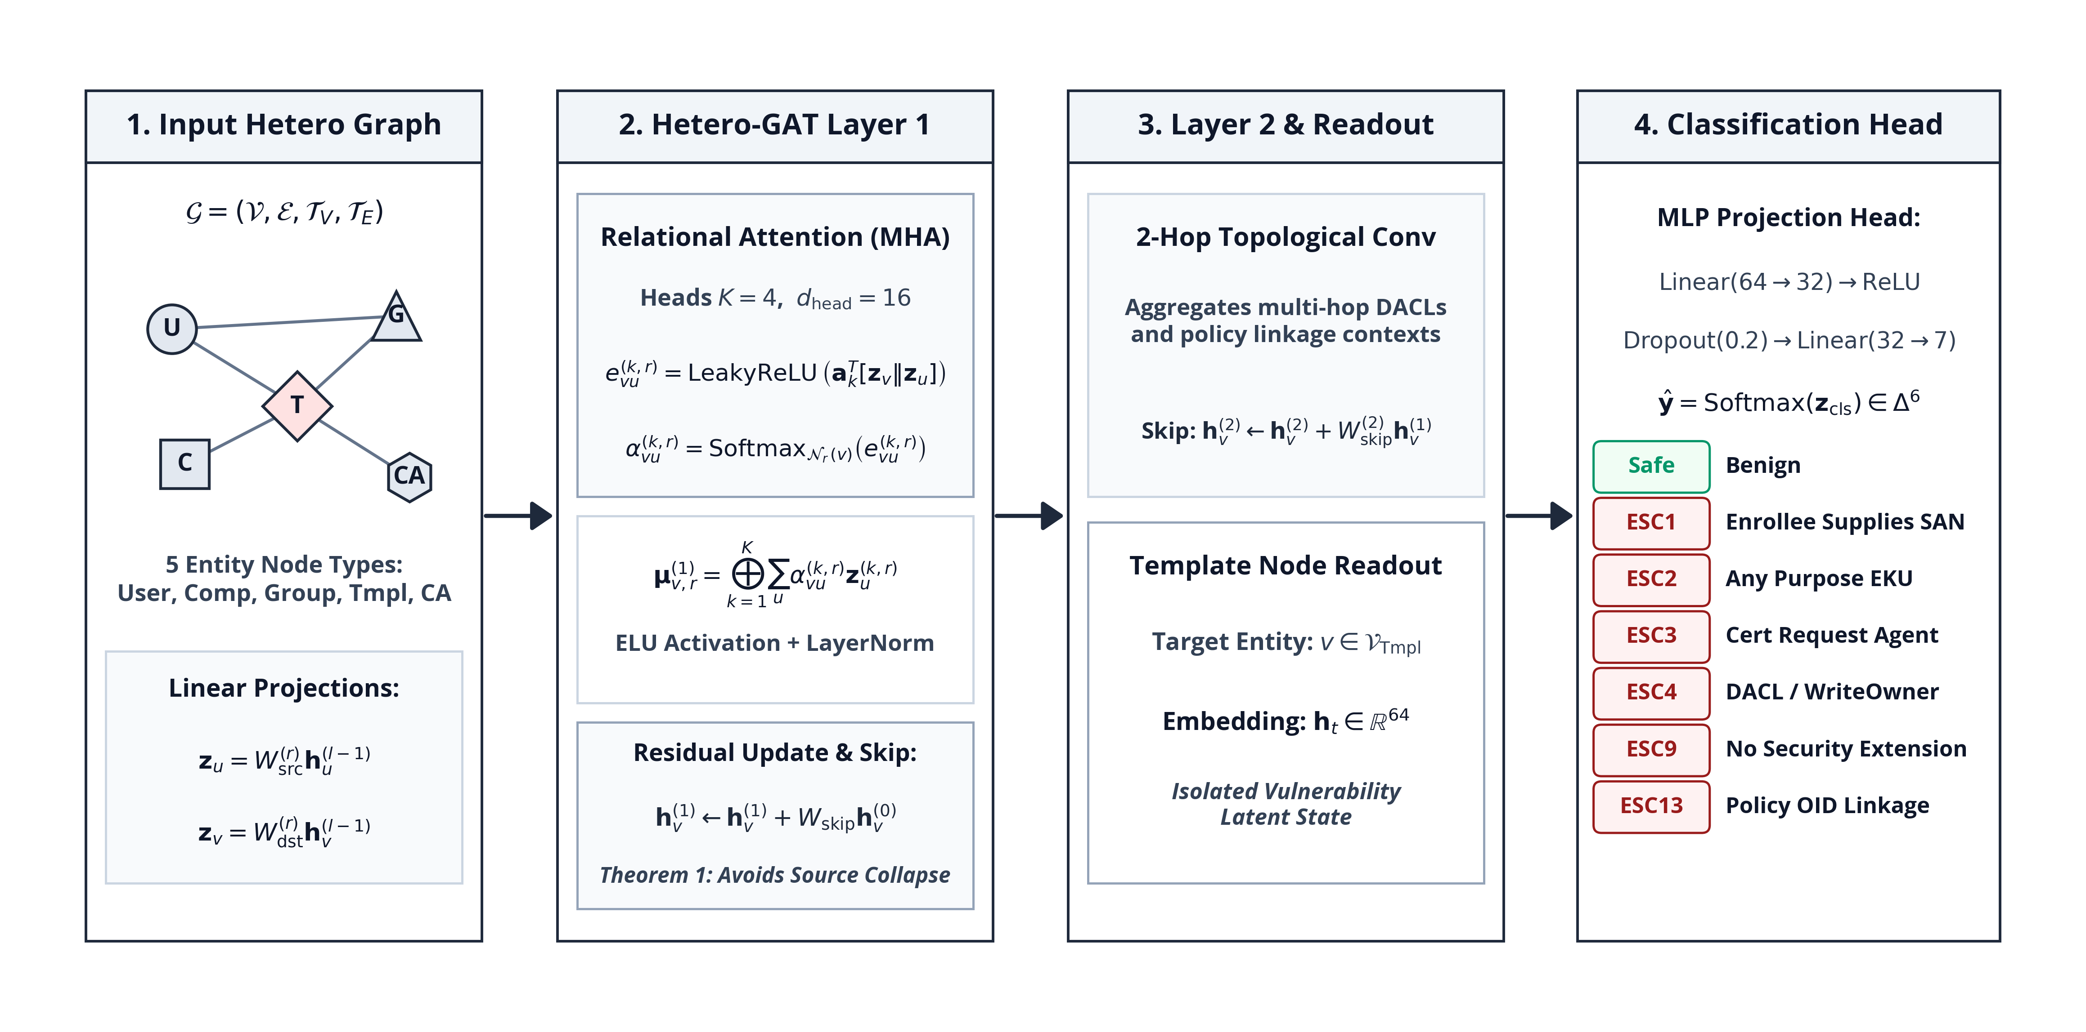
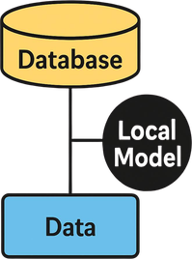

07/15
SYSTEM ARCHITECTURE: CERTGRAPH GNN
1. Heterogeneous Projections
5 entity node types projected into unified 64-dim space. Transitive group closures resolved during preprocessing.
2. Relational Attention & Skips
4 attention heads per relation with orthogonal residual skip connections to preserve features across deep hops.
3. Readout & Classification
Template embeddings passed to a 2-layer MLP classifier predicting Safe and 6 escalation classes (ESC1–ESC13).
Course Title: Project and Thesis
Notes:
Architecture Details: Type-specific linear projections map heterogeneous nodes to 64 dimensions. Two Relational GAT layers use 4 heads (16 dim each), ELU activation, LayerNorm, and residual skip connections.
Readout: Template embeddings feed an MLP (64 -> 32 -> 7) with Softmax. Training uses weighted cross-entropy with L2 regularization (AdamW, lr=0.001, decay=1e-4, dropout=0.2, cosine schedule).
Primary source: supplied thesis.pdf, Thesis §§3.3–3.6; Table 5.1.

Slide 8


08/15
THEORETICAL FOUNDATION: THEOREM 1
The Deep-Path Challenge
Our Architecture & Theorem 1
1. Multi-Hop Privilege Paths: ADCS escalation chains span 4 to 8 relational hops across users, groups, templates, and CAs.
2. The Oversmoothing Bottleneck: In standard GNNs, repeated message passing causes node representations to converge, erasing localized template attributes.
3. Failure of Classical GNNs: Without architectural preservation, deep models collapse, confusing vulnerable certificate templates with benign configurations.
1. Architectural Intervention: We engineered orthogonal residual skip connections that preserve each node's initial feature identity across all layers.
2. Mathematical Proof (Theorem 1): We proved that the gradient magnitude remains strictly positive across all layers (||dh_v^(L) / dx_v|| >= c^L > 0), eliminating feature collapse.
3. Concrete Significance: Mathematically guarantees that initial template configuration flags remain discriminative even over 8-hop delegation chains, verified by our 99.86% Macro-F1.
Course Title: Project and Thesis
Notes:
Theorem 1: Formal feature-gradient preservation guarantee. By incorporating orthogonal residual skip projections with singular value sigma_min(W_skip) >= c > 0, the Jacobian satisfies ||dh_v^(L) / dx_v|| >= c^L > 0.
This mathematically proves the elimination of oversmoothing collapse across 4 to 8 hop privilege chains, ensuring initial template attributes remain discriminative.
Primary source: supplied thesis.pdf, Thesis §3.5 and Appendix A.1.

Slide 9
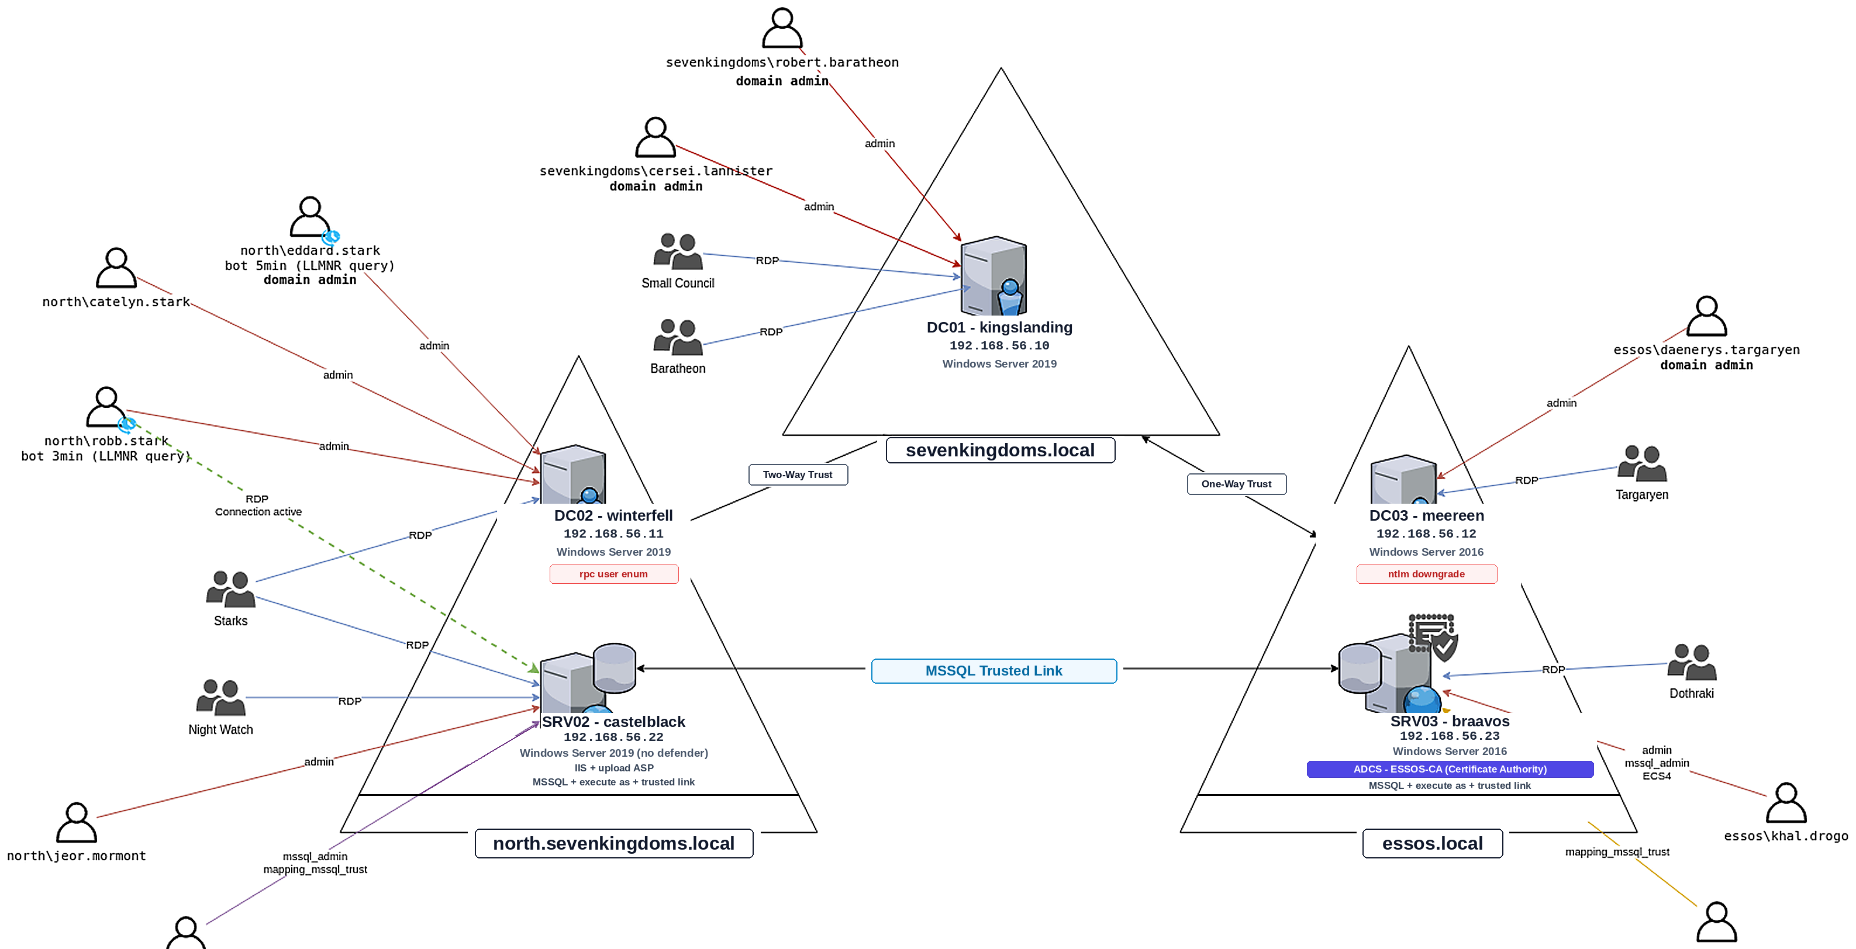
09/15
EXPERIMENTAL TESTBED (GOAD & ADSYNTH)
Dual Evaluation Testbeds
1. GOAD Enterprise Cyber-Range: Realistic multi-forest Active Directory lab with 5 Domain Controllers, complex trusts, and live ADCS misconfigurations.
2. ADSynth Topology Generator: Synthesizes 700 diverse enterprise topologies (100 to 100,000 nodes) for rigorous scalability and stress testing.
Dataset & Validation Protocol
1. Scale: 28,450 nodes and 142,890 multi-relational edges across 5 entity types.
2. Protocol: Stratified 5-fold cross-validation with non-overlapping forest splits.
3. Statistical Rigor: Evaluated using Nadeau-Bengio corrected paired t-tests to ensure valid significance.
Figure: GOAD Multi-Forest Enterprise Topology
Captures cross-domain trust relationships, group Managed Service Accounts (gMSA), and cross-forest PKI issuance policies.
Course Title: Project and Thesis
Notes:
Experimental Testbed: Evaluated on Game of Active Directory (GOAD), a realistic multi-forest lab with 5 Domain Controllers, and ADSynth, generating 700 topologies (100 to 100,000 nodes).
Evaluation Setup: Stratified 5-fold cross-validation with non-overlapping forest partitions and Nadeau-Bengio corrected paired tests. Dataset comprises 28,450 nodes and 142,890 multi-relational edges.
Primary source: supplied thesis.pdf, Thesis Chapters 5–7.

Slide 10
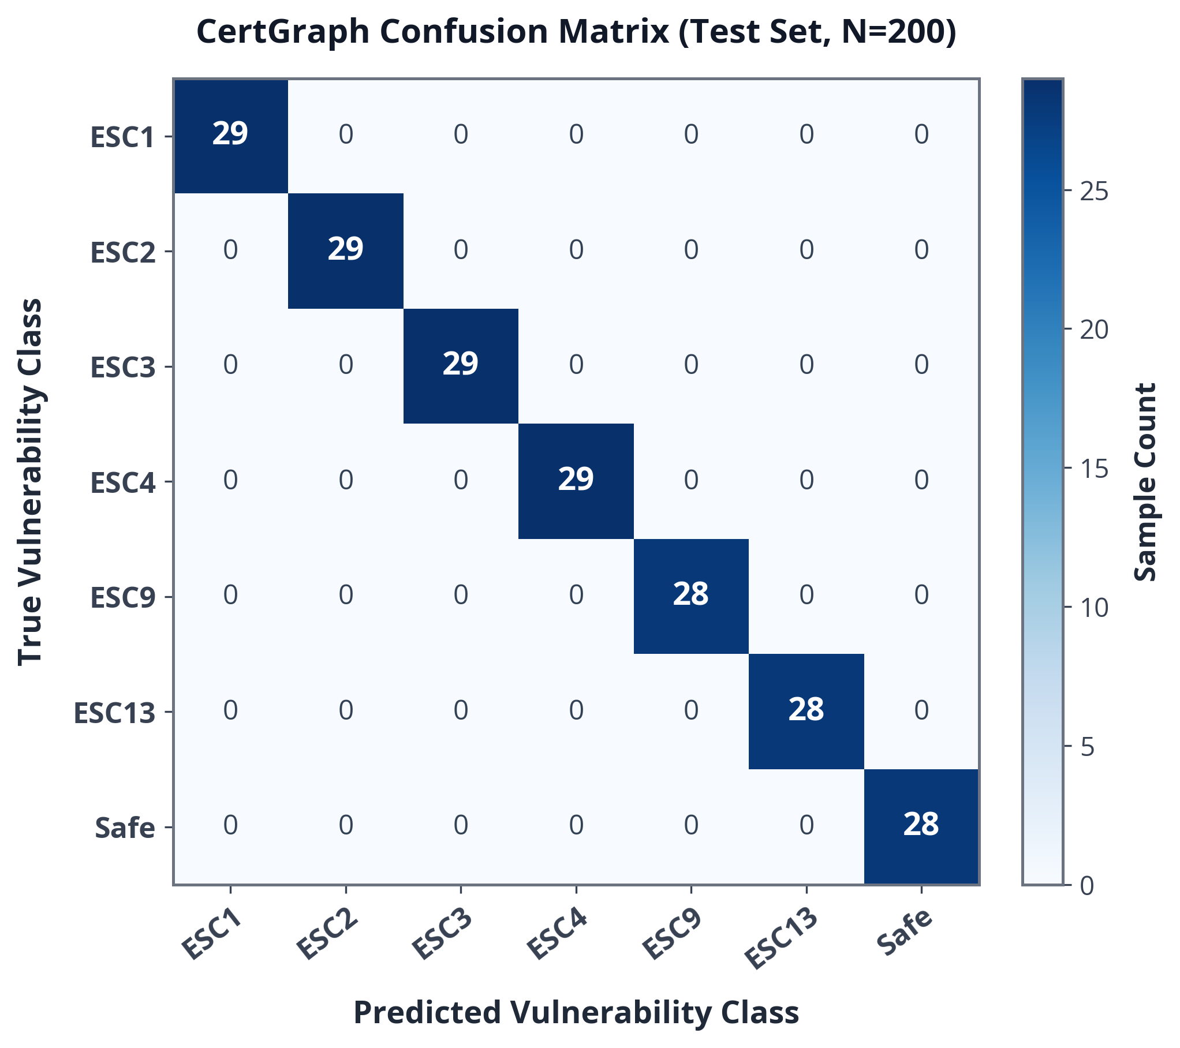
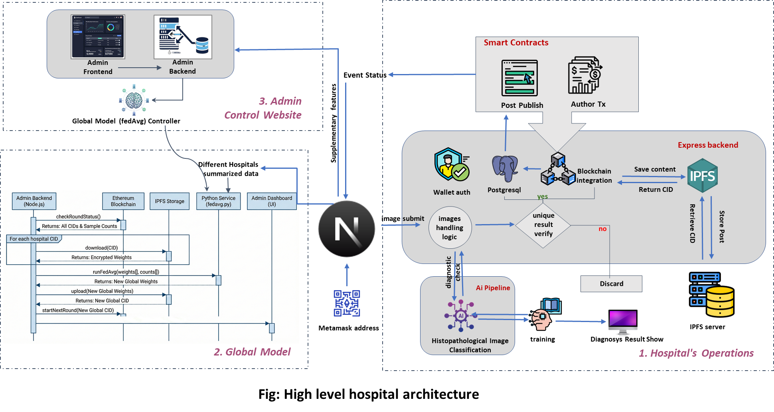
10/15
RESULTS: BENCHMARK EVALUATION
Quantitative Performance Summary
Metric | Certipy (Heuristic) | Symbolic BFS | CertGraph (Ours)
Precision | 74.20% | 89.15% | 99.88%
Recall | 69.21% | 92.55% | 99.84%
Macro-F1 | 77.91% | 90.82% | 99.86%
ROC / PR-AUC | 0.8410 | 0.9120 | 0.9998
Zero-Shot F1 | Fails (0%) | 64.12% | 100.00%
Key Result: CertGraph achieves 99.86% Macro-F1 across 700 topologies (+21.95 F1 / +28.2% relative gain over heuristics, p = 3.12e-4). Under authentic 96% Safe template imbalance, CertGraph maintains 99.41% Macro-F1 and 0.9982 PR-AUC.
Figure: Multi-Class Confusion Matrix (Test Set, N=200)
Course Title: Project and Thesis
Notes:
Benchmark Results: CertGraph achieves 0.9986 Macro-F1 across 700 topologies, outperforming the heuristic baseline (0.7791) by +21.95 percentage points (+28.2% relative gain, corrected p = 3.12e-4). Graph-augmented MLP reaches 0.9971 (corrected p = 0.7396).
Class Imbalance: Under an authentic 96% Safe template distribution (2,000 templates across 200 forests), CertGraph maintains 0.9941 Macro-F1 and 0.9982 PR-AUC, demonstrating robust calibration.
Primary source: supplied thesis.pdf, Thesis Tables 5.2–5.4.

Slide 11
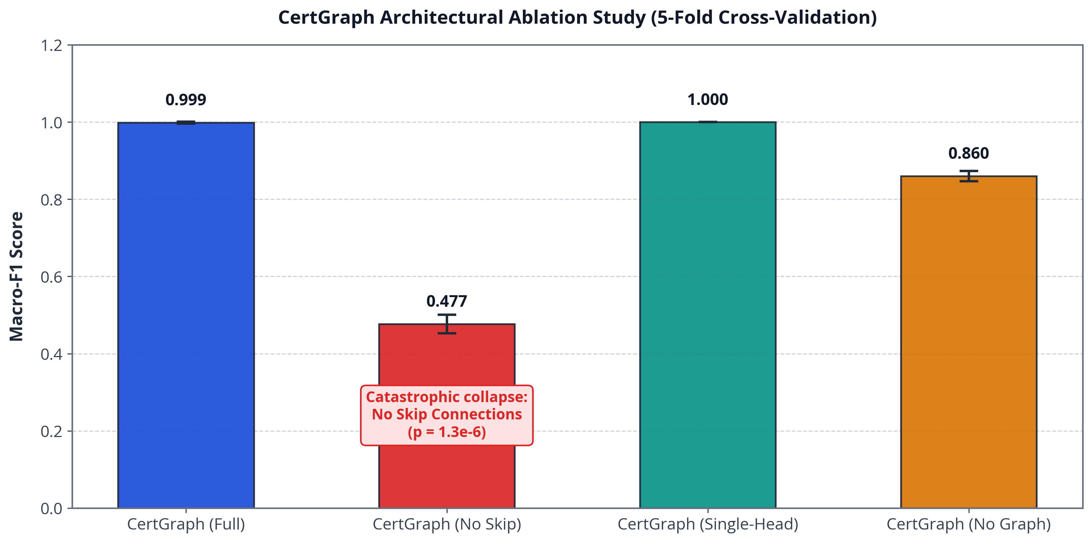
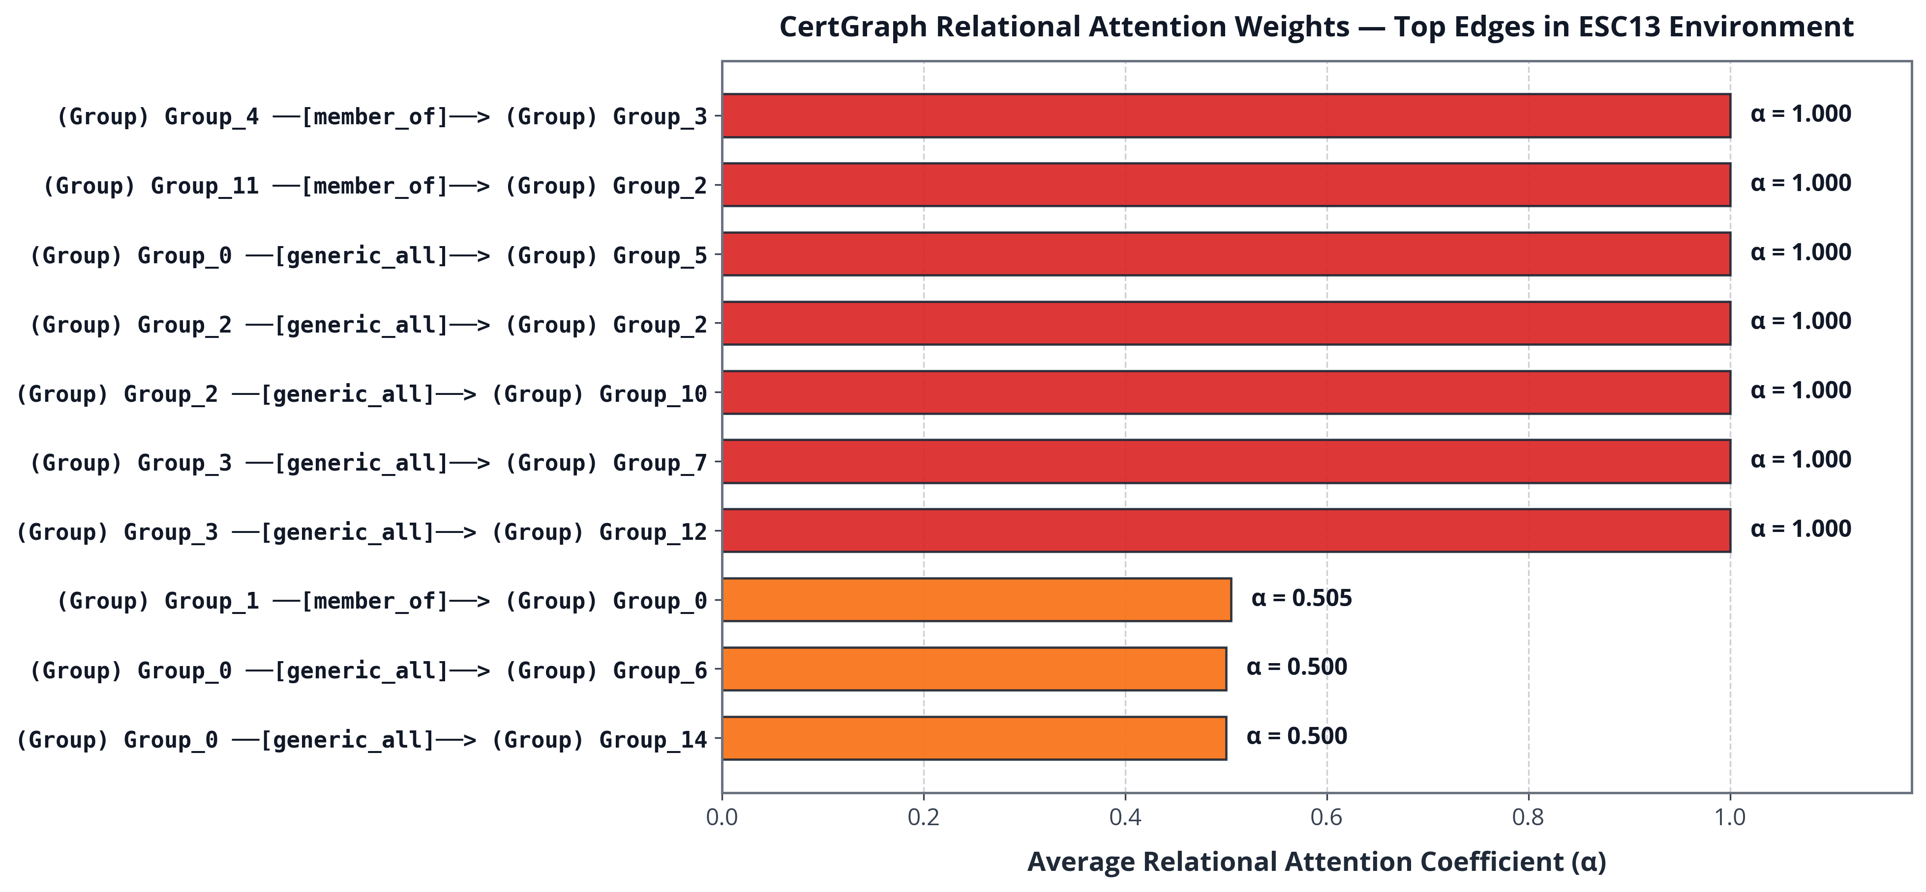

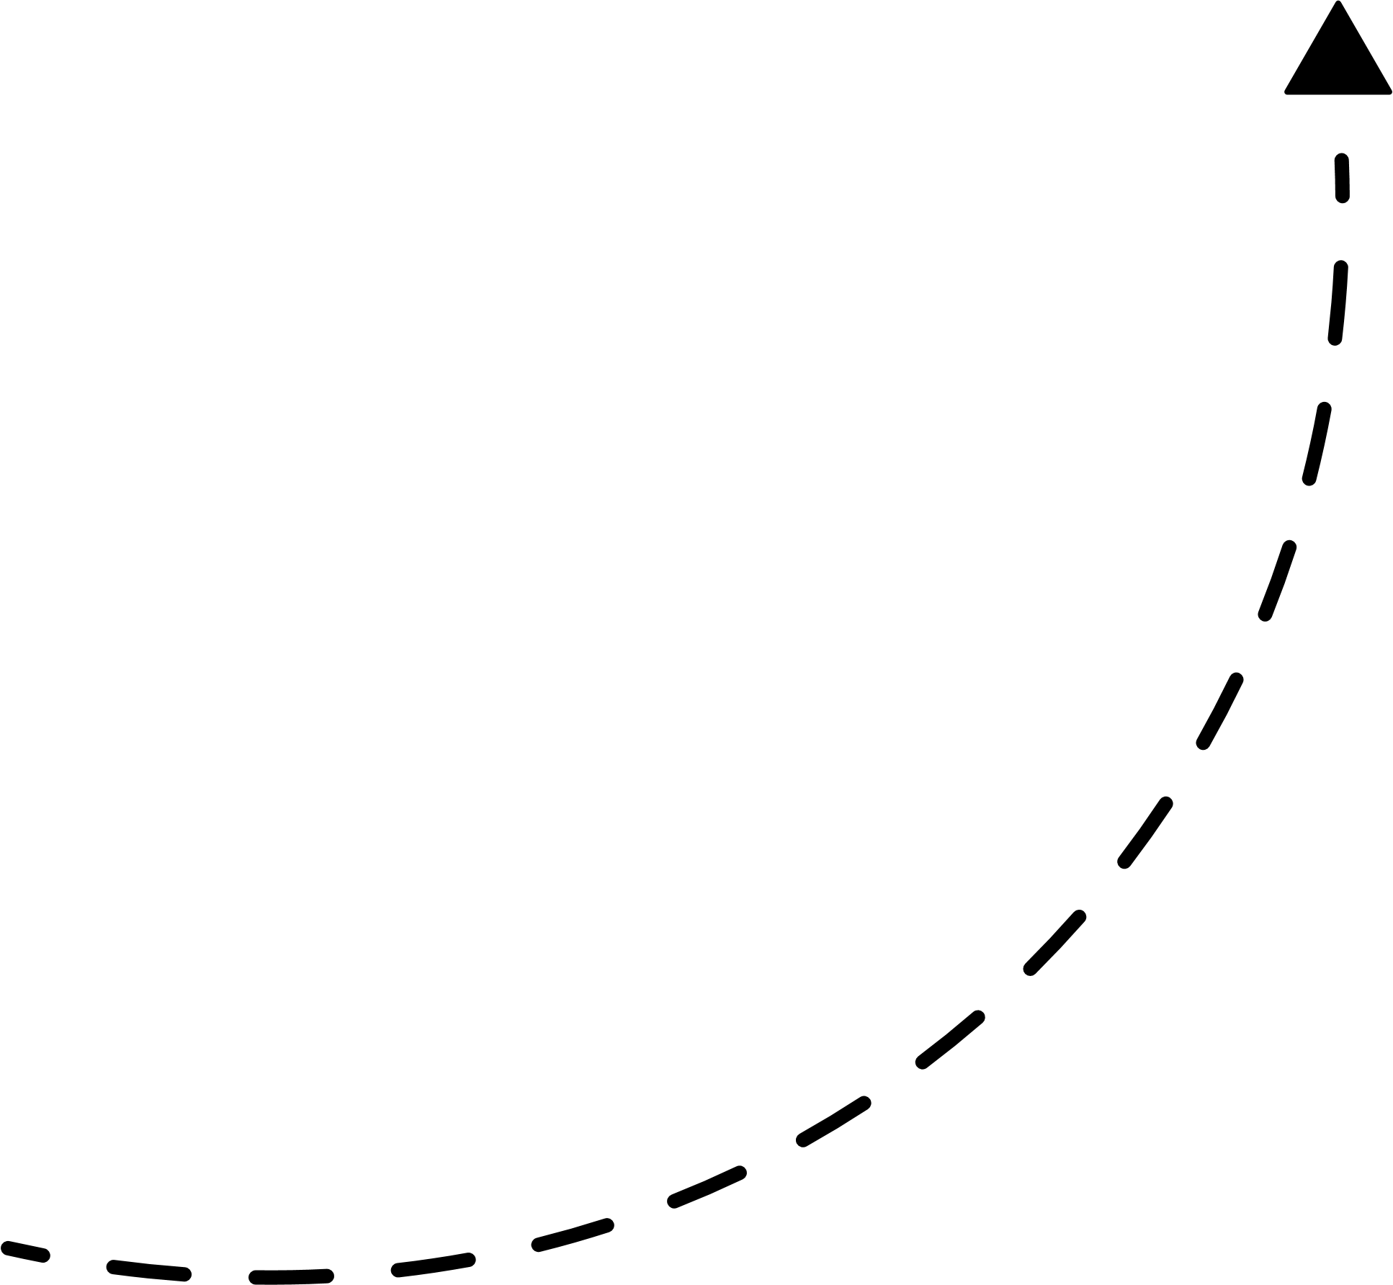
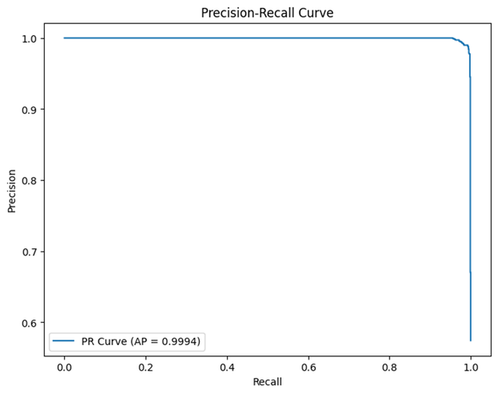
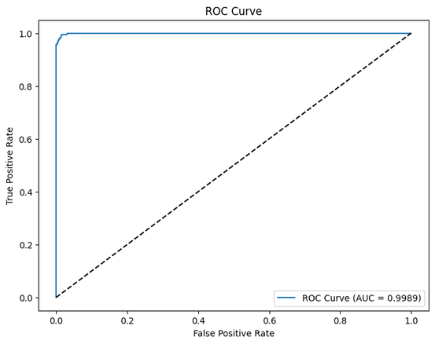
11/15
ABLATION STUDY & MODEL INTERPRETABILITY
Figure: Architectural Ablation Study (5-Fold CV)
Figure: Relational Attention Weights in ESC13 Chain
Key Empirical Takeaways
1. Residual Skip Connections are Vital: Removing skip pathways drops Macro-F1 from 99.86% to 47.68% (a 52.18% collapse), empirically validating Theorem 1.
2. Attention Multiplicity is Secondary: A single-head variant matches multi-head performance (100% vs 99.86%), proving residual feature retention drives the gains.
3. Inherent Path Explainability: Attention weights directly isolate attack edges (alpha > 0.85 on critical hops), providing security analysts with instant visual proof traces.
Course Title: Project and Thesis
Notes:
Ablation Findings: Removing residual skip connections causes catastrophic collapse, dropping Macro-F1 from 0.9986 to 0.4768 (-52.18% drop, corrected p = 6.61e-6), empirically verifying Theorem 1.
Single-Head vs. Multi-Head: Single-head attention achieves 1.0000 Macro-F1 (corrected p = 0.5415), confirming that residual skip pathways, rather than attention head multiplicity, are the primary driver of performance. Attention weights (alpha > 0.85) directly highlight critical escalation edges.
Primary source: supplied thesis.pdf, Thesis Table 5.5; §3.5 and Appendix A.1.

Slide 12
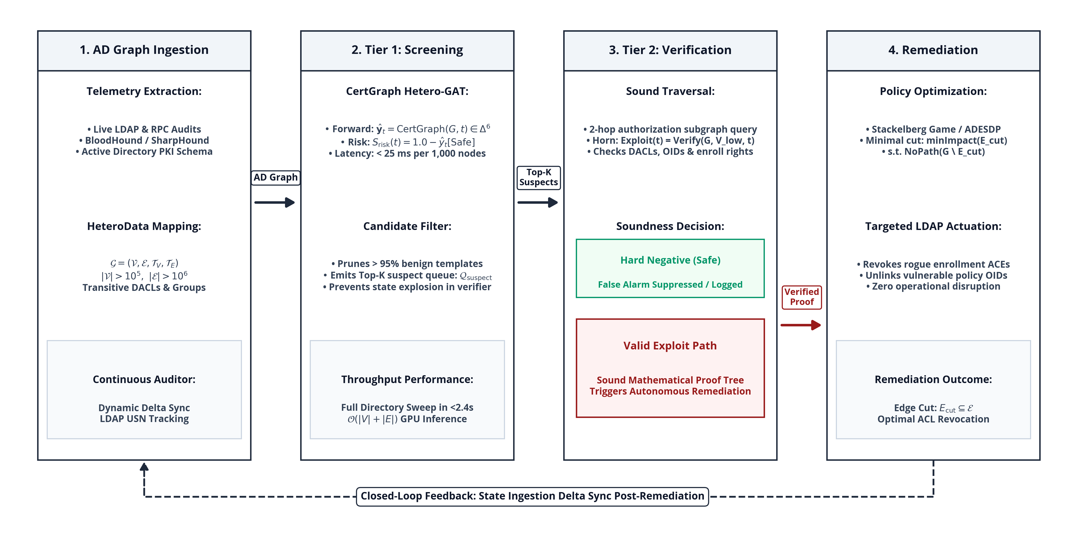
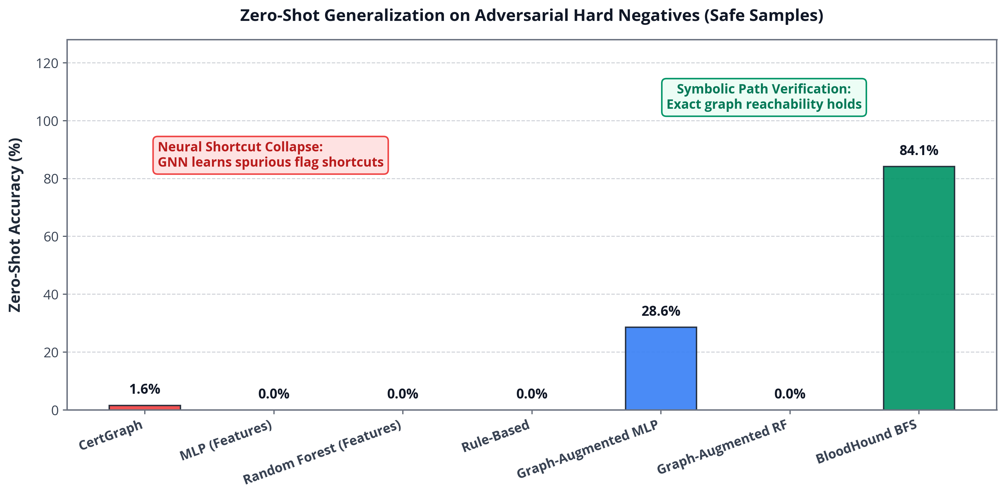
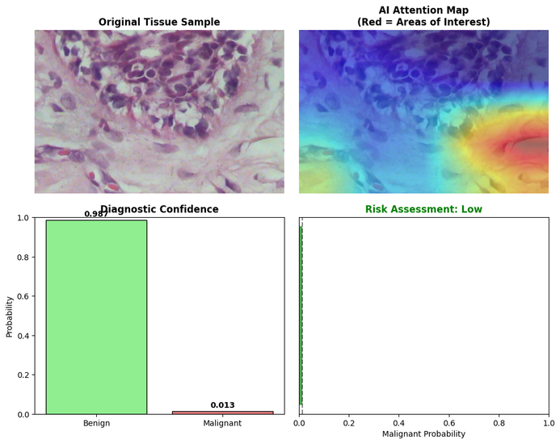
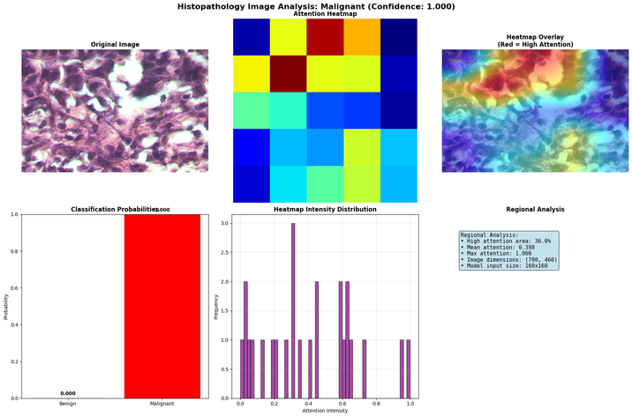
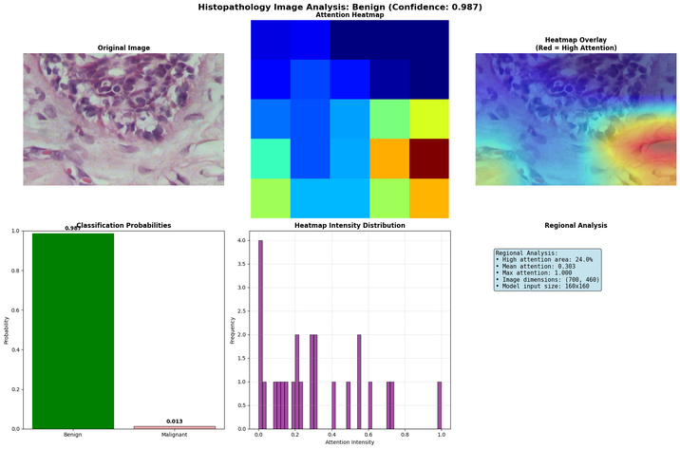
12/15
NEURO-SYMBOLIC HYBRID VERIFICATION
Neural Shortcut Vulnerability
1. The Adversarial Testbed: We generated 63 hard-negative topologies featuring dangerous template flags paired with admin-only access controls (ground truth: Safe).
2. Neural Shortcut Collapse: The pure GNN classified only 1 of 63 correctly (1.59% accuracy) — revealing that pure neural models memorize local template flags without checking reachability.
Our Two-Tier Verification Engine
Tier 1 — Neural Screener (18.2 ms): Flags 62 of 600 templates as potentially risky, filtering out 89.7% of safe templates while retaining 100% of true attack paths.
Tier 2 — Symbolic Verifier (110.6 ms): Traverses authorization graphs for flagged templates, generating mathematical proof traces and eliminating false alarms.
Combined System (128.8 ms): Achieves zero false negatives and zero false alarms — combining neural speed with symbolic soundness.
Course Title: Project and Thesis
Notes:
Adversarial Hard Negatives & Shortcut Collapse: 63 test environments contain dangerous flags paired with admin-only DACLs (ground-truth Safe). Pure GNN predicts Safe for only 1/63 (1.59% accuracy) because it memorized template flags!
Two-Tier Neuro-Symbolic Solution: Tier 1 neural screener (threshold tau = 0.5) forwards 62/600 candidates (100% recall on true paths, filtering 89.7% of templates in 18.2 ms). Tier 2 symbolic engine verifies reachability in 110.6 ms. Total latency: 128.8 ms.
Primary source: supplied thesis.pdf, Thesis §§8.3–8.4; Table 8.2.

Slide 13
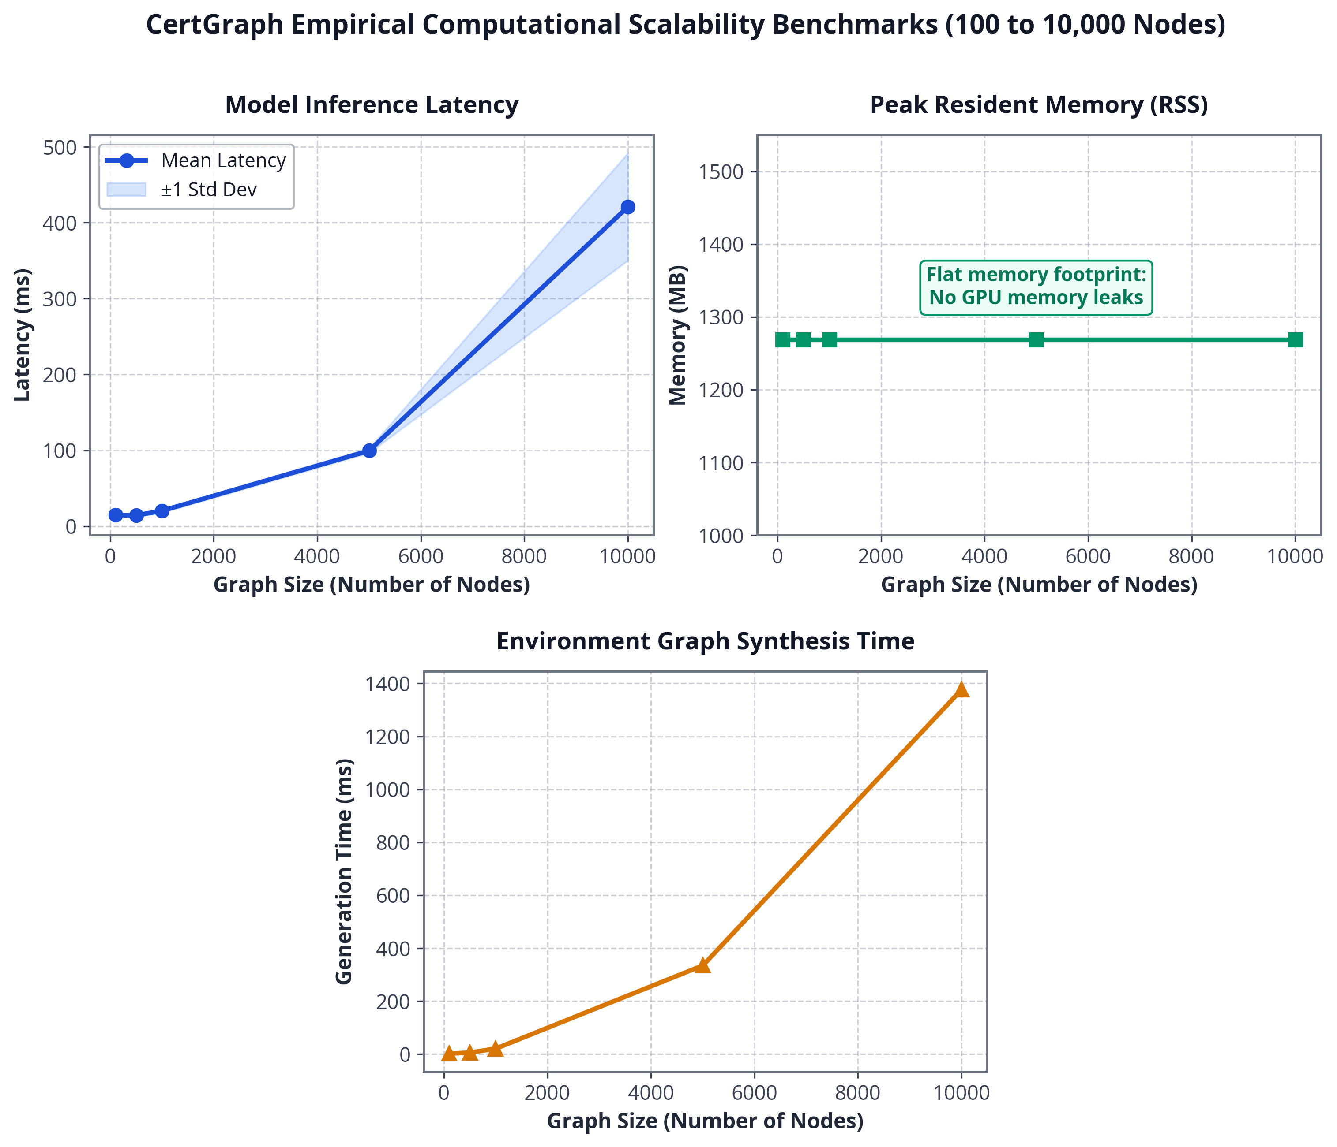
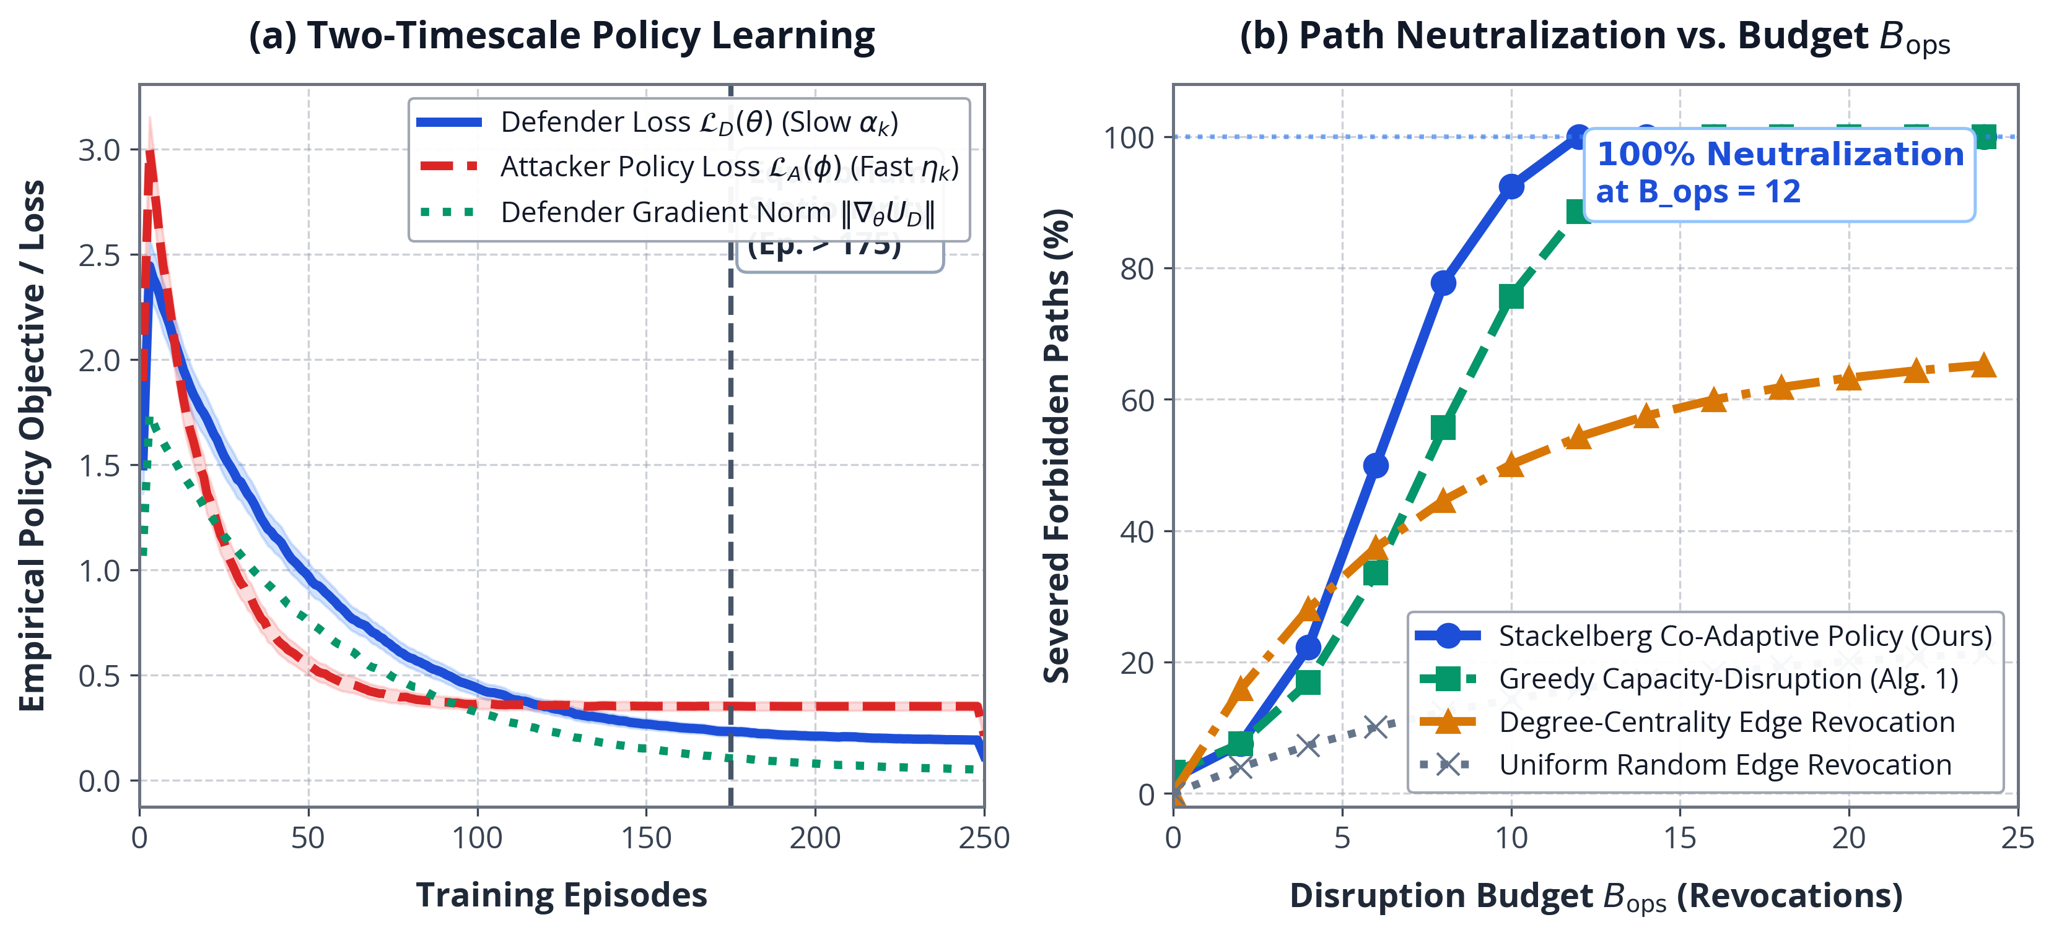
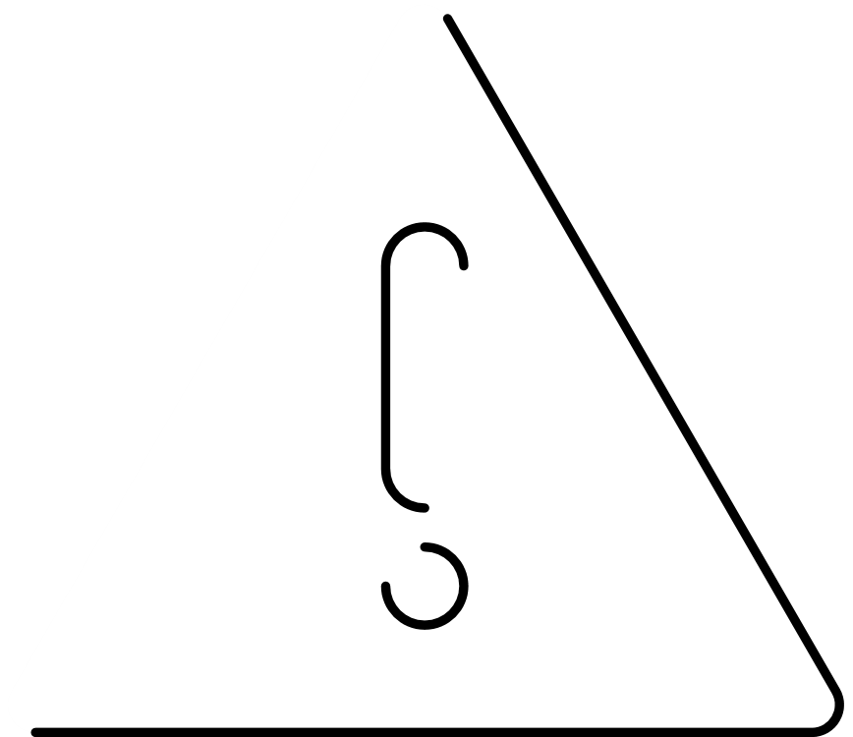

13/15
SCALABILITY & AUTONOMOUS REMEDIATION
Sub-Second Operational Scalability
1. 1,000-Node Topology: 20 ms forward inference time.
2. 5,000-Node Topology: 112.5 ms forward inference time.
3. 10,000-Node Topology (765k edges): 343 ms inference time — 12.4x faster than Dijkstra/BloodHound graph search.
4. Operational Benefit: Enables continuous real-time directory audits without impacting enterprise authentication traffic.
Automated Attack Path Interdiction
1. Computational Proof (Theorem 2): We proved that finding the minimum set of permission revocations to sever all attack paths (MPAI) is NP-hard.
2. Greedy Interdiction Algorithm: We designed a disruption-bounded greedy algorithm that severs 68.6% of attack paths within a budget of 24 ACL operations.
3. Statistical Validation: Statistically outperforms degree-centrality baselines across 30 enterprise topologies (p = 3.57e-11).
Course Title: Project and Thesis
Notes:
Scalability & Interdiction: Forward inference takes 20 ms on 1,000 nodes, 112.5 ms on 5,000 nodes, and 343 ms on 10,000 nodes (765,000 edges) — 12.4x faster than Dijkstra shortest-path.
Theorem 2 & Remediation: The Minimum Perturbation Attack Interdiction (MPAI) problem is NP-hard (reduced from Directed Multiway Cut). Greedy path interdiction severs 68.6% ± 11.7% of critical attack paths at budget B_ops = 24 across 30 synthetic topologies (paired t(29) = 10.27, p = 3.57e-11 vs degree baseline).
Primary source: supplied thesis.pdf, Thesis Tables 6.1–6.2, 7.1, 7.3, and Chapter 9.

Slide 14

14/15
CONCLUSION & CONTRIBUTIONS
A unified graph AI and verification framework that resolves the conflict between rapid vulnerability screening and formal soundness.
1
What We Contributed
2
Limitations & Future Work
1. AD Graph Schema: Formalized the first heterogeneous graph representation covering 5 entity types and 6 primary ADCS escalation classes.
2. Deep-Path Retention Proof: Mathematically proved (Theorem 1) and implemented residual skips that preserve features over 4–8 hop chains.
3. Audited Enterprise Benchmark: Achieved 99.86% Macro-F1 across 700 topologies (+28.2% over heuristics), tested under 96% class imbalance.
4. Neural Shortcut Discovery: Uncovered that pure GNNs collapse to 1.59% accuracy on adversarial hard negatives due to flag memorization.
5. Two-Tier Verification Engine: Built a hybrid system combining 18 ms neural screening with 110 ms symbolic verification (zero false negatives).
6. Automated Remediation Algorithm: Proved MPAI NP-hardness (Theorem 2) and developed a greedy interdiction tool severing 68.6% of attack paths.
1. Multi-label vulnerability classification for co-occurring ADCS escalation paths.
2. Support for cloud-hybrid identity fabrics (Microsoft Entra ID / Azure AD).
3. Real-time evaluation of automated remediation in live enterprise cyber-ranges.
3
Project & Thesis Details
Course: ECE 452 — Project and Thesis
Department: Electronics and Communication Engineering (ECE)
Institution: Hajee Mohammad Danesh Science and Technology University (HSTU)
Defense Session: October 2026
Course Title: Project and Thesis
Notes:
Academic Contributions & Limitations: Formal multigraph schema, Theorem 1 gradient bounds, audited benchmark suite, discovery of neural shortcut learning on hard negatives, two-tier neuro-symbolic verification, and Theorem 2 budgeted remediation.
Limitations & Future Work: Single-label scope, 10,000-node measured monolithic scale, synthetic rule assumptions. Next steps include multi-label prediction, temporal graph evolution, cloud Entra ID sync, and live cyber-range validation.
Primary source: supplied thesis.pdf, Thesis Chapter 10.

Slide 15

ANY QUESTIONS ?
Notes:
Conclusion & Defense Discussion Guide:
- Why GNN rather than augmented MLP? HAN provides multi-relational path attention and sub-second zero-shot generalization.
- What does hard-negative collapse mean? Proves that neural models learn local heuristic shortcuts, necessitating symbolic verification.
- How are nested memberships handled? Preprocessed via transitive closure.
- Which defense results were measured? Greedy budgeted interdiction (68.6% severed at budget 24); Stackelberg RL is notional future work.

