Slide 1


A BLOCKCHAIN-ENABLED FEDERATED LEARNING FRAMEWORK FOR
PRIVACY-PRESERVING HISTOPATHOLOGICAL IMAGE CLASSIFICATION
Course Code: ECE 402
Course Title: Project and Thesis
Prepared By-
Student ID: 2002126 Level:4, Semester:I
Student ID: 2002138 Level:4, Semester:I
Student ID: 2102151 Level:4, Semester:I
Date: February 22, 2026
Department of Electronics and Communication Engineering (ECE)
Hajee Mohammad Danesh Science and Technology University, Dinajpur-5200, Bangladesh

Slide 2




02/10
PROBLEM STATEMENT & SOLUTION
The Problem
The Solution
AI requires massive data, but the Personal Data Protection Ordinance (PDPO) 2025 prohibits centralized pooling of sensitive medical records.
  Medical data isolated across hospitals
  Centralized AI → privacy & breach risk
  Poor model generalization, low trust
  Federated Learning (no raw data sharing)
  Blockchain + IPFS for secure coordination
  Encrypted model updates, auditable training
Research Gap
  Lack of end-to-end FL + blockchain systems
  Missing transparent & verifiable model provenance
  Limited real healthcare-oriented prototypes
Course Title: Project and Thesis

Slide 3



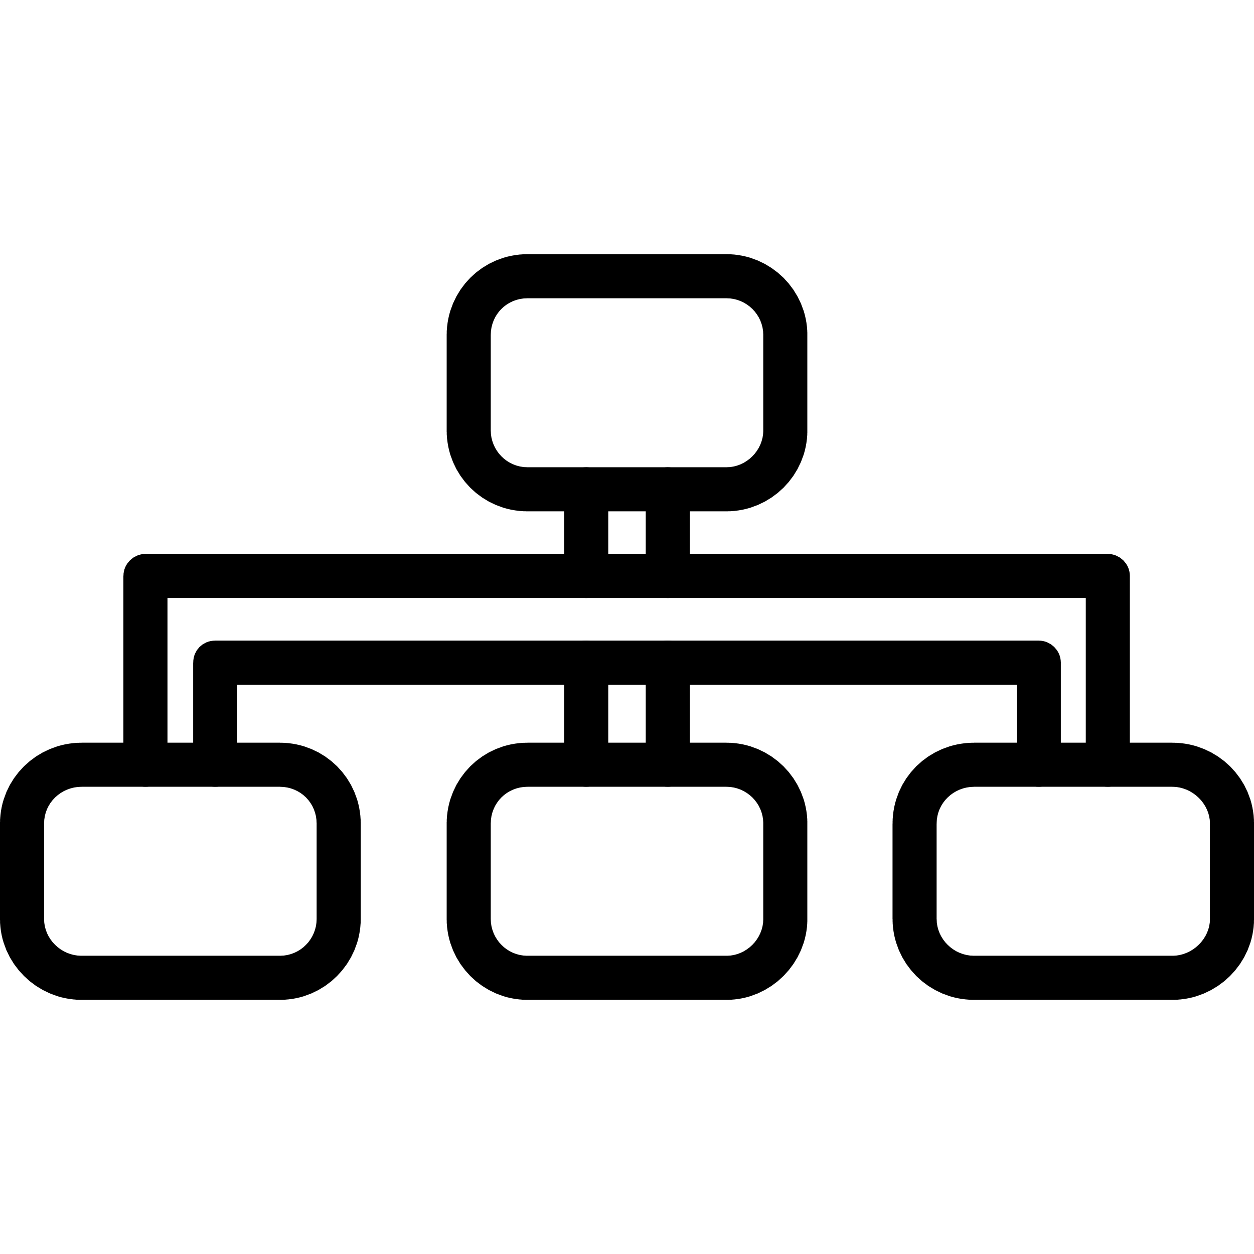

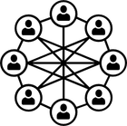




03/10
OBJECTIVE
Secure Patient
Data Handling
AI Model Retrain Without Sharing Actual Data (FL)
Operational Optimization
Decentralized Trust:
Clinical Excellence
The primary goal is to resolve the conflict between data utility and patient privacy in the Bangladeshi healthcare sector by inverting the traditional data-to-model paradigm.
  Secure Patient Data Handling: Develop a decentralized system where raw data remains localized to comply with PDPO 2025.
  AI Model Retrain Without Sharing Actual Data (FL): Inter organizational data sharing with federated learning framework.
  Decentralized Trust: Use Ethereum smart contracts and IPFS to create an immutable, transparent audit trail for model versioning.
  Clinical Excellence: Integrate Grad-CAM and Coordinate Attention to align AI decisions with pathological landmarks like irregular nuclei.
  Operational Optimization: Maintain a lightweight 5.9M parameter footprint to minimize communication overhead in resource-constrained clinics.
Course Title: Project and Thesis

Slide 4
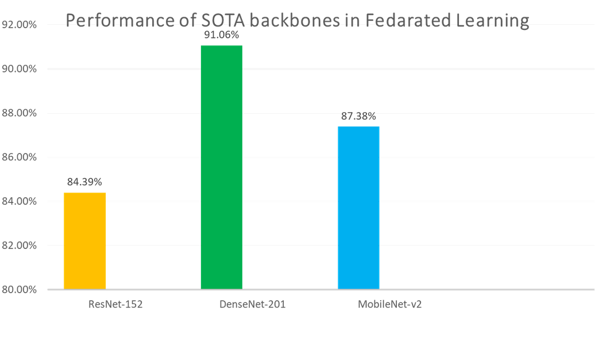


04/10
LITERATURE SURVEY & SOTA MODELS
Proposed Innovations
  C2T2Net: Capsule Twin attention (95.68% ACC).
  FedAvg-CNN: Customized FL logic balancing privacy and performance.
  BC-FL-Breast: Blockchain-empowered framework reaching 98.4% accuracy.
Research Gap
Existing SOTA models achieve high accuracy but fail to provide a decentralized, auditable framework that reconciles privacy-preserving training with clinical explainability and regulatory compliance.
Figure: Benchmarked Architecture
Course Title: Project and Thesis

Slide 5
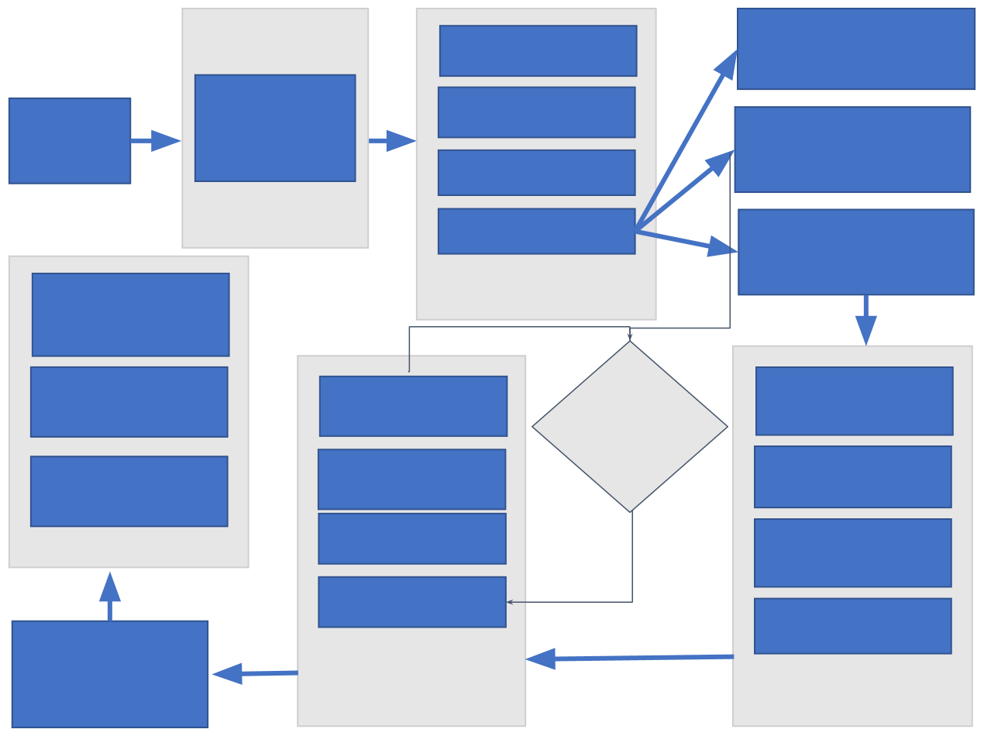

05/10
METHODOLOGICAL WORKFLOW
Main Research Objectives
Image Resize
Training Set
Histopathological Images Types:
Pixel Normalize
Integrating Ethereum blockchain and Federated Learning to enable privacy-preserving, multi-institutional collaboration
Data
Benign, Malignant
Validation Set
acquisition
Data Aggregation
Multi source
datasets
Dataset Splitting
Preprocessing
Test Set
Automated
Materials and Methods
Medical Report
Produced Class
Lebel
Probability
Score
Diagnostic Output
  Phase 1: Pre-processing: 160×160 RGB resizing, pixel normalization, and stochastic augmentation (rotation/flipping).
  Phase 2: Hybrid Feature Extraction: Integration of EfficientNet-B0 with a Coordinate Attention module to capture spatially structured pathological features.
  Phase 3: Centralized vs. Federated Baseline: Rigorous training using Adam optimizer and BCE loss to establish a performance upper bound.
Adam optimizer
Early
Input Tensor Representation
CNN Extraction
Deep Feature
Extraction
stopping
check
Back Propagation
Binary Core Entropy Loss
Forward
Propagation
Classification Head
Model
Evaluation
Training Process
Model Architecture
Course Title: Project and Thesis

Slide 6





06/10
BLOCKCHAIN-FL INTEGRATION
Orchestration
=> Consists of 3 main components: Admin Control, Global Model, Hospitals
=> Ethereum (Sepolia Testnet) manages hospital registration and model versioning.
Admin Control
Storage
Model weights are encrypted (AES-256-CBC) and stored on IPFS.
Global Model
Verification
Blockchain records 46-character CIDs; any tampering with the model file invalidates the on-chain hash.
HOSPITAL A
HOSPITAL B
HOSPITAL C
Course Title: Project and Thesis

Slide 7

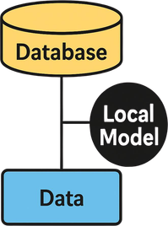
06/10
BLOCKCHAIN-FL INTEGRATION
Orchestration
=> Consists of 3 main components: Admin Control, Global Model, Hospitals
=> Ethereum (Sepolia Testnet) manages hospital registration and model versioning.
Admin Control
Storage
Model weights are encrypted (AES-256-CBC) and stored on IPFS.
Global Model
Verification
Blockchain records 46-character CIDs; any tampering with the model file invalidates the on-chain hash.
HOSPITAL A
HOSPITAL B
HOSPITAL C
Course Title: Project and Thesis

Slide 8


06/10
BLOCKCHAIN-FL INTEGRATION
Orchestration
=> Consists of 3 main components: Admin Control, Global Model, Hospitals
=> Ethereum (Sepolia Testnet) manages hospital registration and model versioning.
Admin Control
Storage
Model weights are encrypted (AES-256-CBC) and stored on IPFS.
Global Model
Verification
Blockchain records 46-character CIDs; any tampering with the model file invalidates the on-chain hash.
HOSPITAL A
HOSPITAL B
HOSPITAL C
Course Title: Project and Thesis

Slide 9
06/10
BLOCKCHAIN-FL INTEGRATION
Orchestration
=> Consists of 3 main components: Admin Control, Global Model, Hospitals
=> Ethereum (Sepolia Testnet) manages hospital registration and model versioning.
Admin Control
Storage
Model weights are encrypted (AES-256-CBC) and stored on IPFS.
Global Model
Verification
Blockchain records 46-character CIDs; any tampering with the model file invalidates the on-chain hash.
HOSPITAL A
HOSPITAL B
HOSPITAL C
Course Title: Project and Thesis

Slide 10
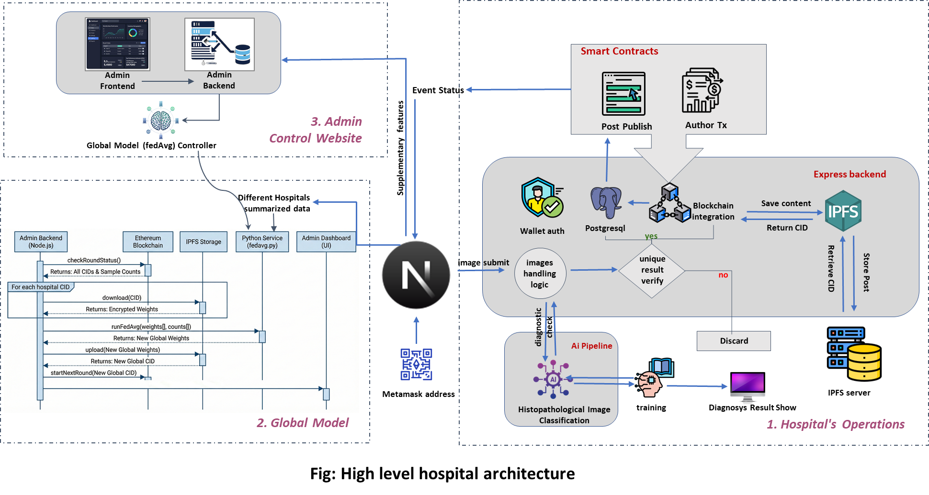
SYSTEM ARCHITECTURE
07/10

Slide 11
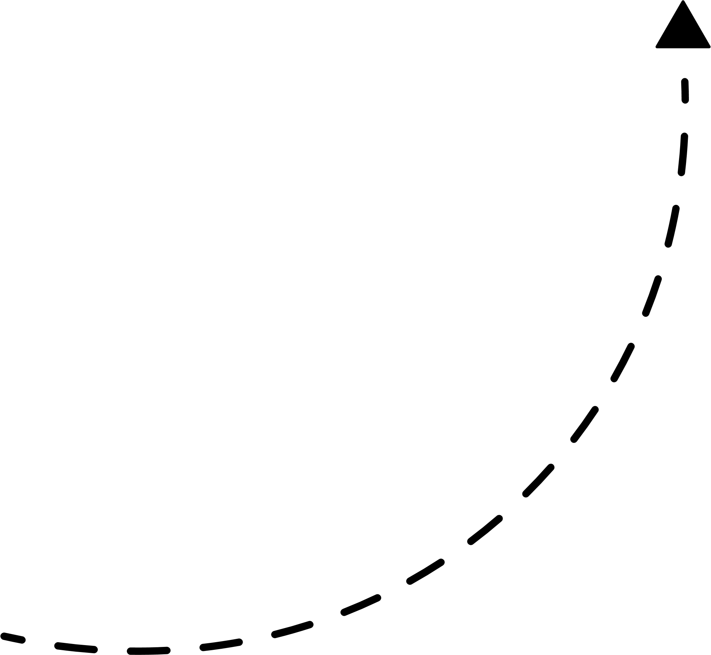
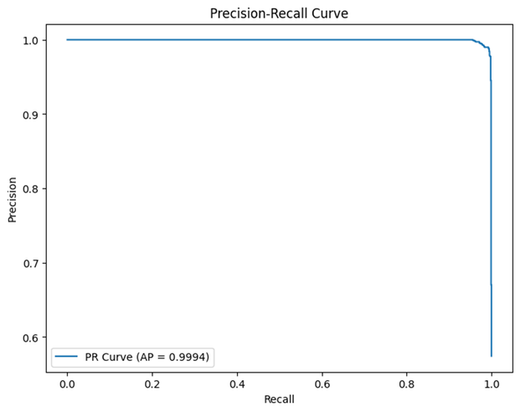

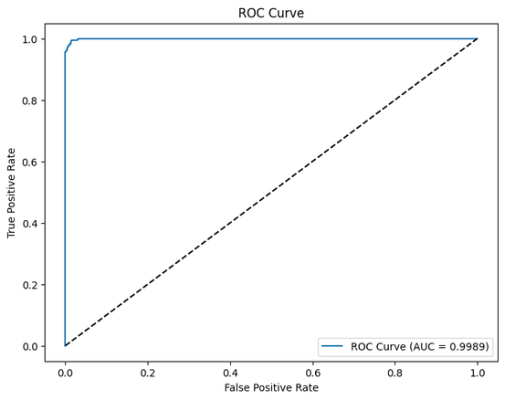
08/10
RESULTS
Quantitative Performance Summary
Metric | Our Framework | SOTA Review Peak
Accuracy | 98.95% | 97.54%
Recall (Sensitivity) | 99.45% | 98.0%
Precision | 98.80% | 96.5%
AUC | 0.9995 | 0.990
Significance: Achieving nearly 99.5% sensitivity ensures that fewer than 1 in 200 malignant cases are missed.
Course Title: Project and Thesis

Slide 12
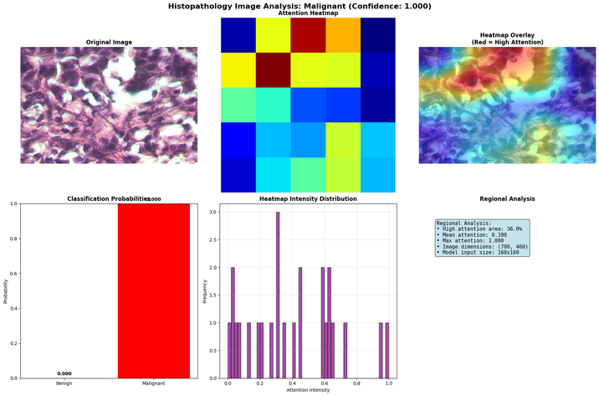
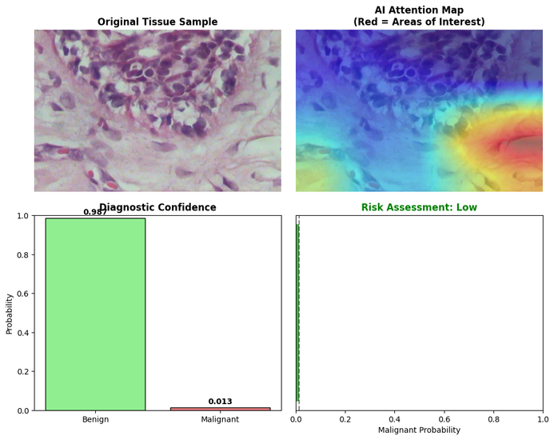
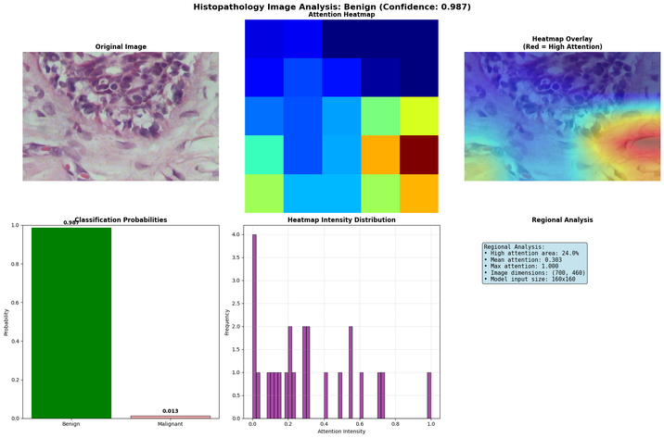
09/10
EXPLAINABLE AI (XAI)
  Clinical Trust: Integration of Grad-CAM visualizes spatial regions driving predictions.
  Pathological Alignment: High attention is concentrated on irregular nuclei and high cellular density in malignant samples.
  XAI Utility: Moves beyond "black-box" AI, allowing pathologists to use the system as a verifiable "second opinion".
Course Title: Project and Thesis

Slide 13
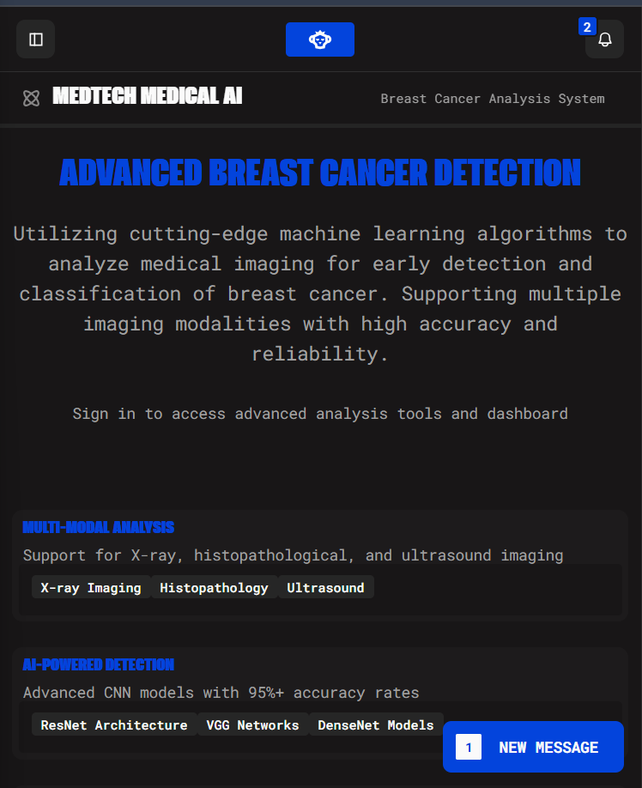

10/10
CONCLUSION
Novelty: A technical and philosophical framework that resolves the conflict between data utility and patient privacy.
1
Contributions
  Verified 98.95% accuracy in a decentralized environment.
  Compliance with PDPO 2025 accountability standards.
  Lightweight model (5.9M parameters) optimized for resource-constrained clinics.
2
Future Research
Exploring Zero-Knowledge Proofs (ZKP) and multi-modal integration (MRI/Genomic data)
Course Title: Project and Thesis

Slide 14

ANY QUESTIONS ?

