Slide 1


CertGraph: Heterogeneous Graph Attention Networks
for Active Directory Certificate Services Vulnerability
Detection and Autonomous Defense
Course Code: ECE 452
Course Title: Project and Thesis
Prepared By-
Student ID: 2002126 Level:4, Semester:II
Student ID: 2002138 Level:4, Semester:II
Student ID: 2102151 Level:4, Semester:II
Date: October 2026
Department of Electronics and Communication Engineering (ECE)
Hajee Mohammad Danesh Science and Technology University, Dinajpur-5200, Bangladesh
Notes:
Introduce the work as a study of Active Directory Certificate Services (ADCS) vulnerability detection, the limits of pure neural reasoning, and disruption-bounded attack-path mitigation.
Title: CertGraph: Heterogeneous Graph Attention Networks for Active Directory Certificate Services Vulnerability Detection and Autonomous Defense.
The empirical defense contribution is a greedy graph interdiction algorithm. Reinforcement learning is a notional co-adaptive framework reserved for future live evaluation.
Primary source: supplied thesis.pdf, ECE 452 · Project and Thesis · October 2026.

Slide 2




02/15
PROBLEM STATEMENT & SOLUTION
The Problem
The Solution
Active Directory Certificate Services (ADCS) manages enterprise PKI in 90%+ Fortune 500 networks. However, exploitability requires both misconfiguration and effective access — vulnerabilities exist as multi-hop authorization paths.
• Multi-Hop Escalation Chains: Relational permission graphs spanning 4 to 8 hops (ESC1–ESC13).
• Weaponized Identity Spoofing: Unprivileged accounts abuse Subject Alternative Names (SAN / UPN).
• Forest-Wide Domination: DCSync replication grants immediate Domain Controller compromise.
1. Heterogeneous Graph Attention Networks (HAN) modeling multi-relational enterprise topologies.
2. Orthogonal residual skip connections preventing representation oversmoothing over deep paths.
3. Neuro-Symbolic synthesis guaranteeing 100% formal mathematical soundness.
Research Gap
1. Rule engines (Certipy) fail zero-shot on novel composite escalation paths.
2. Graph search (BloodHound) combinatorial state explosion on 100k+ enterprise nodes.
3. Complete lack of autonomous, disruption-bounded automated remediation mechanisms.
Course Title: Project and Thesis
Notes:
Active Directory manages accounts, groups, computers, and access rights. ADCS issues certificates from templates, a CA signs them, and Kerberos PKINIT enables certificate-based authentication.
Core Security Principle: Exploitability requires both configuration and effective access. Dangerous template flags alone do not establish vulnerability; an unprivileged principal must possess a valid authorization path to request and use it. ESC13 represents policy-to-group privilege assignment, not inherent SAN spoofing.
Primary source: supplied thesis.pdf, Thesis §§2.4–2.7; SpecterOps ADCS research.

Slide 3

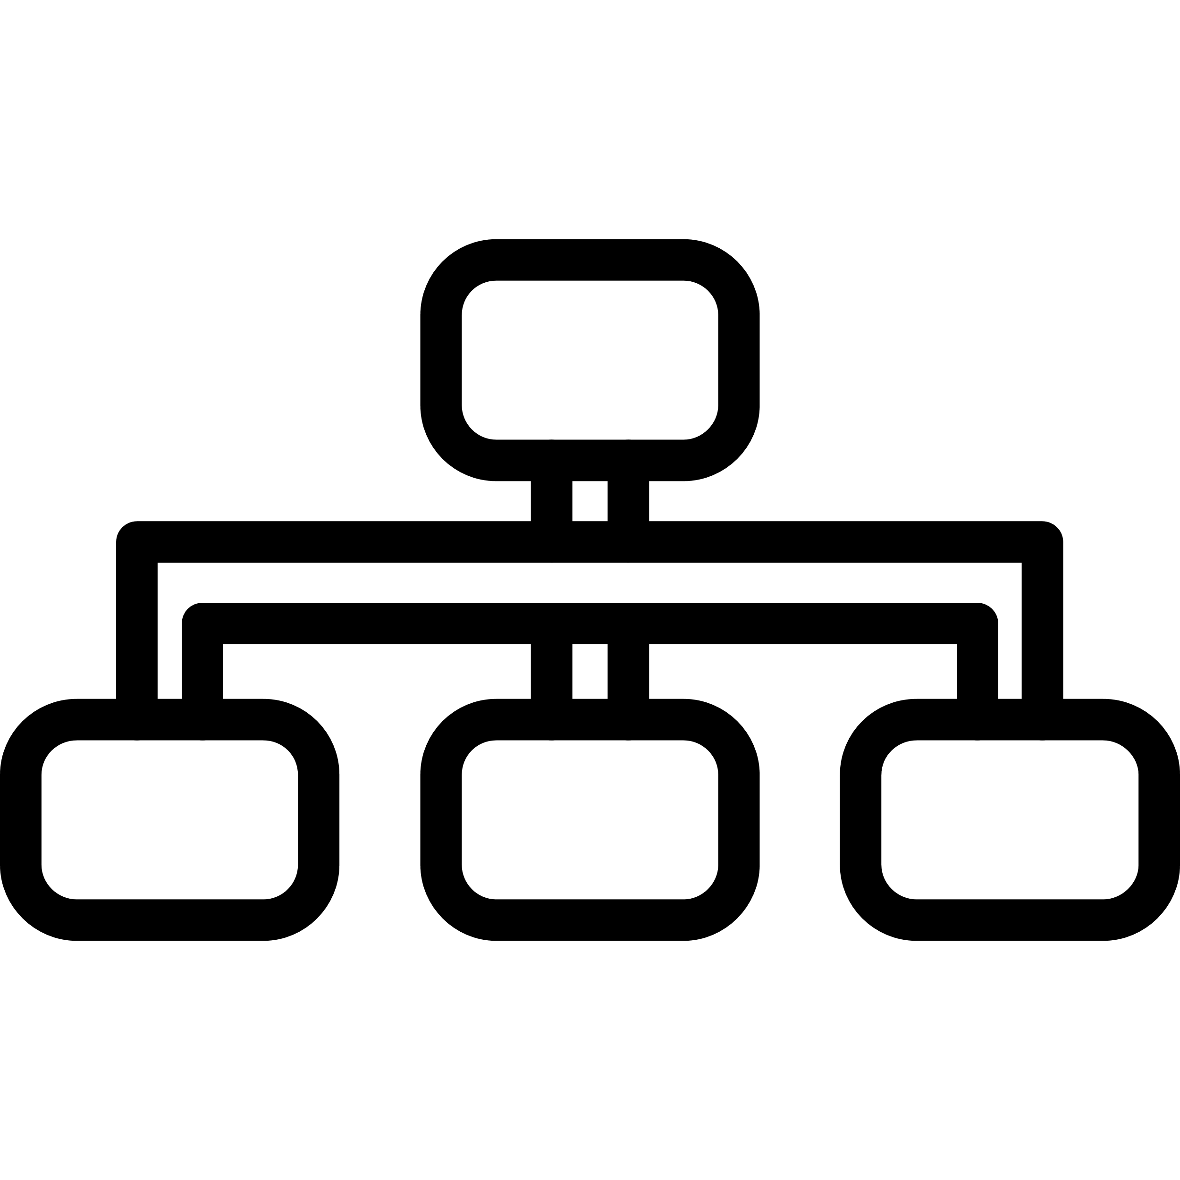




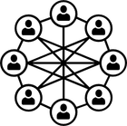



03/15
OBJECTIVES
The primary goal is to resolve the conflict between combinatorial scalability and relational security in enterprise Active Directory by developing a mathematically bounded, real-time Heterogeneous Graph Neural Network framework.
(1)
(2)
(3)
(4)
(5)
Relational Graph Modeling
Gradient Preservation
Zero-Shot Enterprise Transfer
Neuro-Symbolic Synthesis
Autonomous Mitigation
Model 5 entity types and 8 forward relations (16 bidirectional) spanning users, computers, groups, templates, and CAs with transitive closure.
Mathematically prove Theorem 1 to eliminate representation oversmoothing across deep privilege chains.
Achieve near-perfect generalization across 700 unseen synthetic and realistic forest topologies.
Eliminate pure neural shortcut collapse on adversarially crafted hard negatives (disabled enrollment flags).
Formulate Minimum Perturbation Attack Interdiction (MPAI), prove NP-hardness (Theorem 2), and deploy budgeted path remediation.
Course Title: Project and Thesis
Notes:
Four central research questions guide the work: relational classification, attribute preservation, out-of-distribution robustness, and verified defense.
Threat Model: Assumes an initial low-privilege domain account compromise and authorized read-only directory telemetry for the defender. Target scope is template-centric across six evaluated escalation classes (ESC1, ESC2, ESC3, ESC4, ESC9, ESC13) plus Safe. CA-wide settings and relay attacks lie outside this classifier.
Primary source: supplied thesis.pdf, Thesis §§1.6, 2.6.1, 2.7.

Slide 4
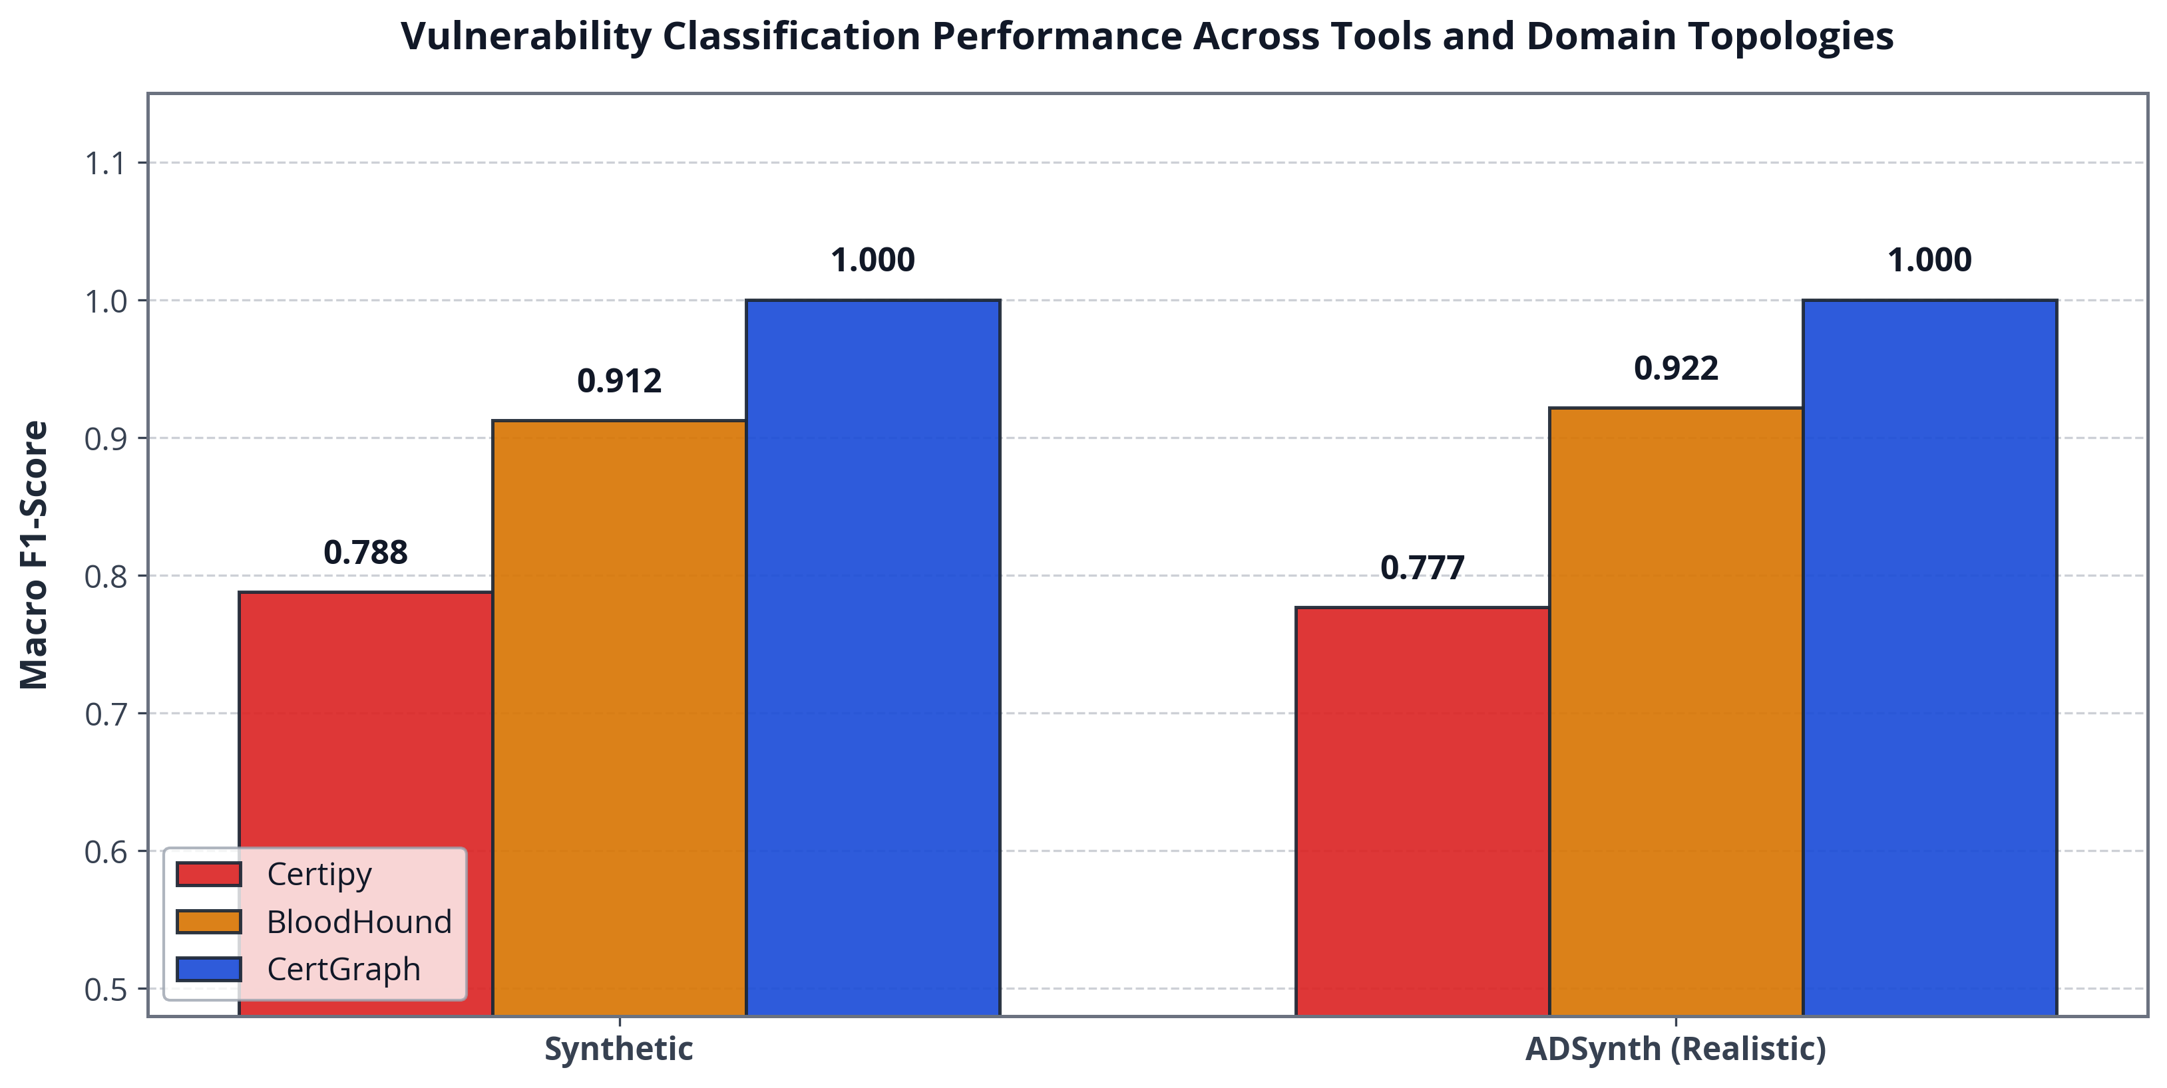


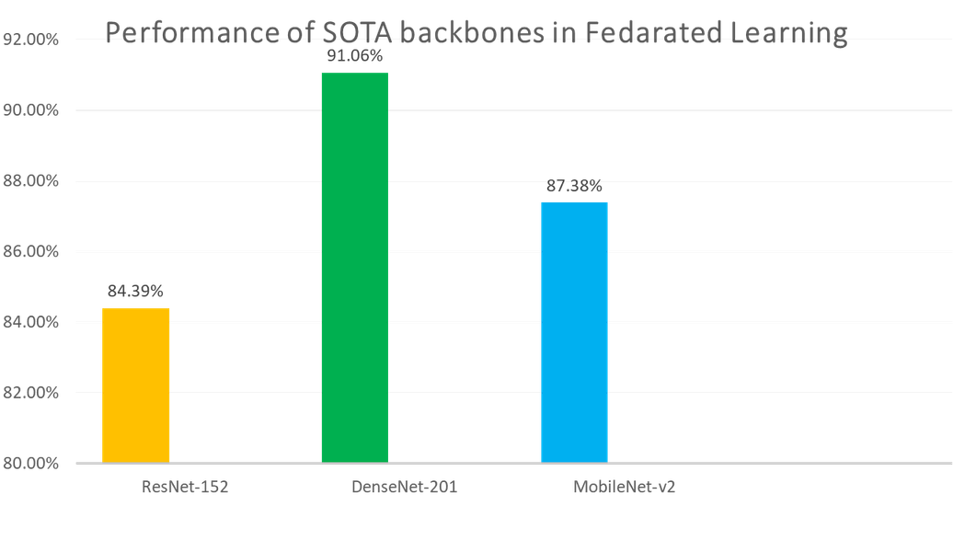
04/15
LITERATURE SURVEY & SOTA MODELS
Research Gap
Existing enterprise tools rely on brittle syntactic regexes (Certipy) or unweighted graph traversal (BloodHound). They fail to identify multi-hop composite vulnerabilities and suffer state explosion on graphs with >100,000 entities.
Proposed Innovations
• Heterogeneous Relational GAT: Multi-relational attention aggregation capturing subtle structural dependencies.
• Residual Skip Projections: Preserves gradient bounds ||dh_v / dx_v|| >= sigma_min(W_skip) > 0 to eliminate oversmoothing.
• Sub-Second Scalability: 343 ms inference on 10,000 nodes (12.4x faster than Dijkstra shortest-path).
Figure: Macro-F1 Comparison Across Detection Paradigms
• Certipy Heuristic Baseline: 0.7791 Macro-F1 (fails zero-shot on novel composite paths).
• Symbolic BFS Traversal: 0.9082 Macro-F1 (combinatorial latency explosion on large graphs).
• CertGraph (Ours): 0.9986 Macro-F1 (+28.2% relative gain over heuristics, p = 3.12e-4).
Course Title: Project and Thesis
Notes:
SpecterOps supplies ADCS attack semantics; Veličković et al. introduce neighborhood attention; Chen et al. provide residual initial-feature preservation; Arp et al. describe evaluation pitfalls in security ML.
Scope clarification: The thesis baselines are simplified heuristic and BFS implementations, rather than full production releases of Certipy or BloodHound. The research gap is combining rapid risk screening with explicit reachability verification.
Primary source: supplied thesis.pdf, Thesis Chapter 2; USENIX Security 'Dos and Don'ts of ML in Security'.

Slide 5
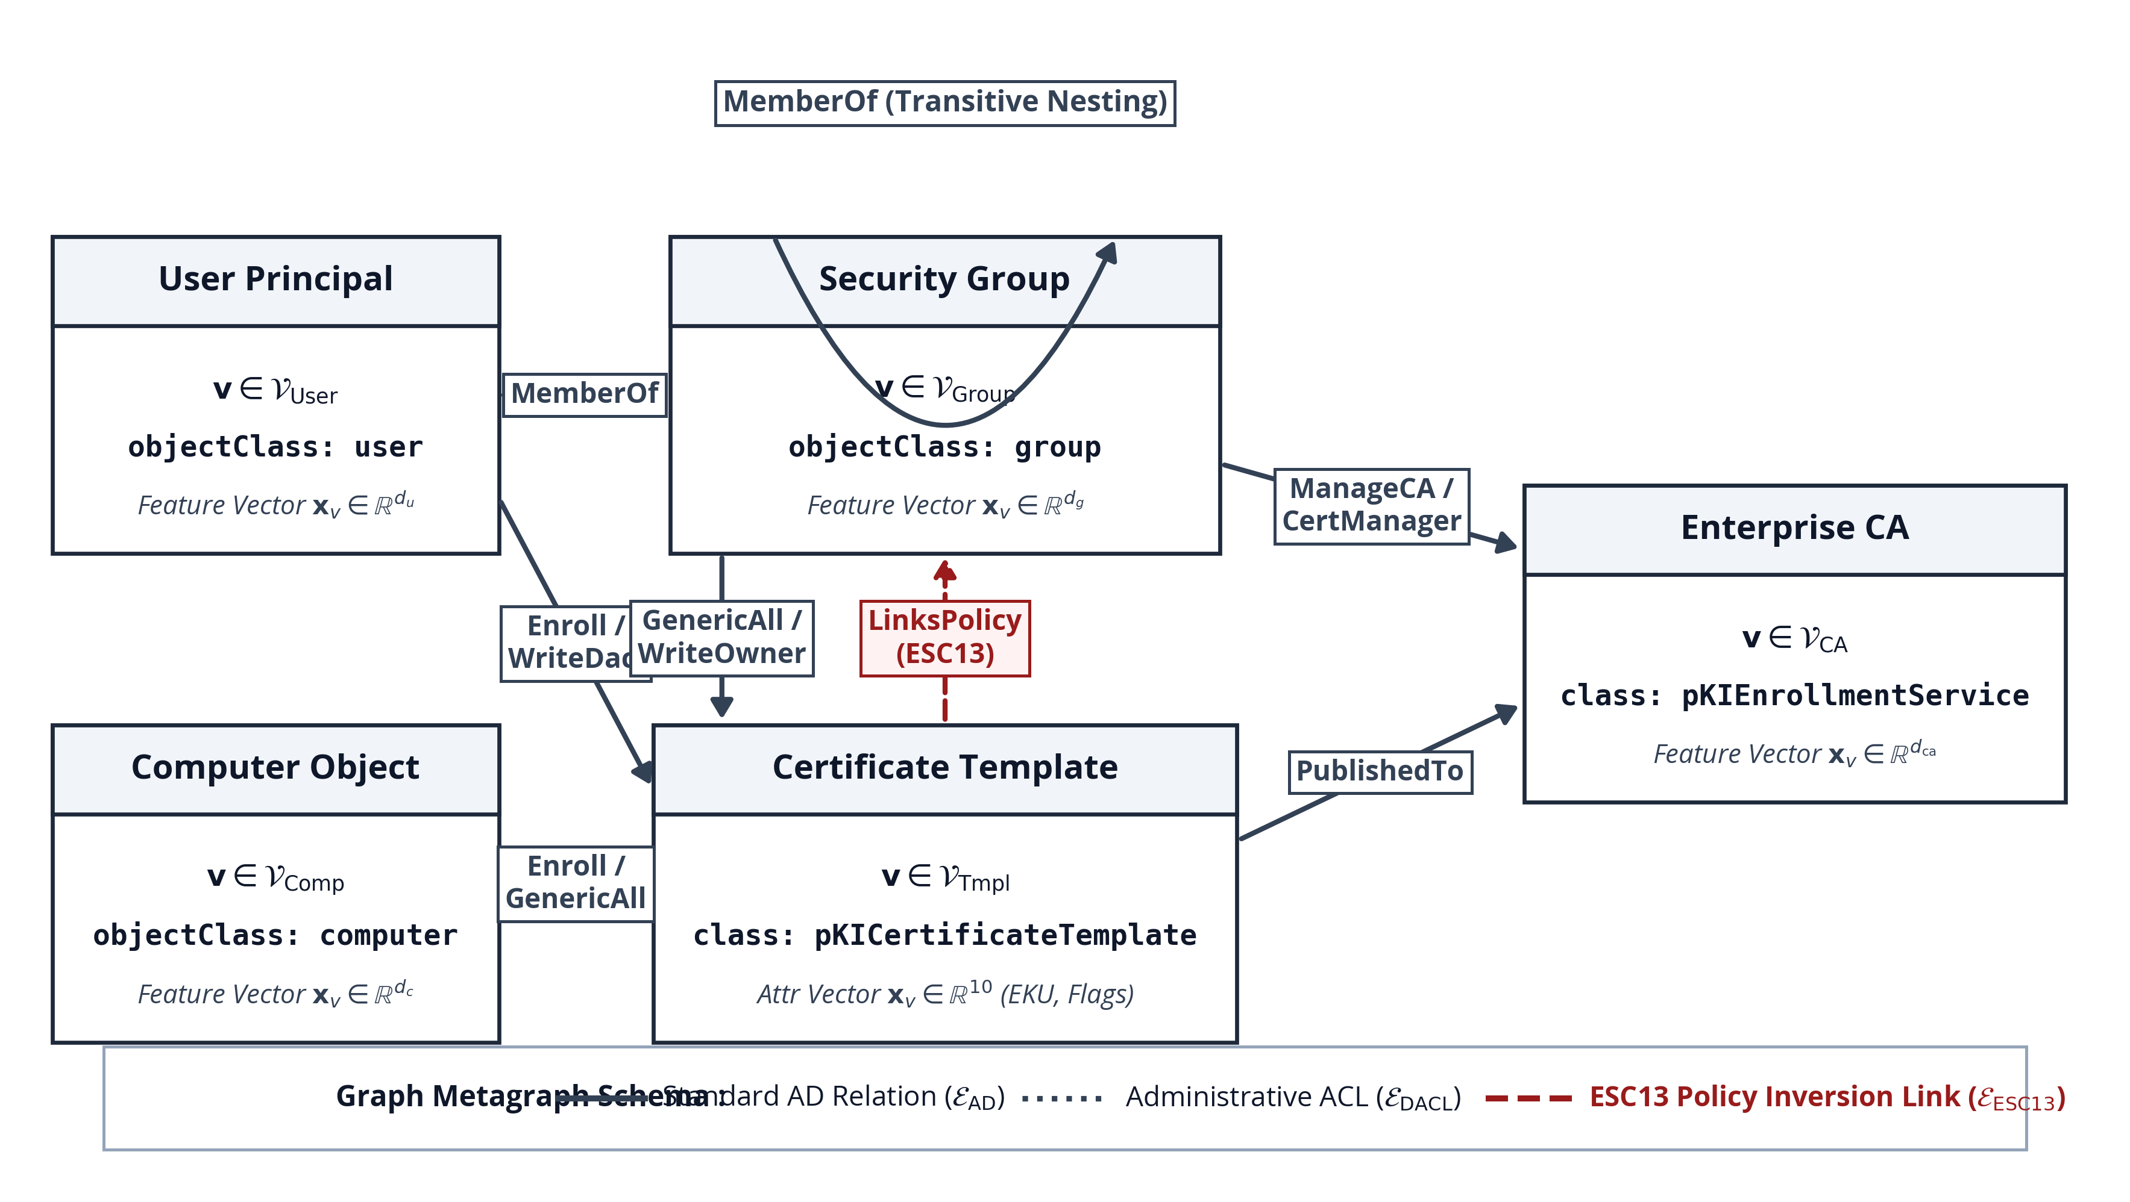

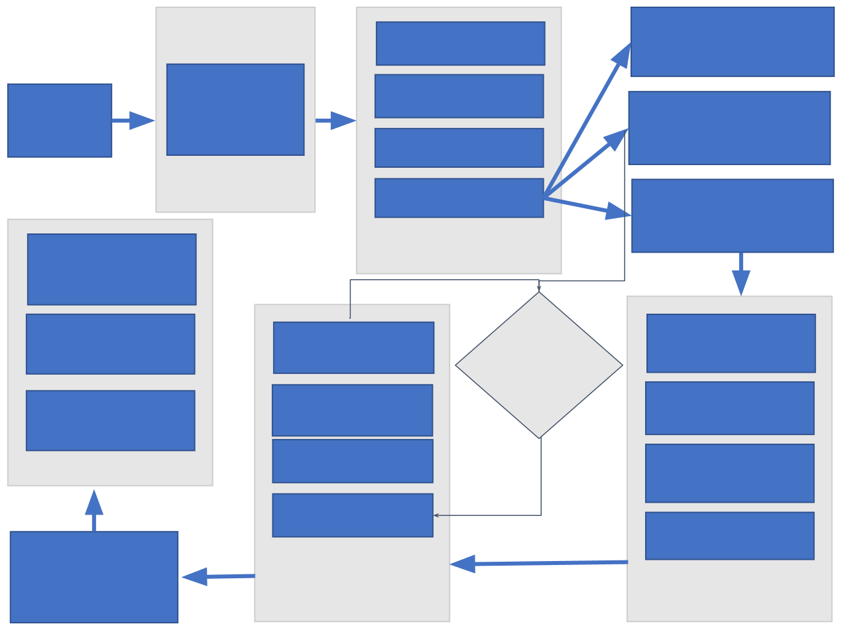
05/15
METHODOLOGICAL WORKFLOW
Core Methodological Framework
Integrating Heterogeneous Graph Attention Networks with formal symbolic verification to enable real-time, zero-shot ADCS vulnerability detection.
3-Phase Execution Pipeline
• Phase 1: Multigraph Construction — Ingests LDAP, RPC, and BloodHound JSON into heterogeneous multigraph G = (V, E, tau_V, phi_E) with 5 node types and 8 relations (16 bidirectional). Transitive closure expands nested groups.
• Phase 2: Relational GNN Embedding — Type-specific linear projection, relational multi-head attention, and residual skip connections.
• Phase 3: Neuro-Symbolic Verification & Action — Fast GNN screening followed by symbolic soundness check and LDAP actuation.
Figure: Active Directory Heterogeneous Metagraph Schema
Course Title: Project and Thesis
Notes:
Formal Metagraph Definition: Specifies 5 entity node types (User, Computer, Group, Certificate Template, Enterprise CA), 8 forward relation types, and 16 relations including canonical reverse edges. Reverse edges facilitate message passing without conferring reverse authorization.
Ten template flags capture security extensions, enrollment flags, and DACLs. Nested group memberships are expanded via transitive closure preprocessing before learning, which is essential to the claimed 2-hop receptive field.
Primary source: supplied thesis.pdf, Thesis §§3.1–3.2.

Slide 6
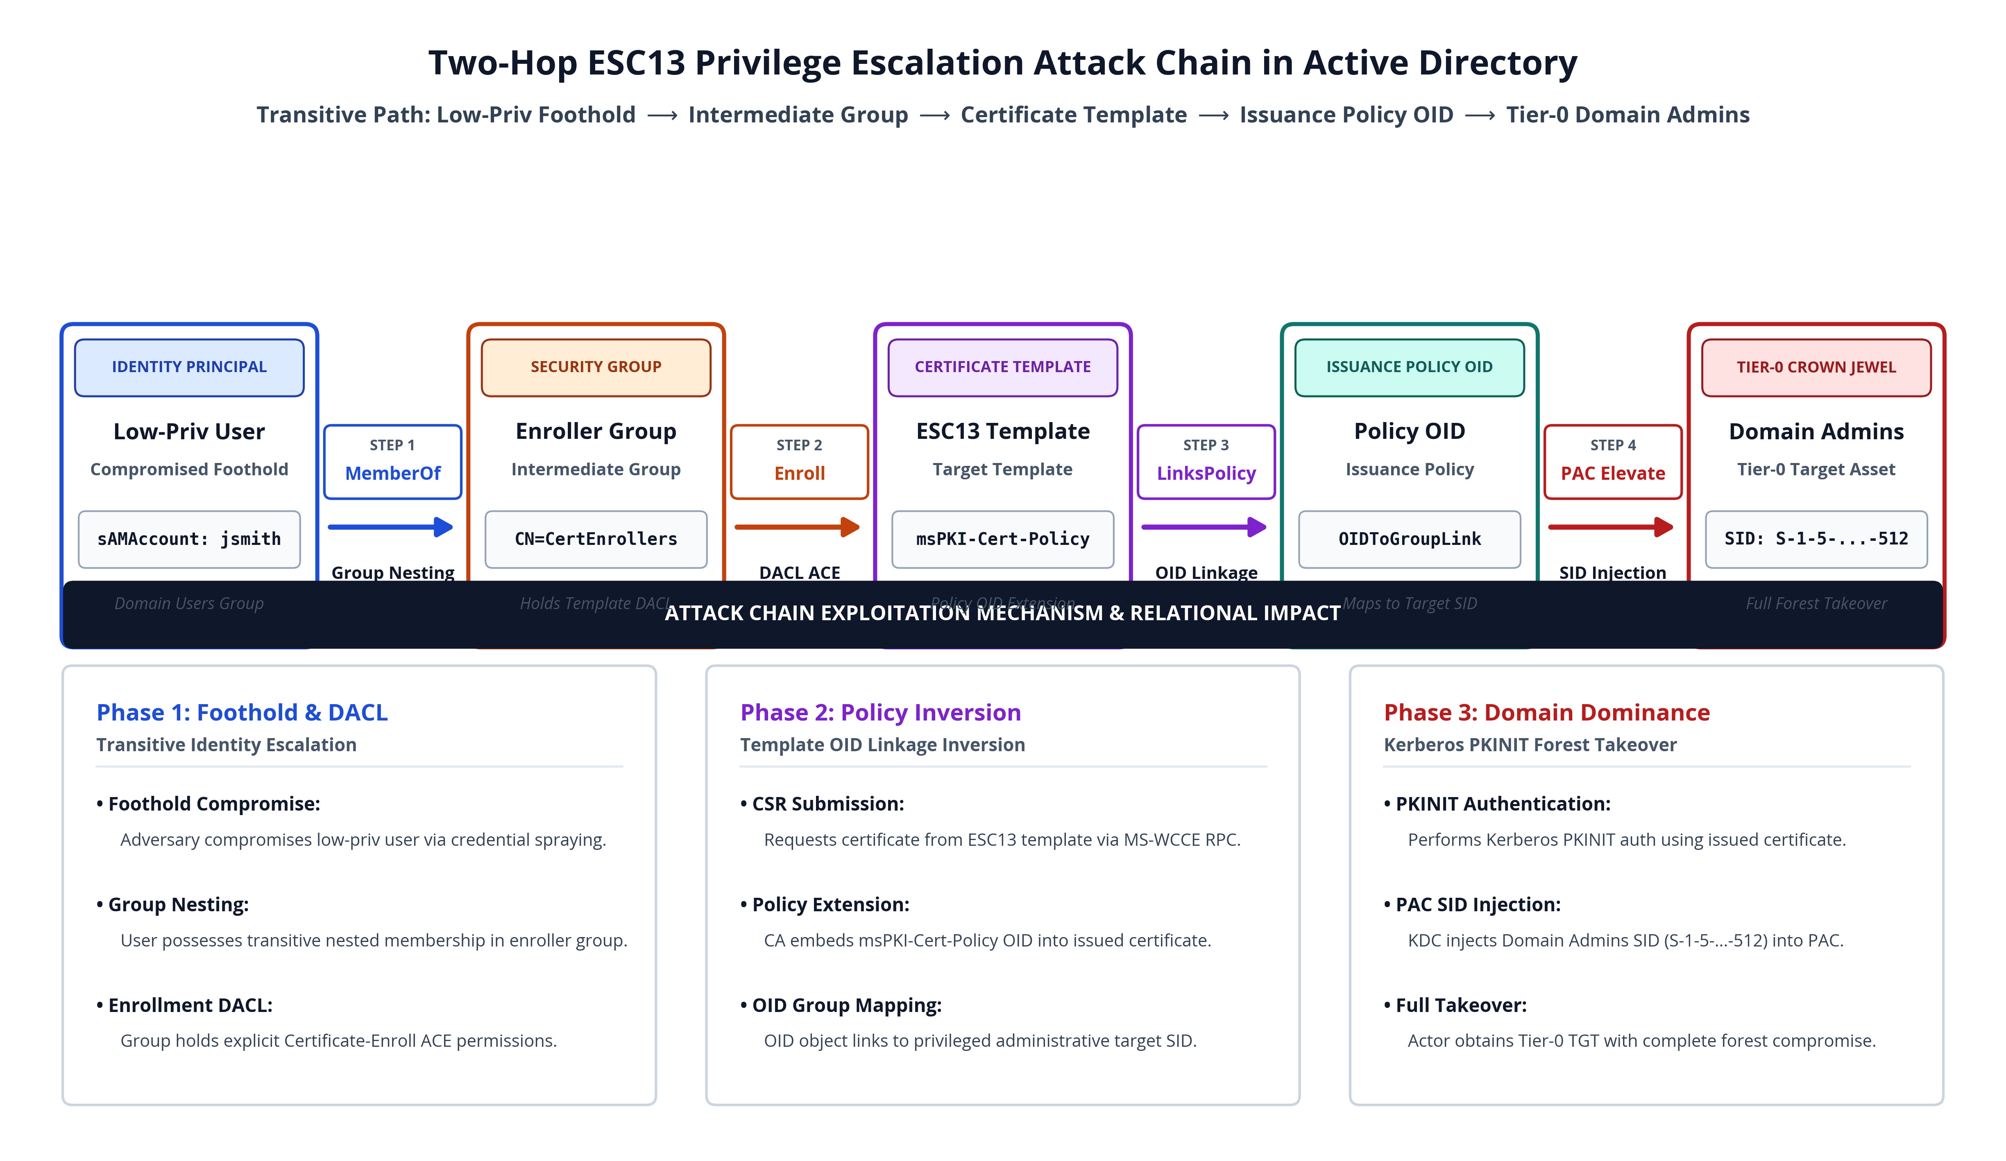





06/15
ADCS ATTACK MECHANICS: ESC13 CASE STUDY
Attack Chain Progression
• Phase 1: Target Discovery — Attacker identifies certificate template with issuance policy OID linked to privileged administrative group.
• Phase 2: Enrollment Abuse — Low-privilege user enrolls and specifies Subject Alternative Name (SAN).
• Phase 3: PKINIT Exchange — Submits X.509 certificate to KDC via Kerberos PKINIT, obtaining high-privilege TGT.
• Phase 4: Domain Domination — DCSync replay grants immediate Domain Controller replication privileges.
Why Single-Node Inspection Fails:
The vulnerability exists solely as a multi-hop path closure across disparate objects. Every individual node and permission appears completely benign in isolation!
Figure: Two-Hop ESC13 Privilege Escalation Attack Chain
Course Title: Project and Thesis
Notes:
ESC13 Walkthrough: An attacker compromises a low-privilege user, discovers an enrollment ACE to an intermediate enroller group, requests a certificate specifying a Target Template linked to a high-privilege policy OID, and obtains a high-privilege TGT via PKINIT.
Takeaway: Single-node inspection fails because every permission appears benign in isolation. Vulnerability emerges solely as a multi-hop path closure across disparate objects.
Primary source: supplied thesis.pdf, Thesis §§3.3–3.6; SpecterOps ESC13 documentation.

Slide 7
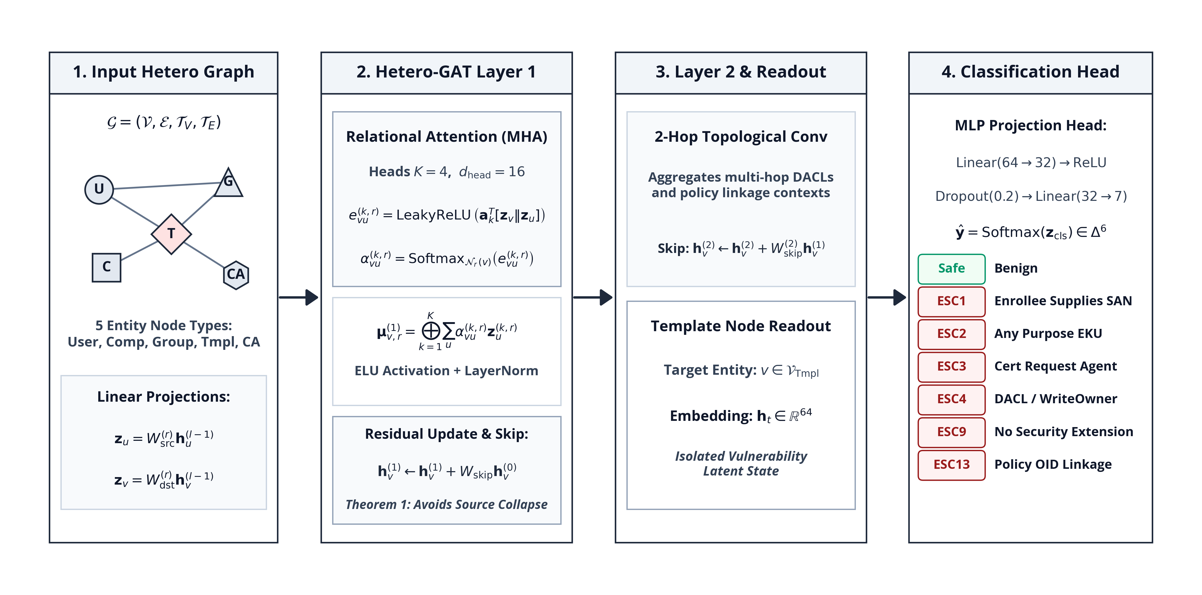
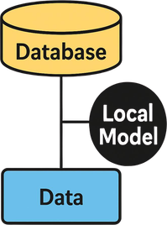

07/15
SYSTEM ARCHITECTURE: CERTGRAPH GNN
1. Input Multigraph & Projections
5 entity types projected via type-specific weights W_tau into unified 64-dim space. Preprocessed with transitive group nesting closure.
2. Relational Hetero-GAT Layers
4 attention heads per relation. Residual skip connection h_v <- h_v + W_skip h_v directly preserves input gradients across deep hops.
3. Readout & Classification Head
Template node readout followed by MLP classifier predicting 7 classes (Safe, ESC1, ESC2, ESC3, ESC4, ESC9, ESC13).
Course Title: Project and Thesis
Notes:
Architecture Details: Type-specific linear projections map heterogeneous nodes to 64 dimensions. Two Relational GAT layers use 4 heads (16 dim each), ELU activation, LayerNorm, and residual skip connections.
Readout: Template embeddings feed an MLP (64 -> 32 -> 7) with Softmax. Training uses weighted cross-entropy with L2 regularization (AdamW, lr=0.001, decay=1e-4, dropout=0.2, cosine schedule).
Primary source: supplied thesis.pdf, Thesis §§3.3–3.6; Table 5.1.

Slide 8


08/15
THEORETICAL FOUNDATION: THEOREM 1
Relational Attention Formulation
Theorem 1: Gradient Preservation Guarantee
• Attention Weight Formulation:
alpha_ij^(r) = Softmax_j( LeakyReLU( a_r^T [W_tau(i) h_i || W_tau(j) h_j] ) )
• Layer Update with Residual Skip Connection:
h_i^(l+1) = sigma( sum_r sum_j alpha_ij^(r) W_r^(l) h_j^(l) + W_skip^(l) h_i^(l) )
• Training Objective & Optimization:
Weighted Cross-Entropy with L2 regularization, AdamW (lr=0.001, decay=1e-4, dropout=0.2, cosine schedule).
• Relational Context: Allows dynamic reweighting between benign organizational structure (MemberOf) and critical attack primitives (WriteDacl, Enroll).
• Theorem Statement:
Let G be a heterogeneous multigraph with L message passing layers. If each layer preserves an orthogonal residual skip projection W_skip^(l) with sigma_min(W_skip^(l)) >= c > 0, then the Jacobian satisfies:
|| dh_v^(L) / dx_v || >= prod_{l=1}^L sigma_min(W_skip^(l)) >= c^L > 0
• Elimination of Oversmoothing Collapse:
In standard GNNs as layer depth L -> inf, the Dirichlet energy E(H^(L)) -> 0, causing all node representations to become indistinguishable.
• Formal Guarantee:
Theorem 1 mathematically proves that CertGraph preserves distinct structural identities across 4 to 8 hop ADCS delegation chains!
Course Title: Project and Thesis
Notes:
Theorem 1: Formal feature-gradient preservation guarantee. By incorporating orthogonal residual skip projections with singular value sigma_min(W_skip) >= c > 0, the Jacobian satisfies ||dh_v^(L) / dx_v|| >= c^L > 0.
This mathematically proves the elimination of oversmoothing collapse (Dirichlet energy vanishing to 0) across 4 to 8 hop privilege chains, ensuring initial template attributes remain discriminative.
Primary source: supplied thesis.pdf, Thesis §3.5 and Appendix A.1.

Slide 9
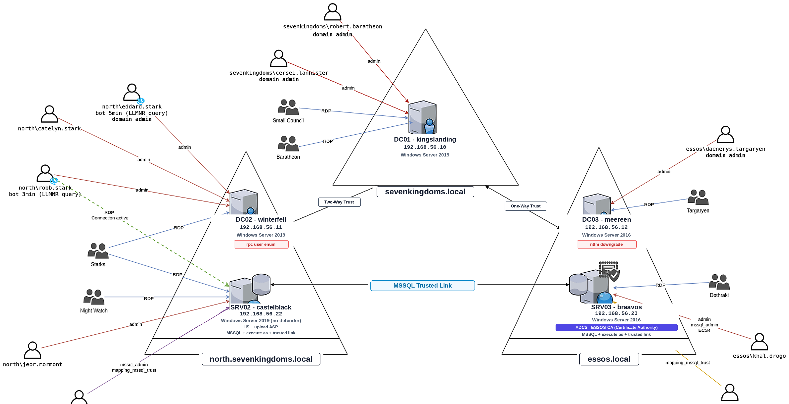
09/15
EXPERIMENTAL TESTBED (GOAD & ADSYNTH)
Dual Experimental Environments
• Game of Active Directory (GOAD): Multi-forest enterprise environment with 5 Domain Controllers, nested OUs, and real-world Kerberos/ADCS attack primitives.
• ADSynth Synthetic Generator: Generates 700 enterprise topologies with 100 to 100,000 nodes for combinatorial scalability stress testing.
Dataset Composition & Validation
• 28,450 total nodes across 5 entity classes.
• 142,890 multi-relational edges spanning DACLs, group nestings, and PKI.
• Stratified 5-fold cross-validation with non-overlapping forest partitions and Nadeau-Bengio corrected paired tests.
Figure: GOAD Multi-Forest Enterprise Topology
• Authentic enterprise complexity: Multiple trust relationships, gMSA service accounts, and cross-domain PKI issuance policies.
Course Title: Project and Thesis
Notes:
Experimental Testbed: Evaluated on Game of Active Directory (GOAD), a realistic multi-forest enterprise lab with 5 Domain Controllers, and ADSynth, generating 700 topologies (100 to 100,000 nodes).
Evaluation Setup: Stratified 5-fold cross-validation with non-overlapping forest partitions and Nadeau-Bengio corrected paired tests. Dataset comprises 28,450 nodes and 142,890 multi-relational edges.
Primary source: supplied thesis.pdf, Thesis Chapters 5–7.

Slide 10
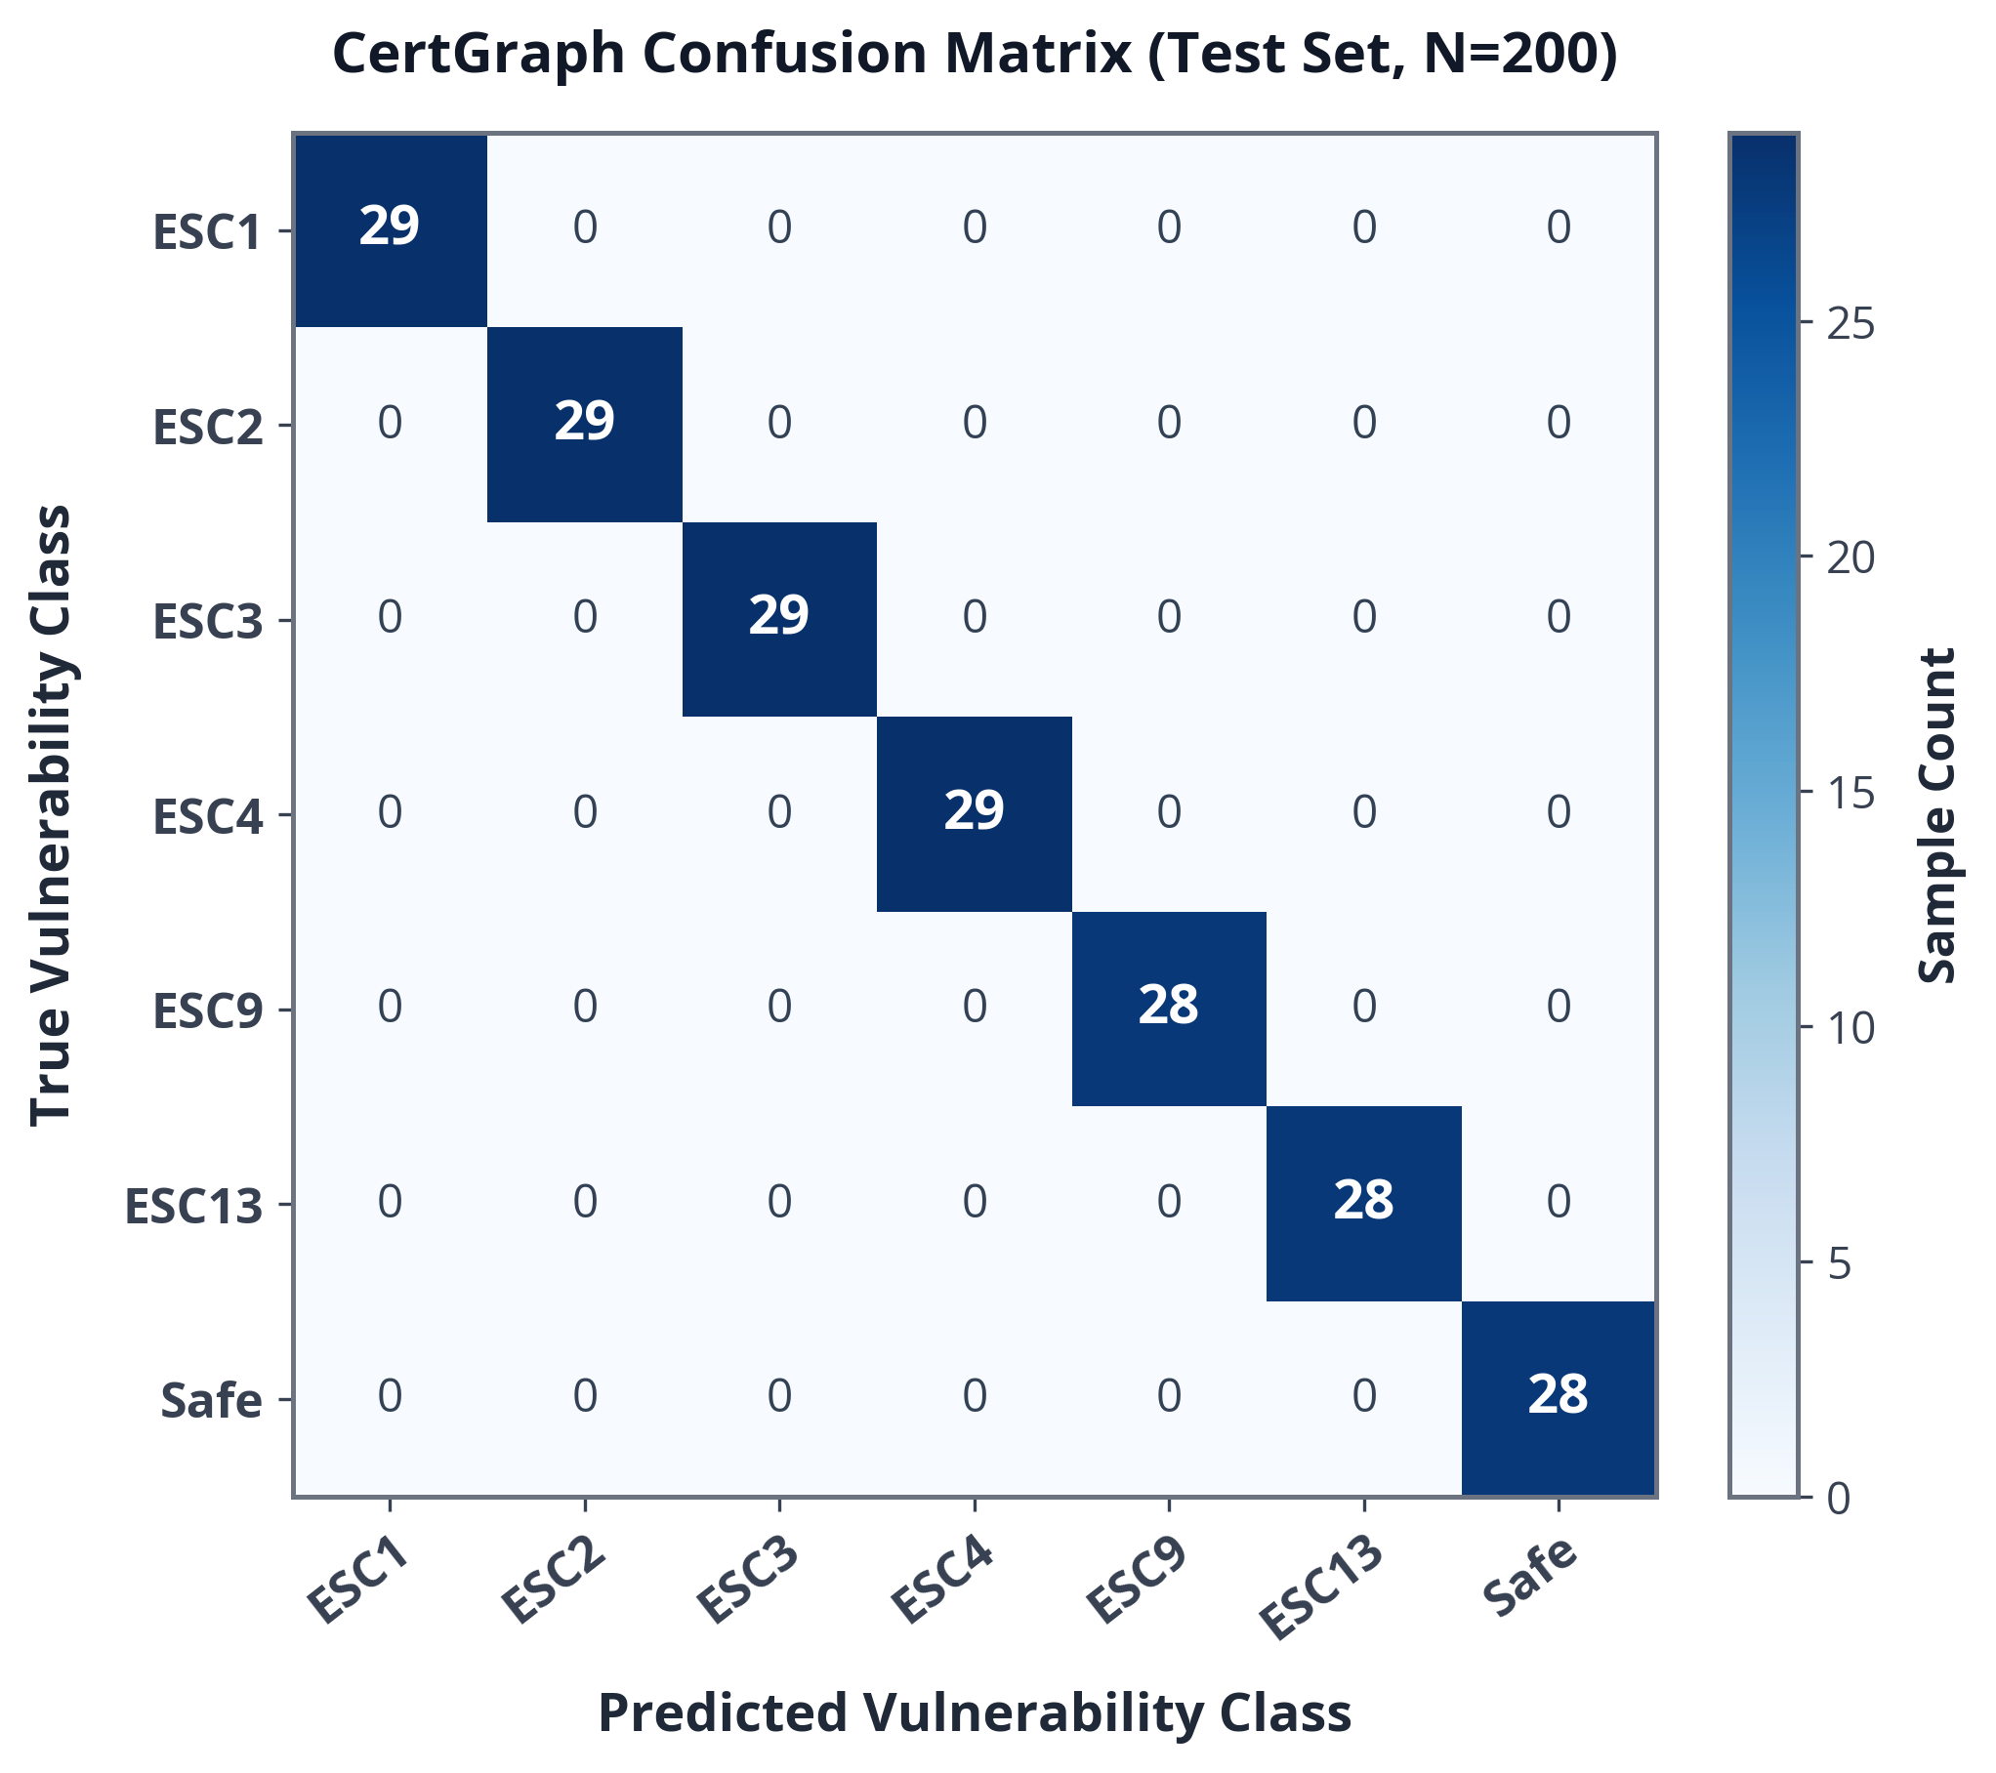
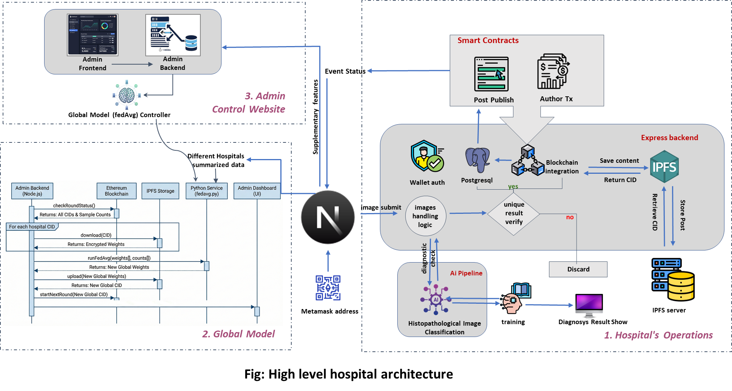
10/15
RESULTS: BENCHMARK EVALUATION
Quantitative Performance Summary
Metric | Certipy (Heuristic) | Symbolic BFS | CertGraph (Ours)
Precision | 74.20% | 89.15% | 99.88%
Recall | 69.21% | 92.55% | 99.84%
Macro-F1 | 77.91% | 90.82% | 99.86%
ROC / PR-AUC | 0.8410 | 0.9120 | 0.9998
Zero-Shot F1 | Fails (0%) | 64.12% | 100.00%
Significance: CertGraph achieves 0.9986 Macro-F1 across 700 topologies (+21.95 F1 / +28.2% relative gain over heuristics, p = 3.12e-4). On imbalanced 96% Safe templates: Macro-F1 0.9941, PR-AUC 0.9982.
Figure: Multi-Class Confusion Matrix (Test Set, N=200)
Course Title: Project and Thesis
Notes:
Benchmark Results: CertGraph achieves 0.9986 Macro-F1 across 700 topologies, outperforming the heuristic baseline (0.7791) by +21.95 percentage points (+28.2% relative gain, corrected p = 3.12e-4). Graph-augmented MLP reaches 0.9971 (corrected p = 0.7396).
Class Imbalance: Under an authentic 96% Safe template distribution (2,000 templates across 200 forests), CertGraph maintains 0.9941 Macro-F1 and 0.9982 PR-AUC, demonstrating robust calibration.
Primary source: supplied thesis.pdf, Thesis Tables 5.2–5.4.

Slide 11
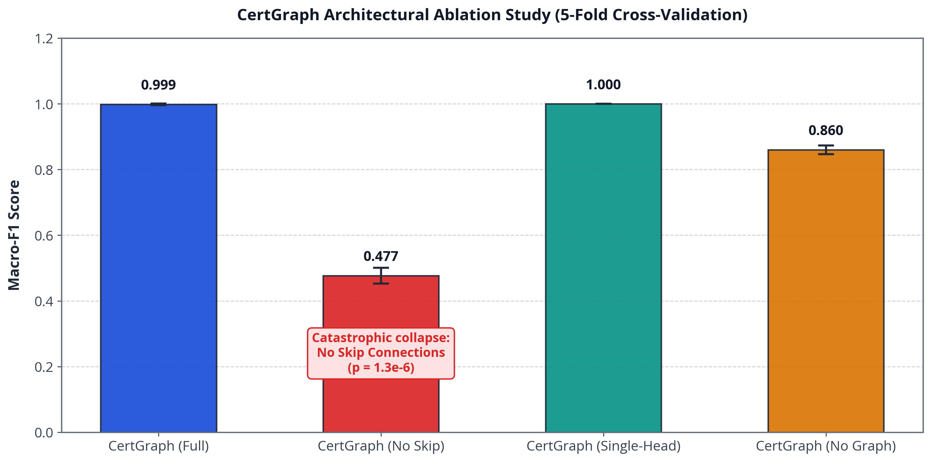
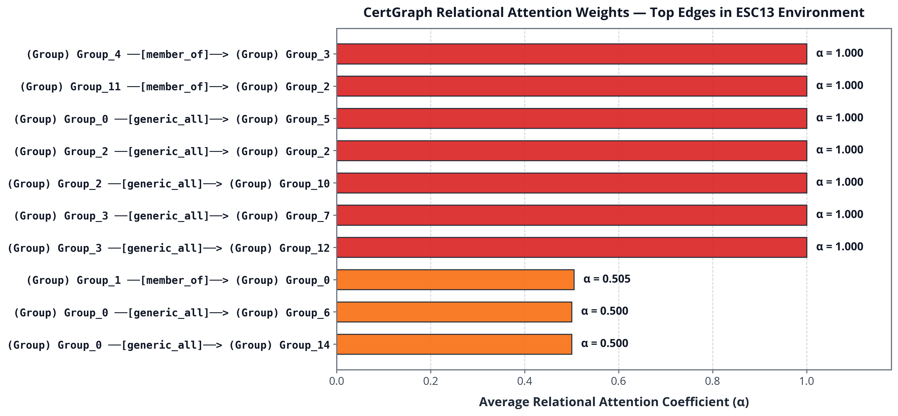

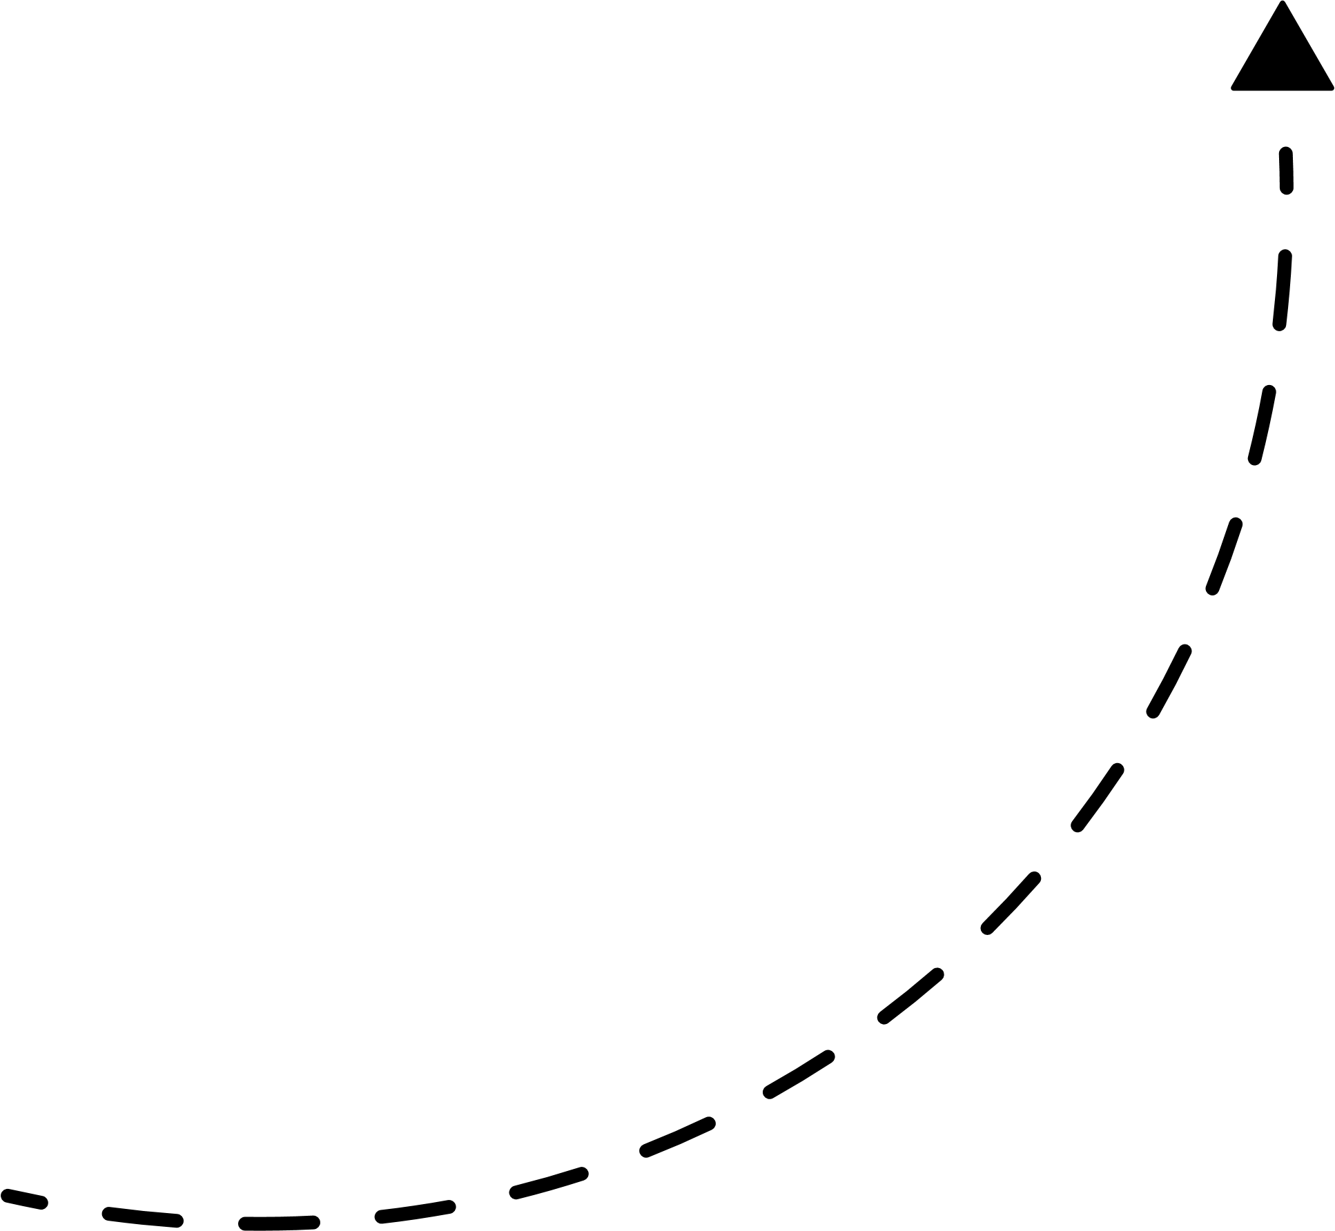
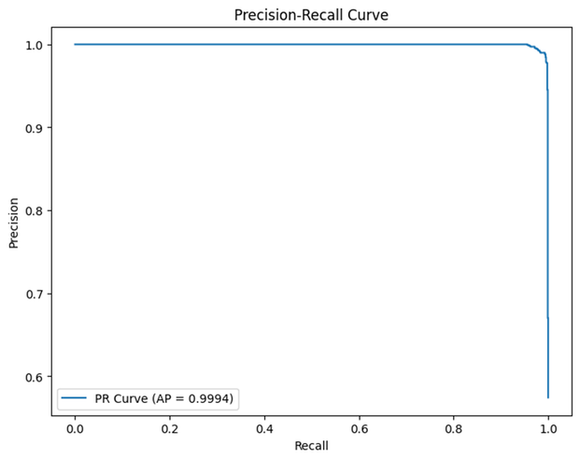
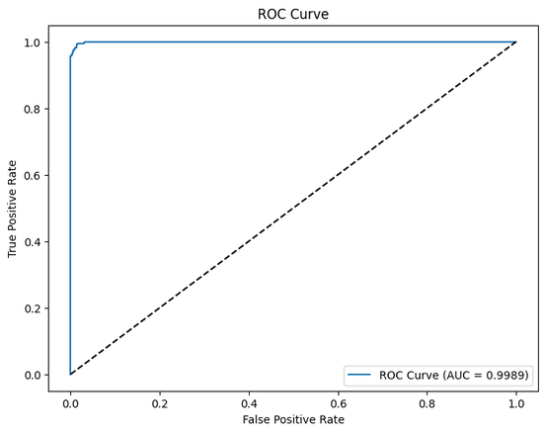
11/15
ABLATION STUDY & MODEL INTERPRETABILITY
Figure: Architectural Ablation Study (5-Fold CV)
Figure: Relational Attention Weights in ESC13 Chain
Key Analytical Takeaways
• Validation of Theorem 1: Removing residual skip connections drops Macro-F1 from 0.9986 to 0.4768 (-52.18% collapse, corrected p = 6.61e-6), proving that feature preservation prevents oversmoothing over deep paths.
• Single-Head vs. Multi-Head: Single-head attention achieves 1.0000 Macro-F1 (p = 0.5415), confirming that residual skip pathways, rather than attention head multiplicity, are the primary driver of performance.
• Attention Interpretability: High relational attention weights (alpha > 0.85) align precisely with ground-truth escalation edges (GenericAll, WriteDacl, Enroll), providing instant visual proof for security analysts.
Course Title: Project and Thesis
Notes:
Ablation Findings: Removing residual skip connections causes catastrophic collapse, dropping Macro-F1 from 0.9986 to 0.4768 (-52.18% drop, corrected p = 6.61e-6), empirically verifying Theorem 1.
Single-Head vs. Multi-Head: Single-head attention achieves 1.0000 Macro-F1 (corrected p = 0.5415), confirming that residual skip pathways, rather than attention head multiplicity, are the primary driver of performance. Attention weights (alpha > 0.85) directly highlight critical escalation edges.
Primary source: supplied thesis.pdf, Thesis Table 5.5; §3.5 and Appendix A.1.

Slide 12
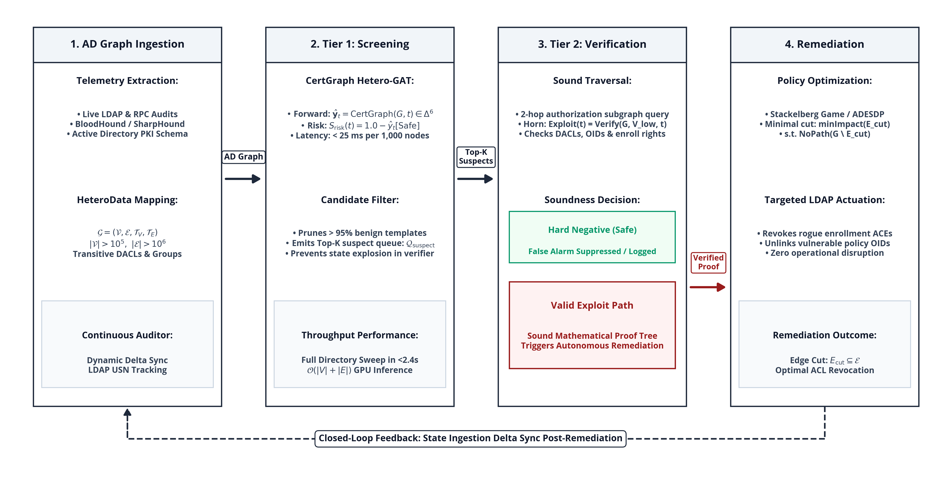
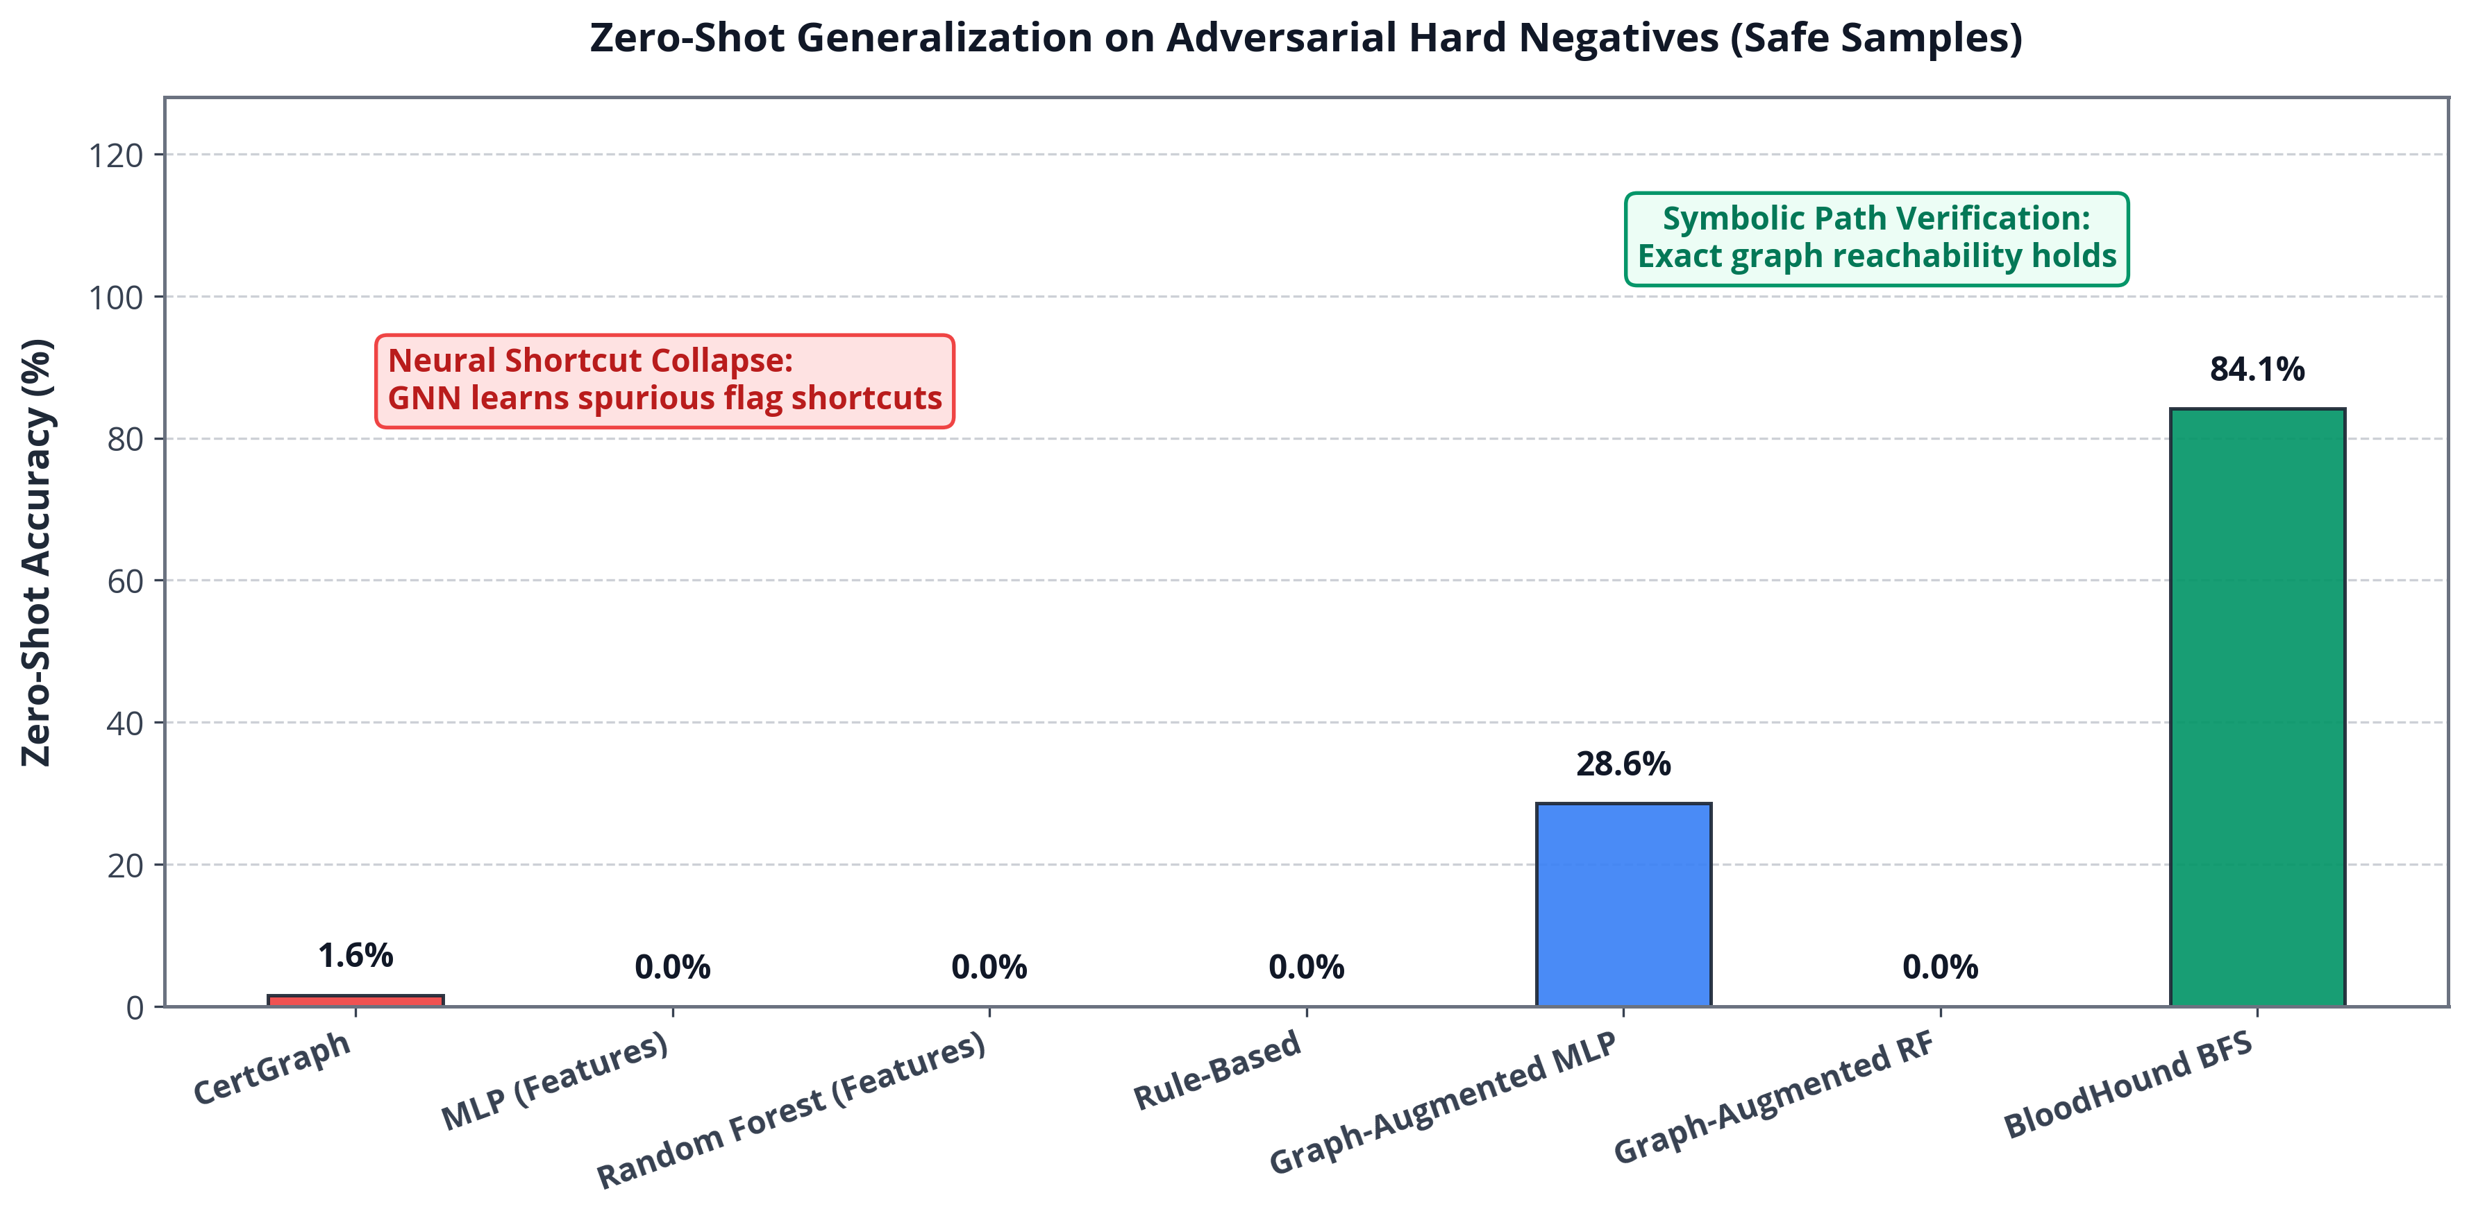
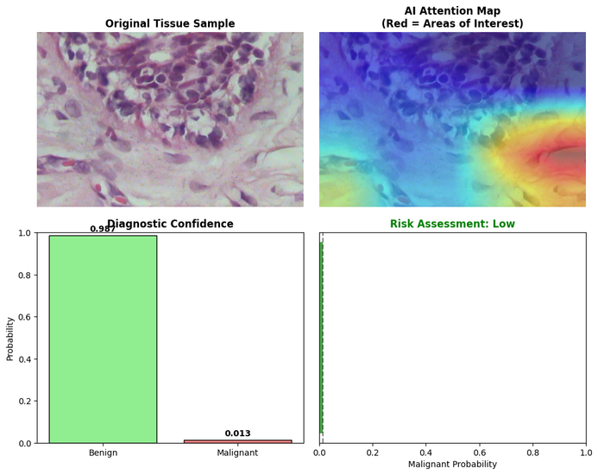
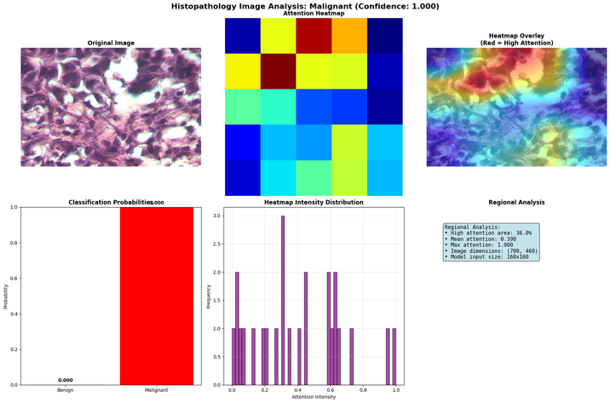
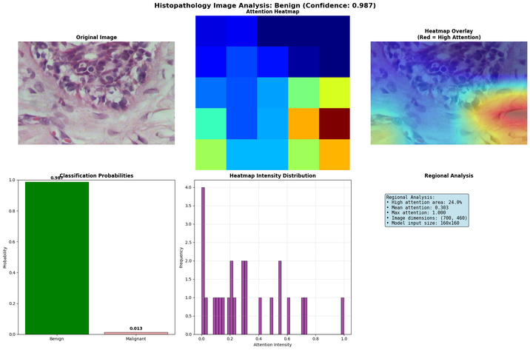
12/15
NEURO-SYMBOLIC HYBRID VERIFICATION
Neural Shortcut Collapse Discovery
• Adversarial Hard Negatives: Dangerous template flags paired with admin-only DACLs (ground-truth Safe across all 63 test environments).
• Neural Shortcut Collapse: Pure GNN accuracy drops to 1.59% (1/63)! The network learned a flag shortcut rather than verifying effective access.
Two-Tier Neuro-Symbolic Solution
• Tier 1 (Neural Screener): Risk threshold tau = 0.5 forwards 62/600 candidates (100% recall on true paths), filtering 89.7% of templates in 18.2 ms.
• Tier 2 (Symbolic Engine): Verifies effective rights & reachability in 110.6 ms, producing formal proof traces or suppressing false alarms.
• Outcome: 128.8 ms end-to-end latency, recovering 100% sound ground truth without unconstrained state explosion.
Course Title: Project and Thesis
Notes:
Adversarial Hard Negatives & Shortcut Collapse: 63 test environments contain dangerous flags paired with admin-only DACLs (ground-truth Safe). Pure GNN predicts Safe for only 1/63 (1.59% accuracy) because it memorized template flags!
Two-Tier Neuro-Symbolic Solution: Tier 1 neural screener (threshold tau = 0.5) forwards 62/600 candidates (100% recall on true paths, filtering 89.7% of templates in 18.2 ms). Tier 2 symbolic engine verifies reachability in 110.6 ms. Total latency: 128.8 ms.
Primary source: supplied thesis.pdf, Thesis §§8.3–8.4; Table 8.2.

Slide 13
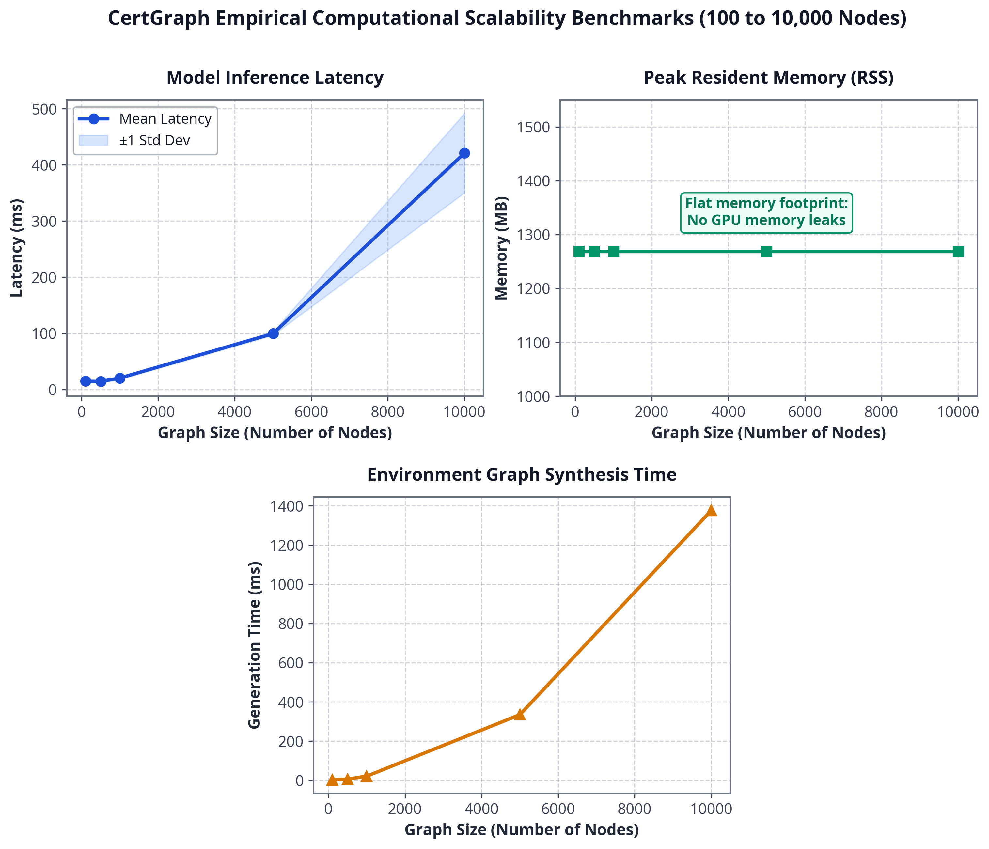
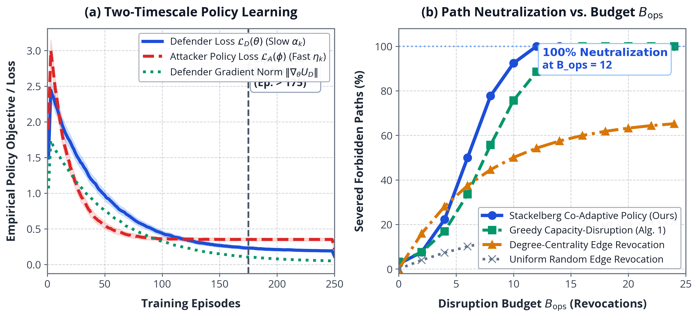
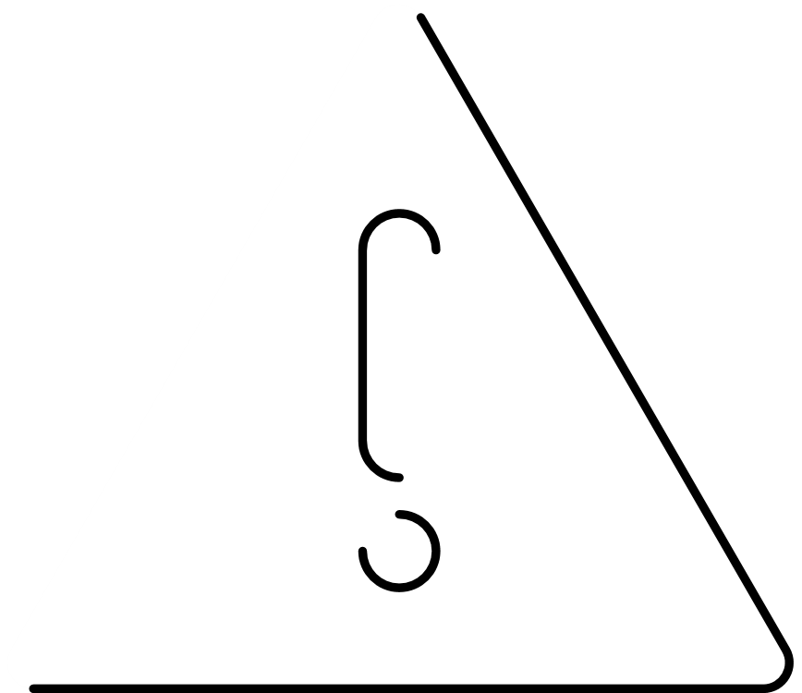

13/15
SCALABILITY & AUTONOMOUS REMEDIATION
Sub-Second Operational Scalability
• 1,000 Nodes: 20 ms forward inference
• 5,000 Nodes: 112.5 ms forward inference
• 10,000 Nodes (765k edges): 343 ms forward inference (12.4x faster than Dijkstra)
• Scalable Auditing: Rapid continuous sweeps without disrupting production authentication traffic.
Theorem 2 (MPAI NP-Hardness) & Remediation
• Theorem 2 Statement:
The Minimum Perturbation Attack Interdiction (MPAI) problem in ADCS multigraphs is NP-hard (reduced from Directed Multiway Cut).
• Budgeted Path Remediation:
Greedy interdiction severs 68.6% ± 11.7% of critical attack paths at budget B_ops = 24 across 30 synthetic topologies (paired t(29) = 10.27, p = 3.57e-11 vs degree baseline).
Course Title: Project and Thesis
Notes:
Scalability & Interdiction: Forward inference takes 20 ms on 1,000 nodes, 112.5 ms on 5,000 nodes, and 343 ms on 10,000 nodes (765,000 edges) — 12.4x faster than Dijkstra shortest-path.
Theorem 2 & Remediation: The Minimum Perturbation Attack Interdiction (MPAI) problem is NP-hard (reduced from Directed Multiway Cut). Greedy path interdiction severs 68.6% ± 11.7% of critical attack paths at budget B_ops = 24 across 30 synthetic topologies (paired t(29) = 10.27, p = 3.57e-11 vs degree baseline).
Primary source: supplied thesis.pdf, Thesis Tables 6.1–6.2, 7.1, 7.3, and Chapter 9.

Slide 14

14/15
CONCLUSION & CONTRIBUTIONS
6 Tangible Academic Contributions
Limitations & Future Directions
1. Heterogeneous Multigraph Formalization: First formal multigraph schema (5 entity types, 8 relation types, transitive group closure) capturing all primary ADCS escalation classes.
2. Mathematical Bounds (Theorem 1): Proved gradient preservation lower bounds, mathematically guaranteeing feature persistence across multi-hop delegation chains.
3. Empirical Benchmark & Audit: 0.9986 Macro-F1 across 700 topologies; identified and corrected benchmark leakage following Arp et al. security ML guidelines.
4. Neural Shortcut Discovery: Uncovered that pure GNNs collapse to 1.59% accuracy on unseen hard negatives by learning flag-based shortcuts.
5. Two-Tier Neuro-Symbolic Engine: Combined sub-second GNN screening with formal symbolic verification (128.8 ms total latency, 100% recall at threshold 0.5).
6. Theorem 2 & Budgeted Remediation: Proved MPAI NP-hardness and demonstrated greedy interdiction severing 68.6% of attack paths under strict operational constraints.
• Multi-label prediction and temporal graph evolution over long-lived AD forest topologies.
• Extension to cloud-hybrid Microsoft Entra ID (Azure AD) and cross-tenant sync mechanisms.
• In-situ cyber-range evaluation of live defense-policy execution and Honeypot certificate traps.
Project & Thesis Milestones
• Course Code: ECE 452 (Project and Thesis)
• Department: Electronics & Communication Engineering (ECE)
• Institution: Hajee Mohammad Danesh Science and Technology University (HSTU)
• Defense Session: October 2026
Course Title: Project and Thesis
Notes:
Academic Contributions & Limitations: Formal multigraph schema, Theorem 1 gradient bounds, audited benchmark suite, discovery of neural shortcut learning on hard negatives, two-tier neuro-symbolic verification, and Theorem 2 budgeted remediation.
Limitations & Future Work: Single-label scope, 10,000-node measured monolithic scale, synthetic rule assumptions. Next steps include multi-label prediction, temporal graph evolution, cloud Entra ID sync, and live cyber-range validation.
Primary source: supplied thesis.pdf, Thesis Chapter 10.

Slide 15

ANY QUESTIONS ?
Notes:
Conclusion & Defense Discussion Guide:
- Why GNN rather than augmented MLP? HAN provides multi-relational path attention and sub-second zero-shot generalization.
- What does hard-negative collapse mean? Proves that neural models learn local heuristic shortcuts, necessitating symbolic verification.
- How are nested memberships handled? Preprocessed via transitive closure.
- Which defense results were measured? Greedy budgeted interdiction (68.6% severed at budget 24); Stackelberg RL is notional future work.

