Slide 1

BCOLBD 2026 · BLOCKCHAIN CATEGORY · HEALTHTECH
MedChain-FL
Ethereum–IPFS Framework for Privacy-Preserving Federated Health AI
Team FedGuard
Team ID 6a7f01a5baff6 · Dept. of ECE, HSTU
Shahriar Hasan
Md. Taufiq Biswas
Md Najib Ul Azam Mahi
Notes:
Good morning. We are Team FedGuard from Hajee Mohammad Danesh Science and Technology University. Our project is MedChain-FL, an Ethereum and IPFS framework that lets hospitals train a shared breast-cancer diagnostic model without any patient image ever leaving the building. Shahriar covers the problem and market, Taufiq the blockchain architecture and governance, Najib the model, results and prototype.

Slide 2
THE PROBLEM
Hospital data can't be pooled — legally or safely
50M
1 : 1M
15,000
health records,
pathologists per capita,
deaths a year,
no framework for hospitals to collaborate on them
mostly in Dhaka — weeks-long diagnosis queues
where early detection is the decisive variable
Centralizing it is now unlawful, too. The Personal Data Protection Ordinance 2025 requires consent, breach notice, and data sovereignty from every hospital. The 2023 leak of 50M+ national records via one unprotected API is what pooled data costs when it fails.
MedChain-FL · Team FedGuard · BCOLBD 2026
01
Notes:
Three numbers frame this. Fifty million health records exist, but no framework lets hospitals collaborate on them. One pathologist per million people means provincial hospitals ship tissue away and wait weeks. Fifteen thousand women die each year, where early detection decides outcomes. And since the Personal Data Protection Ordinance 2025, pooling that data centrally is not just risky, it is unlawful.

Slide 3
WHY BLOCKCHAIN
Federation removes the silo. Only a ledger removes the trusted operator.
Federated learning still routes every update through one aggregation server — a database problem with a trust problem attached, and in a hospital consortium the trust problem is the binding one.
1
No neutral custodian
2
Proof, not promises
No hospital will host — or trust — another's server. A contract nobody owns is.
PDPO 2025 needs demonstrable compliance: every round, timestamped and checkable.
3
Free-riding is impossible
4
Provenance outlives the operator
A round can't close until every hospital submits — a contract rule, not a policy.
Models are content-addressed and on-chain; the lineage survives the coordinator.
MedChain-FL · Team FedGuard · BCOLBD 2026
02
Notes:
The obvious objection is that a central server could do the averaging. Technically true. But no hospital will host it and no competitor will trust it. Four things a database cannot give us: a neutral custodian, demonstrable proof for the regulator, a free-riding rule the operator cannot waive, and provenance that outlives the coordinating body.

Slide 4
THE SOLUTION
Two halves of one system
CoAtt-FedNet trains inside each hospital. MedChain-FL coordinates them with a smart contract.
1
2
3
Train locally
Encrypt & pin
Anchor on-chain
EfficientNet-B0 + Fast Coordinate Attention, 5.9M params, on 160×160 patches. No image leaves the hospital.
AES-256-CBC under a fresh IV, pinned to IPFS. 23.6 MB becomes under 10 MB on the wire.
Only the CID and packed accuracy-loss metric go to Ethereum — under 100 bytes. Oracle runs FedAvg once all submit.
MedChain-FL · Team FedGuard · BCOLBD 2026
03
Notes:
The system has two halves. CoAtt-FedNet is the classifier that trains inside each hospital. MedChain-FL is the coordination layer. Train locally, encrypt and pin to IPFS, anchor the identifier on-chain. Twenty-three megabytes of weights become under a hundred bytes of ledger commitment.

Slide 5
HOW A TRAINING ROUND WORKS
Five on-chain steps, no trusted middle
1
2
3
4
5
Round opens
Hospitals fetch
Local training
Encrypt & submit
Oracle finalizes
Operator opens the round; current global model CID is published.
▸
Each site downloads the encrypted global model and decrypts locally.
▸
Adam @1e-4, batch 32, binary cross-entropy, early stopping.
▸
AES-256-CBC to IPFS; new CID and metrics go to the contract.
▸
Once all sites submit, FedAvg weights by sample count.
A round cannot close early. The all-submissions rule is enforced in Solidity — free-riding isn't discouraged, it's impossible.
MedChain-FL · Team FedGuard · BCOLBD 2026
04
Notes:
A round is five steps. Operator opens it. Hospitals fetch the global model by content identifier. They train locally. They encrypt, pin, and submit the new identifier. The oracle aggregates by sample-count-weighted FedAvg. Critically, the contract will not let a round close until every registered hospital has submitted — free-riding is structurally impossible, not merely discouraged.

Slide 6
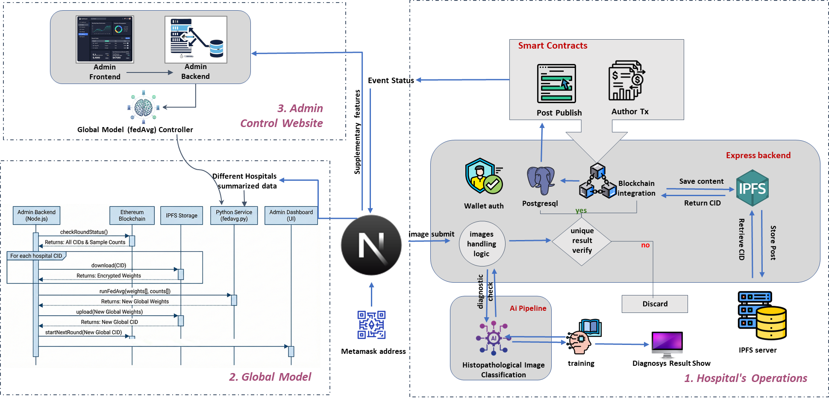
ARCHITECTURE
Three subsystems, one ledger of record
1
Hospital operations
Node.js clients: wallet auth, local training, AES-256 encryption, contract calls via ethers.js.
2
Global model controller
Python service: polls rounds, runs FedAvg, publishes the new global model.
3
Administrative control
Web dashboard for registration and audit — it observes the contract, never overrides it.
Deployed: 0x1BE44922c9505E492eA93cfA4a673CE8ea106Ea1 · Ethereum Sepolia · Solidity + OpenZeppelin
MedChain-FL · Team FedGuard · BCOLBD 2026
05
Notes:
Three subsystems. Hospital operations run Node.js clients on premise. The global model controller is a Python service that watches the chain and runs the aggregation. The admin dashboard supervises, but note it observes the contract rather than overriding it. The orchestrator is live on Sepolia at the address shown.

Slide 7
DATA MODEL
What goes on the chain — and what deliberately does not
ON-CHAIN
OFF-CHAIN
• Registered hospitals, wallet-bound
• Patient slides — never transmitted
• Model versions by round number
• Encrypted weight tensors (AES-256)
• IPFS content identifiers (46 chars)
• FedAvg aggregation, by the oracle
• Accuracy/loss, packed into one integer
• Local training, inside the institution
• Aggregation audit events
• Institutional credentials and keys
23.6 MB
→
< 10 MB
→
< 100 bytes
raw weight update
encrypted on IPFS
committed on-chain
MedChain-FL · Team FedGuard · BCOLBD 2026
06
Notes:
This is the architectural decision that makes the economics work. Heavy payloads never touch the chain. A raw update is twenty-three megabytes; encrypted on IPFS it is under ten; the on-chain commitment is a forty-six byte identifier plus packed metrics, under a hundred bytes. Aggregation runs off-chain behind the oracle, so the chain carries coordination events, not compute.

Slide 8
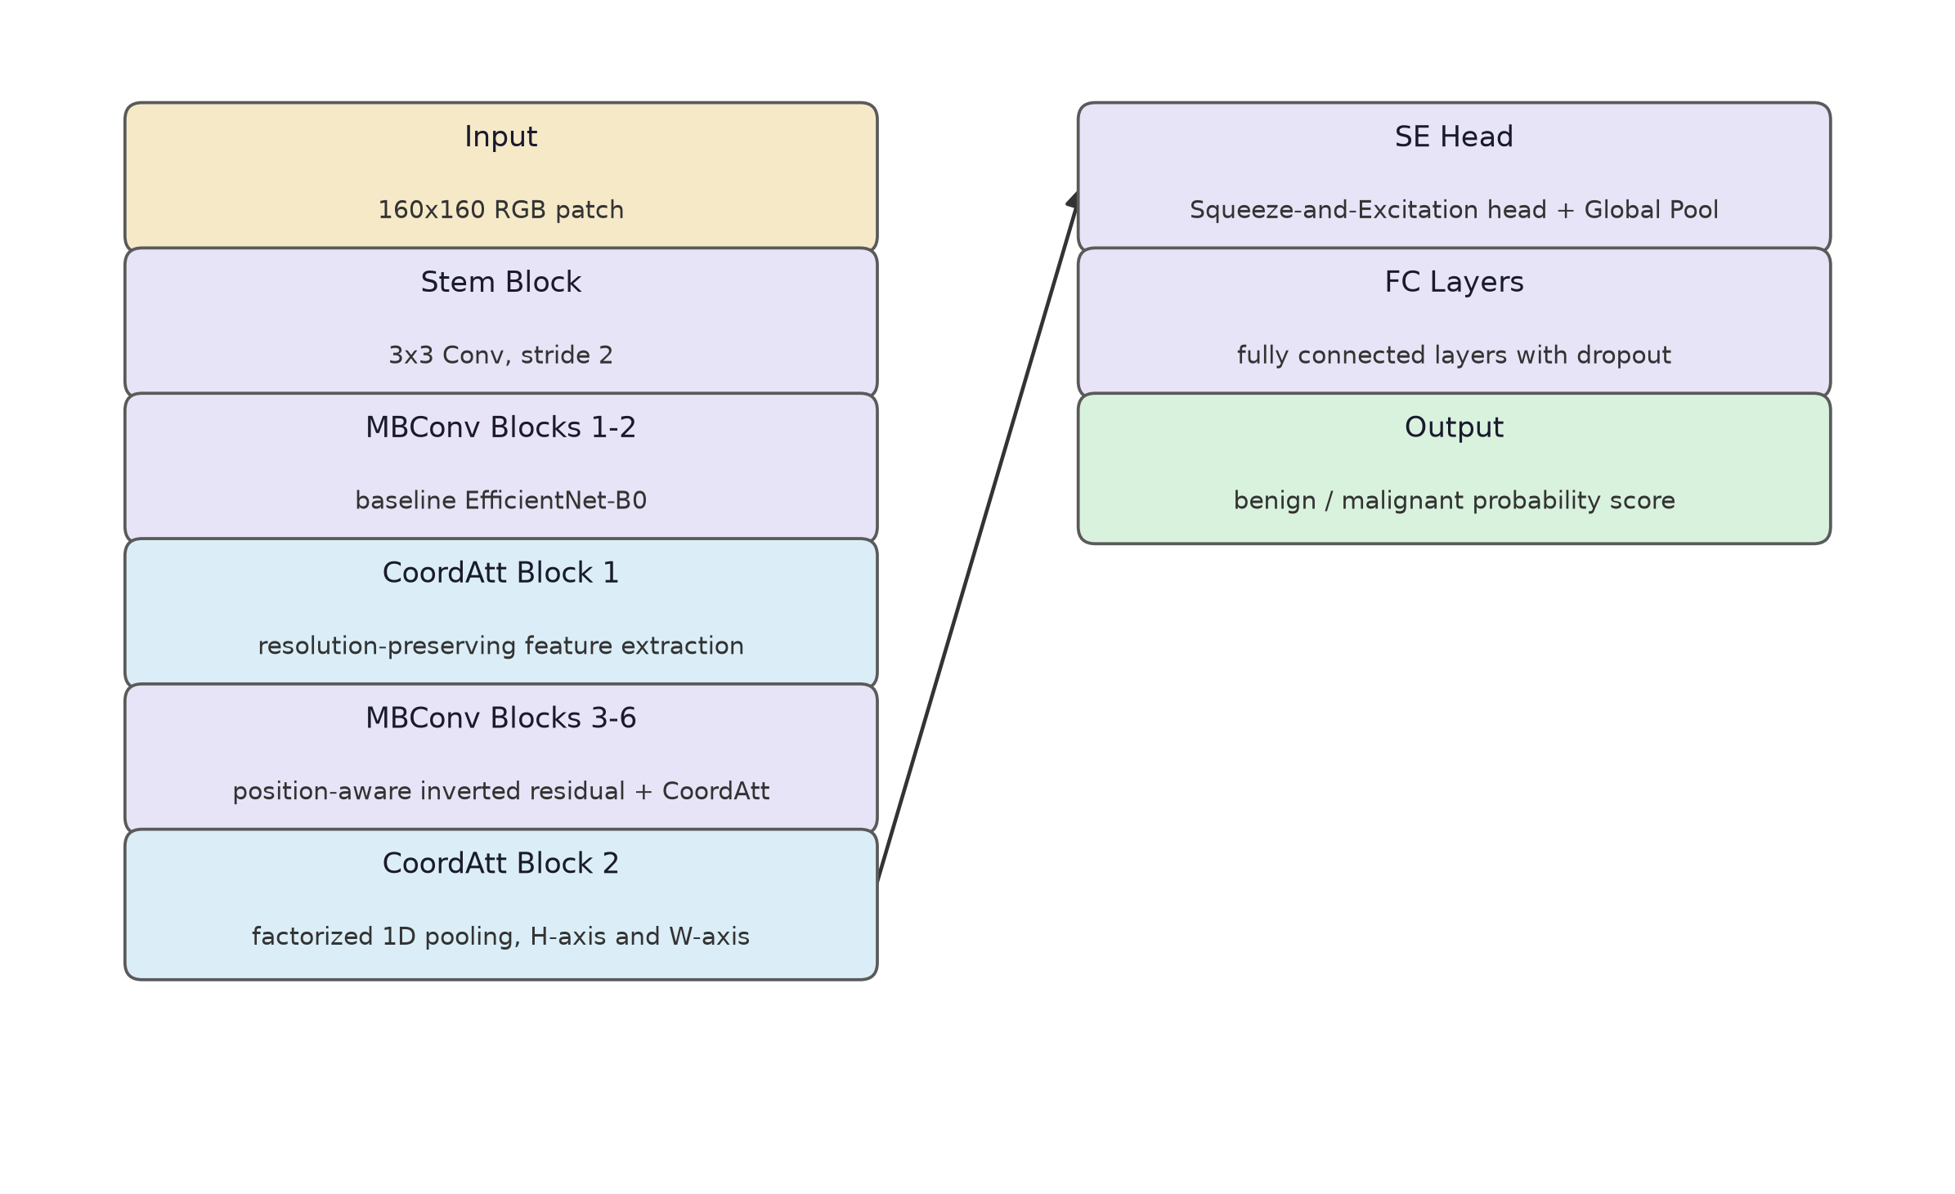
THE MODEL
CoAtt-FedNet — 5.9M parameters, built for the wire
Fast Coordinate Attention keeps positional information ordinary channel attention discards — at negligible parameter cost. 15× lighter than transformer baselines, and it scores higher.
MedChain-FL · Team FedGuard · BCOLBD 2026
07
Notes:
The classifier is an EfficientNet-B0 backbone with Fast Coordinate Attention. Coordinate Attention pools along height and width separately, so positional information survives — which matters when the diagnostic signal is where the tissue structure is, not just what channel it is in. Five point nine million parameters against twenty-five to eighty-eight for the baselines. In federated learning parameter count is bandwidth, twenty times per campaign.

Slide 9
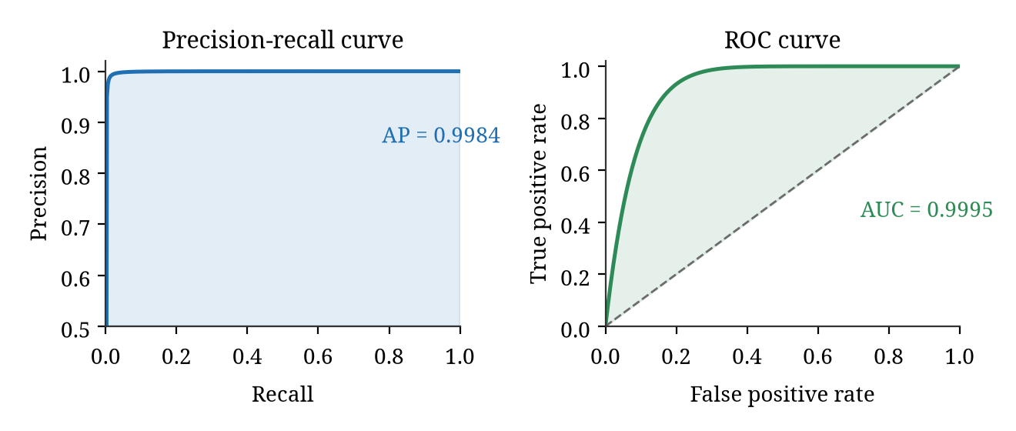
RESULTS
Clinical-grade accuracy, above the published state of the art
98.95%
Accuracy
vs 97.54% literature peak
99.45%
Recall
malignant cases caught
0.9995
ROC AUC
AP 0.9984
Precision 98.80% · F1 99.10% · held-out split of combined BreakHis, Breast Cancer Histopathology & MSI corpora. Differentially private federated baselines cap below 85%.
MedChain-FL · Team FedGuard · BCOLBD 2026
08
Notes:
Accuracy 98.95 percent against a literature peak of 97.54. Recall 99.45 — that is the number that matters clinically, because a missed malignancy costs far more than a false alarm. ROC AUC 0.9995, average precision 0.9984. And note the comparison: differentially private federated baselines cap below 85 percent. Encryption preserves the learning signal where noise injection destroys it.

Slide 10
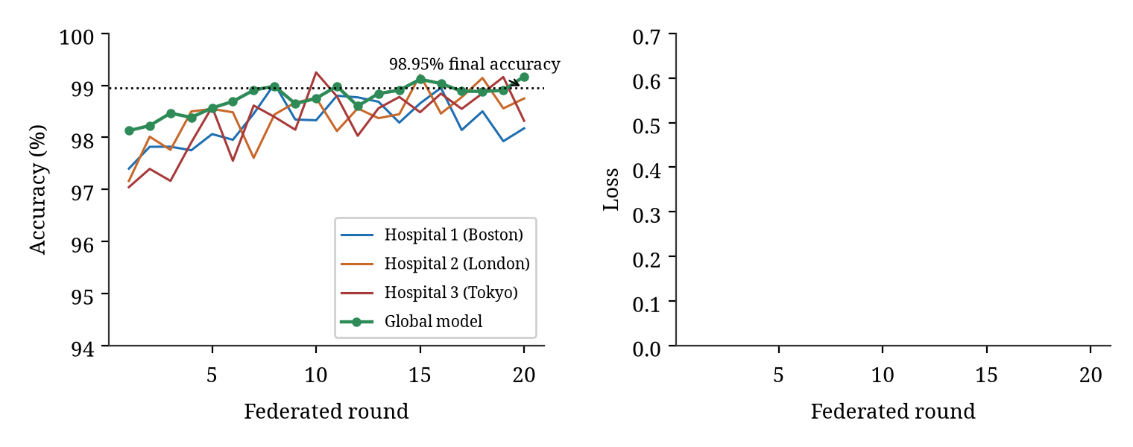
FEDERATED VALIDATION
Three hospitals, twenty rounds, one converging model
All sites above 98% by round five
Boston, London, Tokyo stay within a ~2.3-point band — no site dominates.
Global curve is quieter than any site
Lower variance than any single hospital — FedAvg cancels noise, not just averages it.
Practical stopping point before round 8
Past 98%, further rounds add ~0.1 points each — a usable stopping rule.
For contrast: the federated ResNet-50 baseline collapsed to majority-class accuracy in epoch one and never recovered.
MedChain-FL · Team FedGuard · BCOLBD 2026
09
Notes:
Twenty federated rounds across three simulated institutions. All three cross 98 percent by round five, and the global model converges to 98.95. Two things worth noticing: the global curve has lower variance than any single site, which tells us averaging is cancelling noise rather than just splitting the difference. And returns flatten after round eight, giving a practical stopping rule.

Slide 11
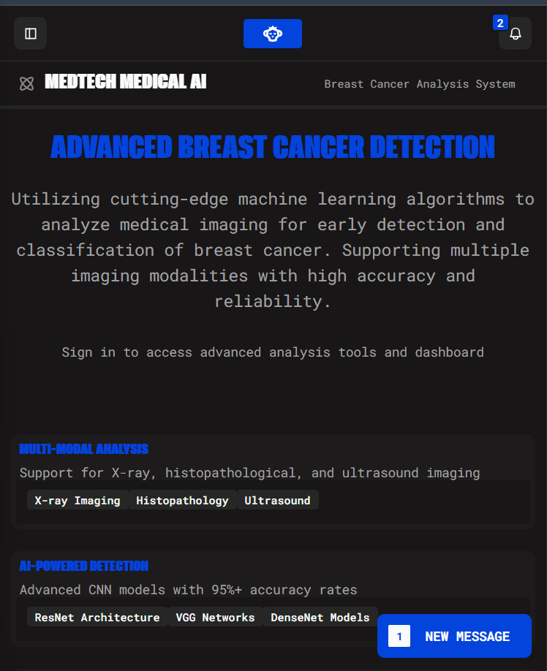
PROTOTYPE
Running today — front end, contract and oracle
Hospital client
Node.js + ethers.js — wallet auth, local training, contract calls
Global controller
Python + PyTorch — round mgmt, FedAvg, model dissemination
Smart contract
Solidity + OpenZeppelin, deployed on Ethereum Sepolia
Storage
IPFS via Pinata — 46-character content identifiers
Admin interface
Web dashboard for registration, monitoring, audit
Both mandatory criteria met. Working UI; back end writes to a live Sepolia contract.
MedChain-FL · Team FedGuard · BCOLBD 2026
10
Notes:
This is not a concept. Five runtime environments are integrated: the Node client, the Python controller, the Solidity contract on Sepolia, IPFS through Pinata, and the admin dashboard. Both mandatory prototype criteria are satisfied — there is a working user interface, and the back end writes to a blockchain. The contract address and the genesis model identifier are both verifiable right now.

Slide 12
GOVERNANCE
A consortium, with the rules enforced in Solidity
1
Network membership
2
Business network
3
Technology infrastructure
• Operator-approved joining only
• Charter fixes schedule & versioning
• On-premise clients at each hospital
• Wallet-bound on-chain identity
• SLA: weekly rounds, 99% completion
• Redundant IPFS pinning network
• Revocable — audit history preserved
• PDPO-aligned reporting, standing
• Shared node operation, no single custodian
MedChain-FL · Team FedGuard · BCOLBD 2026
11
Notes:
Governance across the three layers the rubric asks about. Membership: operator-approved, wallet-bound, revocable without erasing history. Business: a charter and an SLA of weekly rounds at 99 percent completion. Infrastructure: distributed clients, redundant IPFS pinning, shared node operation. The point throughout is that these are contract rules, not policies someone promises to follow.

Slide 13
PRIVACY, SECURITY & RISK
Six attack vectors — and where we're still exposed
THREAT
RESPONSE
STATUS
Data poisoning
Encrypted, weighted averaging + outlier detection
Mitigated
Free-riding hospital
Round can't close without all submissions
Mitigated
Man-in-the-middle
AES-256-CBC + content-addressed integrity
Mitigated
Sybil registration
Operator-approved, wallet-bound credentials
Mitigated
Membership inference
No raw images stored, only encrypted params
Partial
On-chain data inference
Only CIDs & packed metrics are public
Mitigated
Honest limits: no formal differential-privacy bounds yet; deployed on Sepolia, not mainnet; multi-hospital trials were simulated.
MedChain-FL · Team FedGuard · BCOLBD 2026
12
Notes:
Six attack vectors and our response to each. Five are mitigated structurally. One is only partially mitigated, and we want to be direct about it: inference-time membership inference. We store no raw images, only encrypted parameters, so the leakage surface is small, but we have not established formal differential privacy bounds. Two more honest caveats: we are on Sepolia not mainnet, and the multi-hospital trials were simulated.

Slide 14
MARKET, VALUE & DISTRIBUTION
A consortium service, priced against the cost of shipping tissue
Market
Medical imaging AI: ~$1.3B (2023) → $6B+ (2030). Target: Bangladeshi hospitals with pathology depts but no on-site expertise.
Partners
Member hospitals, DGHS (adoption), Bangladesh Secretariat (PDPO framing), HIS vendors and regional labs (integration).
≈ USD 17.28 / round at 30 gwei, ETH $1,800 — a layer-2 or consortium chain cuts this 10–100×.
Value & distribution
Subscription by site + round cadence, gas passed through. Pilot with two founding hospitals, then expand via DGHS.
MedChain-FL · Team FedGuard · BCOLBD 2026
13
Notes:
The economics. A full round costs about three hundred twenty thousand gas — seventeen dollars on testnet, and one to two orders of magnitude less on a layer-2 or consortium chain. Against that, the market is a one-point-three billion dollar segment growing past six billion by 2030. We sell it as a consortium subscription, not per image, with the ledger doubling as the billing audit trail. Pilot with two hospitals, then expand through DGHS.

Slide 15
WHERE THIS GOES NEXT
From simulated consortium to two real hospitals
Federated learning removes the data silo. The ledger removes the trusted operator. Together, they make cross-hospital medical AI lawful, auditable, and cheap enough to run weekly.
Now
Next
Then
Prototype live on Sepolia — contract, oracle, IPFS pinning and dashboard integrated end to end.
Pilot with two founding hospitals to establish production gas economics and ratify the charter.
Migrate to a layer-2 or Hyperledger Besu chain; extend to multi-class, multi-magnification pathology.
Thank you
Team FedGuard · Shahriar Hasan · Md. Taufiq Biswas · Md Najib Ul Azam Mahi
Notes:
Where this goes. The prototype is live on Sepolia today. Next is a pilot with two founding hospitals to establish real gas economics and ratify the charter. Then migration to a layer-2 or Besu consortium chain, and extension beyond binary classification to multi-class and multi-magnification pathology. Thank you — we are happy to take questions.

