Slide 1
Plasma based High resolution microscopy
4-6-2017

Slide 2
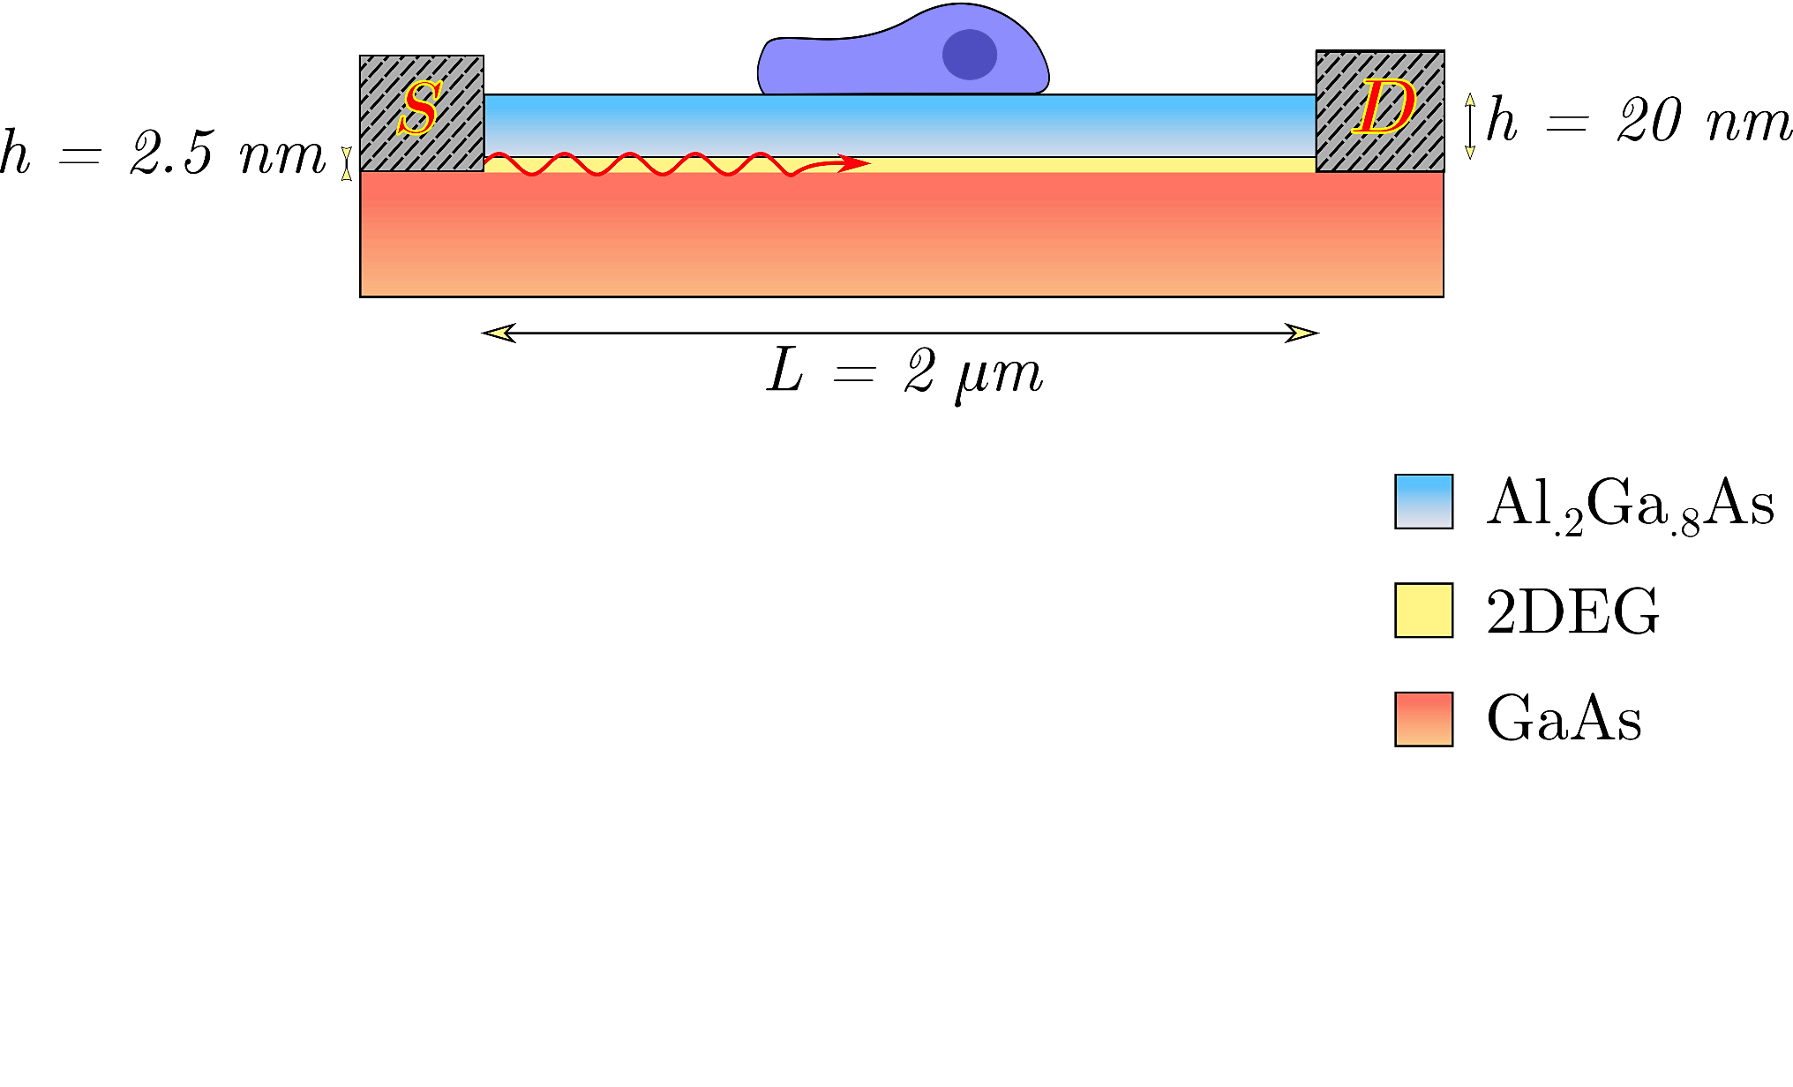
Structure Details

Slide 3
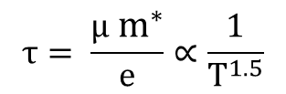
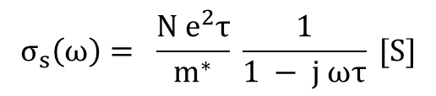
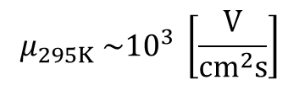
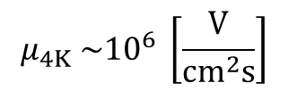

Electrical Properties of 2DEG
Thin sheet of charge
Charge density depending on heterostructure materials
Mobility is temperature dependent
$$N \sim {10}^{11}−{10}^{14}{[cm}^{−2}]$$
$$μ_{4K} \sim {10}^{6} \left[\frac{V}{{cm}^{2}s}\right]$$
$$μ_{295K} \sim {10}^{3} \left[\frac{V}{{cm}^{2}s}\right]$$
$$τ= \frac{μ{ m}^{∗}}{e}∝\frac{1}{T^{1.5}}$$
$$σ_{s}\left(ω\right)= \frac{N e^{2}τ}{m^{∗}} \frac{1}{1 − j ωτ} [S]$$

Slide 4
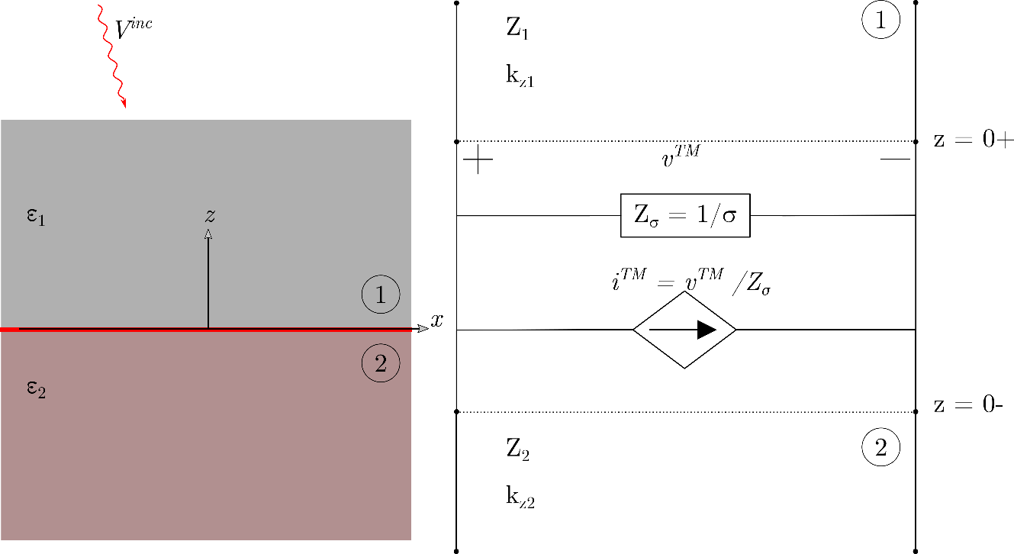
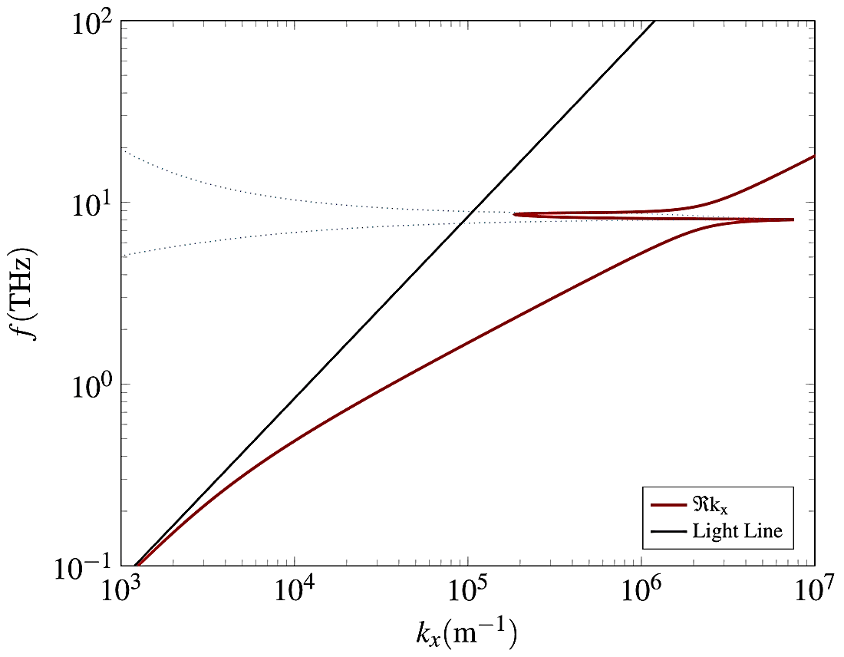



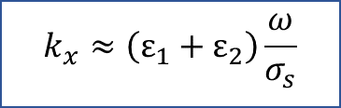
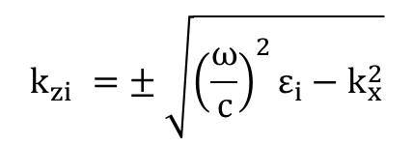
Dispersion Relation
$$Y_{1}+Y_{2}+Y_{σ}=0$$
$$\frac{ε_{1}}{k_{z1}}+ \frac{ε_{2}}{k_{z2}} =−\frac{σ_{s}\left(ω\right)}{ω ε_{0}}$$
$$Y_{i}=\frac{1}{Z_{i}}=\frac{ωε_{i}}{k_{zi}}$$
$$k_{zi} =± \sqrt{{\left(\frac{ω}{c}\right)}^{2}ε_{i}−k_{x}^{2}}$$
$$Y_{σ}=\frac{1}{Z_{σ}}=σ_{s}$$
$$k_{x}≈\left(ε_{1}+ε_{2}\right)\frac{ω}{σ_{s}}$$
Notes:
Multilayer structures can be conveniently analysed by transmission line equivalent formulation. The thin 2DEG region is modeled as an admittance equal to the surface conductivity. For a TM polarization, a surface current also exists along the 2DEG.

Slide 5
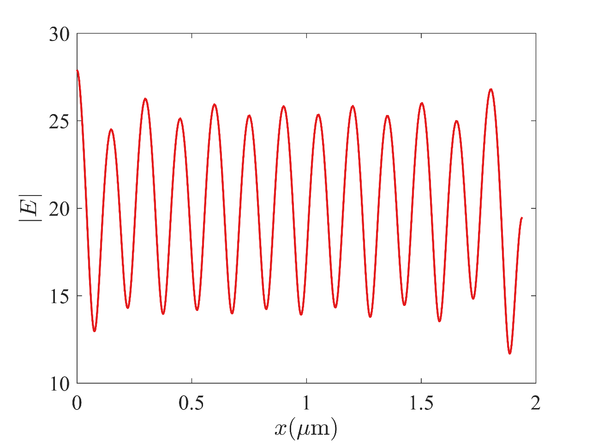
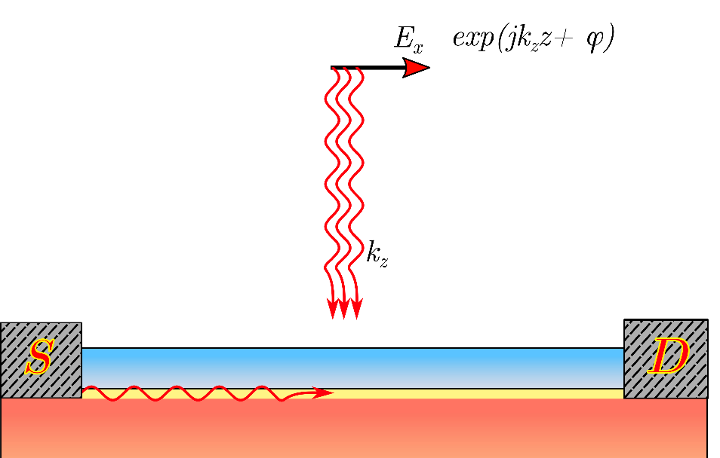
Shifting of standing wave
f = 25 THZ
Standing wave pattern in the 2DEG

Slide 6
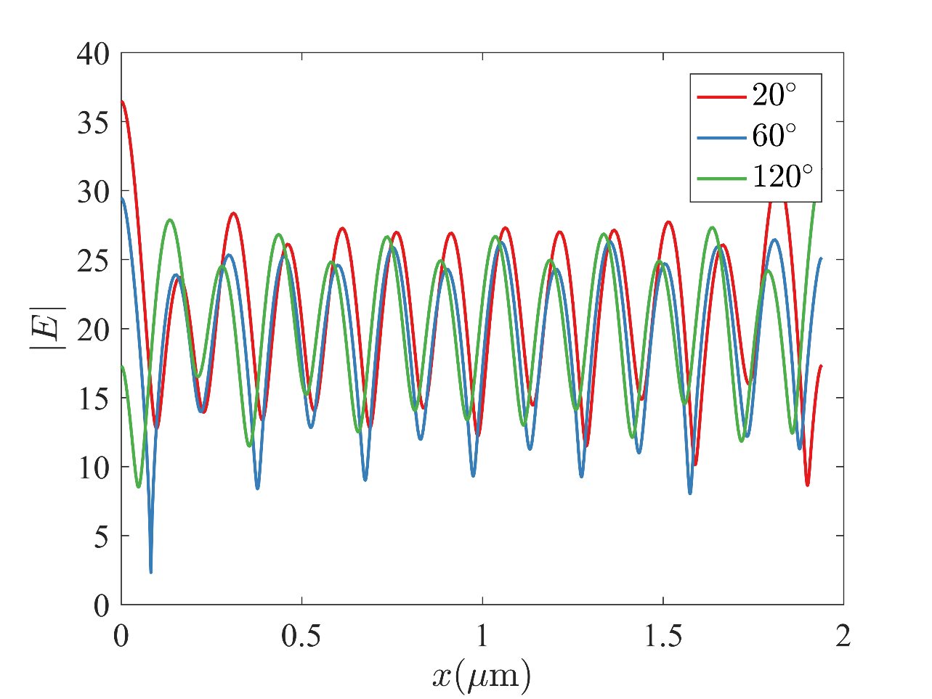
Standing wave in 2DEG
f = 25 THZ
Standing wave pattern with shifting phase of incident TM wave

Slide 7
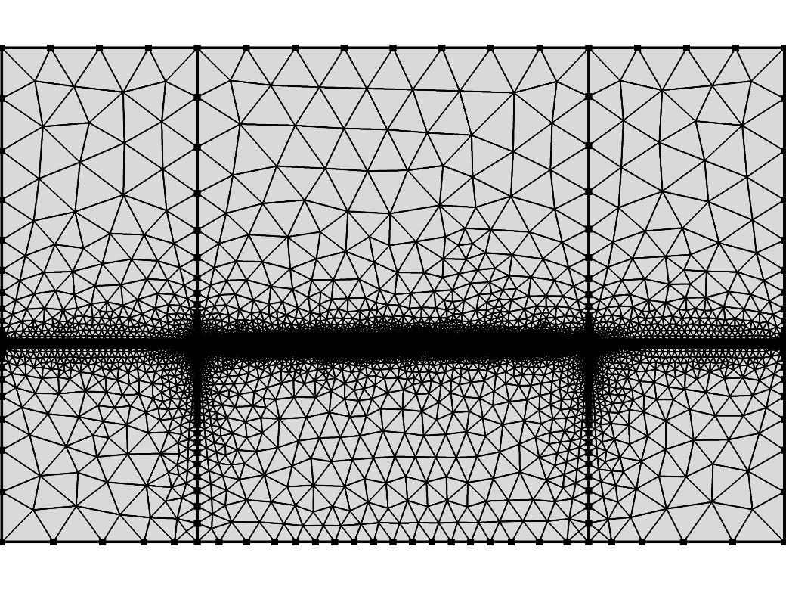
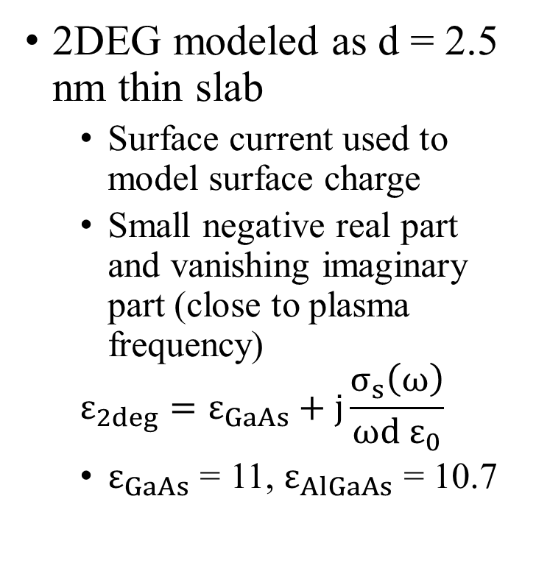
COMSOL Simulation
2DEG modeled as d = 2.5 nm thin slab
Surface current used to model surface charge
Small negative real part and vanishing imaginary part (close to plasma frequency)
$$ε_{2deg}=ε_{GaAs}+j\frac{σ_{s}\left(ω\right)}{ωd ε_{0}}$$
$ε_{GaAs}$ = 11, $ε_{AlGaAs}$ = 10.7

