Slide 1
Overview
Numerical Integration Using Gauss_Quadratures
PLOTTING

Slide 3
clear; close all
lambda = 1;
load em_constants.mat
mu0 = mu_0;
ep0 = epsilon_0;
ep1 = 10 + 1i*.01;
omega = 2*pi*c/lambda;
K0 = 2*pi/lambda;
K1 = 2*pi/lambda*sqrt(ep1);
w = lambda/2;
L = 2*w;
len = 1;
M = 300; % Sections on the strip
deltax = L / M;
gamma = exp(vpa(eulergamma));
e = exp(1);
euler = vpa(eulergamma);
% x = linspace(0 + deltax , L - deltax, M);
x = linspace(-0.5*L , 0.5*L , M);
Z = zeros(1,M);
Y = zeros(1,M);
for j = 1 : 1 % Only one iteration is needed as impedance matrix can be constructed through its Toeplitz property
for k = 1 : M

Slide 4
fun1 = @(xp) besselh(0,2,K0*abs(x(j) - xp)) + ...
besselh(0,2,K1*abs(x(j) - xp));% Make a symbolic Function of x_prime
fun2 = @(xp) besselh(2,2,K0*abs(x(j) - xp)) + ...
besselh(2,2,K1*abs(x(j) - xp));
% This calculation is based on the reference cited in the code
% introduction.
% Mathematical Modeling of Eq. 4.63
xp_upper = x(k) + deltax; % Upper limit of integration
xp_lower = x(k); % Lower limit of integration

Slide 5
Numerical Integration Using Gauss_Quadratures

Slide 7
if abs( j - k) >= 1
int_part1 = integral(fun1,xp_lower,xp_upper,'RelTol',1e-12,'AbsTol',1e-12);
int_part2 = integral(fun2,xp_lower,xp_upper,'RelTol',1e-12,'AbsTol',1e-12);
%
Z(j,k) = int_part1; % Pocklington Integral for j not equal to k
Y(j,k) = int_part2; % Pocklington Integral for j not equal to k
elseif j == k
Z(j,k) = deltax*(1 - 1i*2/pi*log(gamma*K0*deltax/(4*e))) + ...
deltax*(1 - 1i*2/pi*log(gamma*K1*deltax/(4*e)));;
Y1 = deltax* K0^2*deltax^3/96 - j*deltax/pi*...
(2*log(gamma*K0*deltax/(4*e)) + 16/(K0*deltax)^2);
Y2 = deltax* K1^2*deltax^3/96 - j*deltax/pi*...
(2*log(gamma*K1*deltax/(4*e)) + 16/(K1*deltax)^2);
Y(j,k) = Y1 + Y2;
end

Slide 8
end
end
Z = toeplitz(real(Z(1,:))) + 1i*toeplitz(imag(Z(1,:))); % Make a Toeplitz matrix out of a row vector
Y = toeplitz(real(Y(1,:))) + 1i*toeplitz(imag(Y(1,:))); % Make a Toeplitz matrix out of a row vector
% Z = toeplitz(Z);
%
phi = 1*pi/2;
% V = 4\(omega*mu0)*exp(1i*K*x'*cos(phi));
V1 = exp(1i*K0*x'*cos(phi));
V2 = sin(phi)*exp(1i*K0*x'*cos(phi));
I1 = Z\V1;
I2 = Y\V2;

Slide 9
PLOTTING

Slide 10
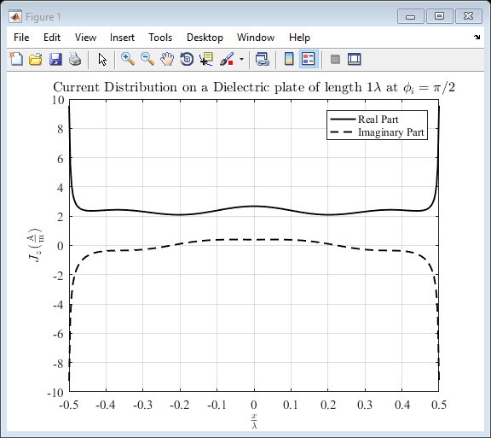
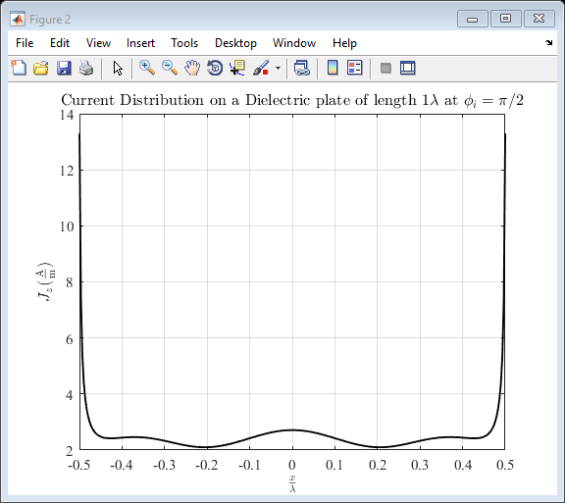
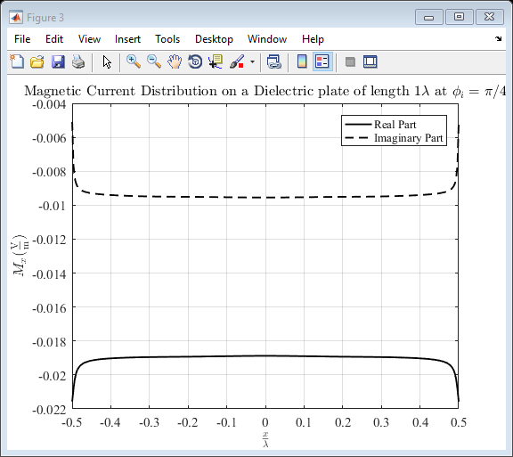
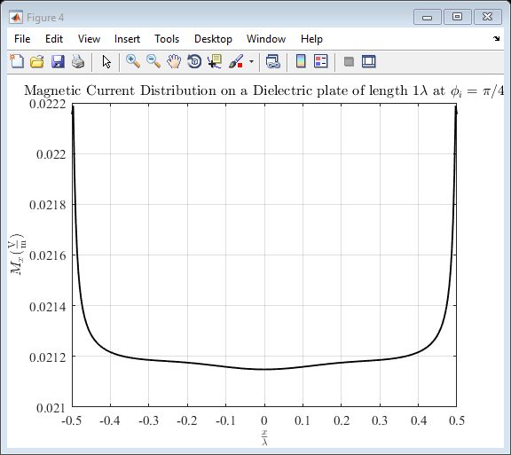
First plot the displacement

Slide 11
% Electric Current Plot
figure(1)
% x = linspace(-.7*lambda/2, .7*lambda/2, M) ;
H = plot(x, real(I1),x, imag(I1));
ax = gca;
H(1).Color = 'black';
H(1).LineWidth = 1.4;
H(2).Color = 'black';
H(2).LineWidth = 1.4;
H(2).LineStyle = '--';
% title(['Current on the wire of half-length $ h = .35\lambda$ at f = ',int2str(f/1e6), ' MHz'],'Interpreter','latex')
set(gcf,'Color','white'); % Set background color to white
set(gca,'FontName','times new roman','FontSize',11) % Set axes fonts to Times New Roman
% ax.XTick = [-.3498 -0.2625 -0.1750 -0.0875 0 0.0875 0.1750 0.2625 0.3498];
% ax.XTickLabel = { '-h','-.75h','-.5h','-.25h' , '0' ,'.25h', '5h', '.75h', 'h'};
% ax.YTick = [-2e-3 -1e-3 0 1e-3 2e-3];
% ax.YTickLabel = { '-.002','-.001','0' , '.001', '.002'};
% axis([ -.3498 .3498 -2.5e-3 2.5e-3]);
hold on
title(['Current Distribution on a Dielectric plate of length ',int2str(len), '$\lambda$ at $\phi_i = \pi/2$'],'Interpreter','latex')
xlabel('$\frac{x}{\lambda}$','interpreter','latex')
ylabel('$J_z (\mathrm{\frac{A}{m}})$','interpreter','latex')
legend('Real Part', 'Imaginary Part');
grid on
% Electric Current Plot Absolute Value
figure(2)
% x = linspace(-.7*lambda/2, .7*lambda/2, M) ;
H = plot(x, abs(I1));
ax = gca;
H(1).Color = 'black';
H(1).LineWidth = 1.4;
% title(['Current on the wire of half-length $ h = .35\lambda$ at f = ',int2str(f/1e6), ' MHz'],'Interpreter','latex')
set(gcf,'Color','white'); % Set background color to white
set(gca,'FontName','times new roman','FontSize',11) % Set axes fonts to Times New Roman
% ax.XTick = [-.3498 -0.2625 -0.1750 -0.0875 0 0.0875 0.1750 0.2625 0.3498];
% ax.XTickLabel = { '-h','-.75h','-.5h','-.25h' , '0' ,'.25h', '5h', '.75h', 'h'};
% ax.YTick = [-2e-3 -1e-3 0 1e-3 2e-3];
% ax.YTickLabel = { '-.002','-.001','0' , '.001', '.002'};
% axis([ -.3498 .3498 -2.5e-3 2.5e-3]);
hold on
title(['Current Distribution on a Dielectric plate of length ',int2str(len), '$\lambda$ at $\phi_i = \pi/2$'],'Interpreter','latex')
xlabel('$\frac{x}{\lambda}$','interpreter','latex')
ylabel('$J_z (\mathrm{\frac{A}{m}})$','interpreter','latex')
grid on
% Magnetic Current Plot
figure(3)
% x = linspace(-.7*lambda/2, .7*lambda/2, M) ;
H = plot(x, real(I2),x, imag(I2));
ax = gca;
H(1).Color = 'black';
H(1).LineWidth = 1.4;
H(2).Color = 'black';
H(2).LineWidth = 1.4;
H(2).LineStyle = '--';
% title(['Current on the wire of half-length $ h = .35\lambda$ at f = ',int2str(f/1e6), ' MHz'],'Interpreter','latex')
set(gcf,'Color','white'); % Set background color to white
set(gca,'FontName','times new roman','FontSize',11) % Set axes fonts to Times New Roman
% ax.XTick = [-.3498 -0.2625 -0.1750 -0.0875 0 0.0875 0.1750 0.2625 0.3498];
% ax.XTickLabel = { '-h','-.75h','-.5h','-.25h' , '0' ,'.25h', '5h', '.75h', 'h'};
% ax.YTick = [-2e-3 -1e-3 0 1e-3 2e-3];
% ax.YTickLabel = { '-.002','-.001','0' , '.001', '.002'};
% axis([ -.3498 .3498 -2.5e-3 2.5e-3]);
hold on
title(['Magnetic Current Distribution on a Dielectric plate of length ',int2str(len), '$\lambda$ at $\phi_i = \pi/4$'],'Interpreter','latex')
xlabel('$\frac{x}{\lambda}$','interpreter','latex')
ylabel('$M_x (\mathrm{\frac{V}{m}})$','interpreter','latex')
legend('Real Part', 'Imaginary Part');
grid on
% Magnetic Current Plot Absolute Value
figure(4)
% x = linspace(-.7*lambda/2, .7*lambda/2, M) ;
H = plot(x, abs(I2));
ax = gca;
H(1).Color = 'black';
H(1).LineWidth = 1.4;
% title(['Current on the wire of half-length $ h = .35\lambda$ at f = ',int2str(f/1e6), ' MHz'],'Interpreter','latex')
set(gcf,'Color','white'); % Set background color to white
set(gca,'FontName','times new roman','FontSize',11) % Set axes fonts to Times New Roman
% ax.XTick = [-.3498 -0.2625 -0.1750 -0.0875 0 0.0875 0.1750 0.2625 0.3498];
% ax.XTickLabel = { '-h','-.75h','-.5h','-.25h' , '0' ,'.25h', '5h', '.75h', 'h'};
% ax.YTick = [-2e-3 -1e-3 0 1e-3 2e-3];
% ax.YTickLabel = { '-.002','-.001','0' , '.001', '.002'};
% axis([ -.3498 .3498 -2.5e-3 2.5e-3]);
hold on
title(['Magnetic Current Distribution on a Dielectric plate of length ',int2str(len), '$\lambda$ at $\phi_i = \pi/4$'],'Interpreter','latex')
xlabel('$\frac{x}{\lambda}$','interpreter','latex')
ylabel('$M_x (\mathrm{\frac{V}{m}})$','interpreter','latex')
grid on

