Slide 1
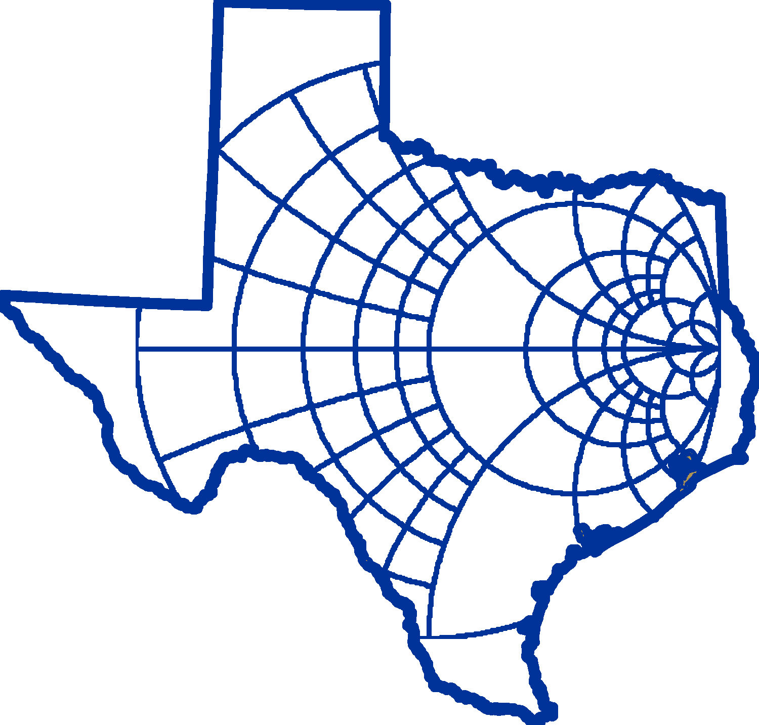



Plasma based terahertz devices
IEEE MTT 2017 Texas Symposium on Wireless and Microwave Circuits and Systems
Baylor University, Waco, Texas
March 30-31, 2017
Session 2 - Paper 3
Hasan T. Abbas, Robert D. Nevels and Krzysztof A. Michalski
Department of Electrical & Computer Engineering
Texas A&M University
hasantahir@tamu.edu
Notes:
Thank you for attending our talk. We are going to show how multilayer semiconductor structures exhibit electromagnetic wave support in the form of plasma waves.

Slide 2
Outline
Two-dimensional electron gas (2DEG)
Electrical properties of 2DEG
Dispersion relation: Device miniaturization
Plasma waves
High resolution imaging
Summary
Notes:
At low terahertz frequencies, the electrical properties of iii-v materials are plasma like with

Slide 3
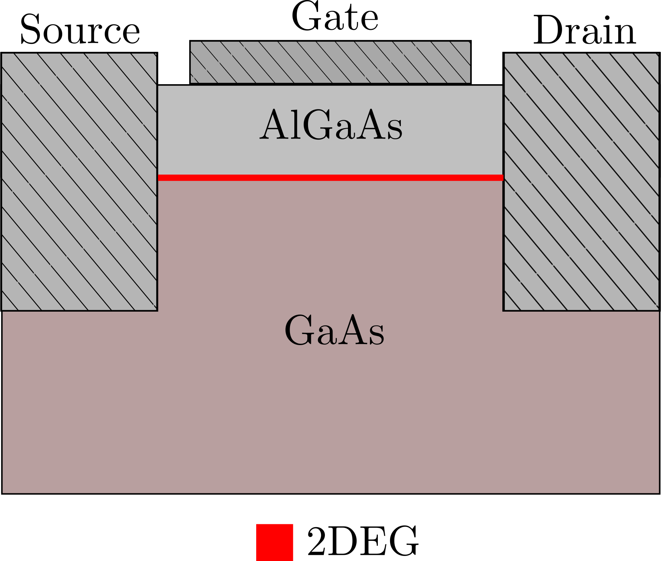
Two-dimensional Electron Gas (2DEG)
Semiconductor Hetero-interfaces in transistors
High concentration of free electrons
Quantum well formation
Free electrons spatially confined
2D Surface waves

Slide 4
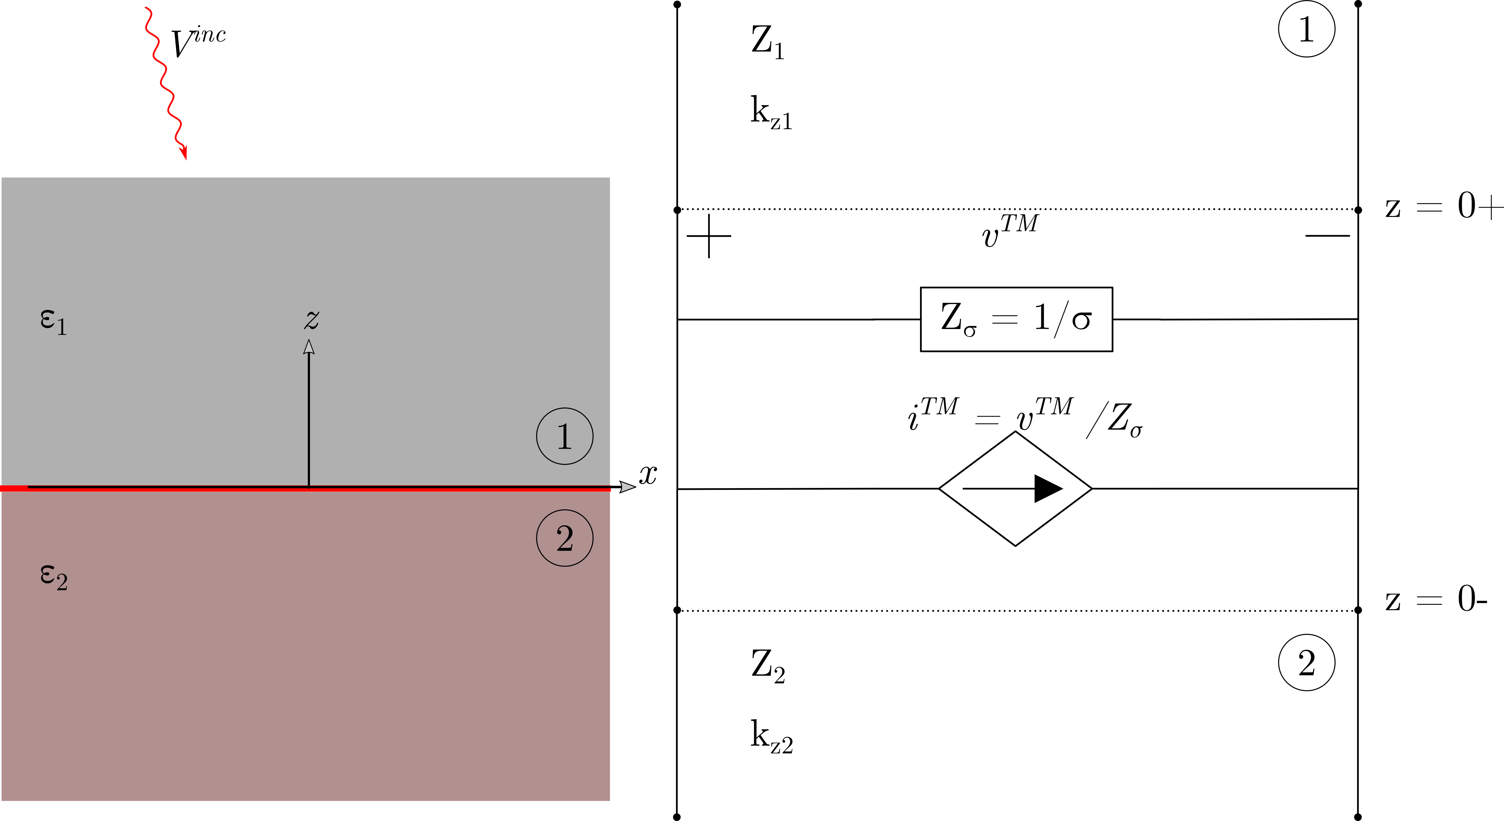
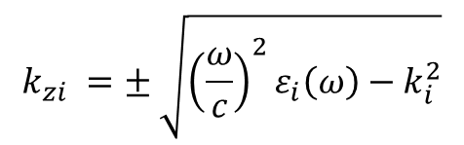


Transmission Line Equivalent
$$k_{zi} =± \sqrt{{\left(\frac{ω}{c}\right)}^{2}ε_{i}\left(ω\right)−k_{i}^{2}}$$
$$Y_{i}=\frac{1}{Z_{i}}=\frac{ωε_{i}}{k_{zi}}$$
$$Y_{σ}=\frac{1}{Z_{σ}}=σ$$
K. A. Michalski, “Electromagnetic field computation in planar multilayers," Encyclopedia of RF and microwave engineering, 2005.

Slide 5
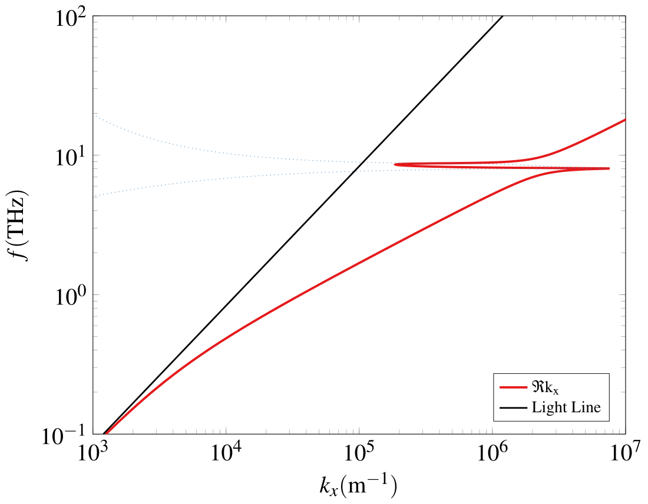
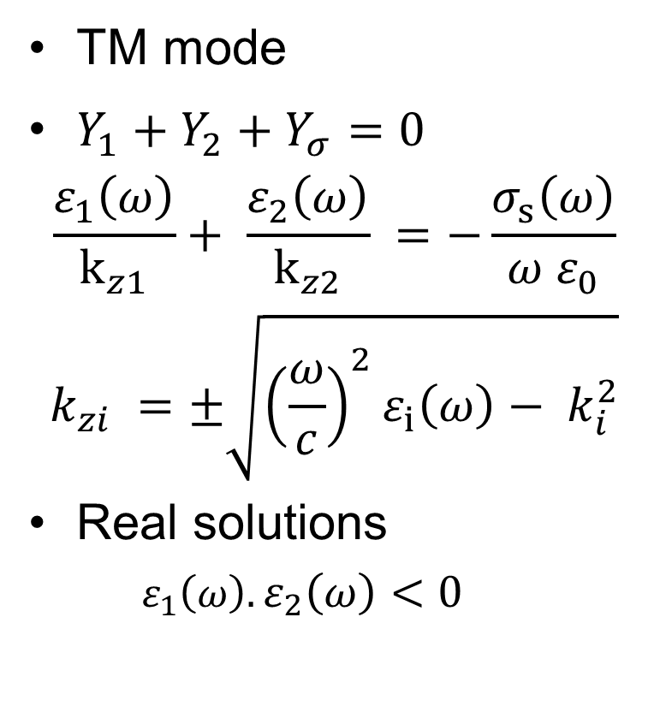

Dispersion relation
TM mode
$Y_{1}+Y_{2}+Y_{σ}=0$
$$\frac{ε_{1}\left(ω\right)}{k_{z1}}+ \frac{ε_{2}\left(ω\right)}{k_{z2}} =−\frac{σ_{s}\left(ω\right)}{ω ε_{0}}$$
$$k_{zi} =±\sqrt{{\left(\frac{ω}{c}\right)}^{2}ε_{i}\left(ω\right)− k_{i}^{2}}$$
Real solutions
$$ε_{1}\left(ω\right).ε_{2}\left(ω\right)<0$$
$$ω_{p}$$

Slide 6
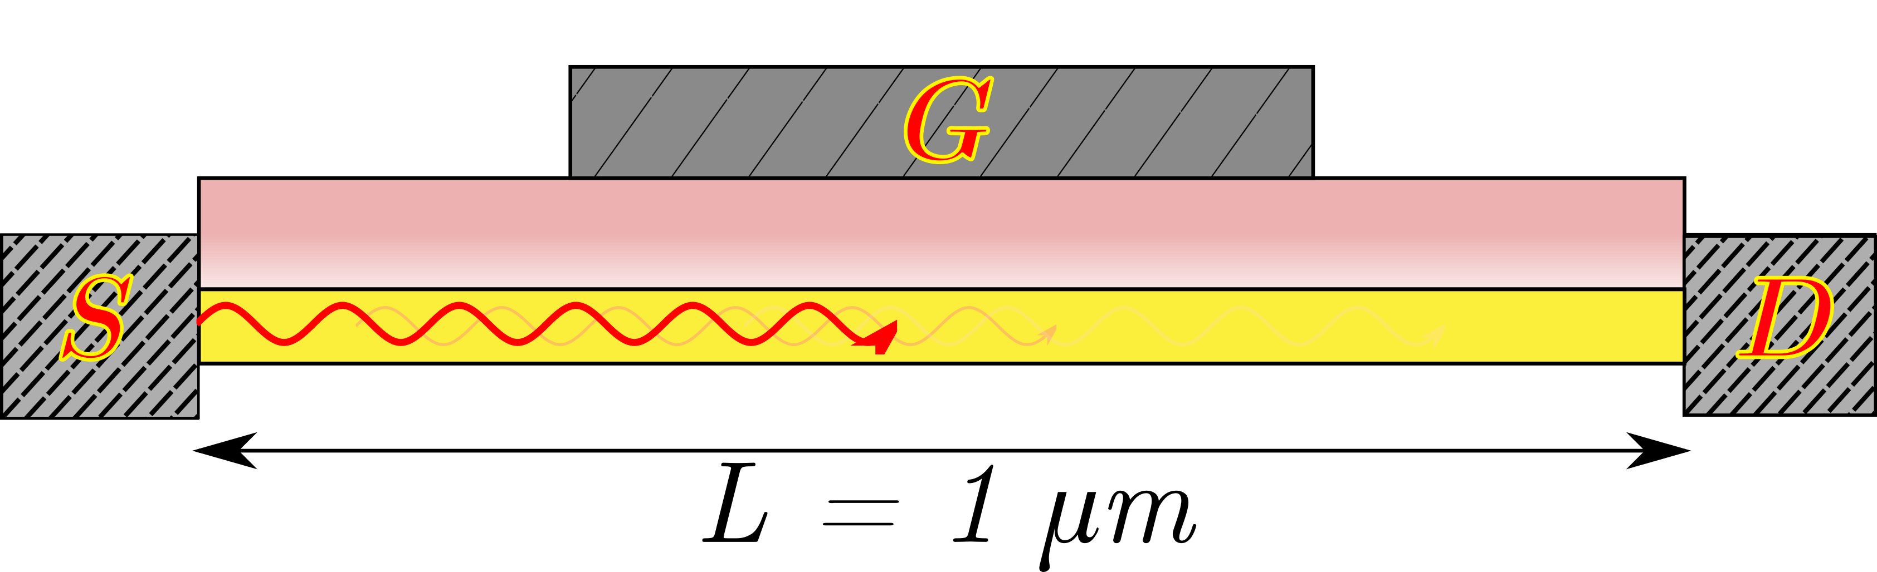
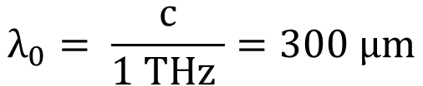
Plasma waves in 2DEG
Dyakonov-Shur instability
Asymmetric Boundary conditions
DC bias across source and drain terminals
Resonant plasma oscillations
Terahertz radiation
2DEG
$$λ_{0}= \frac{c}{1 THz }=300 μm$$
SEM image of multilayer structure

Slide 7
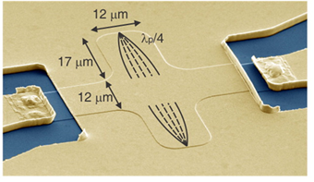
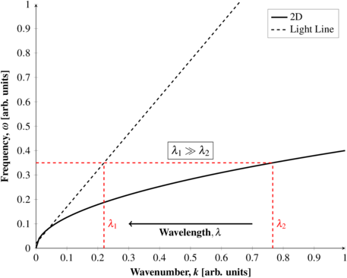
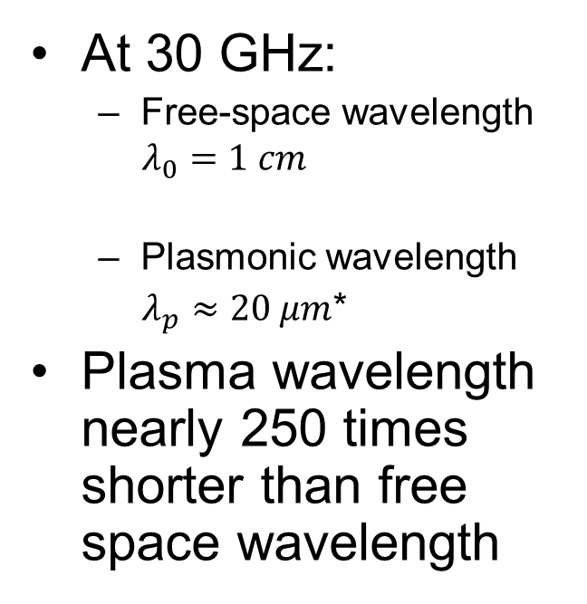
Wavelength Reduction
At 30 GHz:
Free-space wavelength
$$λ_{0}=1 cm$$
Plasmonic wavelength
$λ_{p}≈20 μm$*
Plasma wavelength nearly 250 times shorter than free space wavelength
*Andress, W. A. et al., “Ultra-Subwavelength Two-Dimensional Plasmonic Circuits,” in Nano Letters vol. 12 no. 5, pp. 2272-2277, 2012.
Notes:
Owing to the difficulties in engineering Graphene in bulk and the its high cost, we focus on the 2DEG found in semiconductor heterojunction that are formed naturally in the fabrication process.

Slide 8
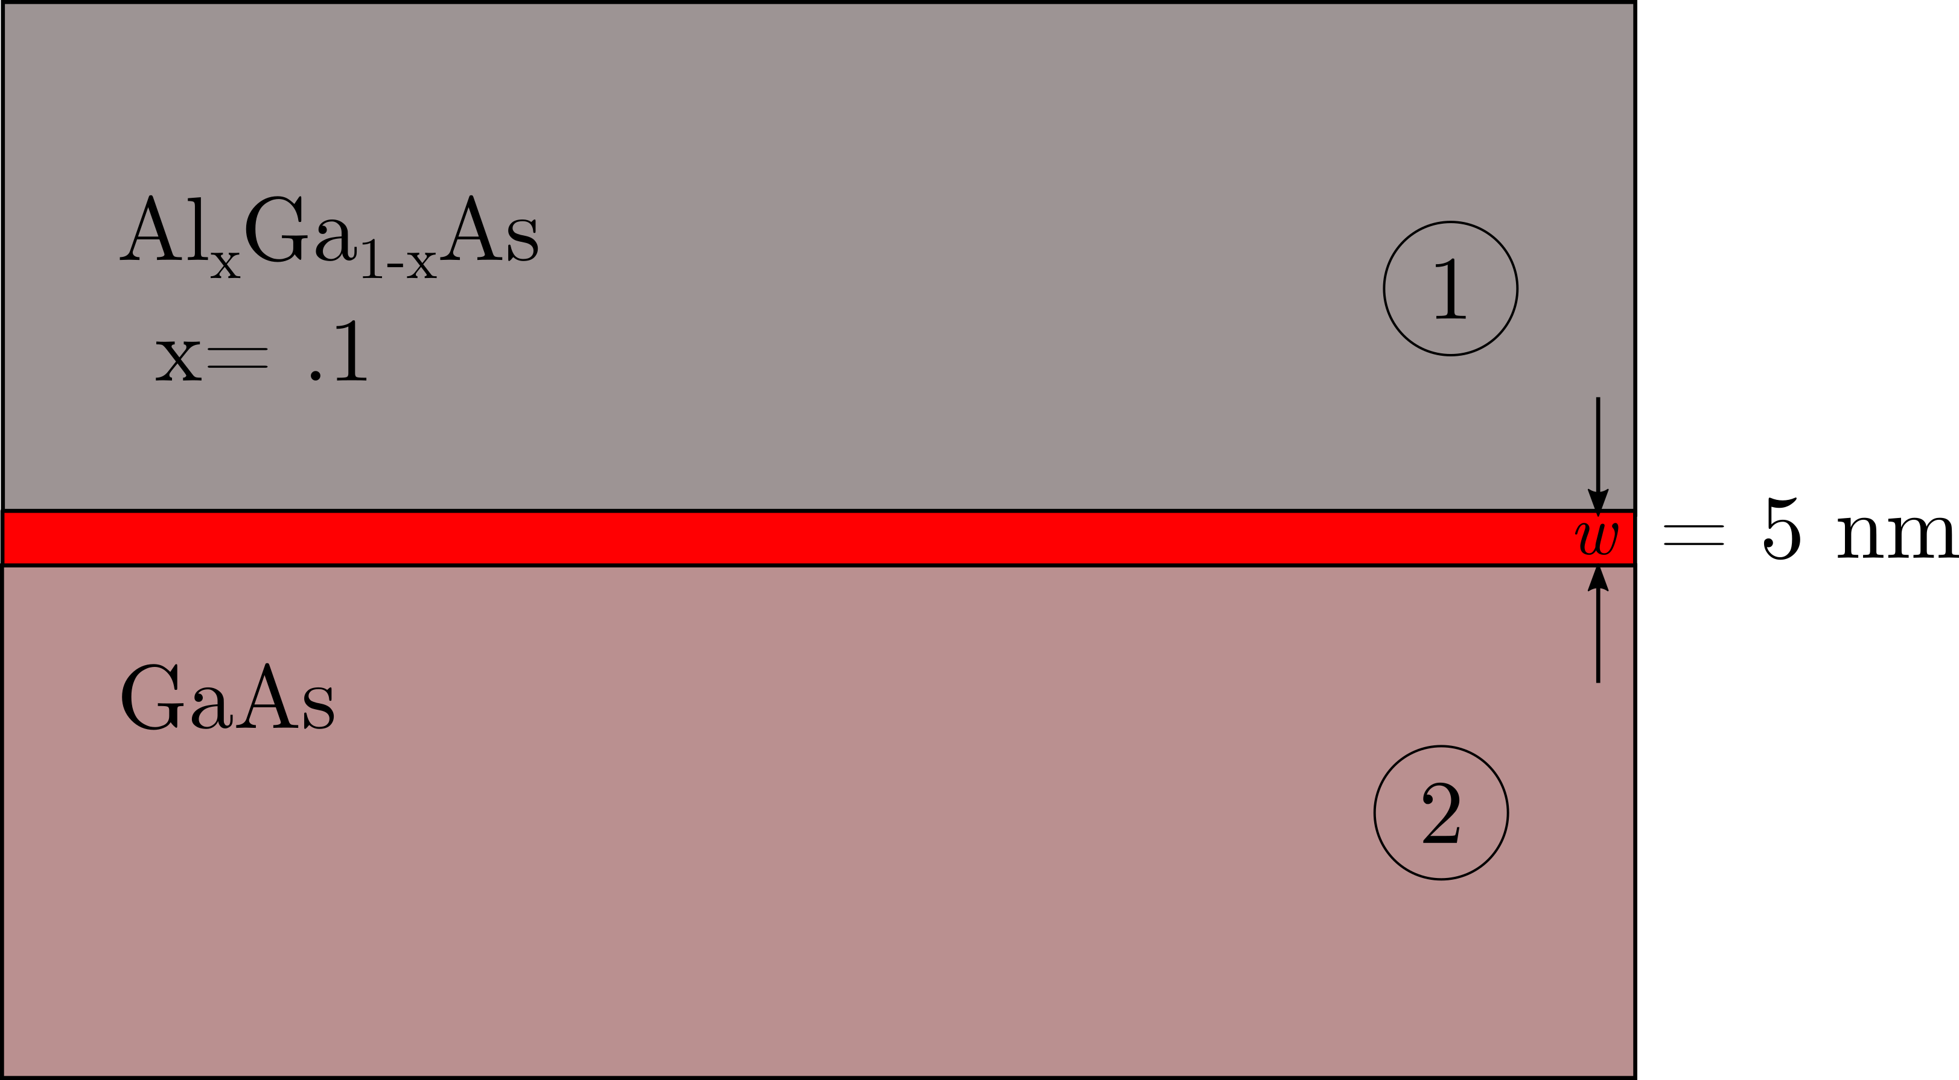
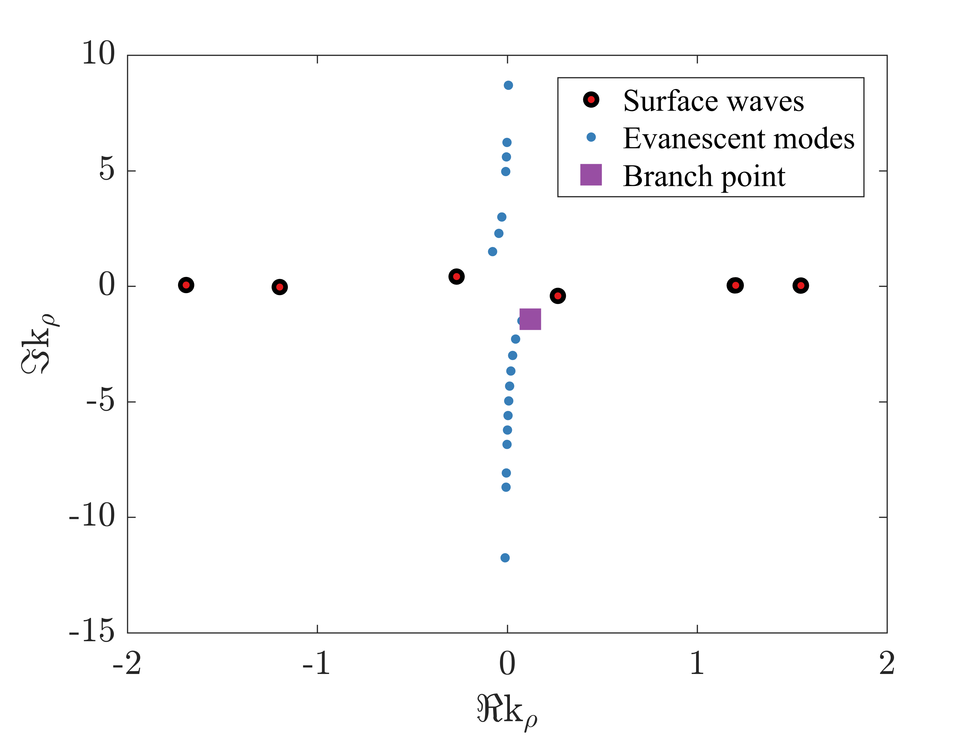
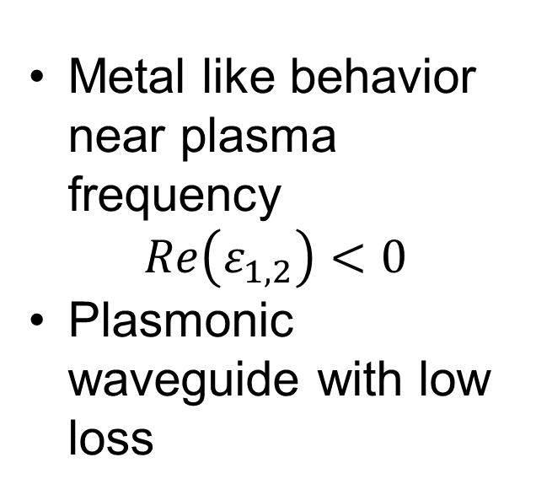
Surface waves in 2DEG
Metal like behavior near plasma frequency
$$Re\left(ε_{1,2}\right)<0$$
Plasmonic waveguide with low loss

Slide 9
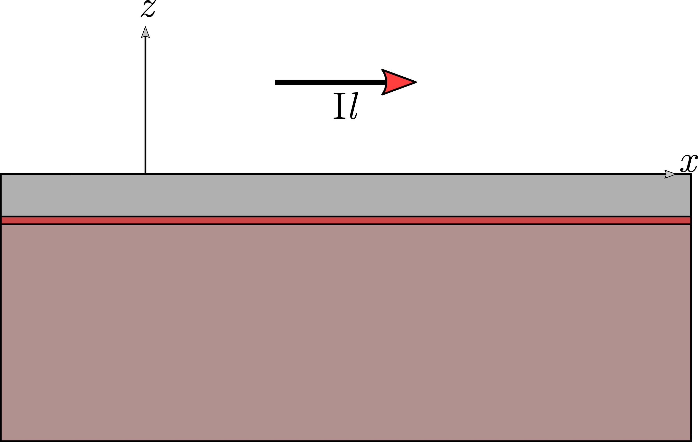
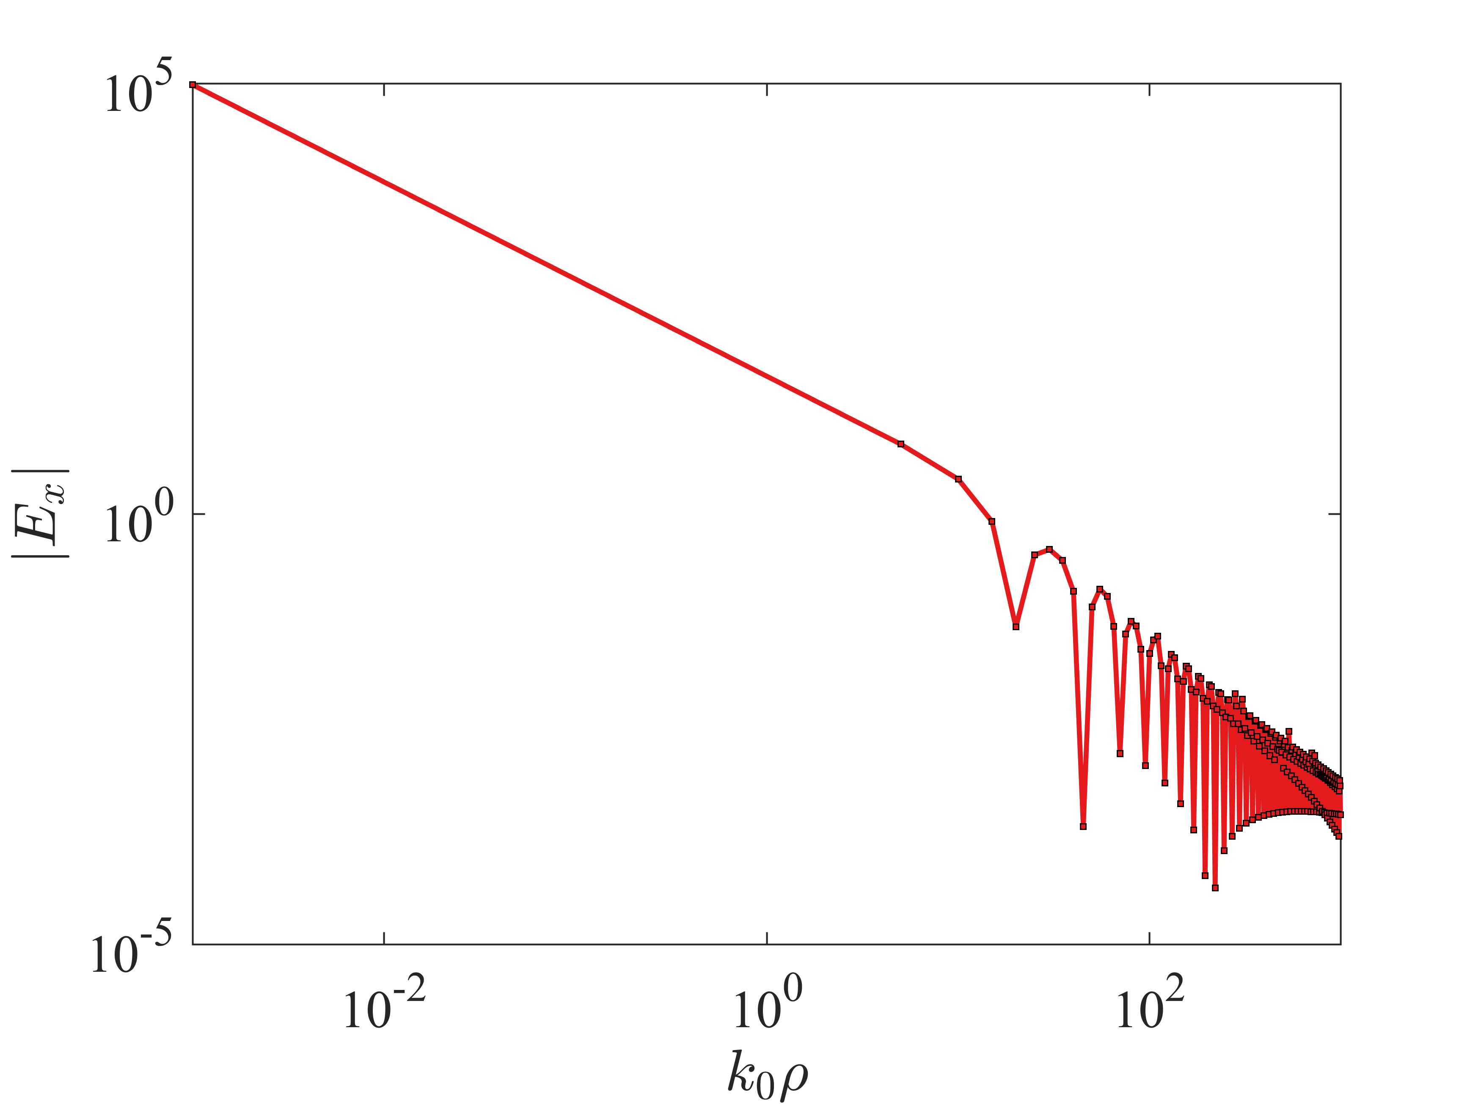
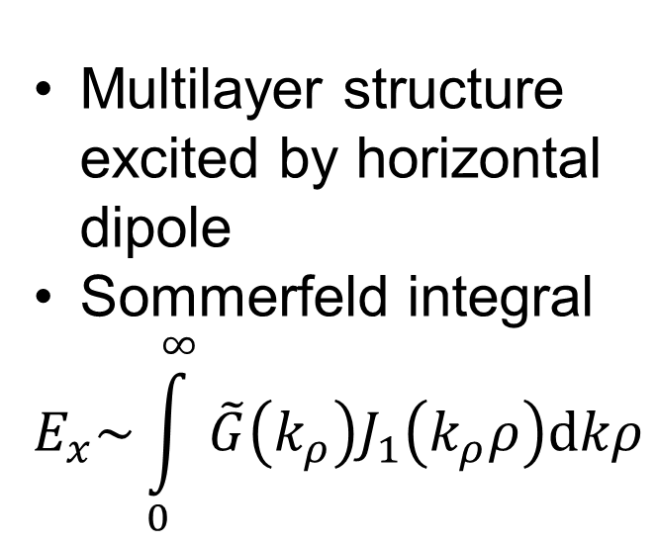
Plasma wave Propagation
Multilayer structure excited by horizontal dipole
Sommerfeld integral
$$E_{x}\sim \int_{0}^{∞}{\tilde{G}\left(k_{ρ}\right)J_{1}\left(k_{ρ}ρ\right)dkρ}$$
Krzysztof A. Michalski & Juan R. Mosig (2016) Efficient computation of Sommerfeld integral tails – methods and algorithms, Journal of Electromagnetic Waves and Applications, 30:3, 281-317

Slide 10
Plasmon Propagation
Multilayer structure excited by horizontal dipole
Sommerfeld integral
$$E_{x}\sim \int_{0}^{∞}{\tilde{G}\left(k_{ρ}\right)J_{1}\left(k_{ρ}ρ\right)dkρ}$$
Questions?
Krzysztof A. Michalski & Juan R. Mosig (2016) Efficient computation of Sommerfeld integral tails – methods and algorithms, Journal of Electromagnetic Waves and Applications, 30:3, 281-317

Slide 11
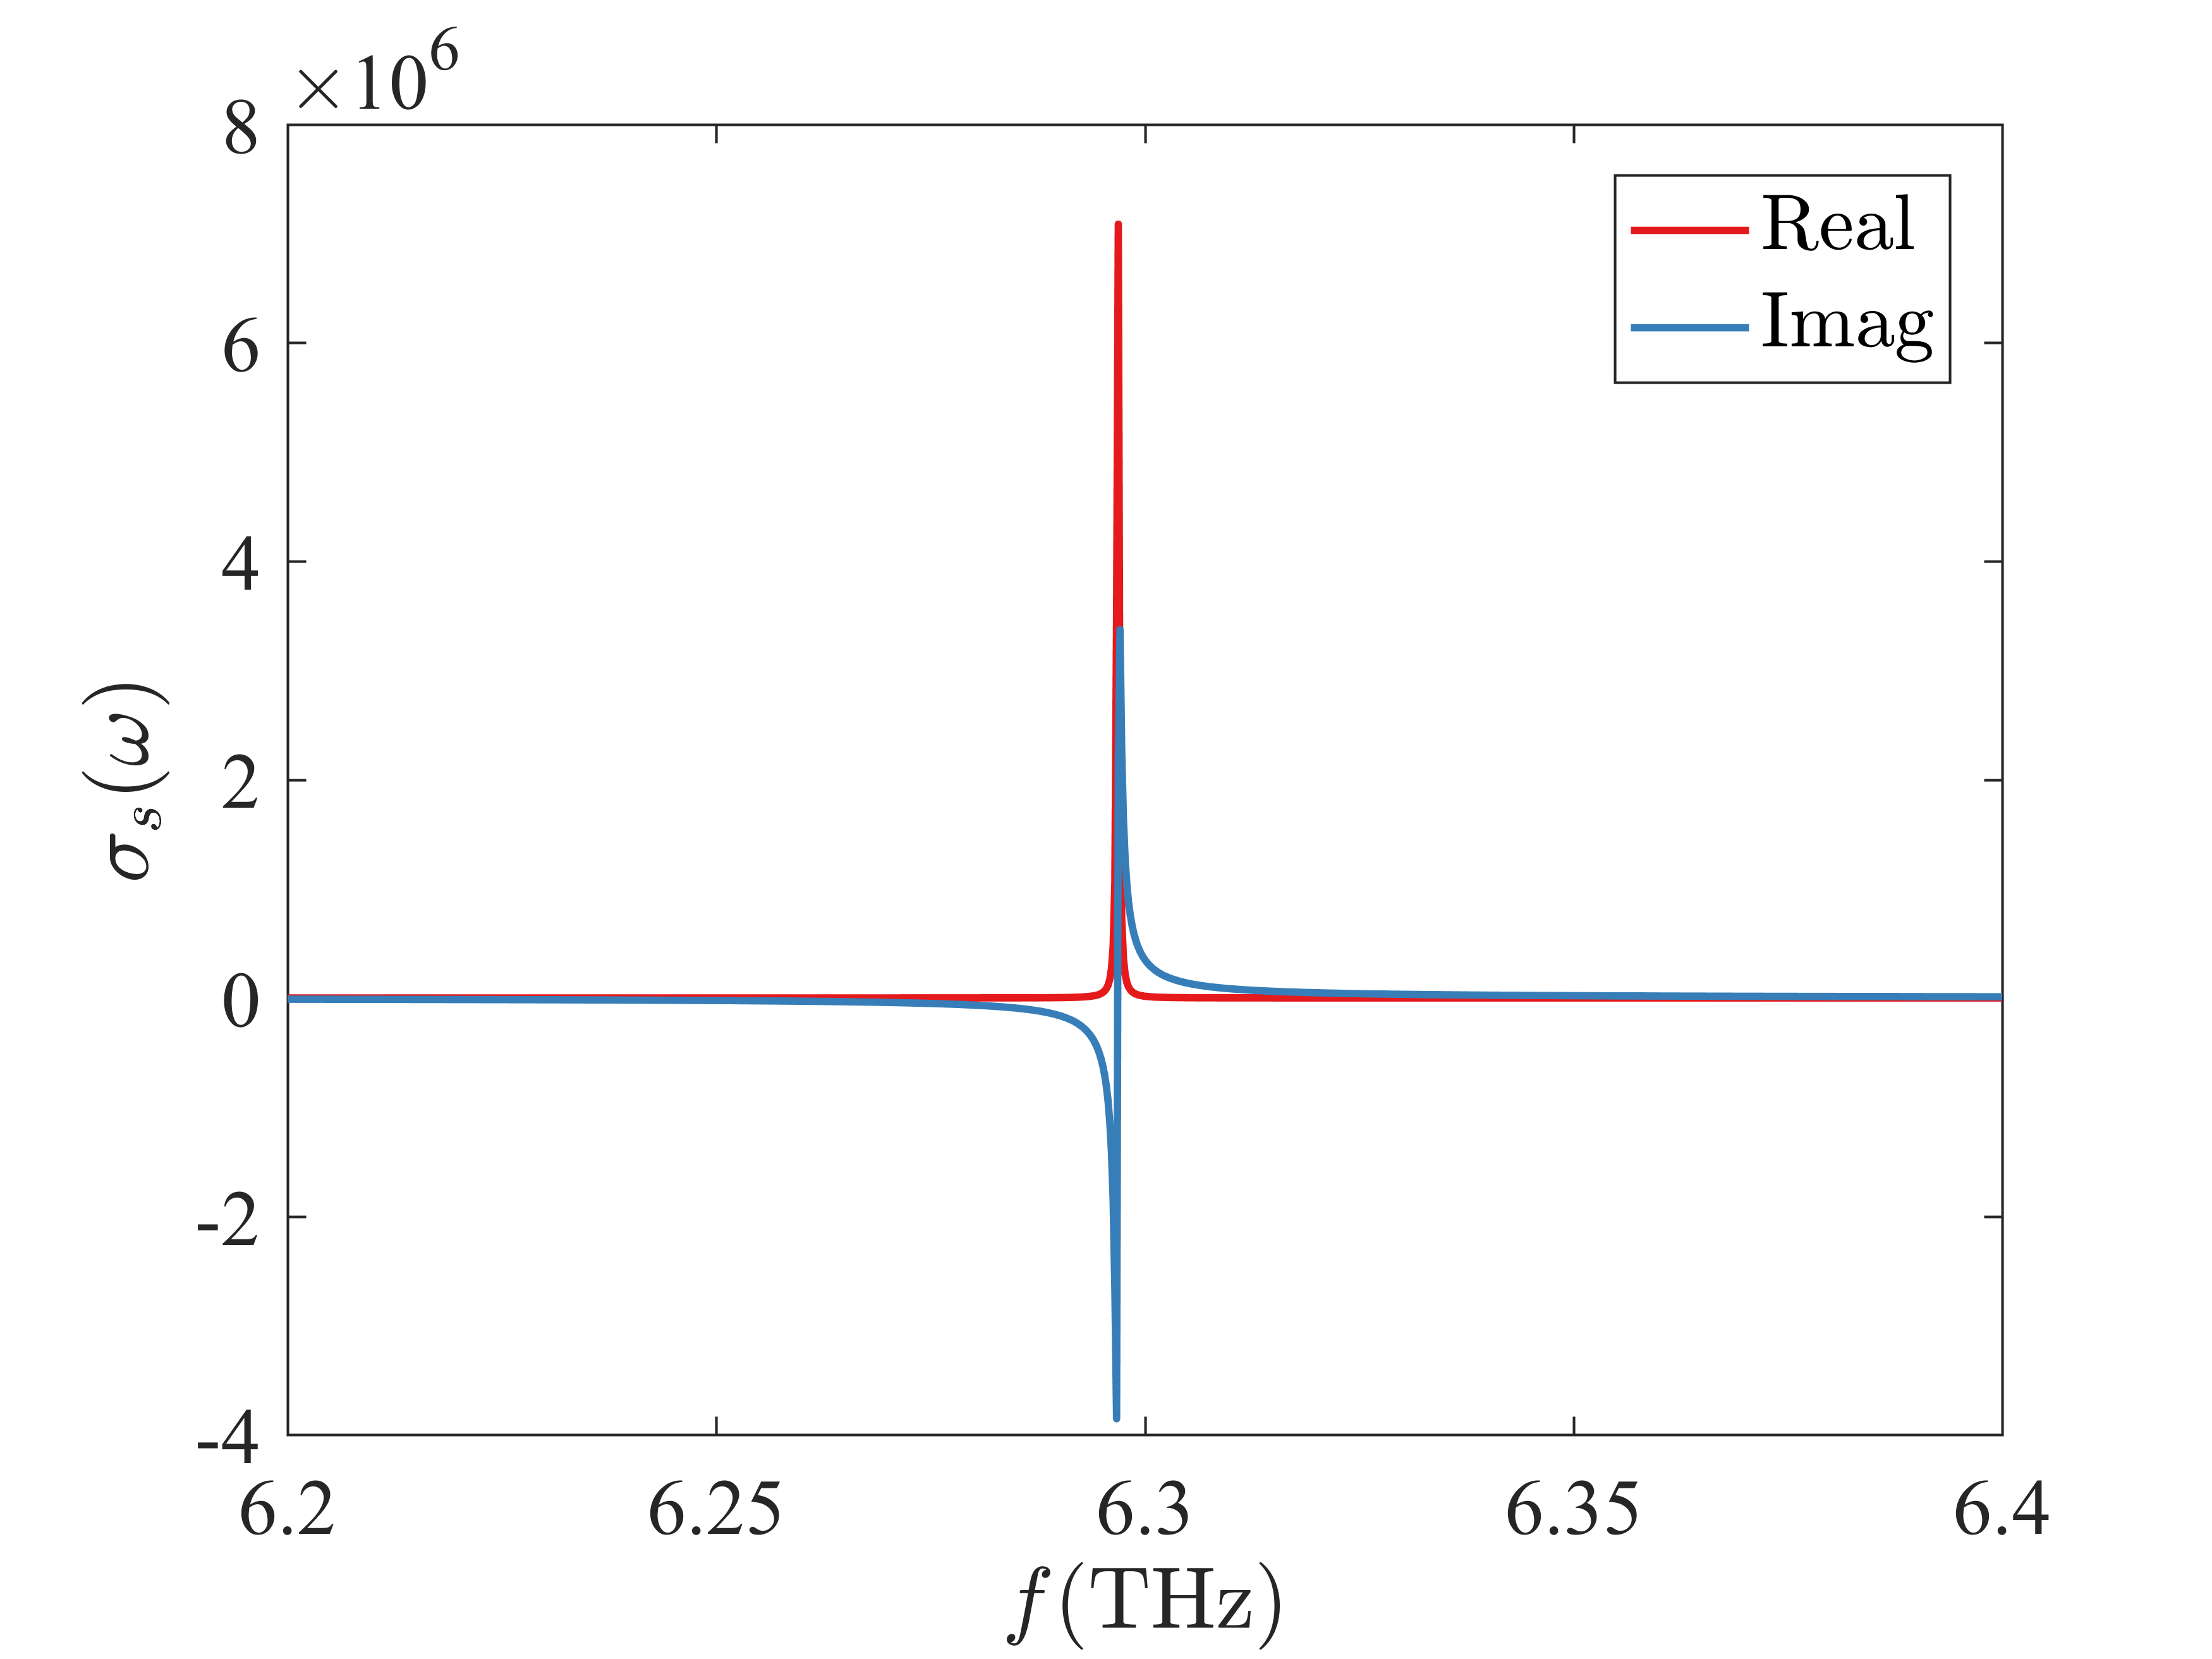
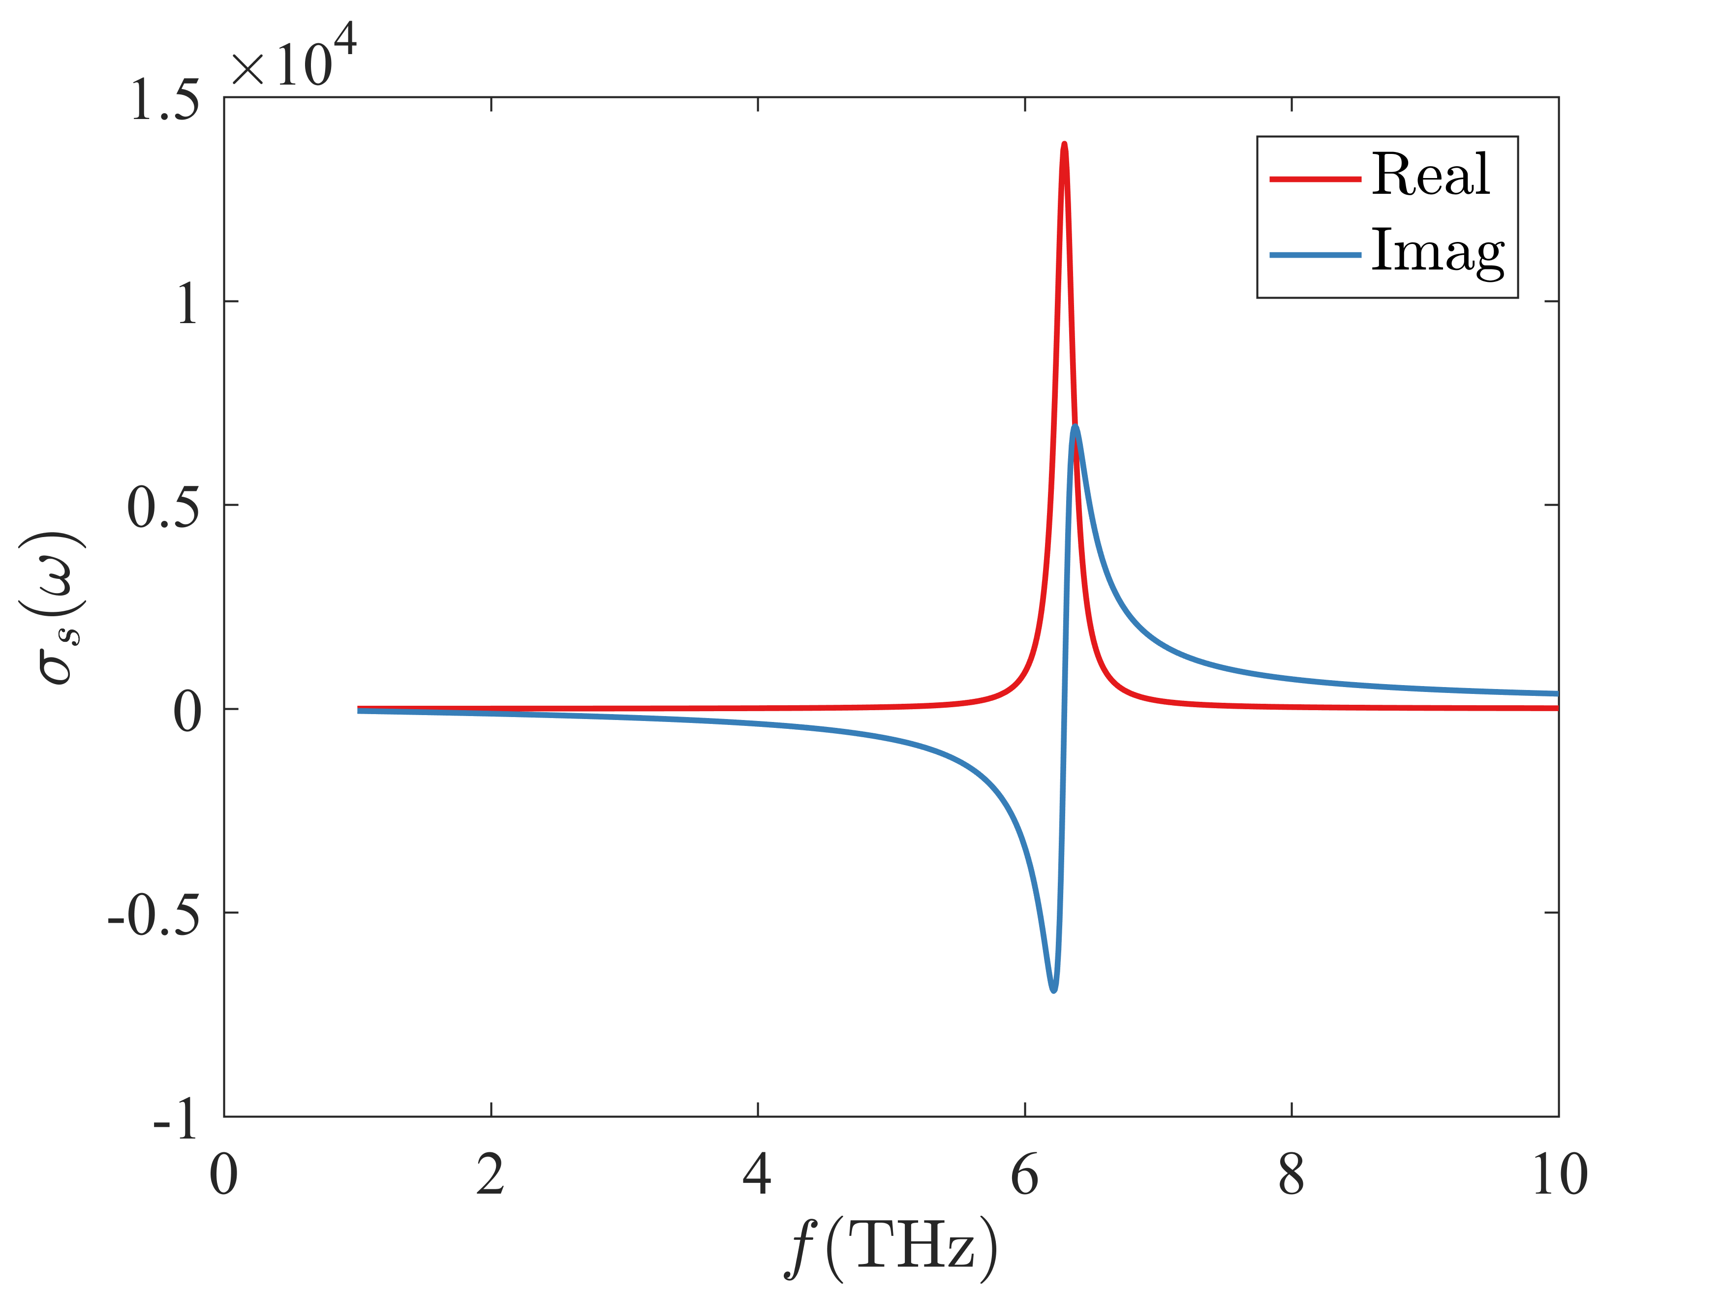
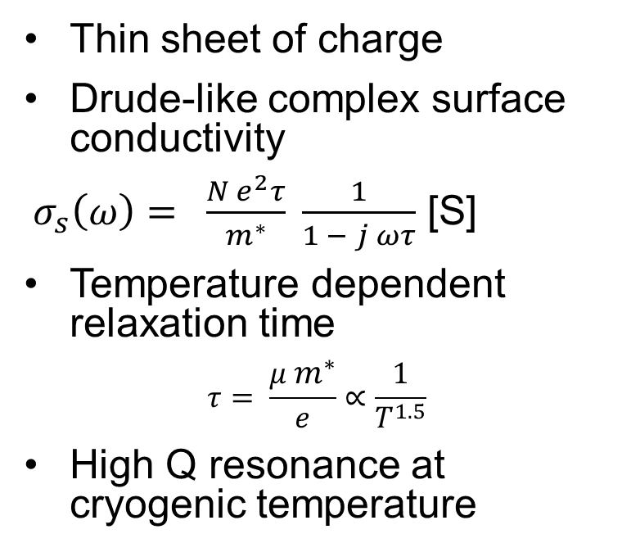
Electrical properties of 2DEG
Thin sheet of charge
Drude-like complex surface conductivity
$σ_{s}\left(ω\right)= \frac{N e^{2}τ}{m^{∗}} \frac{1}{1 − j ωτ}$ [S]
Temperature dependent relaxation time
$$τ= \frac{μ{ m}^{∗}}{e}∝\frac{1}{T^{1.5}}$$
High Q resonance at cryogenic temperature
4.2 K
295 K

Slide 12
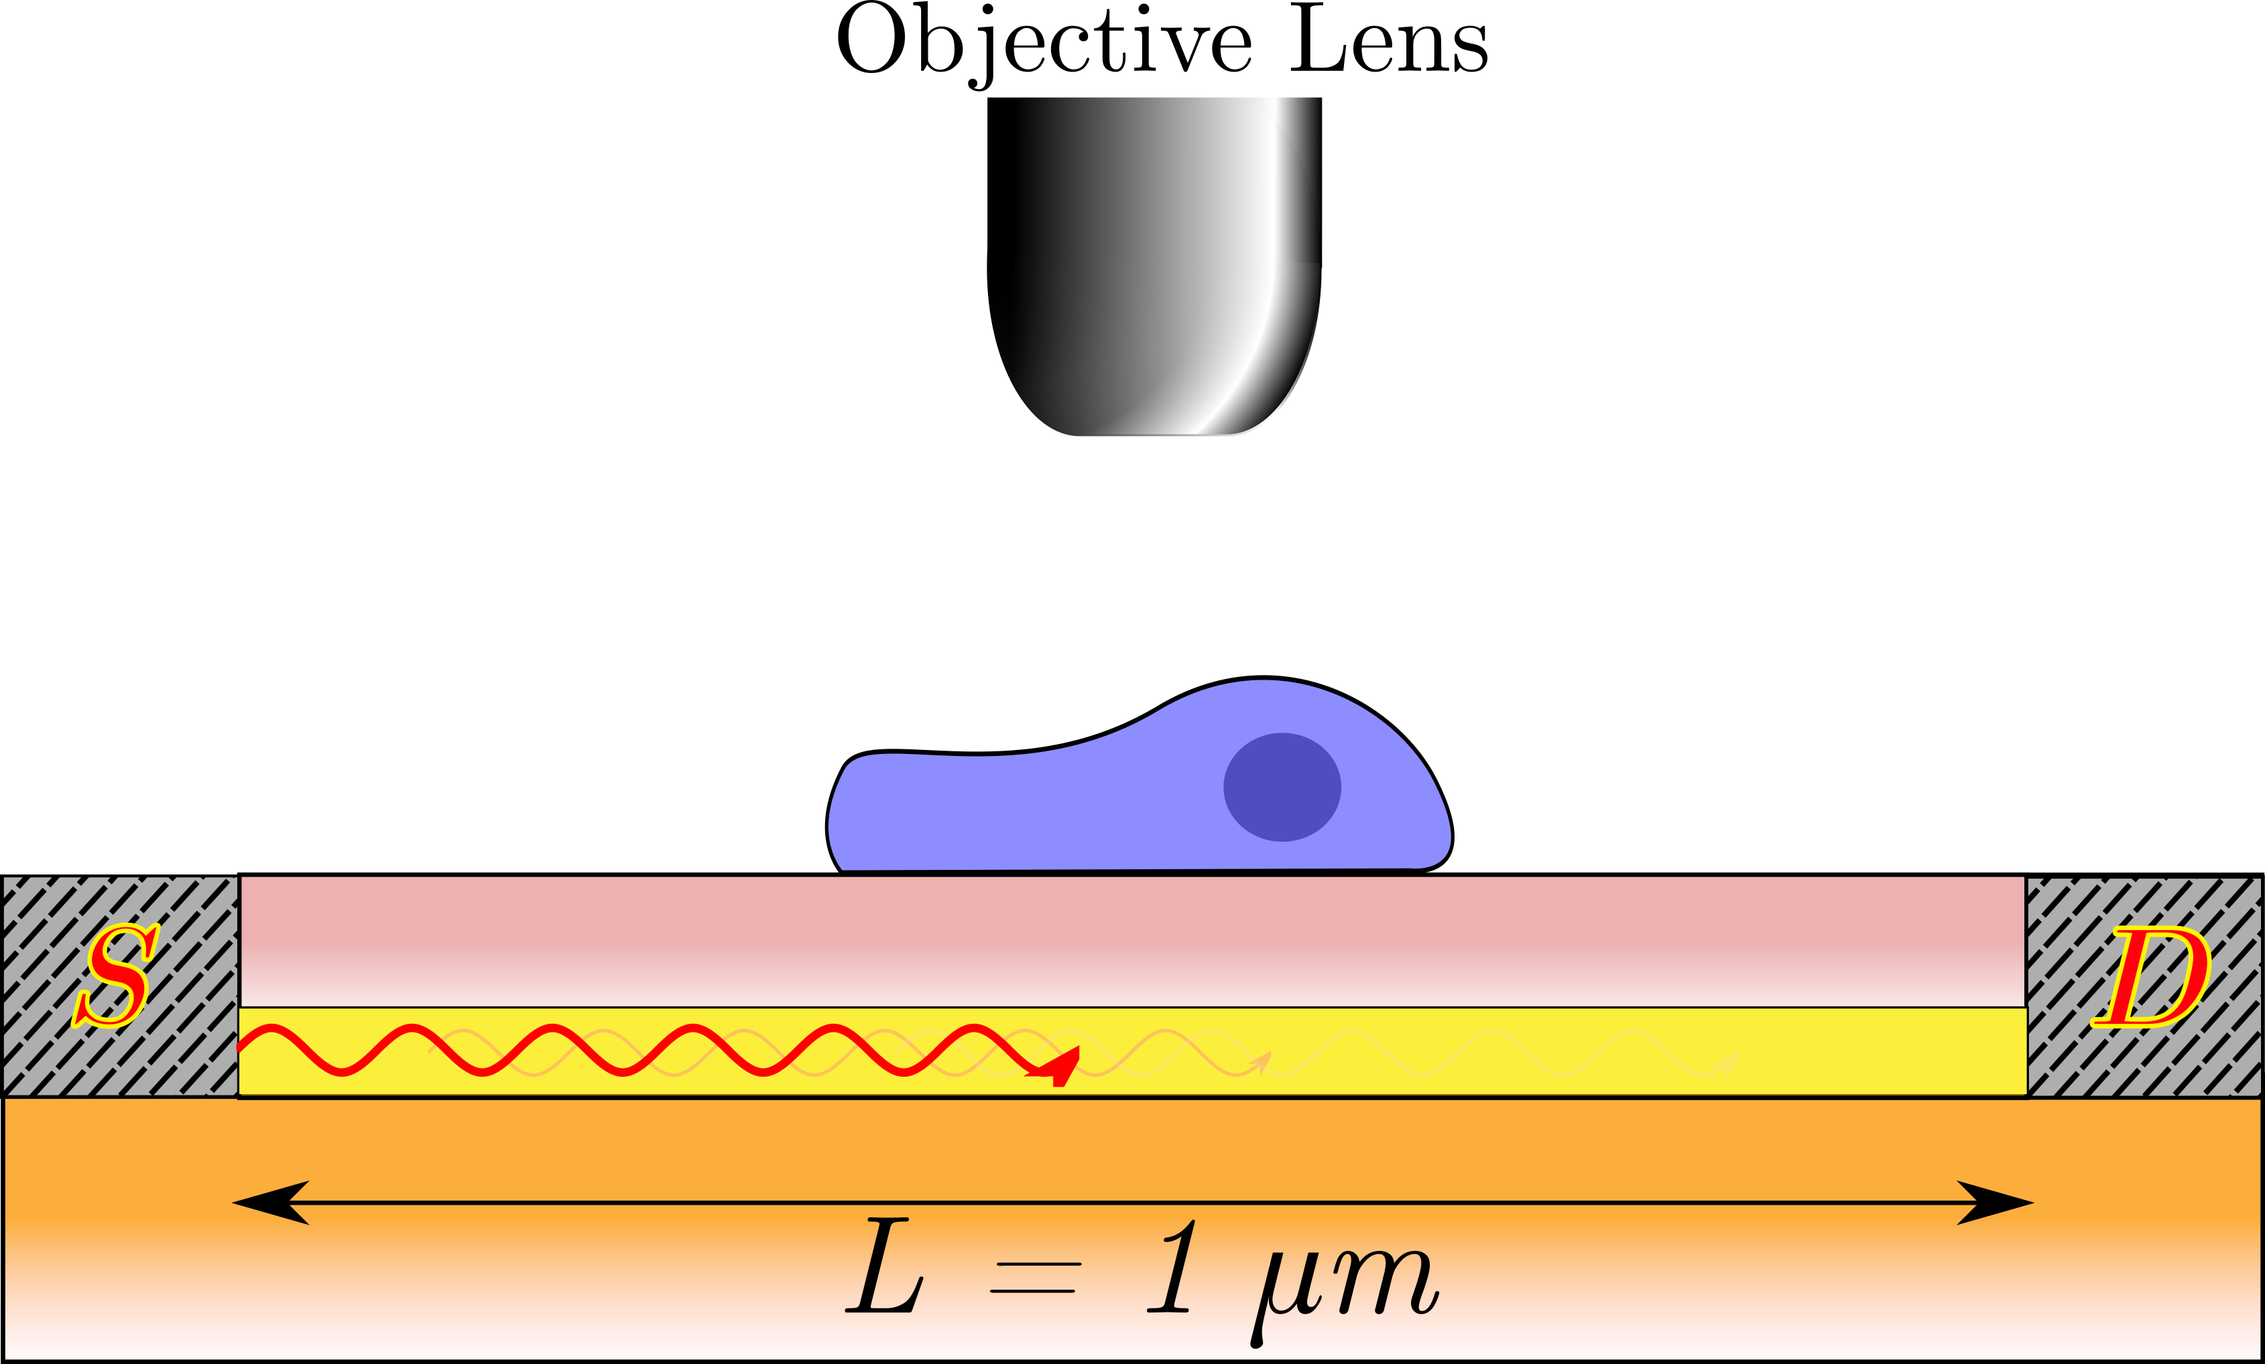
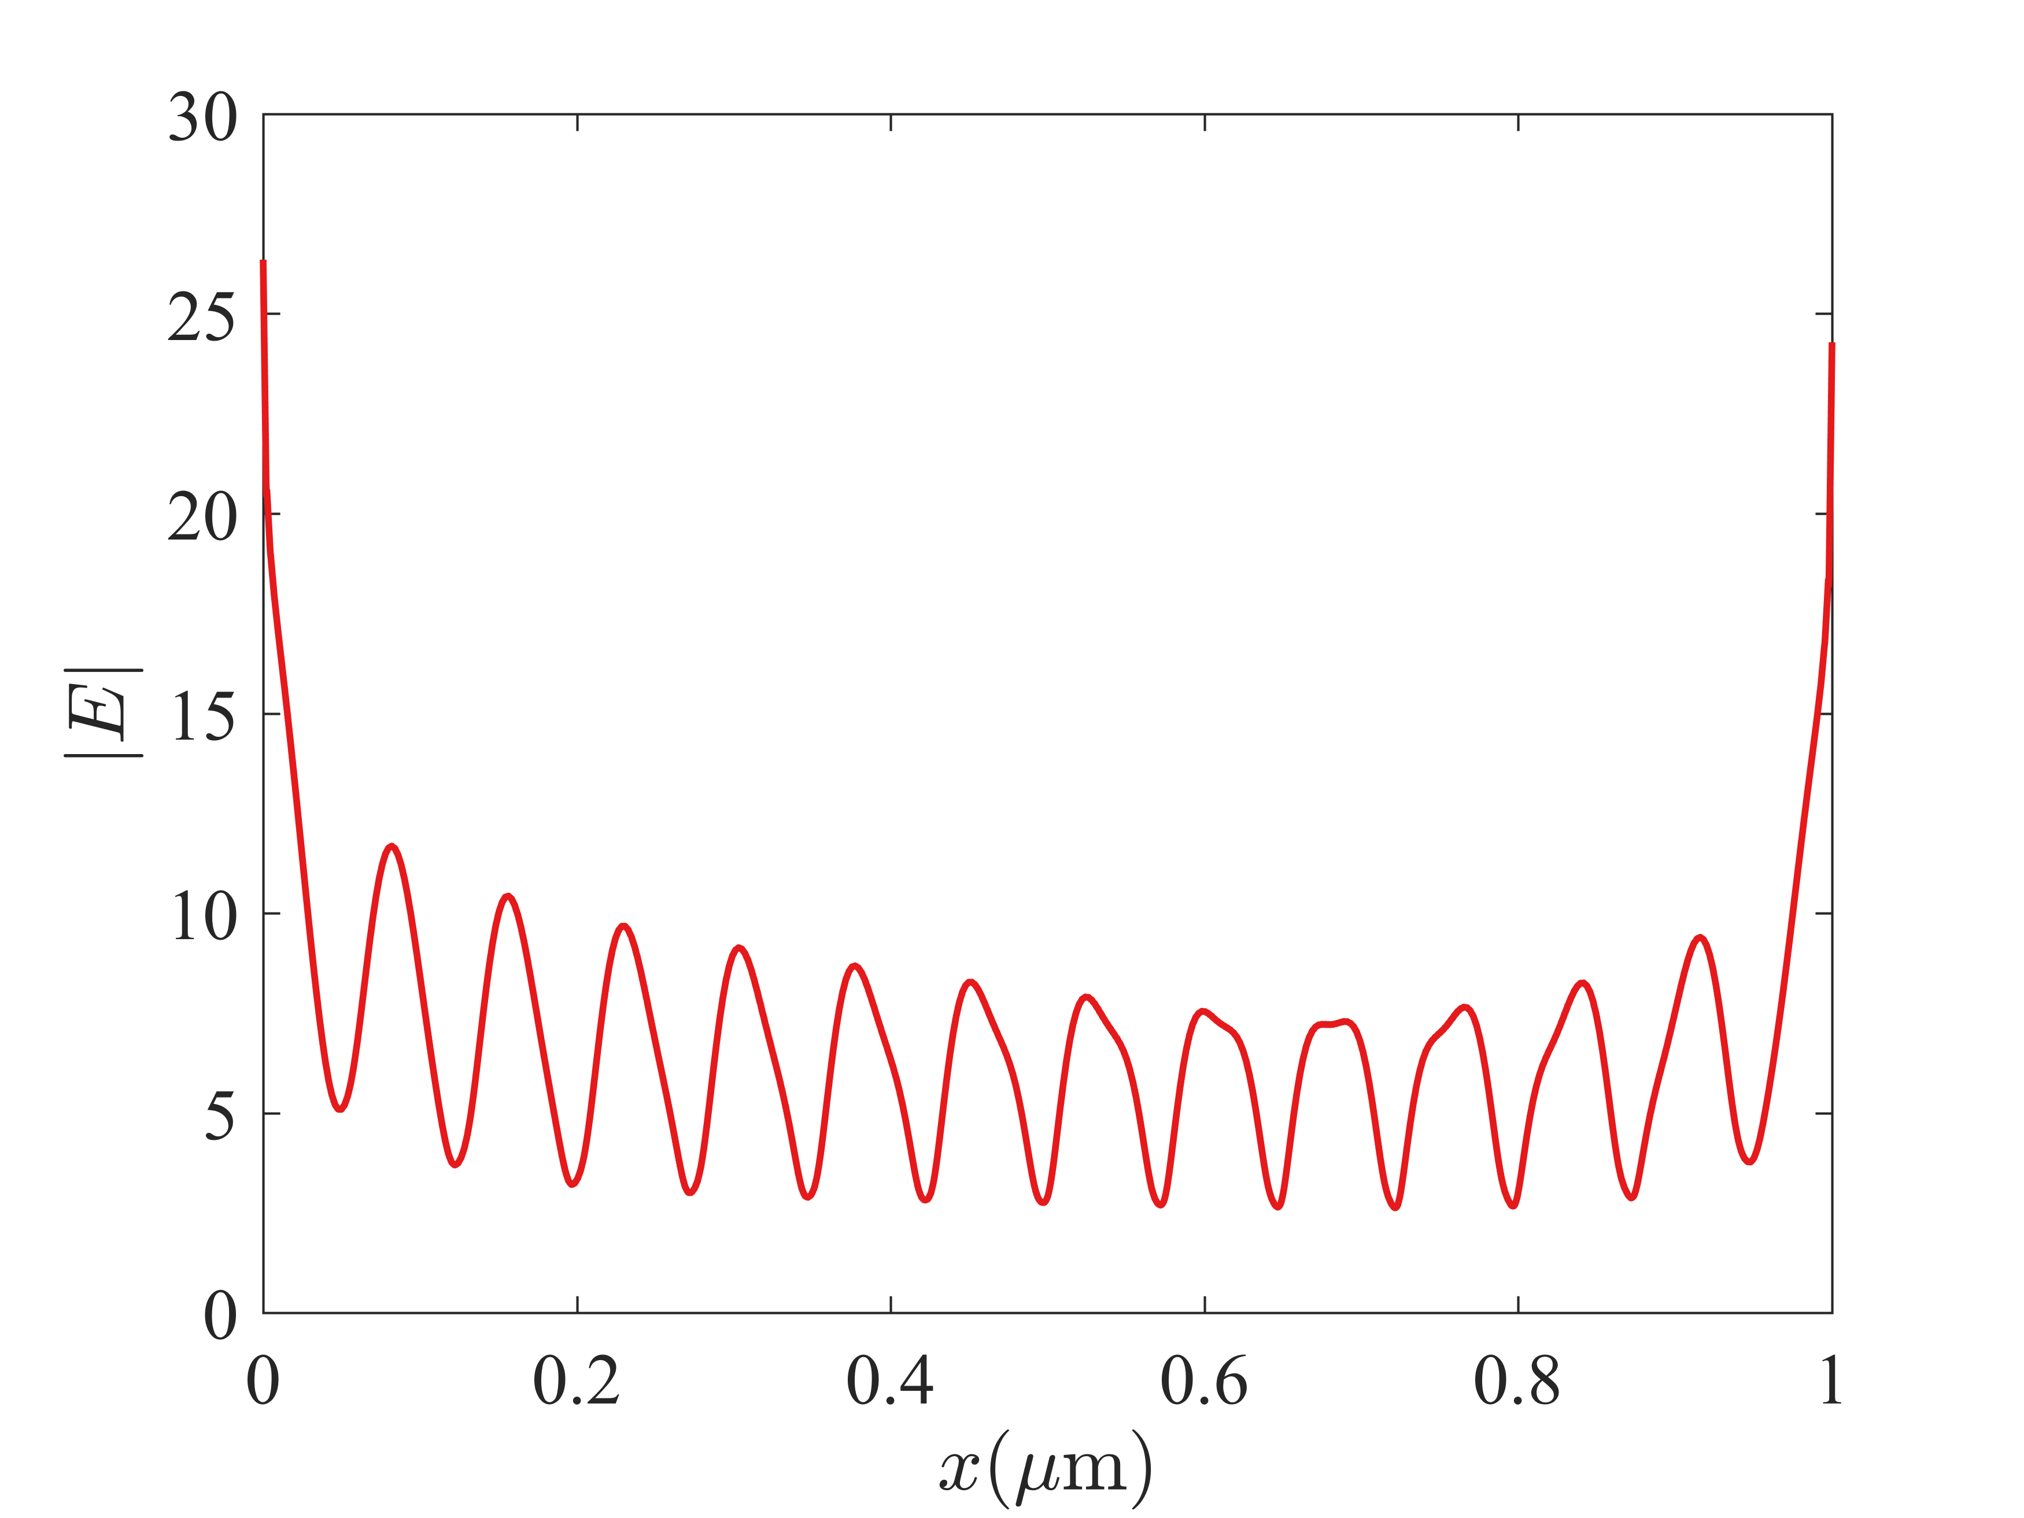

High resolution imaging
Structure Illumination Microscopy
Resolution enhancement beyond the diffraction limit
Moiré fringes
Capture frequencies higher than normally permitted by microscope
Post-processing yields high resolution image
$$f_{0}=25 THz$$

Slide 13
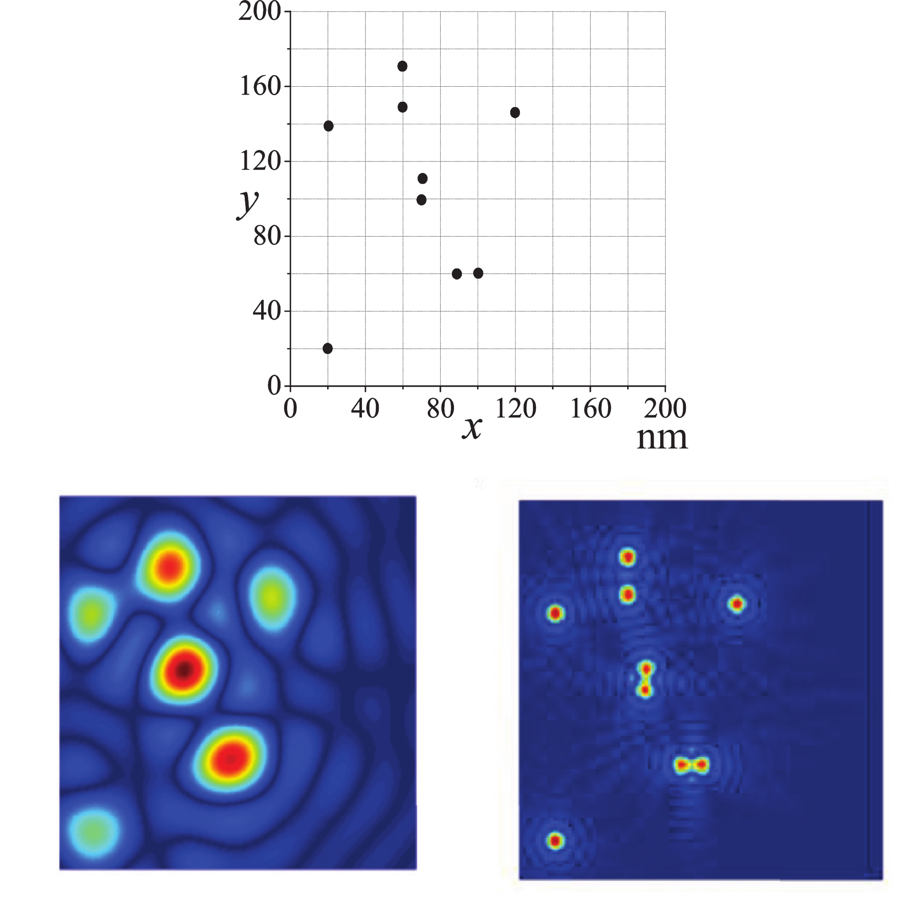
High resolution imaging
Sample
Conventional
Plasmonic

Slide 14
Summary
III-V semiconductor and perovskite heterostructures support plasma waves
Terahertz devices
High resolution imaging
Device Size reduction

