Slide 1
Project Name : Tic Tac Toe Game
Developed By:
Busy Buddies
Team Mate:
Name: Hasan Talukder
Id:11709037
Name: Abu Yousuf
Id:11709004
Name: Rafiq Khan
Id:11709028
Name: Shuvo Kumer Singh
Id:11609042
Name : Rifayet Zahan Upoma
Id:11709052

Slide 2
Working Process:
To Build Tic Tac Toe Game We need use Button for use data which user click to play.
And also need Text View for display Player Name and score.
And we also use button to reset all the game score.
We use toast message displaying which player will be win.
Advantage of User :
1.User can play interesting Tic Toc Toe game easily.
2.User can set data where user want to set it.
3.User can see increase his/her gaming score.
4.At a time Two player can play the game
5.User can see With Toast message Who is win the game.
6.User can reset game score for next match .

Slide 3
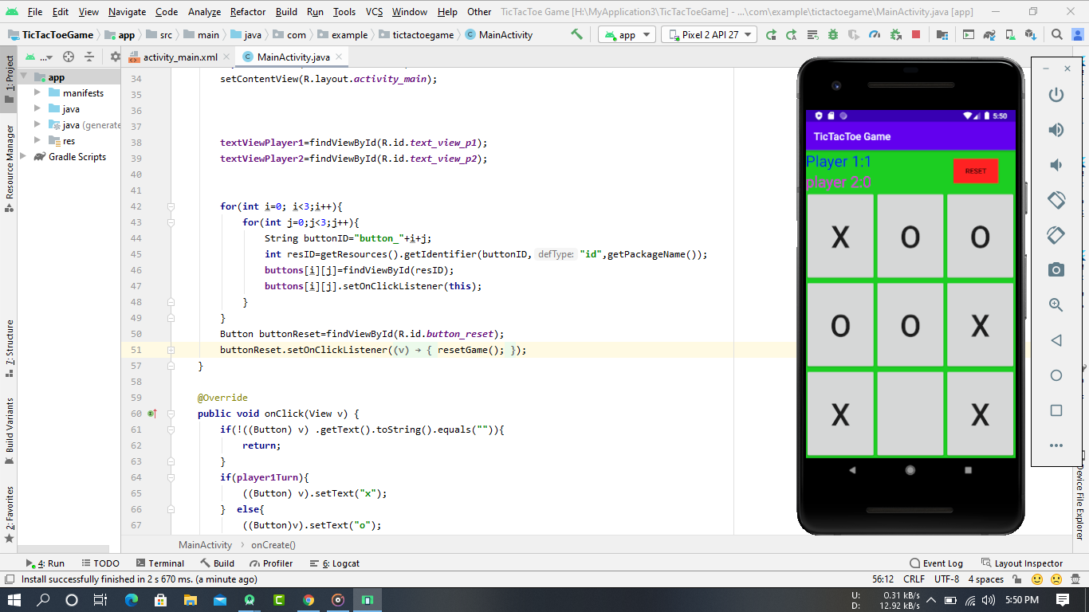
Some Screen shot of The Game

Slide 4
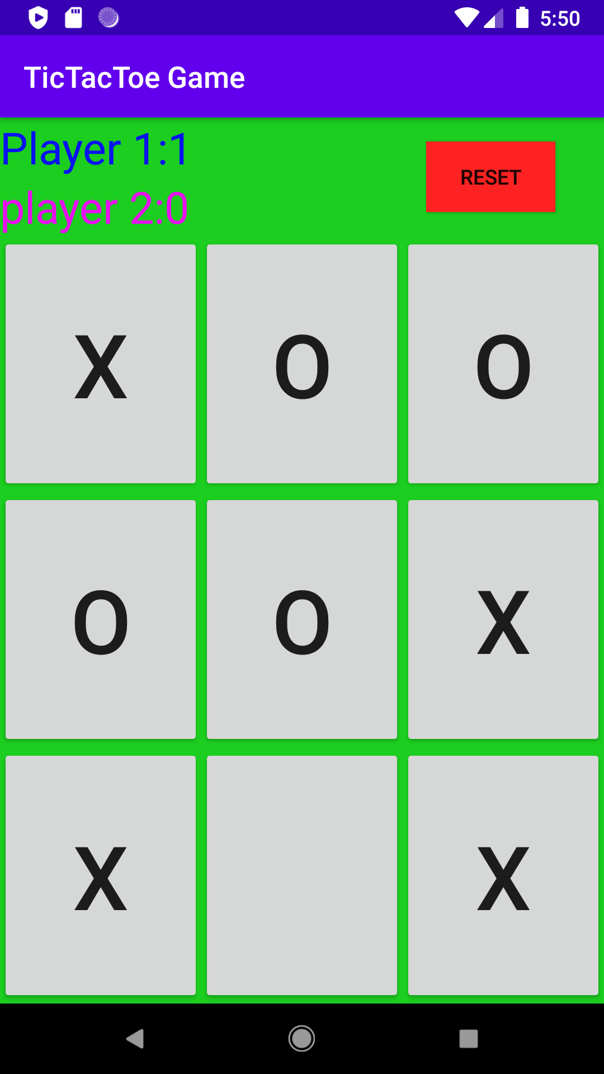
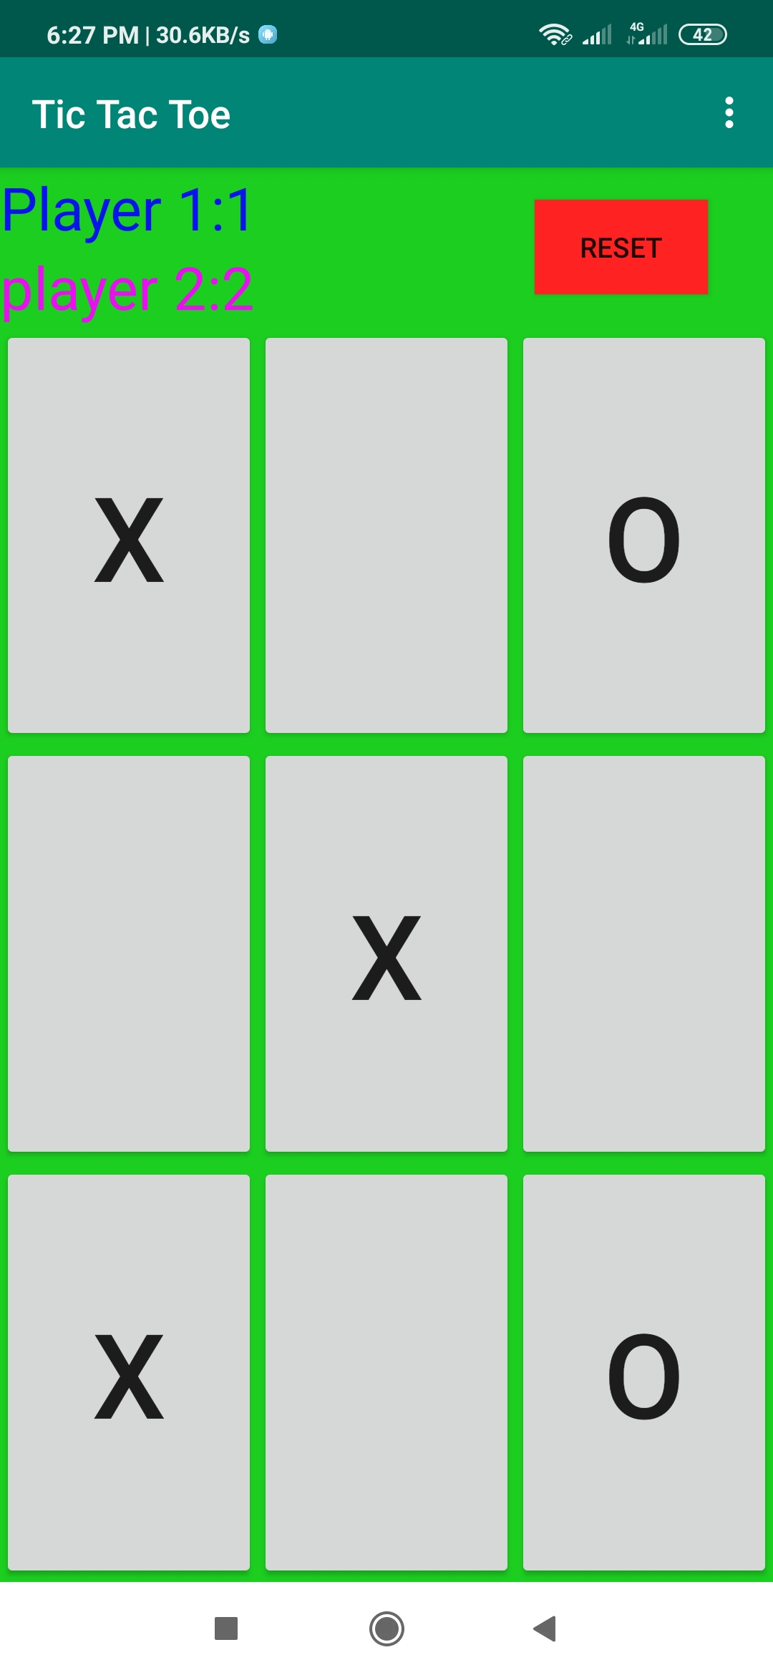
Some Screen shot of The Game

