Slide 1
PROGRAMMING PLATFORM
SOFTWARE PROJECT LAB-II

Slide 2
SUPERVISED BY
MOHAMMAD SHOYAIB
PROFESSOR
INSTITUTE OF INFORMATION TECHNOLOGY
UNIVERSITY OF DHAKA
PROJECT MEMBERS
MD. SHAYAKH SHIHAB UDDIN
BSSE 813
MD. HASAN TAREK
BSSE 818

Slide 3
OUTLINE
PROJECT OVERVIEW
DELIVERABLES
SCOPE
FEATURES

Slide 4
PROJECT OVERVIEW
A Programming platform is a platform where users can
Surf programming problems
Solve them by writing code
Submit that code in that system for judgment
Get verdict

Slide 5
DELIVERABLES
ADMINISTRATOR
Arrange a contest
Modify a contest
Delete a contest
Add problems
Remove problems
See participant list of a contest
See rank list of a contest

Slide 6
DELIVERABLES
NORMAL USER
Participate in contest
Solve Programming Problems
Submission Languages are C, C++
Get verdict of submission
Verdicts are Accepted, Wrong Answer, Time Limit Exceed and Runtime Error
See the submission list
See the rank of a contest

Slide 7
SCOPE
Arrangement, modification and Deletion of a Contest
Rank list of a contest
Submission Language are C and C++.
Solve problems even if a contest is over
Verdicts are Accepted, Wrong Answer, Time Limit Exceed and Runtime Error
User Profile Modification
Server is installed in Linux based OS (Ubuntu 16.04LTS)

Slide 8
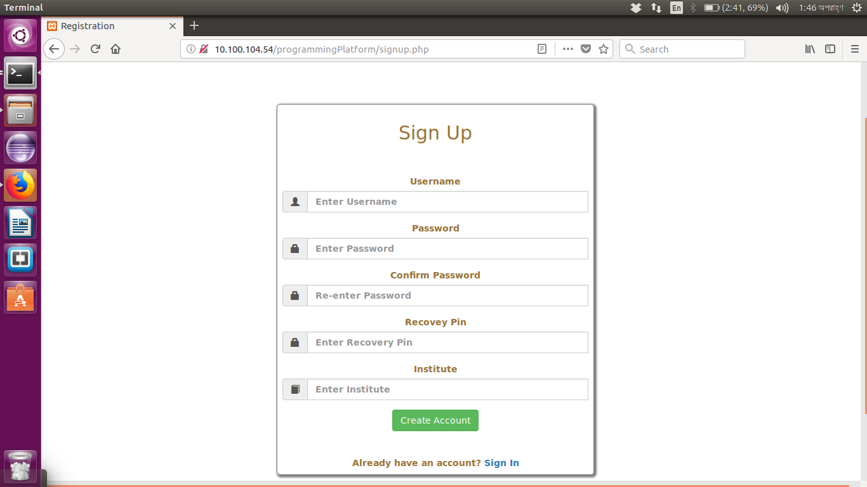
FEATURES
REGISTRATION

Slide 9
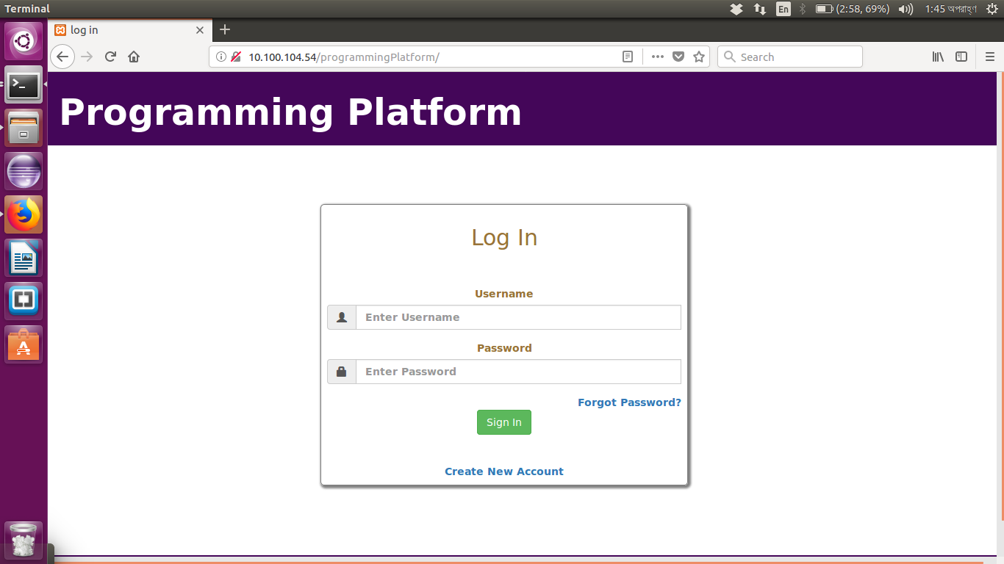
FEATURES
LOGIN

Slide 10
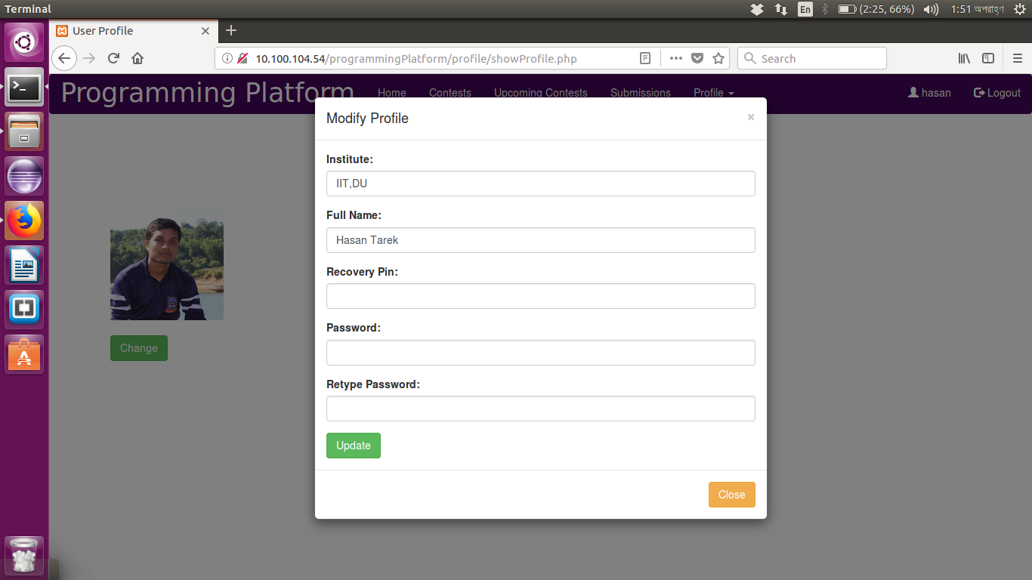
FEATURES
USER PROFILE MODIFICATION

Slide 11
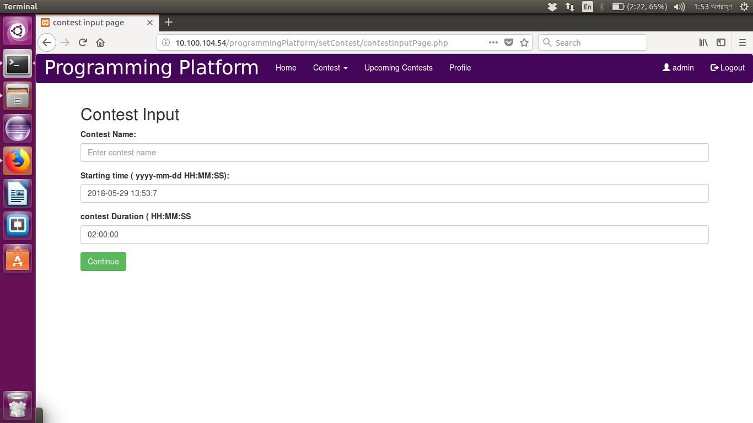
FEATURES
SET CONTEST

Slide 12
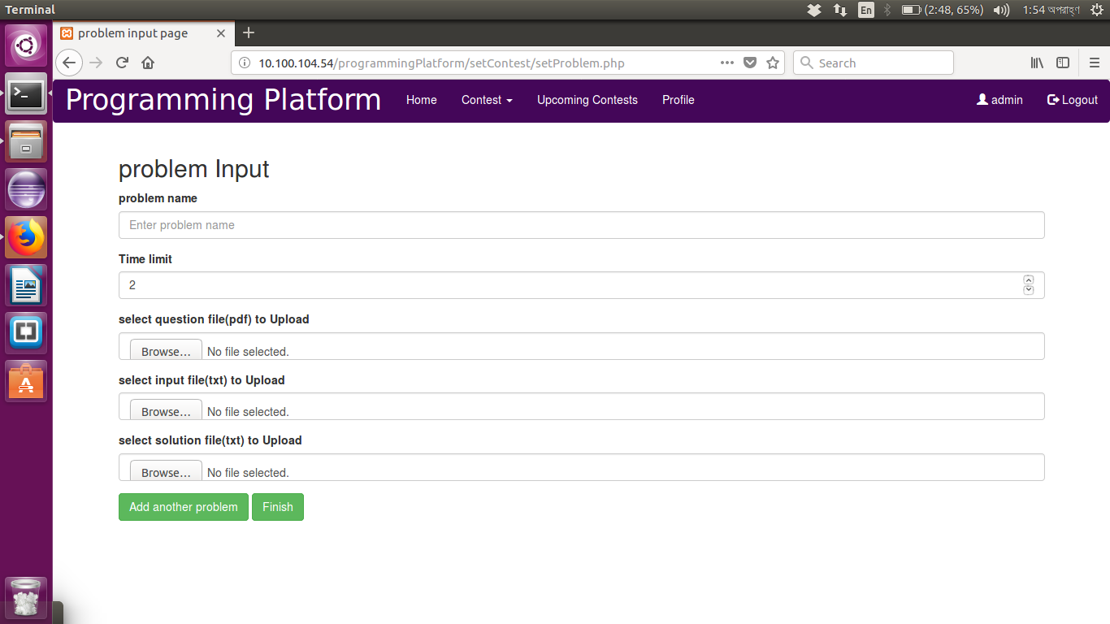
FEATURES
SET PROBLEM

Slide 13
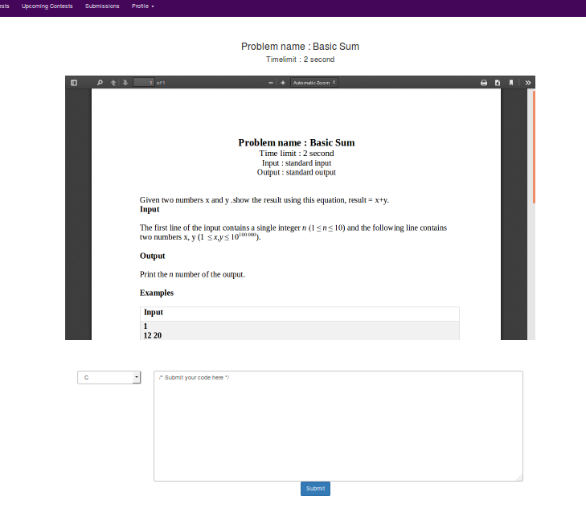
FEATURES
PROBLEM DESCRIPTION AND SUBMISSION

Slide 14
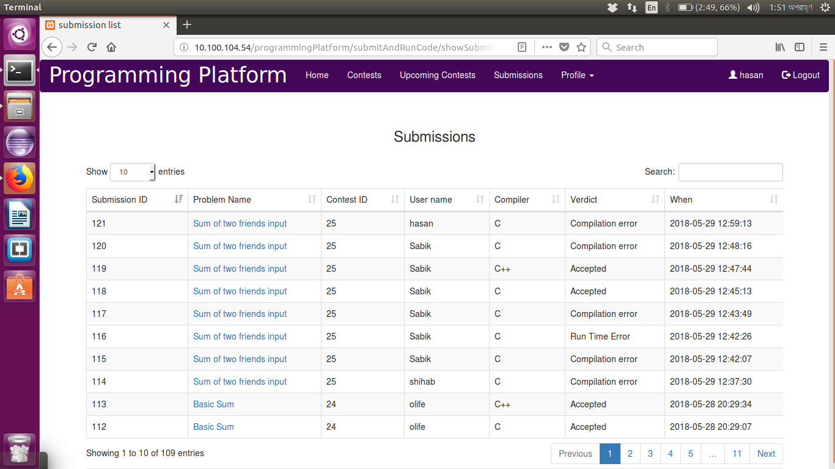
FEATURES
SUBMISSION STANDING LIST

Slide 15
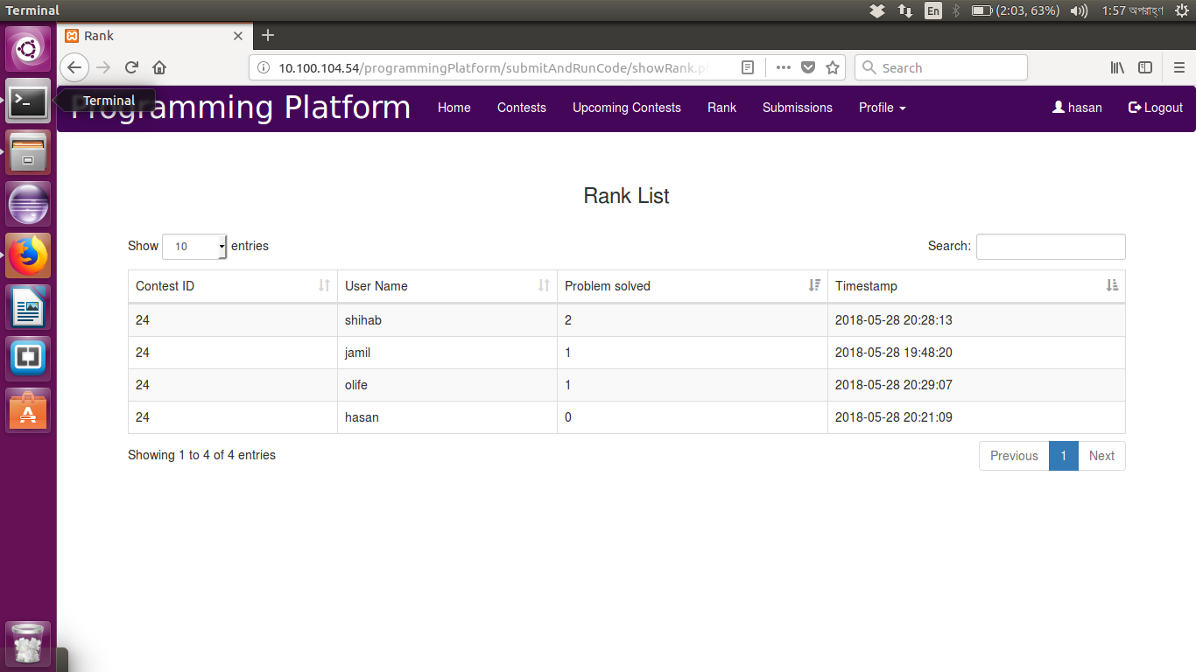
FEATURES
CONTEST RANKS

Slide 16
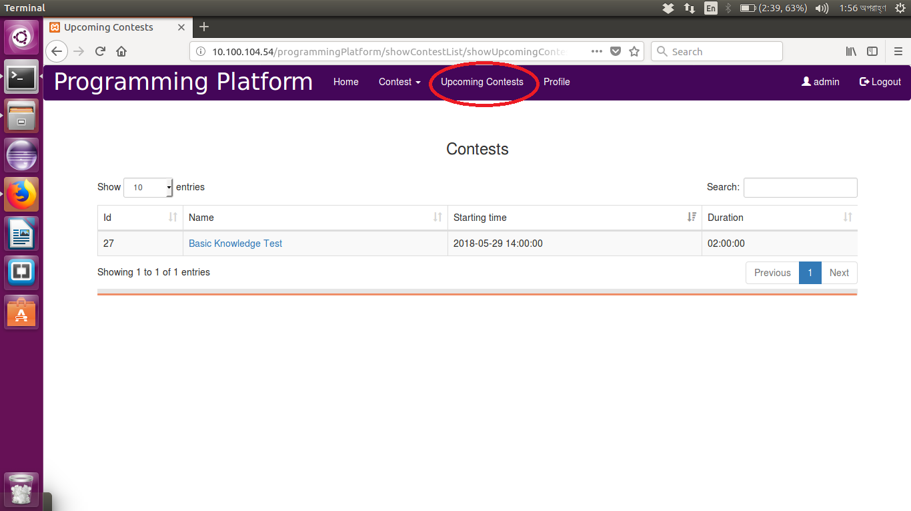
FEATURES
UPCOMING CONTESTS

Slide 17

FEATURES
PERSONAL SUBMISSIONS

Slide 18
PROJECT DEMONSTRATION

Slide 19
THANK YOU

