Slide 1
UNRESYST
Universal Recommender System
UNRESYST
Master thesis presentation
8th March 2011

Slide 2
Presentation overview
Quick Introduction to Recommender Systems
Problem Analysis
System Design
Adaptation to Datasets
Challenges
Finale, Discussion

Slide 3



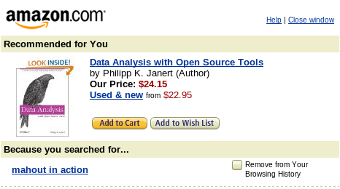


1. Intro
Recommenders
User actions
  Find items I will like
  Find me novel items
  Sort items by preference
  Advise me on particular item

Slide 4
1. Intro:
Recommender Applicability
Many items in the domain
Choice based on taste
Taste data
Homogeneous items

Slide 5



1. Intro:
Recommender as a Research Area
Gathering user preference
Algorithms transforming past user actions to recommendations
Privacy, legacy and other aspects
Measuring recommender efficiency
Recommender system implementation

Slide 6
1. Intro:
Recommender as a Research Area
Gathering user preference
Algorithms transforming past user actions to recommendations
Privacy, legacy and other aspects
Measuring recommender efficiency
Recommender system implementation

Slide 7
1. Intro
Thesis: Universal Recommender
Features:
Domain Independence
Using and combining multiple data sources
Simple and developer-friendly interface
Verification on various domains
Thesis type:
Implementace
Výzkumný problém
Analýza a návrh řešení zadaného problému
Srovnávací studie

Slide 8
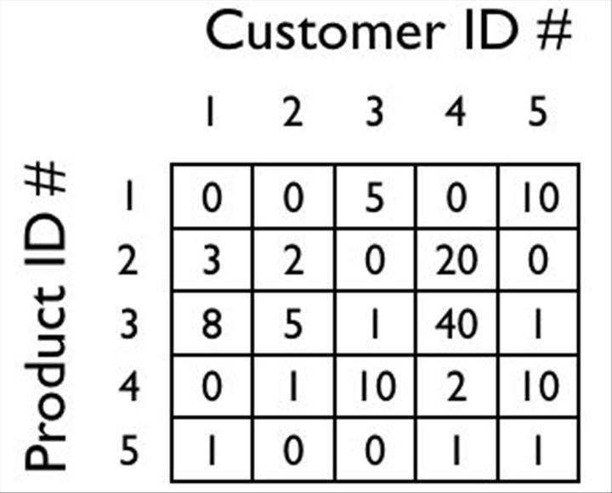




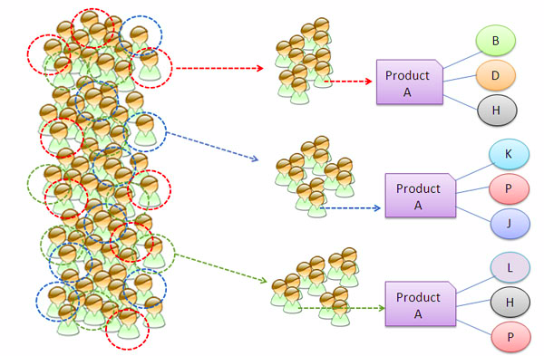
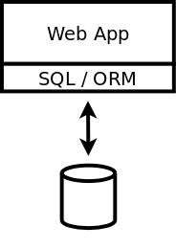
2. Analysis
Implementing Recommender in a Web System
Options for a system holder:
Implement their own recommendations
Use a recommender framework
Use the Universal Recommender System
(Use a Google API)

Slide 9
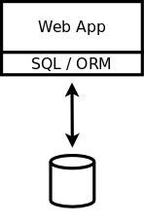
2. Analysis
(a) Implement Their Own Recommendations
Benefits and drawbacks:
+ no framework needed
+ efficient for simple filtering
- maintenance
- modern algorithms have to be implemented if needed

Slide 10
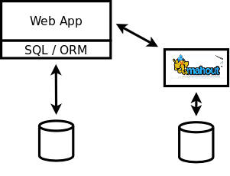
2. Analysis
(b) Use a Recommender Framework
Benefits and drawbacks
+ variety of modern algorithms
+ scalable implementations
- incorporating the framework to
the system (DB setup, interface
adapter)
- a single source of preference
data

Slide 11
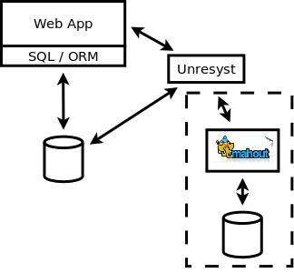
2. Analysis
(c) Use the Universal Recommender System
Benefits and drawbacks
+ easy-to-use interface
+ can share the system DB
+ can use external algorithm
implementation
- needs setup

Slide 12
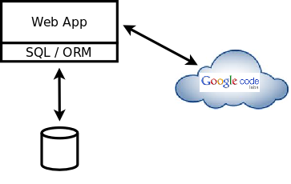
2. Analysis
(d) (Use the Google Prediction API)
Benefits and drawbacks
? little information available
? access on request through
a waiting list
- passing customer data to
Google

Slide 13
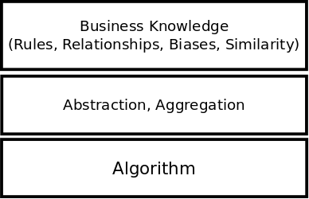
2. Analysis
UNRESYST Added Value
Multiple data sources and their combination
Multiple recommenders in one system
Using both implicit and explicit feedback, not just rating
Domain specific rules
(e.g. no double GPS purchase)
Isolating business knowledge
from recommender algorithms

Slide 14
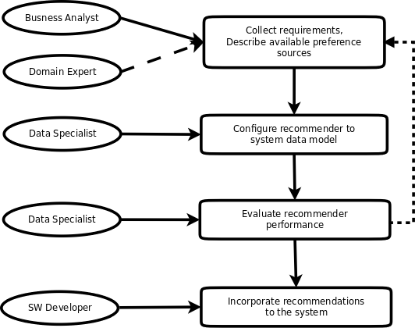
2. Analysis
The Process of Implementing a Recommender

Slide 15
3. UNRESYST Design
Interface
Adaptation :
  subjects, objects, predicted relationship
  rules and relationships
  clusters
  bias
Runtime:
  build
  update
  predict, recommend – using system classes

Slide 16
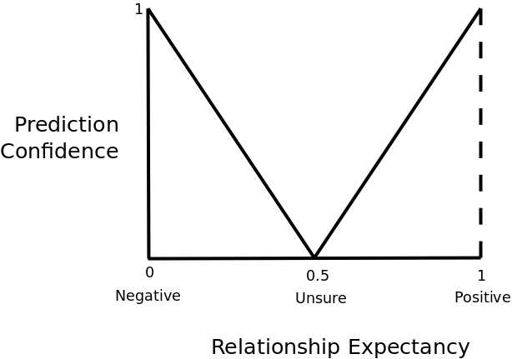
3. UNRESYST Design
Defining rules
Rule semantics:
  Preference
  Similarity
Parameters
  Generator/Condition
  Positiveness
  Confidence
  Name, description

Slide 17
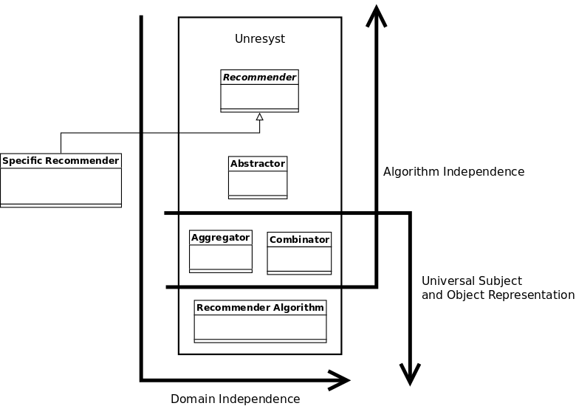
3. UNRESYST Design
Architecture - Layers

Slide 18
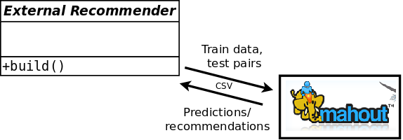
4. Adaptation to Datasets, Comparison
Overview
Adaptation
  Create data model, import data from csv file (or its subset)
  Configure Unresyst
  Divide data into train and test set
  Build the recommender with the train set
  Run evaluation
Comparison
  Mahout implementation
  of collaborative filtering
  algorithms

Slide 19
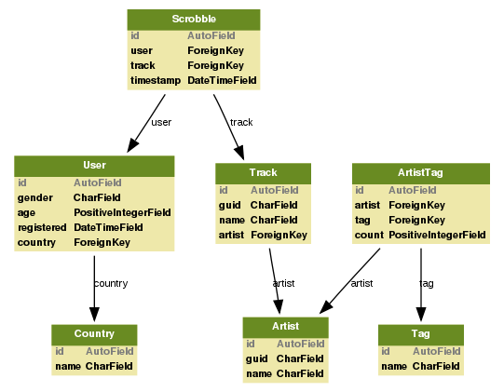
4. Adaptation to Datasets, Comparison
Last.fm Data Set
Users listening to Tracks
by Artists
  Originally 20 mil.
  scrobbles, 1000 users
  Reduced to 100 users,
  6000 scrobbles
Artist social tags
  Available for 10% of artists
Recommending artists
to users
http://www.dtic.upf.edu/~ocelma/MusicRecommendationDataset/lastfm-1K.html
http://musicmachinery.com/2010/11/10/lastfm-artisttags2007/

Slide 20
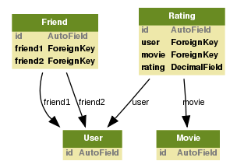
4. Adaptation to Datasets, Comparison
Flixster Data Set
Users rating movies
  Originally 8 mil. ratings
Social links between users
  Originally 7 mil. links
Classical collaborative filtering data set
extended by social links
No timestamps available
http://www.cs.sfu.ca/~sja25/personal/datasets/

Slide 21
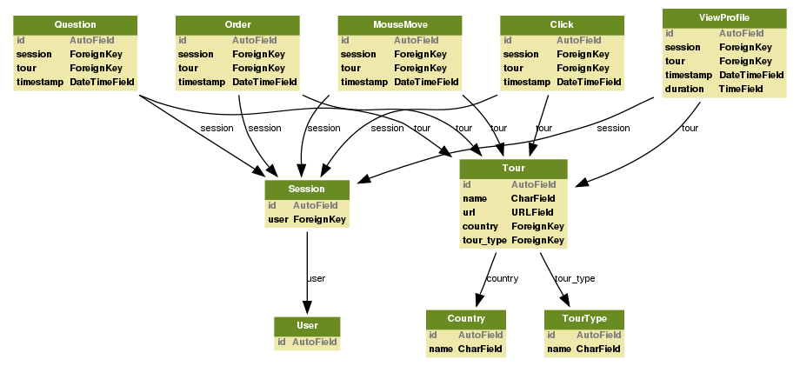
4. Adaptation to Datasets, Comparison
Travel Agency Data Set
Users viewing and ordering tours
Various kinds of implicit feedback

Slide 22
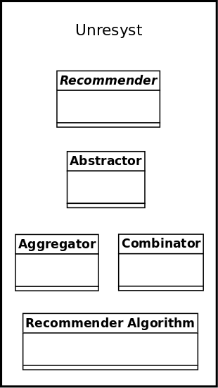
5. Challenges
Preference/Similarity/Bias combination
Combining Expectancies
Aggregator:
  Subject, object similarity, clusters
  Subject, object biases
Output: entity pair similarity, entity bias
Combinator:
  Preference rules and relationships
  Aggregated biases, similarity
Output: preference prediction

Slide 23

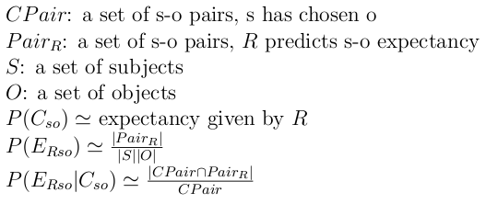

5. Challenges
Preference/Similarity/Bias combination
Expectancy: probability estimated by an isolated rule
Multiple rules applied to an s-o pair:
Rules taken as independent?

Slide 24
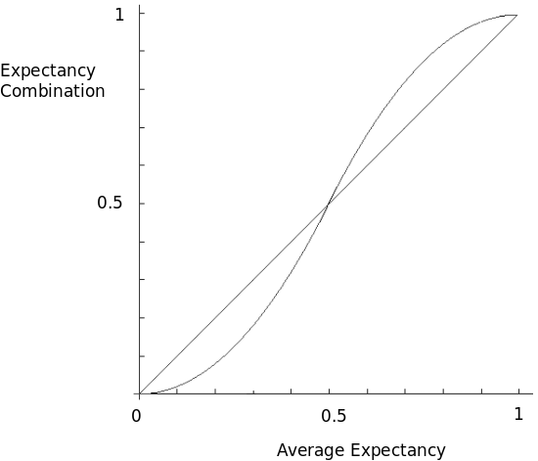
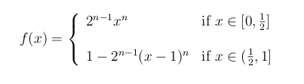
5. Challenges
Preference/Similarity/Bias combination
Combining preferences
Intuitively:
  Positive + Negative
  => Neutral
  Positive + Positive
  => More positive
  Negative + Negative
  => More negative

Slide 25


5. Challenges
Efficiency Measure: Prediction
Trying to predict the expectancies of the pairs in the test set
Root Mean Square Error
+ widely used
+ large errors highly increase the resulting error
- only for datasets where negative feedback is also available

Slide 26


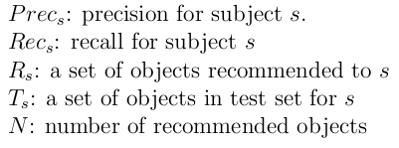
5. Challenges
Efficiency Measure: Recommendation
Generating N recommendations for each subject, evaluating how many of them appear in test pairs
Precision/Recall
+ using only first N objects (relative)
+ more intuitive
- scaling (different object count for subjects in test set)
- multiple appearance of an object in the test set
- not a single number
- rarely used for evaluating recommender systems

Slide 27
6. Finale
Questions, discussion

Slide 28
6. Finale
Contacts, References
Unresyst project homepage:
  http://code.google.com/p/unresyst/
Recommender system leaders:
  http://www.amazon.com/
  http://www.last.fm/
  http://news.google.com/
Open source recommender algorithm libraries
  http://mahout.apache.org/
  http://www.cs.waikato.ac.nz/ml/weka/
  http://duineframework.org/
Thanks for your attention.

