Slide 1
UNRESYST
Universal Recommender System
UNRESYST
Universal Recommender System
17th May 2011

Slide 2
Presentation overview
Quick Introduction to Recommender Systems
Problem Analysis
System Design
Adaptation to Datasets
Finale, Discussion

Slide 3



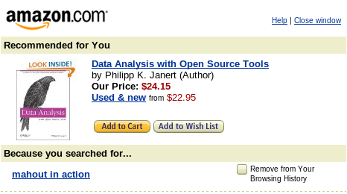


1. Intro
Recommenders
User actions
  Find items I will like
  Sort items by preference
  Advise me on particular item

Slide 4



1. Intro:
Recommender as a Research Area
Gathering user preference
Algorithms transforming past user actions to recommendations
Privacy, legacy and other aspects
Measuring recommender efficiency
Recommender system implementation

Slide 5
1. Intro:
Recommender as a Research Area
Gathering user preference
Algorithms transforming past user actions to recommendations
Privacy, legacy and other aspects
Measuring recommender efficiency
Recommender system implementation
Thesis type:
Implementace
Výzkumný problém
Analýza a návrh řešení zadaného problému
Srovnávací studie

Slide 6
2. Analysis
Features:
Domain Independence
Using and combining multiple data sources
Domain specific rules
Simple and developer-friendly interface
Verification on various domains
Adaptation :
subjects, objects
rules and relationships
predicted relationship
bias

Slide 7
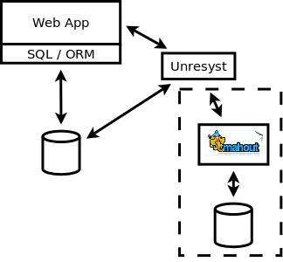
2. Analysis
Universal Recommender System
Benefits and drawbacks
+ easy-to-use interface
+ can share the system DB
+ can use external algorithm
implementation
- needs setup

Slide 8
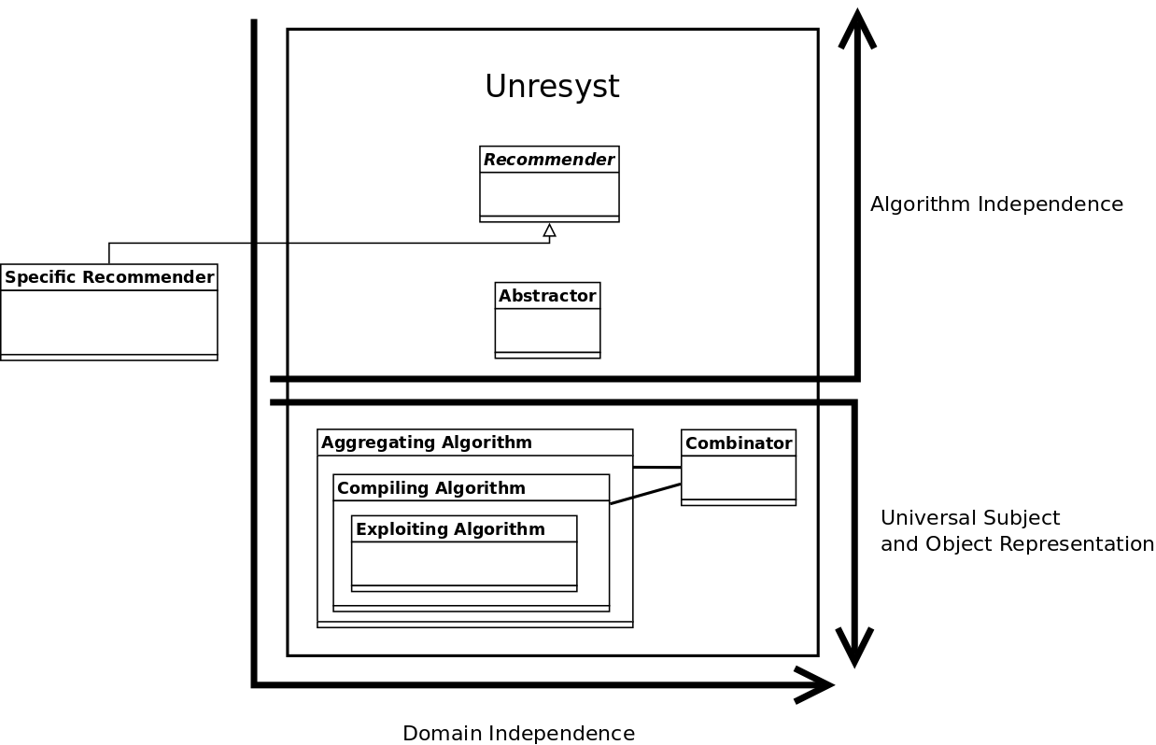
3. UNRESYST Design
Architecture - Layers

Slide 9
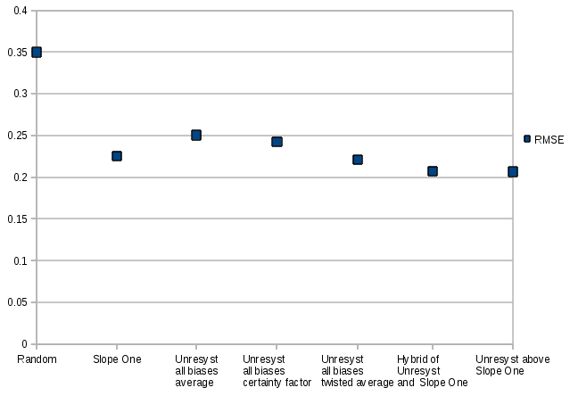
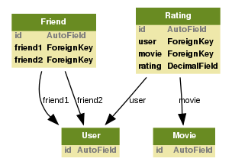
4. Adaptation to Datasets, Comparison
Flixster Data Set
Users rating movies
Social links between users

Slide 10
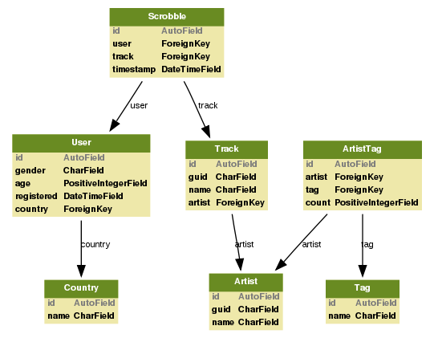
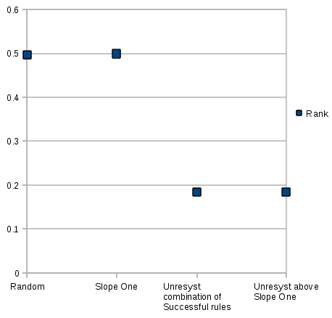
4. Adaptation to Datasets, Comparison
Last.fm Data Set
Users listening to Tracks by Artists
Recommending Artists to Users

Slide 11
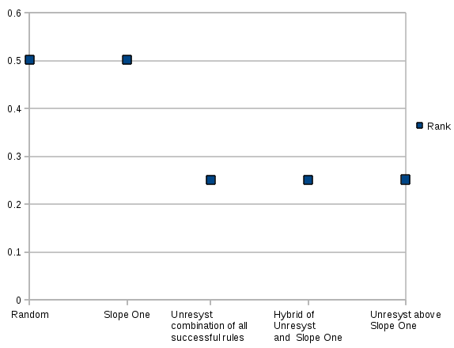
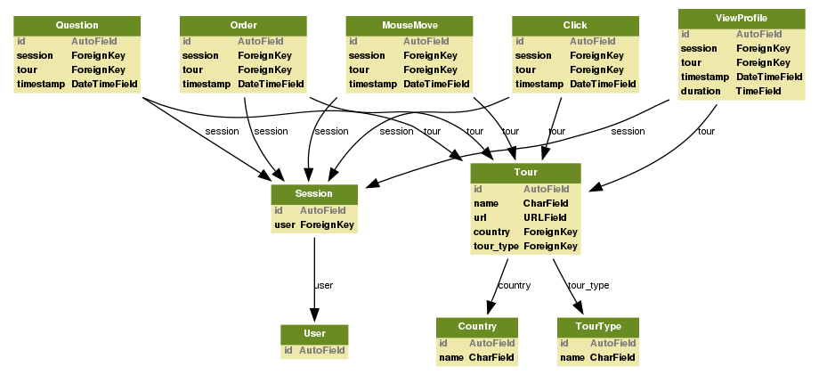
4. Adaptation to Datasets, Comparison
Travel Agency Data Set
Users viewing and ordering tours
Various kinds of implicit feedback

Slide 12
6. Finale
Thanks for your attention.
Unresyst project homepage: http://code.google.com/p/unresyst/

Slide 13
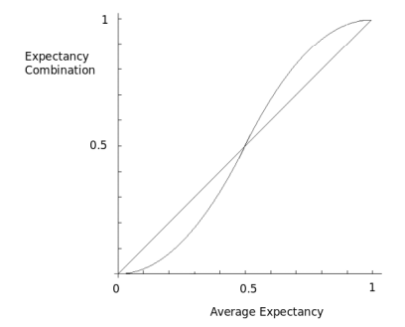

BACKUP
Combination – Twisted average

Slide 14

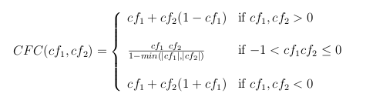
BACKUP
Combination – Mycin

Slide 15
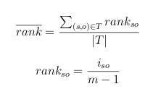
BACKUP
Measuring Efficiency – Average Rank

Slide 16
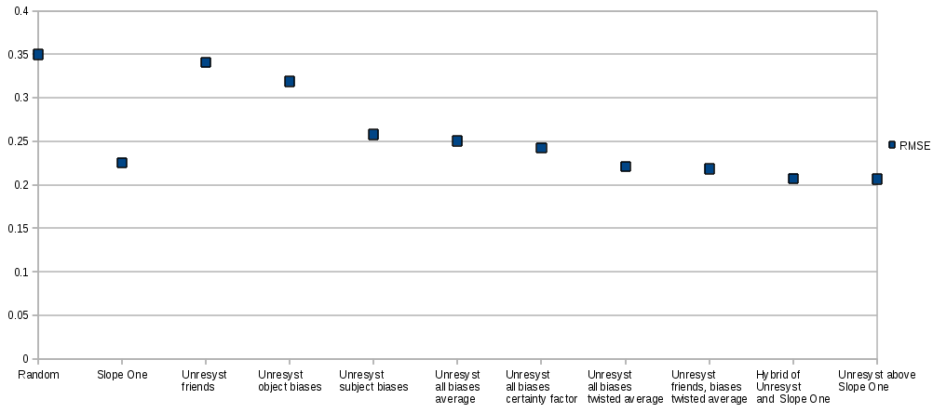
BACKUP
Flixster

Slide 17
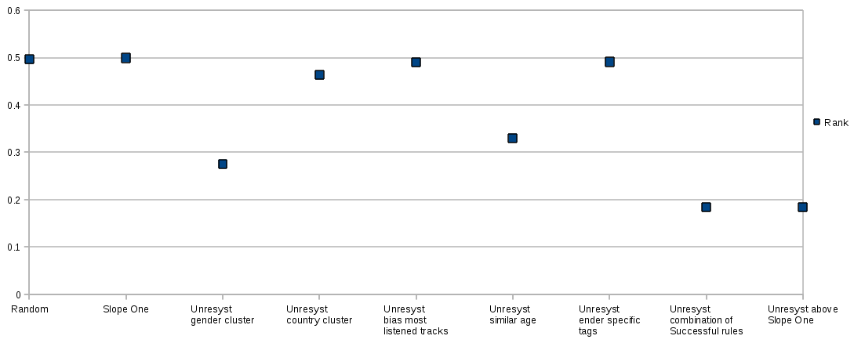
BACKUP
Last.fm

Slide 18
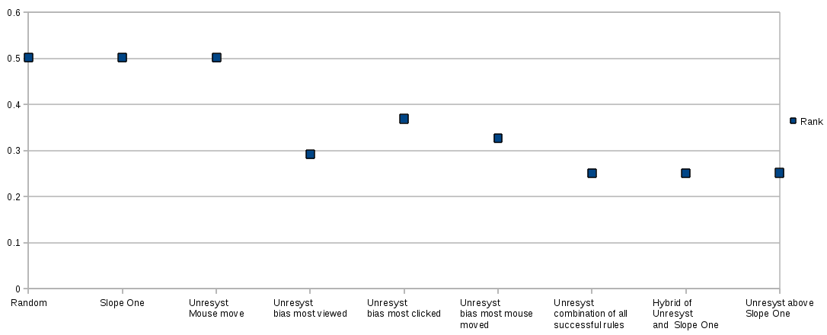
BACKUP
Travel Agency

