Slide 1
Universal Recommender System
UNREST

Slide 2
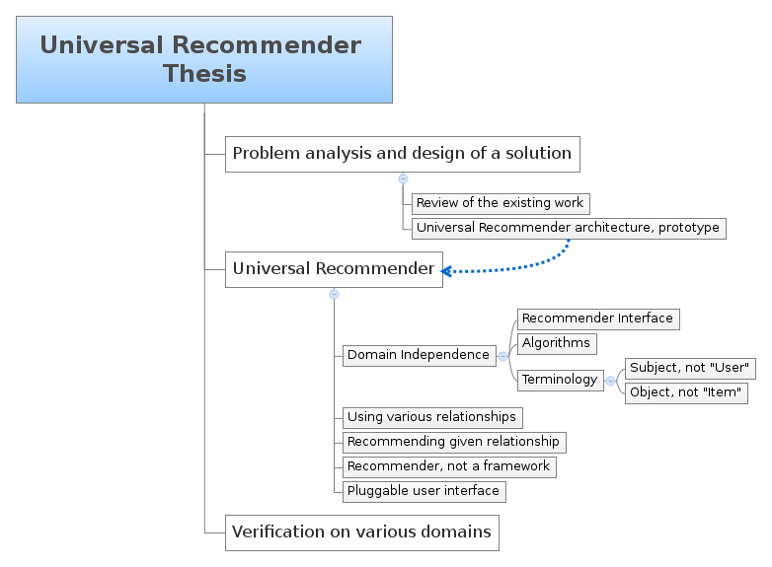
Thesis Concepts

Slide 3
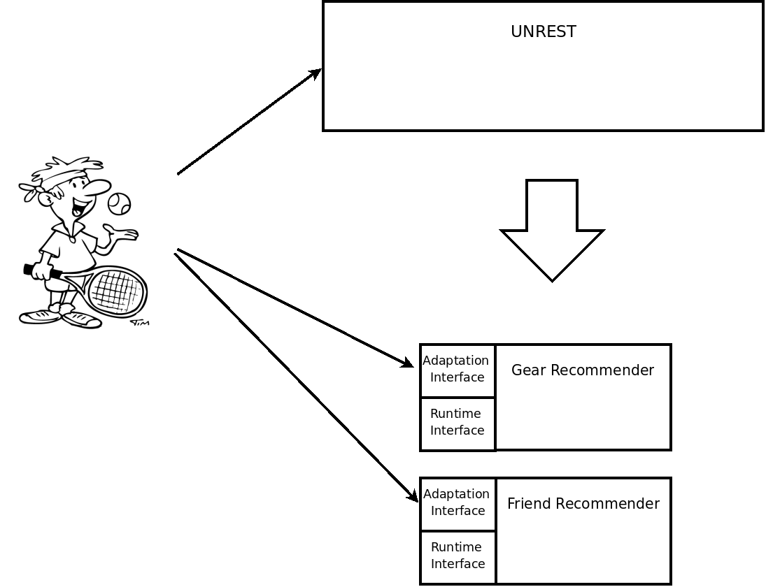
UNREST Adaptation Phase

Slide 4
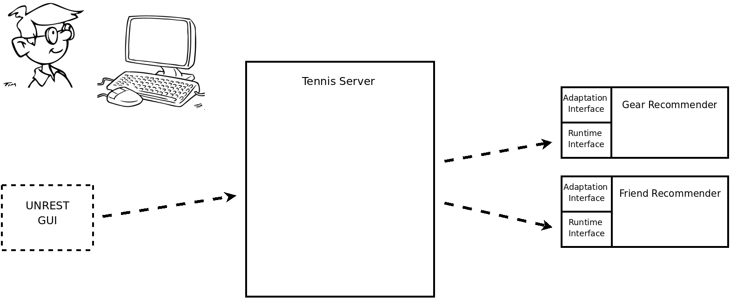
UNREST Incorporation Phase

Slide 5
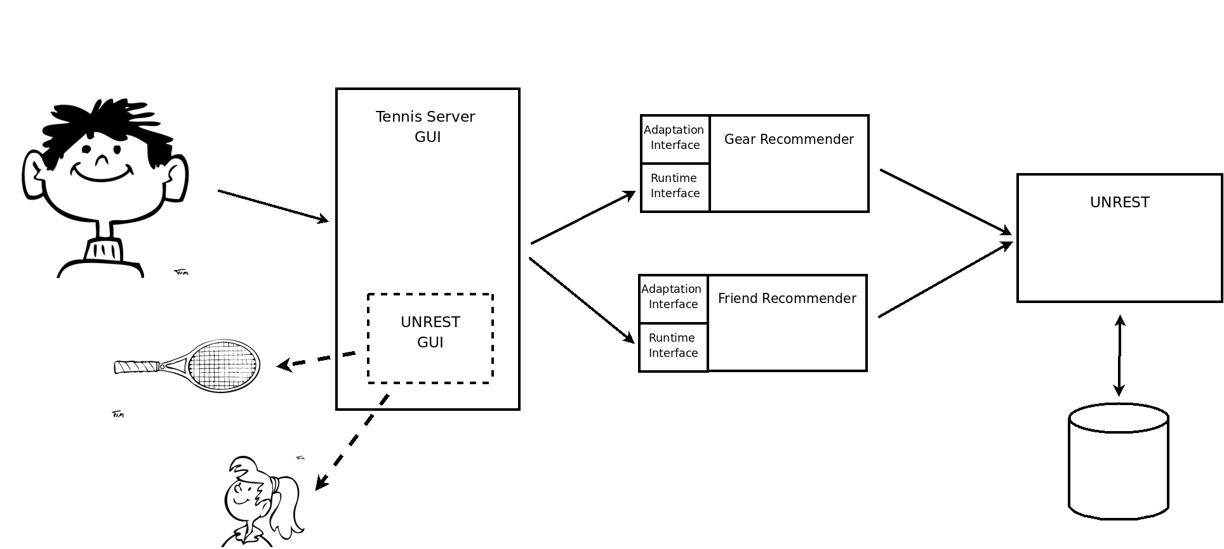
UNREST Runtime

Slide 6
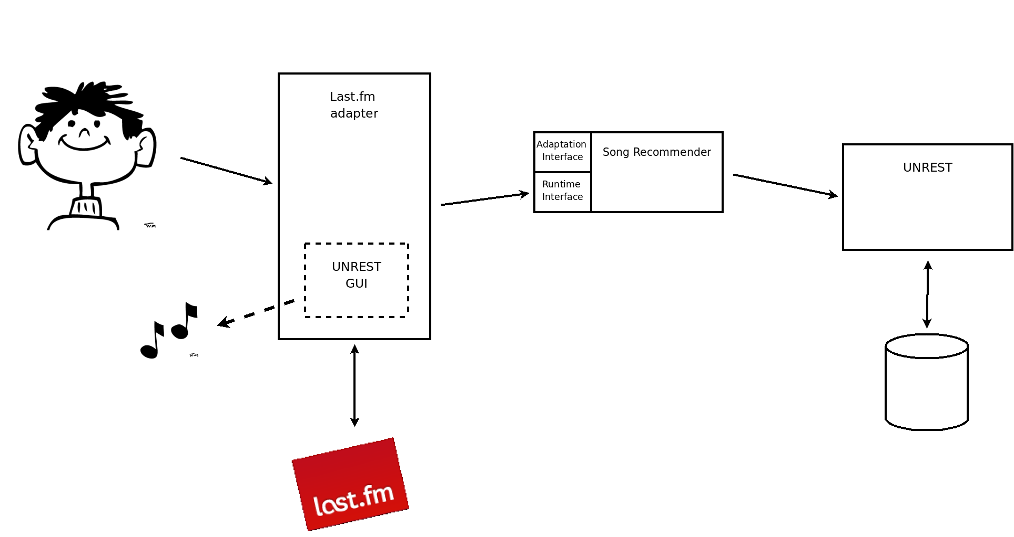
Using UNREST in an adapter to a 3rd party system

Slide 7
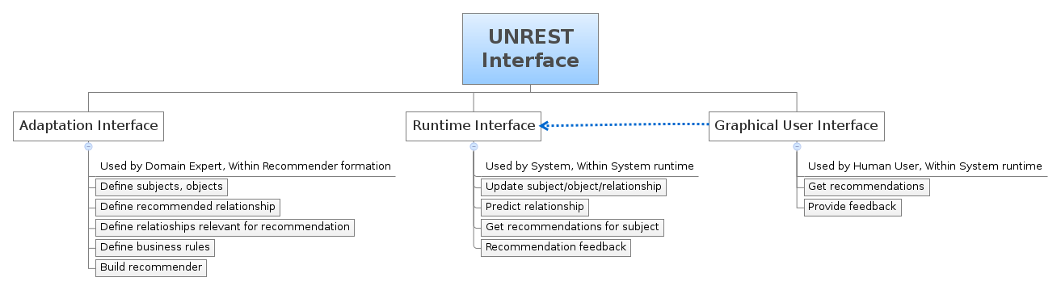
UNREST Interfaces

Slide 8
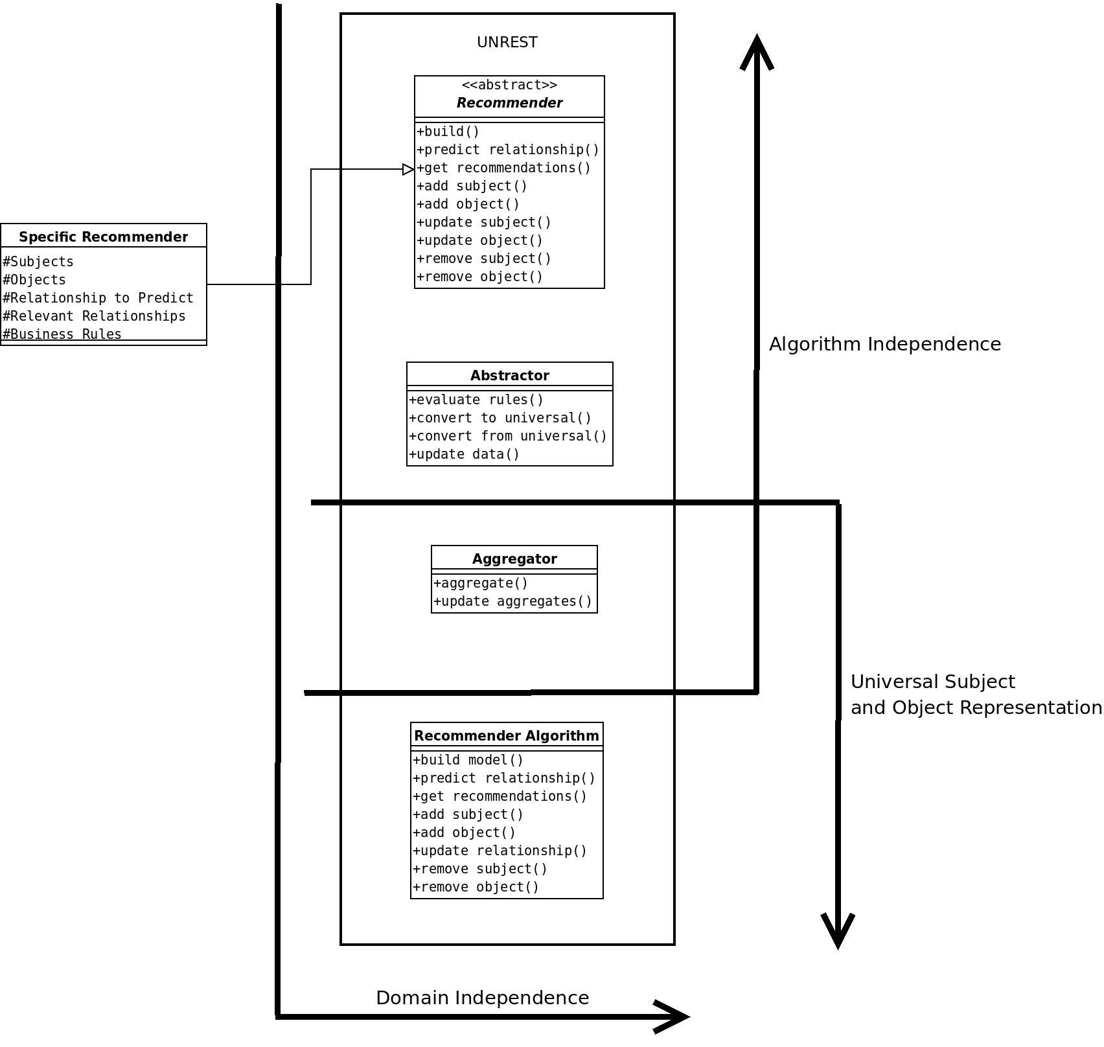

Slide 9
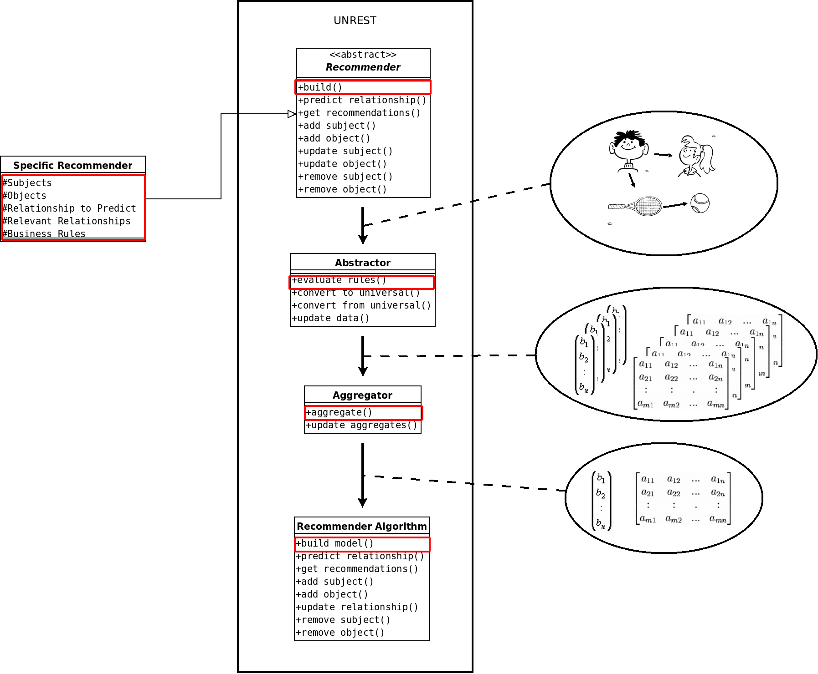

Slide 10
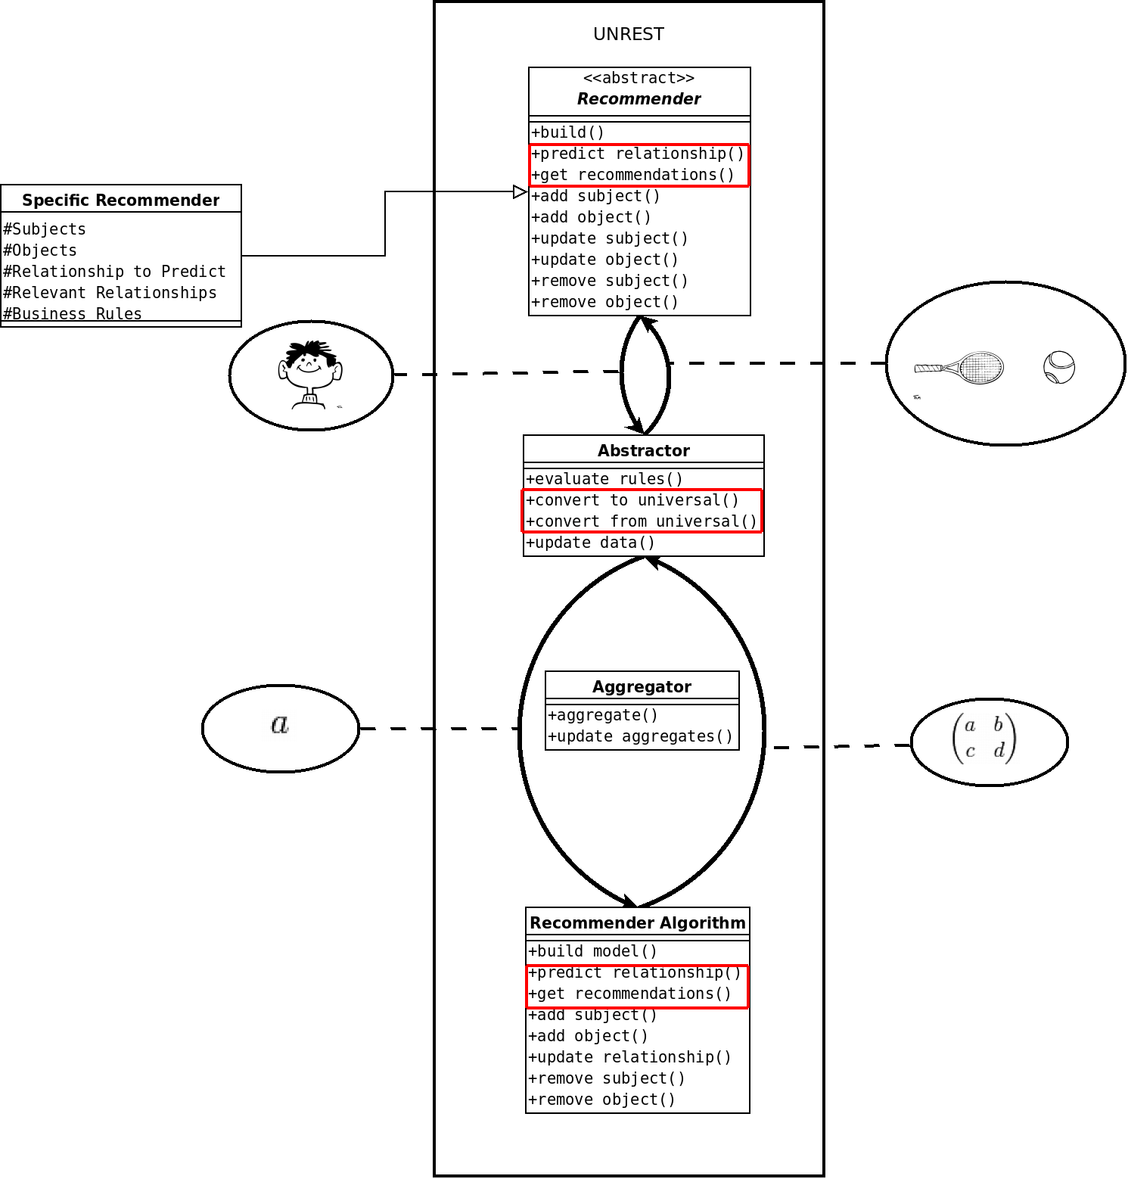

Slide 11
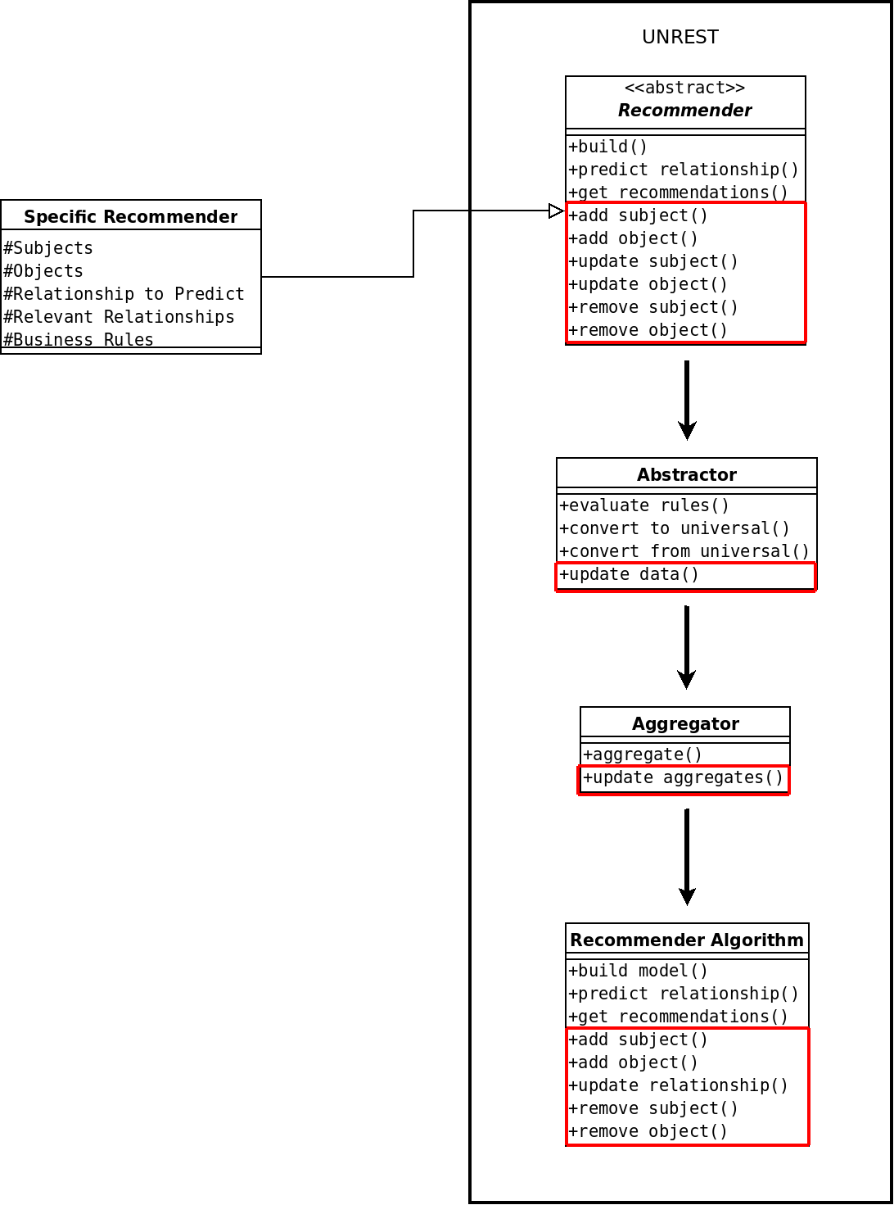

Slide 12
Possible Extensions
feedback to recommendation
meta data value prediction
directed relationships
N-ary relationships
user/item biases
temporal effects
operation complexity
robustness

