Slide 1
UNRESYST
Universal Recommender System
UNRESYST
Universal Recommender System
30th May 2011

Slide 2
Presentation Overview
Quick Introduction to Recommender Systems
Problem Analysis
System Design
Adaptation to Datasets
Example Use
Finale, Discussion

Slide 3



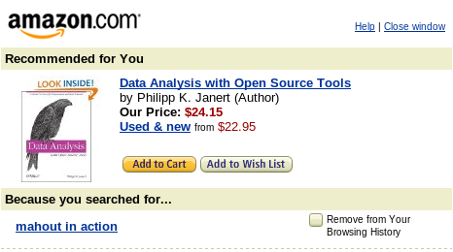


1. Intro
Recommenders
User actions
  Find items I will like
  Sort items by preference
  Advise me on particular item

Slide 4



1. Intro:
Recommenders as a Research Area
Gathering user preference
Algorithms transforming past user actions to recommendations
Privacy, legacy and other aspects
Measuring recommender efficiency
Recommender system implementation

Slide 5
2. Analysis:
Chosen Research Areas
Gathering user preference
Algorithms transforming past user actions to recommendations
Privacy, legacy and other aspects
Measuring recommender efficiency
Recommender system implementation
Thesis type:
Implementace
Výzkumný problém
Analýza a návrh řešení zadaného problému
Srovnávací studie

Slide 6
2. Analysis
Requirements
Features:
Domain Independence
Using and combining multiple data sources
Simple and developer-friendly interface
Verification on various domains
Adaptation :
subjects, objects
rules and relationships
predicted relationship
bias

Slide 7
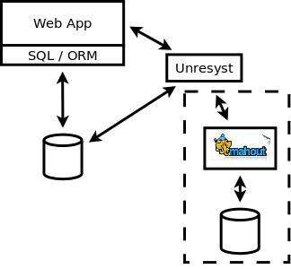
3. Design
Unresyst
Architecture concepts:
  outside the client system
  easy-to-use interface
  can share parent system DB
  can use external algorithm
  implementation
  needs setup

Slide 8
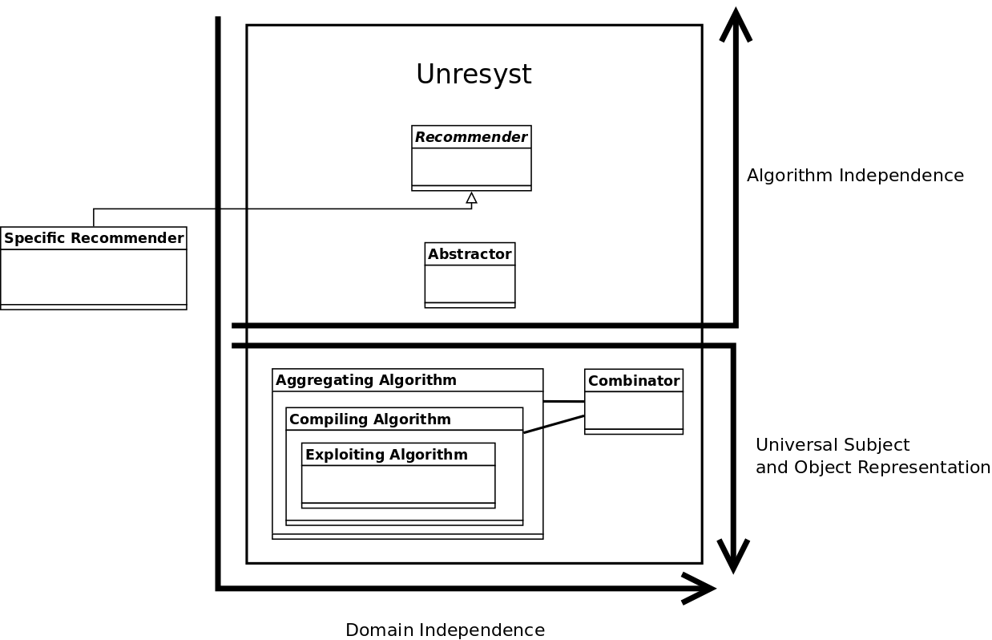
3. Design
Architecture - Layers

Slide 9
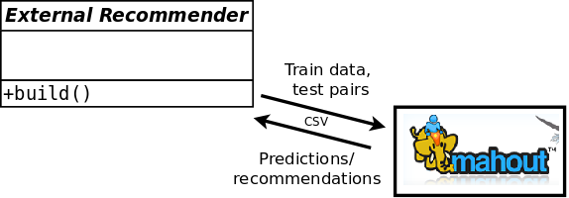
4. Adaptation to Datasets, Comparison
Offline accuracy analysis:
  Divide data to train and test set (timestamp).
  Run recommender on train set.
  Validate the recommendations against test set values, using RMSE and Rank metrics
Comparison to a collaborative filtering algorithm (slope one).

Slide 10
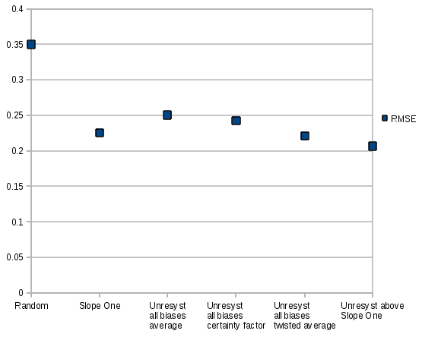
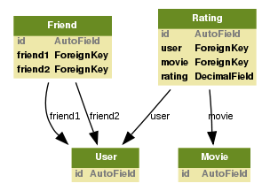
4. Adaptation to Datasets, Comparison
Flixster Data Set
Users rating movies
Social links between users

Slide 11
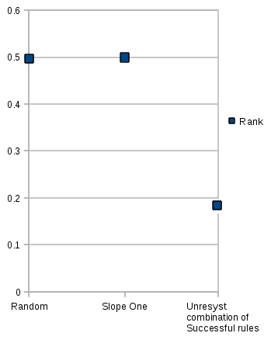
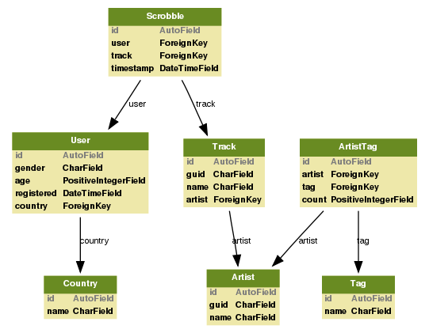
4. Adaptation to Datasets, Comparison
Last.fm Data Set
Users listening to Tracks by Artists
Recommending Artists to Users

Slide 12
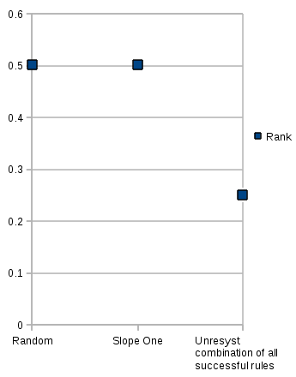
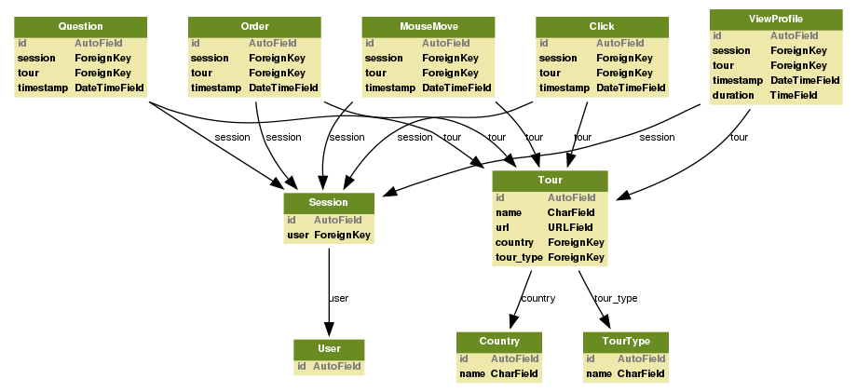
4. Adaptation to Datasets, Comparison
Travel Agency Data Set
Users viewing and ordering tours
Various kinds of implicit feedback

Slide 13
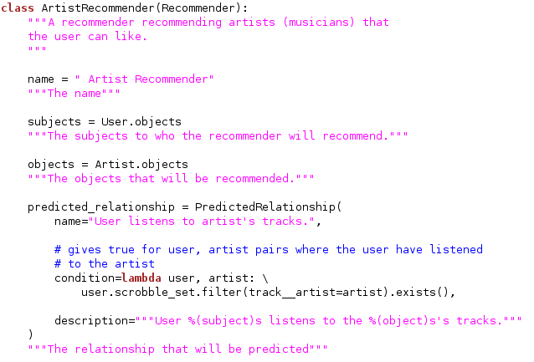
5. Example Use
Unresyst Setup (Adaptation)
Creating a recommender

Slide 14
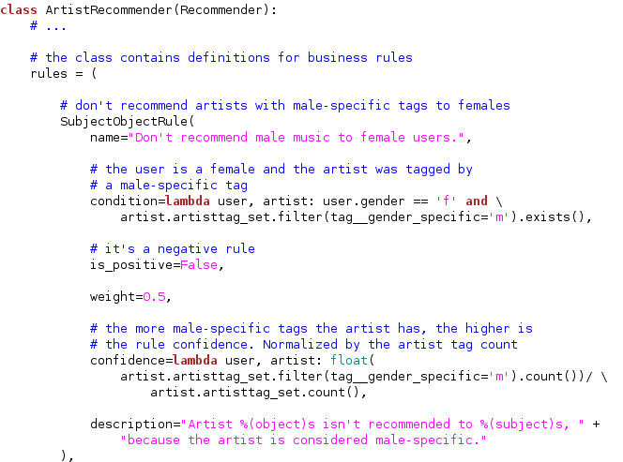
5. Example Use
Unresyst Setup (Adaptation)
Adding rules and relationships

Slide 15
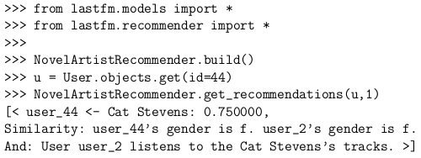
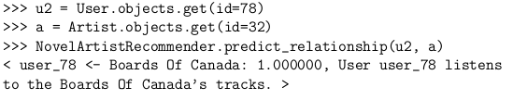
5. Example Use
Using the Runtime Recommender API
Building a recommender and getting a recommendation
Getting a relationship prediction
Full example source code available at:http://code.google.com/p/unresyst/source/browse/trunk/code/adapter/recommender_example.py

Slide 16
6. Finale
Thanks for your attention.
Unresyst project homepage: http://code.google.com/p/unresyst/

Slide 17
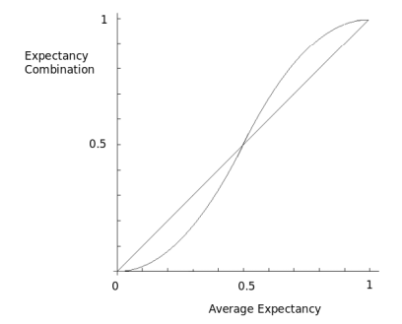

BACKUP
Combination – Twisted average

Slide 18

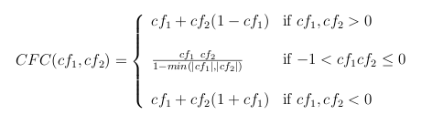
BACKUP
Combination – Mycin

Slide 19
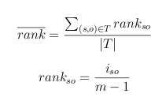
BACKUP
Measuring Efficiency – Average Rank

Slide 20
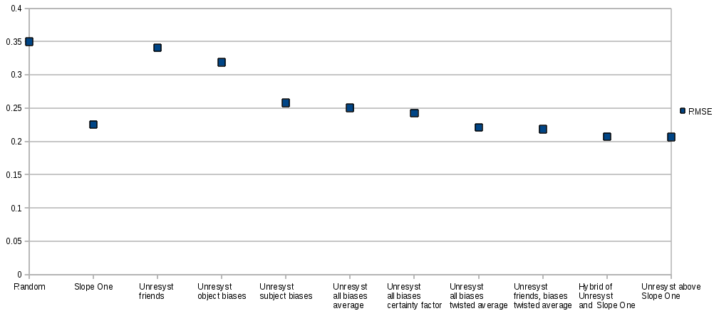
BACKUP
Flixster

Slide 21
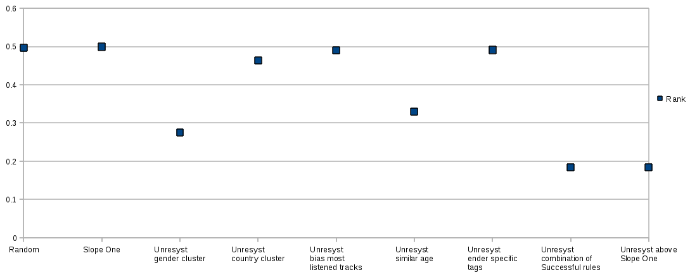
BACKUP
Last.fm

Slide 22
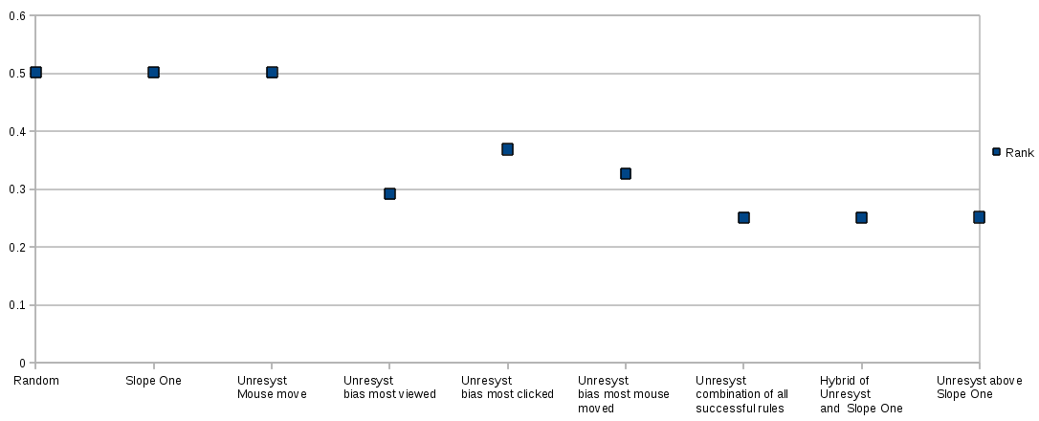
BACKUP
Travel Agency

