Slide 1

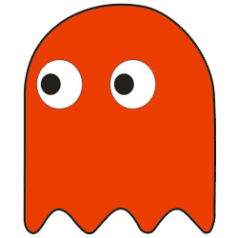


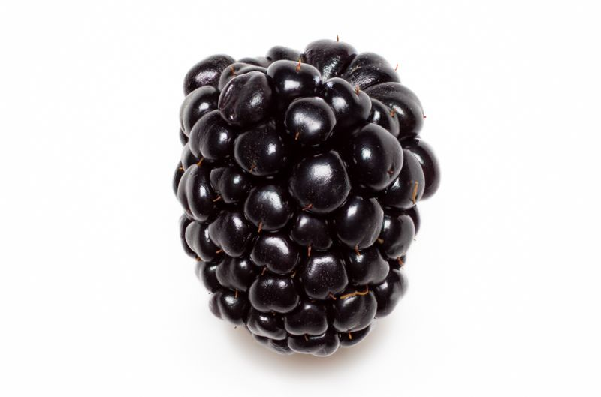
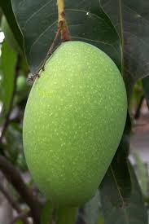

Pac-man
Search Ghost :
Able to track Pac-man.
Random Ghost :
Move randomly through the blank space of the maze.
Normal Food :
Able to increase score 15 points.
Bonus Food 1 :
Able to freeze ghost.
Bonus Food 2 :
Able to increase life.
W - Up
S – Down
A – Left
D - Right
Bonus Food 3 :
Able to increase score 100 points.
Symbol of life.

