Slide 1
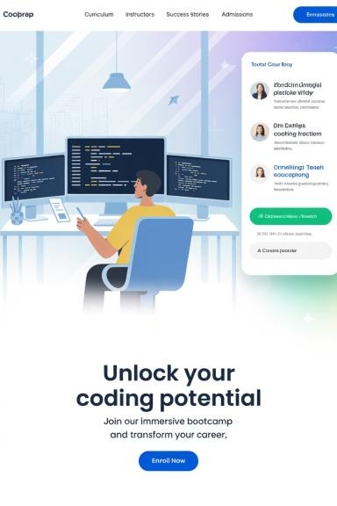
Lab 04 – Object Interaction I
Abstraction, Modularization, and Object Cooperation

Slide 2





Welcome to Object-Oriented Programming
What are Objects?
Think of objects as building blocks in your program. Each object has specific data (attributes) and behaviors (methods) that work together to accomplish tasks.
Why Object Interaction Matters
Real programs aren't built with single objects working alone. Objects must communicate, share data, and coordinate their actions to solve complex problems effectively.

Slide 3




Understanding Abstraction
Abstraction is one of the fundamental principles of object-oriented programming. It's the process of hiding complex implementation details while showing only the essential features of an object.
Complex Problem
Break Into Parts
Start with a big, complicated challenge that seems overwhelming
Divide the problem into smaller, manageable subproblems
Create Solutions
Combine & Solve
Build individual components that solve each smaller problem
Connect the components to solve the original complex problem

Slide 4

The Power of Modularization
Modularization is the practice of breaking down complex systems into smaller, independent modules. Each module handles a specific responsibility and can be developed, tested, and maintained separately.
Maintainability
Reusability
Changes to one module don't break others. Debug and fix issues in isolated components without affecting the entire system.
Well-designed modules can be used across multiple projects, saving development time and ensuring consistent behavior.
Scalability
Add new features by creating new modules or extending existing ones without rewriting the entire application.

Slide 5


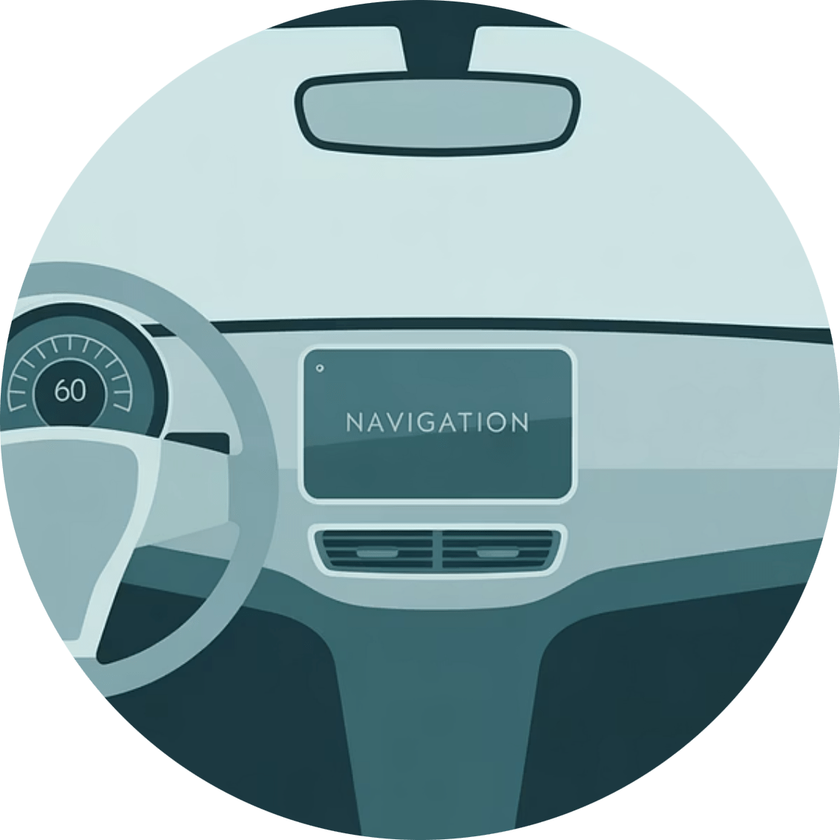
Abstraction in Software Development
Let's understand abstraction through a real-world analogy that makes the concept crystal clear.
Engine Component
Wheel System
Control Interface
The engine handles power generation. You don't need to know about pistons, valves, or combustion - just that it provides power when you turn the key.
Wheels handle movement and steering. The complex mechanics of rotation, friction, and directional control are hidden behind a simple interface.
The dashboard provides a simple interface to complex systems. Buttons and gauges abstract away the underlying electrical and mechanical complexity.
In OOP, we create objects the same way - each object encapsulates complex functionality behind a simple, easy-to-use interface. The engine object, wheel object, and seat object work together to create a complete car system.

Slide 6
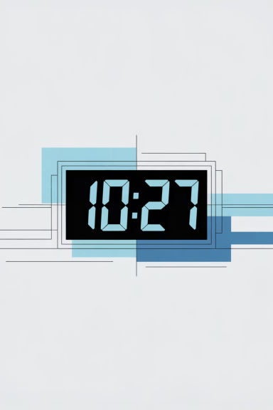
Example: Building a Clock Display
Let's see how abstraction and modularization work together in a practical programming example. We'll build a digital clock by creating cooperating objects.
1
Simple Digits
Start with basic number display (0-9) that can increment and reset
2
Number Display
Create objects that manage digits within specific ranges (0-59 for minutes, 0-23 for hours)
3
Clock Display
Combine multiple NumberDisplay objects to create a complete clock system
This approach demonstrates how simple components (NumberDisplay) can be combined to create more complex systems (ClockDisplay) while keeping each part manageable and reusable.

Slide 7

Clock Display Architecture
Here's how our objects interact to create a functioning digital clock. Notice how each component has a clear responsibility.
Hours (0-23)
ClockDisplay Class
NumberDisplay Class
Contains two Number
Display objects
(hours and minutes)
and coordinates their
interaction to maintain
accurate time.
Manages a single number with a
specific range. Handles
incrementing, rolling over at
limits, and formatting display.
Hours owned by Clock
Number
Display range
Minutes (0-59)
ClockDisplay
Composition
NumberDisplay

Slide 8
Sample Code: ClockDisplay Implementation
Let's examine the key methods that make our clock work. Notice how the ClockDisplay class uses its NumberDisplay objects to manage time.
public class ClockDisplay {
private NumberDisplay hours;
private NumberDisplay minutes;
// Constructor - creates and initializes the display objects
public ClockDisplay() {
hours = new NumberDisplay(24); // 0-23 hours
minutes = new NumberDisplay(60); // 0-59 minutes
setTime(12, 0); // start at 12:00
}
// Advance time by one minute
public void timeTick() {
minutes.increment();
if (minutes.getValue() == 0) { // rolled over
hours.increment(); // advance hour
}
}
// Set a specific time
public void setTime(int hour, int minute) {
hours.setValue(hour);
minutes.setValue(minute);
}
// Get formatted time string
public String getTime() {
return hours.getDisplayValue() + ":" + minutes.getDisplayValue();
}
}

Slide 9



Lab Tasks Overview
Now it's time to apply what you've learned! These tasks will help you practice object interaction and understand how abstraction makes complex programs manageable.
24-Hour Clock Implementation
Create a complete 24-hour clock system with menu options for tick, set time, reset, and display current time.
12-Hour Format Extension
Extend your clock to support 12-hour format with AM/PM indicators, including proper reset behavior to 12:00 AM.

Slide 10
Task 1: Implement 24-Hour Clock with Menu
Your first challenge is to create a complete clock application with a user-friendly menu system.
1
2
3
Menu System
Input Validation
Display Format
Display current time
Handle invalid menu choices gracefully
Show time as HH:MM format
Tick (advance by 1 minute)
Validate hour input (0-23)
Use leading zeros (09:05, not 9:5)
Set specific time
Validate minute input (0-59)
Update display after each operation
Reset to 00:00
Provide clear error messages
Clear, readable output
Exit application

Slide 11
Task 1 Solution: 24-Hour Clock
Here's a comprehensive solution showing how to implement the menu-driven clock system with proper error handling.

Slide 12

Task 2: Extend for 12-Hour Format with AM/PM
Now let's add complexity by supporting both 24-hour and 12-hour display formats. This task demonstrates how object-oriented design makes extensions manageable.
New Requirements
Design Considerations
Toggle between 24-hour and 12-hour modes
Add a boolean flag for format mode
Display AM/PM indicators in 12-hour mode
Create helper method for 12-hour conversion
Handle 12:00 AM (midnight) correctly
Update getTime() method for formatting
Handle 12:00 PM (noon) correctly
Modify menu to include format toggle
Reset should go to 12:00 AM in 12-hour mode
Handle edge cases (midnight, noon)

Slide 13
Task 2 Solution: 12-Hour Format Implementation
Here's how to extend the ClockDisplay class to support 12-hour format with proper AM/PM handling.

Slide 14
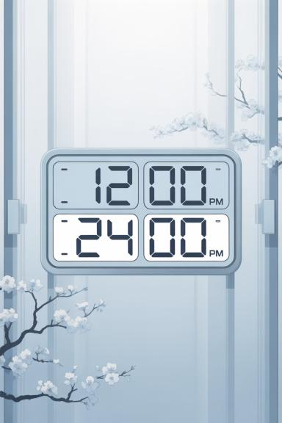
Enhanced Menu with Format Toggle
The updated application menu now includes the ability to switch between time formats, demonstrating how modular design makes feature additions straightforward.

Slide 15








Key Programming Concepts Demonstrated
Through these clock exercises, you've experienced several fundamental object-oriented programming principles in action.
Abstraction
Composition
NumberDisplay hides complex number management behind simple methods like increment() and getValue(). Users don't need to understand internal implementation.
ClockDisplay contains NumberDisplay objects, demonstrating how objects can be built from other objects to create more complex functionality.
Reusability
Encapsulation
The same NumberDisplay class works for both hours and minutes by accepting different range limits in its constructor.
Private instance variables protect object state, while public methods provide controlled access to functionality.

Slide 16
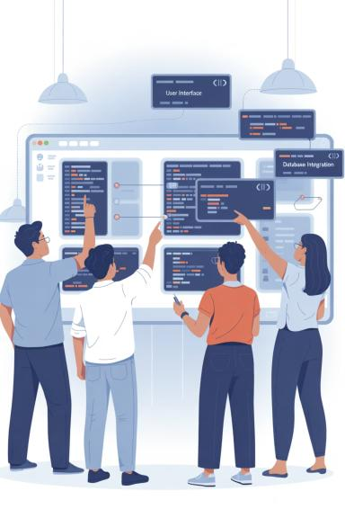
Benefits of Object Interaction
Working through these examples reveals why object interaction is so powerful in software development. Let's examine the advantages this approach provides.
Easier Testing
Simplified Maintenance
Each class can be tested independently. You can verify NumberDisplay works correctly before testing ClockDisplay, making debugging much more manageable.
Changes to time formatting only require updates to the ClockDisplay class. The NumberDisplay objects continue working without modification.
Enhanced Flexibility
Want a countdown timer? Reuse NumberDisplay with decrement methods. Need a stopwatch? Extend the existing classes rather than starting from scratch.

Slide 17
Common Mistakes to Avoid
As you continue developing object-oriented programs, be aware of these common pitfalls that can make your code harder to maintain and understand.
Over-complicating Simple Tasks
Tight Coupling Between Objects
Ignoring Edge Cases
Always test boundary conditions like midnight (00:00), noon (12:00), and rollover situations. These edge cases often reveal design flaws.
Don't create objects for everything. If a simple variable or method suffices, use it. Objects should solve real complexity, not create artificial complexity.
Avoid making objects too dependent on each other's internal details. Use clear interfaces and minimize direct access to other objects' data.

Slide 18




Extending Your Clock Further
Ready for more challenges? Here are some advanced features you can add to deepen your understanding of object interaction.
Alarm Functionality
Stopwatch Mode
Add an Alarm class that works with ClockDisplay to trigger notifications at specific times. This demonstrates how new objects can interact with existing ones.
Create a Stopwatch class that reuses NumberDisplay for tracking elapsed time. Show how the same components can serve different purposes.
Date Integration
Time Zones
Add a DateDisplay class that cooperates with ClockDisplay to track both date and time, handling month rollovers and leap years.
Implement a TimeZone class that adjusts the displayed time based on different world locations, showing complex object coordination.

Slide 19

Key Takeaways
You've successfully learned how objects interact to solve complex problems through practical implementation. Let's summarize the essential concepts you've mastered.
Objects Cooperate to Solve Larger Problems
Individual objects with specific responsibilities work together to accomplish tasks that would be difficult or impossible for a single object to handle alone.
Abstraction and Modularization Reduce Complexity
By hiding implementation details and breaking problems into smaller pieces, we make complex systems manageable and understandable.
Independent Classes Enable Better Development
When classes are designed with clear responsibilities and minimal dependencies, they become easier to test, debug, maintain, and extend over time.

Slide 20




Thank You!
Congratulations on completing Lab 04! You now understand how objects interact, cooperate, and work together to solve complex programming challenges.
Next Steps
Questions?
Keep Learning
Practice creating your own object interactions. Try building systems where multiple classes work together to solve interesting problems.
Review the code examples, experiment with modifications, and don't hesitate to ask for help when you encounter challenges.
Object interaction is foundational to advanced OOP concepts. Master these basics and you'll be ready for inheritance, polymorphism, and design patterns.

