Slide 1

Lab 7: Grouping Objects: Collections, Loops, and Iterators
Explore the fundamental mechanisms for storing and managing collections of objects in Java. This lab introduces ArrayList for flexible-size collections, arrays for fixed-size storage, and essential iteration techniques using loops and iterators.
Date: 14-10-2025

Slide 2
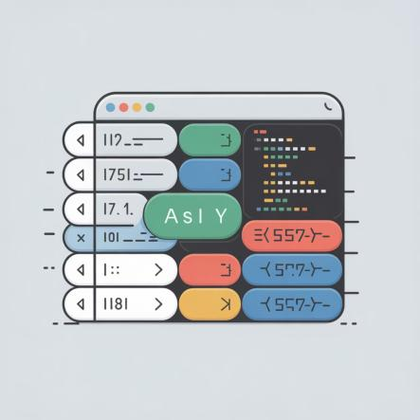
Understanding Arrays in Java
What is an Array?
Java arrays store a fixed-size sequential collection of elements of the same type. Rather than declaring individual variables like number0, number1, number99, you declare one array variable and use indexed access.
Declaration Syntax
// Preferred way:
dataType[] arrayRefVar;
// Works but not preferred:
dataType arrayRefVar[];

Slide 3
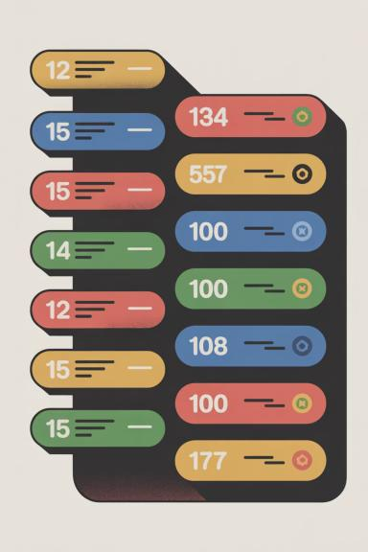



Array Fundamentals
Fixed Size
Same Type
Arrays have a predetermined size that cannot be changed after creation
All elements must be of the same data type
Indexed Access
Elements accessed using zero-based indexing: array[0], array[1], etc.

Slide 4








Introduction to Loops
A loop statement allows us to execute a statement or group of statements multiple times. Loops are fundamental control structures that enable repetitive execution based on conditions.
Initialization
Condition Check
Set starting conditions
Evaluate boolean expression
Update
Execute Statements
Modify loop variables
Run loop body

Slide 5
The For Loop
Purpose
01
A for loop is a repetition control structure that efficiently executes code a specific number of times. It's ideal when you know exactly how many iterations are needed.
Initialization
Executed once at the start
Syntax Structure
02
Boolean Expression
for(initialization; Boolean_expression; update)
{
// Statements
}
Checked before each iteration
03
Statements
Loop body executes
04
Update
Runs after each iteration

Slide 6
While Loop
While Loop Syntax
while(Boolean_expression)
{
// Statements
}
A while loop repeatedly executes a target statement as long as a given condition remains true. The condition is evaluated before each iteration.
Do-While Loop Syntax
do { // Statements}
While
(Boolean_expression);
Similar to while loop, but guarantees at least one execution since the condition is checked after the loop body runs.

Slide 7


Loop Control Statements
Break Statement
Continue Statement
Immediately terminates the loop and resumes execution at the next statement following the loop. Also used to terminate cases in switch statements.
Causes the loop to immediately jump to the next iteration. In for loops, jumps to update statement. In while/do-while, jumps to boolean expression.

Slide 8

Introducing ArrayList
Dynamic Collections
The ArrayList class is a resizable array found in the java.util package. Unlike built-in arrays with fixed sizes, ArrayList elements can be added and removed dynamically whenever needed.
Creating an ArrayList
import java.util.ArrayList;
ArrayList<String> cars = new ArrayList<String>();

Slide 9
Array vs. ArrayList
Built-in Array
Fixed size after creation
Cannot add or remove elements
Must create new array to modify size
Simpler syntax
ArrayList
Dynamic, resizable collection
Add and remove elements freely
Automatic size management
Rich method library

Slide 10




ArrayList Operations
Adding Elements
Getting Values
cars.add("Volvo");
cars.add("BMW");
cars.get(0);
Retrieve elements using get() with the index position
Use the add() method to append elements to the ArrayList
Updating Elements
Removing Elements
cars.set(0, "Opel");
cars.remove(0);
cars.clear();
Modify existing elements using set() with index and new value
Delete specific elements with remove() or clear entire list with clear()

Slide 11
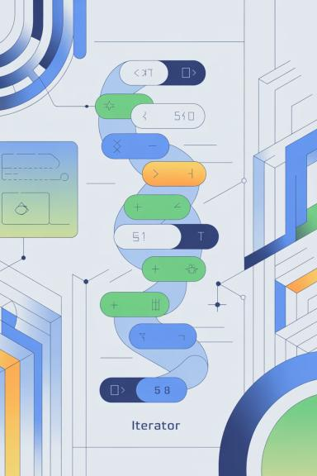
Understanding Iterators
The iterator method of ArrayList returns an Iterator object, defined in java.util package. An Iterator provides a standardized way to traverse through collection elements sequentially.
01
Import Iterator
import java.util.Iterator;
02
Get Iterator Object
Iterator it = myCollection.iterator();
03
Check for Elements
while(it.hasNext())
04
Retrieve Next Object
it.next()

Slide 12
Iterator Pattern in Action
Key Methods
Pseudo Code Example
hasNext()
Iterator it = myCollection.iterator();
while(it.hasNext())
{
call it.next() //to get the next object //do something with that object
}
Returns true if more elements exist in the collection
next()
Returns the next element and advances the iterator position
Important: Ask the iterator to return the next item, not the collection itself.

Slide 13
Lab Tasks Overview
1
2
Second Largest & Smallest
Matrix Multiplication
Write a Java program to find the second largest and second smallest elements in an array
Write a Java program that performs multiplication of two matrices
3
4
Array Equality Test
Code Examination
Write a Java program to test whether two arrays are equal
Execute provided code and examine its behavior

Slide 14
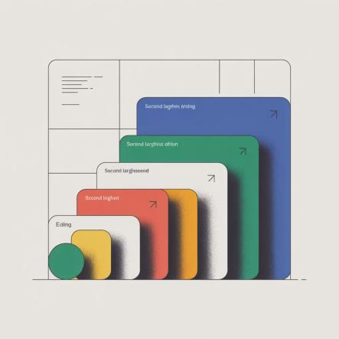
Task 1: Finding Second Largest and Smallest
Problem Statement
Write a Java program to find the second largest element and second smallest element in an array.
Approach
Sort the array or use comparison logic
Track the largest and second largest values
Track the smallest and second smallest values
Handle edge cases (arrays with fewer than 2 elements)

Slide 15



Task 2: Matrix Multiplication
Input Validation
Verify that the number of columns in the first matrix equals the number of rows in the second matrix
Initialize Result Matrix
Create a result matrix with dimensions matching the outer dimensions of input matrices
Nested Loop Multiplication
Use three nested loops to compute each element by multiplying corresponding row and column elements
Display Result
Output the resulting matrix in a readable format

Slide 16
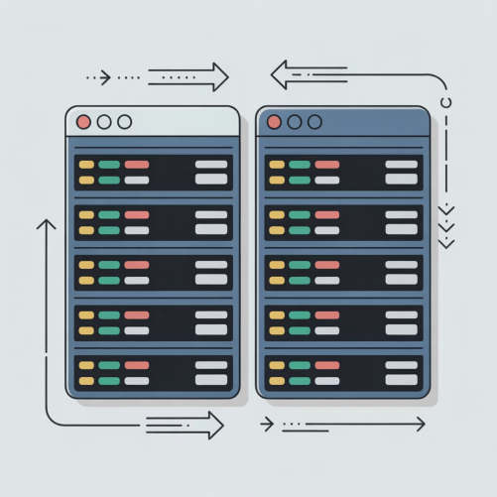
Task 3: Testing Array Equality
Implementation Strategy
Write a Java program to test whether two arrays are equal.
Check lengths first
If arrays have different lengths, they cannot be equal
Compare elements
Iterate through both arrays comparing corresponding elements
Return result
Return true only if all elements match

Slide 17
Task 5: Code Examination
Execute the provided code examples and examine their behavior. This task helps you understand practical implementations of collections, loops, and iterators in real-world scenarios.
Analyze Code Structure
Trace Execution
Review how arrays, ArrayLists, and loops are implemented in the provided examples
Step through the code mentally or with a debugger to understand the flow
Observe Output
Identify Patterns
Run the code and compare actual output with expected results
Recognize common programming patterns and best practices demonstrated

Slide 18

The Java Class Library
The Java class library is a large collection of useful classes that make our own classes more powerful. Understanding and utilizing this library is essential for efficient Java programming.
java.util Package
Built-in Functionality
Contains ArrayList, Iterator, and other collection classes we've explored today
Provides pre-written, tested code for common programming tasks
Continuous Learning
Study the library in detail to discover additional powerful tools and capabilities

Slide 19










Key Takeaways
Master Loops
Collections Are Fundamental
Loops are essential in every project - familiarize yourself thoroughly with writing them
Almost every application needs some form of collection to store and manage multiple objects
Choose Wisely
Use ArrayList for flexible collections and arrays for fixed-size storage
Leverage Libraries
The Java class library offers powerful tools - learn to use them effectively
Iterate Effectively
Iterators provide standardized ways to traverse collection elements

Slide 20

Conclusion
In this lab, we've explored fundamental mechanisms for storing collections of objects rather than single objects in separate fields. We examined ArrayList as a flexible-size collection and arrays as fixed-size collections.
Collections are essential in programming - you'll use them in virtually every project. We also covered iteration techniques using loops and iterators, which are equally fundamental concepts you'll apply constantly.
Make sure you familiarize yourself sufficiently with these concepts - they form the foundation of effective programming.

