Slide 1
Open hypertext concepts
Jens Bjarke Pedersen

Slide 2
Agenda
Hypertext/media
Open hypermedia
Models for open hypermedia
Integration
System structure
Multiple open Services
Construct
The project

Slide 3
Hypertext/media
What is hypertext/hypermedia
WWW
Documents
Links and anchors
Spatial, classification, issue, annotation
Structure of data
Solutions for integration of tools and data
Services
3. Party applications

Slide 4
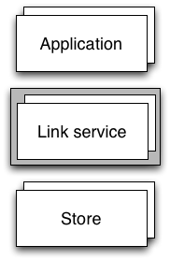
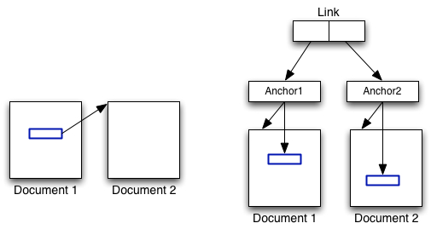
Open hypermedia
Open system and integration
Linking services
Storage services
Open and closed
Notes:
Open systems and integration of information are two critical issues in IS
Current computer systems and tools each support different tasks in our daily work
Typical few for collaboration
Hypermedia provides solution for integration of existing and future computer software and tools
Open hypermedia supports inter-tool linking as a means of integrating distributed heterogeneous tools and data formats
Open systems architecture, link service and storage service, hyperbased management system
Meta data and collaborations
Open linking to other documents

Slide 5
Open hypermedia
Developed inherently
Support single user
Different data formats
Support variety of applications
Support other platforms
Distributions
Notes:
When we develop a OHS some things to consider
Open hypermedia platforms should:
Can use 3. party tools
Supports single, multiple users, and collaboration
Support different data formats
Variety of application areas
Run on different platforms
Distributed across different networks

Slide 6
Open hypermedia
Platform dimensions
Scalability
Openness
Distribution
Heterogeneity
Interoperability
Extensibility
Computation
Notes:
Scalability: Support of multiple users
Openess: The system is open for other applicationsd through protocols
Distributin: The level of distribution it can be centralized
Hetterogeneity: Does it share the same datamodel,? Homos share
Interoperability: The system can use one or more protocols
Extensitivity: Can it be extended with new protocols
Computation: Can the system do any computations

Slide 7
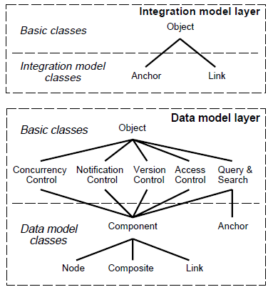
Models for open hypermedia
Integration models
Data model
Basic hypermedia storage services
Creation, storage, retrieval,
updates, queries and
deletion of hypermedia objects

Slide 8
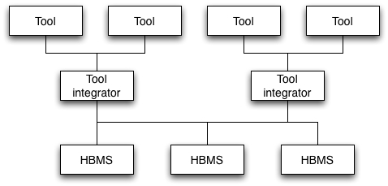
Integration
Integration
Full integration
Partial integration
No Integration

Slide 9
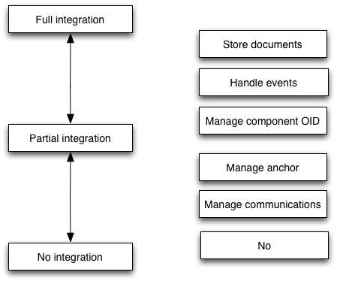
Integration
Levels of integration
Requirements

Slide 10
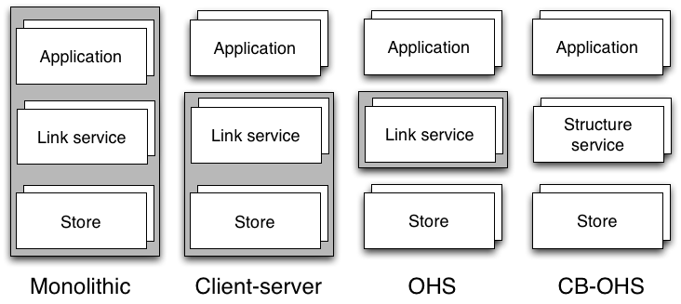
System Structure

Slide 11
Multiple open Services
Requirements
Open architectural framework
General availability
Open Services
Orthogonality of open services
Generality of open services
Scalability of open services
Notes:
Clearly the tighter the integration the more req, is needed to be in place for the client
a set of req is thus defined, for a system based on an open arc framework 3 basic req are needed
First the environment, then the provided services should open, then the services should be open
Open arch frame: The set of components are open, new can be added and old can be modified
General aval: Services should be available on most major platforms, open to a set of clients
Open Serv: important are
An open service should be functionally independent of other services used by participating apps, use service without change existing services, do not interfere with storage services in other apps, by placing other function on ex ctrl-x ctrl-s
Should not interfere with subscription of foundation layer
Should be optional, both internal and acorss other apps (copy paste)
Should not provide different levels of its service
Should apply to all layers
Services belong to a layer
All services at a layer
Each layer is open
Any component can be a client
Standardization and interoperability
Service modularization
Applications integrators
Service developers

Slide 12
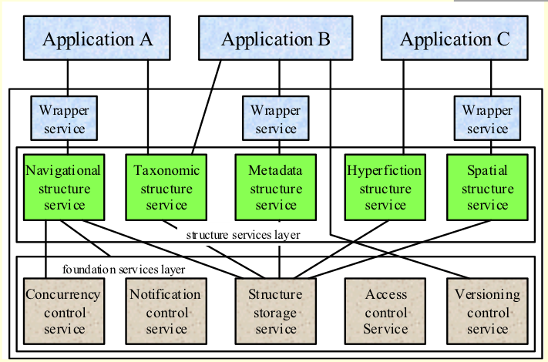
Multiple open Services
Notes:
The idea is thus to create smaller chunks that can be used independently
Services belong to a layer, in app depending on their service
All services at a layer, must comply with the req, func independent, general and scalable, only in same layer
Each layer is open to new services as long as req for open are true
Any component can be a client In fig: B is client of wrapper, structure and foundation, most not the case
Mutli services add:
Standardization and interoperability (operate with other OHS) if all layers are standardize easier for research
Service modularization easier to explorer services
Applications integrators integration to other apps
Service developers only need to develop a service onces

Slide 13
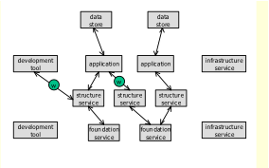
Construct
Example application
Applications
Wrapper service
Structure service
Foundation service
Data store
Infrastructure service
Development tools
Notes:
We look at an example of a OHSapp, this is actually a CB-OHS
Application: includes standard desktop application, mail, word etc
Has wrapper services to integrate
Structure services to to organize, sptaial, taxonomic etc.
Foundation basic services
Structure store, multiuser and collaboration, versioning services
Data store, file system
Infra: to catagories individual compontnes
DevTools. UML for new services, Emas and CSS

Slide 14
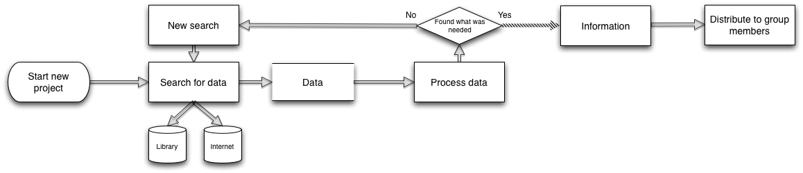
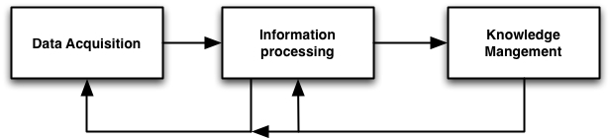
The project
Motivation:
Current work flow(Field study of ourselves)
Split into three phases
14

Slide 15
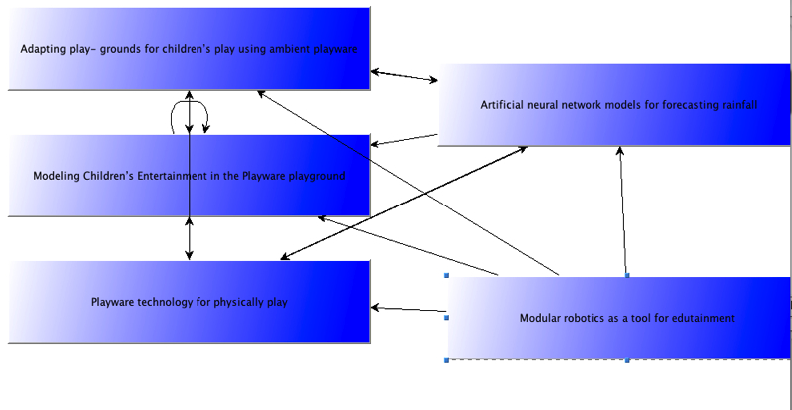
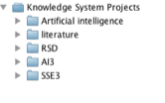
The project
Overview:
Knowledge management system
Reusing existing knowledge, Organize knowledge in projects, sharing knowledge

Slide 16
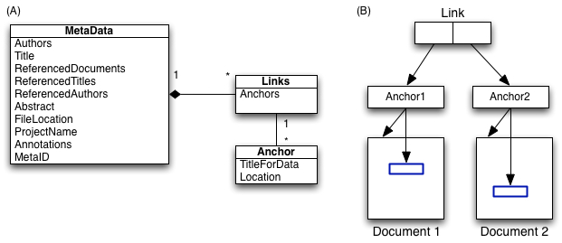
The project
Overview:
Hypertext concepts
Links, anchors, different structures of information

Slide 17
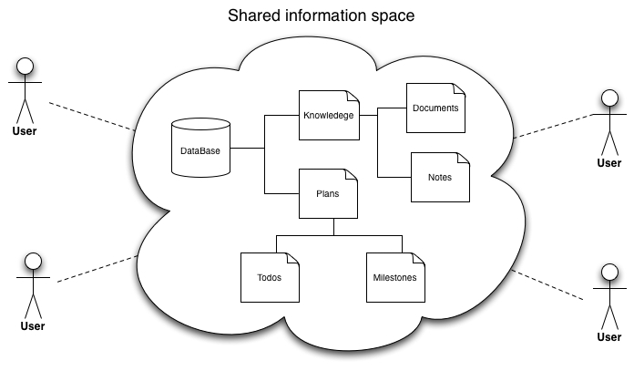
The project
Overview
Computer supported cooperative work
Planning, Shared information space, asynchronous cooperation on documents

Slide 18
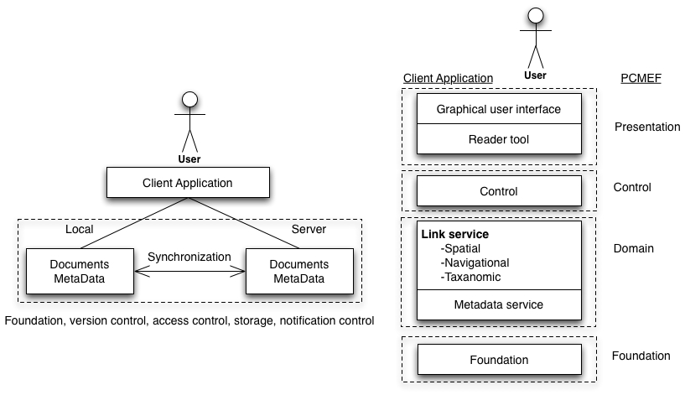
The project
Architecture
Notes:
Structual service burde være link service har skrevet forkert I rapporten

Slide 19
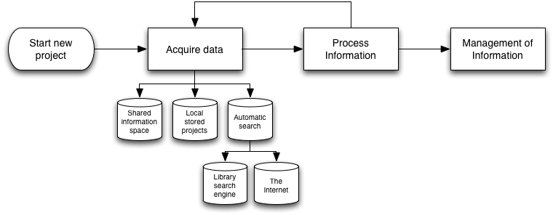
The project
New work flow With the use of the system

