Slide 1
SSE3 Knowledge mangement concepts
Jens Bjarke Pedersen

Slide 2
Agenda
What is knowledge management
Classification of knowledge
Knowledge management process
Common/shared information space
The project
Notes:
This is my agenda and what I will talk about.

Slide 3
What is knowledge management
Utilize the full potential of knowledge resource
Organize important knowledge
Making knowledge available
Creation, distribution and exploration to create knowledge with higher value
Knowledge management is everywhere
Notes:
First a short overview of what knowledge mangement can defined as.
To create better knowledge
KM is everywhere – e.g. the rsd project could have used a km system between the groups

Slide 4
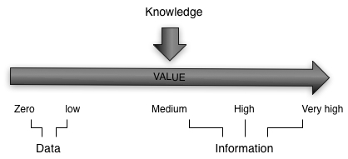
Classification of knowledge
Data
Facts, observation, numbers
Information
Subset of data, Refined data, have context
Knowledge
Enables action and decision
Highest in the hierarchy
Example – Lego robot experiment
Notes:
Clasification of knowledge can be done rather differently
Example from AI2:
We did a experiment with a lego robot whit placing of the sensores. All the oberservations etc can be classified as data.
The statistic results can be classied as information while the knowledge can be classified as knowing what the different placements means and therefore be able to make an desiscion

Slide 5
Classification of knowledge
 |  | General | Contextual | Technical
Declarative Know what | Explicit | Factors to consider described in books | Company documents for handling people | Manuals describing which factor to consider for problem solving
 | Tacit | Knowledge of the factors to consider | Knowledge of which factors to consider for motivation | Knowledge of what to look for
Procedural Know how | Explicit | Sequence of actions described in books | Company documents identifying a sequence of actions | Manual describing how to do it
 | Tacit | Basic knowledge of the sequence to do | Knowledge of which sequence of actions to take | Knowledge of the sequence of actions to do
Declarative
Procedural
Explicit
Tacit
General
Specific
Technically
Contextual
Expertise
Notes:
Declarative knowledge: facts substantive knowledge focus on relation between variables
Procedural: focus on how to do a sequence of actions to get a dsired outcome
Explicit knowledge: which can expressed into numbers and be formally shared
Tacit knowledge: Intitions insights very difficult to share
General knowledge: Something aeverybody knows and can easily be shared
Specific knowledge: Limited to individuals and hard to share
Technically knowledge: deep knowledge on a specific area
Contextually knowledge: knowing which perticular circumstanxed in time and place in which specific work shall be performed

Slide 6
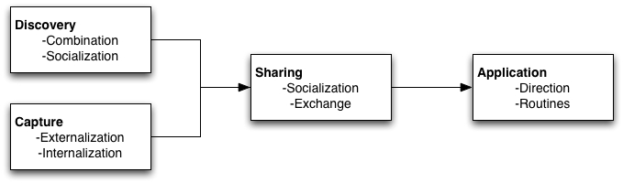
Knowledge management process
Discovery
Combination – Explicit - Reusing knowledge
Socialization – Tacit – cooperation, information exchange

Slide 7
Knowledge management process
Capture
Capturing knowledge from people, artifacts or organizational entities
Knowledge might be captured from the outside, consultants, competitors etc
Externalization converting tacit knowledge into explicit knowledge
Internalization converting explicit into tacit knowledge

Slide 8
Knowledge management process
Sharing
Process in which knowledge is communicated to other individuals
Recommendations is not sharing knowledge
Application
Direction, Getting other people to do it without giving them the knowledge
Routines, Embedded knowledge in procedures, rules etc.

Slide 9
Common/shared information space
Describes the cooperative work done within the organization
Floats across time and place
Contains artifacts for coordination of work and sharing of information
Could be physical
Creates awareness for the cooperation
Several parameters characterize a CIS
The degree of distribution
The multiplicity of webs of significance
The level of required articulation work
Notes:
(i) the degree of distribution: collaborative work implies
almost always a physical distribution of persons. Physical
proximity offers the advantages of visual, oral and auditory
communication without augmentation between actors,
provided that this is possible. E.g. a noisy engine room or
an office full of dividers would not offer these advantages.
While these advantages are not immediately at hand
whenever work is distributed over large physical areas,
they may be achieved by the use of various means of
communication (written documents, phone, e-mail, on-line
video etc).
(ii) the multiplicity of webs of significance: we are all spun
into nets of significance. We grew up with some of these;
whereas others have been learned during education, work
experience etc. The more different webs of significance are
part of a CIS, the more work is required to achieve
sufficient mutual understanding. The more different
cultures, languages, and professions are present, the less
can cooperation depend on already shared contexts of
meaning and the more hermeneutical effort is required.
(iii) the level of required articulation work: cooperative
work varies with the degree to which coordination is
necessary and therefore the level of required articulation
work to achieve sufficient coordination varies. At the
wastewater plant a talk during the coffee breaks is
sufficient to coordinate the workers’ different tasks,
whereas work at the hospital ward is dependent on a much
higher need for continuous coordination.
(iv) the multiplicity and intensity of means

Slide 10
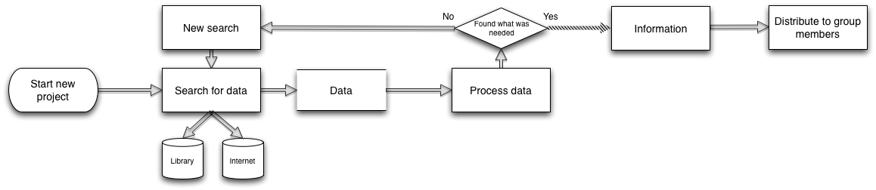
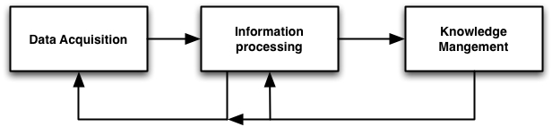
The project
Motivation:
Current work flow(Field study of ourselves)
Split into three phases
10

Slide 11
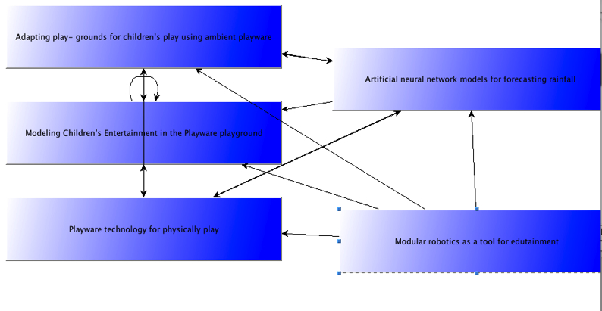
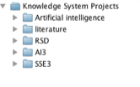
The project
Overview:
Knowledge management system
Reusing existing knowledge, Organize knowledge in projects, sharing knowledge

Slide 12
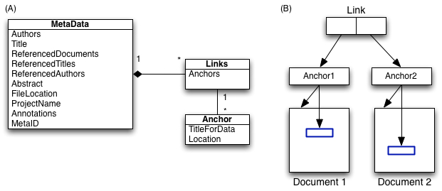
The project
Overview:
Hypertext concepts
Links, anchors, different structures of information

Slide 13
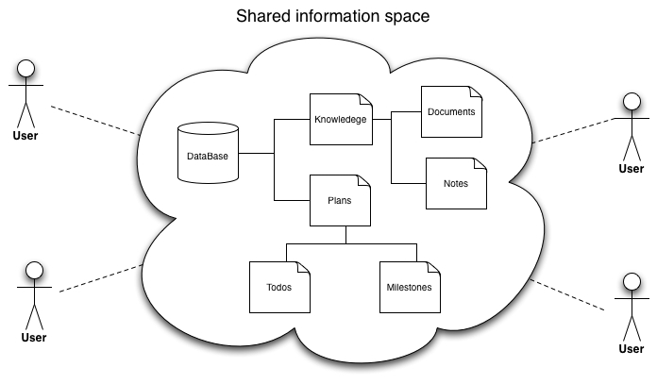
The project
Overview
Computer supported cooperative work
Planning, Shared information space, asynchronous cooperation on documents

Slide 14
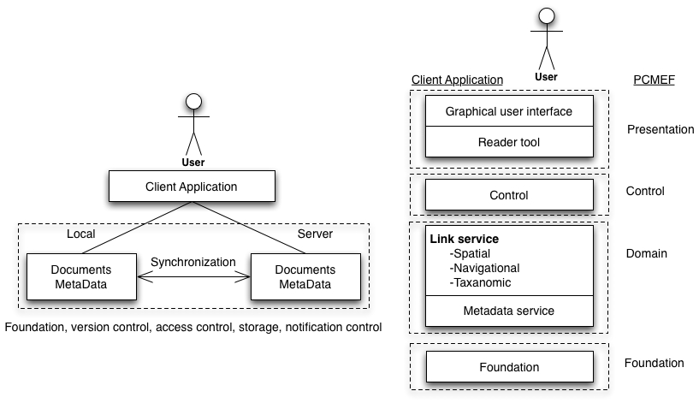
The project
Architecture
Notes:
Structual service burde være link service har skrevet forkert I rapporten

Slide 15
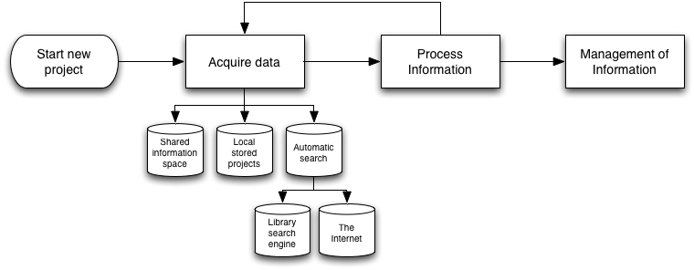
The project
New work flow With the use of the system

